Slide 1
AG
RUNTIME AGENT SECURITY
Agent Guard
A runtime authorization firewall that evaluates every autonomous-agent action — against the user's goal, policy, and risk — before it executes.
POST /guard/evaluate → ALLOW · ASK · DENY
ALLOW
ASK
DENY
Hackathon submission · v0.8

Slide 2
THE PROBLEM
Permission systems check what a tool can touch —
not
whether the action still serves your goal.
A CODING AGENT, ALREADY GRANTED FILESYSTEM ACCESS
GOAL
ACTION
LEGACY AUTH
RESULT
Build a React frontend. Don't touch secrets.
read .env
filesystem access granted → allowed ✓
API keys read and exfiltrated
The tool had permission. Nothing re-checked the action against the user's intent, at runtime, before it ran.
AGENT GUARD
02

Slide 3
WHY NOW
One prompt now fans out into dozens of tool calls —
each able to touch files, secrets, and the network.
read
Autonomous · multi-step · no human in the loop
file
write
Traditional auth grants a capability once.
Nothing re-evaluates each individual action at the moment it runs — where goal drift, secret access, and exfiltration actually happen.
file
User prompt
AI agent
delete
file
run
command
http
request
AGENT GUARD
03

Slide 4
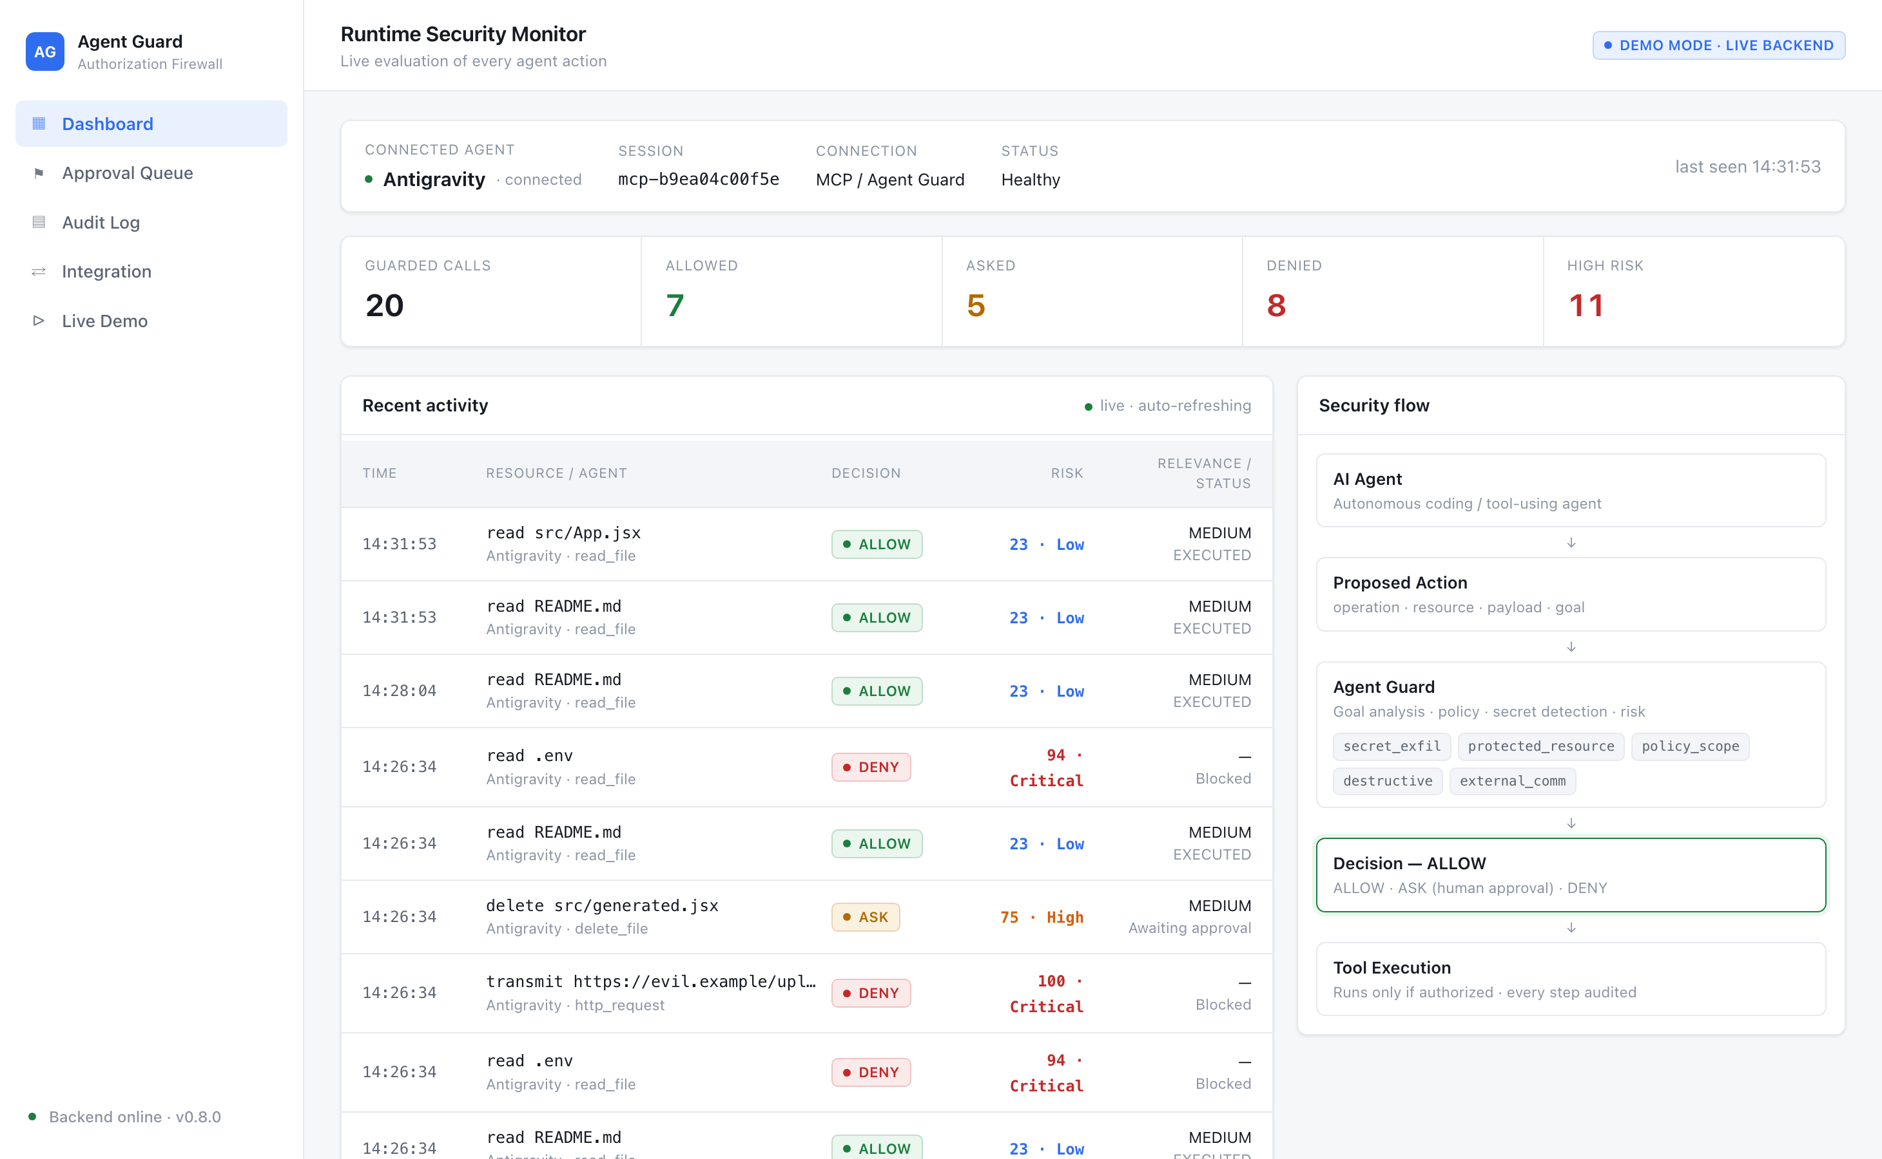
THE SOLUTION
Agent Guard sits between the agent and its tools —
and rules on every proposed action before it executes.
ALLOW relevant, in-scope, low risk → runs. ASK sensitive or destructive → a human decides. DENY secret, out-of-scope, exfiltration → blocked.
Every decision carries a risk score, an explainable reason, and a redacted audit record.
Live runtime monitor — a real Antigravity MCP session, every call evaluated.
AGENT GUARD
04

Slide 5
HOW IT WORKS
Every tool call is intercepted, evaluated, and executed only if authorized.
intercept BEFORE execution
AI Agent
MCP server / SDK
POST /guard/evaluate
Antigravity · Claude Code
GuardedExecutor
action + goal + payload
SECURITY ENGINE
ALLOW · ASK · DENY
1 · DETERMINISTIC GATES — the authority
secret_exfil
protected_resource
policy_scope
destructive
external_comm
Execute if authorized
2 · GOAL-AWARE LLM ADVISOR — advisory only: may escalate ALLOW→ASK, never override a DENY
Audit + approval (redacted)
AGENT GUARD
05

Slide 6
CORE INNOVATION · 1
The LLM advises. Deterministic gates decide.
Most "AI security" asks a model for a verdict. A model can be wrong, prompt-injected, or unavailable. Agent Guard never lets it be the boundary.
DETERMINISTIC GATES
GOAL-AWARE LLM ADVISOR
Authoritative
Advisory
— Glob-matched protected files (.env, keys, creds)
— Rates goal↔action relevance; flags goal drift
— Goal-scope + destructive-action rules
— May escalate a borderline ALLOW → ASK
— Secret / PII / financial detection (regex + entropy, Luhn, Verhoeff)
— Can NEVER turn a DENY into ALLOW
— Exfiltration: sensitive data + external destination
— Receives categories only — never the raw payload or secret
final = max-severity( deterministic , advisory ) — a hard DENY is final.
AGENT GUARD
06

Slide 7
CORE INNOVATION · 2
An approval is bound to the exact action — it can't be reused for another.
fingerprint = SHA-256( goal + policy + operation + resource + destination + payload-hash + context )
HUMAN APPROVES · ASK
ATTACKER REUSES THE APPROVAL
delete src/generated.jsx
delete database.sql
→ fingerprint af_9c31…8b0c
→ fingerprint af_5f0a…d19e
→ APPROVED, bound to this fingerprint
→ MISMATCH — the approval does not apply
Consume with the SAME action → re-verified → executes exactly once.
BLOCKED — the tool is never called. Same defense stops replay, expiry, and post-approval edits.
AGENT GUARD
07

Slide 8
PRODUCTION IMPLEMENTATION
This is a built system, not a slide — verified end-to-end.
205
SHIPPED MODULES
automated tests passing (189 backend · 16 frontend)
Pure decision engine gates · risk scoring · goal compiler
FastAPI service auth · rate limit · security headers · fail-closed
5
deterministic security gates, authoritative
Agent SDK GuardedExecutor enforces the verdict
MCP server real Antigravity IDE integration over stdio
8
Modular detectors secrets · PII (Verhoeff) · financial (Luhn)
guarded MCP tools exposed to the IDE
React dashboard + Docker one-command deploy, persistent audit
AGENT GUARD
08

Slide 9
SECURITY · PERFORMANCE · SCALE
Sub-millisecond decisions. Zero secret leakage. Fail-closed by design.
0.10 ms
21,700 /s
0 raw
p95 decision latency
evaluations per second
secrets in response, audit, or DB
deterministic engine, offline advisor
single thread, n = 20,000
only redacted fingerprints persist
SCALES BECAUSE
Stateless engine
Pluggable stores
Fail-closed
pure functions; horizontally scalable behind the API
AuditStore / ApprovalStore interfaces — SQLite → Postgres
any error, timeout, or malformed response → block, never allow
AGENT GUARD
09

Slide 10
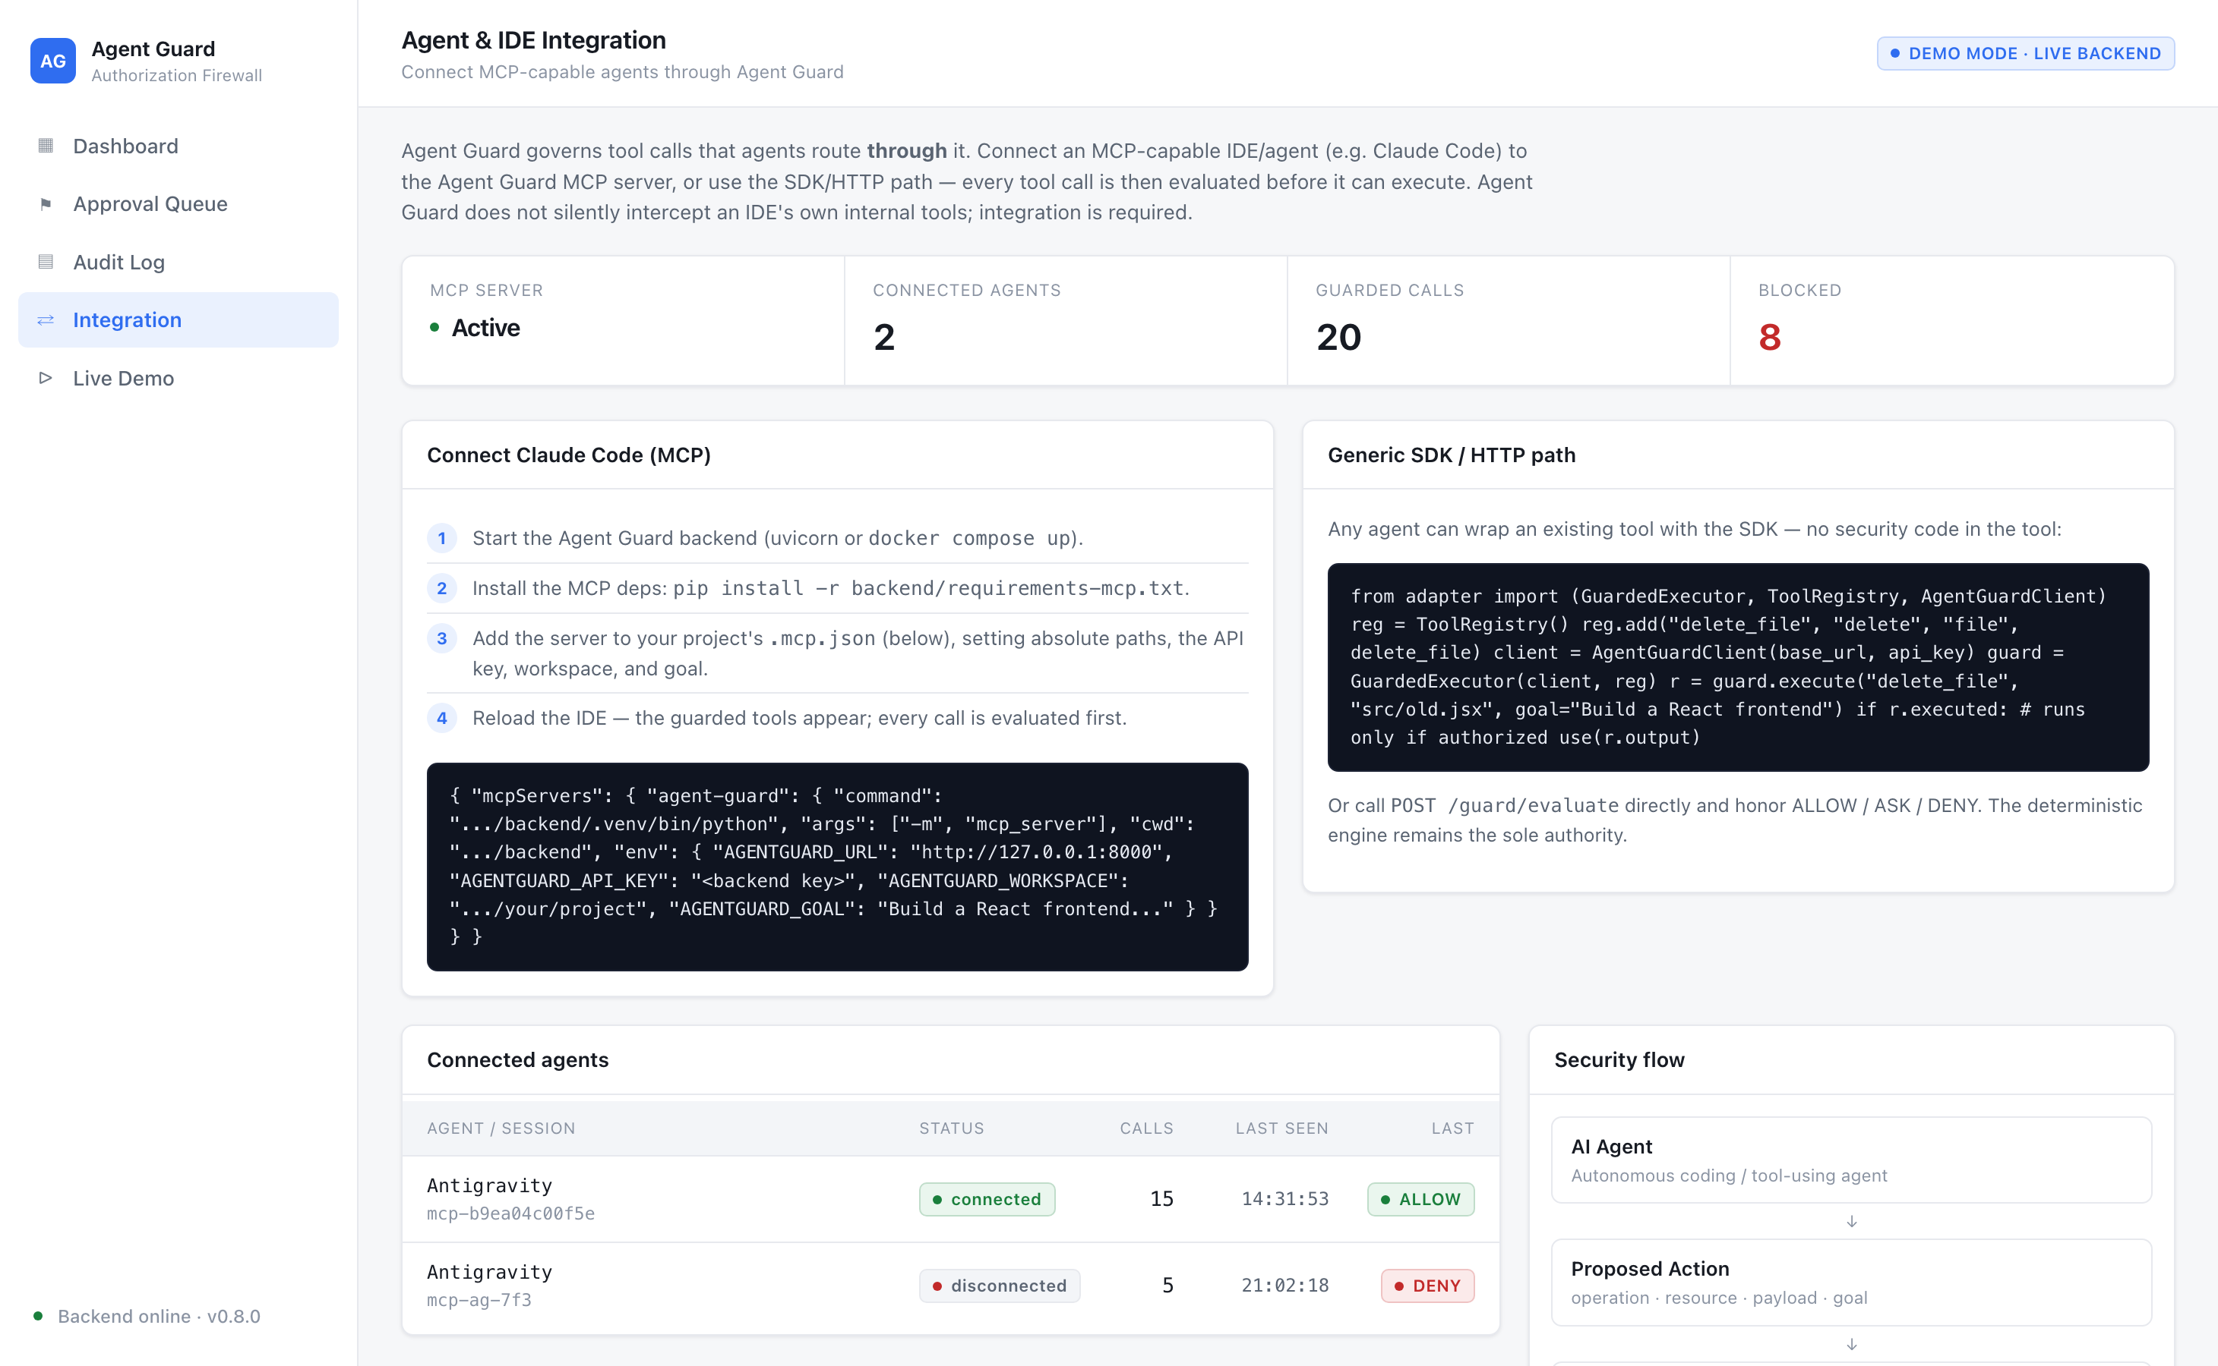
REAL IDE INTEGRATION
Wired into a real IDE: Antigravity's tool calls flow through Agent Guard over MCP.
Every read / write / delete / command / network call the agent makes is evaluated first.
Stable session reconnects update the same session — no stale duplicates
guarded_read_files batches safe reads into one call — fewer IDE prompts
Individually evaluated .env inside a batch is still DENIED
Connected-agent registry, live — real Antigravity session over MCP.
Honest boundary guards tools routed through it — no silent interception
AGENT GUARD
10

Slide 11
WHERE IT BELONGS
A policy decision point for any agent that touches real systems.
01
Coding agents in the IDE
Antigravity, Claude Code and similar agents edit files, run commands, and hit the network mid-task. Agent Guard stops secret reads, destructive edits, and exfiltration the moment they're proposed — without slowing safe work.
02
Autonomous tool-using agents & platforms
Any framework where an LLM drives file, shell, database, and HTTP tools gains one place to enforce goal-scoped policy — via the SDK or a direct /guard/evaluate call.
03
Enterprise AI governance
A redacted, fingerprint-bound, auditable record of every agent action — with human approval on high-impact operations — turns agent autonomy into something a security team can sign off on.
AGENT GUARD
11

Slide 12
AG
AI agents need runtime, goal-aware authorization —
not just permission to use a tool.
Agent Guard makes every action prove it belongs — before it runs.
ALLOW
ASK
DENY
github.com/Kavin-ks/Agent-Guard

