Slide 1
PRDA-04 · PROJECT REPORT
Customer Data Analysis
Shopping Behaviour by Gender, Age, Category & Payment Method
Submitted by
Kavin V
Team ID: PTID-CDA-SEP-26-11151

Slide 2
PRDA-04
Customer Data Analysis
Shopping behaviour across 99,457 transactions in 10 Istanbul malls
TL 251.5M
298,712
99,457
TL 2,529
TOTAL REVENUE
UNITS SOLD
TRANSACTIONS
AVG BASKET

Slide 3
AT A GLANCE
Key performance indicators
TL 251.5M
298,712
TOTAL REVENUE
UNITS SOLD
Jan 2021 – Mar 2023, 10 malls
about 3 items per purchase
99,457
TL 2,529
TRANSACTIONS
AVERAGE BASKET VALUE
one invoice per customer
the same for women and men

Slide 4
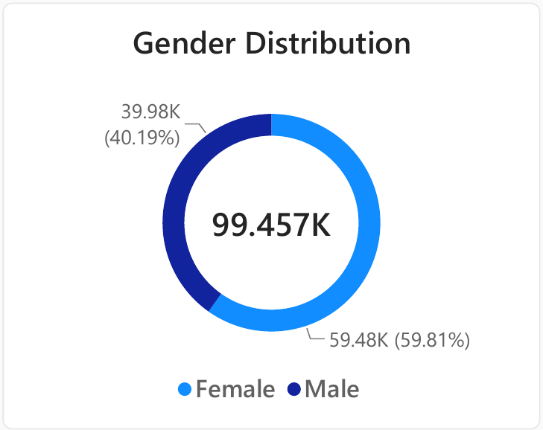
GENDER
Gender distribution
WHAT IT SHOWS
Women make 59.48K of the 99,457 transactions (59.81%); men make 39.98K (40.19%).
The roughly 60/40 split holds in every one of the 10 malls (female share 58.5–61.0%).
Women are the larger customer segment company-wide, not just in a few locations.

Slide 5
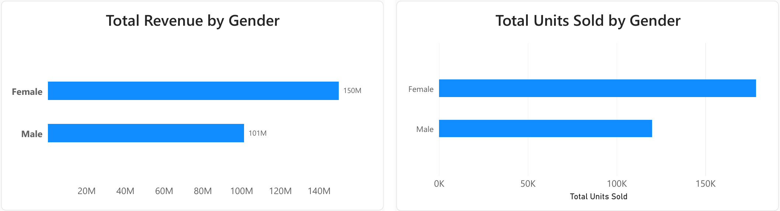
GENDER
Revenue and units sold by gender
WHAT IT SHOWS
Women bought 178,659 units (59.8%) against 120,053 for men (40.2%).
Women generated TL 150.2M (59.7%) against TL 101.3M for men (40.3%).
Average basket is almost identical (TL 2,525 vs TL 2,534), so women lead through more transactions, not larger ones.

Slide 6
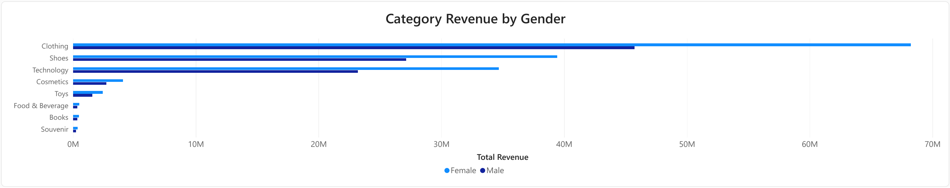
CATEGORIES
Category revenue by gender
WHAT IT SHOWS
Clothing (TL 114.0M), Shoes (TL 66.6M) and Technology (TL 57.9M) produce 94.8% of revenue.
Women lead in every category; Clothing is 45.4% of female and 45.2% of male revenue.
The category mix is nearly identical for both genders.

Slide 7
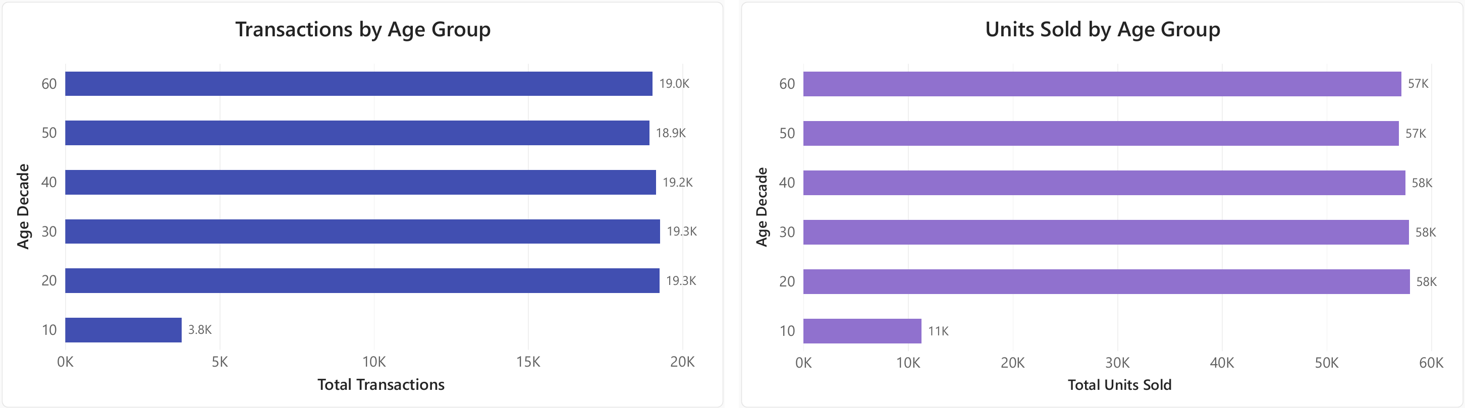
AGE
Shopping distribution by age
WHAT IT SHOWS
Ages 20–69 are almost level: 18.9K–19.3K transactions and 57K–58K units per decade.
The 20s lead narrowly on units (57,949).
The “10” group covers only ages 18–19; per year of age it matches the others (about 1,890 transactions per age year).

Slide 8
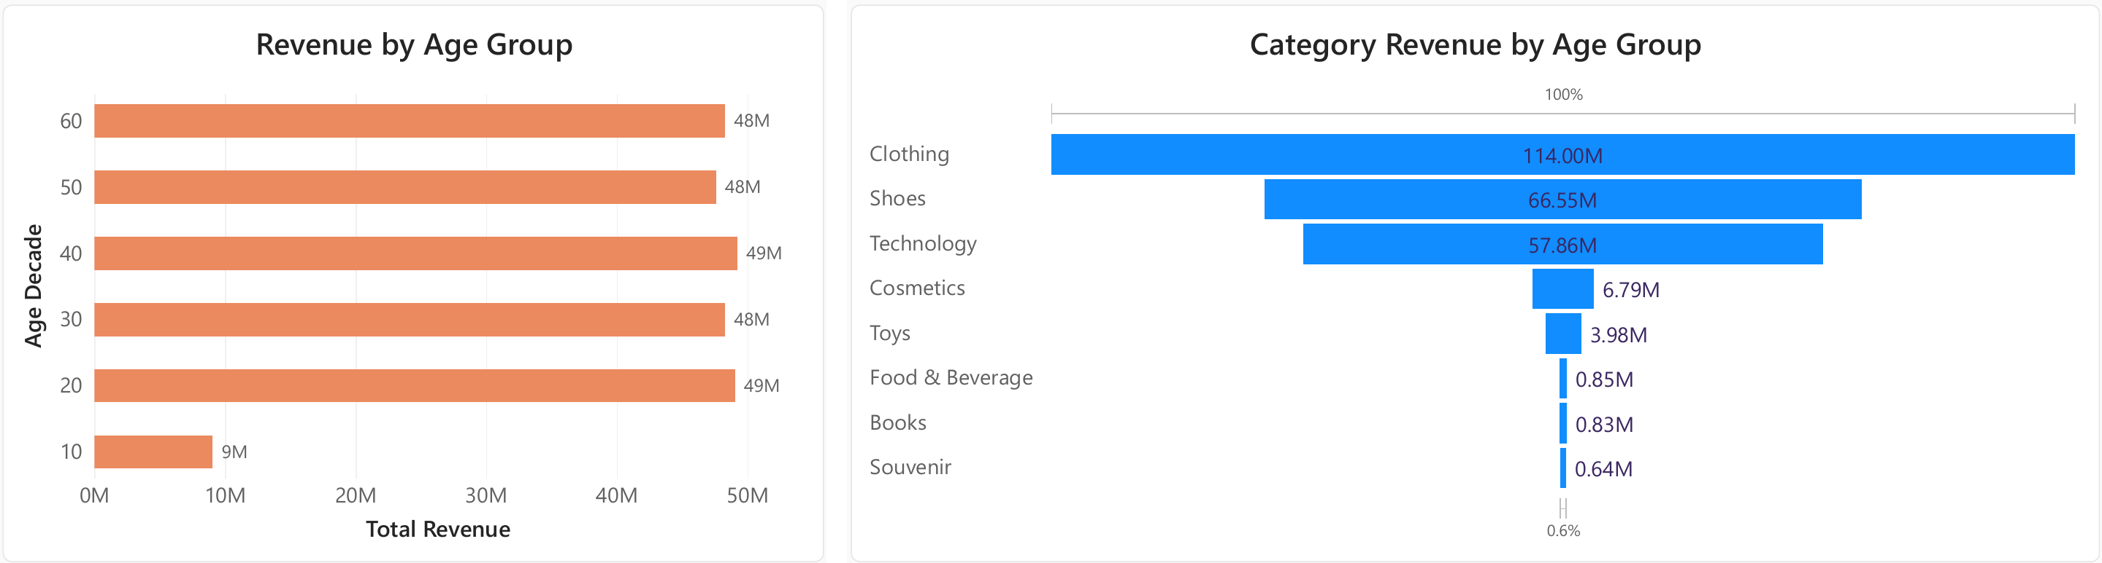
AGE
Revenue and category mix by age
WHAT IT SHOWS
The 40s generate the most revenue (TL 49.2M), then the 20s (TL 49.0M); the 30s, 50s and 60s sit within TL 47.6M–48.3M.
Clothing is 44–47% of revenue in every age group.
Technology is highest in the 30s (24.2%) and lowest at ages 18–19 (19.4%).

Slide 9
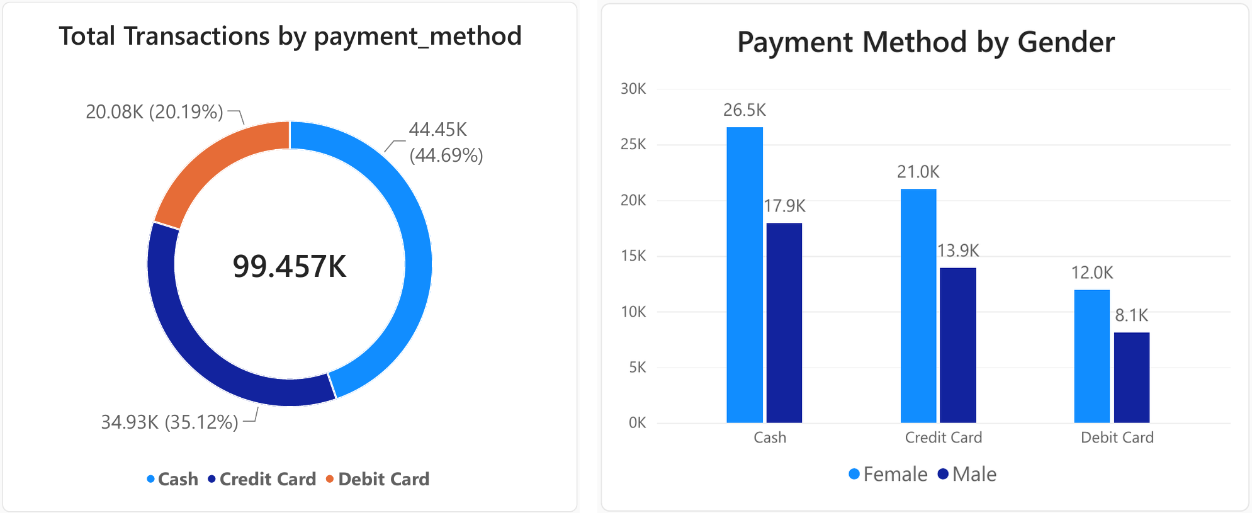
PAYMENT
Payment method distribution
WHAT IT SHOWS
Cash leads with 44,447 transactions (44.69%), then credit card (34,931; 35.12%) and debit card (20,079; 20.19%).
Men and women use each method in the same proportions (about 45 / 35 / 20).

Slide 10
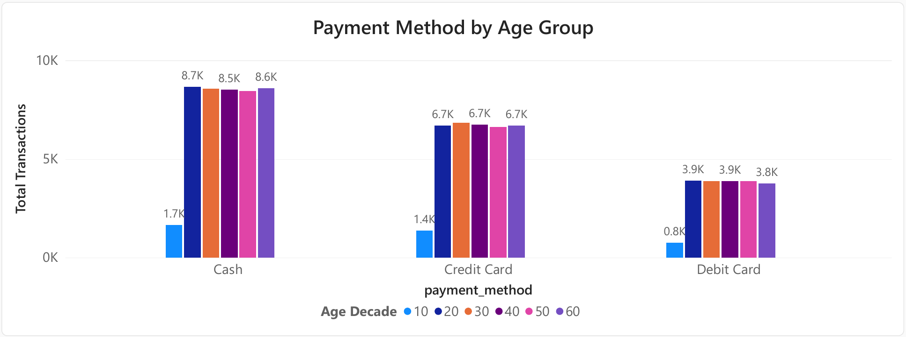
PAYMENT
Payment method by age
WHAT IT SHOWS
The 45 / 35 / 20 split (cash / credit / debit) holds within 1–2 points in every age group.
Chi-square tests find no significant link between payment method and age (p = 0.67) or gender (p = 0.26).

Slide 11
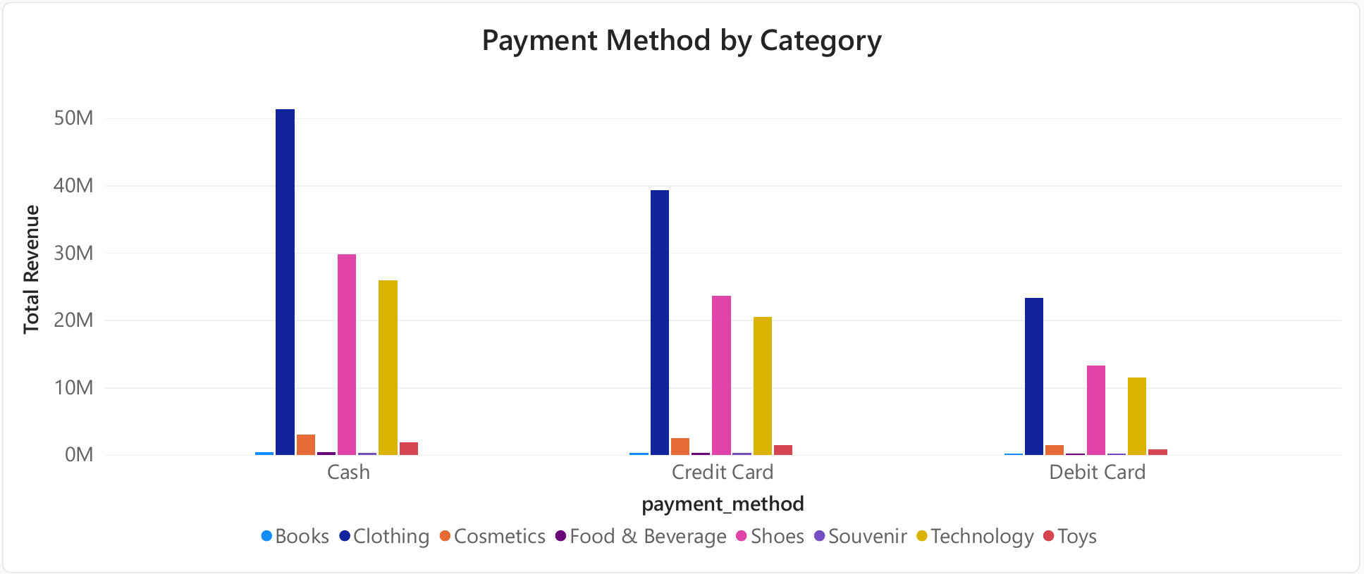
PAYMENT
Payment method by category
WHAT IT SHOWS
The same split holds across all eight categories; bars differ only because category sizes differ.
No significant link with category (p = 0.87), so payment choice cannot be used to segment customers.

Slide 12
CONCLUSION
Verdict & recommendations
THE CUSTOMERS
PRIORITIES
99,457 transactions, TL 251.5M revenue and 298,712 units; average basket TL 2,529 (about 3 items per purchase).
Women drive about 60% of transactions, units and revenue, yet spend the same per visit as men.
Ages 20–69 each contribute roughly one-fifth of sales; no single generation dominates.
Clothing, Shoes and Technology produce 94.8% of revenue; the payment mix (45 / 35 / 20) is uniform across every group.
Target marketing at women, and use offers that bring men in more often, since their basket already matches.
Protect Clothing, Shoes and Technology, and use low-price categories (Cosmetics, Toys, Food & Beverage) as bundle add-ons.
Grow Technology among under-30s (19–22% of revenue vs 24% in the 30s) with student or instalment offers.
Review the seven lower-traffic malls (TL 12–25M vs about TL 50M for the top two) at a similar basket size.

