Slide 1
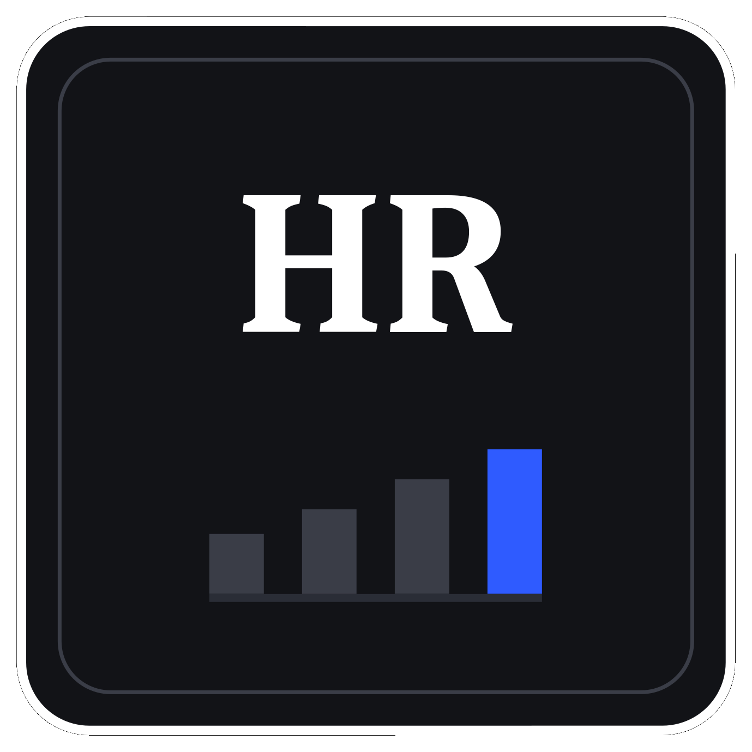
PRDA-03 · PROJECT REPORT
HR Analytics
Workforce Profile, Diversity, Hiring & Composition
Submitted by
Kavin V
Team ID: PTID-CDA-SEP-26-11151

Slide 2
PRDA-03
HR Analytics
Workforce profile, diversity, and hiring across 22,214 employee records
22,214
18,285
25.02%
38.47 yrs
TOTAL RECORDS
ACTIVE
REMOTE
AVERAGE AGE

Slide 3
AT A GLANCE
Key performance indicators
18,285
74.98% / 25.02%
ACTIVE EMPLOYEES
HQ VS REMOTE
of 22,214 total records
predominantly office-based
38.47 yrs
50.8 / 46.5 / 2.7
AVERAGE AGE
GENDER SPLIT %
a mature workforce
Male / Female / Non-Conf.

Slide 4
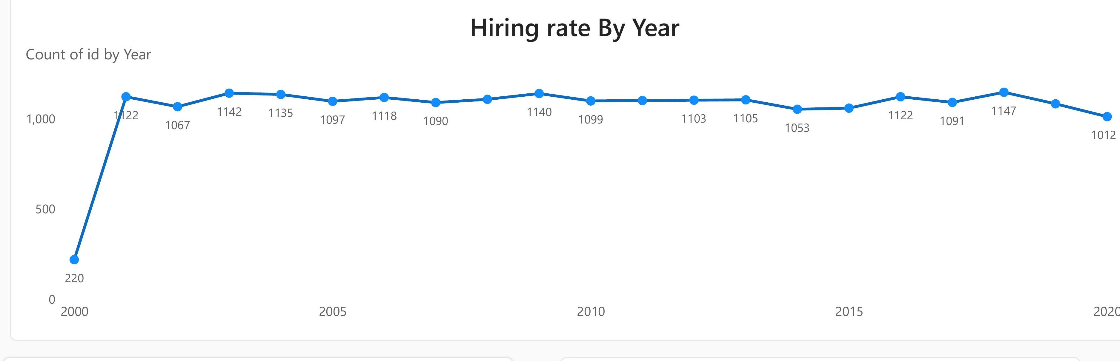
RECRUITMENT
Hiring trend by year
WHAT IT SHOWS
Steady, high-volume hiring of roughly 1,050-1,150 employees per year from 2001 through 2019.
2000 shows a low figure (220) as it's a partial first year in the dataset.
A modest dip in 2020 (1,012) is worth noting against headcount targets — plausibly a pandemic effect.

Slide 5
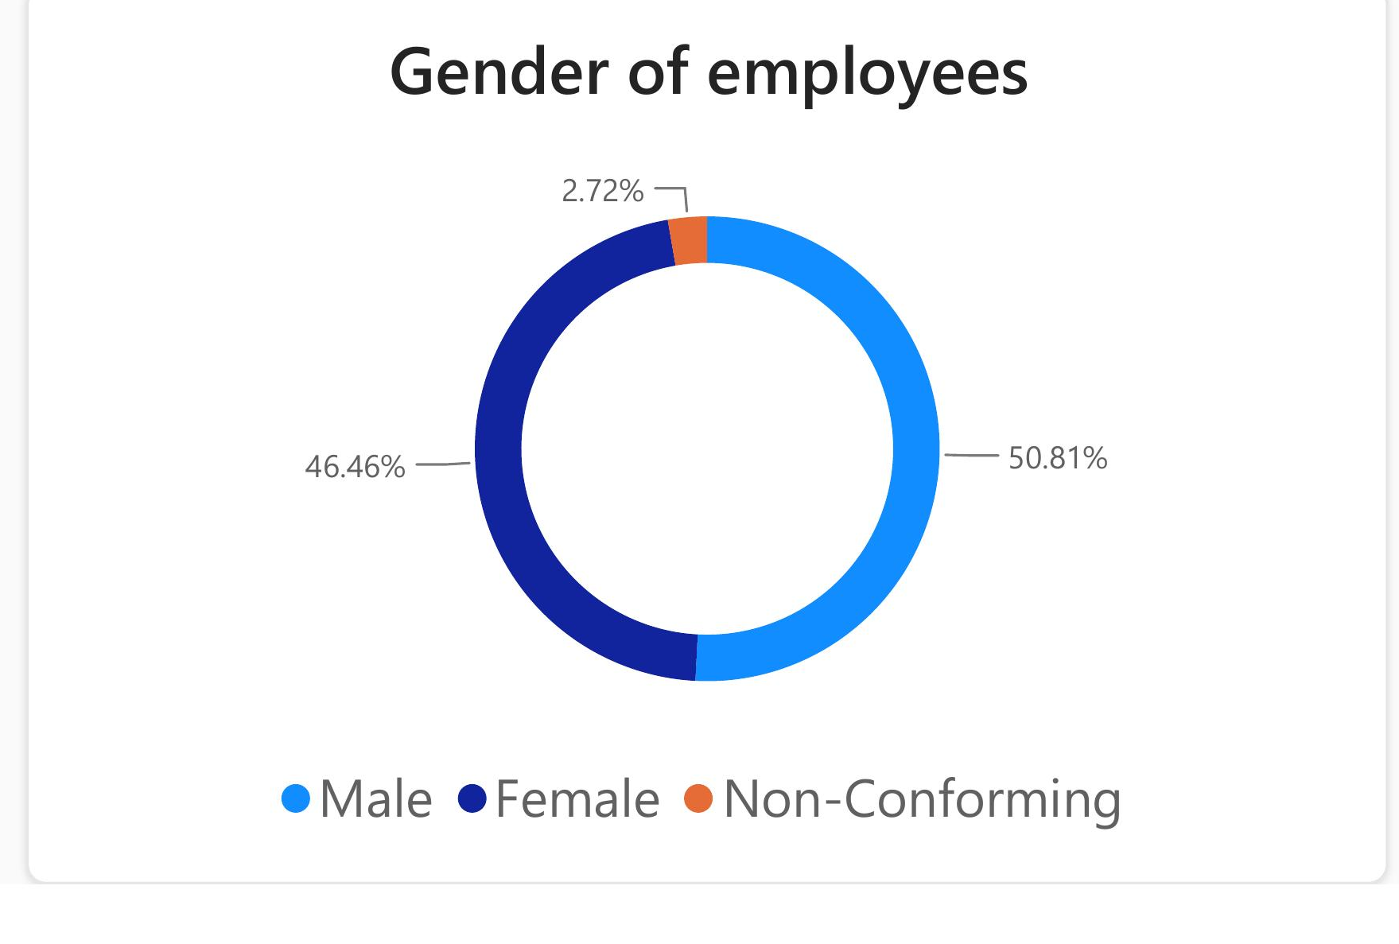
DIVERSITY
Gender distribution
WHAT IT SHOWS
Male 50.81%, Female 46.46%, Non-Conforming 2.72% — a reasonably balanced split within a healthy band.
Worth confirming the balance holds within individual departments and at senior levels, not just company-wide.

Slide 6
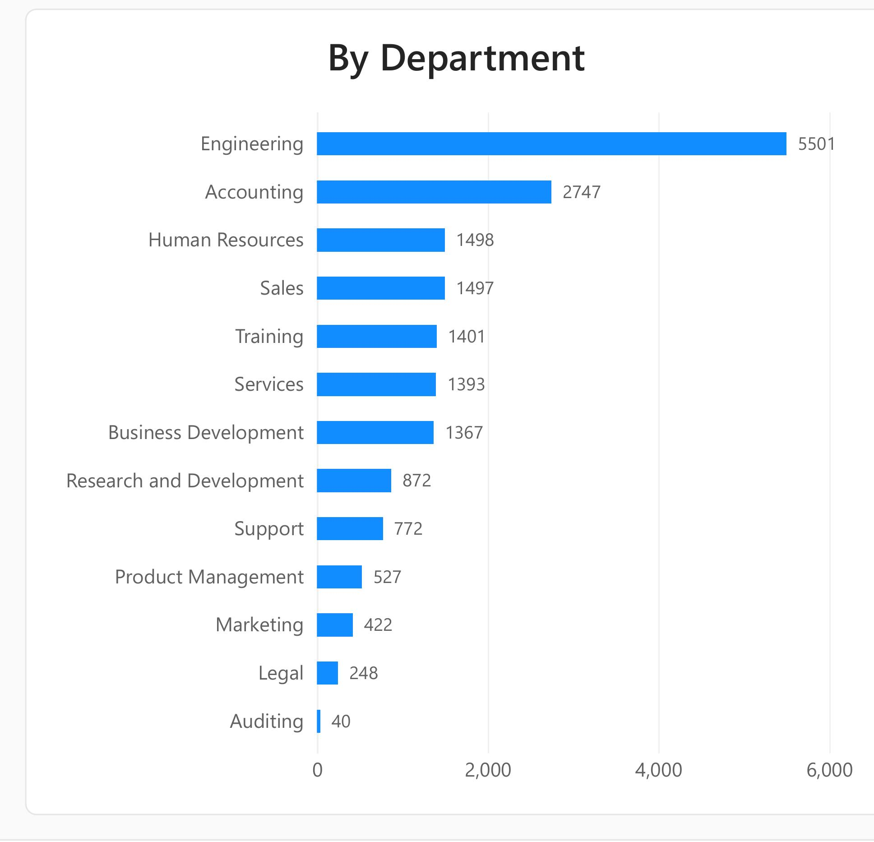
STRUCTURE
Employees by department
WHAT IT SHOWS
Engineering dominates with 5,501 employees — roughly 1 in 3 of the active workforce.
Accounting (2,747) is the next largest, a long tail down to Auditing (40).
Concentration informs where hiring and restructuring effort should focus.

Slide 7
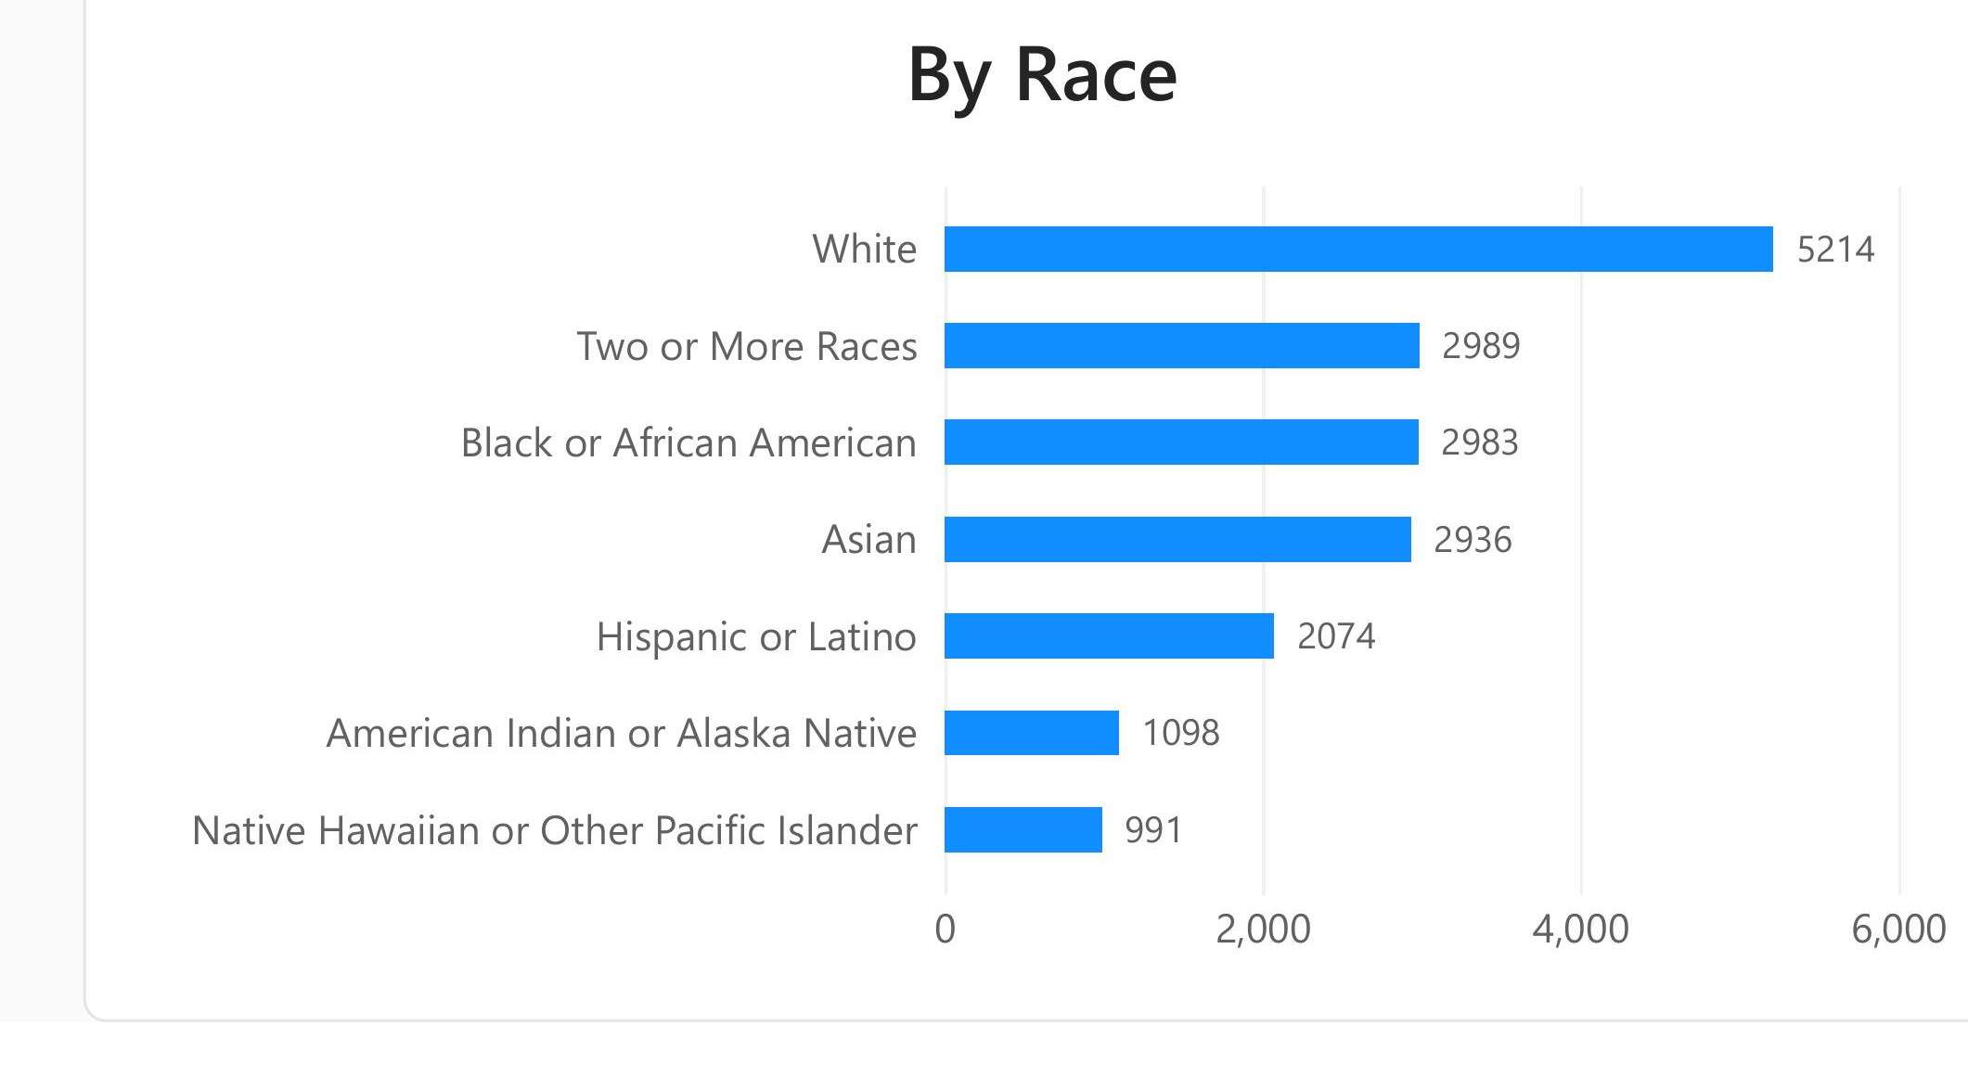
DIVERSITY
Employees by race
WHAT IT SHOWS
White is the largest group (5,214), followed by Two or More Races and Black or African American (both 2,983).
Asian (2,936) is closely represented as well.
A genuinely multi-racial workforce across seven categories, with no single group holding a majority.

Slide 8
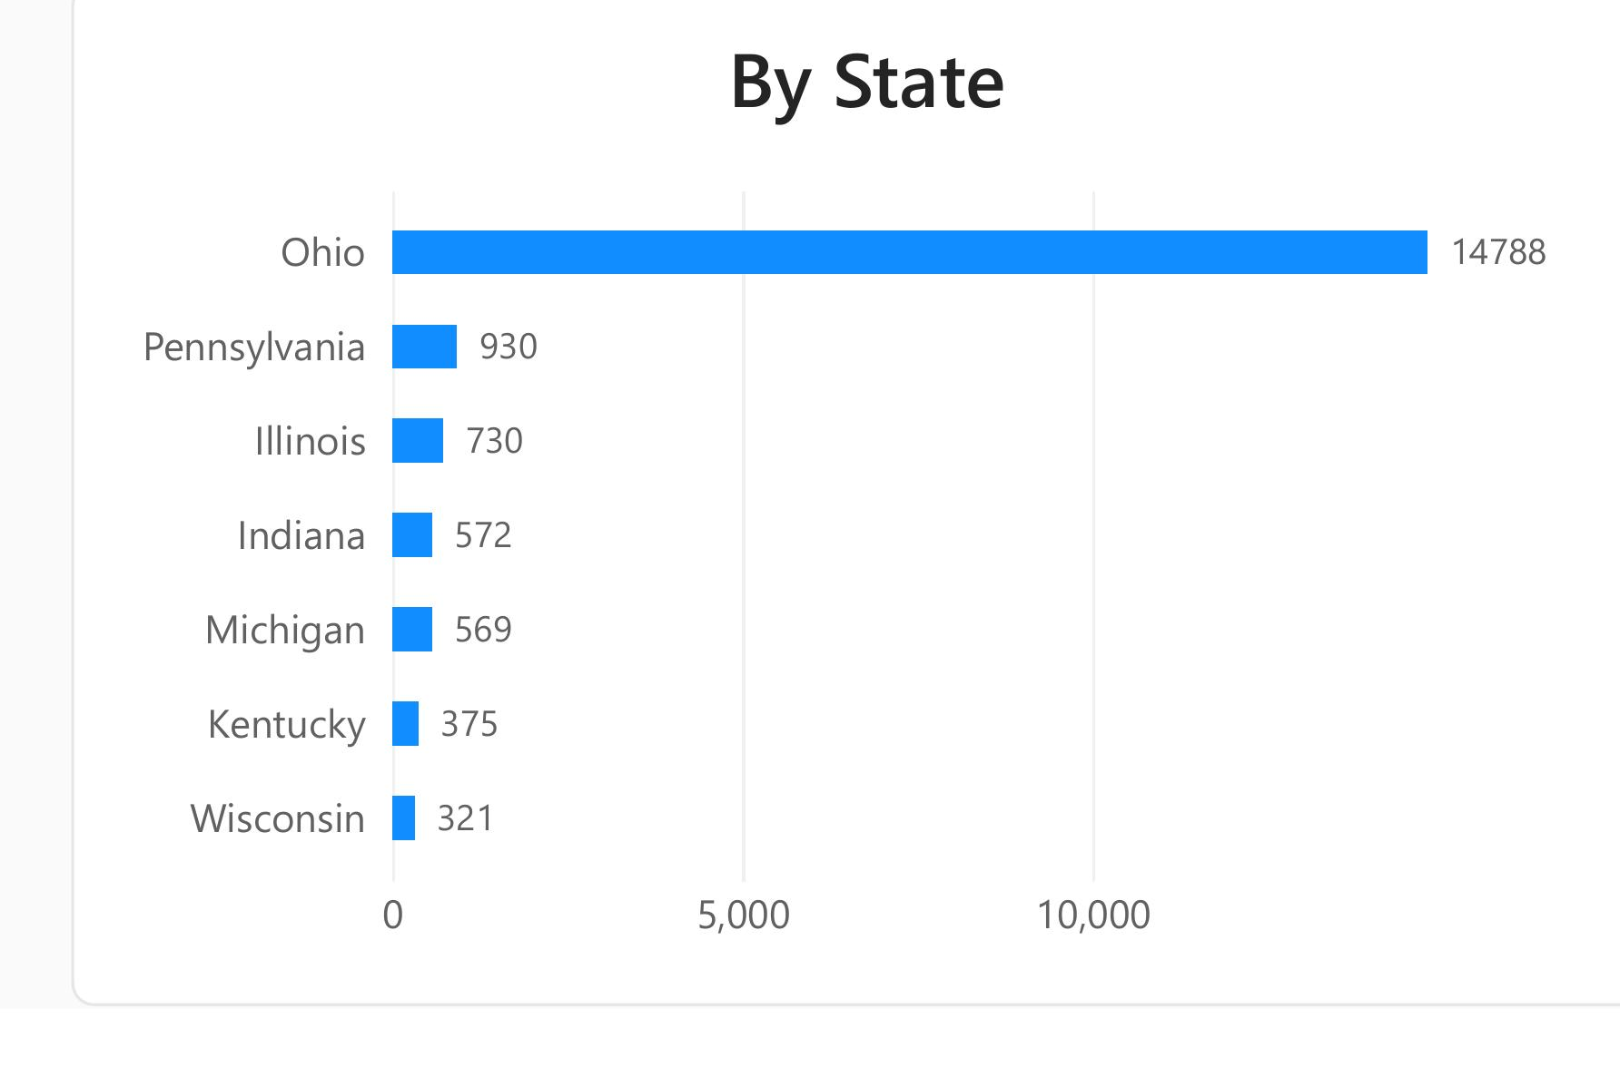
GEOGRAPHY
Employees by state
WHAT IT SHOWS
Ohio holds 14,788 employees — about 81% of the active workforce.
All other states trail far behind (Pennsylvania 930, Illinois 730, and so on).
This heavy concentration is a real business-continuity consideration.

Slide 9
CONCLUSION
Verdict & recommendations
THE WORKFORCE
PRIORITIES
Large, stable, and predominantly office-based, with a 25/75 remote-to-HQ split.
Hiring has been remarkably steady (1,100/year) for two decades — a mature, replacement-driven phase.
Gender split is close to balanced (50.8% / 46.5% / 2.7%); race distribution shows no single majority beyond White (28.5%).
Workforce is heavily concentrated in Ohio (81%) and in Engineering (30%).
Evaluate geographic concentration risk in Ohio; consider remote or secondary-location hiring to diversify.
Track gender/race balance on a recurring cadence, especially within departments and senior roles.
Review staffing depth in Legal and Auditing to confirm adequate coverage for compliance-critical functions.
Budget hiring predictably — a stable 1,100/year pace for two decades supports steady-state, not high-growth, recruiting capacity.

