Slide 1


Chinook Music Store Analytics
KAVIN DURAISAMY
18-10-2023

Slide 2
Problem statement
Chinook Music Store is a leading provider of music records with a diverse range of genres and albums.
Committed to customer satisfaction.
Offers a curated collection of popular artists, classic albums, and niche genres.
A go-to destination for music enthusiasts worldwide.
How can Chinook Music Services leverage customer data to identify key trends, optimize product offerings, and improve marketing strategies in order to maintain its position in the competitive physical music market?

Slide 3
GOALS AND OBJECTIVES
Analyze customer purchasing behavior.
Identify customer preferences and trends in terms of genres, artists, and albums.
Analyze the impact of factors like price, release date, and promotions on customer purchasing decisions.
Identify customer segments with high potential for growth or retention.
Identify growth opportunities and optimize marketing efforts to drive sales.
Develop personalized marketing campaigns based on customer preferences and purchase history.
Ensure and enhance and customer satisfaction and loyalty.

Slide 4
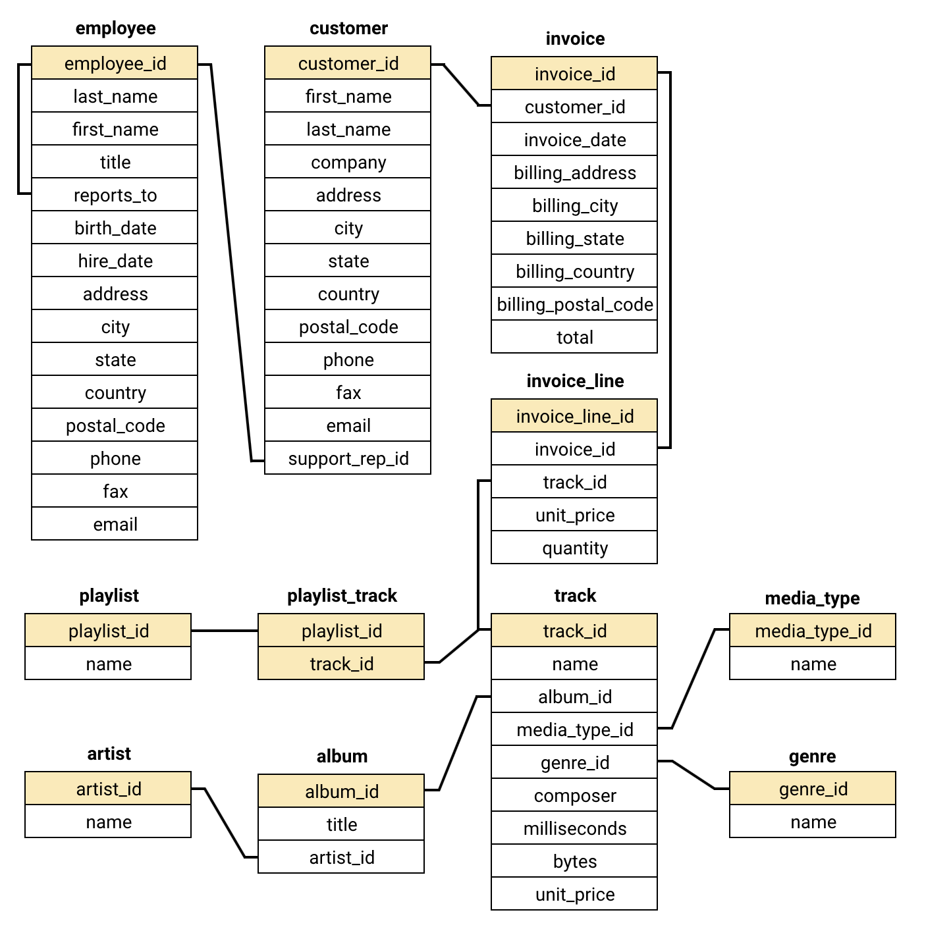
Data Base schema

Slide 5
Understanding our Store Landscape
Attributes
Data Importance
Key Data Points
Key Data Points
Total Tables: 11
Table: 20 employee, customer, invoice, invoice_line, track, album, genre, media_type, playlist_track, artist, playlist
Country Description: 2 (CountryCode, Country Name) 24 different countries
Tracks sold are of 25 different genres
Invoice table to incluse all transactions
This data is critical for analyzing trends in the music sales across different countries.
Examining factors like total , number of customers, churn analysis, and risk and customer lifetime value.
We can identify potential loyal customers and increase customer engagement.
Countries: Data includes sales from various countries.
Ratings: Average rating can help identify customer satisfaction levels.
Price (total): Sales is the measure on which we can analyse different dimensions.
Genre, artist, albums: Shows the customer preferences.
Invoice DAte: Indicates purchasing patterns with time
Data Cleaning:
No duplicates (0 found)
Addressed missing values:
Replaced blank states in State column with “other” in some queries

Slide 6
Analytical approach
Understanding the Data
Familiarize with the tables, columns and relationships
Assess Data Quality
Check for missing values and inconsistency and redundancy
Start with simple queries to retrieve basic info and gradually build more complex queries as needed
Write SQL Queries
Interpret the results
Relate the finding of queries back to original business problem.

Slide 7
Essential details from cleaned Data
The USA has the highest customer count, followed by Canada, Brazil, and France, with customer counts of 13, 8, 5, and 5, respectively.
The Album table is connected to the Artist table and the Track table.
The Playlist table is connected to the Playlist Track table and the Track table.
The Media Type table and Genre table are also connected to the Track table, which serves as a fact table in this context.
Additionally, there are three other tables that provide customer details and their invoices.

Slide 8
Evaluating total revenue for each country
The USA has the highest total revenue, amounting to 1040.49 million, followed by Canada with 535.59 million and Brazil with 427.68 million.
The country with the lowest total revenue among all others is Denmark, with total revenue of 37.62 million.

Slide 9
Top Selling tracks in usa
Given that the USA shows significantly higher sales figures, we are exploring the reasons behind its top position.
The top 10 selling tracks in the USA (as shown in the figure above) prompt us to ask: Which genre do customers in the USA prefer the most

Slide 10
Top selling genre in countries other than usa
Having established that the USA is our top country in sales, we are now examining the top genres in other countries.
Rock Dominates Globally: Across most countries, Rock is the top-selling genre. Countries like Brazil, Canada, France, and the United Kingdom show particularly high sales in Rock, demonstrating its universal appeal beyond the USA.
Genre Variations by Country: While Rock is dominant, genres such as Alternative & Punk and Metal frequently rank in the top three across various countries, indicating their widespread popularity. Additionally, some countries have unique preferences, such as Jazz in Spain and Austria, or Latin music in Argentina and Ireland.

Slide 11
Customer purchasing behaviour
The first graph(frequency graph) will show you which customers are the most frequent buyers.
We can see that František Wichterlová has highest purchase count of 18.
The second graph(average order value graph) allows you to see which customers typically spend more per purchase.
We can see that François Tremblay spends more per purchase.
So now, the question arises: which countries having the top spenders?

Slide 12
Top Spenders
Top Spenders: Countries like the Czech Republic, Ireland, and Spain have the highest average total spending per customer, with totals exceeding $1,000 and more than 90 tracks purchased per customer.
Moderate to Low Spending: The USA has the largest customer base (13), but the average spending per customer is lower at $800 compared to top spenders. Other countries like Denmark and Argentina show much lower spending, with totals below $400.

Slide 13
Conclusion and Recommendation
To effectively enhance Chinook's strategy in the physical music market, the following recommendations are crucial based on purchasing behavior by geographical location:
Focus on High-Spending Countries: Prioritize marketing efforts in countries such as the Czech Republic, Ireland, Spain, and India, where customers exhibit higher average spending. Tailoring promotions and campaigns for these regions can significantly boost revenue from high-value customers.
Cultivate Growth in Low-Spending Regions: While the USA boasts a large customer base, its average spending per customer is relatively low. Implement targeted marketing campaigns, upselling strategies, and bundling offers to increase individual spending and enhance customer lifetime value in these markets.
By strategically focusing on these areas, Chinook can optimize its revenue potential and foster a more engaged customer base.

Slide 14
THANK YOU

