Slide 1

ZOMATO ANALYTICS DASHBOARD
KAVIN DURAISAMY
08-11-2024

Slide 2
GOALS AND OBJECTIVES
The global restaurant industry is currently valued at USD 2.3 billion and is expected to grow to USD 2.4 billion by 2030.
Zomato, a leading online food ordering and restaurant platform, aims to identify the most promising regions for future growth.
This project explores a comprehensive dataset of Zomato restaurants worldwide.
By analyzing factors such as cuisine preferences, average costs, and online ordering trends, we seek to discover hidden gems—ideal locations for Zomato's expansion.
Through meticulous data exploration, we will develop a strategic roadmap to guide Zomato toward regions with the highest potential for a vibrant restaurant scene.

Slide 3

Understanding our Restaurants Landscape
01
02
03
04
Attributes
Data Importance
Key Data Points
Data cleaning and preprocessing
Total Records: 9551
Attributes: 20 (RestaurantID, RestaurantName, CountryCode, City, Address, Locality, LocalityVerbose, Longitude, Latitude, Cuisines, Currency, Has_Table_booking, Has_Online_delivery, Is_delivering_now, Switch_to_order_menu, Price_range, Votes, Average_Cost_for_two, Rating, Datekey_Opening)
Country Description: 2 (CountryCode, Country Name)
This data is critical for analyzing trends in the restaurant industry across different countries.
Examining factors like average rating, number of restaurants, price range, and online delivery options.
We can identify potential locations for opening new restaurants that are likely to be successful.
Countries: Data includes restaurants from various countries.
Ratings: Average rating can help identify customer satisfaction levels.
Price Range: Distribution of restaurants across price ranges helps understand market competition.
Online Delivery & Booking: Shows if these services impact customer ratings.
Votes: Indicates customer review volume and market demand.
Data Cleaning:
Removed duplicates (0 found)
Addressed missing values:
Replaced blank average cost for two with average cost in that price range
Replaced blank/invalid Lat/Long with values from non-duplicate Locality Verbose entries using VLOOKUP
Fixed date format inconsistencies in Datekey_Opening column
Preprocessing:
Created a new "Price Category" column combining currency symbol and average cost

Slide 4





Analytical approach
Data cleaning
Duplicate removal (none in this data)
Missing/ Zero values Handling
Removing inconsistency
Data preprocessing
New field - Price concatenating with currency symbol.
Country field using VLOOKUP
Extracting year
Descriptive Statistics
Pivot tables Average Rating, average votes
Restaurants per country
Average cost for two
Used bar, column charts for restaurants distribution across countries
Segmented data by sort / filter pivoted data to across cuisines, countries, cities & price ranges.
Slicers for dynamic filtering
Visualization and Data segmentation

Slide 5
Country and city wise analysis
country | Count of RestaurantName | Market precentage
Australia | 24 | 0.25%
Brazil | 60 | 0.63%
Canada | 4 | 0.04%
India | 8652 | 90.59%
Indonesia | 21 | 0.22%
New Zealand | 40 | 0.42%
Philippines | 22 | 0.23%
Qatar | 20 | 0.21%
Singapore | 20 | 0.21%
South Africa | 60 | 0.63%
Sri Lanka | 20 | 0.21%
Turkey | 34 | 0.36%
United Arab Emirates | 60 | 0.63%
United Kingdom | 80 | 0.84%
United States of America | 434 | 4.54%
Filtering countries and cities with more competition and Market Saturation
India has more competition with 90% market occupancy
We suggest to open restaurants in countries or cities with minimal competition
We won’t suggest these places as there is already market saturation
city | Count of RestaurantName | market percentage
Ahmedabad | 21 | 0.26%
Amritsar | 21 | 0.26%
Bhubaneshwar | 21 | 0.26%
Faridabad | 251 | 3.12%
Ghaziabad | 25 | 0.31%
Gurgaon | 1118 | 13.88%
Guwahati | 21 | 0.26%
Lucknow | 21 | 0.26%
New Delhi | 5473 | 67.97%
Noida | 1080 | 13.41%

Slide 6
Analysis as per the average price
High Competition:
New Delhi: 5,473 restaurants with a Average price range of 1.63.
Gurgaon: 1,118 restaurants with a Average price range of 1.85.
Lower Competition:
Dehradun: Only 20 restaurants with a modest average cost of 741.26.
Goa: 20 restaurants with a higher average cost of 1,175.
city | Average of Price_range | Average of Average_Cost_for_two | Count of RestaurantName
Dehradun | 3.05 | 741.259 | 20
Goa | 3.65 | 1175 | 20
Hyderabad | 2.888888889 | 1361.111111 | 18
Indore | 2.75 | 960 | 20
Jaipur | 2.85 | 1310 | 20
Kolkata | 2.85 | 1272.5 | 20
Mumbai | 2.75 | 1072.5 | 20
Nashik | 2.8 | 662.5 | 20
Panchkula | 4 | 2000 | 1
Puducherry | 3 | 842.5 | 20
Pune | 2.95 | 1337.5 | 20

Slide 7
Analysis based on popularity
Average vote across countries and yearly trends of restaurant
Average number of votes tell about the popularity of restaurant in different countries
Indonesia, UAE, Turkey, Phillipines, USA, and South Africa are countries with most customer popularity
Recent trends in number of restaurant opened shows double growth since 2016

Slide 8
Extra services and ratings relation
So we can introduce these services in the newly opened restaurants in suggested countries
25 % of total restaurants across globe have option for online delivery
12% of the total restaurants across globe have an option for table booking
Rating insights from restaurant having table bookings and online delivery
We see that average ratings is better when restaurant has table booking and online delivery services.

Slide 9
Top 10 most cuisines
Top 10 vote by cuisines
Dominant Cuisine: North Indian cuisine has the highest popularity score and a market saturation value of 53747
These insights would be even more impactful with slicers, allowing for deeper analysis and filtering of the data based on various criteria. This would enable us to dynamically explore popular cuisines, market saturation, and customer preferences across different dimensions.

Slide 10
TOP 10 CITY AVERAGE RATING
Top 10 Suggested Cities by Average Rating
To identify cities with less competition, we can filter out those with more than 5% market occupancy. This approach will help us target locations with greater growth potential.
The cities with the best ratings are Inner City, Quezon City, Makati City, Pasig City, and Mandaluyong City.

Slide 11
Strategic Recommendation
High Average Rating
The data indicates that customers in the suggested countries are generally more satisfied with restaurants, highlighting a potential market opportunity for your specific cuisine or concept.
Low Restaurant Density
Identify countries with a lower number of restaurants compared to others, as this suggests less competition and potentially greater opportunities for market share.
Expected Impact
This targeted approach enhances the chances of discovering a receptive customer base, resulting in increased customer satisfaction and brand loyalty.

Slide 12
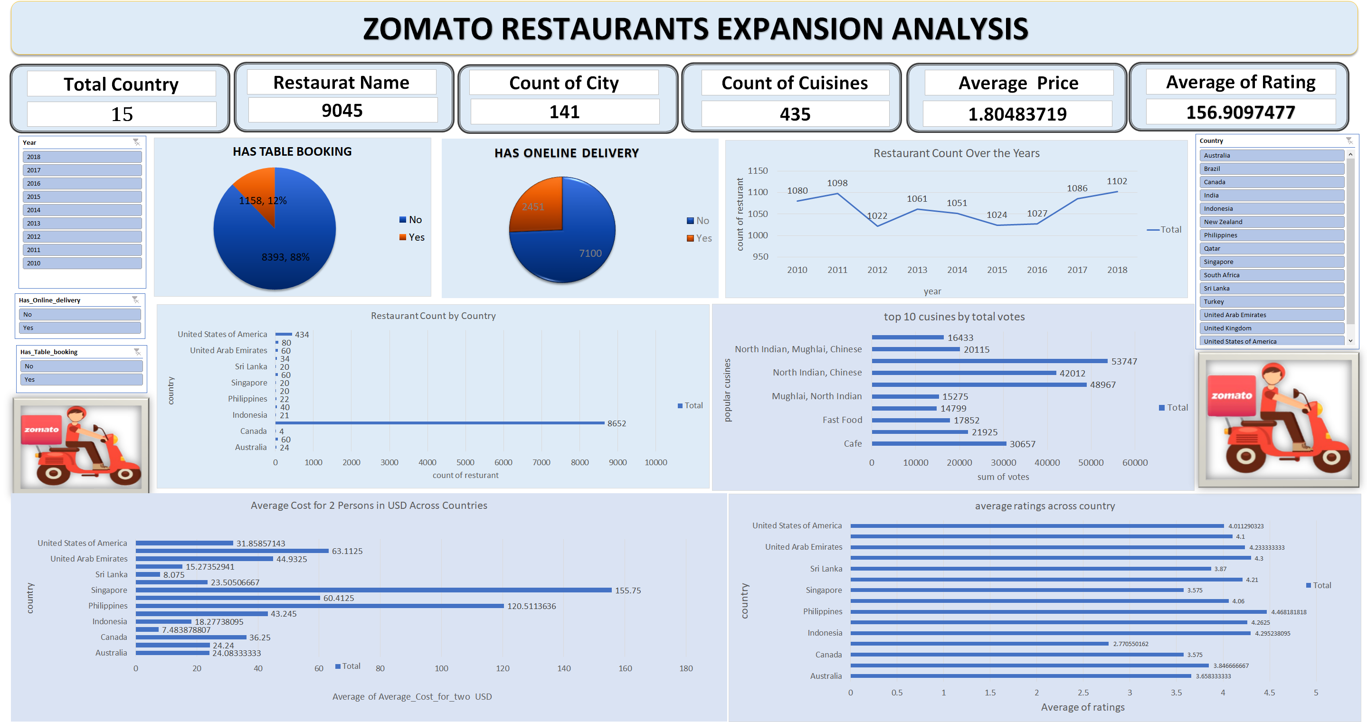

Slide 13
Conclusion
Our comprehensive analysis of restaurant data has revealed significant opportunities for global expansion. By focusing on countries with high average ratings and lower restaurant density, we can strategically position ourselves in markets with less competition. Targeting cities in Indonesia and the Philippines is particularly promising, given their strong customer satisfaction levels.
This data-driven strategy allows us to make informed decisions that enhance our chances of success, ensuring effective restaurant placement and the potential for a thriving global presence. Moving forward, we are equipped to seize these opportunities and drive our growth in new markets

Slide 14
THANK YOU

