Slide 1
Arrays and Lists
  Arrays: Contiguous memory locations => lists
  Forms basis for all other data structures
© 2010 Goodrich, Tamassia
Using Recursion

Slide 2
Array-based Implementation
Use an array A of size N
A variable n keeps track of the size of the array list (number of elements stored)
Operation at(i) is implemented in O(1) time by returning A[i]
Operation set(i,o) is implemented in O(1) time by performing A[i] = o
A
0
1
2
i
n
© 2010 Goodrich, Tamassia
Array Lists

Slide 3
Insertion
In operation insert(i, o), we need to make room for the new element by shifting forward the n − i elements A[i], …, A[n − 1]
In the worst case (i = 0), this takes O(n) time
A
0
1
2
i
n
A
0
1
2
i
n
A
o
0
1
2
i
n
© 2010 Goodrich, Tamassia
Array Lists

Slide 4
Element Removal
In operation erase(i), we need to fill the hole left by the removed element by shifting backward the n − i − 1 elements A[i + 1], …, A[n − 1]
In the worst case (i = 0), this takes O(n) time
A
o
0
1
2
i
n
A
0
1
2
i
n
A
0
1
2
i
n
© 2010 Goodrich, Tamassia
Array Lists

Slide 5
Performance
In the array based implementation of an list:
  The space used by the data structure is O(n)
  size, empty, at and set run in O(1) time
  insert and erase run in O(n) time in worst case
If we use the array in a circular fashion, operations insert(0, x) and erase(0, x) run in O(1) time
In an insert operation, when the array is full, instead of throwing an exception, we can replace the array with a larger one
© 2010 Goodrich, Tamassia
Array Lists

Slide 6




Linked Lists
Linked Lists
Notes:
Sequences

Slide 7
Singly Linked List (§ 3.2)
A singly linked list is a concrete data structure consisting of a sequence of nodes
Each node stores
  element
  link to the next node
next
elem
node
∅
A
B
C
D
Linked Lists

Slide 8
Delete(Node *n) {
Node *tmp = head;
While (tmp->next != n ) {
tmp = tmp->next;
}
Tmp->next = n->next;
Free n;
Linked Lists

Slide 9
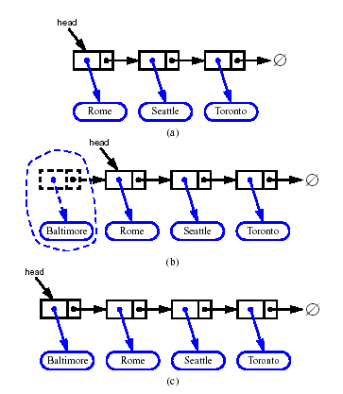
Inserting at the Head
Allocate a new node
Insert new element
Have new node point to old head
Update head to point to new node
Linked Lists

Slide 10
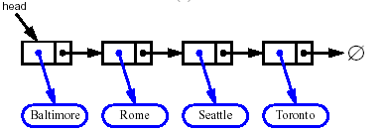


Removing at the Head
Update head to point to next node in the list
Allow garbage collector to reclaim the former first node
Linked Lists

Slide 11
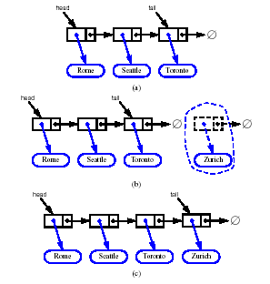
Inserting at the Tail
Allocate a new node
Insert new element
Have new node point to null
Have old last node point to new node
Update tail to point to new node
Linked Lists

Slide 12
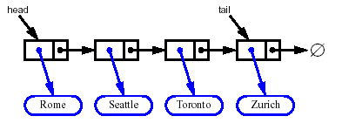
Removing at the Tail
Removing at the tail of a singly linked list is not efficient!
There is no constant-time way to update the tail to point to the previous node
Linked Lists

Slide 13
Main() {
traverse(head); /*use recursion
}
Node {
int val;
Node *next;
}
Traverse(Node tmp) {
if ( tmp == null ) { return }
print tmp.val;
traverse(tmp.next);
}
Linked Lists

Slide 14
Main() {
delete(head, v); /*use recursion
}
delete(Node tmp, int v) {
if ( head.val == v ) { head = tmp.next; return; }
if (tmp.next.val == v ) {
tmp.next = temp.next.next;
return;
}
delete(tmp.next, v); return;
}
Linked Lists

Slide 15
Given a single linked list, can be empty. Write recursive alogirthm to return sum of all nodes.
main() {
s = sum(head);
}
int sum( Node tmp ) {
if ( tmp == null ) { return 0 };
return (tmp.val + sum(tmp.next);
Linked Lists

Slide 16
Given a single linked list, could be empty. Write a recursive algorithm to count the number of nodes in the list.
Main() {
n = count(head);
}
Int count(Node tmp) {
if ( tmp == null ) { return 0 }
else return (1 + count(tmp.next) );
}
Linked Lists

Slide 17
Given a single linked list, not empty, find the largest value in the list. – recursive
Main(){
v = largest(head);
}
Int largest(tmp) {
if(tmp.next == null ) {return tmp.val}
var = largest(tmp.next);
if ( tmp.val > var ) return tmp.val;
else return var;
}
Linked Lists

Slide 18
Doubly Linked List
A doubly linked list provides a natural implementation of the Node List ADT
Nodes implement Position and store:
  element
  link to the previous node
  link to the next node
Special trailer and header nodes
prev
next
elem
node
header
nodes/positions
trailer
elements
© 2010 Goodrich, Tamassia
Lists

Slide 19
Given a double linked list. You have head and the tail.
Assume the # of nodes is odd. Find the middle.
Main() {
n = middle( head, tail);
}
Node middle( tmp1, tmp2 ) {
if ( tmp1 == tmp2 ) {
return tmp1;
}
else return middle(tmp1.next,
tmp2.prev; )
© 2010 Goodrich, Tamassia
Lists

Slide 20
Given a single linked list. You have head and the tail.
Assume the # of nodes is odd. Find the middle.
Main() {
n = middle( head, head);
}
N = middle(head)
Middel( tmp ) {
if (tmp.next == null) {
return tmp;
}
Node middle( tmp1, tmp2 ) {
if ( tmp2.next == null ) {
return tmp1;
}
else return
middle( tmp1.next,
tmp2.next.next);
}
© 2010 Goodrich, Tamassia
Lists

Slide 21
Main() {
traverse(tail);
}
Traverse(tmp) {
if ( tmp == null ) { return }
print tmp.val;
traverse( tmp.prev );
}
Traverse( tmp ) {
if (tmp == null ) { return;}
traverse(tmp.prev);
print tmp.val
Return;
}
© 2010 Goodrich, Tamassia
Lists

Slide 22
Main() {
delete(head, v);
}
delete(tmp, v) {
if ( tmp.val == v ) {
if ( tmp == head ) {
head = tmp.next;
head.prev = null;
return;
}
if ( tmp == tail ) {
tail = tmp.prev;
tail.next = null;
return;
}
tmp.prev.next = tmp.next;
tmp.next.prev = tmp.prev;
return;
}
Delete(tmp.next, v );
© 2010 Goodrich, Tamassia
Lists

Slide 23
Main() {
insertAfter(head, v, n);
}
insertAfter(tmp, int v, int n) {
if ( tmp.val == n ) {
if ( tmp == tail ) {
nd.next = null;
nd.prev = tail;
tail.next = nd;
tail = nd;
return;
}
nd.prev = tmp;
nd.next = tmp.next;
tmp.next = nd;
nd.next.prev = nd;
return;
}
insertAfter(tmp.next, v ,n);
© 2010 Goodrich, Tamassia
Lists

Slide 24
//Given single linked list, contains at least one node, return sum of the values in the list nodes
Int sum( head ) {
if ( head == null ) {
return 0;
}
else {return ( head.val + sum(head.next) }
}
//Given single linked list, contains at least one node, return greatest value node in the list
Greatest( head ) {
if ( head.next == null ) {
return head.val;
}
else {
tmp = greatest( head.next );
if ( head.val > tmp ) { return head.val }
else { return tmp; }
}
© 2010 Goodrich, Tamassia
Lists

Slide 25
Node {
int key;
Node *next;
Node *prev;
}
Rev_trav(tail) {
if ( tail == null ) { return; }
print tail.key
rev_trav(tail.prev);
}
© 2010 Goodrich, Tamassia
Lists

Slide 26
Given - single linked list, head
At least 3 nodes
Odd number of nodes in the list
Find middle node
Recursive function
Main ( ) { middle( head, head);
Middle( head, n ) {
if ( n.next == null ) { return head }
else { return middle( head.next, n.next.next ) ;
© 2010 Goodrich, Tamassia
Lists

Slide 27
Insertion
We visualize operation insert(p, x), which inserts x before p
p
a
b
c
p
a
b
c
q
x
q
p
a
b
x
c
© 2010 Goodrich, Tamassia
Lists

Slide 28
Insertion Algorithm
Algorithm insert(p, e): {insert e before p}
Create a new node v
v→element = e
u = p→prev
v→next = p; p→prev = v {link in v before p}
v→prev = u; u→next = v {link in v after u}
© 2010 Goodrich, Tamassia
Lists

Slide 29
Deletion
We visualize remove(p)
p
a
b
c
d
a
b
c
p
d
a
b
c
© 2010 Goodrich, Tamassia
Lists

Slide 30
Single linked list. Write recursive function that returns the largest node in the list.
Largest(head) {
if ( head == null ) {
return invalid;
}
if ( head->next == null ) {
return( head.val );
}
else return( max( head.val, largest(head.next) );
}
© 2010 Goodrich, Tamassia
Lists

Slide 31
Deletion Algorithm
Algorithm remove(p):
u = p→prev
w = p→next
u→next = w {linking out p}
w→prev = u
© 2010 Goodrich, Tamassia
Lists

Slide 32
Performance
In the implementation of the List ADT by means of a doubly linked list
  The space used by a list with n elements is O(n)
  The space used by each position of the list is O(1)
  All the operations of the List ADT run in O(1) time
  Operation element() of the
  Position ADT runs in O(1) time
© 2010 Goodrich, Tamassia
Lists

Slide 33
Stacks
© 2010 Goodrich, Tamassia
Stacks

Slide 34

The Stack ADT
The Stack ADT stores arbitrary objects
Insertions and deletions follow the last-in first-out scheme
Think of a spring-loaded plate dispenser
Main stack operations:
  push(object): inserts an element
  object pop(): removes the last inserted element
Auxiliary stack operations:
  object top(): returns the last inserted element without removing it
  integer size(): returns the number of elements stored
  boolean empty(): indicates whether no elements are stored
© 2010 Goodrich, Tamassia
Stacks

Slide 35
Exceptions
Attempting the execution of an operation of ADT may sometimes cause an error condition, called an exception
Exceptions are said to be “thrown” by an operation that cannot be executed
In the Stack ADT, operations pop and top cannot be performed if the stack is empty
Attempting pop or top on an empty stack throws a StackEmpty exception
© 2010 Goodrich, Tamassia
Stacks

Slide 36
Applications of Stacks
Direct applications
  Page-visited history in a Web browser
  Undo sequence in a text editor
  Chain of method calls in the C++ run-time system
Indirect applications
  Auxiliary data structure for algorithms
  Component of other data structures
© 2010 Goodrich, Tamassia
Stacks

Slide 37
Array-based Stack
A simple way of implementing the Stack ADT uses an array
We add elements from left to right
A variable keeps track of the index of the top element
Algorithm size()
return t + 1
Algorithm pop()
if empty() then
throw StackEmpty
else
t ← t − 1
return S[t + 1]
…
S
0
1
2
t
© 2010 Goodrich, Tamassia
Stacks

Slide 38
Array-based Stack (cont.)
The array storing the stack elements may become full
A push operation will then throw a StackFull exception
  Limitation of the array-based implementation
  Not intrinsic to the Stack ADT
Algorithm push(o)
if t = S.size() − 1 then
throw StackFull
else
t ← t + 1
S[t] ← o
…
S
0
1
2
t
© 2010 Goodrich, Tamassia
Stacks

Slide 39
Performance and Limitations
Performance
  Let n be the number of elements in the stack
  The space used is O(n)
  Each operation runs in time O(1)
Limitations
  The maximum size of the stack must be defined a priori and cannot be changed
  Trying to push a new element into a full stack causes an implementation-specific exception
© 2010 Goodrich, Tamassia
Stacks

Slide 40
Array-based Stack in C++
template <typename E>
class ArrayStack {
private:
E* S; // array holding the stack
int cap; // capacity
int t; // index of top element
public:
// constructor given capacity
ArrayStack( int c) :
S(new E[c]), cap(c), t(-1) { }
void pop() {
if (empty()) throw StackEmpty
(“Pop from empty stack”);
t--;
}
void push(const E& e) {
if (size() == cap) throw
StackFull(“Push to full stack”);
S[++ t] = e;
}
… (other methods of Stack interface)
© 2010 Goodrich, Tamassia
Stacks

Slide 41
Stack as a Linked List (§ 5.1.3)
We can implement a stack with a singly linked list
The top element is stored at the first node of the list
The space used is O(n) and each operation of the Stack ADT takes O(1) time
nodes
t
∅
elements
Linked Lists

Slide 42
Example use in C++
* indicates top
ArrayStack<int> A; // A = [ ], size = 0
A.push(7); // A = [7*], size = 1
A.push(13); // A = [7, 13*], size = 2
cout << A.top() << endl; A.pop(); // A = [7*], outputs: 13
A.push(9); // A = [7, 9*], size = 2
cout << A.top() << endl; // A = [7, 9*], outputs: 9
cout << A.top() << endl; A.pop(); // A = [7*], outputs: 9
ArrayStack<string> B(10); // B = [ ], size = 0
B.push("Bob"); // B = [Bob*], size = 1
B.push("Alice"); // B = [Bob, Alice*], size = 2
cout << B.top() << endl; B.pop(); // B = [Bob*], outputs: Alice
B.push("Eve"); // B = [Bob, Eve*], size = 2
© 2010 Goodrich, Tamassia
Stacks

Slide 43
Parentheses Matching
Each “(”, “{”, or “[” must be paired with a matching “)”, “}”, or “[”
  correct: ( )(( )){([( )])}
  correct: ((( )(( )){([( )])}
  incorrect: )(( )){([( )])}
  incorrect: ({[ ])}
  incorrect: (
© 2010 Goodrich, Tamassia
Stacks

Slide 44
Parentheses Matching Algorithm
Algorithm ParenMatch(X,n):
Input: An array X of n tokens, each of which is either a grouping symbol, a
variable, an arithmetic operator, or a number
Output: true if and only if all the grouping symbols in X match
Let S be an empty stack
for i=0 to n-1 do
if X[i] is an opening grouping symbol then
S.push(X[i])
else if X[i] is a closing grouping symbol then
if S.empty() then
return false {nothing to match with}
if S.pop() does not match the type of X[i] then
return false {wrong type}
if S.empty() then
return true {every symbol matched}
else return false {some symbols were never matched}
© 2010 Goodrich, Tamassia
Stacks

Slide 45
Evaluating Arithmetic
Expressions
Slide by Matt Stallmann included with permission.
14 – 3 * 2 + 7 = (14 – (3 * 2) ) + 7
Operator precedence
* has precedence over +/–
Associativity
operators of the same precedence group
evaluated from left to right
Example: (x – y) + z rather than x – (y + z)
Idea: push each operator on the stack, but first pop and perform higher and equal precedence operations.
© 2010 Stallmann
Stacks

Slide 46
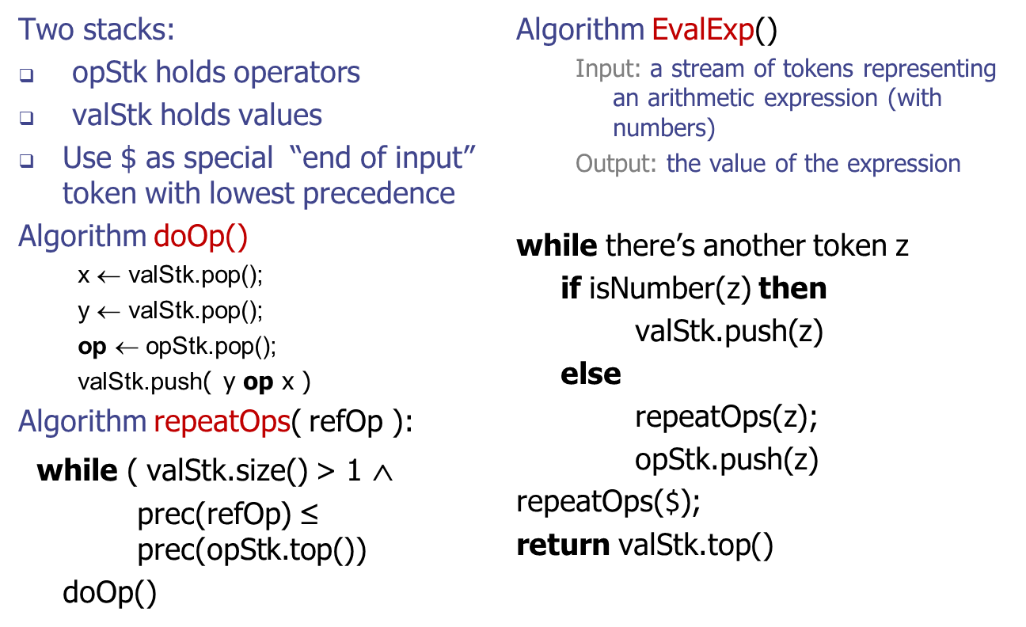
Algorithm for
Evaluating Expressions
Slide by Matt Stallmann included with permission.
© 2010 Stallmann
Stacks

Slide 47
Algorithm on an
Example Expression
Slide by Matt Stallmann included with permission.
Operator ≤ has lower precedence than +/–
14 ≤ 4 – 3 * 2 + 7
4
–
14
≤
3
*
$
$
4
–
7
$
14
≤
F
+
-2
+
5
+
14
≤
14
≤
2
2
3
*
3
*
6
4
–
4
–
4
–
-2
+
14
≤
14
≤
14
≤
14
≤
© 2010 Stallmann
Stacks

Slide 48
Queues
© 2010 Goodrich, Tamassia
Queues
Notes:
Queues

Slide 49
The Queue ADT
The Queue ADT stores arbitrary objects
Insertions and deletions follow the first-in first-out scheme
Insertions are at the rear of the queue and removals are at the front of the queue
Main queue operations:
  enqueue(object): inserts an element at the end of the queue
  dequeue(): removes the element at the front of the queue
Auxiliary queue operations:
  object front(): returns the element at the front without removing it
  integer size(): returns the number of elements stored
  boolean empty(): indicates whether no elements are stored
Exceptions
  Attempting the execution of dequeue or front on an empty queue throws an QueueEmpty
© 2010 Goodrich, Tamassia
Queues
Notes:
Queues

Slide 50
Example
Operation Output Q
enqueue(5) – (5)
enqueue(3) – (5, 3)
dequeue() 5 (3)
enqueue(7) – (3, 7)
dequeue() – (7)
front() 7 (7)
dequeue() – ()
dequeue() “error” ()
empty() true ()
enqueue(9) – (9)
enqueue(7) – (9, 7)
size() 2 (9, 7)
enqueue(3) – (9, 7, 3)
enqueue(5) – (9, 7, 3, 5)
dequeue() – (7, 3, 5)
© 2010 Goodrich, Tamassia
Queues

Slide 51
Applications of Queues
Direct applications
  Waiting lists, bureaucracy
  Access to shared resources (e.g., printer)
  Multiprogramming
Indirect applications
  Auxiliary data structure for algorithms
  Component of other data structures
© 2010 Goodrich, Tamassia
Queues

Slide 52
Array-based Queue
Use an array of size N in a circular fashion
Three variables keep track of the front and rear
  f index of the front element
  r index immediately past the rear element
  n number of items in the queue
normal configuration
Q
0
1
2
f
r
wrapped-around configuration
Q
0
1
2
r
f
© 2010 Goodrich, Tamassia
Queues

Slide 53
Queue Operations
Use n to determine size and emptiness
Algorithm size()
return n
Algorithm empty()
return (n = 0)
Q
0
1
2
f
r
Q
0
1
2
r
f
© 2010 Goodrich, Tamassia
Queues

Slide 54
Queue Operations (cont.)
Algorithm enqueue(o)
if size() = N − 1 then
throw QueueFull
else
Q[r] ← o
r ← (r + 1) mod N
n ← n + 1
Operation enqueue throws an exception if the array is full
This exception is implementation-dependent
Q
0
1
2
f
r
Q
0
1
2
r
f
© 2010 Goodrich, Tamassia
Queues

Slide 55
Queue Operations (cont.)
Operation dequeue throws an exception if the queue is empty
This exception is specified in the queue ADT
Algorithm dequeue()
if empty() then
throw QueueEmpty
else
f ← (f + 1) mod N
n ← n − 1
Q
0
1
2
f
r
Q
0
1
2
r
f
© 2010 Goodrich, Tamassia
Queues

Slide 56
Queue Interface in C++
template <typename E>
class Queue {
public:
int size() const;
bool empty() const;
const E& front() const
throw(QueueEmpty);
void enqueue (const E& e);
void dequeue()
throw(QueueEmpty);
};
C++ interface corresponding to our Queue ADT
Requires the def-inition of exception QueueEmpty
No corresponding built-in C++ class
© 2010 Goodrich, Tamassia
Queues

Slide 57
Application: Round Robin Schedulers
We can implement a round robin scheduler using a queue Q by repeatedly performing the following steps:
  e = Q.front(); Q.dequeue()
  Service element e
  Q.enqueue(e)
Queue
Dequeue
Enqueue
Shared
Service
© 2010 Goodrich, Tamassia
Queues

Slide 58
Queue as a Linked List
We can implement a queue with a singly linked list
  The front element is stored at the first node
  The rear element is stored at the last node
The space used is O(n) and each operation of the Queue ADT takes O(1) time
r
nodes
f
∅
elements
Linked Lists

