Slide 1
Data and Application Security - CS 6348 Project : Dallas Movie Theatre App
Submission by
Group 13
Varadhan Ramamoorthy (vrr180003)
Kavin Kuppusamy(KXK190026)

Slide 2

Brief Overview
The Dallas Movie Theatre App is an application designed to allow customers to purchase tickets to movies at the Dallas Theatre.
Theatre management can also use this app to manage the scheduling of movies by performing adding, updating, and removing actions.
Company employees can do analytical operations and generate report.

Slide 3
Motivation behind implementing Security features
Protecting Sensitive Information like Credit Card details
Enforce enterprise-specific security policies for users and groups
Prevent cybercriminals from accessing your private information while login to application

Slide 4
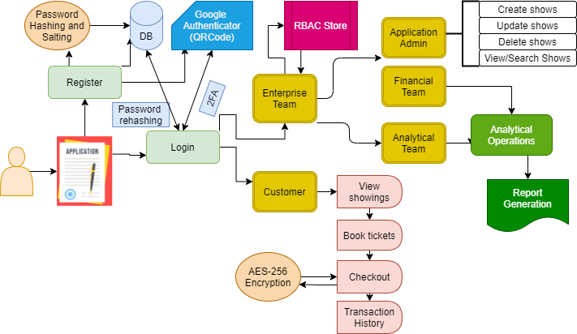
Application Design

Slide 5
Implementation – 2FA Authentication
Based on TOTP (time-based one-time password) algorithm
Generated token is valid for a duration of time, also known as a timestep.
Process includes
Generating the secret key (Using SpeakEasy)
Creating its QR code representation
Scanning the code into Google Authenticator
Validating that GA-given code (6-digit Code) against the user's key

Slide 6
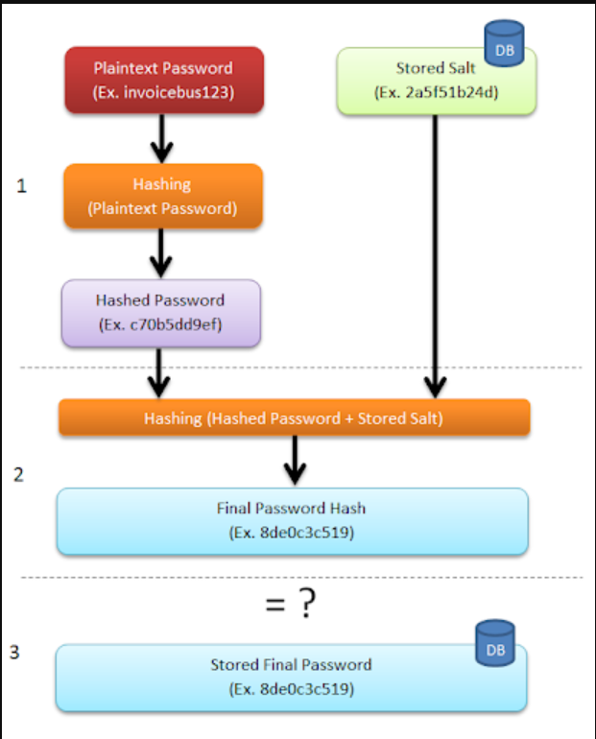
Implementation- Password Hashing and Salting
BCrypt is a computationally difficult algorithm designed to store passwords by way of a one-way hashing function
BCrypt forces you to follow best security practices as it requires a salt (12 rounds) as a part of the hashing mechanism.
Hashing combined with salt protects our application against rainbow table attacks.

Slide 7
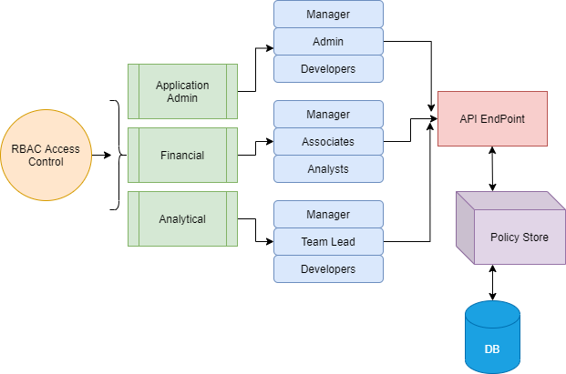
Implementation - RBAC with Query Modification
Role-based access control (RBAC) restricts application access based on a person's role within an organization
Query Modification Algorithm
Application Admin - Add, create movies
Financial Analysts – Perform Analytical Operation on Customer Cohorts, Company Sales and generate reports on it. Access only to the abstracted data of the customer for example only payment type
Financial Manager – Customer Management/ Fraud Detection. Access to critical customer data such as last 4 digits of credit/debit card.

Slide 8
Implementation - Masking Customer credit card details
256-bit AES encryption (Advance Encryption Standard) is an International standard which ensures data is encrypted/decrypted following this approved standard.
It ensures high security and is adopted by the U.S. government and other intelligence organizations across the world.
AES 256 CBC is utilized to encrypt customer details such as Credit Card number.
Masking of first 12 digits of credit card number when accessed either from application portal or report.

Slide 9

Technology Used
Front-end : Bootstrap and jQuery (for Validation)
Back-end : Node JS, Express
Database : MongoDB
Web services : Express routes (RESTful API), AJAX
Security : Speakeasy, QRCode ,Crypto ,Bcrypt

Slide 10
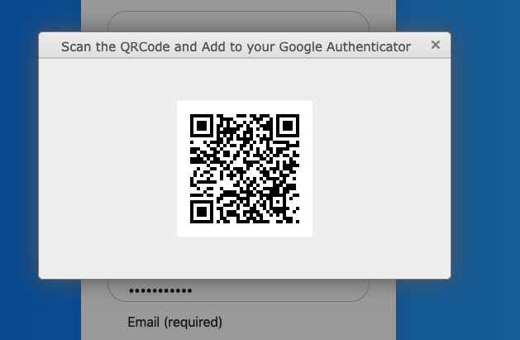
Snapshots – Registration - 2FA

Slide 11
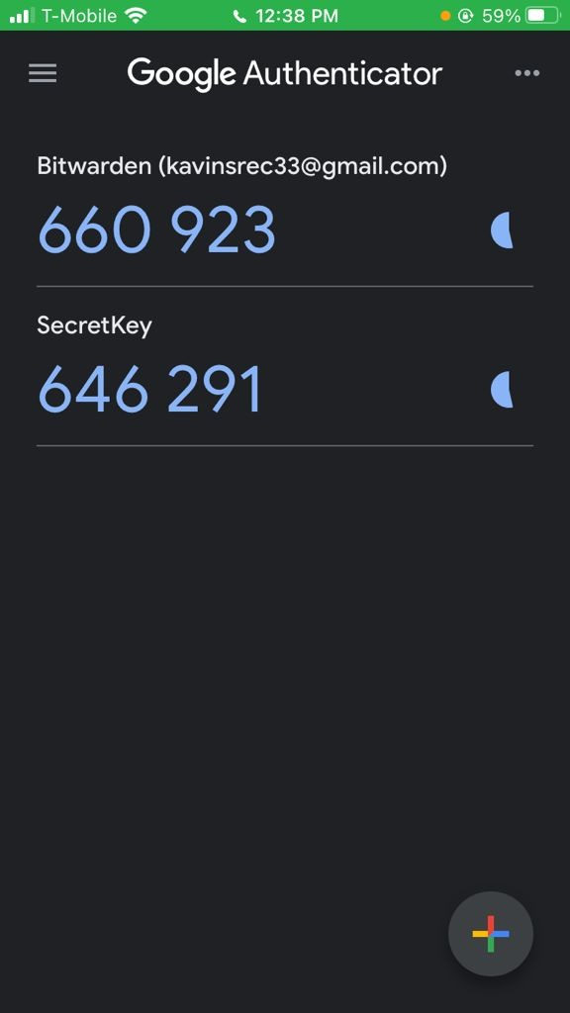
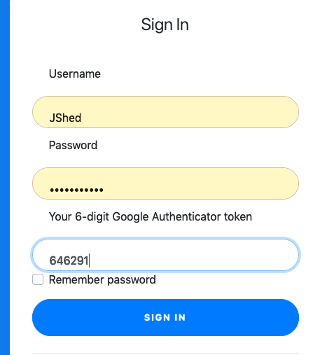
Snapshots – Login - 2FA

Slide 12
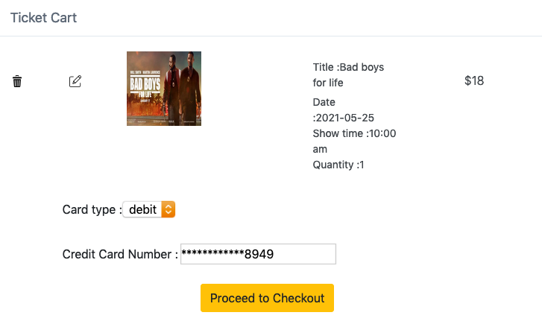
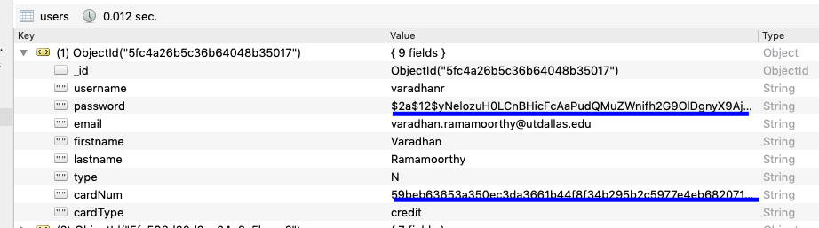
Masking and Hashing
Credit Card Number Masking
Hashed and Salted Password and Encrypted Credit Card Number

Slide 13
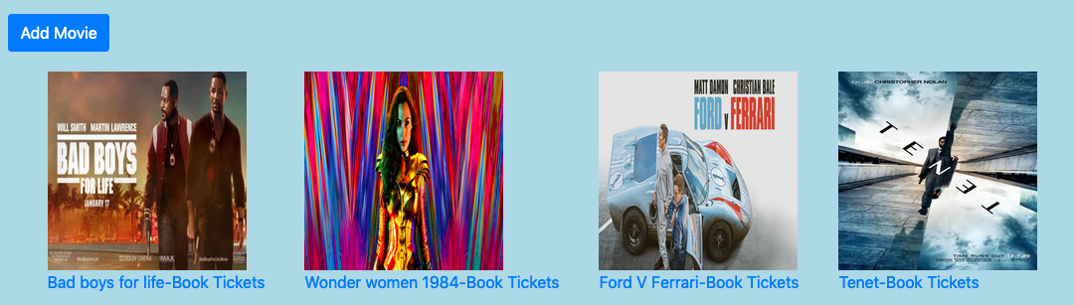
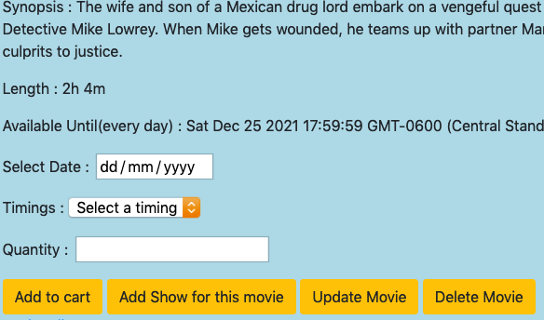
RBAC – Application Admin

Slide 14
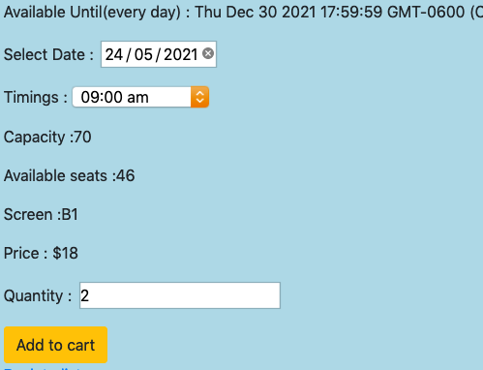
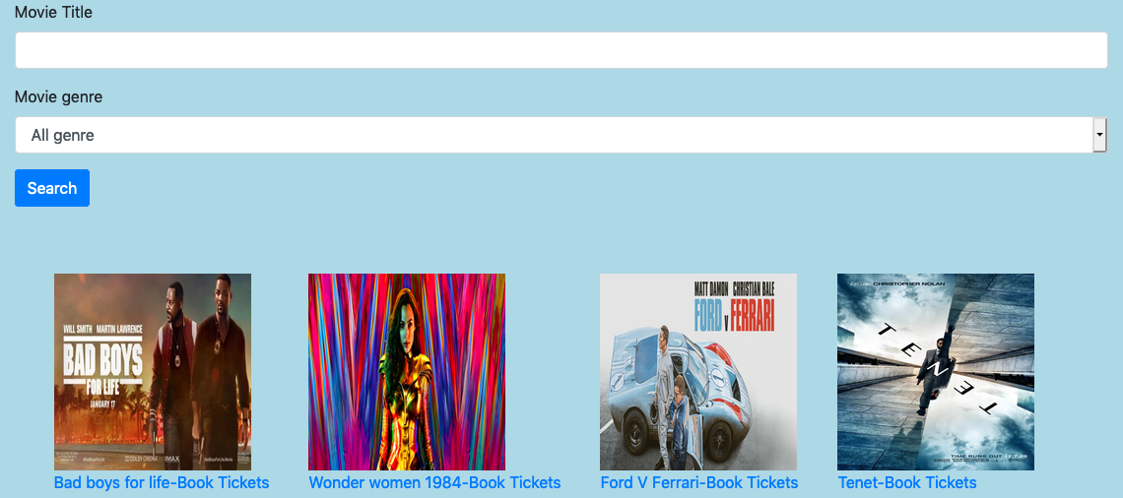
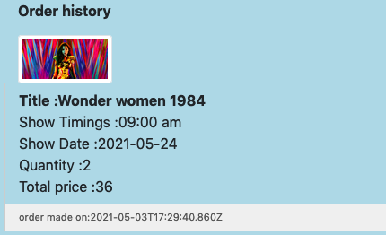
RBAC - Customers
Book shows
Search shows
Transaction History

Slide 15
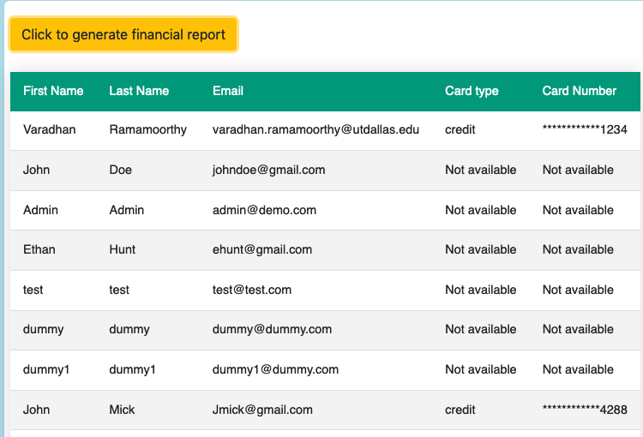
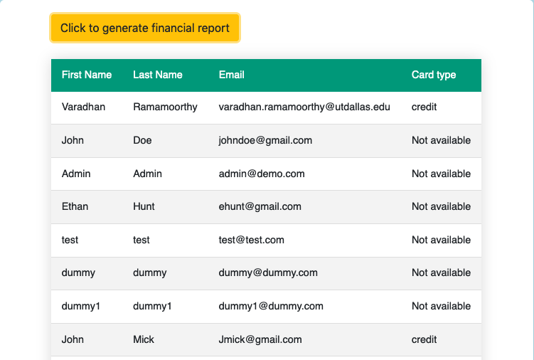
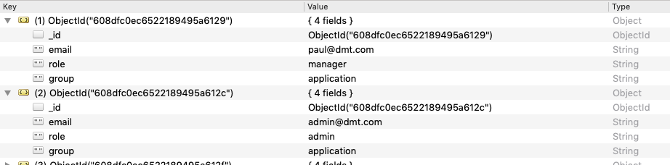
RBAC – Report Generation
Financial Manager Report
Financial Analyst Report
Creating Enterprise users with RBAC groups and roles in MongDB Collection

Slide 16
Challenges
Design and Identification of RBAC entities such as groups, roles, policies etc.
Developing new application portal using node JS, Express integrating with NoSQL database such as MongoDB
Learning security algorithms such TOTP, BCrypt and AES-256

Slide 17
Future Direction
Identifying more customer related attributed like real-word use cases and handle security concerns effectively.
Role authorization: A subject's active role must be authorized for the subject.
Enhancements to application features such as report generation.

Slide 18

Thank you

