Slide 1
Scene Recognition with Deep neural Network Kavin Kuppusamy Shivam Gupta Prachi Vats Bhavya Sree Bombay
December 4, 2019

Slide 2
Agenda
Introduction
Why CNN
Architecture of the Model
Model Implementation
Result and Analysis

Slide 3
Introduction
Image classification
Plays vital role in computer vision field
Process including image processing, feature extraction and matching recognition.
Deep neural network
Implementation of neural networks with hidden layers
Layers in the deep neural network will perform the multiple feature extraction to give multiple levels of abstractions.
CNN is a good deep learning algorithm where it can deal with huge number of parameters and convolve the images with the help filters and produce the output volume

Slide 4
Why CNN?
Feature Engineering is not required in CNN?
What’s feature engineering?
Measuring data and builds derived values (features) intended to be informative and non-redundant, facilitating the subsequent learning and generalization steps
Dimensionality Reduction
Unlike traditional neural network algorithms, CNN tends to give faster performance in scene recognition and feature selection

Slide 5
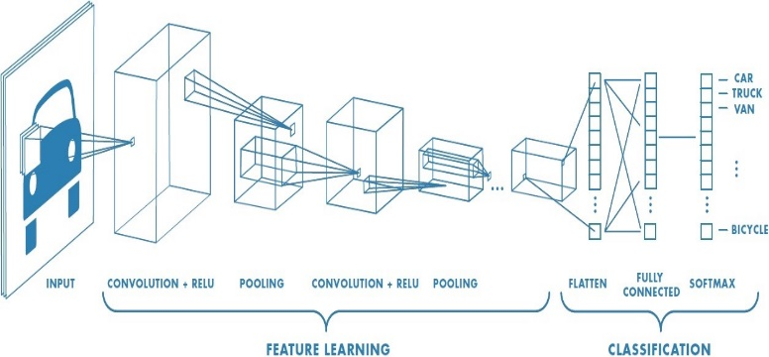
Architecture of the Model

Slide 6
Architecture Components
Convolutional Layer
ReLu Activation Function
Max pooling layer
Flatten layer
Fully Connected layer
Softmax layer

Slide 7
Model Implementation
We have used the Intel Image classification datasets from Kaggle which contains 6 classes: building(label:0), forest(label:1), glacier(label:2), mountain(label:3), sea(label:4), street(label:5)
We took 1200 Images (taking 200 images for each class). The testing datasets consist of 1500 images (taking 200 images for each class).
Resizing to 100 x 100 x 100
Normalizing the Image data
Standardization of Image data

Slide 8
Model Implementation
Layers | Input Size | Parameters | Output Size
INPUT | Variable Size Image |  | 100 X 100 X 3
Convolution | 104 X 104 X 3 | No of filters=6, Kernel size=5, Padding=2, Stride=1, Learning rate=0.01 | 100 X 100 X 6
ReLu | 100 X 100 X 6 |  | 100 X 100 X 6
Max-pooling | 100 X 100 X 6 | Pool size=2, stride=2 | 50 X 50 X 6
Convolution | 54 X 54 X 6 | No of filters=16, Kernel size=5, padding=2, stride=1, Learning rate=0.01 | 50 X 50 X 16
ReLu | 50 X 50 X 16 |  | 50 X 50 X 16
Max-pooling | 50 X 50 X 16 | Pool size=2, stride=2 | 25 X 25 X 16
Convolution | 29 X 29 X 16 | No of filters=72, Kernel size=5, padding=2, stride=1, Learning rate=0.01 | 25 X 25 X 72
ReLu | 25 X 25 X 72 |  | 25 X 25 X 72
Flatten | 25 X 25 X 72 |  | I X 45000
Fully Connected | I X 45000 | No outputs=36, Learning rate= 0.01 | 1 X 36
ReLu | 1 X 36 |  | 1 X 36
Fully Connected | 1 X 36 | No outputs=6, Learning rate= 0.01 | 1 X 6
SoftMax | 1 X 6 |  | 1 X 6
OUTPUT |  |  | 1 X 6

Slide 9
Model Implementation
The images (150X150X3) are pre-processed before giving input to the model.
The architecture used is the improvised LeNet in which we stacked together the convolution layer (5X5 Kernel), ReLU Activation, Maxpooling layer (pooling-2) twice in order to achieve better features.
Another convolution layer (with 72 filters of size 5X5) was stacked to increase the number of feature maps/depths. These feature maps consist of all kind of features like edges, texture, corners, and others which we cannot even imagine of what a CNN can extract.
Flattening is done as we are doing the image classification as we need a single dimensional array in order to classify the whole image as we are doing scene classification (recognition).

Slide 10
Model Implementation
Then we used Fully connected layers which do the matrix multiplication unlike convolution so that we can get required number of feature maps which should be equal to the number of classes(6).
At the end we have used softmax which calculated the probabilities using the exponential functions.
Decide for the classification based on the probabilities out of the 6 classes (depths) that whichever will be the maximum probability we will assign the image to that class.
All the layers are stacked together, and the forward propagation occurs. The cross-entropy loss is calculated to evaluate the model.
The backpropagation occurs which updates all the weights of all the layers. We have used the batch of 30 images together which will be given to the model, the forward and the backward propagation will occur

Slide 11
Result and Analysis
We trained our CNN model with
the learning rate of 0.01,
batch size of 30,
stride of 2
padding size of 2.
All the kernel size of the convolution layer was kept as 5X5. We build the model initially by increasing the feature maps to 72 and decreased at the end to 6 to predict out of those 6 classes.
We trained our modified LeNet model with 3 epochs on 1200 Images (taking 200 images for each class). The losses fluctuated in the range of 1.5-1.8. At the end of the 3rd epoch we were getting the loss of 1.79.

Slide 12
Result and Analysis
Epoch Number | Loss | Training Accuracy | Testing Accuracy
1 | 1.84 | 0.38 | 0.16
2 | 1.81 | 0.40 | 0.17
3 | 1.79 | 0.43 | 0.19

Slide 13
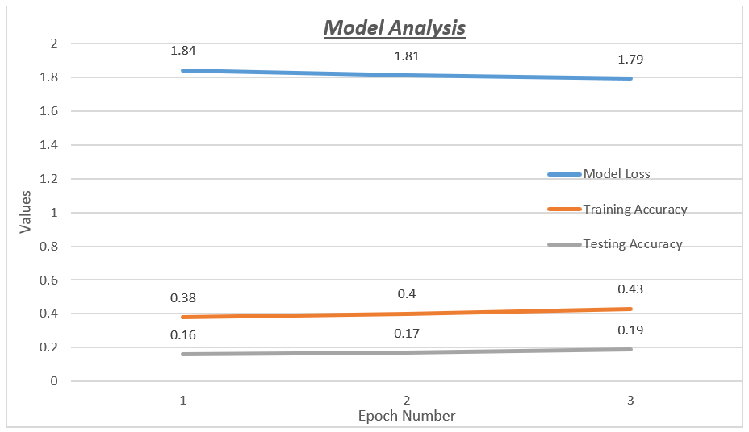
Result and Analysis

Slide 14

Questions?
Thank you
administration@utdallas.edu

