Slide 1

CNC ENGRAVING MACHINE

Slide 2
Overview
3 Working Modes with HMI Panel
Automatic Mode
Manual Mode
G-Code Mode
Alarms
Set Parameters
Language options – English & Polish
User Login options
Support for Recipe

Slide 3
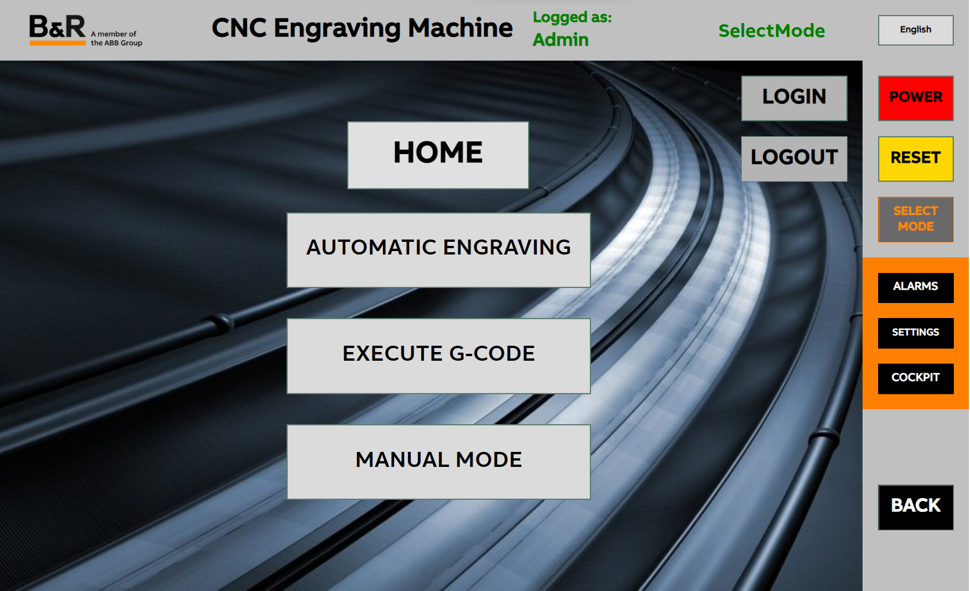
HMI
User friendly Control
Login
Dialogue boxes
English & Polish
Mode Indicator

Slide 4
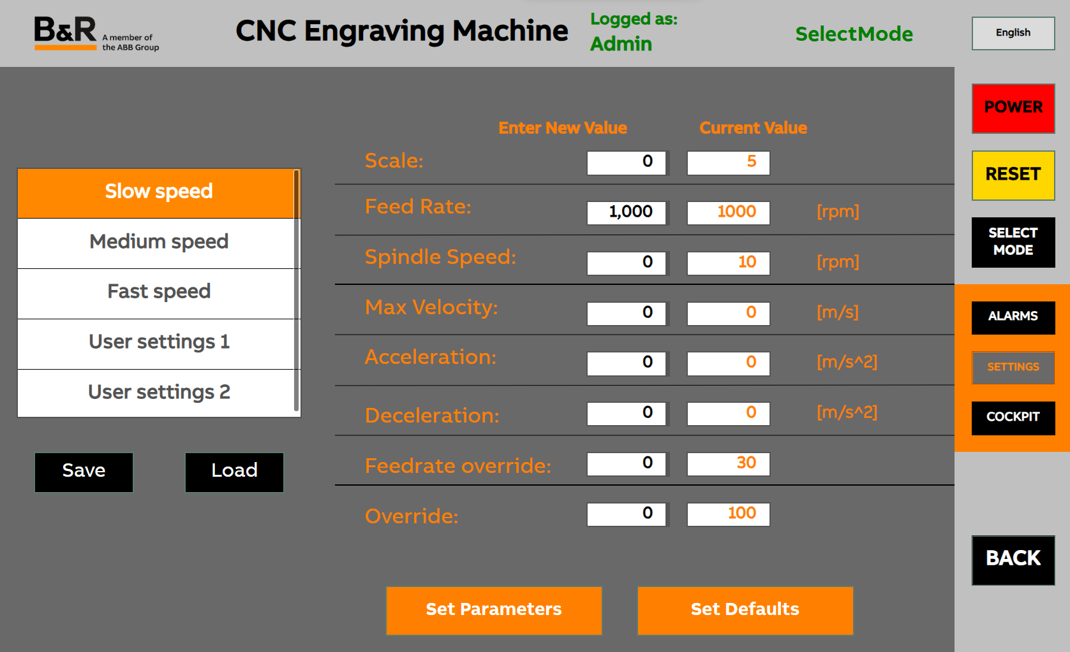
Set Parameters
Default Values
Recipe Configuration

Slide 5
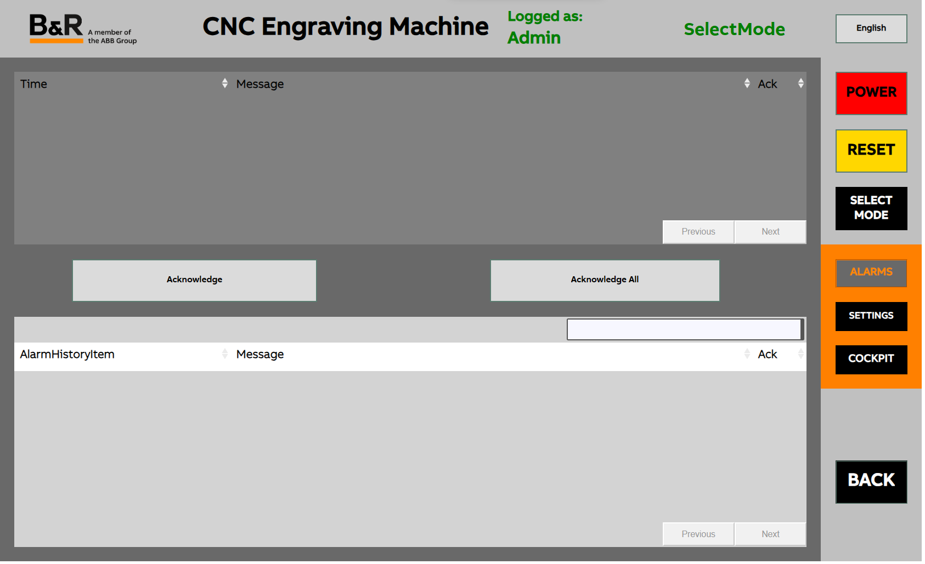
Alarms
Logging
Acknowledging
Status Bubble on Button
Warnings
Multiple Configurations

Slide 6
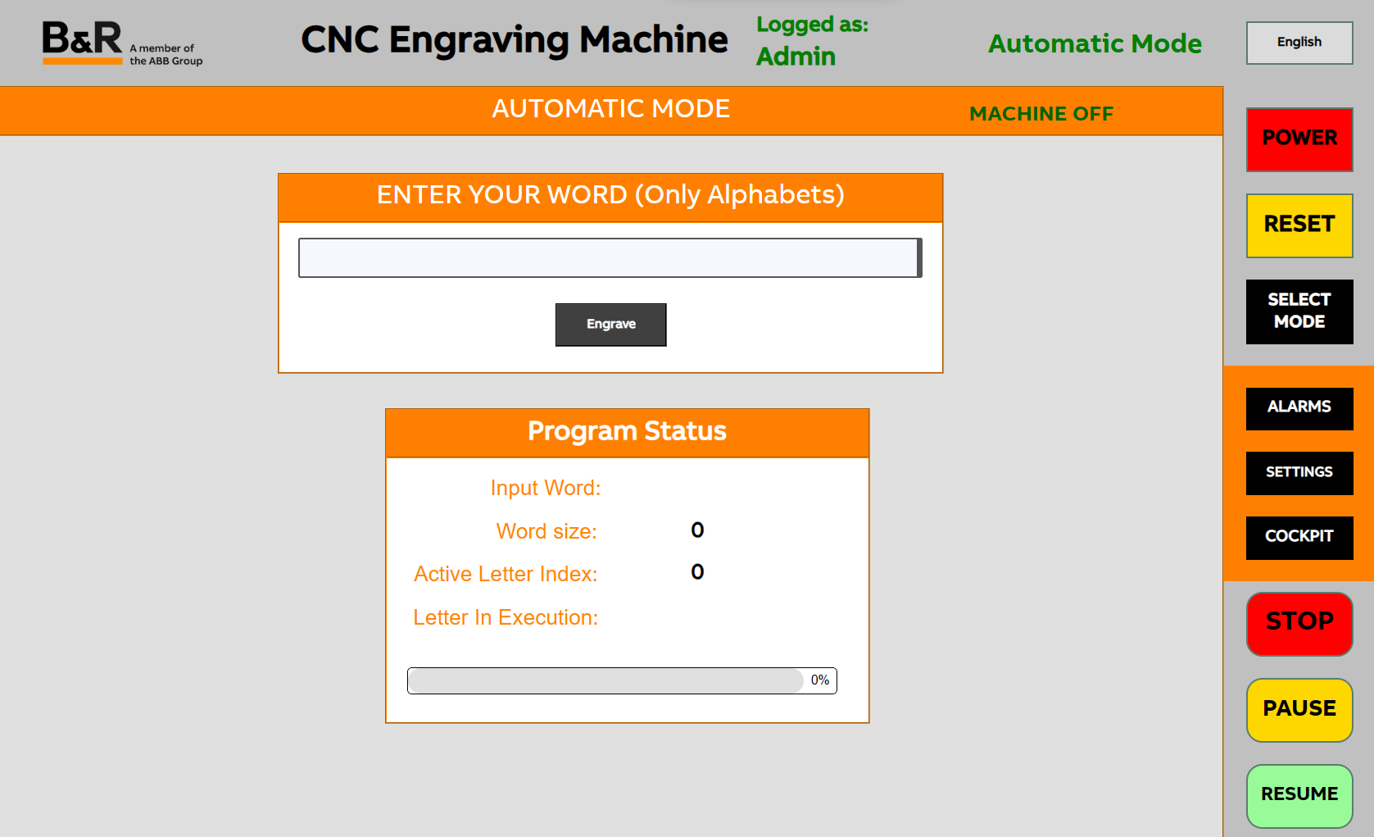
Working Mode - Automatic
Engraves the input word Automatically
Options to set the following parameters
Size of the font via Scale
Spacing between the letters
Control Buttons

Slide 7
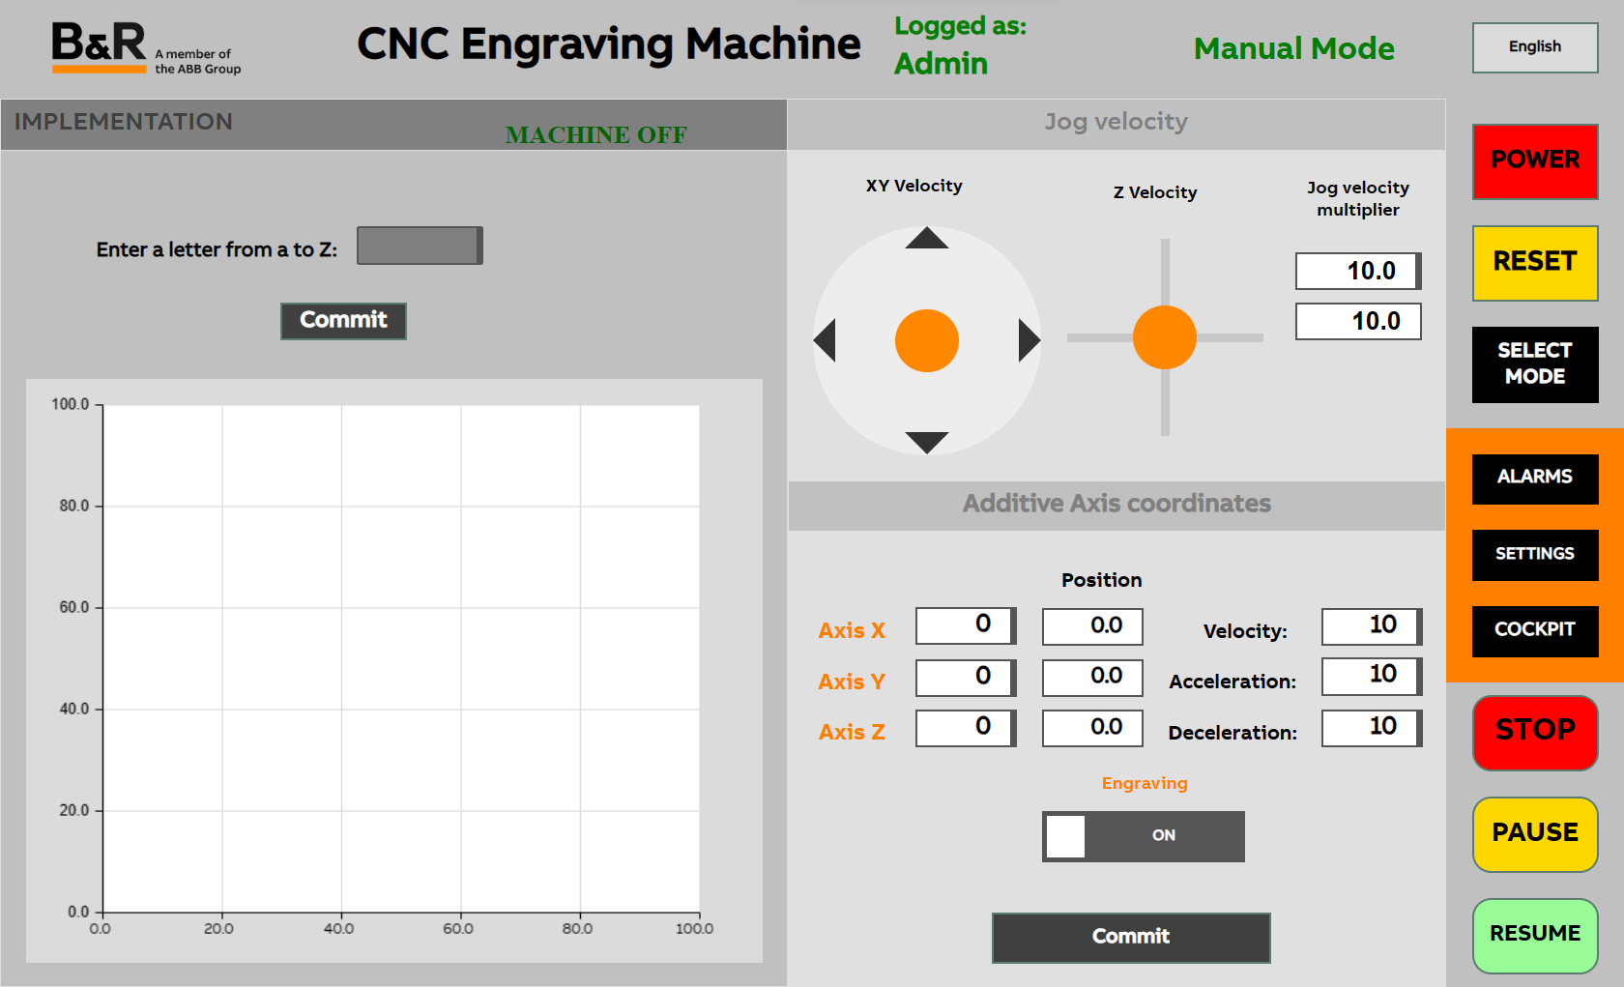
Working Mode - Manual
Jog to desired position using Joysticks / Numerical input
Options to set the following parameters
Size of the font via Scale
Spacing between the letters
Control Buttons
Real time path tracking

Slide 8
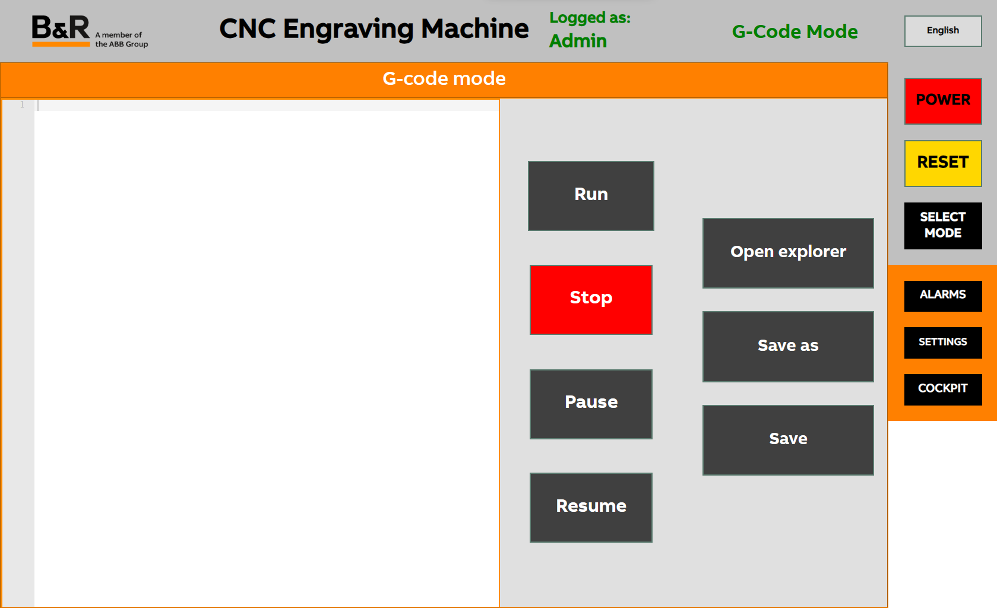
Working Mode - GCode
Direct G-Code Execution
File explorer
Save options
Control buttons

