Slide 1
SmartCop
AUTOMATED PLATFORM TO MITIGATE THE IMPACT OF
ROAD ACCIDENTS​

Slide 2

Group Details
Supervisor Title | Supervisor Name
Supervisor | Dr. Windhya Rankothge
Co - Supervisor | Ms. Narmada Gamage
Member Name | ID
SEWWANDI A.K.T. (Group Leader) | IT16165830
DISSANAYAKE D.M.K.P. | IT16138896
NAVANJANI D.H.K.H. | IT16170094
SHANGAVIE R. | IT16167124

Slide 3
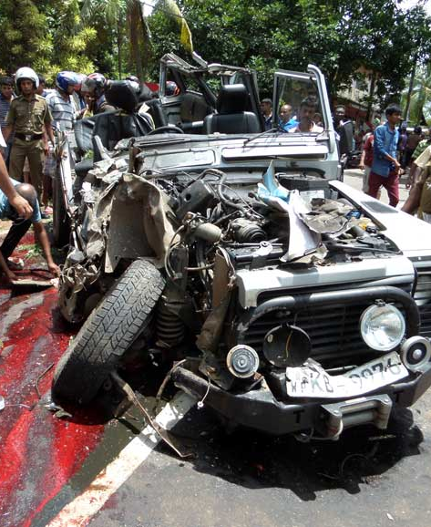
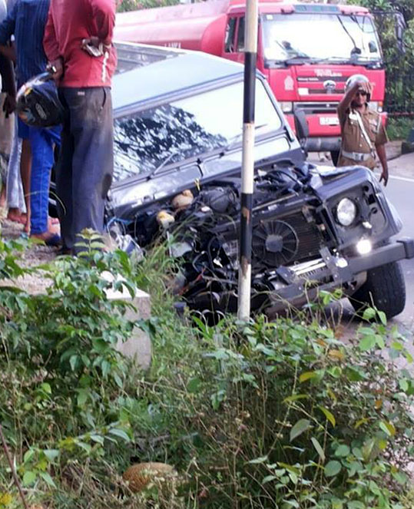
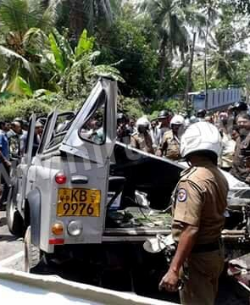
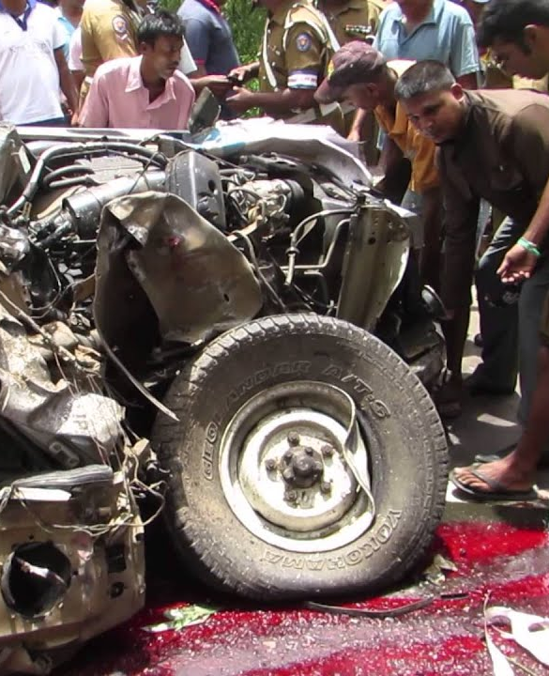
Introduction
Reason for 3,554 of total deaths per year (2.80%) is road accidents (WHO data)
Traffic rule violations , lack of awareness, seat belt misuse, weather conditions and road infrastructure issues identified as main causes for road accidents
Passengers, drivers and police officers struggle a lot to due to road accidents
Automated road accident prediction and awareness platform may support to overcome the situation

Slide 4

Research PROBLEM
How road accident prediction exactly reduce the impact of road accidents?
The number of road accidents has been increased
Terrible Impacts:
Increase the total number of fatalities
Public and private property damages
Drawbacks of available statistical analysis
No significant reduction in the trend of road accidents.
Inconvenience police officer scheduling system
Lack of public awareness.
How proper police officer scheduling system reduce the impact of road accidents?
Do critical thinking skills gained through game-based learning more beneficial to learn road safety best practices?
How road accident response awareness will be improved through game-based learning?

Slide 5

Solution proposed
SmartCop
Automated Platform to mitigate the impact of Road Accidents
Web-based Application
Mobile Application
Access by Sri Lanka Police
Accessed by the Public

Slide 6
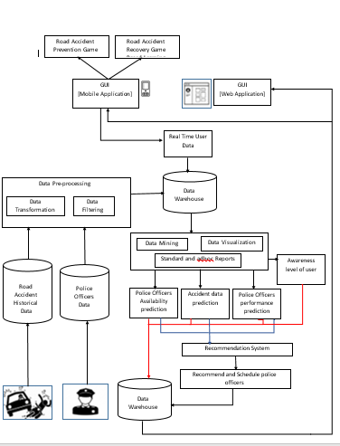
HIGH-LEVEL SYSTEM ARCHITECTURE

Slide 7
Objectives
To develop a model for predicting road accidents
To schedule traffic police officers according to predicted road accidents forecasts
To minimize the impact of road accidents using Machine Learning based prediction and Game Based Learning
To introduce a game-based learning approach to enhance road accident prevention awareness among drivers and pedestrians
To develop a game-based learning application to improve the awareness on road accident response among students and non-medical professionals

Slide 8
Model for Predicting Road Accidents
IT16138896
Function 1

Slide 9
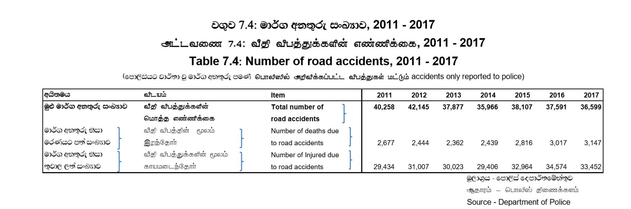
The statistics reported in Department of Census and Statistics in Sri Lanka in 2018

Slide 10


Knowledge gap
IT16138896
Obtained a statistical report or analytics only [2]
Road accident prediction is conducted to obtain one feature [3]
Analyzed the number of road accidents and casualties only [4]
Only defined the analysis of fatalities occurred on pedestrians [6]
Evaluated their predictions only for the part of a pathway [5]

Slide 11




COMPARISON WITH existing systems
IT16138896
Features | Traffic Accident Analysis and Development of Accident Prediction Model [7] | Prediction of the Cause of Accident and Accident Prone Location on Roads Using Data Mining Techniques [8] | Forecasting the Number of Road Accidents and Casualties using Random Forest Regression in the Context of Bangladesh [4] | Road Accident Analysis and Prediction of Accident Severity by Using Machine Learning in Bangladesh [3] | SmartCop - Automated Platform to Mitigate the Impact of Road Accidents
Predict the specific areas of road accidents identified by the region
Identify the frequency of the road accidents in the specified area
Recommend the severity of the accident
Speculate the reason for the accident
Deliver the results through a user-friendly web-based application

Slide 12
proposed solution
IT16138896
Requirements | Methodology | Expected outcome
Objective : Implement a machine learning model to predict road accidents using a supervised learning algorithm during the CDAP evaluation cycle
Mitigate the impact of road accidents
Accurate prediction of specific area, frequency, reason and severity of road accidents
User-friendly web-based application
Function 1
Road accident predicted results
Web-based application
Statistical reports of road accidents

Slide 13
Schedule Traffic Police Officers According to Predicted Road Accidents Forecasts
IT16165830
Function 2

Slide 14
Knowledge gap
IT16165830
examined only the impact of the shift work [11]
Scheduling prediction is conducted based on one prominent feature [10]
explore only the experience of traffic police officers [12]
only examined the impact of enforcement [9]

Slide 15

COMPARISON WITH existing systems
IT16165830
Features | Impact of enforcement on traffic accidents and fatalities[9] | police officer scheduling using goal programming [10] | The Traffic Police Location and Schedule Assignment Problem [11] | Traffic police officers experience of postcrash care to road traffic injury victims a qualitative study in Tanzania [12] | SmartCop Road Safety Awareness Game.
Predict the availability through shift and leave based analysis. | X |  |  | X
Recommending preferable police officers through experience analysis. | X | X | X
Appropriate police officers selection through analysis of police education and training taken. | X | X | X | X
Scheduling recognized police officers to the predicted road accident hotspots.
Send notifications to allocated police officers. | X | X | X | X

Slide 16
proposed solution
IT16165830
Objective : To schedule traffic police officers according to predicted road accidents forecasts.
Requirement
Expected outcome
Predict the availability of police officers
Predict the experience and knowledge of each officer for the relevant reason
Schedule police officers for the predicted accident hotspot.
Send notifications to allocated officers
Function 2
Schedule of recommended police officers
Web based application
Notification system

Slide 17
Game-based Learning Approach to Enhance Road Accident Prevention Awareness
IT16170094
Function 3

Slide 18
Knowledge gap
IT16170094
Not tested for knowledge
retention [17]
Respondents were limited to a specific age group [16]
Only examined the effect of few chosen factors [18]
Need for the games which require more ‘thinking’ has often been pointed out [19]
Participants had a little previous exposure to video games [17]

Slide 19
COMPARISON WITH existing systems
IT16170094
Features | Road Signs Game [26] | Pic Quiz: Road Signs [27] | Pinoy Road Signs Quiz Game [28] | Memory Game - Road Signs [29] | SmartCop Road Safety Awareness Game.
Offering an overview explanation of traffic signs as feedback. |  | X | X | X
Tracking elapsed time. |  | X | X
Enhancing memorization skills.
Allowing to review previous attempts and analyze progress. |  | X | X
Maintaining a leaderboard of best players. | X | X | X | X
Dynamic Difficulty Adjustment in game levels. | X | X | X | X

Slide 20
proposed solution
IT16170094
User and Functional Requirements | Methodology | Expected outcomes
Objective : To introduce Game-based Learning approach for enhancing road accident prevention awareness
Enhance road accident prevention awareness
Analyse awareness progress
Review the overall public awareness
Equally impressive for both children and adults
Contain a game instruction tutorial
Include most of the road accident causing factors
Decide level difficulty according to skill level
Applying a game-based learning to enhance road accident prevention awareness.
Improve road safety skills retention
Review user awareness level
Analyse overall public awareness
Function 3

Slide 21
Game-based Learning Application to Improve The Awareness on Road Accident Response
IT16167124
Function 4

Slide 22
Knowledge gap
IT16167124
focused on a specific age group[38]
Conducted in just one city [17]
longer programs are not providing significant changes in knowledge[39]
Only examined the effect of a couple of chosen factors [18]

Slide 23
COMPARISON WITH existing systems
IT16167124
Features | First Aid Self-Test [35] | First Aid MCQ [32] | First Aid Ireland Pop Quiz [34] | First Aid Quiz[33] | SmartCopFirst Aid Game
Correct answer when answered incorrectly. | X | X | X | X
Measure the awareness level of player using their score | X | X | X
Measure the time that a player spent on each question to answer | X | X | X | X
Maintaining a leaderboard. | X | X | X
Dynamic Difficulty Adjustment in game levels. | X | X | X | X

Slide 24
proposed solution
IT16167124
Requirements | Methodology | Expected outcomes
Objective : To develop Game-based Learning application to improve the awareness on the road accident response using a reinforcement learning during the CDAP evaluation cycle.
Score
Time that spent on each question to answer
Position in leaderboard
Correct answer when answered incorrectly
Awareness level report
Increase the road accident response awareness level
Game based mobile application
Function 4

Slide 25

research area
ICT for Development

Slide 26

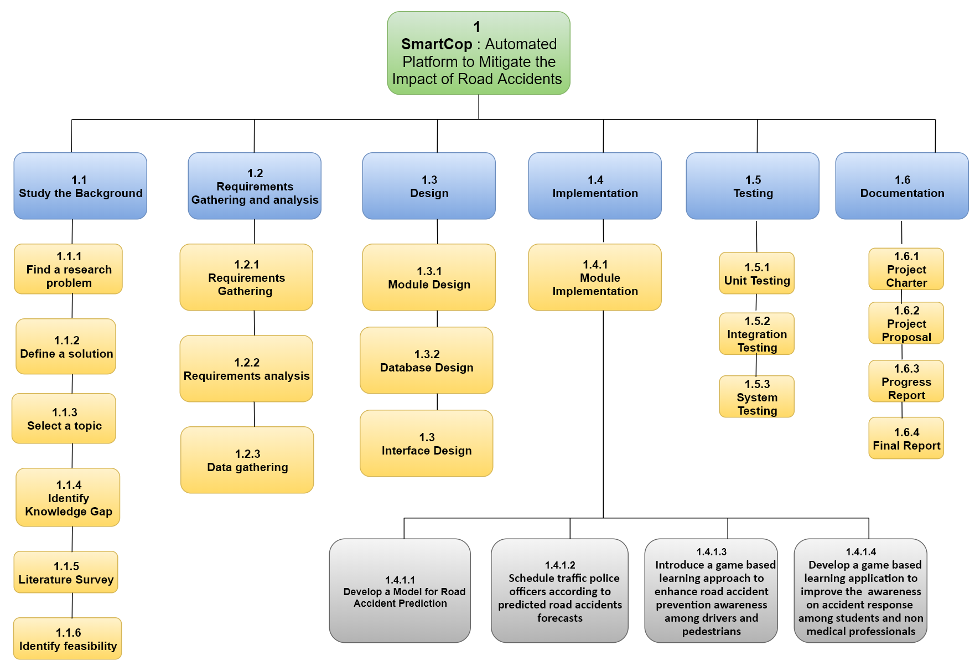
WORK BREAKDOWN STRUCTURE (WBS)

Slide 27
budget
Budget items | Number of items | Cost per item(Rs) | Total cash cost (Rs) | Notes
Field Visits | 4 | 140 | 560 | Public transport
Printing materials | 8 |  | 5000 | Topic registration form Project Charter 4 individual proposal reports 1 group proposal report Final report Product marketing materials(banners)
Access database through cloud | 1 | 6651 | 6651 | Basic trial version
Hosting mobile apps on Google play store | 2 | 4500 | 9000 | Host SmartCop First Aid quiz game Host SmartCop accident prevention puzzle game
Hosting website on Google | 1 | 8038 | 8038 | Host SmartCop website
Twilio API | 1 | 1000 | 1000 | SmartCop has a communication system to inform traffic police officers about enforcement
Total Budget |  |  | 29929

Slide 28

Users and business Model
Users | Product | Business Model
Sri Lankan Police | SmartCop website | Provided free of charge
Drivers | SmartCop Road Safety Awareness Game | Accessible free through google play store.
Pedestrians | SmartCop Road Safety Awareness Game
Students | SmartCop First Aid Game
Non-medical professionals | SmartCop First Aid Game

Slide 29
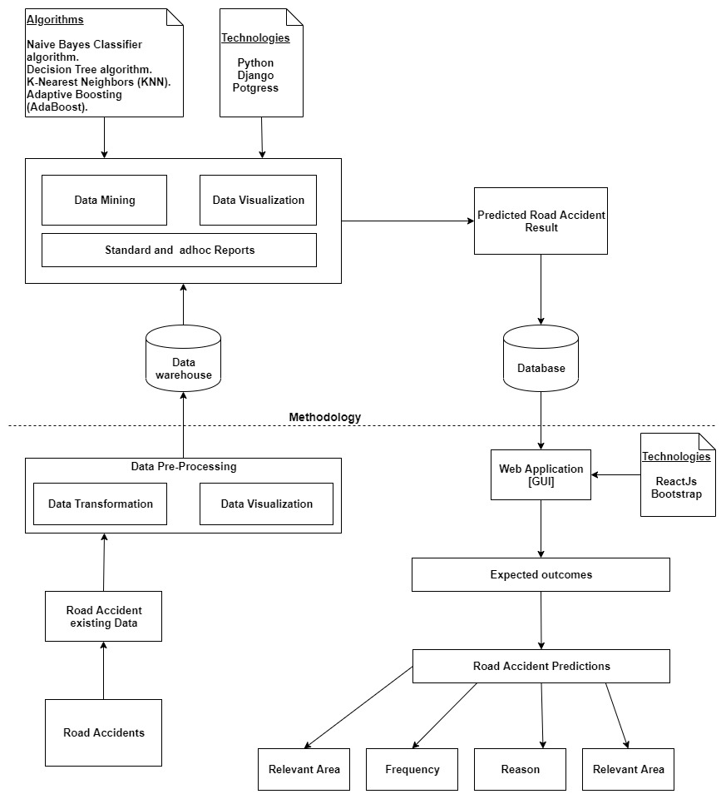
Function 1 Overview diagram

Slide 30

Function 2 Overview diagram
Technologies
Python
Django
Postgress
Algorithms
Unsupervised learning
K-means
Supervised Learning
Naïve Based
K-Nearest neighbors
Decision Tree
Random Forest
Data warehouse
Data Mining
Data Visualization
Data transformation
Data filtering
Road accident predicted data
Police officers, availability predicted results
Police officers' qualification predicted results
Police officers data
Technologies
ReactJS
Bootsrap
Scheduling Process
Scheduled Police Officer Data
GUI
[Web Application]
Database

Slide 31
Function 3 Overview diagram
IT16170094
GUI
(Mobile Application)
Design and Implementation
Technologies
Keras
Tensorflow
Postgress
Requirements Gathering
and Analysis
Reinforcement algorithms
Model free, Value-based, Policy-based
Ex : Asynchronous Actor-Critic Agents (A3C)
Research papers
Surveys
Play store Apps
Real time user data
(score, elapsed time)
Data warehouse
Data Mining
Data visualization
Gather requirements to choose an appropriate game
Next level (dynamic difficulty)
Expected Outcomes
Not
approved
Define an appropriate game
Testing
Release
Product
Individual
user
awareness
Overall
public awareness
Road safety skills retention
System Testing
UAT
Approved

Slide 32
Function 4 Overview diagram
IT16167124
Approved
Reinforcement algorithms
Value-based, Policy-based, Model free
Tecnologies
Android studio
ClassTools
What2Learn
Testing
Release product
GUI
(Mobile Application)
Data warehouse
Not Approved
Real time user data
Data Mining
Data visualization
Get feedbacks
Next question
Design and Implementation
Requirements gathering and analyzing
Questionnaire
Play store
Research papers
Gather requirements to select a suitable game
select a suitable game

Slide 33


References
[1] R. E. AlMamlook, K. M. Kwayu, M. R. Alkasisbeh and A. A. Frefer, "Comparison of Machine Learning Algorithms for Predicting Traffic Accident Severity," 2019 IEEE Jordan International Joint Conference on Electrical Engineering and Information Technology (JEEIT), Amman, Jordan, 2019, pp. 272-276.
[2] TY - AU - Graettinger, Andrew J. AU - Lindly, Jay K. AU - Mistry, Gautam J. A2 - University Transportation Center for Alabama AB
[3] M. F. Labib, A. S. Rifat, M. M. Hossain, A. K. Das and F. Nawrine, "Road Accident Analysis and Prediction of Accident Severity by Using Machine Learning in Bangladesh," 2019 7th International Conference on Smart Computing & Communications (ICSCC), Sarawak, Malaysia, Malaysia, 2019, pp. 1-5.
[4] Q. Liyan and S. Chunfu, "Macro Prediction Model of Road Traffic Accident Based on Neural Network and Genetic Algorithm," 2009 Second International Conference on Intelligent Computation Technology and Automation, Changsha, Hunan, 2009, pp. 354-357.
[5] T Sivakumar, D Amarathung - EASTS 2015 Conference, 2015 (https://pdfs.semanticscholar.org/e616/5783f6c4c85ba5613dd4c926b78d10f48476.pdf)
[6] R. G. Ramani and S. Shanthi, "Classifier prediction evaluation in modeling road traffic accident data," 2012 IEEE International Conference on Computational Intelligence and Computing Research, Coimbatore, 2012, pp. 1-4.

Slide 34
References
[7] TD Liyanage, TM Rengarasu - 2012 - pdfs.semanticscholar.org (https://pdfs.semanticscholar.org/5485/0efc35028fb91630e5853a4d6e556faab9ab.pdf)
[8] G. Kaur and E. H. Kaur, "Prediction of the cause of accident and accident prone location on roads using data mining techniques," 2017 8th International Conference on Computing, Communication and Networking Technologies (ICCCNT), Delhi, 2017, pp. 1-7.
[9] Yannis, G., Papadimitriou, E., & Antoniou, C. (2008). Impact of enforcement on traffic accidents and fatalities: A multivariate multilevel analysis. Safety Science, 46(5), 738–750. doi:10.1016/j.ssci.2007.01.014
[10] Todovic, D., Makajic-Nikolic, D., Kostic-Stankovic, M. and Martic, M. (2015), "Police officer scheduling using goal programming", Policing: An International Journal, Vol. 38 No. 2, pp. 295-313. https://doi.org/10.1108/PIJPSM-11-2014-0124
[11] Adler, N., Hakkert, A. S., Raviv, T., & Sher, M. (2014). The Traffic Police Location and Schedule Assignment Problem. Journal of Multi-Criteria Decision Analysis, 21(5-6), 315–333. doi:10.1002/mcda.1522
[12] Lukumay, G. G., Outwater, A. H., Mkoka, D. A., Ndile, M. L., & Saveman, B.-I. (2019). Traffic police officers’ experience of post-crash care to road traffic injury victims: a qualitative study in Tanzania”. BMC Emergency Medicine, 19(1). doi:10.1186/s12873-019-0274-x
[13] Folkard, S. and Tucker, P. (2003), “Shift work, safety and productivity”, Occupational Medicine, Vol. 53 No. 2, pp. 95-101.
[14] Azaiez, M.N. and Al Sharif, S.S. (2005), “A 0-1 goal programming model for nurse scheduling”, Computers & Operations Research, Vol. 32 No. 3, pp. 491-507.

Slide 35
References
[15] M. Hussin and N. Hanis Mohd Fouzi, "Computer Games as Learning Tool towards Children Road Safety Education", International Journal of Engineering & Technology, vol. 7, no. 415, p. 230, 2018.
[16] Q. Li, R. Tay, "Improving drivers’ knowledge of road rules using digital games", Accident. Anal. Prev., vol. 65, pp. 8-10, 2014.
[17] H. Arbogast, R. Burke, V. Muller, P. Ruiz, M. Knudson and J. Upperman, "Randomized controlled trial to evaluate the effectiveness of a video game as a child pedestrian educational tool", Journal of Trauma and Acute Care Surgery, vol. 76, no. 5, pp. 1317-1321, 2014.
[18] A. Azadeh, M. Zarrin, M. Hamid, "A novel framework for improvement of road accidents considering decision-making styles of drivers in a large metropolitan area,'' Accident Analysis and Prevention, vol. 87, pp. 17-33, 2016.
[19] E. Lehtonen, H. Sahlberg, E. Rovamo, H. Summala, “Learning game for training child bicyclists’ situation awareness”. Accid. Anal. Prev. 105, 72–83,2017.
[20] G. R. Dange, P. K. Parathaman, F. Belllotti, R. Berta, A. De Gloria, M. Raffero, S. Neumeier, "Deployment of Serious Gaming Approach for Safe and Sustainable Mobility", 2017 IEEE Intelligent Vehicles Symposium (IV), 11-14 June 2017.
[21] Q. Li, R. Tay, R. Louis, "Designing Digital Games to Teach Road Safety: A Study of Graduate Students' Experiences", 2012.

Slide 36
References
[22] K. Szczurowski, M. Smith, "“Woodlands”-a Virtual Reality Serious Game Supporting Learning of Practical Road Safety Skills", IEEE Games Entertainment Media Conference (GEM), 2018.
[23] X. Chen, “The relationship between video games, problem-solving skills, and academic performance from IT students’ perspective.” (2019).
[24] S. Heintz, E. L. C. Law, “Digital Educational Games: Methodologies for Evaluating the Impact of Game Type”. ACM Transactions on Computer-Human Interaction (TOCHI), vol. 25, no. 2, 2018.
[25] N. Ikram and S. Mahajan, "Road accidents: Overview of its causes, avoidance scheme and a new proposed technique for avoidance," 2016 3rd International Conference on Computing for Sustainable Global Development (INDIACom), New Delhi, 2016, pp. 497-499.
[26]Play.google.com,2020.[Online].Available:https://play.google.com/store/apps/details?id=com.wmm.androidgame&hl=en. [Accessed: 25- Jan- 2020].
[27]Play.google.com,2020.[Online].Available: https://play.google.com/store/apps/details?id=air.RoadSignQuiz&hl=en. [Accessed: 25- Jan- 2020].
[28]Play.google.com,2020.[Online].Available:https://play.google.com/store/apps/details?id=com.allanjeffreynaval.pinoyroadsignquiz. [Accessed: 25- Jan- 2020].
[29]Play.google.com,2020.[Online].Available:https://play.google.com/store/apps/detailsid=com.wMemorygameroadsigns_9976519.[Accessed: 25- Jan- 2020].

Slide 37
References
[30] http://www.quiz-builder.com/ (accessed at January 2020).
[31] http://school.discoveryeducation.com/quizcenter/ (accessed at January 2020)
[32] https://play.google.com/store/apps/details?id=com.jdapp.firstaidmcq (accessed at January 2020)
[33]https://play.google.com/store/apps/details?id=com.avistechbd.quiz (accessed at January 2020)
[34]https://play.google.com/store/apps/details?id=com.eoinzy.firstaid (accessed at January 2020)
[35]https://play.google.com/store/apps/details?id=uk.co.nightsnow.first_aid_self_test (accessed at January 2020)
[36]J.Brandao, V.Carvalho "GAME QUIZ - Implementing a serious game platform based in quiz games for the teaching of Information and Technology"
[37]S.D.Dharmaratne, A.U.Jayatilleke and A.C. Jayatilleke "Road traffic crashes, injury and fatality trends in Sri Lanka: 1938–2013".
[38]N.A.M.Sharif, M.K.C.Husan, F.I.C.Jamaludin and M.K.Z.H.Firdaus "The need for firstaid education for adolescents"
[39]B.Reveruzzi, L.Buckley and M.Sheehan "School-Based First Aid Training Programs"

Slide 38
Questions ?

Slide 39
THANK YOU ...

