Slide 1
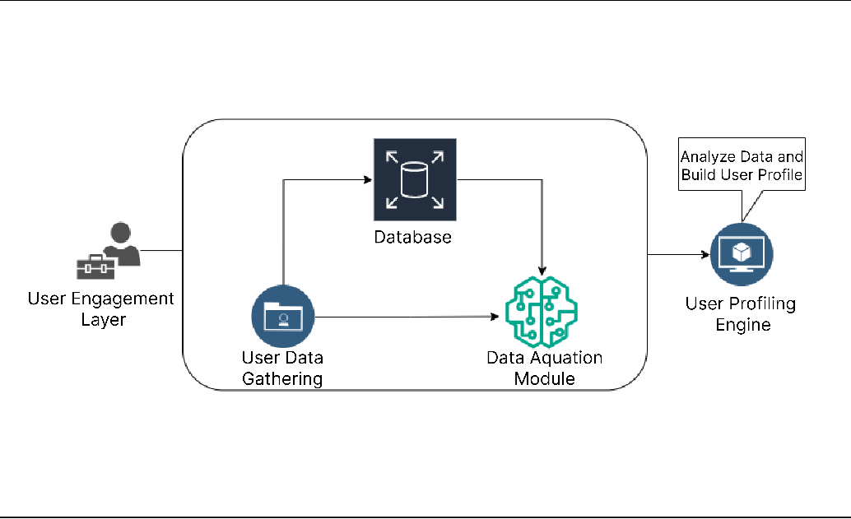
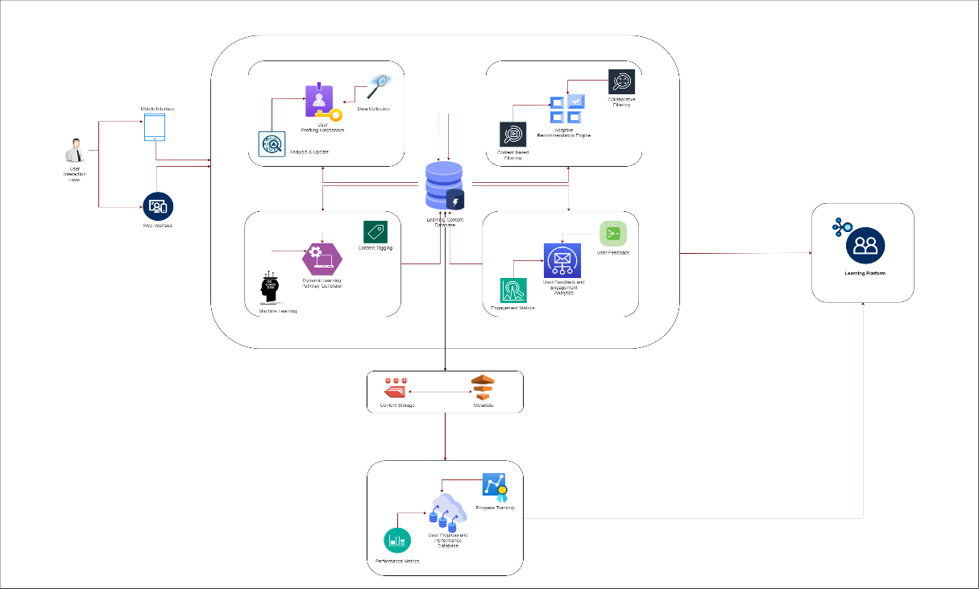
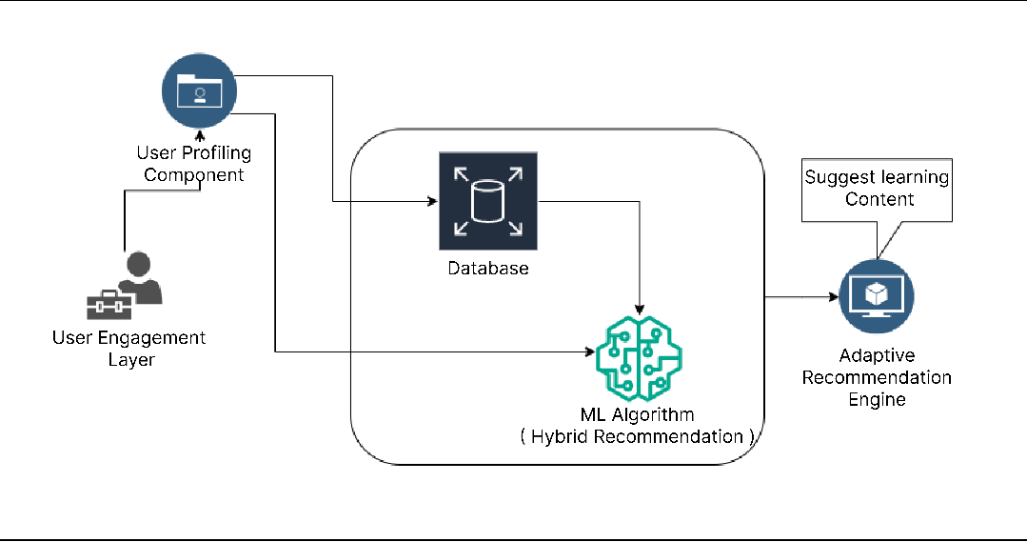
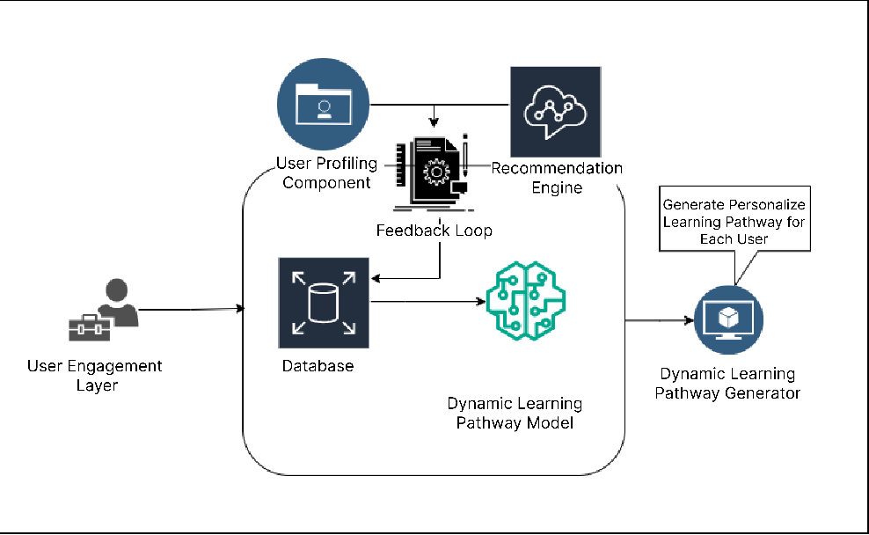
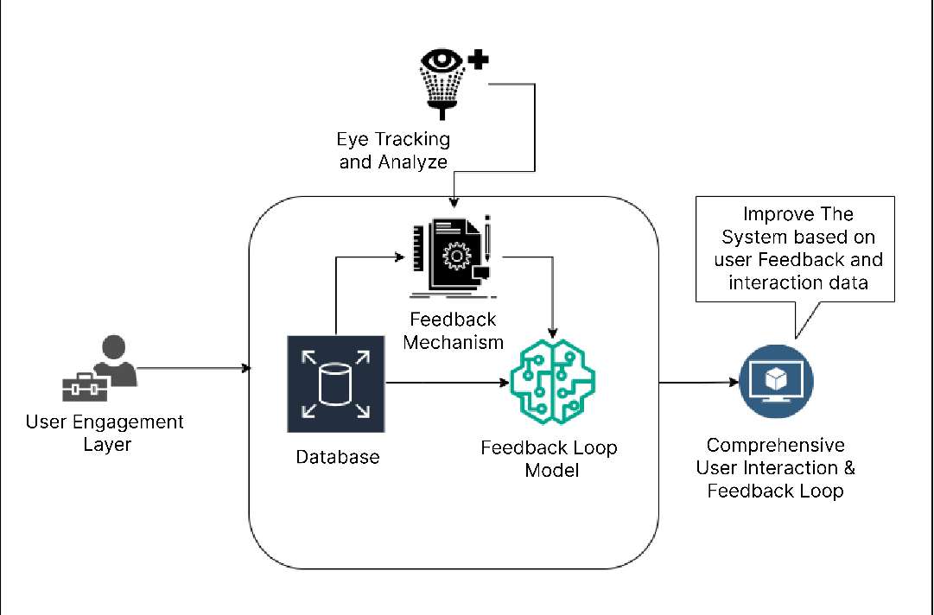
Sri Lanka Institute Of Information Technology
Background Introduction and Literature
E-learning platforms are widely used but often lack personalized learning experiences. Traditional methods offer static content and a “one-size-fits-all” approach, leading to disengagement and low knowledge retention. The research proposes LearnPath+, a personalized e-learning platform using machine learning to adapt content dynamically based on learner preferences and behaviors. The literature review highlights the limitations of existing e-learning systems and explores the potential of adaptive learning technologies to address these issues.
System Diagram and the Provided Solution
Core Components:
User Profiling System:
Tracks and analyzes learner behaviors and preferences.
Generates dynamic, personalized profiles.
Adaptive Learning Engine:
Utilizes supervised and unsupervised machine learning.
Adjusts learning pathways based on user interactions and performance.
Content Management System:
Modular delivery of learning content.
Scalable and flexible to cater to different learning preferences.
Dynamic Learning Pathway Generator:
Creates individualized learning paths based on learner profiles.
Real-time updates based on feedback and interactions.
Technologies Used:
Python, MySQL, OpenAI, HTML, CSS, JavaScript for front and backend.
APIs for integration between components.
Results and Discussion
Results:
User Engagement: 35% increase in usage, with higher interaction rates compared to traditional systems.
Knowledge Retention: 28% improvement in knowledge retention due to personalized learning paths.
Learner Satisfaction: Over 90% of users reported higher satisfaction, with 22% improvement in self-assessment scores.
Profiling and Recommendation Accuracy: Profiling accuracy improved to 90%, with 92% accuracy in learning material recommendations.
Learning Path Optimization: Quiz completion rates increased by 20%, and time spent on learning materials rose from 4.5 to 6.2 hours per week.
System Improvements: User feedback led to interface simplifications, faster response times, and the addition of advanced learning resources.
Discussion:
Effectiveness: LearnPath+ enhances engagement, retention, and academic performance through adaptive, personalized content.
Motivation and Satisfaction: Personalized pathways improved learner motivation and satisfaction, outperforming traditional static e-learning systems.
Limitations: Small sample size and short study duration.
Future Research: Recommended larger-scale studies and incorporating more advanced methods like reinforcement learning for further personalization.
Provided Solution
An adaptive e-learning platform that personalizes learning paths based on user behaviors and preferences.
Utilizes machine learning to dynamically adjust content and recommendations.
Core Components:
User Profiling System: Tracks learner behaviors to create personalized profiles.
Adaptive Learning Engine: Uses machine learning algorithms to tailor learning pathways.
Content Management System: Modular system for delivering flexible learning content.
Materials and methods
Needs Assessment:
Surveys, literature reviews, and consultations with educators and students.
Identification of gaps in existing e-learning platforms and user preferences.
Design and Development:
Design of an adaptive learning system integrating UX/UI and machine learning.
Creation of algorithms for personalized recommendations.
Components:
User Profiling: Learner behaviors and preferences.
Adaptive Learning Engine: Machine learning models (supervised/unsupervised).
Testing and Feedback:
Algorithms tested and refined through user feedback.
Iterative development approach to improve learning pathways.
System Implementation:
Scalable website hosting (AWS).
Continuous real-time data collection and refinement.
Research Problem and Objectives
Research Problem:
E-learning systems are generalized and fail to cater to diverse learning needs.
Limited engagement and low retention due to static content.
Research Objectives:
Develop an adaptive learning framework using machine learning.
Improve user engagement, satisfaction, and retention in e-learning platforms.
Personalize learning experiences based on user data.
Acknowledgment
Key Contributors'. Sanjeevi Chandrasiri: Senior Lecturer, provided support and guidance.
Ms. Akshi De Silva: Lecturer, offered input and suggestions.
Mr. Harshana Samaranayake: Associate Technical Lead at Tiqri, provided technical assistance.
Mr. J. W. P. Nuwan Deshapriya: Senior Site Reliability Engineer, supported system reliability and development.
References
ources cover topics such as:The impact of e-learning on education.
The role of machine learning and AI in personalized learning.
The benefits of adaptive learning systems for user engagement and retention.
Research studies on adaptive learning in e-learning environments.

