Slide 1

LearnPath+ Enhancing Personalized E-Learning: A Novel Approach to Adaptive Learning Pathways for Individualized Knowledge Acquisition
Project ID : R24-112

Slide 2


OUR TEAM
Supervisor
Ms. Sanjeevi Chandrasiri
Co-Supervisor
Miss Akshi De Silva
IT21033032
Nishshanka N.A.P.K.R
IT21021602
Abeykoon R.M.S.P
IT21032806
Jayasinghe K.A.K.N
IT21032974
Nishshanka N.A.G.A.A

Slide 3
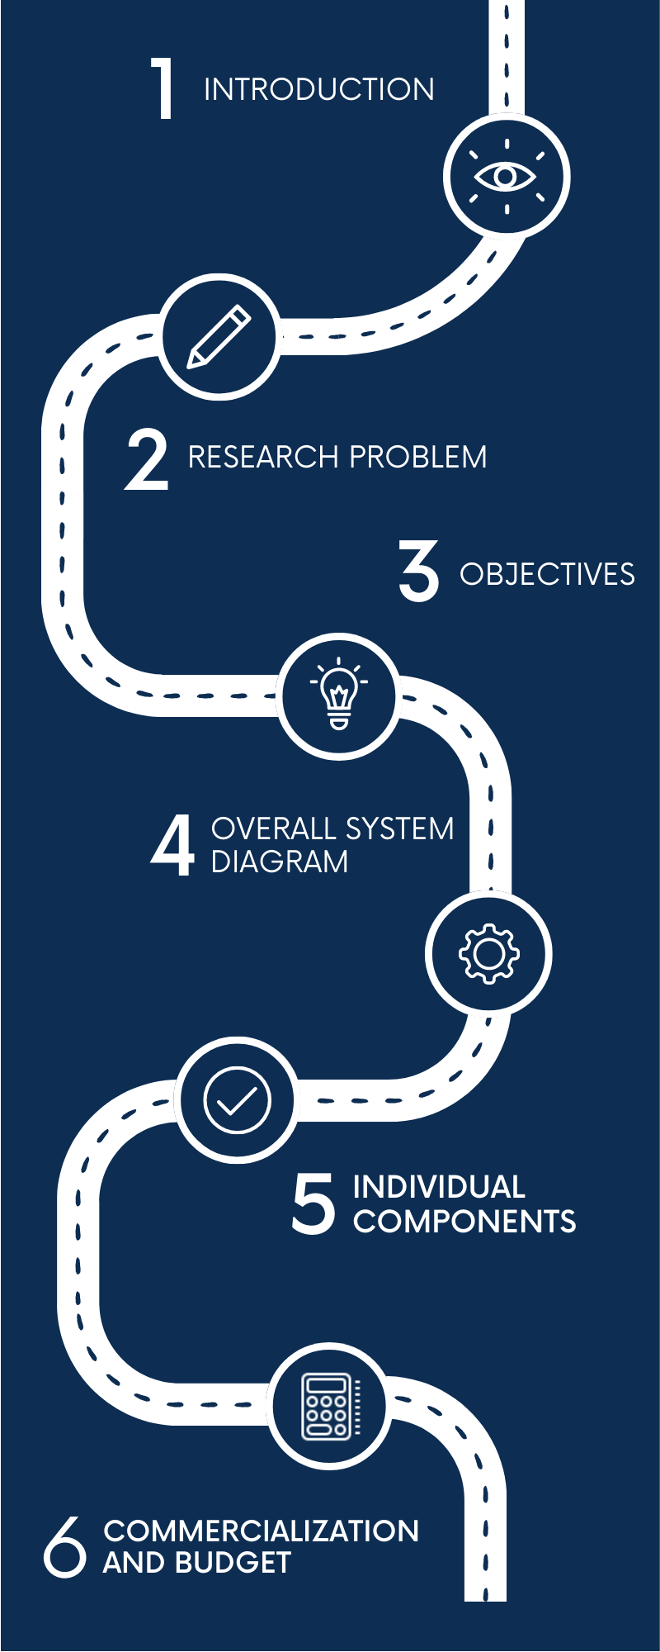
ROADMAP

Slide 4
Introduction
In response to the limitations of current e-learning systems in providing personalized learning experiences, our project endeavors to revolutionize the landscape by implementing an innovative framework grounded in adaptive machine learning. By addressing the gap between generic content delivery and tailored learning pathways, our objective is to create a user-centric approach that seamlessly integrates insights from machine learning, educational technology, and user experience design. Through this endeavor, we aim to enhance user engagement, optimize knowledge retention, and elevate satisfaction levels in e-learning platforms, ultimately redefining the way individuals interact with educational content in the digital age.

Slide 5
Research problem
Lack of Personalization: Existing e-learning platforms often struggle to provide personalized learning experiences tailored to individual preferences and learning styles.
Generic Approaches: Current systems rely on generic content delivery methods that may not optimize user engagement and knowledge retention.
Limited Adaptability: Many platforms lack the ability to dynamically adapt to the diverse needs and preferences of individual learners, resulting in challenges in finding relevant materials.
Gap in Literature: There exists a notable gap in the literature regarding the development of a straightforward adaptive machine learning model tailored for customizing learning pathways in online education.

Slide 6
Main objective
The main objective of our project is to create an innovative framework for personalized learning in e-learning platforms using adaptive machine learning. This framework aims to revolutionize the way educational content is delivered by tailoring learning experiences to individual users' preferences and learning styles. Through the application of adaptive machine learning techniques, our goal is to enhance user engagement, optimize knowledge retention, and increase satisfaction levels in online education.

Slide 7
Sub objectives
01
02
03
04
User Profiling Component
Adaptive Recommendation Engine
Dynamic Learning Pathway Generator
Engagement Analytics and Feedback Loop

Slide 8
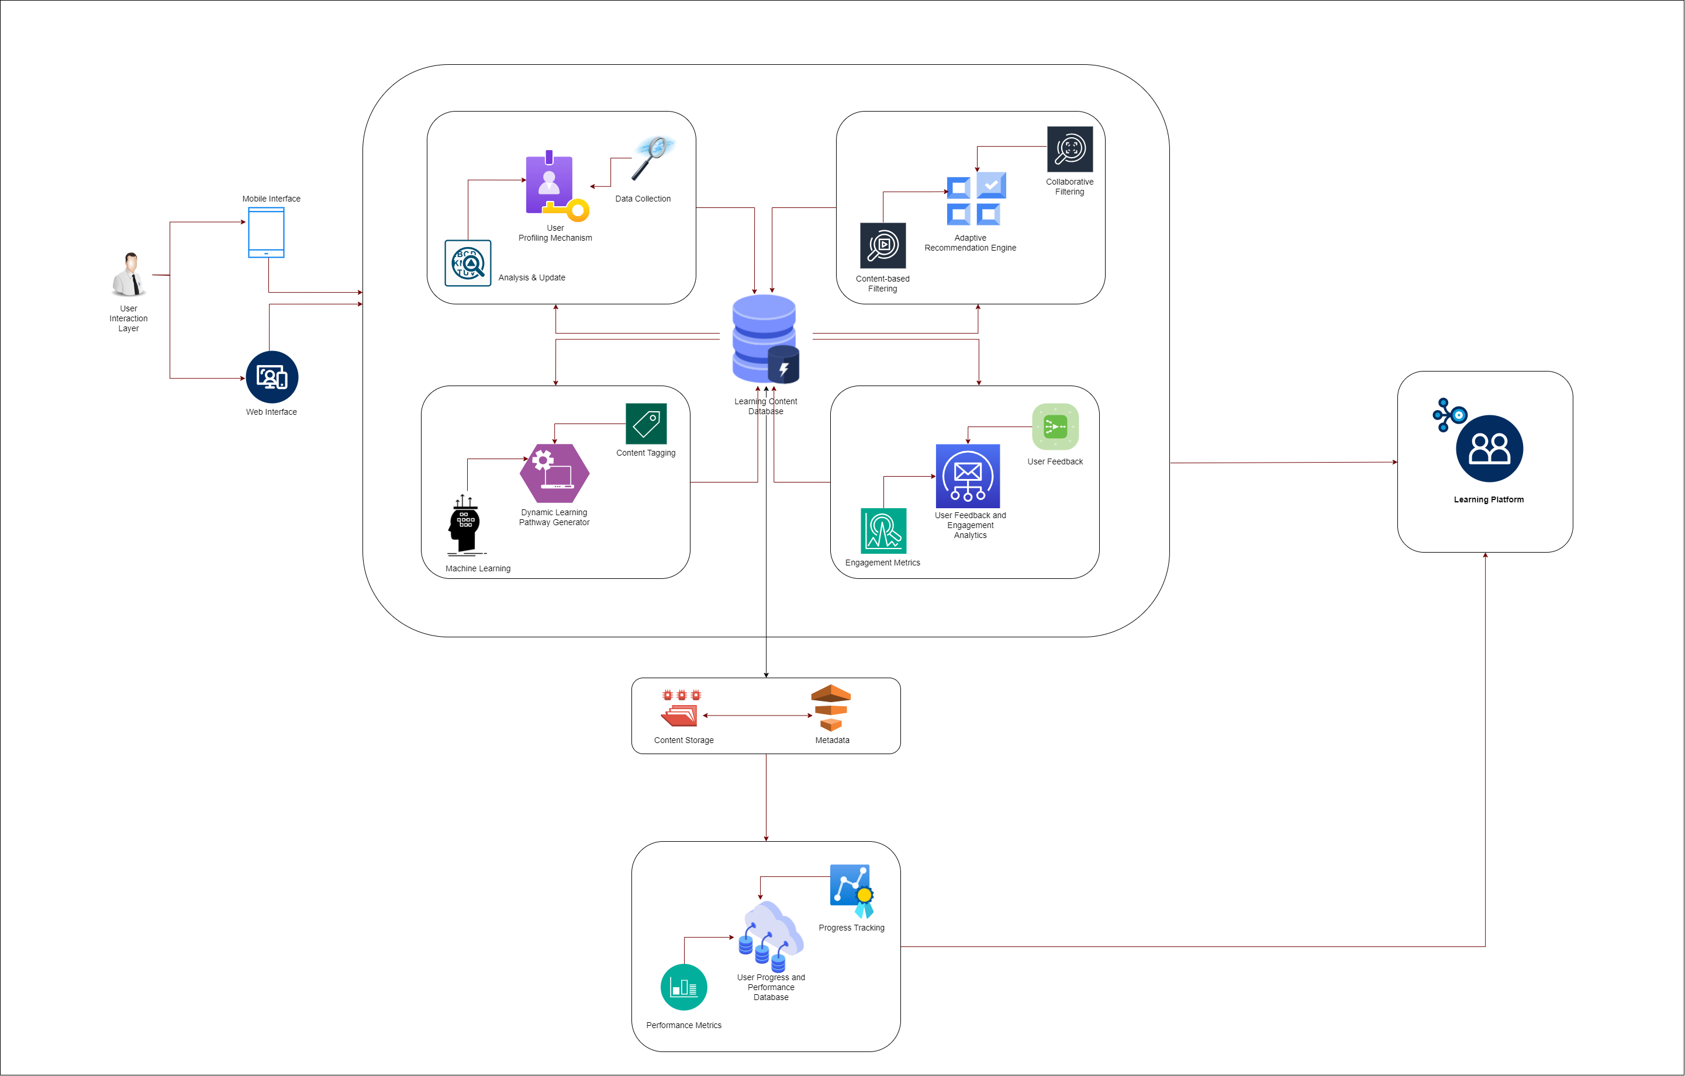
Overall system diagram

Slide 9
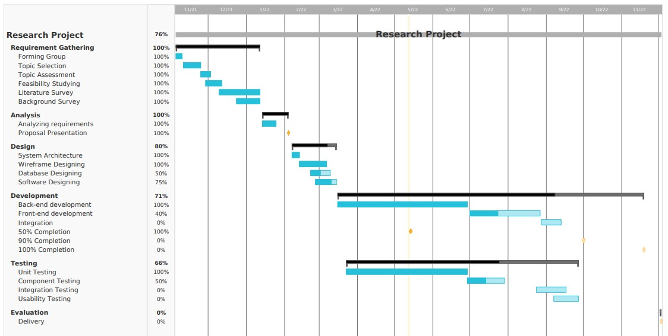
GANTT CHART

Slide 10
01
User Profiling Component
IT21033032
Nishshanka N.A.P.K.R

Slide 11
background
The field of personalized e-learning has witnessed significant advancements in recent years, driven by the increasing availability of user data and the development of sophisticated machine learning techniques. Traditional e-learning platforms often provide static content without considering individual learner characteristics, leading to suboptimal engagement and knowledge retention. Recognizing this limitation, researchers have explored various approaches to personalize the learning experience, ranging from adaptive learning algorithms to intelligent recommendation systems.

Slide 12
Research questions
How can user data, including learning preferences, past performance, and preferred learning styles, be effectively gathered and analyzed to create personalized profiles?
What methodologies can be employed to incorporate non-traditional data, such as eye contact within initial assessments, to assess user attention and inform personalized learning strategies?
How do different factors within user profiles interact to influence the effectiveness of personalized learning experiences?
What are the privacy and ethical considerations associated with collecting and utilizing user data for personalized e-learning?

Slide 13
SPECIFIC AND SUB OBJECTIVE
Main objective : The main objective of the research is to design and implement a robust user profiling component for personalized e-learning platforms. This component will gather and analyze user data to create personalized profiles, ultimately enhancing engagement, knowledge retention, and satisfaction.
Sub objectives :
Develop algorithms to collect and process user data, including learning preferences, past performance, and preferred learning styles.
Investigate methods to incorporate non-traditional data, such as eye contact within initial assessments, into user profiles to assess attention and inform personalized learning strategies.
Evaluate the effectiveness of different profiling techniques in enhancing user engagement and knowledge retention.
Address privacy and ethical considerations associated with user data collection and utilization.

Slide 14
requirements
Functional requirements
Data collection mechanisms for gathering user information.
Algorithms for analyzing user data and creating personalized profiles.
Integration with the e-learning platform to dynamically adjust learning content based on user profiles.
User interface for users to view and manage their profiles.
Data encryption and security measures to protect sensitive user information.
Scalability to accommodate a large number of users and diverse learning profiles.
Compatibility with different devices and browsers to ensure accessibility for all users.
Integration with learning content repositories to dynamically adjust recommendations based on available resources

Slide 15
Requirements Contd.
User requirements
Transparent communication about data collection and usage.
Ability to provide feedback on the accuracy and usefulness of personalized profiles.
Customization options for users to adjust their profile preferences.
Clear and intuitive user interface for viewing and interacting with personalized profiles.
Personalization options for users to customize their learning experience based on their preferences and goals.
Accessibility features to accommodate users with disabilities, such as screen readers and alternative input methods.
Support for multiple languages to cater to a diverse user base.

Slide 16
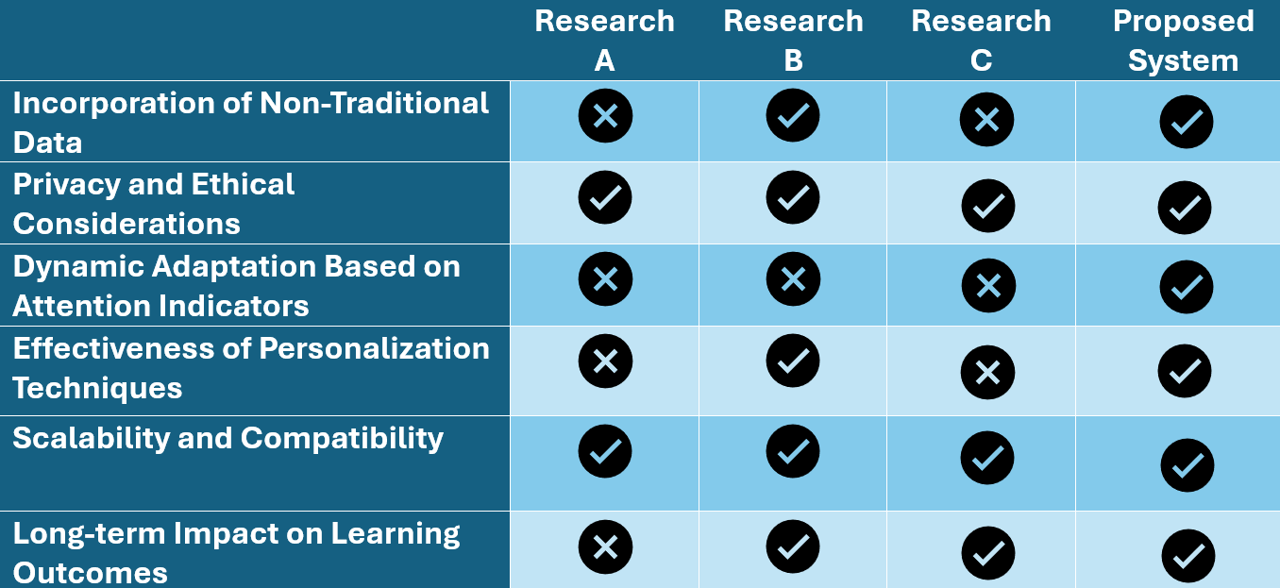
Research gap

Slide 17
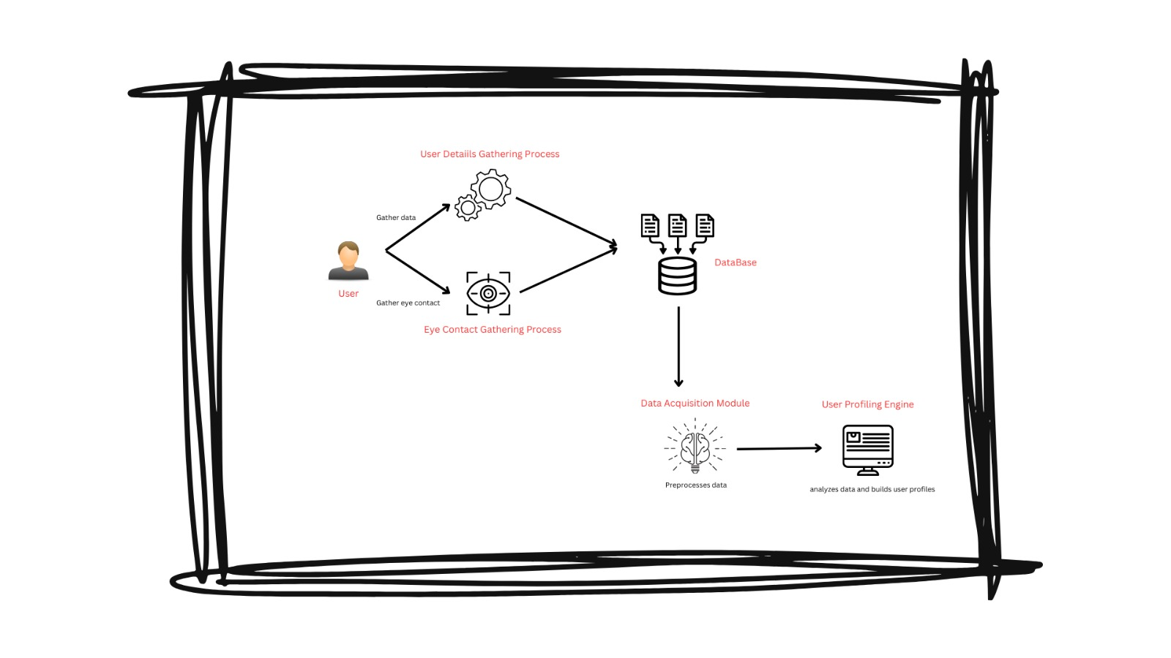
System diagram

Slide 18
Methodology
Step 1
Step 2
Utilize surveys, user interviews, and user interactions within the e-learning platform to gather user data.
Employ statistical analysis techniques to identify patterns and correlations within the collected data.
Step 3
Step 4
Build a prototype of the user profiling component integrating the gathered data and analysis techniques.
Conduct usability testing sessions with representative users to evaluate the effectiveness and usability of the prototype.
Step 5
Step 6
Incorporate feedback from usability testing sessions to refine and improve the user profiling component iteratively.
Assess the effectiveness of the developed user profiling component in enhancing user engagement and satisfaction through quantitative metrics and user feedback.

Slide 19
Commercialization
The developed user profiling component can be commercialized as a standalone product for e-learning platforms or integrated into existing learning management systems. Potential commercialization strategies include licensing the technology to educational institutions or partnering with e-learning platform providers.

Slide 20
REFERENCE
S. S. Farooq and S. S. Khalid, "E-Learning Environment Based Intelligent Profiling System for Enhancing User Adaptation," in International Conference on Advanced Computer Science Applications and Technologies (ACSAT), 2021, pp. 1-6. Available: [Link](https://www.researchgate.net/publication/364422509_E-Learning_Environment_Based_Intelligent_Profiling_System_for_Enhancing_User_Adaptation)
P. Brusilovsky, "User Modeling and User Profiling in Adaptive E-learning Systems," in User Modeling and User-Adapted Interaction, vol. 12, no. 4, pp. 279-283, Dec. 2002. Available: [Link](https://www.researchgate.net/publication/238685545_User_Modeling_and_User_Profiling_in_Adaptive_E-learning_Systems)
3. M. Khamparia, S. Pandey, V. Singh, and M. K. Gupta, "Enhancing the Learning Experience Through Adaptive Learning Systems: A Review," SSRN Electronic Journal, May 2019. Available: [Link](https://papers.ssrn.com/sol3/papers.cfm?abstract_id=3389811)
J. A. Molina-Carmona, J. R. Ruiz-Sarmiento, J. M. Alonso-Hernández, and D. L. Morales-Rodríguez, "Personalization of the eLearning Experience: A Review," Electronics, vol. 11, no. 20, pp. 1-27, Oct. 2022. Available: [Link](https://www.mdpi.com/2079-9292/11/20/3354)

Slide 21
02
Adaptive Recommendation Engine
IT21021602
Abeykoon R.M.S.P

Slide 22
background
The background for the Adaptive Recommendation Engine sub-component is grounded in the identified shortcomings of existing e-learning systems, emphasizing the need for a more adaptive and user-centric approach. The sub-component seeks to overcome the challenges observed in traditional recommendation algorithms by employing a straightforward yet effective algorithm that adjusts recommendations in real-time based on user interactions and feedback.

Slide 23
Research questions
To what extent does the Adaptive Recommendation Engine improve the relevance and appropriateness of learning content recommendations compared to traditional e-learning systems?
What is the impact of real-time adjustments in recommendations on user engagement within the e-learning platform?
How effectively does the Adaptive Recommendation Engine adapt to changes in user preferences over time?
How does the Adaptive Recommendation Engine compare with traditional e-learning systems in terms of providing tailored learning experiences?
How does the inclusion of user feedback in real-time adjustments impact the quality and effectiveness of recommendations?

Slide 24
SPECIFIC AND SUB OBJECTIVE
Main objective : The main objective of the Adaptive Recommendation Engine sub-component is to enhance the personalization of learning experiences within e-learning platforms through the implementation of a straightforward recommendation algorithm. This algorithm suggests learning content based on the user's profile and adjusts recommendations in real-time, thereby aiming to provide a dynamic and tailored learning journey for each individual user. The overarching goal is to contribute to the project's mission of improving user engagement, knowledge retention, and satisfaction in the realm of personalized e-learning.
Sub objectives :
Develop and implement a straightforward recommendation algorithm capable of optimizing the relevance of learning content suggested to users based on their profiles.
Design and integrate a real-time adjustment mechanism that allows the recommendation engine to adapt swiftly to user interactions and feedback, ensuring up-to-date and personalized suggestions.
Evaluate the adaptability of the recommendation engine in aligning with changes in user preferences, ensuring that it remains responsive to the evolving needs and interests of individual users over time.
Examine the integration of user feedback in real-time adjustments, assessing the effectiveness of user input in refining and improving the quality of recommendations.

Slide 25
requirements
Functional requirements
The system shall collect and store user data, including learning preferences, past performance, and initial assessments, to create and maintain personalized user profiles.
The system shall implement a straightforward recommendation algorithm that analyzes user profiles and suggests relevant learning content based on individual preferences and needs.
The system shall incorporate a real-time adjustment mechanism that enables the recommendation engine to adapt and update recommendations based on user interactions and feedback.
The recommendation algorithm shall employ a hybrid approach, combining collaborative and content-based filtering algorithms to enhance the accuracy and adaptability of suggested content
The system shall assemble dynamic learning pathways by integrating recommendations, content tags, and user preferences, offering personalized and evolving learning journeys for individual users.

Slide 26
Requirements Contd.
User requirements
Users should be able to create and manage their profiles easily, providing information on learning preferences, goals, and past performance.
Users should have the ability to provide feedback on recommended content, expressing their satisfaction or suggesting improvements.
Users should receive notifications or updates when the system makes real-time adjustments to their recommendations based on user interactions and feedback.
Learners should feel empowered in shaping their learning experience through active participation, such as contributing to the feedback loop and influencing future recommendations.
Learners should have visibility into how recommendations are generated, including an explanation of the factors considered such as user preferences and content tags.

Slide 27
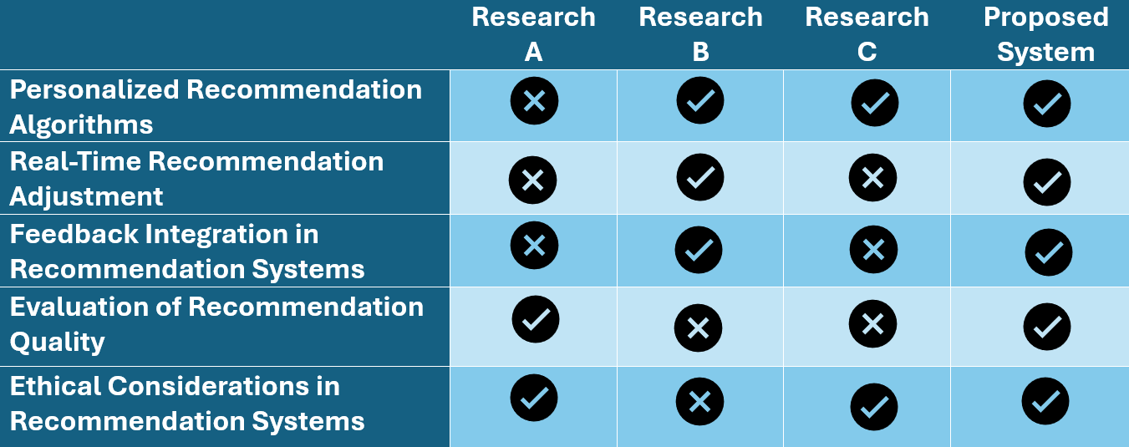
Research gap

Slide 28
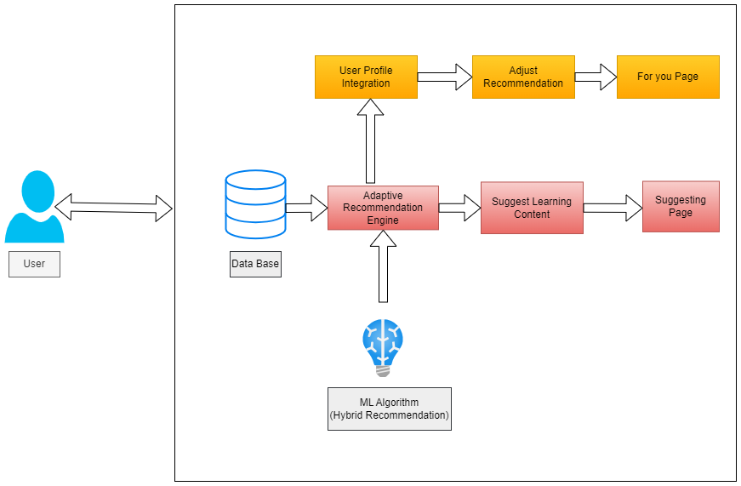
System diagram

Slide 29
Methodology
Algorithm to be used: Hybrid Recommendation algorithm which uses both collaborative and content-based filtering algorithm.
Step 1
Step 2
Choose or design a hybrid recommendation algorithm that combines collaborative and content-based filtering
Develop a user profiling mechanism that gathers and stores relevant user data, including learning preferences, past performance, and initial assessments.
Step 3
Step 4
Implement a real-time adjustment mechanism that allows the recommendation engine to adapt suggestions based on user interactions and feedback.
Develop a dynamic learning pathway generator that assembles personalized learning paths considering content tags, user preferences, and learning goals.
Step 5
Step 6
Implement an engagement analytics system to track user interactions and completion rates.
Evaluate user satisfaction through surveys, feedback forms, and analytics to measure the effectiveness of the Adaptive Recommendation Engine.

Slide 30
Commercialization
Implement a multi-channel marketing strategy to reach the target audience.
Utilize online channels such as social media, content marketing, and targeted advertising.
Attend relevant industry conferences and collaborate with influencers to increase visibility.
Develop a sales strategy that includes both direct sales and partnerships with e-learning platforms or educational technology providers.
Offer product demonstrations and trials to potential clients.

Slide 31
REFERENCE
International Conference on Computer Science and Software Engineering, CSSE 2008, Volume 5: E-learning and Knowledge Management / Socially Informed and Instructinal Design / Learning Systems Platforms and Architectures / Modeling and Representation / Other Applications , December 12-14, 2008, Wuhan, China
An adaptive and personalized open source e-learning platform Dimitrios Tsolisa *, Sofia Stamoub , Paraskevi Christiaa , Soultana Kampanaa , Triseugeni Rapakouliaa , Maria Skoutaa , Athanasios Tsakalidisa a Computer Engineering and Informatics Department, University of Patras, Building B, Patras, 26504, Greece b Department of Archives and Library Science,Ionian University, Corfu,49100, Greece
Submission received: 9 November 2023 / Revised: 30 November 2023 / Accepted: 4 December 2023 / Published: 6 December 2023
Allal L., Ducrey G. P. (2000). Assessment of—or in—the zone of proximal development. Learning and Instruction, 10(2), 137–152. https://doi.org/10.1016/s0959-4752(99)00025-0

Slide 32
03
Dynamic Learning Pathway Generator
IT21032806
Jayasinghe K.A.K.N

Slide 33
background
The sub-component is designed to overcome the rigidity of traditional learning paths, providing a solution that adapts to individual needs, preferences, and performance. By offering a diverse mix of content and dynamically adjusting the learning sequence, the generator aims to create an engaging, personalized, and effective learning journey for each user. The ultimate goal is to contribute to enhanced user satisfaction, knowledge retention, and overall success in the realm of personalized e-learning.

Slide 34
Research questions
How can the Dynamic Learning Pathway Generator effectively gather and analyze user preferences to create personalized learning profiles?
How can the Dynamic Learning Pathway Generator dynamically adjust recommended content in real-time based on user interactions and performance?
How can the generator ensure a well-rounded learning experience by incorporating a varied mix of content formats and difficulty levels?
To what extent do dynamically generated learning paths contribute to improved user engagement in comparison to static learning paths?
What impact does the use of dynamic learning pathways have on user satisfaction with the e-learning platform?

Slide 35
SPECIFIC AND SUB OBJECTIVE
Main objective : The main objective of the Dynamic Learning Pathway Generator is to design and implement a system that creates personalized and adaptive learning pathways for individual users within e-learning platforms. This sub-component aims to overcome the limitations of static learning paths by dynamically sequencing recommended content. The overarching goal is to enhance user engagement, knowledge retention, and satisfaction by tailoring the learning experience to individual needs.
Sub objectives :
Develop a robust mechanism for user profiling that gathers and analyzes data on learning preferences, past performance, and initial assessments.
Implement algorithms and methodologies for real-time adjustment of the learning pathway based on user interactions and performance.
Design a system that incorporates a diverse mix of content formats and difficulty levels in the learning pathway.
Assess the impact of dynamically generated learning paths on user engagement in comparison to static paths.

Slide 36
requirements
Functional requirements
The system must collect and analyze data on user learning preferences, past performance, and initial assessments.
The system must employ algorithms to dynamically adjust the learning pathway in real-time based on user interactions and performance.
The system should incorporate a diverse mix of content formats, including text, video, quizzes, and interactive activities.
Ensure seamless integration with the Adaptive Recommendation Engine.
Implement mechanisms to track user interactions with the learning pathway.
Implement visualizations or progress indicators to display user advancement within the learning pathway.

Slide 37
Requirements Contd.
User requirements
Users should have the ability to create and manage personalized profiles.
Users should be able to customize their learning preferences, including content types, difficulty levels, and preferred formats.
The interface should be user-friendly, intuitive, and easy to navigate.
Users should receive real-time feedback on their interactions and performance within the learning pathway.
Users should have access to visualizations or indicators displaying their progress within the learning pathway.
The system should be accessible to users with varying abilities and preferences.
The system should provide support and guidance to users on how to effectively utilize the personalized learning features.

Slide 38
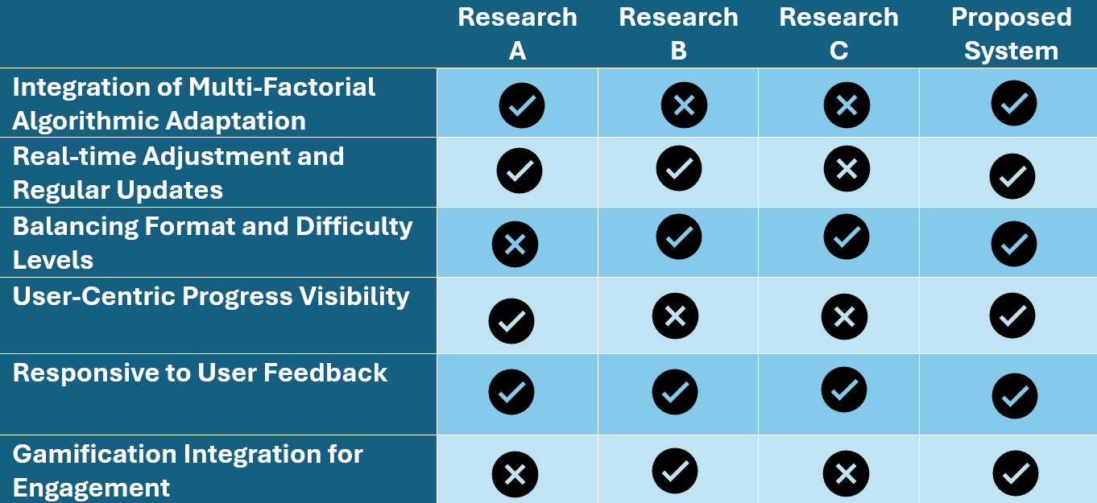
Research gap

Slide 39
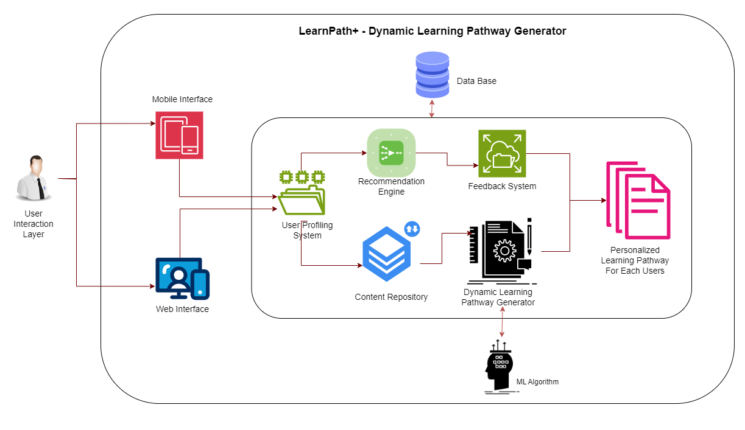
System diagram

Slide 40
Methodology
Step 1
Step 2
Implement automated content tagging systems using Natural Language Processing (NLP) and machine learning algorithms to categorize learning resources accurately and efficiently.
Explore machine learning algorithms such as collaborative filtering, reinforcement learning, or hybrid approaches to generate personalized recommendations based on user profiles and content metadata.
Step 3
Step 4
Develop algorithms to dynamically assemble learning pathways for each user based on their profile, preferences, and recommended content.
Design user interfaces to provide visibility into users' current progress within the learning pathway, allowing users to track their advancement and achievements.
Step 5
Step 6
Identify key gamification elements such as badges, points, levels, and challenges that align with the learning goals and objectives of the platform.
Conduct usability testing and user studies to evaluate the effectiveness and usability of the Dynamic Learning Pathway Generator component.

Slide 41
Commercialization
Develop a comprehensive marketing strategy to raise awareness and generate interest in the Dynamic Learning Pathway Generator.
Utilize digital marketing channels such as social media, content marketing, search engine optimization (SEO), and email campaigns to reach target audiences.
Attend industry conferences, trade shows, and networking events to showcase the product and build relationships with potential customers and partners.
Create compelling sales collateral, including product demonstrations, case studies, and testimonials, to support the sales process.

Slide 42
REFERENCE
"Generation of a Learning Path in E-Learning Environments: Literature Review." ResearchGate, 2021. https://www.researchgate.net/publication/369959738_GENERATION_OF_A_LEARNING_PATH_IN_E-LEARNING_ENVIRONMENTS_LITERATURE_REVIEW.
"Blended Learning in Higher Education: Trends and Implications." ERIC, 2017. https://files.eric.ed.gov/fulltext/EJ1185780.pdf.
"Deriving a Prototype for the Dynamic Generation of Learning Path in an E-Learning Environment Using Genetic Algorithm." ResearchGate, 2014. https://www.researchgate.net/publication/264835476_Deriving_a_prototype_for_the_dynamic_generation_of_learning_path_in_an_e-learning_environment_using_genetic_algorithm.
"e-Learning Reference PDF." Scribd, 2019. https://www.scribd.com/document/419554469/e-Learning-Reference-PDF.

Slide 43
04
Engagement Analytics and Feedback Loop
IT21032974
Nishshanka N.A.G.A.A

Slide 44
background
the integration of engagement analytics and a feedback loop represents a significant step towards enhancing the efficacy and user experience of e-learning platforms. By leveraging facial expression analysis and user feedback, these platforms can move beyond static content delivery to dynamically adapt to users' evolving needs and preferences, ultimately fostering deeper engagement and more effective learning outcomes.

Slide 45
Research questions
How effectively can facial expression analysis be utilized to assess user engagement and satisfaction within e-learning environments?
How do different types of learning content (e.g., videos, interactive quizzes, textual materials) influence user engagement and facial expressions?
What types of feedback are most valuable for informing iterative improvements to e-learning content and delivery methods?
How does the incorporation of a feedback loop within engagement analytics influence user satisfaction and perceived learning effectiveness?
What are the potential ethical considerations associated with the collection and analysis of facial expression data in e-learning contexts, and how can these concerns be addressed responsibly?

Slide 46
SPECIFIC AND SUB OBJECTIVE
Main objective : The main objective of the Engagement Analytics and Feedback Loop component is to enhance the overall effectiveness and user experience of e-learning platforms by leveraging advanced technologies, such as facial expression analysis, to track user engagement, analyze learning patterns, and incorporate user feedback. By implementing this component, the aim is to create a dynamic and adaptive learning environment that responds to individual user needs and preferences, ultimately improving learning outcomes and satisfaction.
Sub objectives :
Develop algorithms and systems capable of tracking and analyzing user engagement during e-learning sessions, with a focus on capturing facial expressions as indicators of attentiveness, interest, and satisfaction.
Utilize data analytics techniques to identify patterns in user engagement and interaction with learning content, including trends in facial expressions, time spent on different activities, and progress through learning modules.
Use insights gathered from engagement analytics and user feedback to iteratively improve the e-learning platform, including content recommendations, user interface design, and personalized learning pathways.
Prioritize the design and implementation of features that enhance the overall user experience, such as intuitive feedback mechanisms, real-time adjustments based on user engagement, and responsive interfaces.

Slide 47
requirements
Functional requirements
The system must be able to capture and analyze facial expressions of users during e-learning sessions.
It should recognize and interpret key facial cues such as smiles, frowns, raised eyebrows, and eye movements.
The system should track user interactions with the e-learning platform, including time spent on activities, interactions with content, and frequency of engagement.
The system should analyze user engagement data to identify effective learning patterns and strategies.
The platform should provide mechanisms for users to provide feedback on their learning experience.
The system should analyze user feedback to identify areas for improvement in the e-learning platform.
Based on engagement analytics and user feedback, the system should dynamically adapt content delivery and presentation in real-time.

Slide 48
Requirements Contd.
User requirements
Users should be able to monitor their own engagement levels and progress within the e-learning platform.
Users should have the ability to submit feedback on their learning experience, including suggestions for improvement, difficulties encountered, and overall satisfaction.
Users must be informed about the collection and use of their data, particularly when capturing sensitive information such as facial expressions.
The system should provide clear explanations of how user data will be used and allow users to opt-in or opt-out of data collection if possible.
The system should take into account user feedback and engagement data to tailor recommendations to each user's needs.
Users should have visibility into how their engagement data and feedback are being used to improve the e-learning platform.
Users should be able to provide feedback quickly and efficiently without disrupting their learning experience.

Slide 49
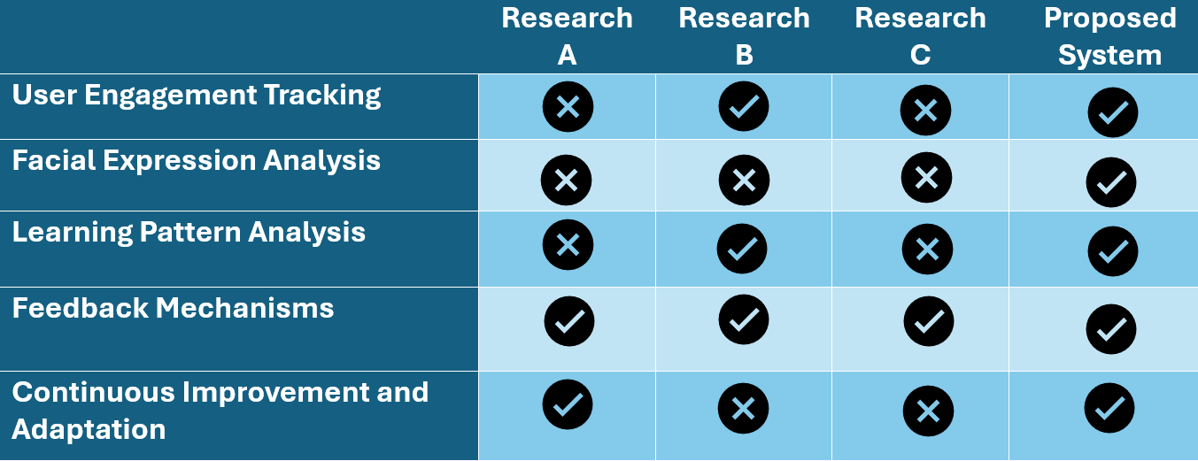
Research gap

Slide 50
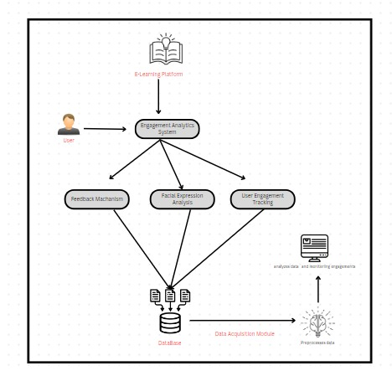
System diagram

Slide 51
Methodology
Step 1
Step 2
Select appropriate tools or libraries for facial expression analysis, considering factors such as accuracy, real-time processing capabilities, and compatibility with the e-learning platform.
Develop algorithms to analyze engagement data and identify patterns or trends indicative of user engagement levels and learning behaviors.
Step 3
Step 4
Design and implement user-friendly interfaces for collecting feedback within the e-learning platform, providing options for users to submit feedback in various formats (e.g., text, ratings, surveys).
Develop algorithms for analyzing user feedback, categorizing responses, and identifying actionable insights for improving the e-learning platform.
Step 5
Step 6
Develop algorithms and rules for dynamically adapting content delivery and presentation based on engagement analytics and user feedback.
Validate the effectiveness of the component in improving user engagement, satisfaction, and learning outcomes through controlled experiments or user studies.

Slide 52
Commercialization
Develop a comprehensive go-to-market strategy to reach target customers effectively.
Utilize various channels, including direct sales, partnerships with e-learning platform providers, online marketplaces, and digital marketing campaigns, to promote the component.
Leverage industry events, conferences, and webinars to showcase the capabilities of the component and engage with potential customers and partners.
Implement a flexible pricing model that aligns with the value provided by the component and the budget constraints of customers.
Offer tiered pricing plans based on features, usage volume, and customer segments (e.g., individual learners, educational institutions, corporate training programs).
Provide options for subscription-based pricing, one-time licensing fees, or pay-per-use models to accommodate diverse customer needs.

Slide 53
REFERENCE
Ayo, C. K., Adewumi, A. O., & Ayo, O. O. (2023). Investigating the Impact of Learning Management Systems on Student Engagement: A Study of Nigerian Universities. Sustainability, 15(10), 7849. https://doi.org/10.3390/su15107849
Smit, I., Pooe, D. R., & Sosibo, S. M. (2022). Exploring Students' Engagement Towards the Learning Management System (LMS) Using Learning Analytics. Frontiers in Education, 7, 851019. https://doi.org/10.3389/feduc.2022.851019
Khamees, M., & Al-Kabi, M. N. (2021). The Impact of Social Presence on Learner Engagement in Online Learning: The Mediating Role of Instructor Immediacy. International Journal of Learning, Teaching and Educational Research, 20(10), 74–91. https://files.eric.ed.gov/fulltext/EJ1296879.pdf
Gurevych, I., Zesch, T., & Meyer, C. M. (2021). Applying Learning Analytics in Online Environments: Measuring Learners' Engagement Unobtrusively. IEEE Transactions on Learning Technologies, 1–1. https://doi.org/10.1109/TLT.2021.3137816

Slide 54
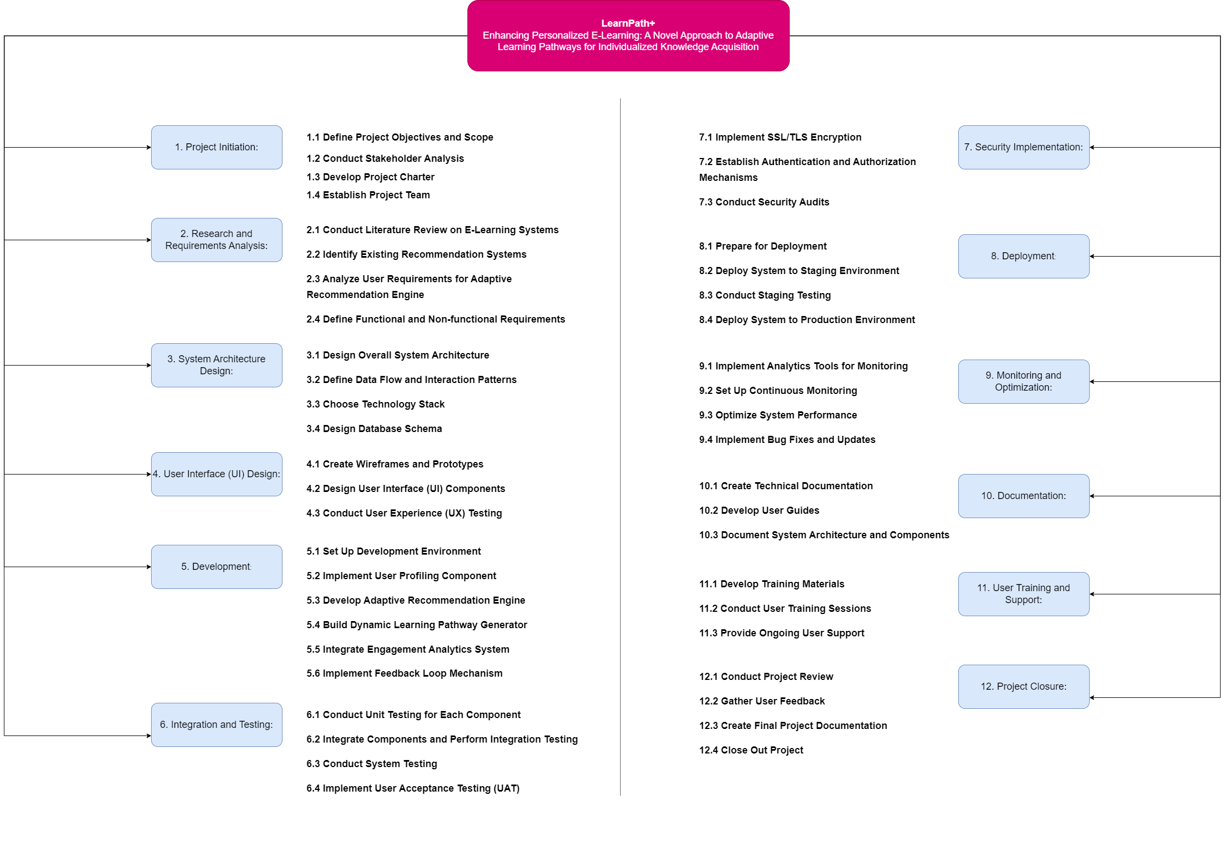
Work Breakdown Structure (WBS)

Slide 55
Thank You!
Do you have any questions?

