Slide 1
Data Cleaning &
Visualization
messy_dataset_Mukesh.csv · Python · Pandas · Seaborn
10 Issues Fixed
9 Clean Rows
7 Visualizations
Mukesh · May 3, 2026

Slide 2
The Problem — 10 Issues in Raw Data
⚠ messy_dataset_Mukesh.csv (10 rows)
1
Duplicate rows — ID=2 'Bob' — two rows with complementary NaNs
6
Missing date — Charlie's Join Date was blank → imputed
2
Missing ID — Eve's ID was blank (assigned 6)
7
Missing Age — Bob (one row) and Heidi → filled with median
3
Text as number — Age 'thirty-eight' for David → 38
8
Missing Salary — Bob (one row) and Heidi → filled with median
4
Text as number — Salary 'sixty five thousand' (ID=7) → 65,000
9
Missing Country — Grace's country was blank → filled with mode
5
Invalid date — Eve's date '2019-13-01' — month 13 → NaT
10
Wrong code — 'AU' should be 'AUS' — standardised
Data Cleaning & Visualization | Mukesh | May 2026

Slide 3
The Solution — Cleaning, Outliers & Correlation
🔧 Cleaning Steps
📐 IQR Outlier Detection
pd.to_numeric(errors='coerce') — type conversion
Bob duplicate rows merged (ffill + bfill)
Eve's ID assigned = 6
'AU' → 'AUS' standardized
Dates parsed (multiple formats); invalid → NaT
NaN Age & Salary → filled with column median
NaN Country → filled with mode (NZ)
NaN Join Date → filled with median (2020-01-15)
Column | Q1 | Q3 | IQR | Bounds | Outliers
Age | 27 | 35 | 8 | [15 – 47] | ✔ 0
Salary | $59K | $65K | $6K | [$50K–$74K] | ✔ 0
📊 Pearson Correlation
Age ↔ Salary r = +0.6289
Moderate-strong positive
Age ↔ Join Year r = −0.6957
Strong negative
Salary ↔ Join Year r = −0.1188
Weak negative
Data Cleaning & Visualization | Mukesh | May 2026

Slide 4
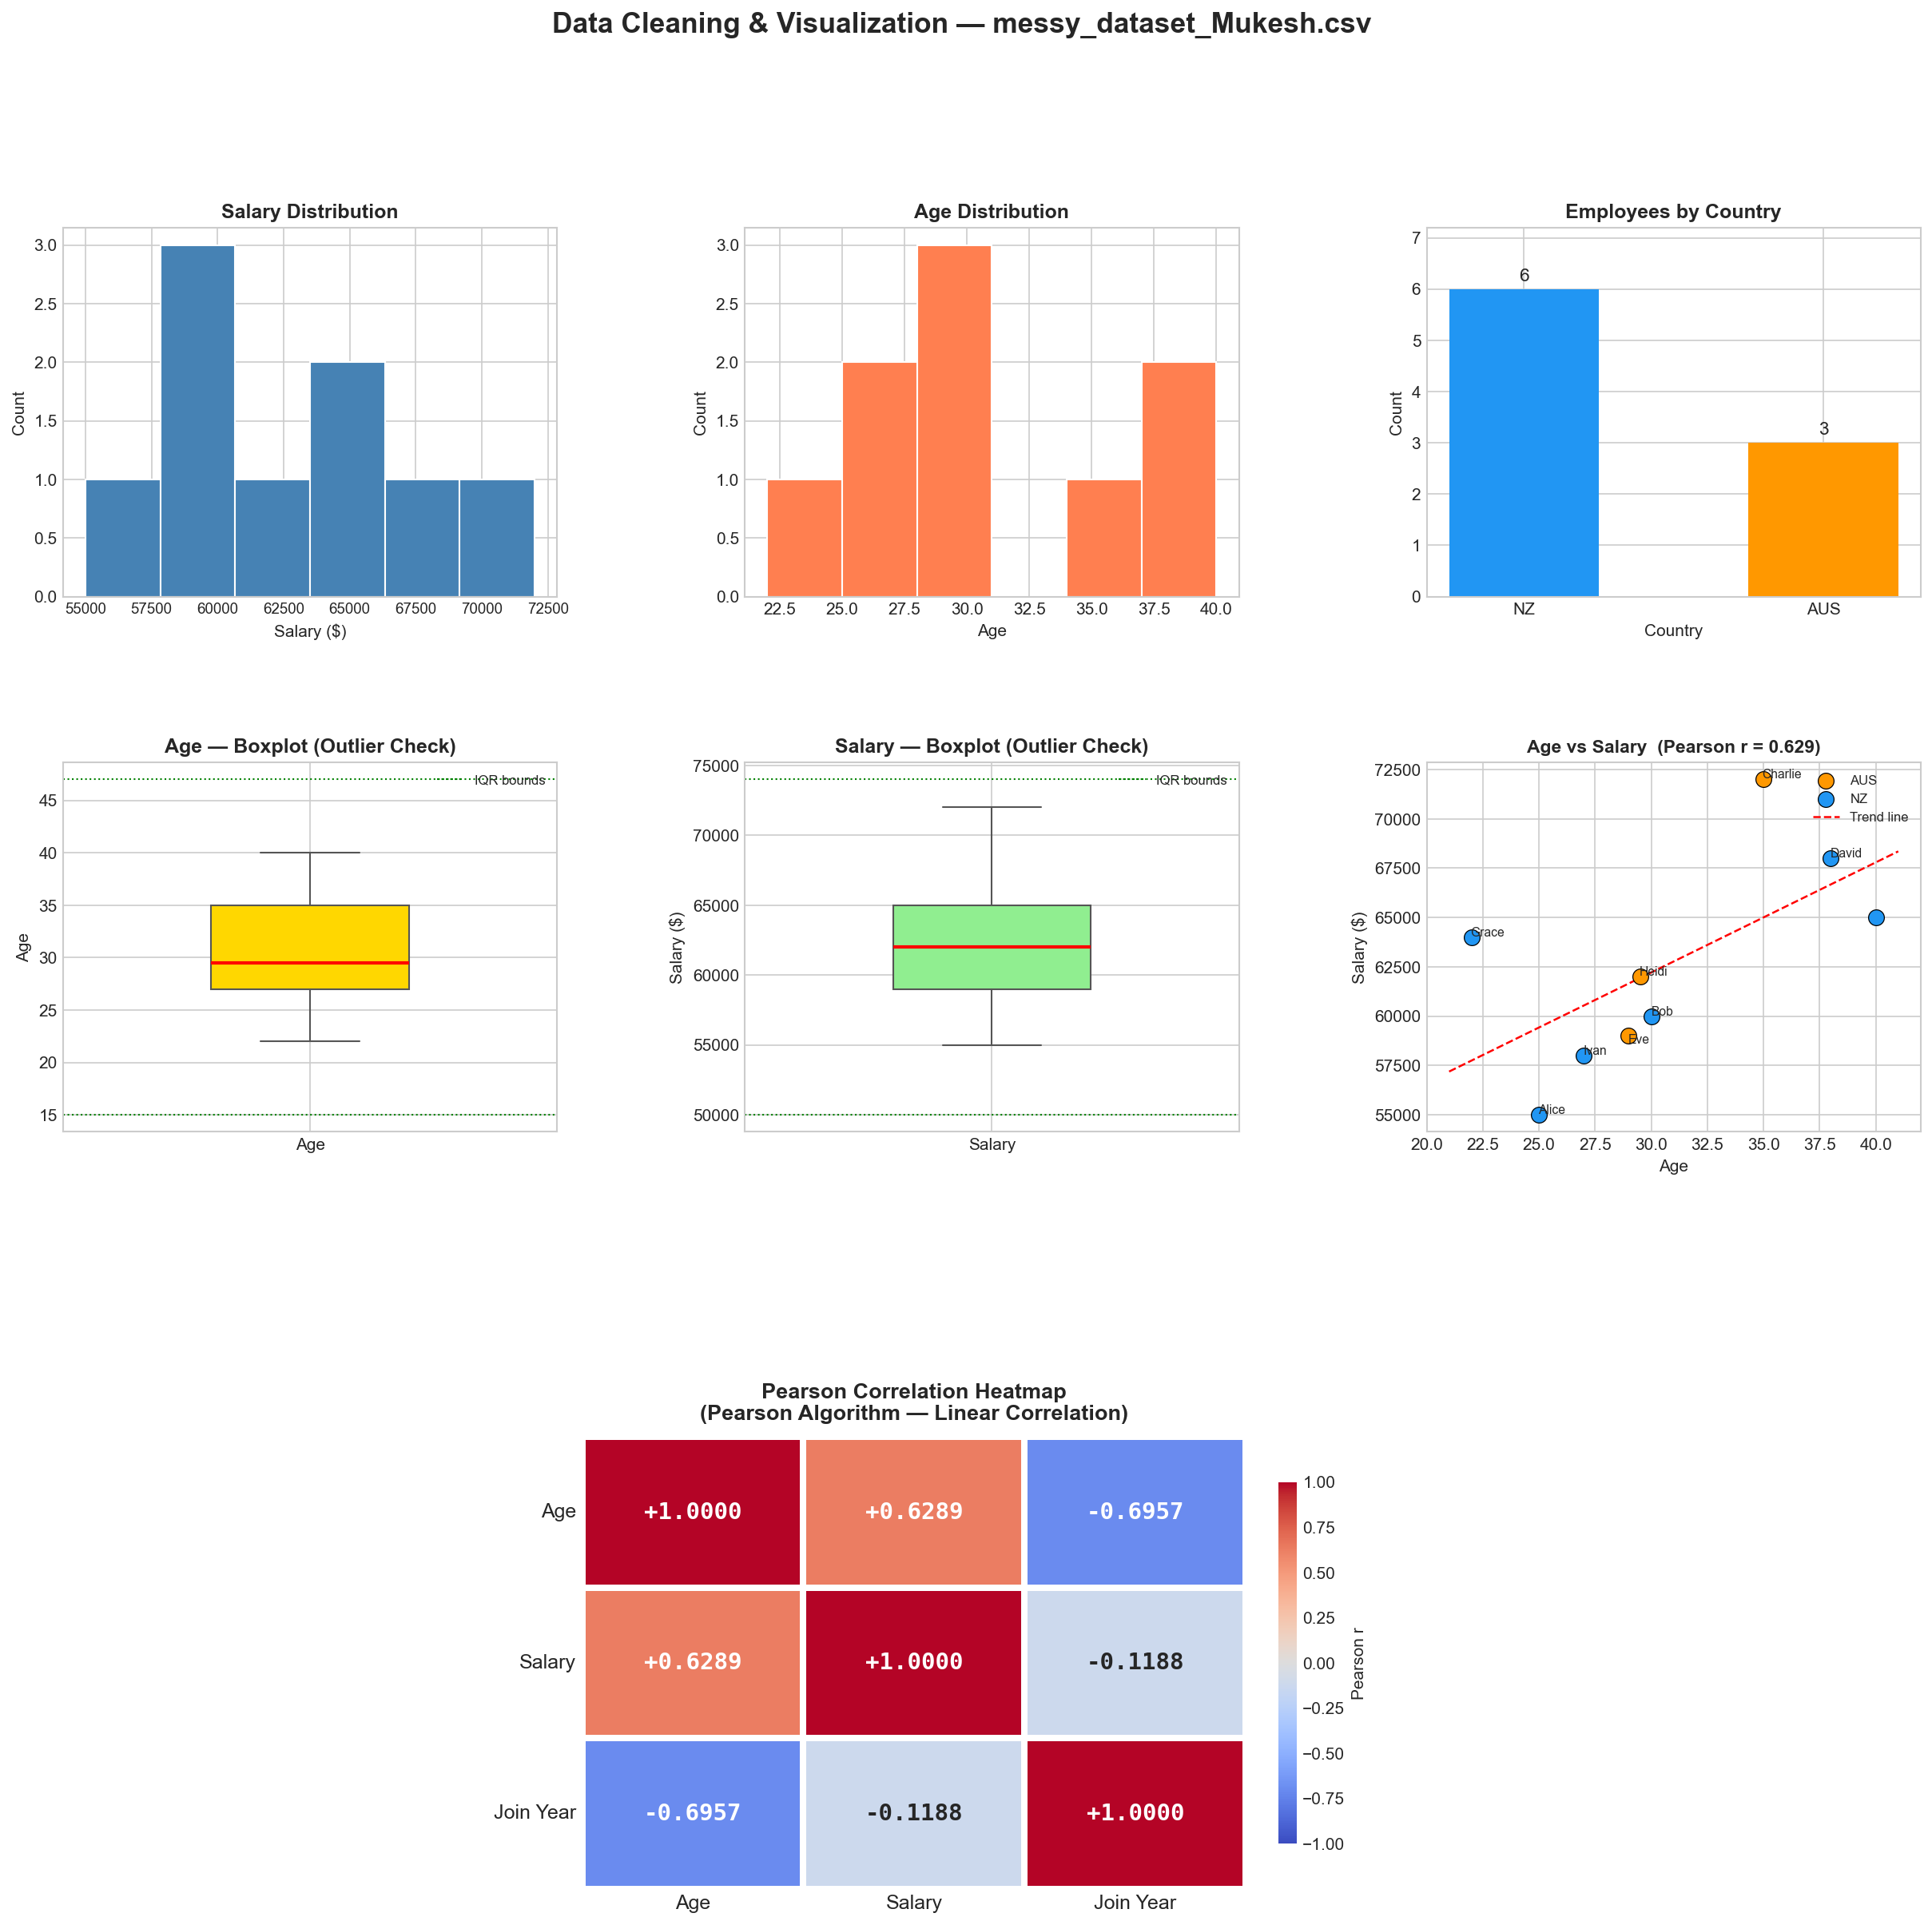
Visualizations — 7 Charts Generated
1
Salary Distribution
2
Age Distribution
3
Employees by Country
4
Age Boxplot
5
Salary Boxplot
6
Age vs Salary Scatter
7
Pearson Heatmap
Saved: data_cleaning_Mukesh.png (180 DPI)
Data Cleaning & Visualization | Mukesh | May 2026

Slide 5
Results & Conclusion
$62,556
30.6 yrs
NZ 67%
0
Avg Salary
Avg Age
Majority
Outliers
✅ 10 data quality issues identified and resolved
📐 No outliers — Age [15–47], Salary [$50K–$74K]
📈 Age ↔ Salary r = +0.629 | Age ↔ Join Year r = −0.696
🎨 7 visualizations generated and explained individually
🏁 Final dataset: 9 clean rows, 0 remaining NaNs
Python 3 · Pandas · NumPy · Matplotlib · Seaborn · adjustText

