Slide 1
Data Cleaning &
Visualization
Analyzing and Cleaning messy_dataset_Mukesh.csv
Mukesh · May 3, 2026 · Python | Pandas | Seaborn

Slide 2
Project Overview
📂
🎯
🛠️
📊
Dataset
Goal
Tools Used
Output
messy_dataset_Mukesh.csv
Employee records:
ID · Name · Age · Country
Salary · Join Date
10 rows (raw)
Identify, document, and fix
all data quality issues
in the raw dataset
Python 3
Pandas · NumPy
Matplotlib · Seaborn
adjustText
9-row cleaned dataset
IQR Outlier Detection
Pearson Correlation
7 Visualizations
Data Cleaning & Visualization | Mukesh | May 2026

Slide 3
Issues Found in Raw Data
⚠ 10 data quality problems identified
1
Duplicate ID=2 for 'Bob' across two rows (complementary NaNs)
6
Missing Join Date for Charlie (ID=4)
2
Missing ID for 'Eve' (row 5)
7
Missing Age for Bob (one row) and Heidi (ID=9)
3
Age as text: 'thirty-eight' for David (ID=5) → 38
8
Missing Salary for Bob (one row) and Heidi (ID=9)
4
Salary as text: 'sixty five thousand' for ID=7 → 65,000
9
Missing Country for Grace (ID=8)
5
Invalid date '2019-13-01' for Eve (month 13 doesn't exist)
10
Inconsistent country code: 'AU' should be 'AUS'
Data Cleaning & Visualization | Mukesh | May 2026

Slide 4
Data Cleaning Process
🔧 Fixes Applied
📋 Imputation Strategy
Replaced text-encoded numbers with numeric values
Used pd.to_numeric(errors='coerce') for type conversion
Merged duplicate Bob rows via forward/backward fill
Assigned Eve's missing ID = 6 (next logical value)
Standardized 'AU' → 'AUS' country code
Parsed dates with multiple formats; invalid → NaT
Numeric NaNs (Age, Salary) → filled with column median
Missing Country → filled with mode (most frequent)
Missing Join Date → filled with median date (2020-01-15)
Dataset sorted by ID after all merges
Index reset; ID cast to int
Final NaN count: 0 (except Name for ID=7)
Data Cleaning & Visualization | Mukesh | May 2026

Slide 5
Outlier Detection — IQR Method
Formula: Lower Bound = Q1 − 1.5 × IQR | Upper Bound = Q3 + 1.5 × IQR | Values outside bounds = Outlier
Column | Q1 | Q3 | IQR | Lower Bound | Upper Bound | Outliers
Age | 27.0 | 35.0 | 8.0 | 15.0 | 47.0 | ✔ 0
Salary ($) | 59,000 | 65,000 | 6,000 | 50,000 | 74,000 | ✔ 0
✅ No outliers detected in Age or Salary — all 9 employee values fall within the IQR fence bounds.
Boxplot Concept:
Q1−1.5×IQR
Q1
Median
Q3
Q3+1.5×IQR
Data Cleaning & Visualization | Mukesh | May 2026

Slide 6
Pearson Correlation Analysis
Linear correlation between Age, Salary, and Join Year
 | Age | Salary | Join Year
Age | +1.0000 | +0.6289 | −0.6957
Salary | +0.6289 | +1.0000 | −0.1188
Join Year | −0.6957 | −0.1188 | +1.0000
Key Insights
📈 Age ↔ Salary
Moderate-strong positive (r = +0.63)
📉 Age ↔ Join Year
Strong negative (r = −0.70)
➡️ Salary ↔ Join Year
Color scale: Dark Blue = strong → Light Blue = weak | Blue = positive, Light = negative
Weak negative (r = −0.12)
💡 Older employees earn more (r = +0.63) and joined earlier (r = −0.70). Salary and join year are nearly independent (r = −0.12).
Data Cleaning & Visualization | Mukesh | May 2026

Slide 7
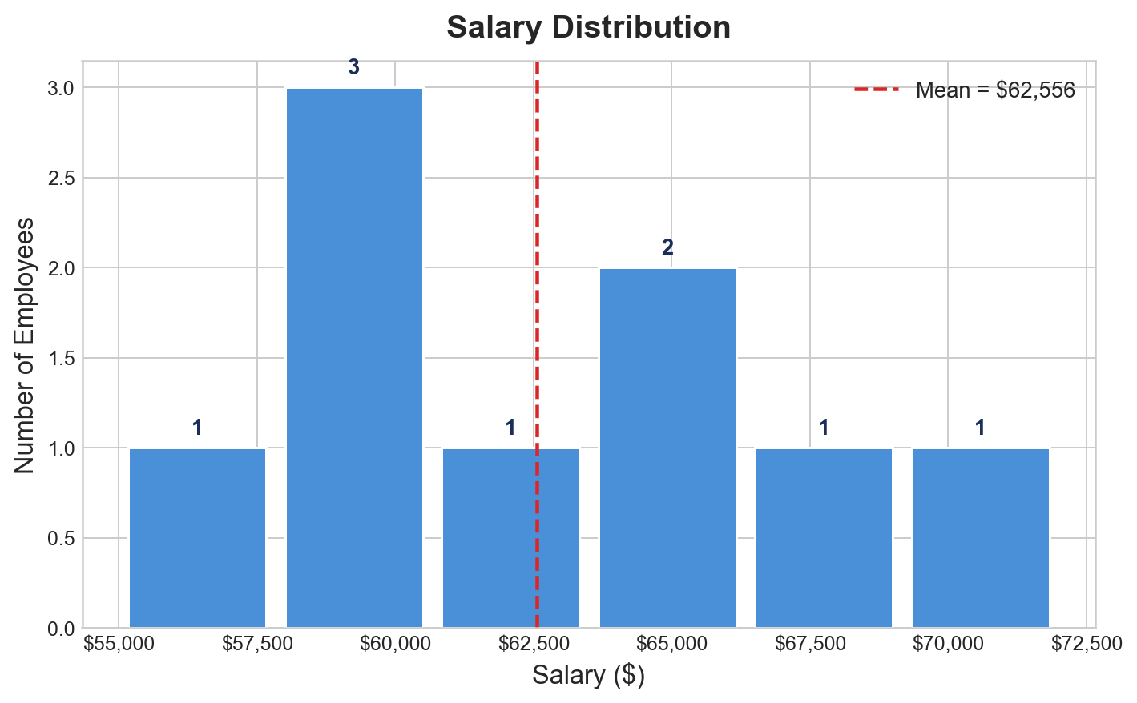
Chart 1 — Salary Distribution
1
WHAT THIS CHART SHOWS
Histogram of employee salaries
across 6 bins after cleaning.
Red dashed line = mean salary.
HOW IT WAS GENERATED
ax.hist(df['Salary'], bins=6)
Mean line: ax.axvline(mean)
Count labels above each bar
x-axis formatted as currency
KEY OBSERVATIONS
Salaries range: $55,000 – $72,000
Mean salary = $62,556
Most employees earn $58K–$68K
Charlie ($72K) is the highest earner
No extreme outliers in salary
Data Cleaning & Visualization | Mukesh | May 2026

Slide 8
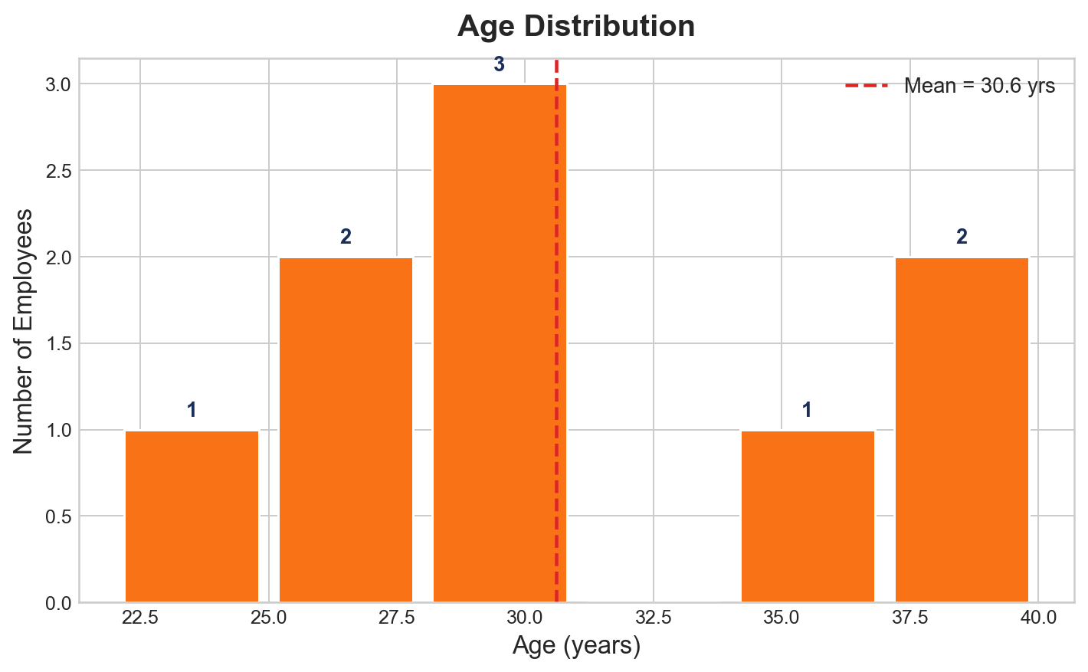
Chart 2 — Age Distribution
2
WHAT THIS CHART SHOWS
Histogram of employee ages
across 6 bins after cleaning.
Red dashed line = mean age.
HOW IT WAS GENERATED
ax.hist(df['Age'], bins=6)
Mean line: ax.axvline(mean_age)
Count labels above each bar
KEY OBSERVATIONS
Ages range: 22 – 40 years
Mean age = 30.6 years
Heidi's age was imputed (29.5)
Most employees are in their 20s–30s
No age outliers detected
Data Cleaning & Visualization | Mukesh | May 2026

Slide 9
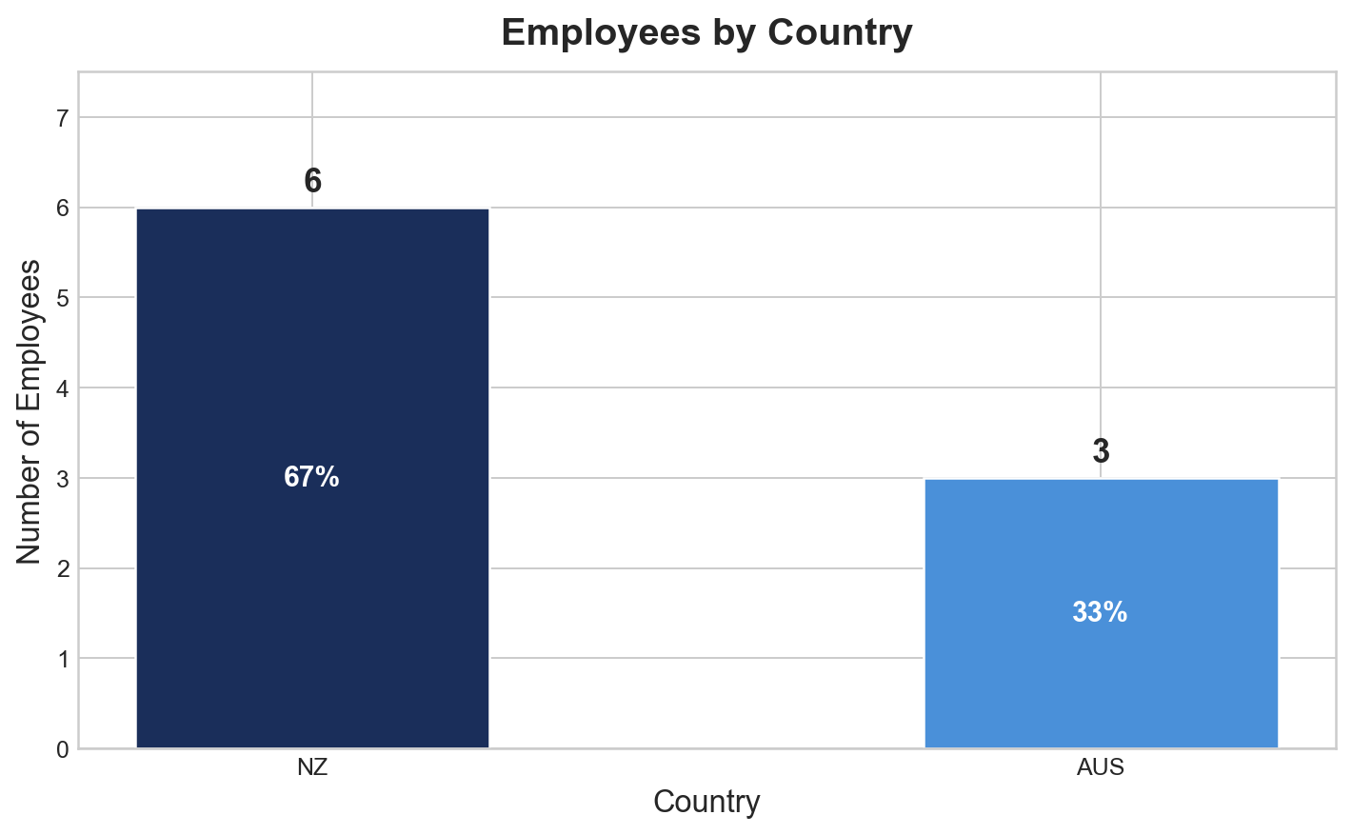
Chart 3 — Employees by Country
3
WHAT THIS CHART SHOWS
Bar chart of employee count
by country (NZ vs AUS).
Percentages shown inside bars.
HOW IT WAS GENERATED
df['Country'].value_counts()
ax.bar() with custom colors
Percentage labels via ax.text()
KEY OBSERVATIONS
NZ: 6 employees (67%)
AUS: 3 employees (33%)
'AU' was corrected to 'AUS'
Grace's missing country → imputed
NZ is the majority country
Data Cleaning & Visualization | Mukesh | May 2026

Slide 10
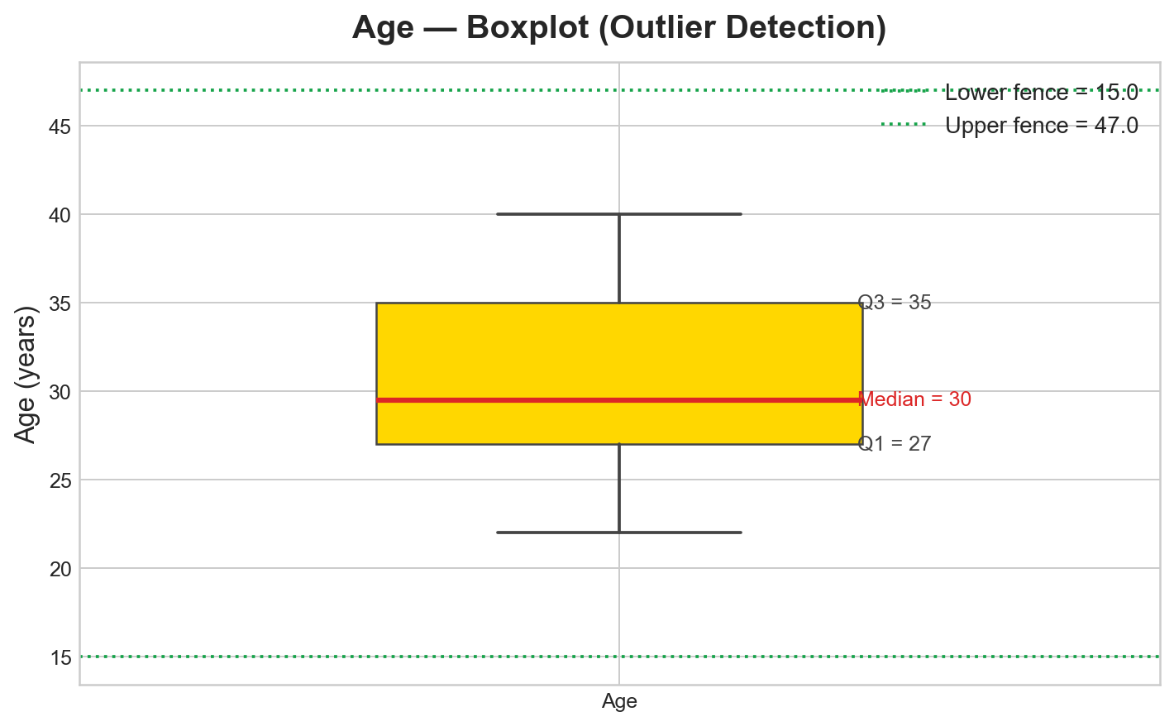
Chart 4 — Age Boxplot (Outlier Check)
4
WHAT THIS CHART SHOWS
Boxplot of Age with IQR fence
lines to detect outliers visually.
Green dotted = fence boundaries.
HOW IT WAS GENERATED
ax.boxplot(df['Age'])
IQR fences: Q1-1.5×IQR, Q3+1.5×IQR
Q1, Median, Q3 annotated on plot
KEY OBSERVATIONS
Q1 = 27, Median = 29.5, Q3 = 35
IQR = 8.0
Lower fence = 15.0
Upper fence = 47.0
✅ All 9 age values within fences
Data Cleaning & Visualization | Mukesh | May 2026

Slide 11
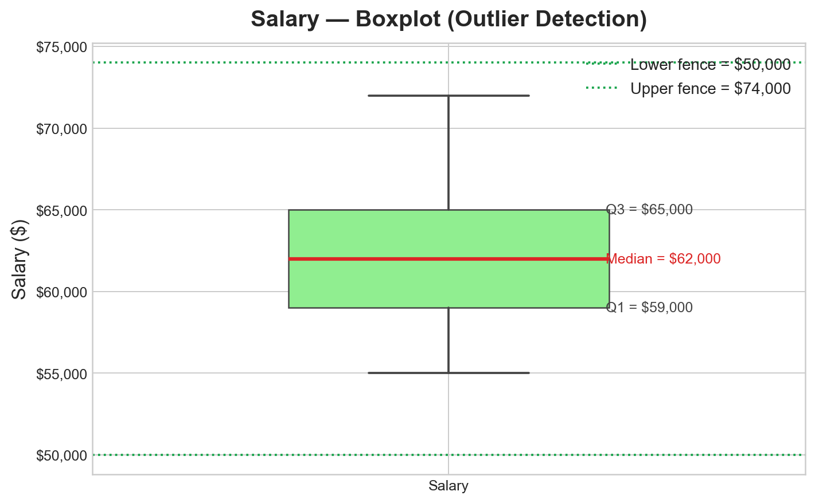
Chart 5 — Salary Boxplot (Outlier Check)
5
WHAT THIS CHART SHOWS
Boxplot of Salary with IQR fence
lines for outlier detection.
Green dotted = lower/upper fences.
HOW IT WAS GENERATED
ax.boxplot(df['Salary'])
Fences: Q1-1.5×IQR, Q3+1.5×IQR
Dollar-formatted y-axis labels
KEY OBSERVATIONS
Q1 = $59,000 | Q3 = $65,000
Median = $62,000
IQR = $6,000
Lower fence = $50,000
Upper fence = $74,000
✅ All 9 salary values within fences
Data Cleaning & Visualization | Mukesh | May 2026

Slide 12
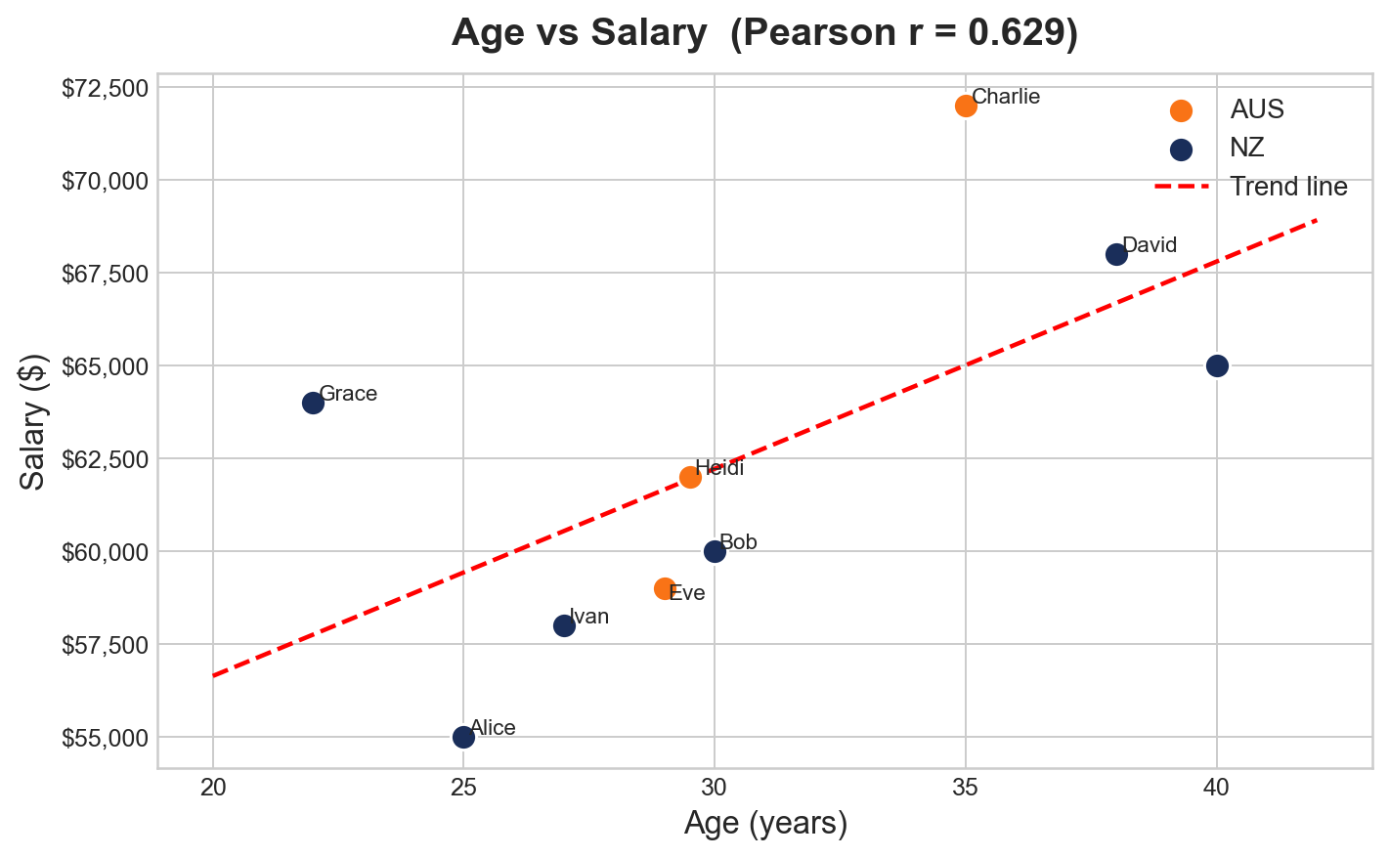
Chart 6 — Age vs Salary Scatter Plot
6
WHAT THIS CHART SHOWS
Scatter plot of Age vs Salary.
Color = country (NZ/AUS).
Red dashed = linear trend line.
HOW IT WAS GENERATED
ax.scatter() grouped by Country
np.polyfit() for trend line
adjust_text() for name labels
Pearson r shown in chart title
KEY OBSERVATIONS
Pearson r = +0.629 (moderate-strong)
Clear upward trend: older → higher salary
David (38, $68K) and Charlie (35, $72K)
Alice (25, $55K) is youngest
NZ and AUS follow the same trend
Data Cleaning & Visualization | Mukesh | May 2026

Slide 13
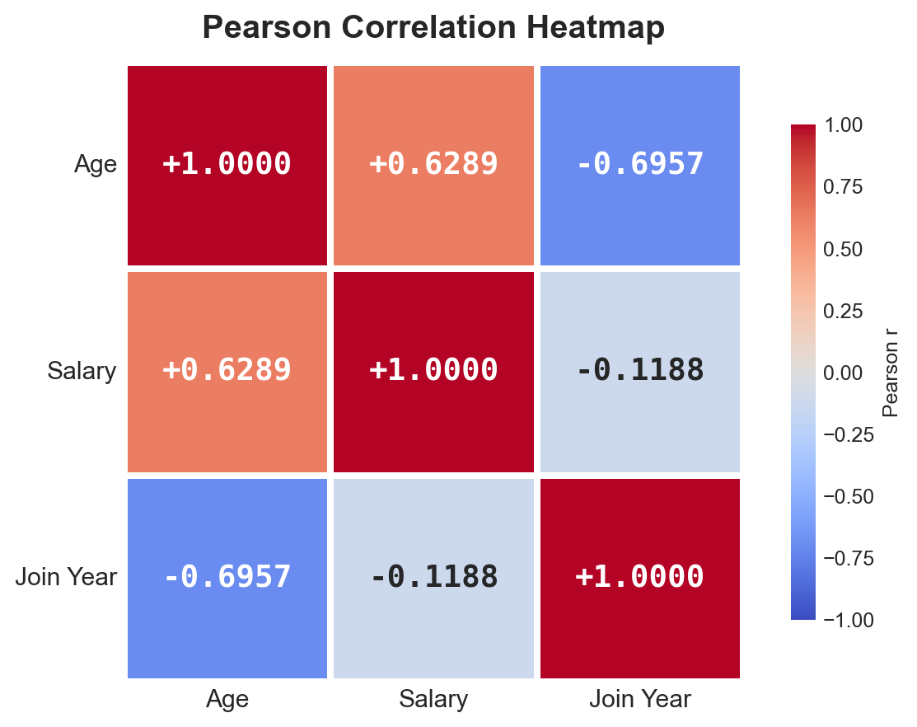
Chart 7 — Pearson Correlation Heatmap
7
WHAT THIS CHART SHOWS
Heatmap of the 3×3 Pearson
matrix for Age, Salary, Join Year.
Red=positive, Blue=negative.
HOW IT WAS GENERATED
df.corr(method='pearson')
sns.heatmap(cmap='coolwarm')
center=0, vmin=-1, vmax=1
Values annotated in each cell
KEY OBSERVATIONS
Age ↔ Salary: r = +0.6289
Age ↔ Join Year: r = −0.6957
Salary ↔ Join Yr: r = −0.1188
Diagonal = 1.0000 (self-correlation)
Strongest link: Age and Join Year
Data Cleaning & Visualization | Mukesh | May 2026

Slide 14
Key Findings & Insights
$62,556
30.6 yrs
NZ: 6 | AUS: 3
0
Average Salary
Average Age
Country Split
Outliers Found
No outliers detected — all Age values in [15.0, 47.0] and all Salary values in [$50K, $74K]
Moderate-strong positive correlation: Age ↔ Salary (r = +0.629) — older employees earn more
Strong negative correlation: Age ↔ Join Year (r = −0.696) — older employees joined earlier
Weak negative correlation: Salary ↔ Join Year (r = −0.119) — nearly independent
Dataset cleaned from 10 identified issues to 0 remaining NaNs (Name for ID=7 unfixed by design)
NZ dominates headcount: 6 of 9 employees (67%) are from New Zealand
Data Cleaning & Visualization | Mukesh | May 2026

Slide 15
Final Cleaned Dataset
9 employees — complete, validated data (Name for ID=7 could not be recovered)
ID | Name | Age | Country | Salary ($) | Join Date
1 | Alice | 25.0 | NZ | 55,000 | 2020-01-15
2 | Bob | 30.0 | NZ | 60,000 | 2020-02-20
4 | Charlie | 35.0 | AUS | 72,000 | 2020-01-15 *
5 | David | 38.0 | NZ | 68,000 | 2019-11-01
6 | Eve | 29.0 | AUS | 59,000 | 2020-01-15 *
7 | (unknown) | 40.0 | NZ | 65,000 | 2018-05-30
8 | Grace | 22.0 | NZ | 64,000 | 2021-07-25
9 | Heidi | 29.5 † | AUS | 62,000 | 2021-07-25
10 | Ivan | 27.0 | NZ | 58,000 | 2019-03-15
* Join Date imputed using median date (2020-01-15) † Age imputed using column median (29.5)
Data Cleaning & Visualization | Mukesh | May 2026

Slide 16
Conclusion
✅ Identified and resolved 10 data quality issues across 10 raw rows
🔧 Applied type conversion, deduplication, imputation & standardization
📐 IQR detection: 0 outliers — Age in [15, 47], Salary in [$50K, $74K]
📊 Pearson: Age↔Salary r=+0.63 (positive), Age↔Join Year r=−0.70 (negative)
🎨 Generated and explained 7 individual visualizations at 180 DPI
🏁 Final dataset: 9 employees, clean and ready for analysis
Tools: Python 3 · Pandas · NumPy · Matplotlib · Seaborn · adjustText

