Slide 1
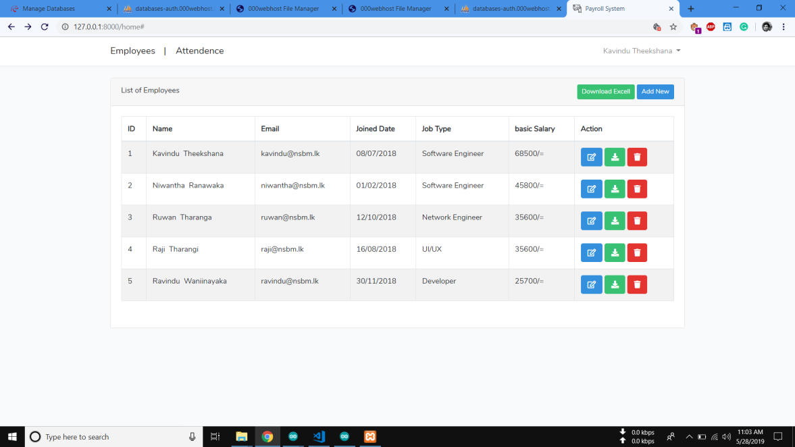
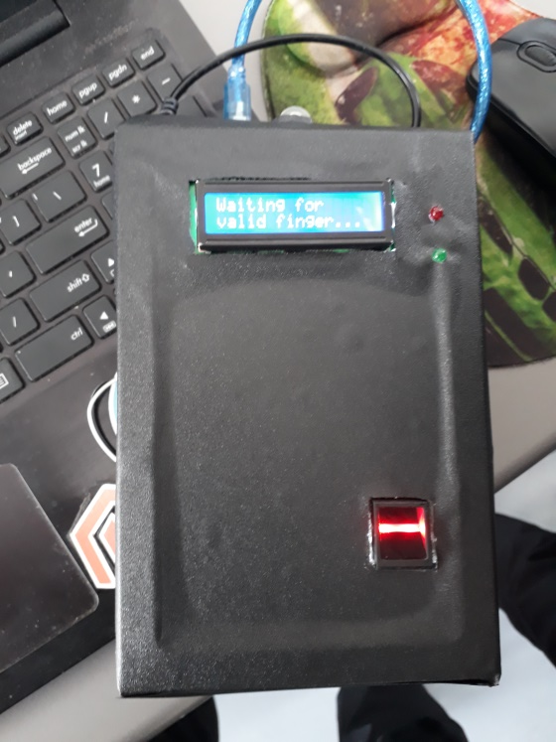
What We Made
Fully Automated Payroll System

Slide 2
What are the Tools We Used to Create It
Softwares
Hardwares
Laravel PHP Framework
My SQL API
Fingerprint Scanner
Node MCU
LED Display
Ardino UNO

Slide 3
API
Data save through creating an API using Cloud Base My SQL

Slide 4
Laravel Framework
Created Web Application using Laravel Framework.
Web Application can use only for the Admin.
Data (Such as attendance, monthly salary, working hours) of the Database can view on Web Application.
Paysheet can download using Web Application.

Slide 5
Ardinoboard, Node UNO and Node MCU
Programmed using Ardino IDE
Programed Using Adafruit Library
Making Circuit Architecture

Slide 6
THANKYOU!

