Slide 1
4 - Accounting and Finance
Definition of Accounting
“The process of identifying, measuring and communicating economic information to permit informed judgments and decisions by users of the information ” - American Accounting Association
Users of financial statements
Owners/Shareholders , Management , Employees , Suppliers , Customers , Lenders , Government , Potential Investors
General Public
Elements of Accounting
Assets Capital Income
Liabilities Expenditure

Slide 2
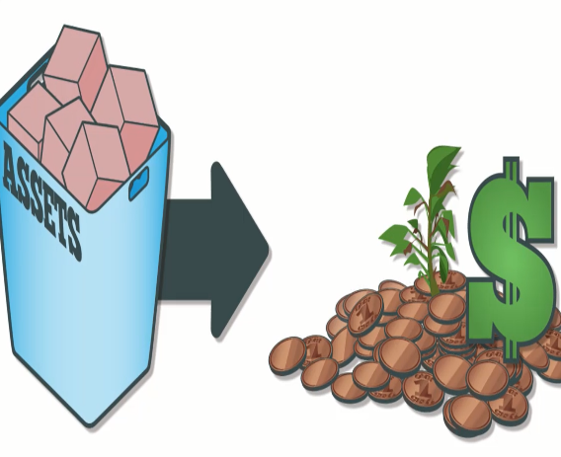
What is an Asset?
Asset is a resource controlled by the business from which future economic benefits are expected to flow, arising out of past transaction or event.
The three essential characteristics of assets are;
Future economic benefits
Owned or controlled by the business
Arisen from past event or transaction

Slide 3


Categorization of Assets-I
Fixed Assets
  Are not bought primarily to be sold
  Are bought to be used in the business
  Are expected to be of use to the business for a long time.
  E.g. Land, buildings, machinery, vehicles
  Current Assets
  Are likely to change in the short term and certainly within twelve months of the balance sheet date.
    E.g. Stocks, debtors , cash in hand and bank

Slide 4
Categorization of Assets - II
Tangible Assets
Are assets that have a physical existence (i.e. they can be touched).
E.g. Buildings, machinery, land, vehicles
Intangible Assets
Are identifiable non-monetary assets that can not be seen, touched, or physically measured, which are created through time and/ or effort and that are identifiable as a separate asset.
E.g. Goodwill, patents, copyrights, trade marks, brand names

Slide 5
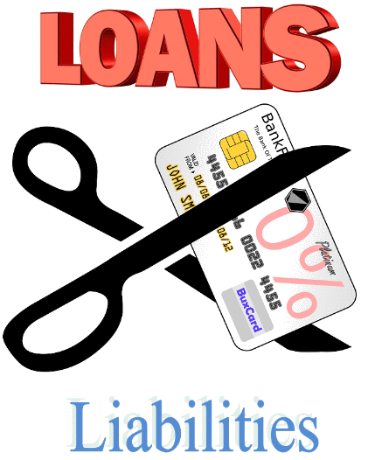
What is a Liability?
Present obligation of the entity arisen from past events, the settlement of which is expected to result in an outflow from the entity’s resources embodying economic benefits.
Current Liabilities
E.g. Bank ODs, trade creditors
Long-term liabilities
E.g. Long-term bank loans, Debentures

Slide 6

What is Capital?
Capital is an investment of money (funds) in a business with the intention of earning a return.
In other words, residual in the assets of the entity after deducting all it’s liabilities.
E.g. Sole proprietor – personal funds
Company – share capital

Slide 7

What is an Income?
Increase in economic benefits during the accounting period in the form of inflows, which eventually results in receiving money. Revenue increases profits.
E.g. sales revenue, interest received

Slide 8
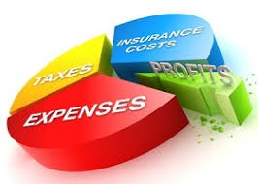
What is an expense?
Decrease in economic benefits during the accounting period in the form of out flow. Costs used up in the activities of the organization.
E.g. inventories consumed
electricity consumed
advertising costs

Slide 9
The Accounting Equation
ASSETS = CAPITAL +LIABILITIES
Assets of the business show what resources the business owns & controls.
Liabilities & capital show who contributed these resources to the business and how much each group contributed.
E.g.
Assets = Owner’s equity + Liabilities
1,750,000 = 1,000,000 + 750,000

Slide 10
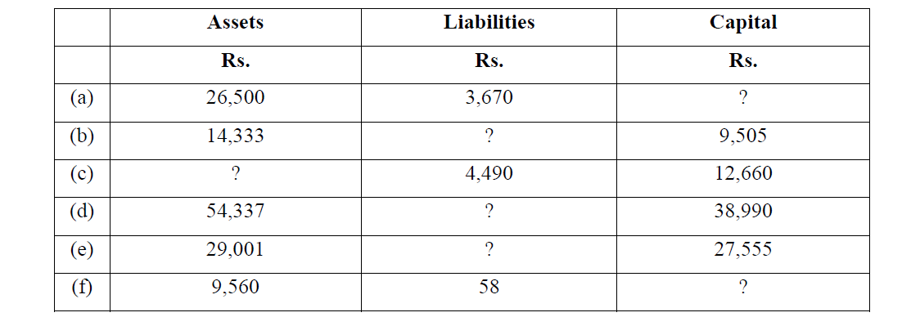
Activity 1-Complete the gaps in the following table

Slide 11
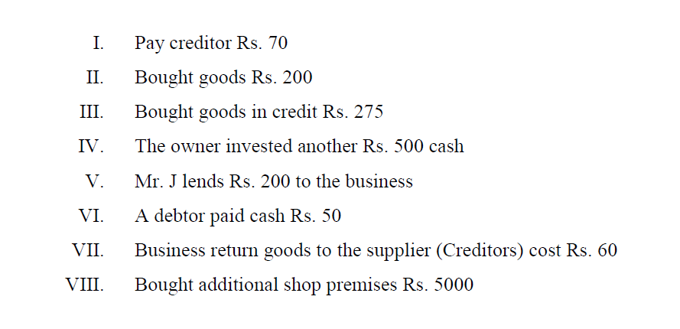
Activity 2-
Apply following transactions to the Accounting equation.

Slide 12
Process of Financial Accounting
Source document
Day Books / Journals
Ledger (Accounts)
Trial Balance
Financial Statements : Trading and Profit & Loss A/c, Balance Sheet
Interpretation of Financial Statements : Ratio Analysis

Slide 13
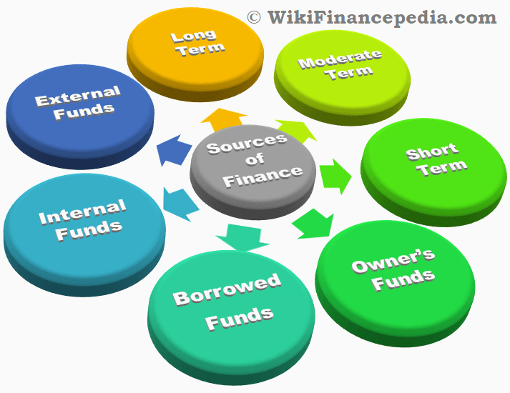
Sources of Finance

Slide 14
Types of Sources of Finance
Internal sources : Finance that come from owners.
External sources : Finance provided by banks, other institutional lenders and creditors.

Slide 15
Internal Sources of Finance
Own capital-This is a common source of finance especially for start up business that provide by the individuals who form the business – entrepreneurs.
Personal Saving –The amount of money that a business person or partner has at their disposal
Sale of assets –Business can raise funds by selling its assets where they could finance in new activities or pay- off debts.

Slide 16
External Sources of Finance
Debentures – debentures are secured loans and are said to have either fixed or floating charges with them.
Overdraft facilities – Short term loan arrangement made with bank on current accounts.
Hire purchase – method of acquiring assets without having to invest full amount in buying them.
Bank loans – long term source of finance often used to buy fixed assets such as machinery ,vehicles ,etc.

