Slide 1

clustering
Data Science & analytics (it3080)

Slide 2
Overview
Supervised and unsupervised learning
What is a cluster and cluster analysis?
Applications of cluster analysis
Methods of clustering
K-means algorithm
Hierarchical clustering

Slide 3
Learning outcomes
Compare and contrast supervised and unsupervised learning
Explain what is cluster analysis
Identify applications of cluster analysis
Apply k-means algorithm for cluster analysis
Apply Agglomerative hierarchical clustering

Slide 4
Supervised learning
Supervised learning is a learning in which we teach or train the machine using data which is well labeled that means some data is already tagged with the correct answer.
  Ex: In the email spam filter problem, we have a dataset of emails with all the text within each and every email.
  We also know which of these emails are spam or not (the so-called labels).
  These labels are very valuable in helping the supervised learning to separate the spam emails from the rest.
Classification and regression are common examples for supervised learning.

Slide 5
Unsupervised learning
In unsupervised learning, labels are not available.
  Ex: Consider the email spam filter problem, this time without labels.
  To identify a spam email, now the underlying structure of emails should be understood and emails should be separated into different groups such that emails within a group are similar to each other but different from emails in other groups.
Clustering is the most common type of unsupervised learning.

Slide 6
What is cluster analysis?
Cluster analysis or simply clustering is the process of partitioning a set of data objects (or observations) into subsets.
Each subset is a cluster, such that objects in a cluster are similar to one another, yet dissimilar to objects in other clusters.
The goal of clustering is to maximize the similarity of observations within a cluster and maximize the dissimilarity between clusters.

Slide 7
What is cluster analysis? (Contd.)
Cluster analysis does not have any labels
When cluster analysis is done, the analyst is not aware of number of clusters that are available, whether they are correct or whether they are useful
Labelling outputs is up to the analyst or other stake holders

Slide 8
An example
Notes:
Here I’m showing some data to cluster
Let’s say high-D data, but projected it down to 2 most important dimensions for clustering
It’s obvious to us even with 2-D projection that red points shouldn’t be in same cluster
But, standard clustering algorithm like GAC needs to compare these using all dimensions of the data
However, different story for the blue points.
Here, using the projection, we don’t know if they are in the same cluster.
We’d want to use the high-D metric to determine if there should be clustered together or apart.
We can encode exactly this type of information in an overlapping clustering of the data created by the inexpensive distance metric

Slide 9
An example
Notes:
Here I’m showing some data to cluster
Let’s say high-D data, but projected it down to 2 most important dimensions for clustering
It’s obvious to us even with 2-D projection that red points shouldn’t be in same cluster
But, standard clustering algorithm like GAC needs to compare these using all dimensions of the data
However, different story for the blue points.
Here, using the projection, we don’t know if they are in the same cluster.
We’d want to use the high-D metric to determine if there should be clustered together or apart.
We can encode exactly this type of information in an overlapping clustering of the data created by the inexpensive distance metric

Slide 10
Applications of cluster analysis
  Information retrieval/organization: topic-based news
  Land use: Identification of areas of similar land use in an earth observation database
  Marketing: Help marketers discover distinct groups in their customer bases, and then use this knowledge to develop targeted marketing programs
  Social network mining: special interest group automatic discovery

Slide 11
Clustering methods
Partitioning Method
Hierarchical Method
Density-based Method
Fuzzy clustering
Model-Based Method

Slide 12
Clustering methods – partitioning methods
Given a set of n objects, a partitioning method constructs k partitions of the data, where each partition represents a cluster and k<= n.
That is, it divides the data into k groups such that each group must contain at least one object.
Most partitioning methods are distance-based.

Slide 13
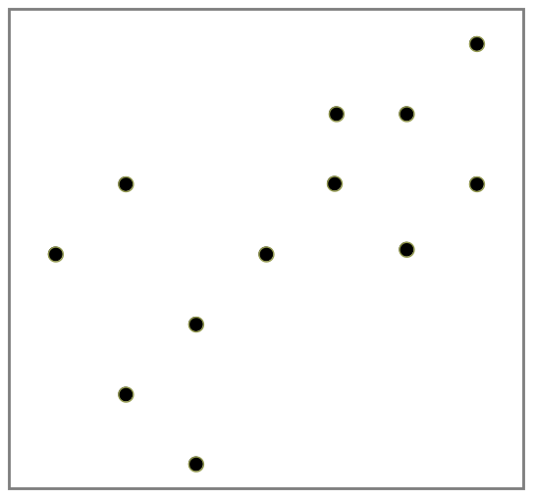
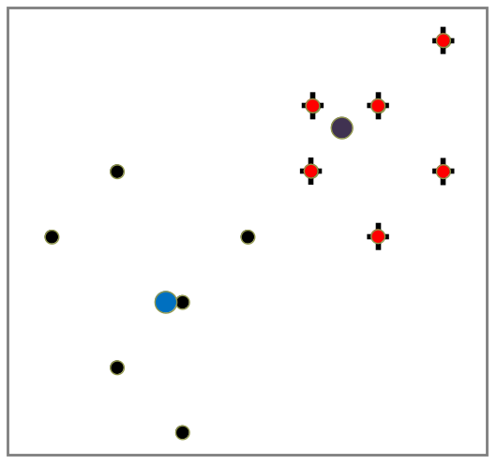
Clustering methods – partitioning methods
Typical methods: K-means, K-medoids, CLARANS, ……

Slide 14
Clustering methods – Hierarchical methods
Hierarchical method creates a hierarchical decomposition of the given set of data objects.
A hierarchical method can be classified as being either agglomerative or divisive, based on how the hierarchical decomposition is formed.
  The agglomerative approach, also called the bottom-up approach, starts with each object forming a separate group.
    It successively merges the objects or groups close to one another, until all the groups are merged into one
  The divisive approach, also called the top-down approach, starts with all the objects in the same cluster.
    In each successive iteration, a cluster is split into smaller clusters, until eventually each object is in one cluster, or a termination condition holds.

Slide 15
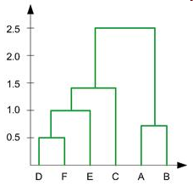
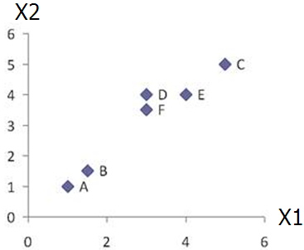
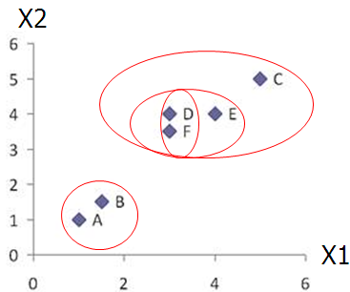
Clustering methods – Hierarchical methods
Typical methods: Agglomerative, Diana, Agnes, BIRCH, ROCK

Slide 16
Clustering methods – Density-Based methods
Most partitioning methods cluster objects based on the distance between objects.
Such methods can find only spherical-shaped clusters and encounter difficulty in discovering clusters of arbitrary shapes.
Other clustering methods have been developed based on the notion of density.
Their general idea is to continue growing a given cluster as long as the density (number of objects or data points) in the “neighborhood” exceeds some threshold.
For example, for each data point within a given cluster, the neighborhood of a given radius has to contain at least a minimum number of points.
Such a method can be used to filter out noise or outliers and discover clusters of arbitrary shape

Slide 17
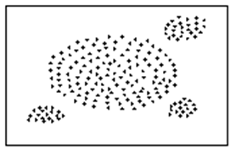
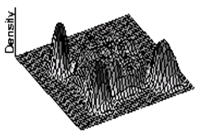
Clustering methods – Density-Based methods
Typical methods: DBSACN, OPTICS, DenClue

Slide 18
Clustering procedure- what is to consider?
Choosing variables
Similarity and dissimilarity measurement
Standardization
Weights and thresholds

Slide 19
Choosing variables
Select relevant variables
  Ex: identifying which type of drivers are at high risk of insurance claims
    Relevant variables : age, penalties, marital status
    Irrelevant : height, weight of vehicle
  Inclusion of a variable such as the height or weight of an automobile may adversely affect the outcome of the categorization because they are not relevant to the problem.
fewer the better to adequately address the problem

Slide 20
Similarity and dissimilarity measurement
Similarity or dissimilarity refers to the likeness of two objects.
A proximity measure can be used to describe similarity or dissimilarity.
There are several techniques in widespread use to determine the proximity of one object in relation to another.
Ex: Euclidean distance

Slide 21
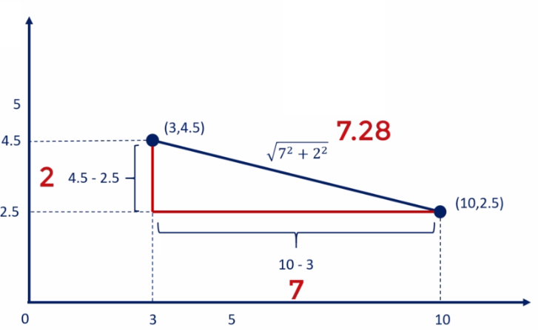
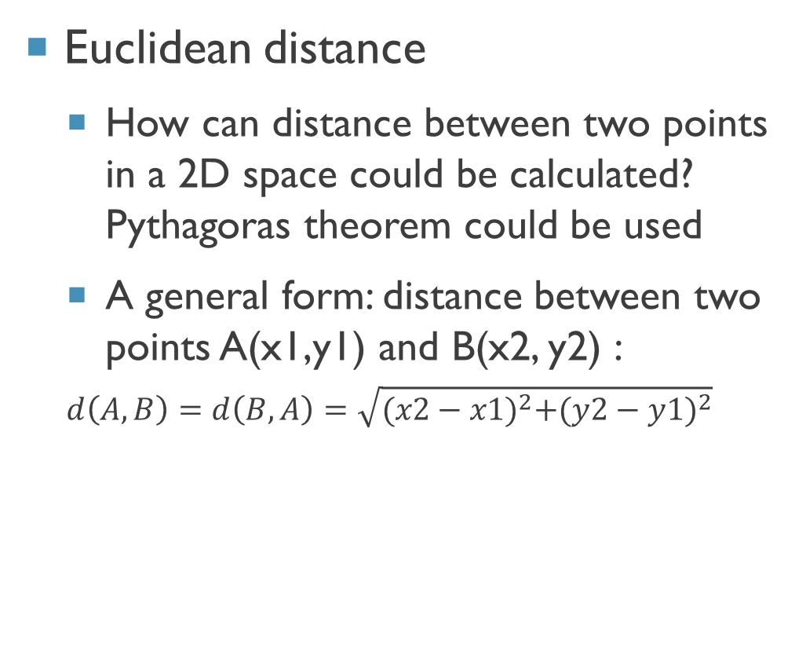
Similarity and dissimilarity measurement(contd.)
Euclidean distance
  How can distance between two points in a 2D space could be calculated? Pythagoras theorem could be used
  A general form: distance between two points A(x1,y1) and B(x2, y2) :
  $$d\left(A,B\right)=d\left(B,A\right)=\sqrt{{(x2−x1)}^{2}+{(y2−y1)}^{2}}$$

Slide 22
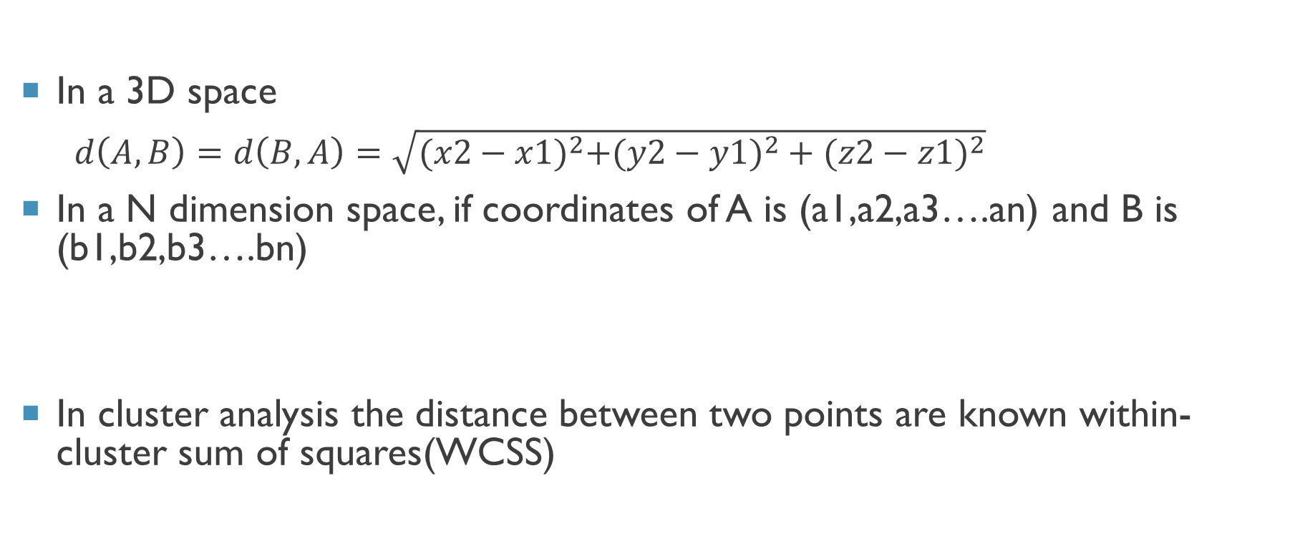
Similarity and dissimilarity measurement(contd.)
In a 3D space
$d\left(A,B\right)=d\left(B,A\right)=\sqrt{{(x2−x1)}^{2}{+(y2−y1)}^{2}+{(z2−z1)}^{2}}$
In a N dimension space, if coordinates of A is (a1,a2,a3….an) and B is (b1,b2,b3….bn)
In cluster analysis the distance between two points are known within-cluster sum of squares(WCSS)
$$d\left(A,B\right)=d\left(B,A\right)=\sqrt{{\left(a2−b1\right)}^{2}{\left.+(a2−b2\right)}^{2}+…+{\left(an−bn\right)}^{2}}$$

Slide 23
Standardization
When different variables are often represented in different dimensions (units) standardization of variables might be required.
The standardization of an attribute involves two steps:
  calculate the difference between the value of the attribute and the mean of all samples involving the attribute, and
  divide the difference by its standard deviation

Slide 24
K-means algorithm
With an input of k, which denotes the number of expected clusters, k centers or centroids will be defined that will facilitate defining the k partitions.
The centroid is (typically) the mean of the points in the cluster.
‘Closeness’ is measured by Euclidean distance, cosine similarity, correlation, etc.
Initial centroids are often chosen randomly.

Slide 25
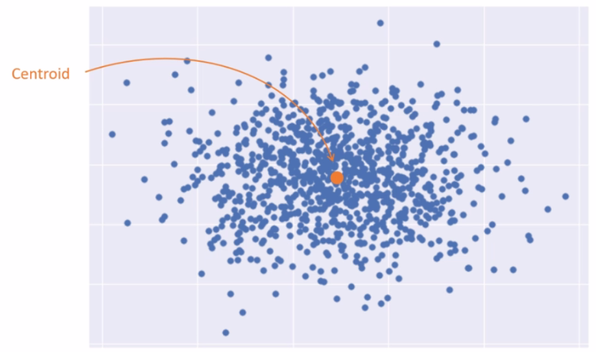
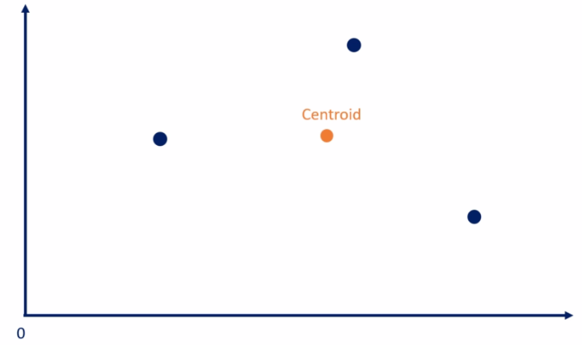
What is a centroid?
A centroid is the mean position of a group of points

Slide 26
K-means algorithm
Based on these centers (centroids), the algorithm identifies the members and thus builds a partition followed by the re-computation of the new centers based on the identified members.
This process is iterated until the clear, and optimal dissimilarities that make the partition really unique are exposed.
Hence, the accuracy of the centroids is the key for the partition-based clustering algorithm to be successful.

Slide 27
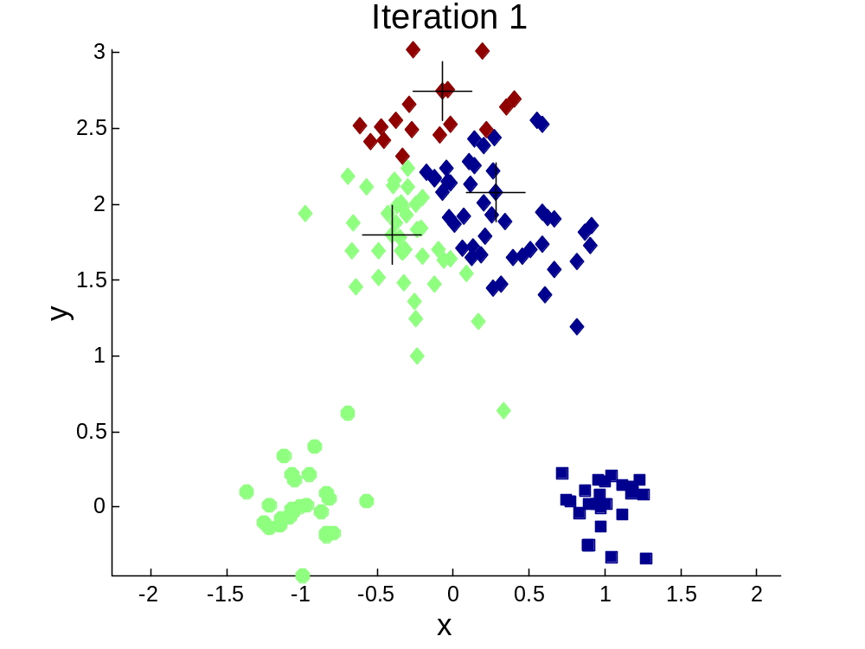
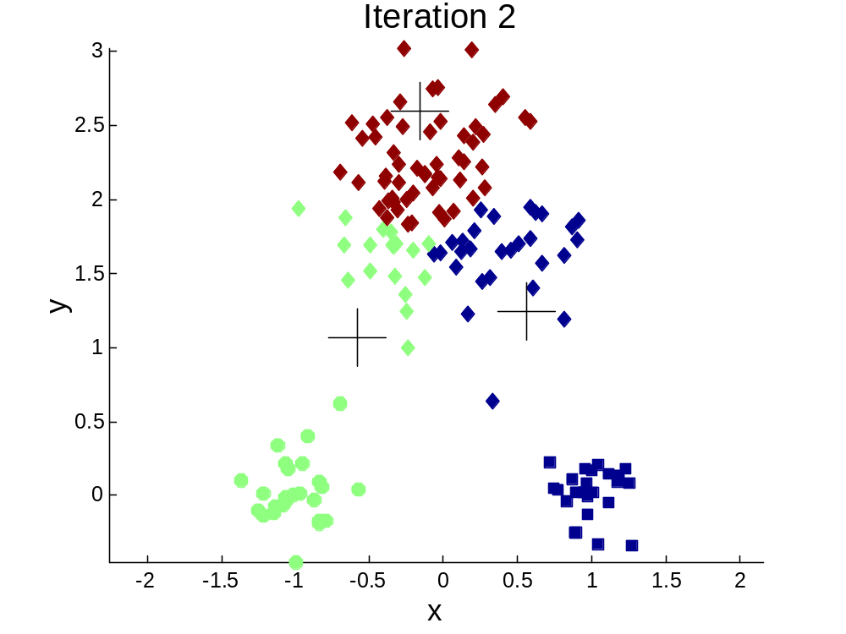
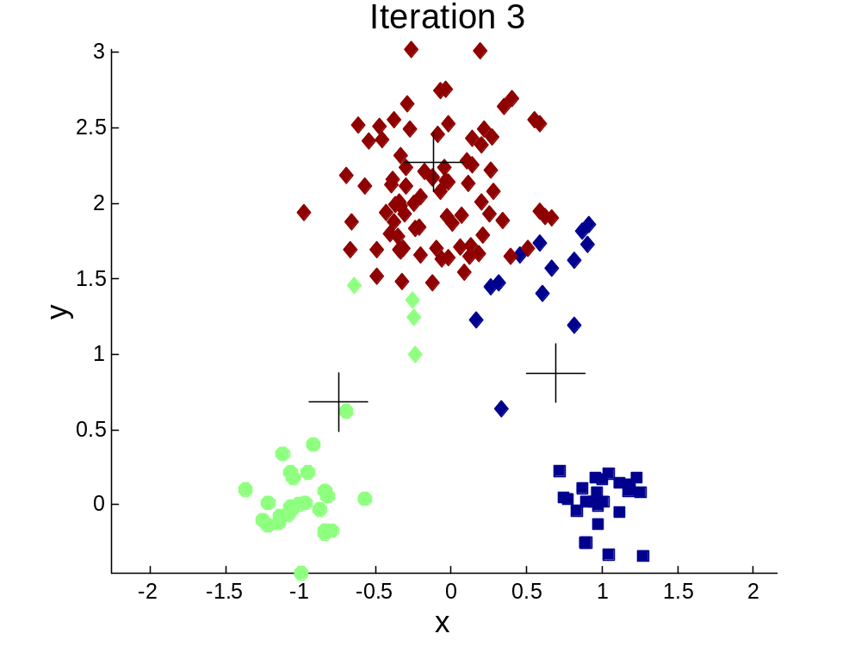
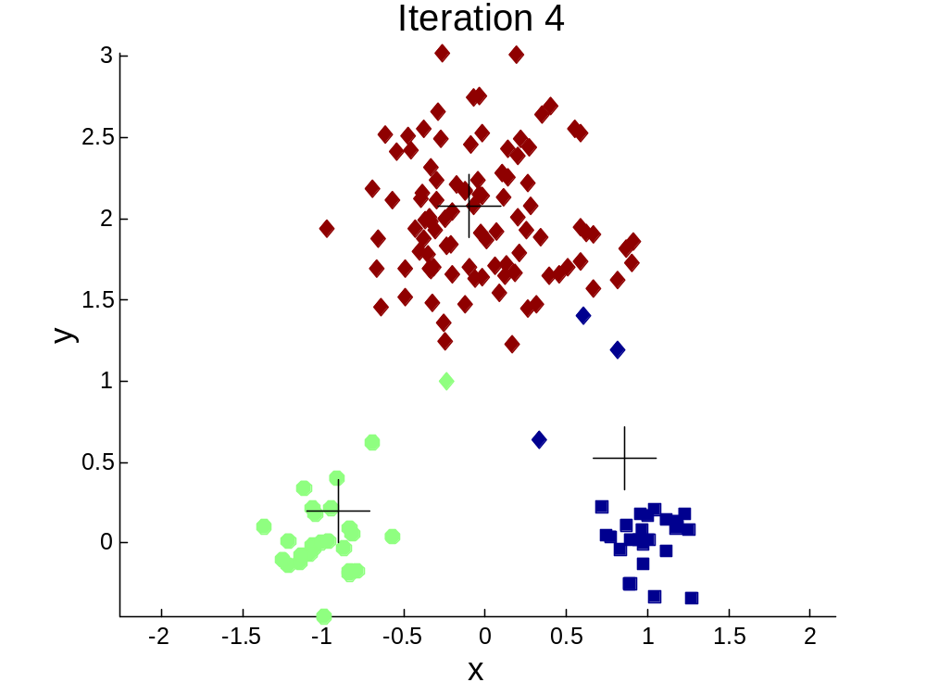


How the clusters are computed

Slide 28
K-means algorithm
Input: S (instance set), K (number of cluster)
Output: clusters
1: Initialize K cluster centers.
2: while termination condition is not satisfied do
  3: Assign instances to the closest cluster center.
  4: Update cluster centers based on the assignment.
5: end while

Slide 29
DEMO

Slide 30
Exercise
Consider the following observations. Assuming k=2 and initial centroids are A and C.
  Identify the observations belonging to each cluster after the first epoch
  Calculate the new centroid.
 | X | Y
A | 1 | 1
B | 1 | 0
C | 0 | 2
D | 2 | 4
E | 3 | 5

Slide 31
Limitations of k-means
K should be picked
Sensitive to initialization of centroids
Issues in clustering data of varying sizes and density.
Sensitive to outliers
Produce spherical solutions since Euclidean distance from centroids are used

Slide 32
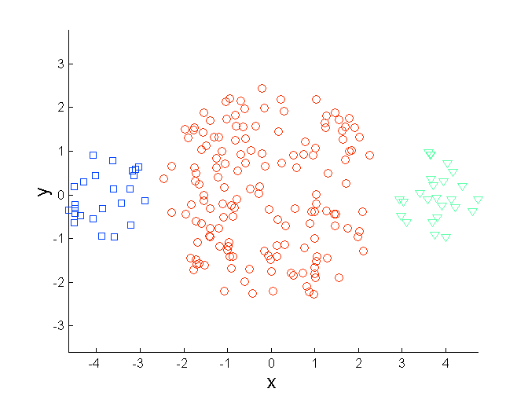
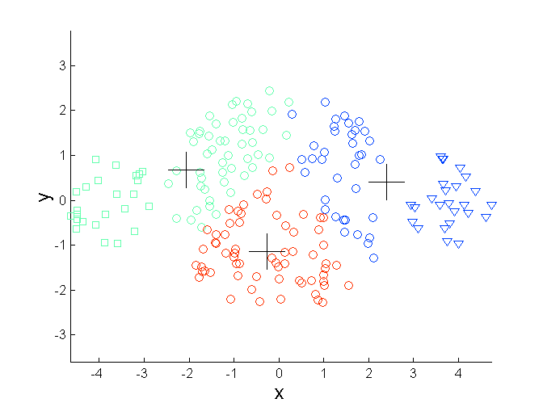
Limitations of k-means (Contd.)
Original Points
K-means (3 Clusters)

Slide 33
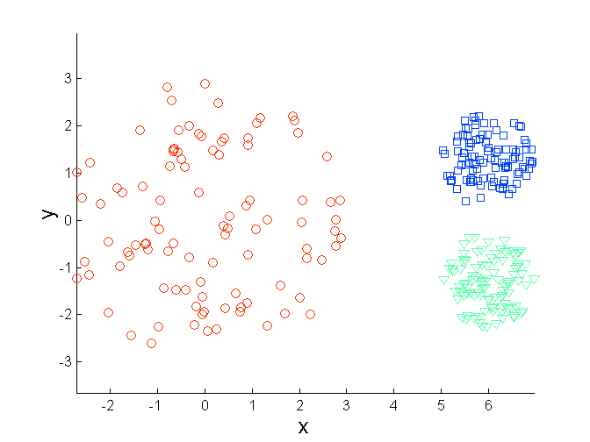
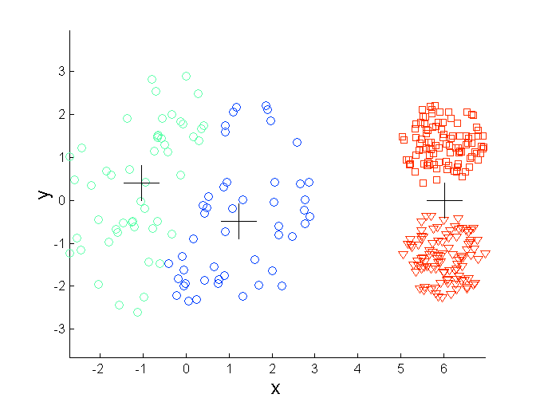
Limitations of k-means (Contd.)
Original Points
K-means (3 Clusters)

Slide 34
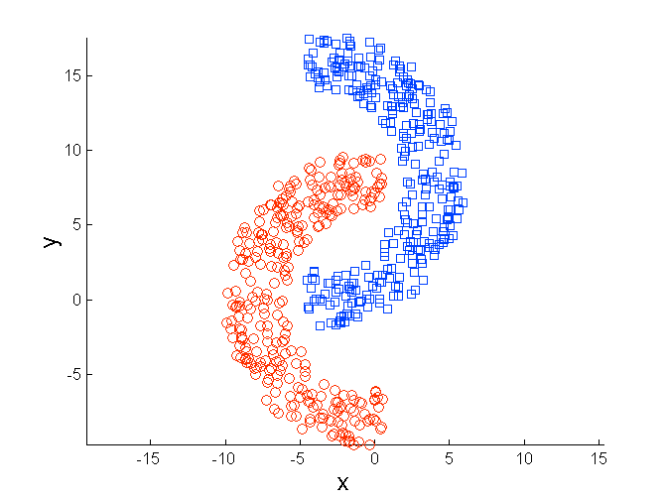
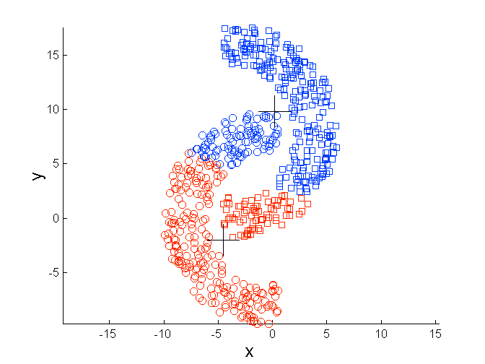
Limitations of k-means (Contd.)
Original Points
K-means (2 Clusters)

Slide 35
The optimal number of clusters
Minimizing WCSS leads to the perfect clustering solution
WCSS=0 when there is one point in every cluster, which is useless
Ideally it is required to have a small number for WCSS while having small number of clusters

Slide 36
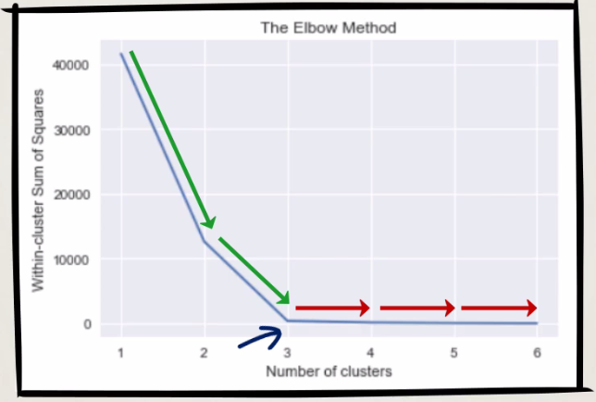
Elbow method
When WCSS is plotted against the number of clusters, a graph which looks like an elbow is resulted.
At the beginning WCSS declining extremely.
But once it reaches the elbow not so much.
The biggest number of clusters for which there is still a significant amount of decrease in WCSS is the best candidate for the number of clusters.

Slide 37
Hierarchical clustering
Hierarchical clustering mainly involves transforming a proximity matrix, into a sequence of nested partitions.
The sequence can be represented with a tree-like dendrogram in which each cluster is nested into an enclosing cluster.
Hierarchical algorithms can be further categorized into two kinds: agglomerative and divisive

Slide 38
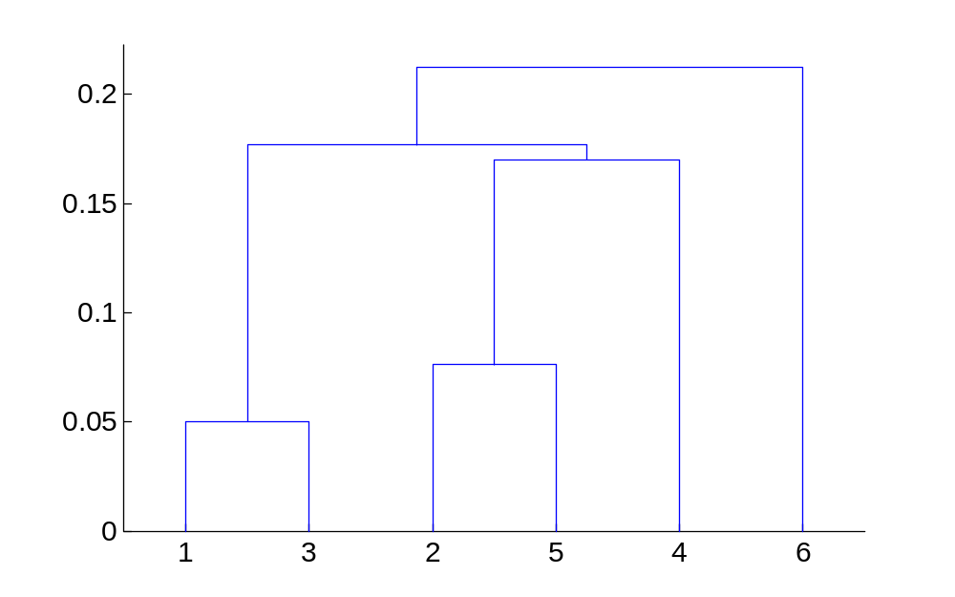
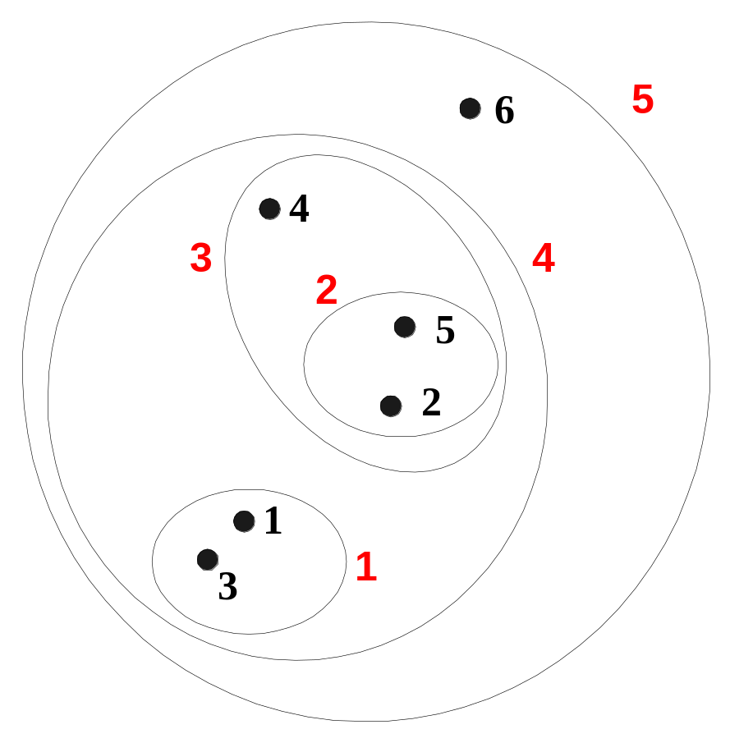
An example

Slide 39
Dendogram: Hierarchical Clustering
Clustering obtained by cutting the dendrogram at a desired level: each connected component forms a cluster.

Slide 40
Agglomerative hierarchical clusters
An agglomerative algorithm starts with a disjoint clustering, which places each of the n objects in a cluster by itself and then merges clusters based on their similarities.
The merging continues until all the individual objects are grouped into a single cluster.
Whenever a merger occurs, the number of clusters is reduced by one.
The similarities between the new merged cluster and any of the other clusters need to be recalculated.

Slide 41
Agglomerative hierarchical clusters
Basic algorithm is straightforward
  Compute the proximity matrix
  Let each data point be a cluster
  Repeat
  Merge the two closest clusters
  Update the proximity matrix
  Until only a single cluster remains

Slide 42
Similarity measurement
The similarity measurement with the Euclidean distance can be determined by minimum, maximum, average, or centroid distance between two clusters to be merged.
There are four hierarchical clustering methods corresponding to each criterion.
They are called single-link, complete-link, group-average, and centroid clustering methods, respectively

Slide 43
Similarity measurement (contd.)
The single-link and complete-link methods consider the distance between each individual object in each cluster
The group-average method concerns the distances of all objects in the clusters.
In the centroid method, the distance between two clusters is defined as the (squared) Euclidean distance between their centroids.

Slide 44
Similarity measurement (contd.)
Single-link
Complete-link
×
×
Group Average
Centroid Clustering

Slide 45
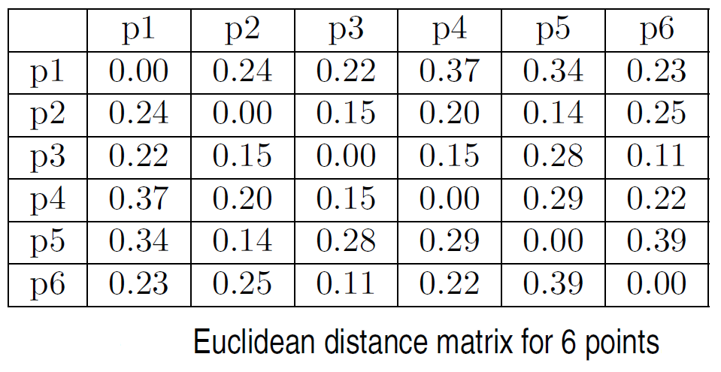
Example

Slide 46
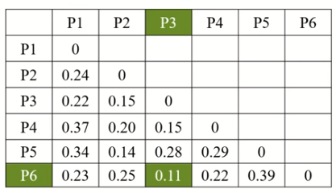
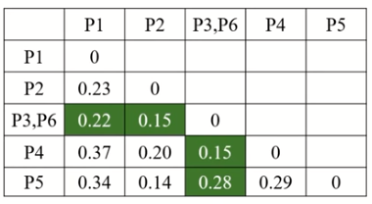
Example - Single-Link
1
0.2
5
2
1
0.15
3
6
0.1
4
0.05
0
3
6
2
5
4
1

Slide 47
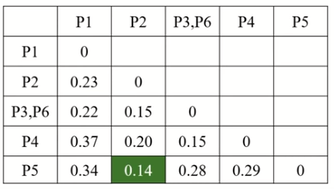
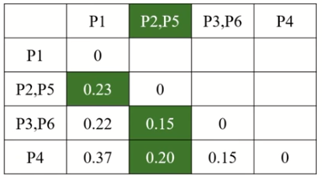
Example - Single-Link (Contd.)
1
0.2
5
2
1
0.15
2
3
6
0.1
0.05
4
0
3
6
2
5
4
1

Slide 48
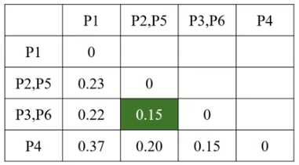
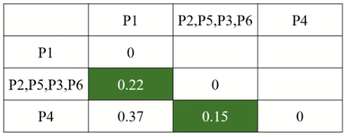
Example - Single-Link (Contd.)
1
3
0.2
5
0.15
2
1
2
3
6
0.1
4
0.05
0
3
6
2
5
4
1

Slide 49
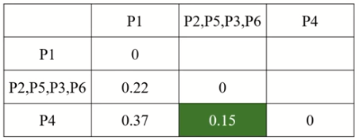
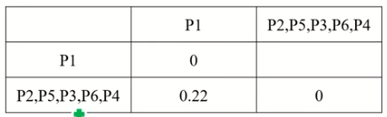
Example - Single-Link (Contd.)
1
3
0.2
5
2
1
0.15
2
3
6
0.1
4
0.05
4
0
3
6
2
5
4
1

Slide 50
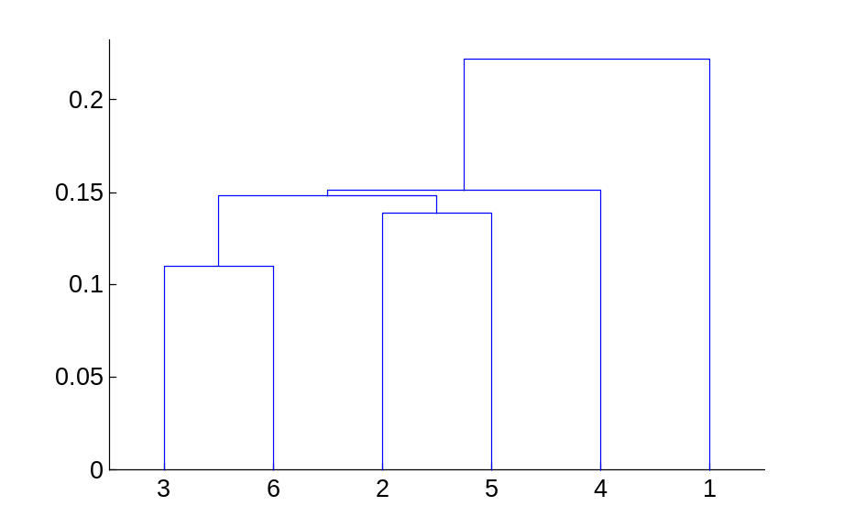
Example - Single-Link (contd.)
5
1
3
5
2
1
2
3
6
4
4

Slide 51
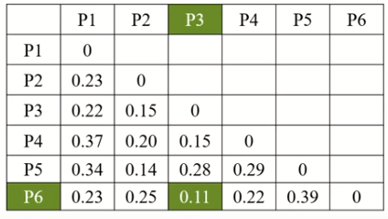
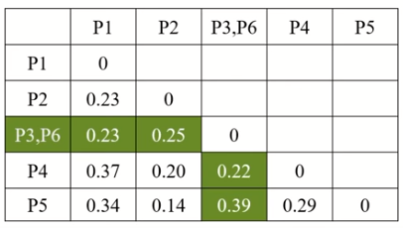
Example - Complete-Link
1
0.2
5
2
1
0.15
3
6
0.1
0.05
4
0
3
6
2
5
4
1

Slide 52
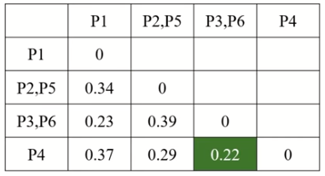
Example - Complete-Link (contd.)
1
0.2
5
0.15
2
1
2
3
6
0.1
0.05
4
0
3
6
2
5
4
1
1
2
0.4
5
0.35
2
0.3
0.25
3
6
0.2
3
1
0.15
0.1
4
0.05
0
3
6
4
1
2
5

Slide 53
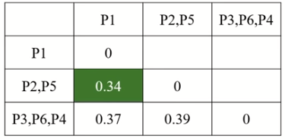
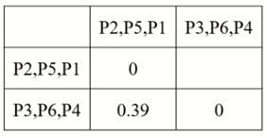
Example - Complete-Link (contd.)
4
1
2
0.4
0.35
5
0.3
2
0.25
3
6
0.2
3
1
0.15
0.1
4
0.05
0
3
6
4
1
2
5

Slide 54
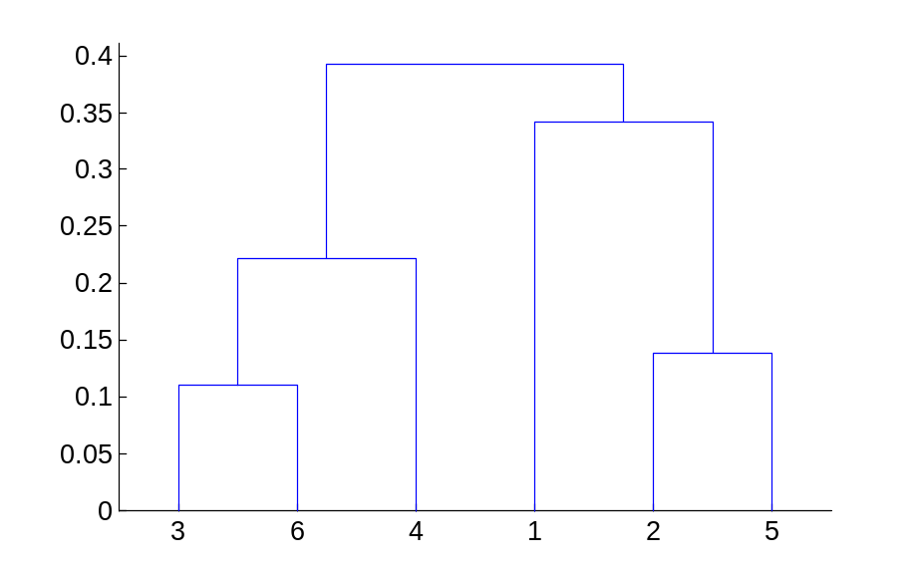
Hierarchical clustering : complete-link
4
1
2
5
5
2
3
6
3
1
4

Slide 55
DEMO

Slide 56

Thank You

