Slide 1

regression
Data Science & analytics (it3080)

Slide 2
Overview
Applications of regression
Simple linear-regression
Least square method
Determinants of a good regression
Multiple regression

Slide 3
Lesson learning outcomes
Identify applications of regression
Explain determinants of a good regression
Develop a simple linear regression model for a given dataset
Interpret results obtained by application of simple and multiple regression in python.

Slide 4
Introduction to regression
Regression analysis is a statistical technique for investigating and modeling the relationship between variables.
It is also one of the most common methods of prediction
The technique concerned with predicting some variables by knowing others
More precisely regression attempts to explain the variation in a dependent variable using the variation in independent variables.
It is used whenever there is a causal relationship between variables

Slide 5
Applications of regression analysis
Prediction of
  Economy growth
  Sales,
  Product prices & etc.
Optimizing business processes
Generate insights on consumer behavior

Slide 6
Procedure of regression analysis
Select some sample data
Design a model that works for that sample
Make the prediction for the population based on the model developed.
  Population: is a group of phenomena that have something in common.
  Sample: is a smaller group of members of a population selected to represent the population

Slide 7
Linear regression
Linear regression assumes linear dependence between two or more variables: constant rate of increase of one variable with respect to another.
Examples:
    Income and educational level
    Demand for electricity and the weather
    Home sales and interest rates

Slide 8
Linear regression (contd.)
Assume Y is a dependent variable which is being predicted.
Assume x₁, x₂, x₃ …., x_{k} are independent variables which are predictors.
In linear regression we assume that Y is a function of the independent variable x₁ to x_{k} which could be denoted as
Y= F(x₁, x₂, x₃ …., x_{k} )
Simple linear regression which considers only one independent variable is the simplest form of linear regression

Slide 9
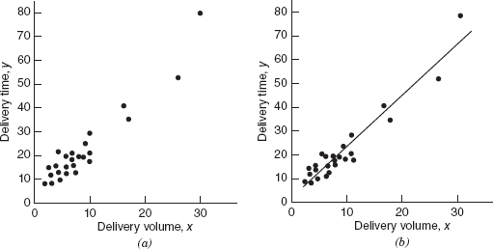
Simple linear regression - An example
Suppose we assume that there is a linear relationship between your years of education and salary.
We collect data from a number of people regarding their education and salary.
When we plot the data using a scatter plot as shown in figure we can clearly suggests a linear relationship between years of education and salary.
The data points in the plot generally, but not exactly, fall along a straight line.

Slide 10
An example (contd.)
If y represent salary and x represent years of education, then the equation of a straight line relating these two variables could be shown in the format : y= β₀ + β₁x+є
    β₀ is the intercept and β₁ is the slope.
    The data points do not fall exactly on a straight line and it should be reflected in the equation.
    error ε is the the difference between the observed value of y and the straight line (β₀ + β₁x)

Slide 11
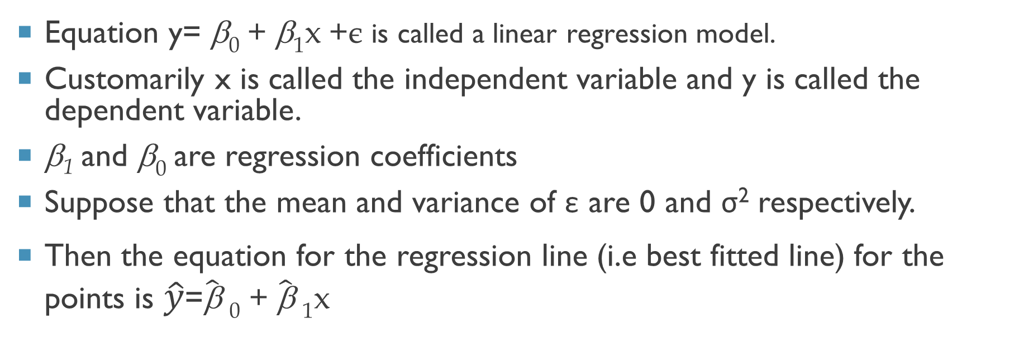
Simple linear regression model
  Equation y= β₀ + β₁x +є is called a linear regression model.
  Customarily x is called the independent variable and y is called the dependent variable.
  β₁ and β₀ are regression coefficients
  Suppose that the mean and variance of ε are 0 and σ² respectively.
  Then the equation for the regression line (i.e best fitted line) for the points is $\hat{y}$=$\hat{\text{β}}$ ₀ + $\hat{\text{β}}$ ₁x

Slide 12
Assumptions of simple linear regression
Linearity: The existing relation between X and Y is linear
Homogeneity: The mean value of the error is zero
Homoscedasticity: The variance of the errors is constant
Normality: The predicted variable and errors follow a normal distribution

Slide 13
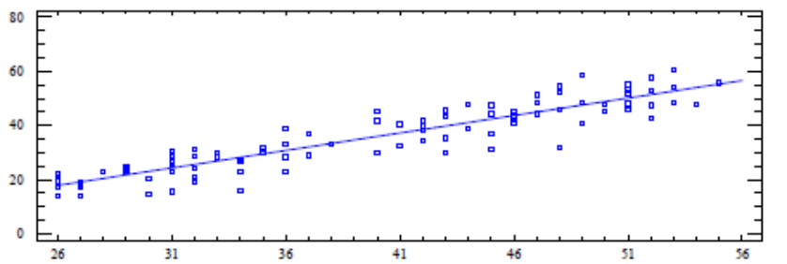
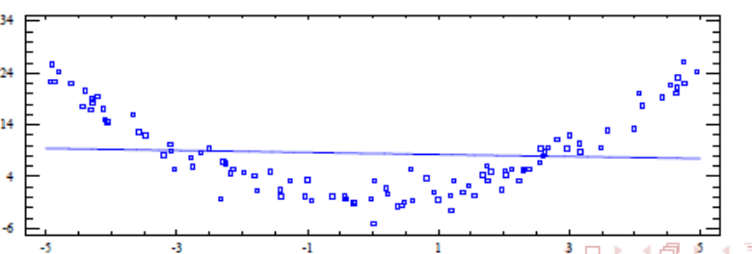
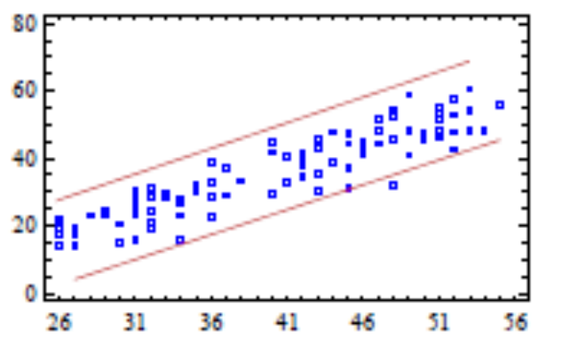
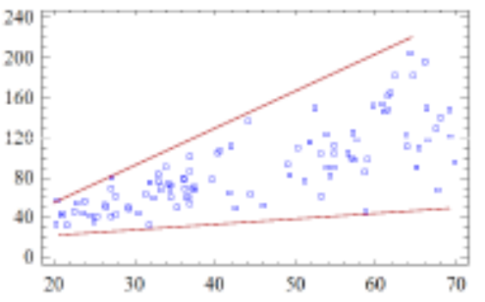
Assumptions of simple linear regression
The existing relation between X and Y is linear
Homogeneity: The mean value of the error is zero

Slide 14
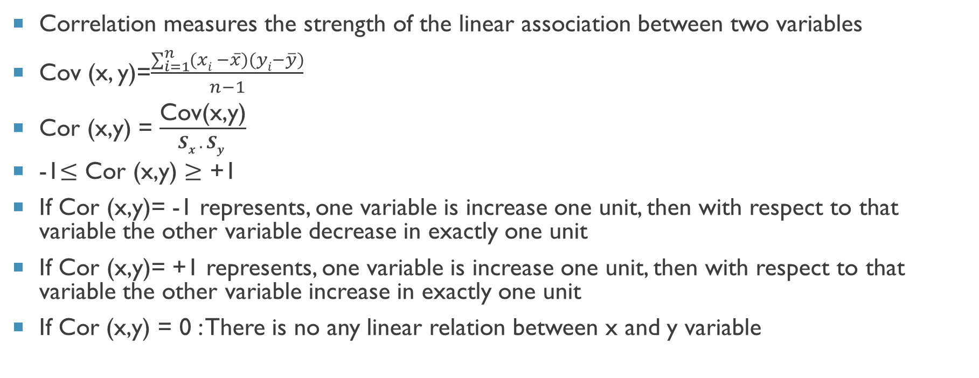
Measuring the linearity of variables
Correlation measures the strength of the linear association between two variables
Cov (x, y)=$\frac{\sum_{i=1}^{n}{(xi −\overline{x})(yi−\overline{y})}}{n−1}$
Cor (x,y) = $\frac{\text{Cov}\text{(}\text{x}\text{,}\text{y}\text{)}}{Sx . Sy }$
-1$≤\text{Cor}\text{ (}\text{x}\text{,}\text{y}\text{)}≥$ +1
If $\text{Cor}\text{ (}\text{x}\text{,}\text{y}\text{)}$= -1 represents, one variable is increase one unit, then with respect to that variable the other variable decrease in exactly one unit
If $\text{Cor}\text{ (}\text{x}\text{,}\text{y}\text{)}$= +1 represents, one variable is increase one unit, then with respect to that variable the other variable increase in exactly one unit
If Cor (x,y) = 0 : There is no any linear relation between x and y variable

Slide 15
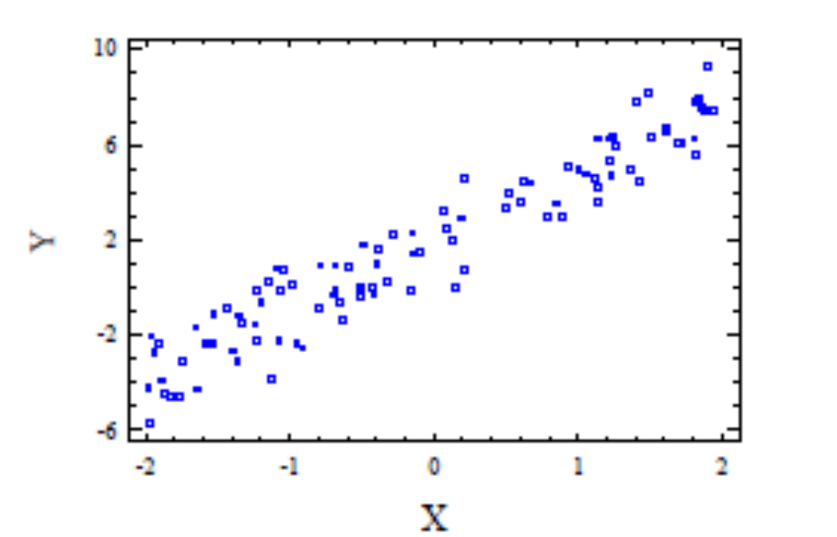
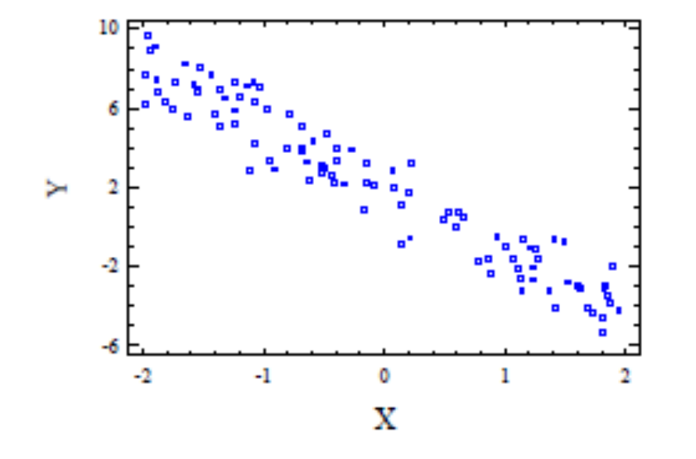
Simple linear regression model (contd.)
If Cor (X,Y) > 0 there is a positive linear relationship. Then then β1 > 0
If Cor (X,Y) < 0 there is a negative linear relationship. Then β1 < 0

Slide 16
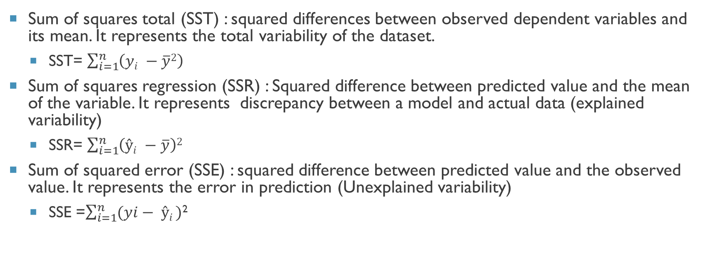
Determinants of a good regression
Sum of squares total (SST) : squared differences between observed dependent variables and its mean. It represents the total variability of the dataset.
  SST= $\sum_{i=1}^{n}{\left(yi −\overline{y}2\right)}$
Sum of squares regression (SSR) : Squared difference between predicted value and the mean of the variable. It represents discrepancy between a model and actual data (explained variability)
  SSR= $\sum_{i=1}^{n}{\left(ŷi −\overline{y}\right)2}$
Sum of squared error (SSE) : squared difference between predicted value and the observed value. It represents the error in prediction (Unexplained variability)
  SSE =$\sum_{i=1}^{n}{(yi− ŷi )}$²

Slide 17
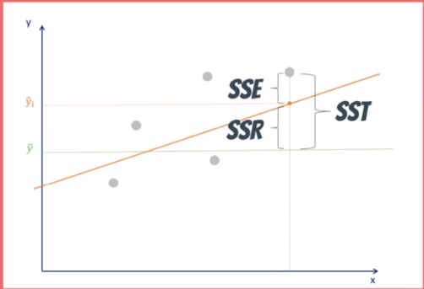
Determinants of a good regression(Contd.)
SST= SSR +SSE
Total = explained + unexplained
variability variability variability
Lower SSE results better regression

Slide 18
Determinants of a good regression(Contd.)
  Adequacy of a regression model could be checked using the F-static
    If p value associated with the F-statistic is significant (p<α) then, the model is considered adequate.
    α is the probability that our conclusion is incorrect
  Significance of the regression coefficients is determined by t-statistic
  Assuming
    Null hypothesis (H0) : β1 = 0
    Alternative hypothesis (H1) : β1 ≠ 0
  If p value associated with the t-statistic is not significant then the null hypothesis is not rejected.

Slide 19
Estimation of β₀ and β₁
There are a number of methods to predict β₀ and β_{1.}
These include,
  Ordinary least square
  Generalized least square
  Maximum Likelihood estimation
  Bayesian regression
  Kernel regression

Slide 20
Least square method
Gauss proposed in 1809 the method of least squares for obtaining the values β₀ and β₁ that best ﬁt the data:
In Least Square Method β₀ and β₁ are estimated so that the SSE is minimum
When SSE is minimum the model has a better explanatory power.
Lower error leads to better explanatory power.

Slide 21
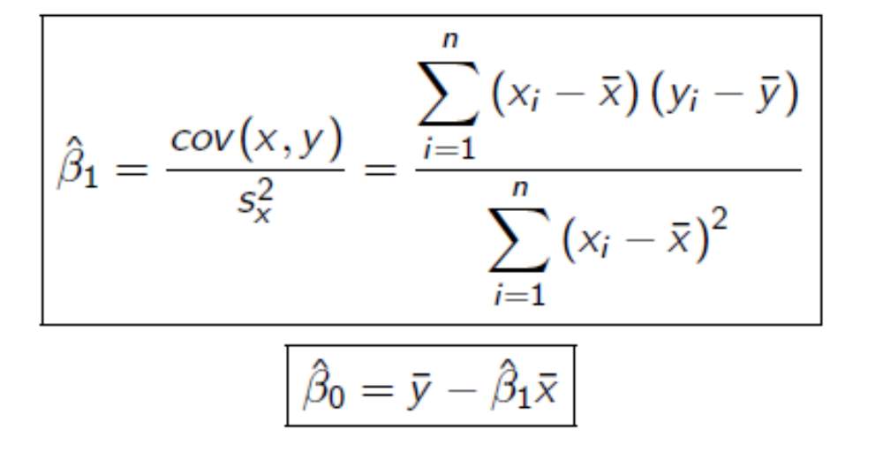
Least square method (contd.)
Results are given by

Slide 22
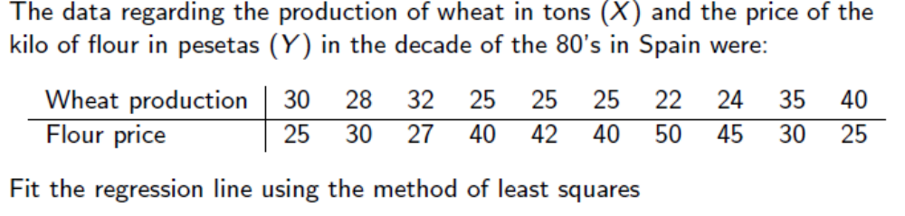
Exercise

Slide 23
DEMO

Slide 24
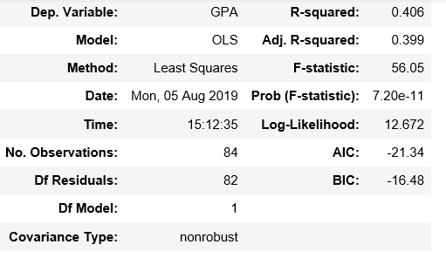
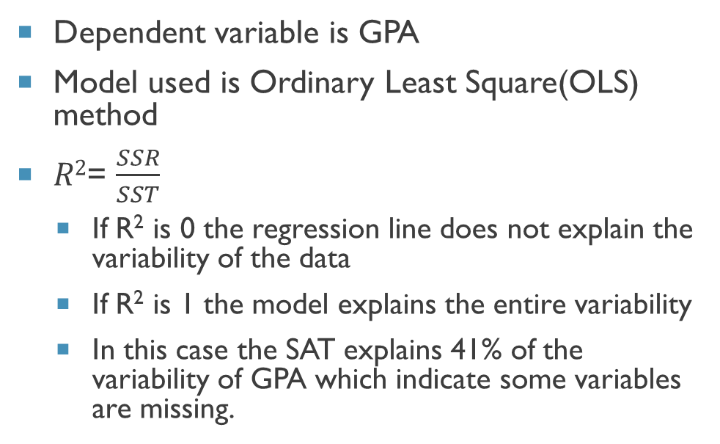
Interpreting python output
Dependent variable is GPA
Model used is Ordinary Least Square(OLS) method
$R2$= $\frac{SSR}{SST}$
  If R² is 0 the regression line does not explain the variability of the data
  If R² is 1 the model explains the entire variability
  In this case the SAT explains 41% of the variability of GPA which indicate some variables are missing.

Slide 25

Interpreting python output (contd.)
β₀= 0.2750 & β ₁=0.0017
Regression equation
  Ŷ= 0.0275+0.0017x₁
  GPA = 0.0275+0.0017 * SAT
Standard error shows the accuracy of the prediction
  Expected value is low
P value shows whether the null hypothesis is accepted or not
  If P<0.05 null hypothesis is rejected

Slide 26
Multiple regression
Practically variables such as GPA cannot be predicted based on a single variable
You might have to consider other variables such as income, marital status, gender & etc.
If we need a good model, we might have to use multiple regression.

Slide 27
Multiple regression (contd.)
Population multiple regression model is
  γ = β₀ + β₁x₁ + β₂x₂ ………+ β_{k}x_{k} +є
Since the equation is having more than 3 dimensions, there is no visual way to represent the equation.
Therefore, what is concerned in multiple regression is finding a best fitting model with minimum SSE and high SSR
Note that, if the SSR is high, the model has a more explanatory power.

Slide 28
DEMO

Slide 29
Removing ineffective variables
Every time you add a predictor to a model, the R-squared increases, even if due to chance alone.
It never decreases.
Suppose you compare a five-predictor model with a higher R-squared to a one-predictor model.
  Does the five predictor model have a higher R-squared because it’s better?
  Or is the R-squared higher because it has more predictors? Simply compare the adjusted R-squared values to find out!
Thus, we need another way to identify whether our predictors improve the model or not.

Slide 30
Removing ineffective variables
The adjusted R-squared penalizes excessive use of variables
It is always lower than the R-squared.
The adjusted R-squared compares the explanatory power of regression models that contain different numbers of predictors.
The adjusted R-squared increases only if the new term improves the model more than would be expected by chance.
It decreases when a predictor improves the model by less than expected by chance
The adjusted R-squared and p-value of the variables are useful in removing ineffective variables from the model.

Slide 31

Thank You

