Slide 1
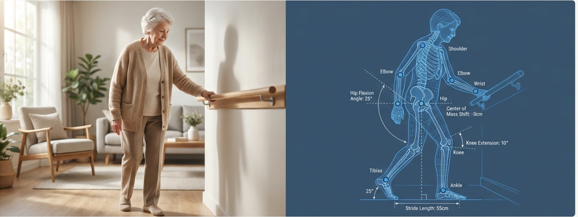

Multimodal Intelligent Fall Monitoring System for
Elderly Care
R26-IT-051

Slide 2

Main Components
Context-Aware Activity Recognition for Elderly Fall Risk Detection
Environmental Risk Mapping & Smart Safety Zone System
Intelligent Multi-Level Alert System for Elderly Safety Monitoring
Intelligent Monitoring Dashboard
R26-IT-051

Slide 3




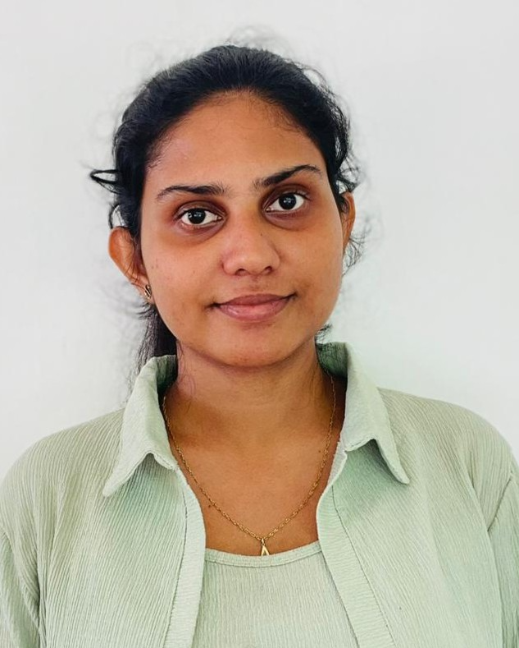
TEAM
R26-IT-051
Supervisor
Co-Supervisor
Mr. Uditha Dharmakeerthi
Mr. Kanishka Yapa
M T K Chathuri
IT22548078
D H S Diwyangi
IT22559968
W A H Divyanjalie IT22227690
E D K M Kulathunga
IT21066948

Slide 4
Comments received & Improvements
IT Numbers | Comments Received
IT22548078 | No idea regarding the categorization of a doctor & the department division. And the department division should be done from the backend, not manually.
IT22559968 | Just entering the details by a doctor, which cannot be considered as a research component. Usage of blockchain for this component is questionable. WARNING LETTER IS ISSUED.
IT22227690 | Cannot restrict the patient information for a single doctor, it should be at least visible to 1 type of doctor category. If all the patent information is available, the using of a chatbot is again questionable just to retrieve the data. no research component at all. WARNING LETTER IS ISSUED.
IT21066948 | No research component at all, haven't gone through a report. Just perform all the operation where a typical report does. WARNING LETTER IS ISSUED.
R26-IT-051

Slide 5
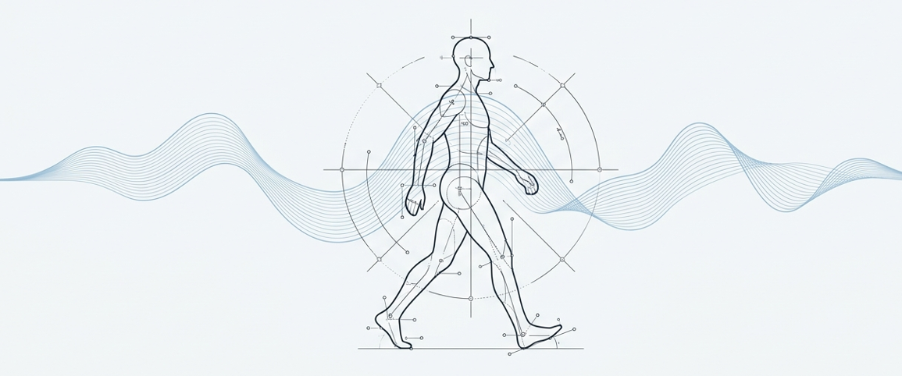
Context-Aware Activity Recognition for Elderly Fall Risk Detection
IT22548078 | Chathuri M T K | R26-IT-051

Slide 6
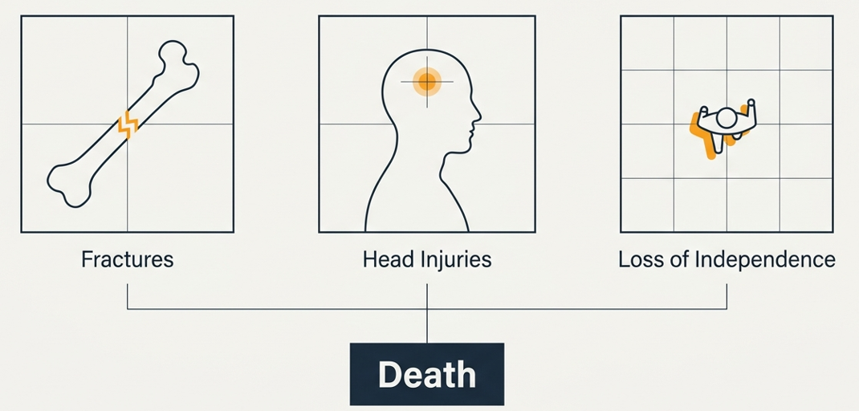
Elderly falls present a critical global healthcare challenge
IT22548078 | Chathuri M T K | R26-IT-051

Slide 7
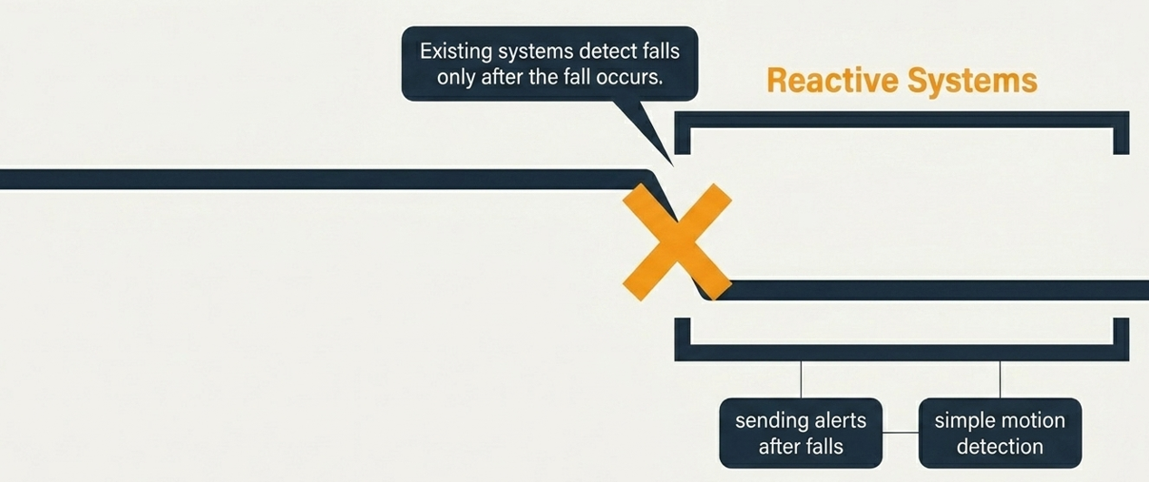
Current fall detection systems operate only after the damage is done
IT22548078 | Chathuri M T K | R26-IT-051

Slide 8
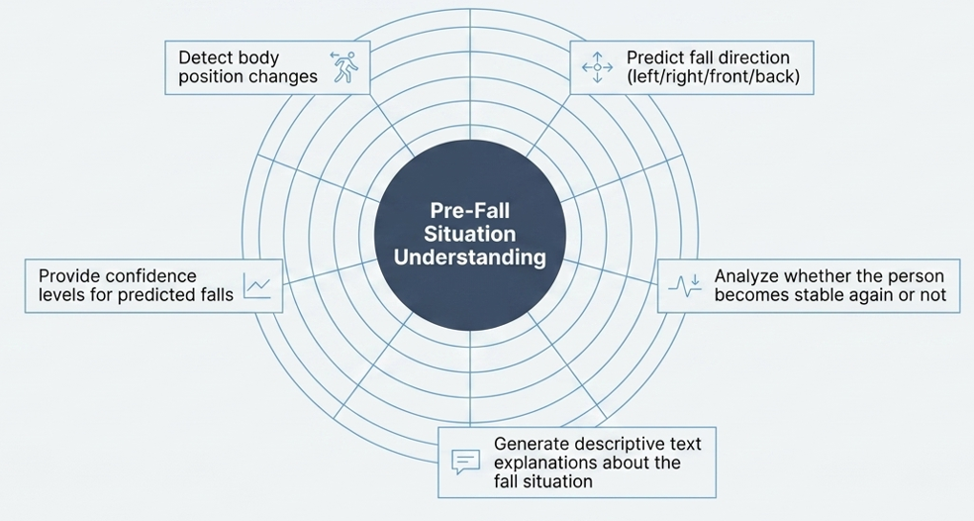
Research Component Overview
Research Objective & Innovation
To develop an IoT and Machine Learning based system that can predict elderly fall risks in real time by analyzing body movements, posture changes and stability conditions before an actual fall occurs.
Main End Users
Elderly People
Caregivers
Elderly Care Centers
IT22548078 | Chathuri M T K | R26-IT-051

Slide 9
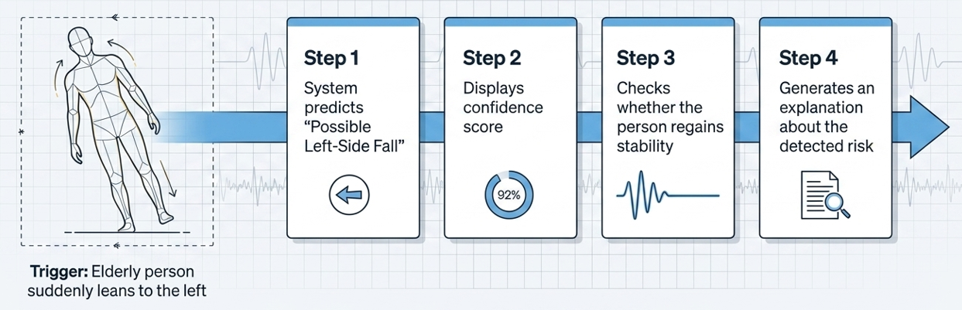
Real-time prediction and explanation in a left-side fall scenario
IT22548078 | Chathuri M T K | R26-IT-051

Slide 10
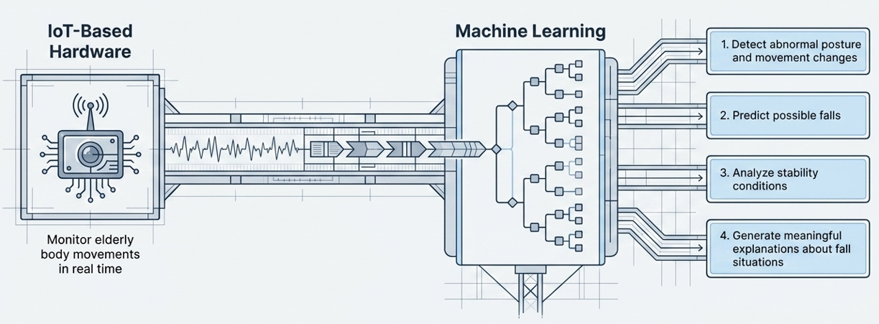
A dual-engine approach combing IoT Hardware and Machine Learning
IT22548078 | Chathuri M T K | R26-IT-051

Slide 11
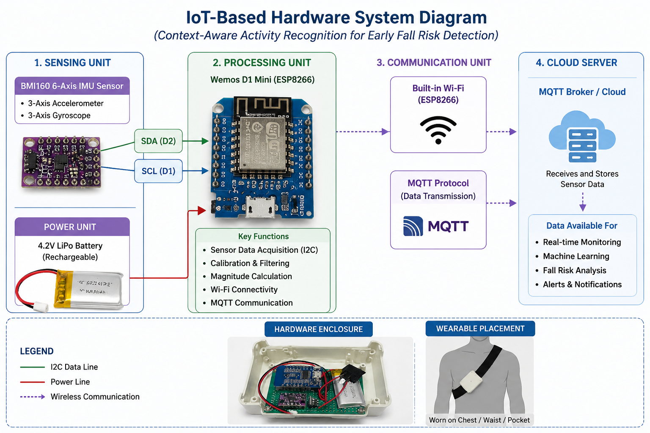
IOT-Based Hardware System Diagram
IT22548078 | Chathuri M T K | R26-IT-051

Slide 12
Fall Detection — End-to-End ML Pipeline
Fall Detection — End-to-End ML Pipeline
train.py — Model Training
server.py — Live Prediction (Flask)
Step 1 — Load CSV
Step 1 — Start server
fall_detec.csv → DataFrame (12,156 rows · 6 classes)
Load model · scaler · label_encoder → port 5050
Step 2 — Sliding window
Step 2 — Receive request
window = 20 samples · step = 10 (50% overlap)
IoT device → POST /predict → JSON window (20 samples)
Step 3 — Feature extraction
Step 3 — Validate
7 sensors × 7 stats + 3 correlations = 52 features
Shape must be (20, 7) — else return 400 error
Step 4 — Encode · Split · Scale
Step 4 — Extract · Scale
LabelEncoder → 80/20 stratified split → StandardScaler
Same 52 features as train.py → same StandardScaler
Step 5 — Train 3 models
Step 5 — RF predict
Random Forest (200 trees) · Decision Tree · KNN (k=5)
predict() → label · predict_proba() → probabilities
Step 6 — Evaluate
Step 6 — Context engine
Accuracy · weighted F1 · confusion matrix · feature importance
Fall direction → right / left / front / back
Stability → stable / slightly_unstable / unstable
Step 7 — Final comparison · select best model
Prev. activity → walking / standing_still
Random Forest
100.00%
✓ Best
Human message → "User fell right while walking"
Decision Tree
98.62%
Step 7 — Return JSON response
KNN
98.62%
{label · confidence · probabilities · context · human_message}
Step 8 — Save .pkl files
fall_rf_model.pkl · scaler.pkl · label_encoder.pkl
.pkl files

Slide 13
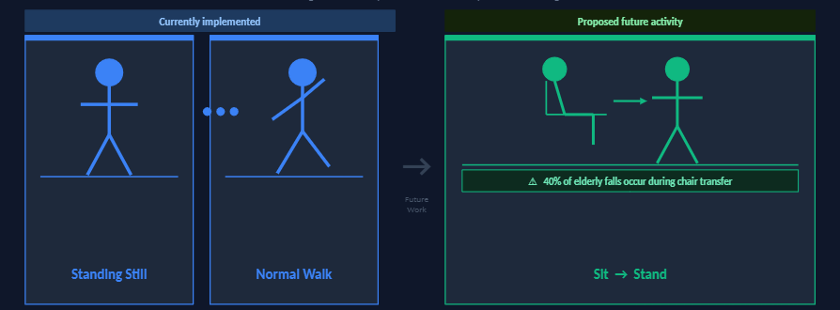
Future Development
IT22548078 | Chathuri M T K | R26-IT-051

Slide 14
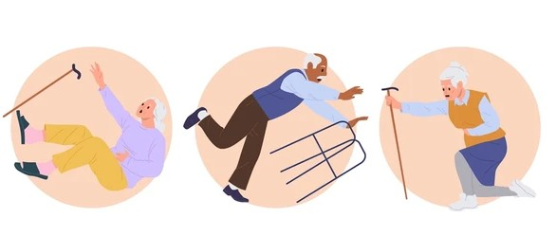
Environmental Risk Mapping &
Smart Safety Zone System
IT22559968| Diwyangi D.H.S| R26-IT-051
Notes:
The environment factors in each location in the environment are analized to determine whether there is a risk of someone falling in that environment like moisture light, motion gyro
NodeMCU ESP32S microcontroller ● MPU6050 accelerometer and gyroscope sensor ● BH1750 light intensity sensor ● VL53L0X laser distance sensor ● Soil moisture sensor ● PIR motion sensor ● Wi-Fi communication module (built into ESP32)

Slide 15
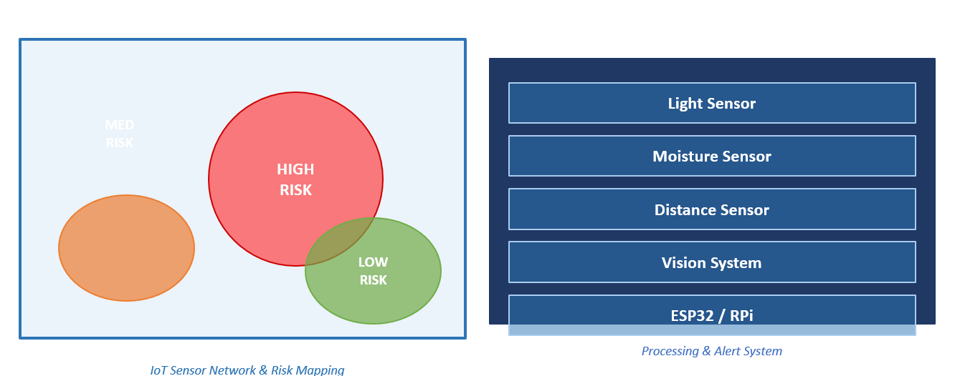
MED RISK
IT22559968| Diwyangi D.H.S| R26-IT-051
Notes:
The environment factors in each location in the environment are analized to determine whether there is a risk of someone falling in that environment like moisture light, motion gyro
NodeMCU ESP32S microcontroller ● MPU6050 accelerometer and gyroscope sensor ● BH1750 light intensity sensor ● VL53L0X laser distance sensor ● Soil moisture sensor ● PIR motion sensor ● Wi-Fi communication module (built into ESP32)

Slide 16
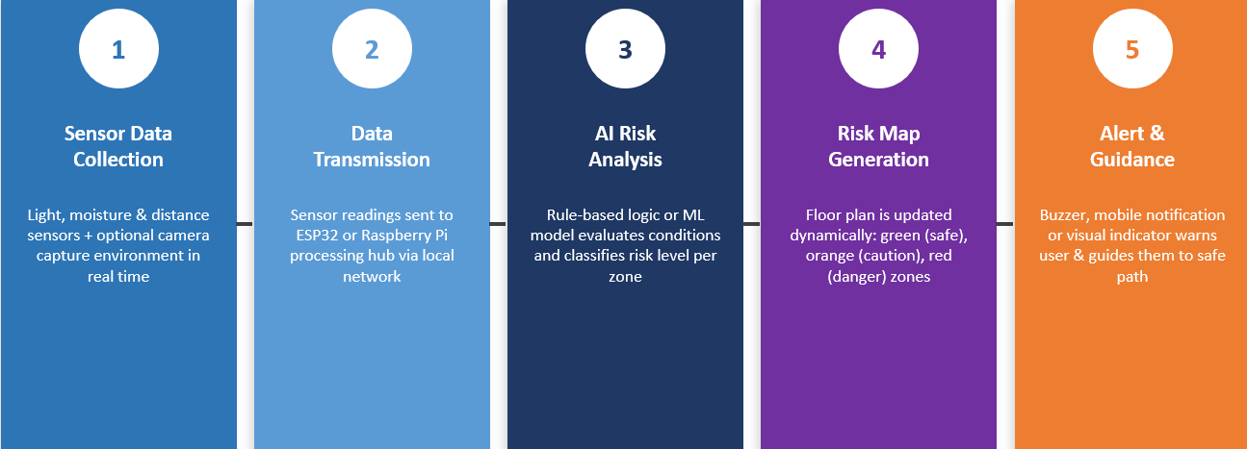
Smart Safety Zone
IT22559968| Diwyangi D.H.S| R26-IT-051

Slide 17
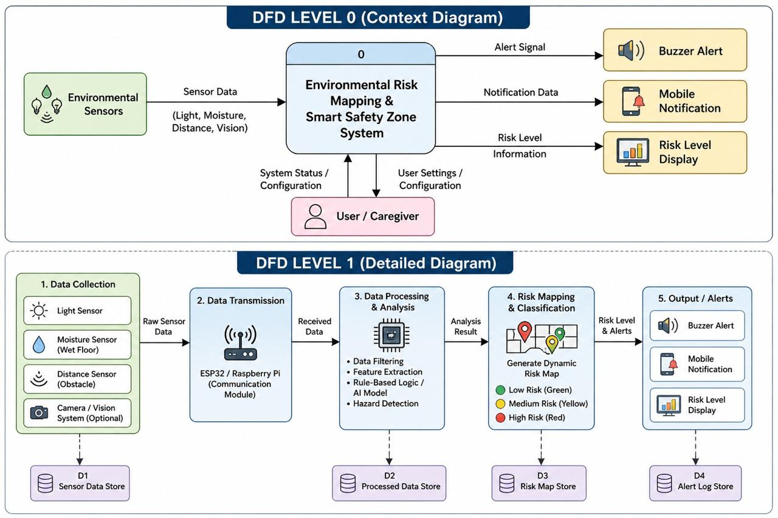
IT22559968| Diwyangi D.H.S| R26-IT-051

Slide 18

Intelligent Multi-Level Alert System for Elderly Safety Monitoring
A real-time smart alert system designed to detect high-risk situations such as falls in elderly individuals and trigger immediate emergency notifications.
IT21066948| Kulathunga E D K M| R26-IT-051

Slide 19
Users & Stakeholders
Elderly users
Caregivers and family members
Hospitals and healthcare providers
Emergency response teams
Assisted living facilities
IT21066948| Kulathunga E D K M| R26-IT-051

Slide 20

Motivation
Falls are a major risk for elderly people
Delayed help can lead to serious injuries
Many elderly people live alone without support
Need for a fast and reliable alert system
IT21066948| Kulathunga E D K M| R26-IT-051

Slide 21
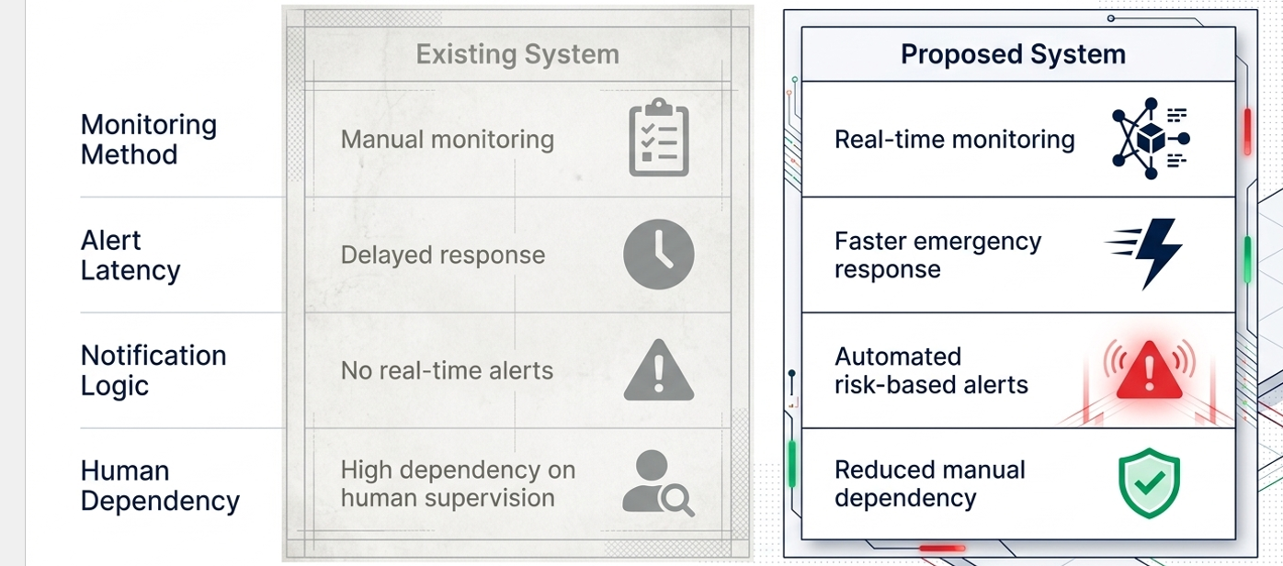
Existing System vs Proposed System
IT21066948| Kulathunga E D K M| R26-IT-051

Slide 22
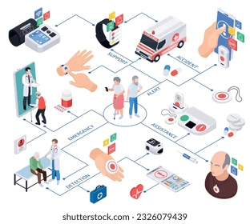
System Overview
Collects data from sensors / user input
Processes the detected event
Identifies emergency situations
Sends alerts to connected users
IT21066948| Kulathunga E D K M| R26-IT-051

Slide 23
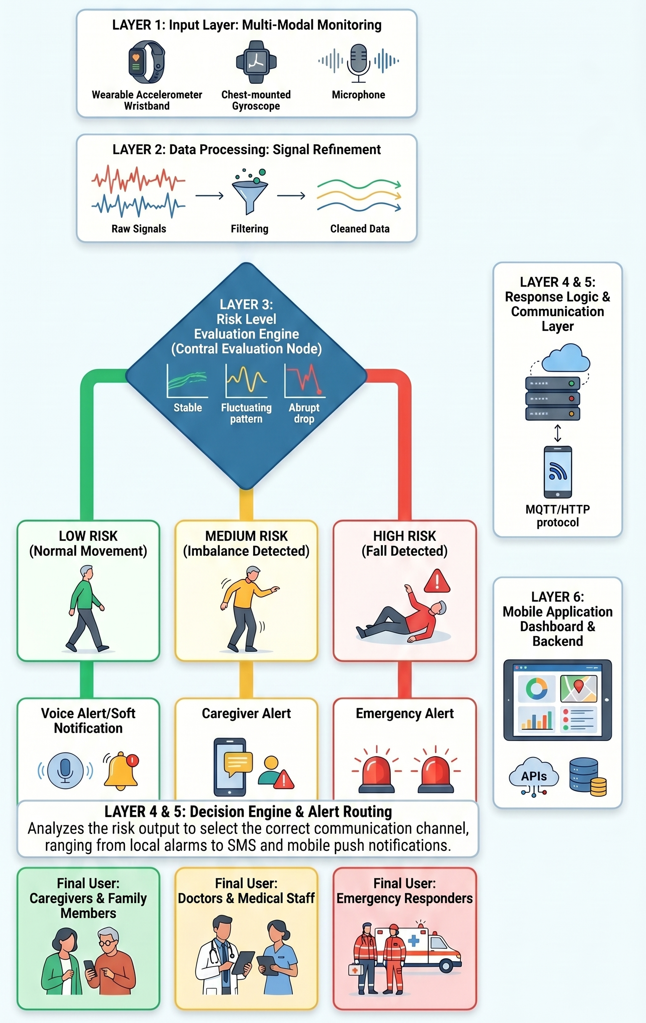
System Architecture
IT21066948| Kulathunga E D K M| R26-IT-051

Slide 24

Key Features
Real-time emergency alerts
Automatic fall detection
Quick notification system
Easy to use interface
Reliable and fast response
IT21066948| Kulathunga E D K M| R26-IT-051

Slide 25
System Flow
Input captured from sensors or manual trigger
System continuously monitors conditions
Emergency condition identified
Alert is generated instantly
Notifications sent to relevant users
IT21066948| Kulathunga E D K M| R26-IT-051

Slide 26

Expected Outcome
Faster emergency response
Improved safety for elderly individuals
Reduced risk of serious injury
Increased confidence for caregivers
IT21066948| Kulathunga E D K M| R26-IT-051

Slide 27
Intelligent Monitoring Dashboard
Component 4: Advanced Visualization & Decision Support System for Hospital Clinical Staff.
Strategic Objective
Bridging the gap between AI-driven Gait Analysis and actionable Clinical Intervention through a high-fidelity monitoring interface.
IT22227690| Divyanjalie W.A.H| R26-IT-051

Slide 28

Primary User: Hospital Staff
Designed for Clinicians
•
Real-time monitoring of multiple patient wards.
•
Detailed Gait parameters for professional diagnosis.
•
High-priority visual and audible alerts for fall risks.
•
Intuitive design to reduce cognitive load on nurses.
IT22227690| Divyanjalie W.A.H | R26-IT-051

Slide 29
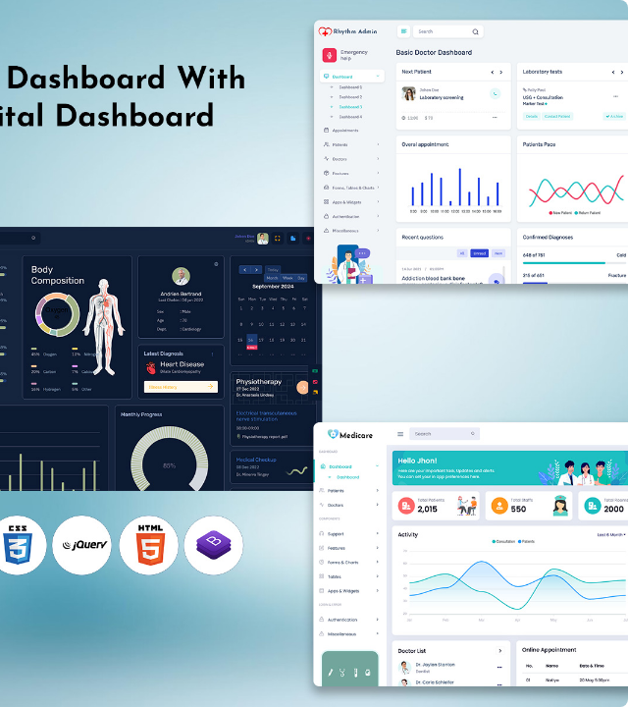
Centralized Ward View
The ward-level monitoring interface allows nursing staff to oversee all patients simultaneously.
High-risk candidates are automatically moved to the top of the grid with distinct visual warnings.
Eliminating the need for manual hourly checks, the system provides 24/7 proactive surveillance.
IT22227690| Divyanjalie W.A.H| R26-IT-051
Notes:
Currently, hospital staff rely on manual observation or CCTV, which can be reactive and slow.
My component is designed specifically for clinicians and nurses.
It reduces their 'cognitive load' by taking complex gait data and turning it into simple, visual alerts
This allows them to monitor multiple patients simultaneously without needing to be in the room 24/7.

Slide 30






Core Dashboard Pillars
Live Risk Meter
Gait Analytics
XAI Engine
Real-time probability score derived from Single-Sensor IMU data streams.
Visualization of Tilt, Balance, and Speed metrics for clinical deep-dives.
Explainable AI insights providing the "Why" behind every high-risk prediction.
IT22227690| Divyanjalie W.A.H| R26-IT-051
Notes:
"The dashboard stands on three pillars:
The Live Risk Meter: it disply real-time probability score.
Gait Analytics: it Deep-dives into balance and posture.
The XAI Engine: This provides the 'Why' behind every prediction.

Slide 31
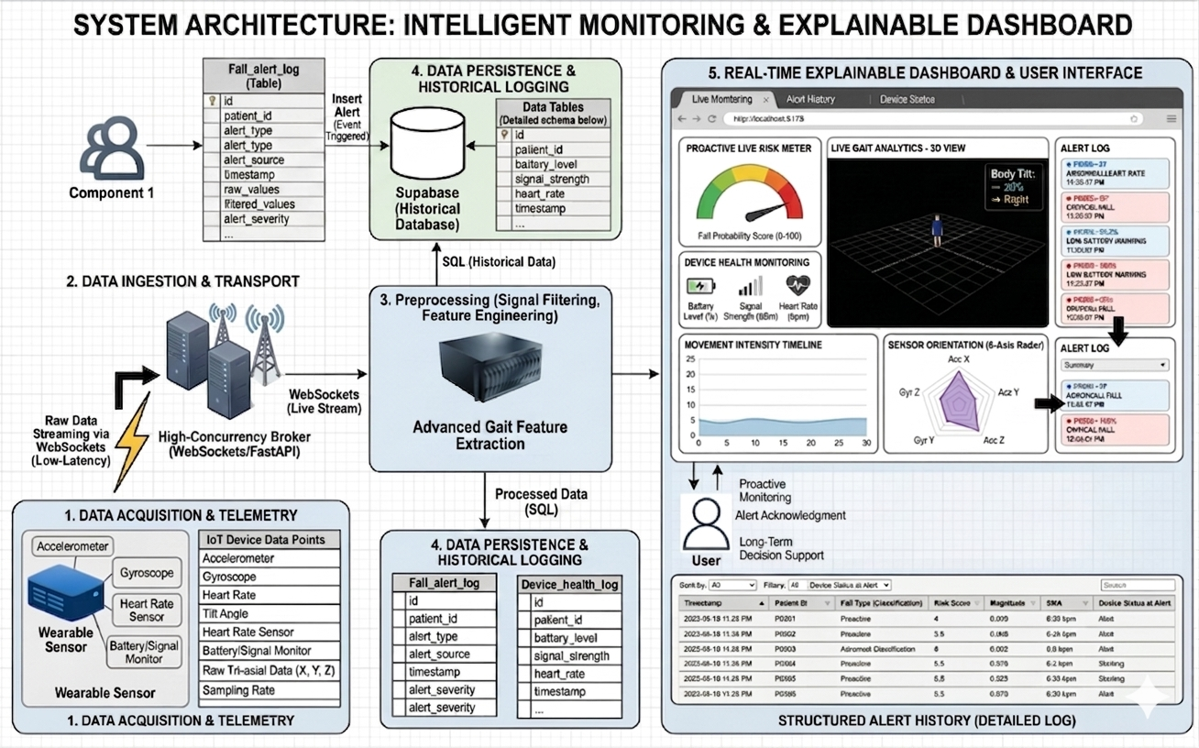
IT22227690| Divyanjalie W.A.H| R26-IT-051
Notes:
Magnitude is equal to the square root of the sum of the squares of x, y, and z. The process begins with a Wearable Sensor that captures real-time data, including movement (Accel/Gyro), heart rate, and device health (battery/signal).
Raw data is go via WebSockets and FastAPI. This ensures "low-latency,"
In the Preprocessing engine, it do signal filtering and Advanced Gait Feature Extraction like magnirtude All data is sent to Supabase. Meantime Component 1 inserts critical alerts into the Fall_alert_log table.
Finally, the React Dashboard visualizes everything for the clinician. It shows a 3D Gait View, a Live Risk Meter, and a detailed Alert History

Slide 32
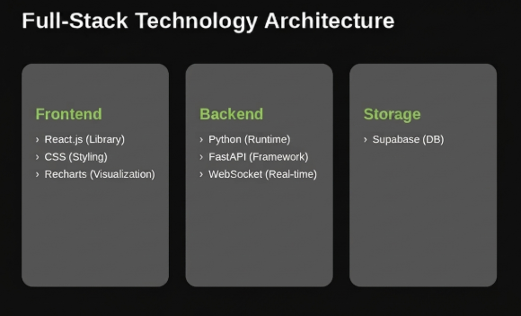
IT22227690| Divyanjalie W.A.H| R26-IT-051

Slide 33
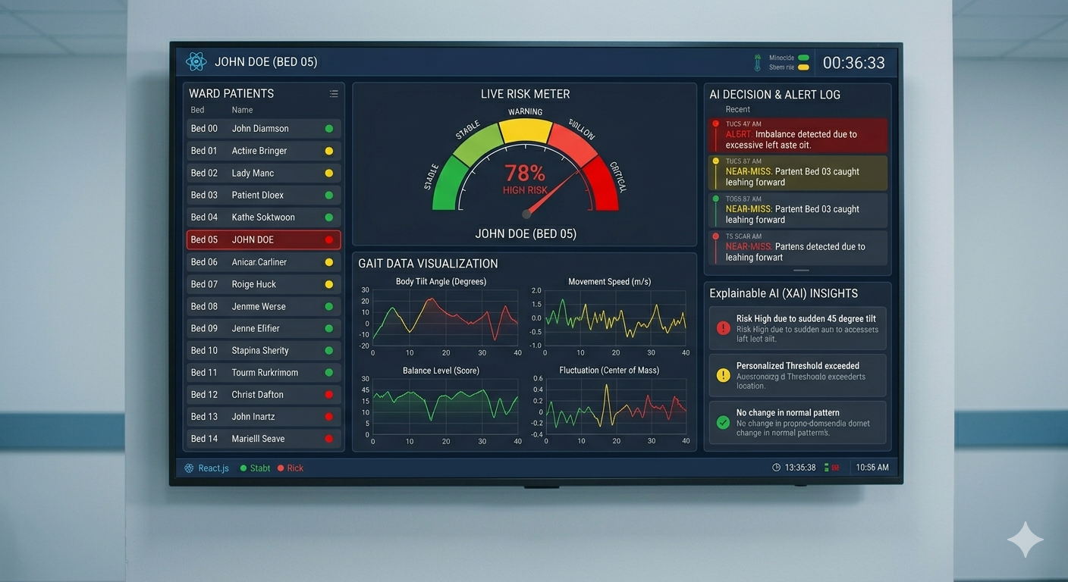
IT22227690| Divyanjalie W.A.H| R26-IT-051
Notes:
If ipatients Magnitude value is not a value close to 9.8 it add some risk score. And unstable or have fall history / If identify fall, and if movement is abnormal
Designed to help clinical staff make fast and accurate decisions.
At the center, shows the patient’s real-time fall risk as a percentage, with red indicating a critical situation.
Ward Overview: On the left, nurses can monitor the entire ward at once. High-risk patients, like John Doe in Bed 05, are automatically highlighted so staff can prioritize them immediately.
Gait Analytics: The bottom charts visualize movement speed and balance, providing doctors with objective data instead of manual observations.
XAI Insights: Most importantly, the Explainable AI section on the right explains why the risk is High such as when disply Risk High: and as the reason it disply- Suddenly 45% body tilt to the right detected..

Slide 34
Thank You
R26-IT-051

