Slide 1

DATA ANALYTICS CAPSTONE
Mutual Fund Analytics
An end-to-end platform for fund performance, risk analysis, and investor insights.
Programme
Present by
Bluestock Fintech Internship
Kavinesh Haribaskar

Slide 2
Project Overview
A comprehensive analytics platform built to transform raw mutual fund data into actionable investment intelligence.
End-to-End Platform
10 Datasets Processed
Automated ETL
Interactive Dashboard
Built a robust ETL pipeline feeding a structured SQLite database.
Developed a full Mutual Fund Analytics pipeline from data ingestion to visualisation.
Cleaned, validated, and modelled data across ten distinct mutual fund datasets.
Created a Power BI dashboard for advanced financial and investor analysis.
Tech Stack: Python · Pandas · NumPy · SQLite · Plotly · Power BI · Git & GitHub

Slide 3
Problem Statement & Objectives
Investors lack a centralised system to analyse mutual fund performance, risk, SIP trends, and investor behaviour. Existing data is fragmented across multiple sources and lacks actionable insights.
The Challenge
Project Objectives
Fragmented data sources, inconsistent formats, and no unified view of fund performance or investor patterns make holistic analysis nearly impossible for retail and institutional investors alike.
1
ETL Pipeline
Build an automated extraction, transformation, and loading workflow.
2
Data Quality
Clean, validate, and standardise all datasets for analysis.
3
Performance & Risk
Analyse fund returns and compute key risk metrics.
4
Dashboard & Insights
Deliver an interactive Power BI dashboard with investment insights.

Slide 4

Data Engineering & ETL Pipeline
A six-stage pipeline transforming raw CSV files into a structured analytics-ready SQLite database.
Raw CSV
Cleaning
Validation
SQLite DB
The pipeline ensures data integrity at every stage, from ingestion through to dashboard visualisation.
Datasets Integrated
Fund Master
NAV History
Scheme Performance
Investor Transactions
Core fund metadata and classification.
Historical Net Asset Value records.
Returns across multiple time horizons.
Buy, sell, and switch activity logs.
Portfolio Holdings
Benchmark Indices
Monthly SIP Inflows
Category Inflows
Asset allocation and sector exposure.
Market benchmarks for comparison.
Systematic investment plan trends.
Fund category-level capital flows.
Industry Folio Count
AUM by Fund House
Investor participation metrics.
Assets under management distribution.

Slide 5

Exploratory Data Analysis
Five core analytical lenses applied to uncover patterns in fund performance, investor behaviour, and market trends.
NAV Trend
AUM by Fund House
SIP Trend
Tracked Net Asset Value trajectories across fund categories to identify growth patterns and volatility clusters.
Compared assets under management across major fund houses to map market share and dominance.
Analysed systematic investment plan inflows over time to gauge retail investor sentiment.
Correlation Matrix
Investor Demographics
Examined relationships between fund returns, risk metrics, and market variables.
Profiled investor segments by age, geography, and investment behaviour.
Key Insights: SBI Mutual Fund held the highest AUM · SIP inflows grew steadily from 2022 to 2025 · Large-cap funds demonstrated relatively stable NAV growth.

Slide 6
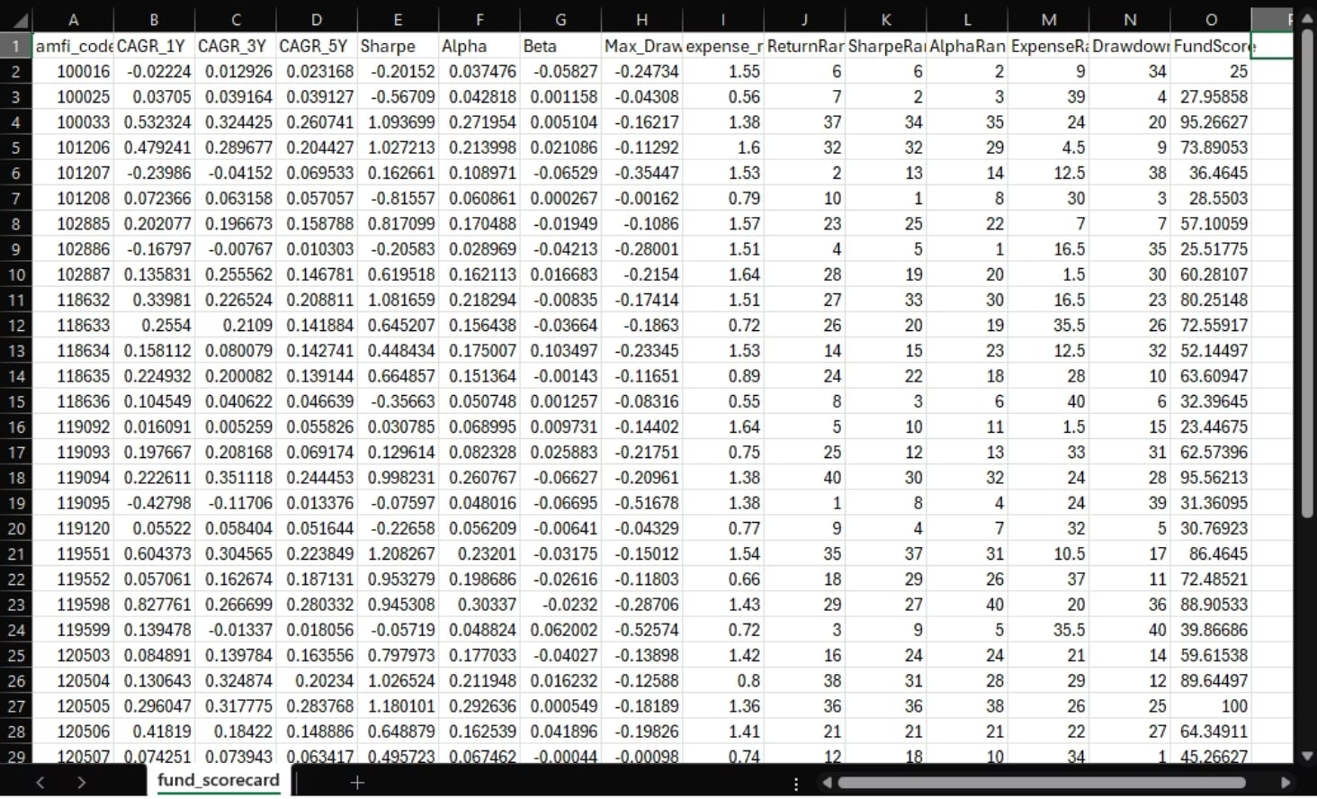
Performance & Risk Analytics
A comprehensive suite of financial metrics computed to evaluate returns, risk-adjusted performance, and benchmark alignment.
Metrics Computed
Return Metrics
Risk-Adjusted Returns
Daily Returns · CAGR (1Y, 3Y, 5Y)
Sharpe Ratio · Sortino Ratio
Market Risk
Downside Risk
Alpha & Beta · Tracking Error
Maximum Drawdown · VaR & CVaR

Slide 7
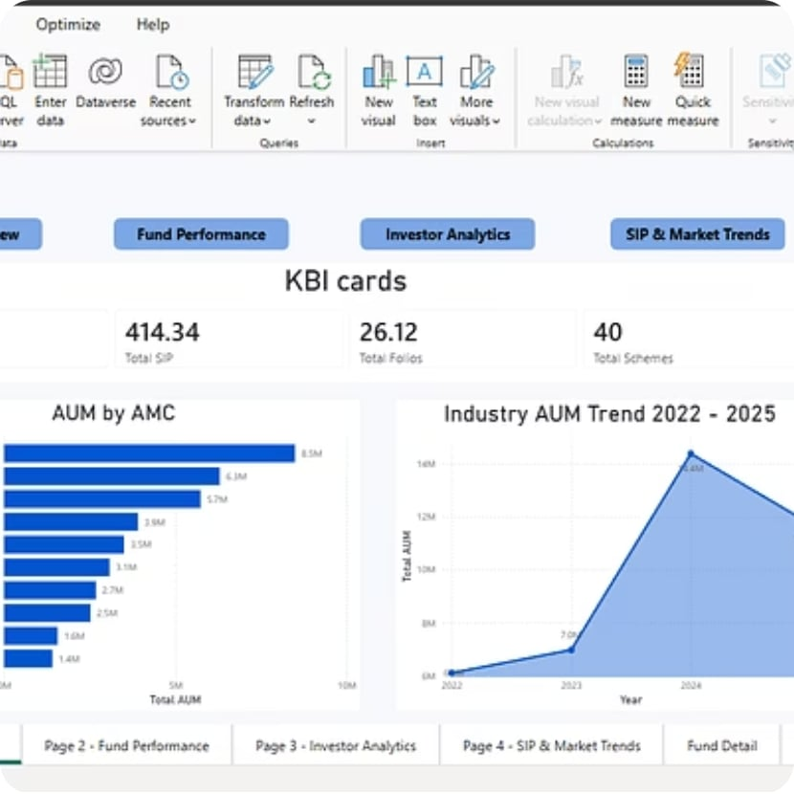
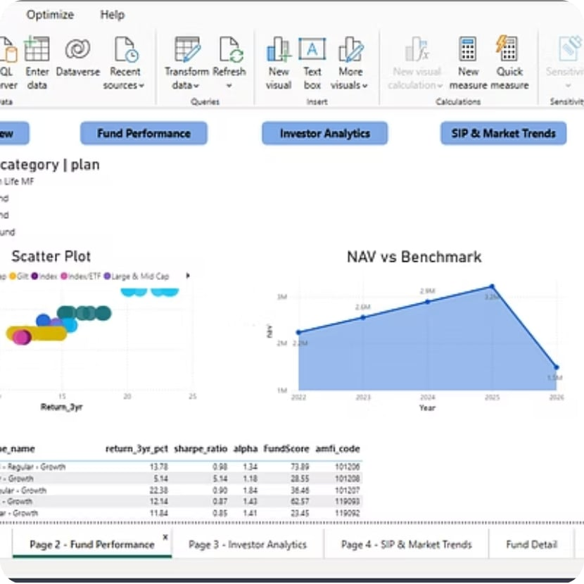
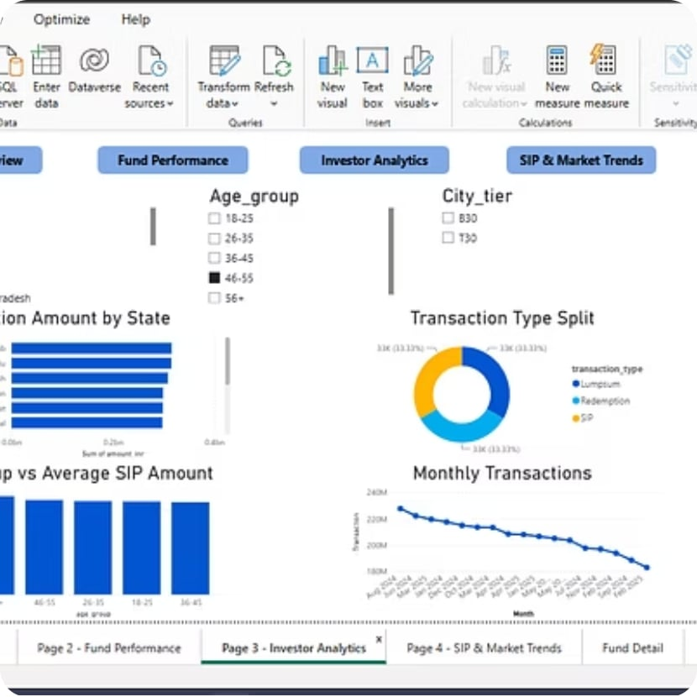
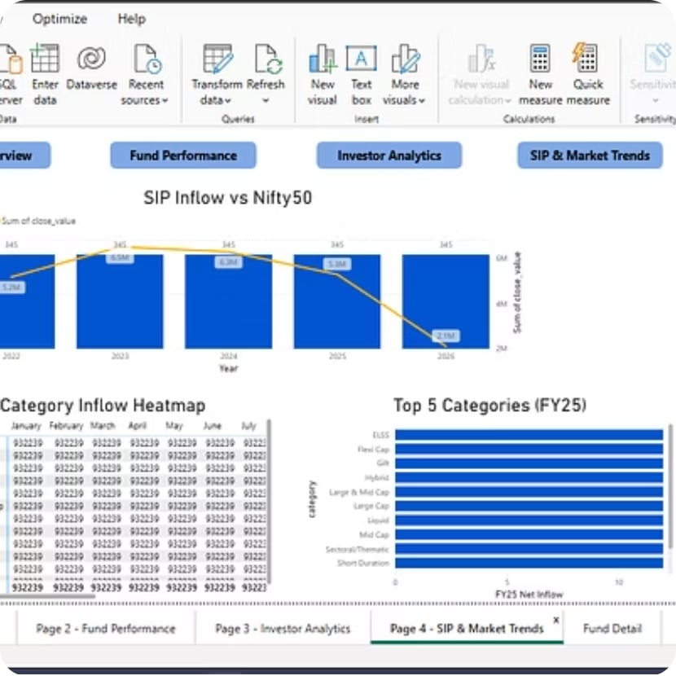
Power BI Dashboard
Four interactive pages delivering a 360° view of the mutual fund landscape.
KPI Cards
Slicers
Drill-Through
Tooltips
At-a-glance summary metrics for key indicators.
Dynamic filtering by fund, category, and period.
Navigate from summary to detailed fund-level views.
Contextual insights on hover for deeper analysis.
Investor Analytics
Delving into investor behaviour to understand preferences, trends, and engagement across various mutual fund schemes.

Slide 8
Advanced Analytics
Six specialised analyses providing deeper insight into risk, investor behaviour, and fund concentration.
Historical VaR & CVaR
Rolling 90-Day Sharpe Ratio
Investor Cohort Analysis
Quantified downside risk using historical simulation to estimate potential portfolio losses at confidence intervals.
Tracked risk-adjusted performance over time to identify consistently performing funds beyond point-in-time snapshots.
Segmented investors by entry period to study retention and behaviour patterns across market cycles.
SIP Continuity Analysis
Sector HHI Concentration
Risk-Based Fund Recommender
Measured systematic investment plan persistence and dropout rates to gauge investor discipline.
Computed Herfindahl-Hirschman Index to assess portfolio diversification and sector concentration risk.
Developed a model matching funds to investor risk profiles using quantitative scoring.

Slide 9
Key Findings & Conclusion
Key Findings
Conclusion
1
Consistent Risk-Adjusted Returns
Successfully delivered an end-to-end ETL pipeline, advanced analytics, and an interactive Power BI dashboard — providing actionable insights into mutual fund performance and investor behaviour.
Large-cap funds delivered the most consistent risk-adjusted returns across all categories analysed.
2
Record SIP Inflows
SIP inflows reached all-time highs in December 2025, signalling strong retail investor confidence.
3
Lower Concentration Risk
Diversified funds exhibited significantly lower concentration risk compared to sector-specific funds.
4
Rolling Sharpe Insights
Rolling Sharpe analysis identified funds with sustained performance, not just short-term winners.
5
Recommender Validation
The risk-based recommender successfully matched funds to investor profiles with high accuracy.

Slide 10
Future Scope
Live NAV Updates
Streamlit Web App
Monte Carlo Simulations
Scheduled ETL jobs for real-time Net Asset Value tracking and automated data refresh.
Deploy analytics as an interactive web application for broader accessibility.
Probabilistic modelling of portfolio returns under thousands of market scenarios.
Portfolio Optimisation
Automated Reports
Apply Markowitz mean-variance optimisation for efficient frontier construction.
Scheduled email delivery of personalised fund performance and risk summaries.
Thank You
Email
Connect
kavineshharibaskar2005@gmail.com
LinkedIn · GitHub

