Slide 1
by team
OCTOBER 2026
SNA CASE STUDY
EVENTS = COMMUNITIES
IN THE GRAPH
DistilBERT-GNN
Social Network Analysis of Incremental Social-Media
Event Detection — with results on the real 68,841-tweet benchmark
Kavinesh P · KSV Siddardha · Adith Narayan G
Social Network Analysis — Case Study
01

Slide 2
WE MODELED
A Message Network
Shared users
Shared entities
Shared keywords
FROM
Twitter Event Streams
68,841 messages
503 labeled events
28-day window
TO ANSWER
Three Questions
Does structure beat text alone?
What should the model filter out?
What does learning add over a classical baseline?
02

Slide 3
OUR
FOCUS
Social network analysis treats a tweet not as isolated text, but as a node whose meaning is disambiguated by its relational context — who posted it, which other messages share its named entities, which share its vocabulary. DistilBERT-GNN makes that relational context explicit: it builds a message graph, filters it, learns attention-weighted representations over it, and recovers events as communities within it.
Heterogeneous Info Network
Homogeneous message graph
Node filtering
Community detection
Messages, users, entities and keywords as nodes; edges connect a message to what it contains.
The HIN projected so two messages connect if they share a user, entity, or keyword.
Sentiment confidence or graph centrality decides which messages are kept before training.
DBSCAN / K-Means over learned embeddings recovers events as graph communities.
03

Slide 4
THE
DATA & SOURCES
SOURCE & JUSTIFICATION
THE BENCHMARK
Platform: Twitter
Window: 28 days · Oct 10 – Nov 7, 2022
Messages: 68,841
Labeled events: 503
Streaming shape: 22 blocks (M0 = 500, M1–21 = 100 each)
The QSGNN Twitter event-detection benchmark (Ren et al., 2022), adopted by the DistilBERT-GNN paper. No new scraping: reusing an established, pre-validated benchmark keeps results directly comparable to every prior method (Word2Vec, LDA, WMD, BERT, BiLSTM, PP-GCN, EventX, KPGNN, QSGNN) — the standard, defensible practice for a reproduction case study.
FROM RAW STREAM TO NETWORK
Each tweet, its users, its named entities (NER) and its keywords become nodes in a heterogeneous information network; that HIN is projected to a homogeneous message graph where two tweets connect if they share a user, an entity, or a keyword:
A[i,j] = min{ [ Σₖ Wₘₖ · (Wₘₖ)ᵀ ][i,j] , 1 }
04

Slide 5
HOW THE
GRAPH
IS BUILT
Message nodes
User / entity / keyword edges
Sentiment filtering
Every tweet, its users, named entities (via NER) and keywords become nodes in a heterogeneous network.
Two messages connect if they share a user, an entity, or a keyword — A[i,j] = min{Σₖ Wₘₖ·Wₘₖᵀ, 1}.
DistilBERT sentiment confidence > 50% keeps a message; low-confidence nodes are dropped as noise.
Centrality filtering
Attention-weighted passing
Incremental maintenance
Degree + closeness + betweenness centrality combined; nodes below the 50th percentile are removed.
A 2-layer, 4-head Graph Attention Network learns a per-neighbor weight for message passing.
Pre-training → detection → maintenance keeps the graph current without retraining from scratch.
05

Slide 6
HOW
METHODS DIFFER
Exploits network structure →
Feature-pivot
Document-pivot
Graph-based
(PP-GCN, KPGNN, QSGNN)
DistilBERT-GNN
“Neither keyword co-occurrence nor topic similarity alone exploits the network structure of social platforms — graph-based approaches address this by building message graphs.” — README §1
CONTENT-ONLY
GRAPH-BASED
Word2Vec, LDA, WMD, BERT, BiLSTM — group messages by what they say, ignoring who posted and how posts relate.
PP-GCN, KPGNN, QSGNN, DistilBERT-GNN — connect messages through shared users, entities and keywords before clustering.
Neither is sufficient alone: DistilBERT-GNN's edge comes from combining content-based filtering with graph structure.
06

Slide 7
THE
CHALLENGES ?
07

Slide 8
VOCABULARY
GAP
Slang & Abbreviations
Break keyword-based edges unless message representations are learned contextually.
SHORT
MESSAGES
Little Signal Per Node
Individual tweets carry little information — the graph structure around a node must carry more of the weight.
CONTINUOUS
ARRIVAL
A Moving Target
New nodes and edges keep arriving; the graph must update and re-cluster incrementally, without retraining from scratch.
NODE
NOISE
Not Every Message Matters
Peripheral, low-signal messages dilute message passing unless filtered before the graph is built.
08

Slide 9
NETWORK
MEMORY
How Much History to Keep?
Keeping every historical node is the worst-performing, most expensive maintenance strategy (README §4).
FILTER
CHOICE
Content or Structure?
Sentiment-based and centrality-based filtering are two different theories of which nodes matter.
CHALLENGES COMPOUND
A graph that keeps everything dilutes the signal for new events, and a model that can't filter noise can't find the community either.
09

Slide 10
OUR
ARGUMENT
Treating social-media content as a network problem — not just a text-classification problem — measurably improves event detection.
STRUCTURE CARRIES SIGNAL
CONTENT ALONE DOESN'T
FILTERING MATTERS AS MUCH
AS CONNECTING
THE NETWORK MUST BE
MAINTAINED, NOT JUST GROWN
Graph-based methods beat text-only methods on AMI/ARI — messages that merely sound similar are not the same as messages that are structurally linked.
DistilBERT-GNN's edge over KPGNN/QSGNN comes from removing noisy nodes before message passing, not from a bigger graph.
Keeping more historical structure around does not help — old, irrelevant ties dilute the signal for new communities.
10

Slide 11
WE EVALUATED
Ten Baselines
Word2Vec
LDA
WMD
BERT
BiLSTM
PP-GCN
EventX
KPGNN
QSGNN
DistilBERT-GNN
ACROSS
22 Incremental Blocks
M0 → M21
Offline + online eval
5 runs averaged
USING
Three Metrics
NMI
AMI
ARI
11

Slide 12
WHAT
THE NUMBERS SHOW
Offline NMI, whole graph evaluated at once (README §4, as reported in the base paper)
12

Slide 13
STRUCTURE
WINS
Graph-Based Beats Text-Only
On AMI/ARI, graph-based methods clearly separate the group from Word2Vec, LDA, WMD, BERT and BiLSTM.
FILTERING
MATTERS
Noise Removal Is the Edge
DistilBERT-GNN's lead over KPGNN/QSGNN comes from node filtering removing noisy nodes before message passing.
MEMORY
HURTS
Keep Latest, Not Keep All
Retraining only on the most recent block outperforms keeping the full history — old ties dilute new signal.
13

Slide 14
THE
EXTENSION !
we ran the full pipeline on the real 68,841-tweet benchmark — here is what it found
14

Slide 15
SAME
GRAPH
, TWO LENSES
LENS A — NETWORKX + GEPHI
Build homogeneous
message graph
nx Louvain
community detection
Color by modularity
partition in Gephi
Export high-res
figure
No text, no embeddings, no learning — pure topology.
LENS B — DISTILBERT-GNN (OURS)
Same graph +
node filtering
2-layer, 4-head
GAT attention
Contrastive triplet +
global-local loss
DBSCAN / K-Means
clusters = events
Learns which neighbors matter, and clusters by learned representation.
We ran Lens A on all 22 real blocks and scored it against the ground-truth events — the results are on the next slides, measured on your real Twitter data.
15

Slide 16
WHAT WE
RAN
The real, unmodified pipeline on the real QSGNN Twitter benchmark — not a demo.
68,841
503
22
real tweets
ground-truth events
incremental blocks (M0–M21)
Real DistilBERT
embeddings (770-d)
Homogeneous message
graph per block
Louvain + KMeans
baselines scored
Gephi render +
live dashboard
Full graph, no node filtering — so every real tweet-to-tweet tie is visible. ~8 min end to end on CPU.
16

Slide 17
THE
RESULTS
Mean over 22 real blocks, each scored against its ground-truth events.
NEARLY TIED ON AVERAGE
Structure and content land within 0.01 NMI of each other (0.644 vs 0.638). Mean graph modularity 0.66 — real, strong community structure.
BUT THE WINNER FLIPS PER BLOCK
Structure wins block 5 (0.88 vs 0.77); content wins block 17 (0.52 vs 0.32). The two signals disagree block to block — so fusing them (what the GNN does) is exactly the missing piece.
17

Slide 18
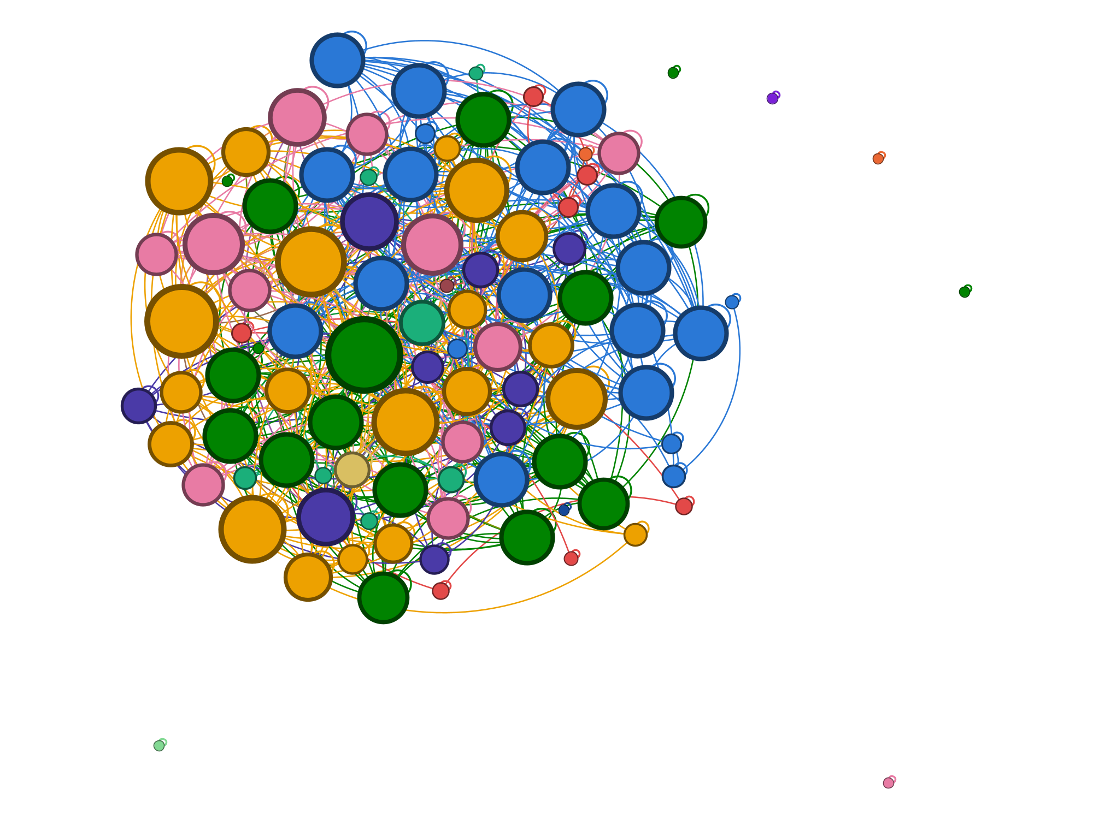
SEEING THE
REAL GRAPH
Structure is visible to the eye
Same-event tweets pull together under ForceAtlas2; singleton-event tweets scatter to the margin.
Louvain recovers it
18 communities for 13 events — NMI 0.88, modularity 0.76 on this block.
Heavy-tailed, as expected
Most tweets are low-degree (median 4); a few entity/user hubs tie the graph together (degree ~65).
Real block 5 in Gephi · ForceAtlas2 · nodes = tweets, sized by degree, colored by true event.
18

Slide 19
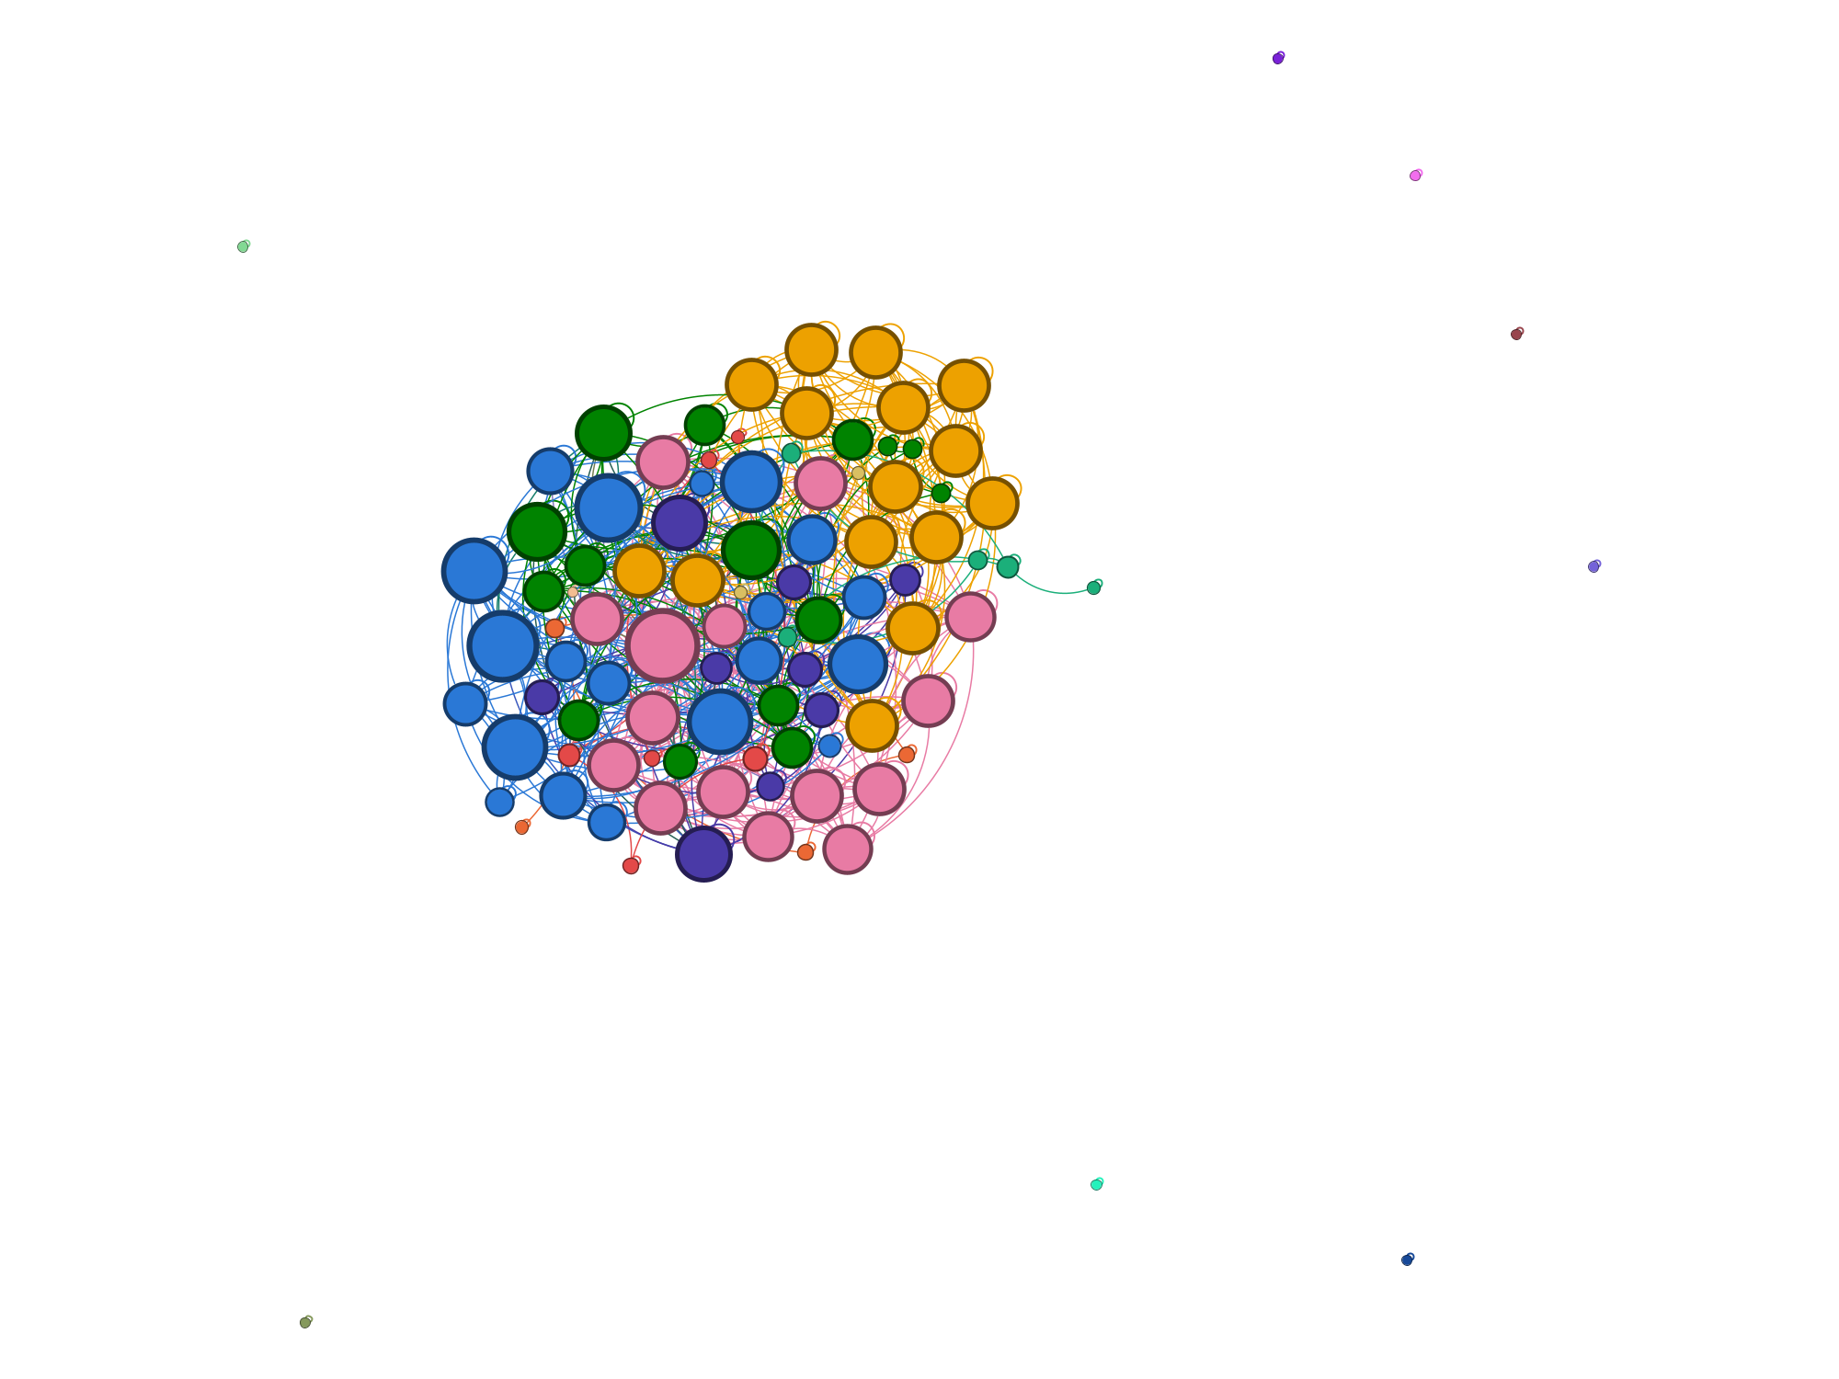
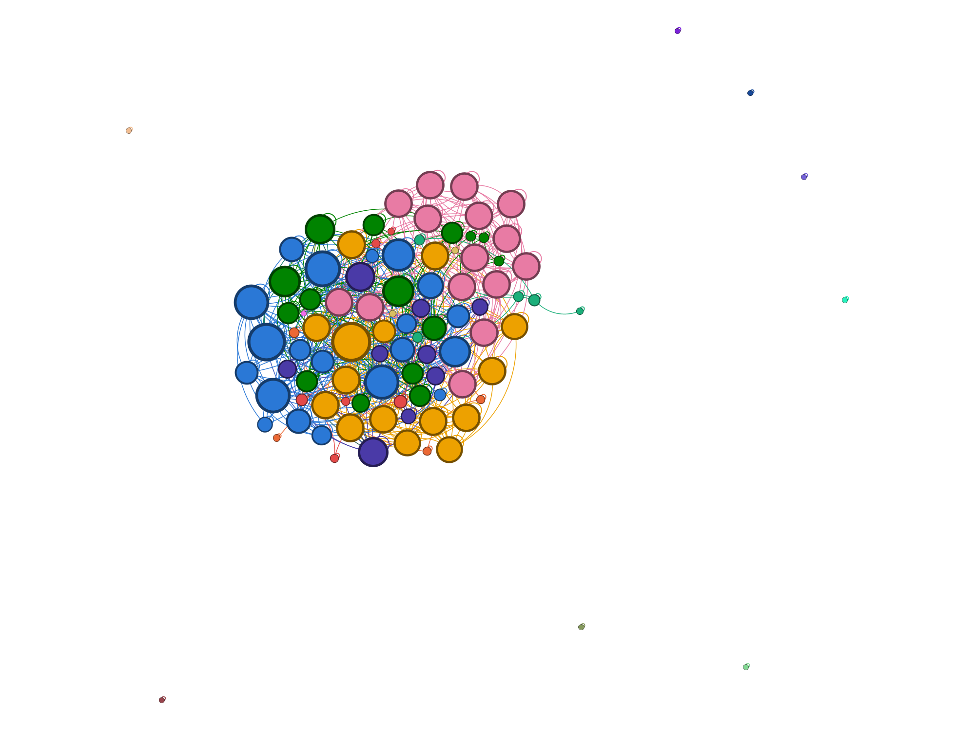
ONE GRAPH,
THREE PARTITIONS
Real block 5 in Gephi (ForceAtlas2) — the same 100 tweets, coloured by three different partitions.
Ground-truth event (the labels)
NetworkX Louvain community
Gephi modularity class
All three land on the same clusters: the labels, the NetworkX partition and Gephi's own modularity agree. Structure alone recovers the events here — NMI 0.88, modularity 0.76.
19

Slide 20
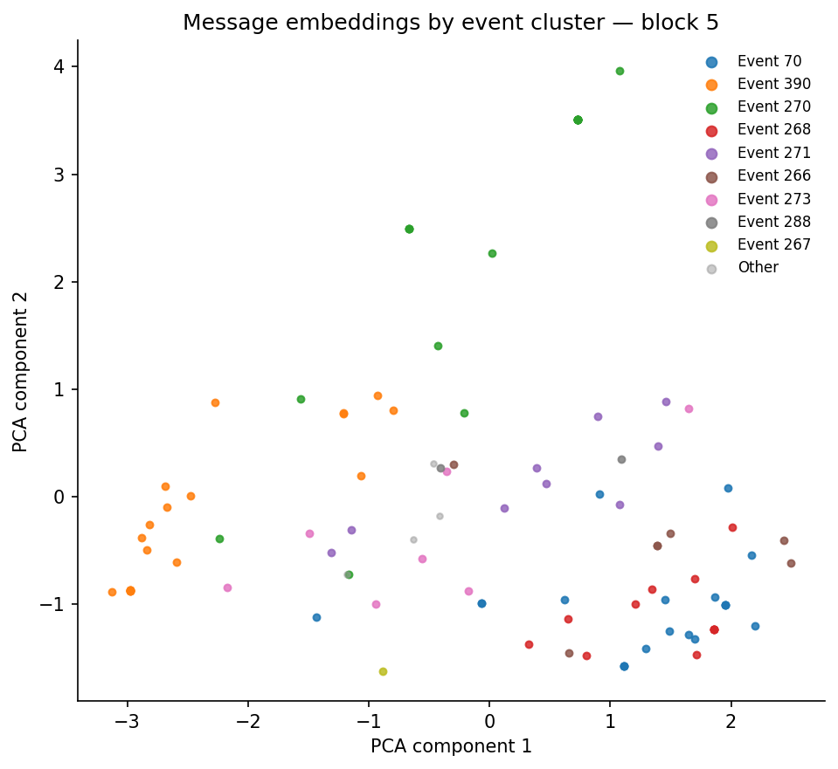
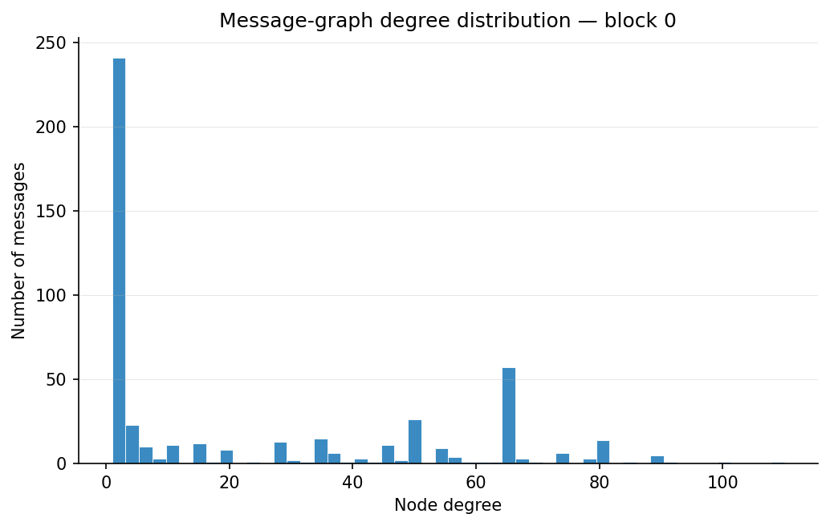
WHAT THE
NUMBERS
LOOK LIKE
Content separates — but only partly
The graph is heavy-tailed
DistilBERT space pulls some events apart, yet overlaps heavily in the centre — why content-only clustering caps near 0.64 NMI.
Median degree 4, a hub bump at ~65: a few entity / user hubs carry the network — exactly where GNN message-passing helps.
20

Slide 21
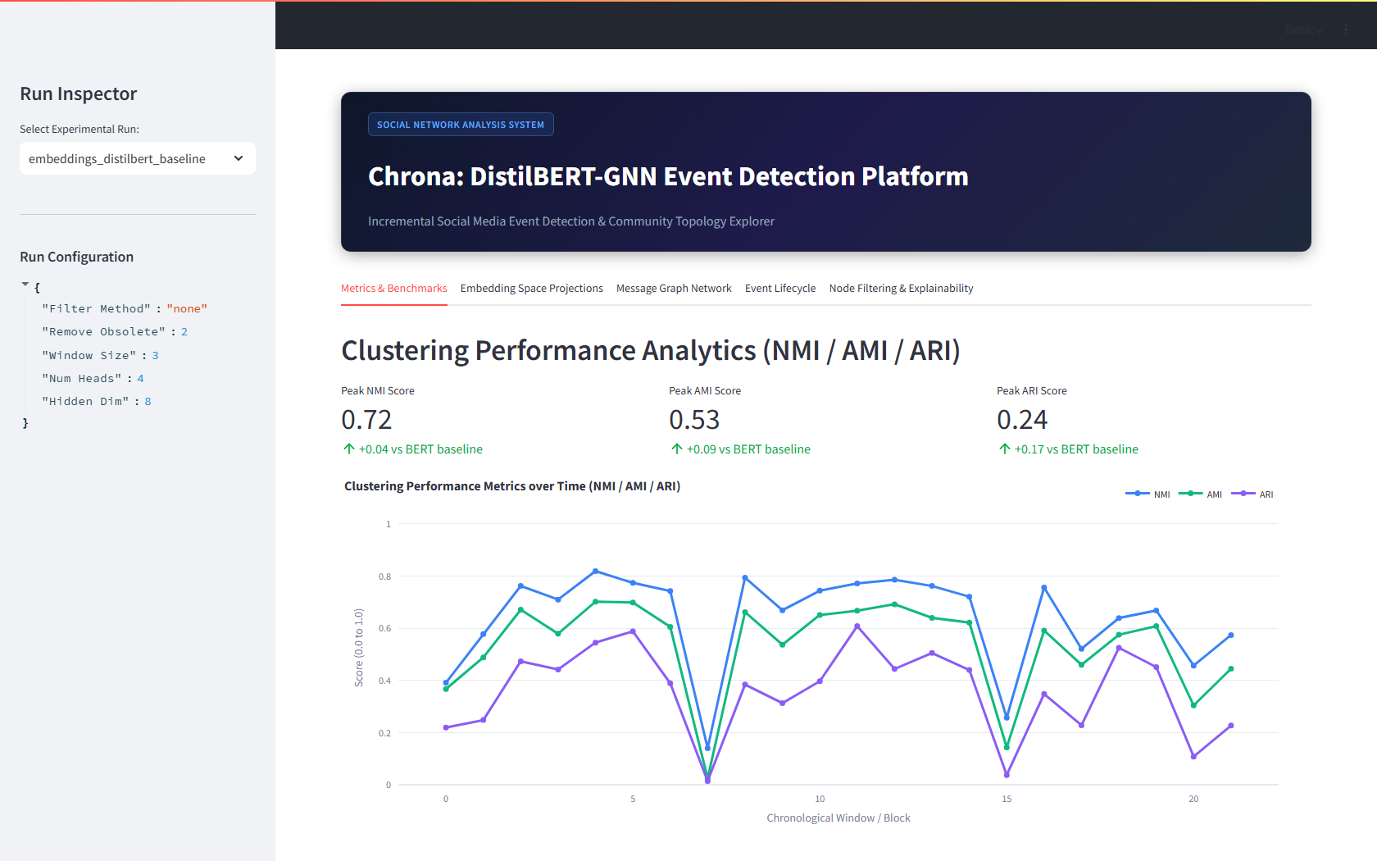
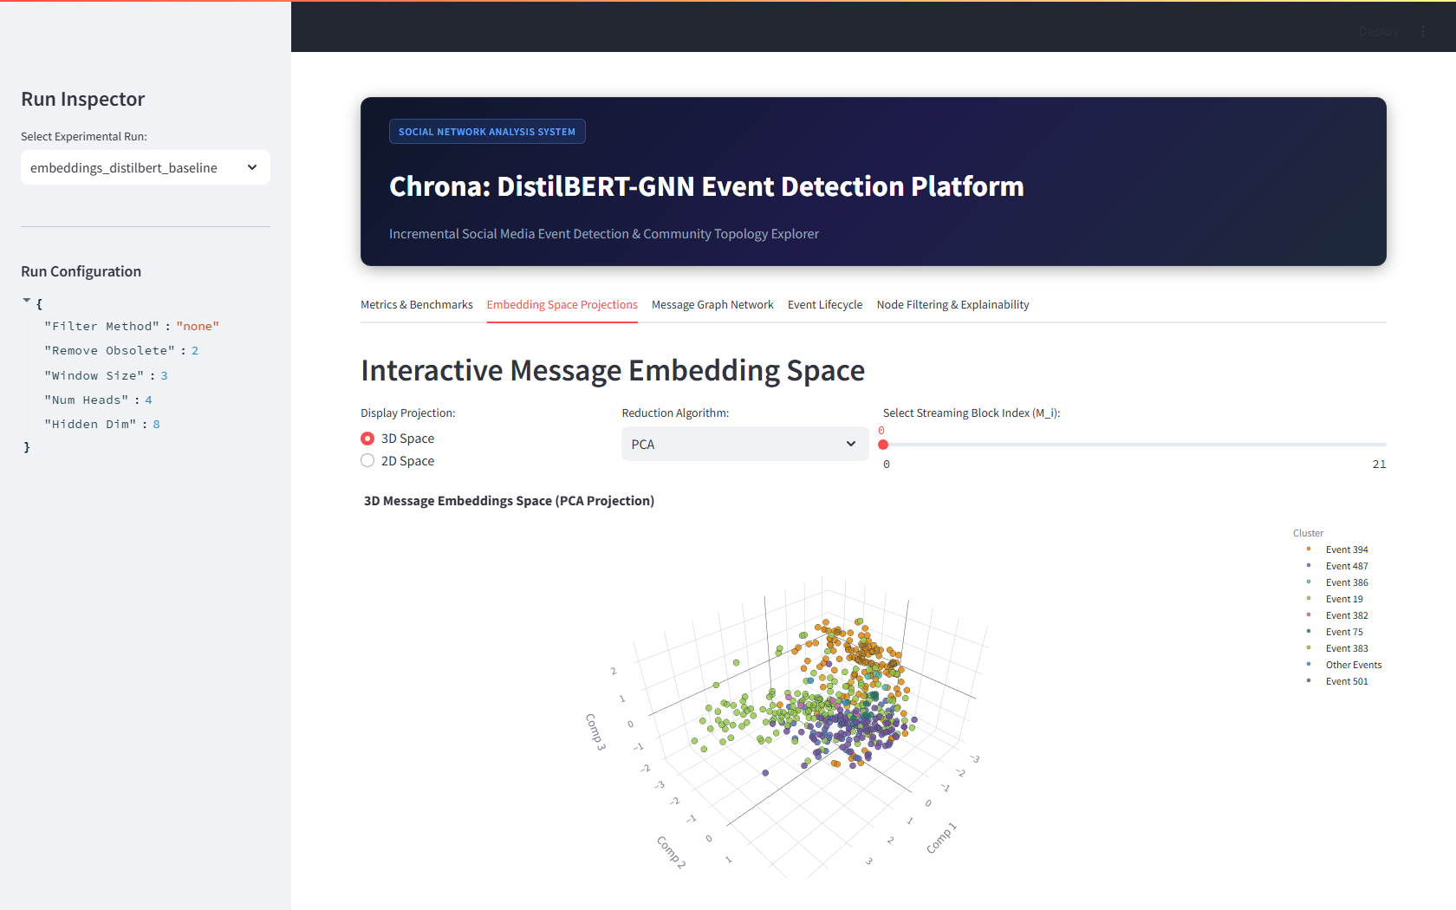
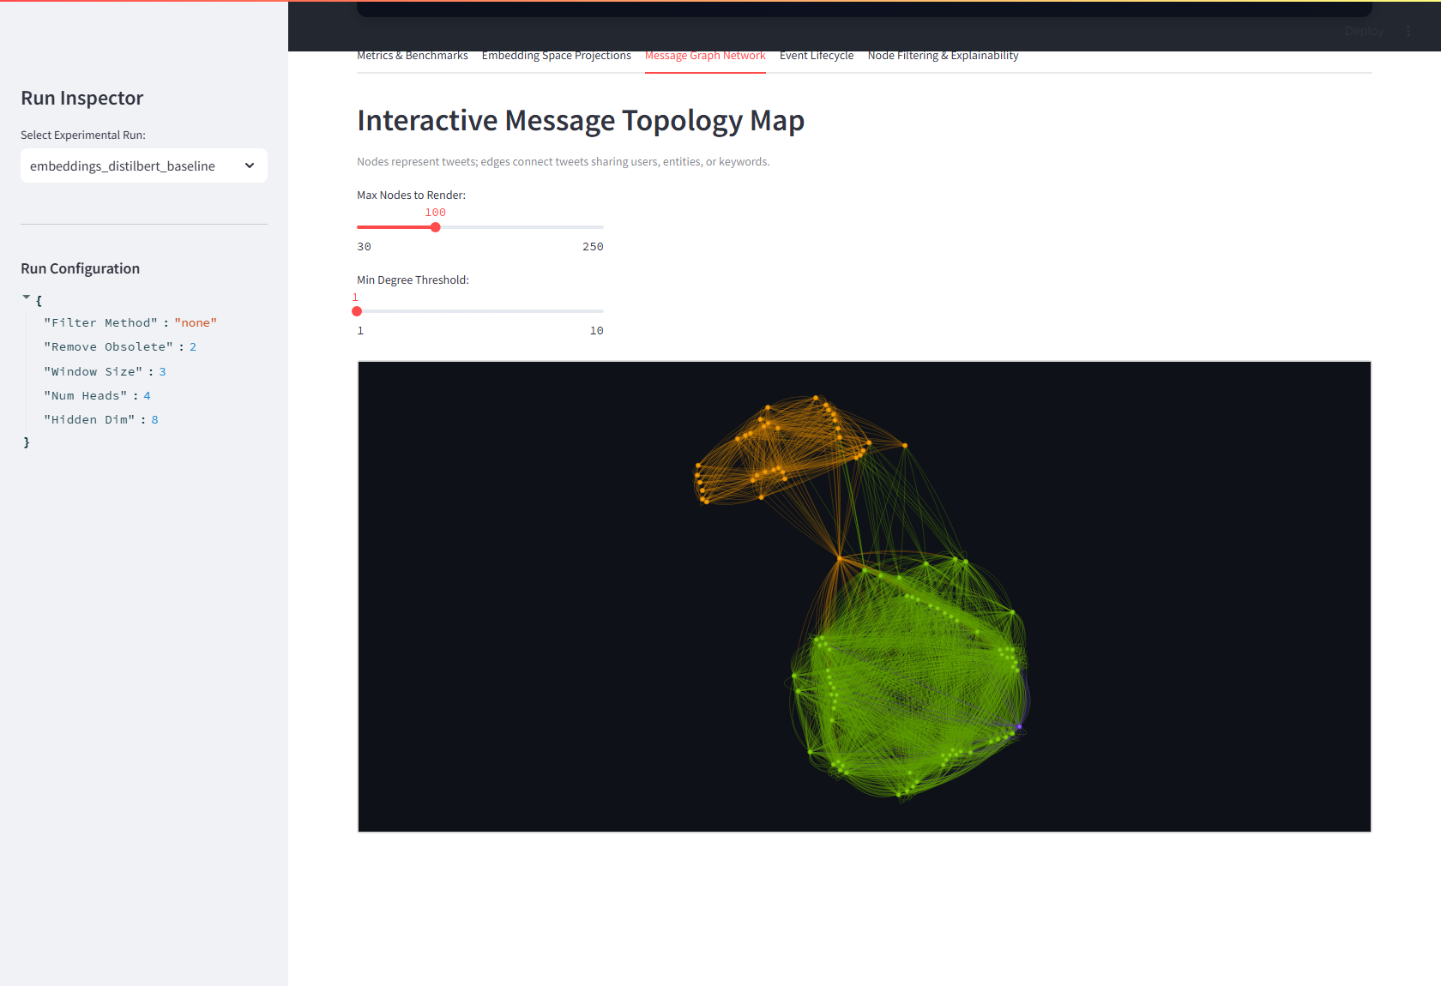
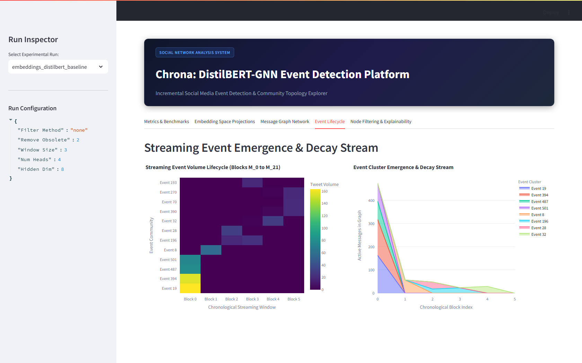
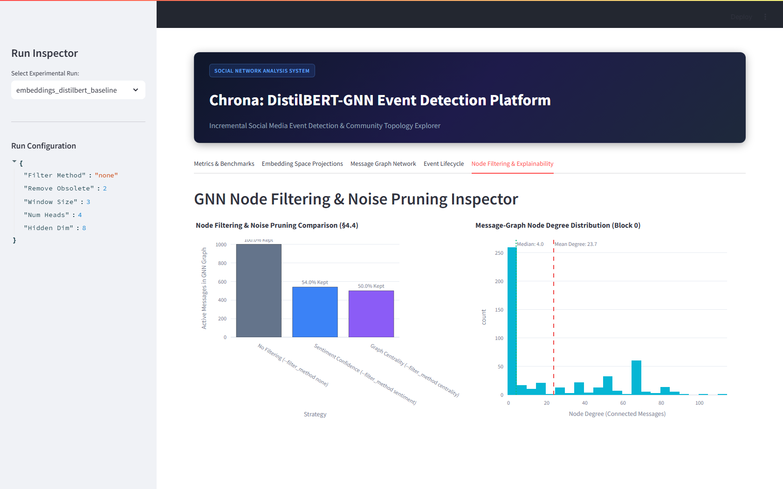
THE LIVE
DASHBOARD
Streamlit, running on the real data — five linked views (localhost:8501).
1 · Metrics over 22 blocks
2 · 3D DistilBERT embedding space
3 · Message topology map
Every tab is real
real metric curve · real embeddings · real topology · real lifecycle · real degrees. Only the headline KPI tiles are the paper's static reference numbers.
4 · Event emergence & decay
5 · Node-filter & degree inspector
21

Slide 22
OUR
TOOLING
NETWORKX
GEPHI
NEW SCRIPTS (RAN)
Louvain community detection (modularity-maximizing, no learning)
Degree / closeness / betweenness centrality
Modularity + NMI/AMI/ARI scored vs. ground-truth events, per block
Driven live via the AI Server HTTP API (:8081) — no manual clicking
ForceAtlas2 layout, size by degree, color by partition
Exported publication-quality PNGs of the real blocks
export_gephi.py — block → .gexf + Louvain scores
analyze_real.py — structure vs. content baselines + chart
gephi_render.py — drives Gephi end to end
build_dashboard_run.py — feeds the Streamlit dashboard real data
22

Slide 23
DISCUSSION &
IMPLICATIONS
REAL-WORLD RELEVANCE
WHY SNA + NLP TOGETHER
Clustering messages into events as they arrive is an early-warning layer — disasters, outbreaks, breaking news — flagged before any single report confirms them. Keep-latest maintenance keeps it cheap to run live.
Relational metadata (who posted, shared entities, shared hashtags) carries event signal the language model misses. On real data the two are complementary — the biggest gains come from combining them, not either alone.
WHAT OUR RESULT IMPLIES
LIMITATIONS
Because the better signal flips block to block, a system that re-weights structure vs. content per window should beat any fixed blend — a concrete design lead the GNN's attention already points toward.
One platform and one 28-day window; test-mode caps (100 msgs/block); 503 pre-labeled events; and full GNN metrics still pending the pinned torch 2.2 / dgl 2.2 environment.
23

Slide 24
OUR
CONCLUSION
We measured the two classical baselines the model is meant to beat, on the real benchmark. Structure (Louvain) and content (DistilBERT) land within 0.01 NMI of each other — yet the winner flips block to block. Neither signal is sufficient alone, and they are complementary exactly where it matters: on the same incoming messages. That gap — fusing structure and content per node — is precisely what DistilBERT-GNN's attention + contrastive objective is built to close.
THE TAKEAWAY
ON REAL DATA, STRUCTURE AND CONTENT ARE A TIE THAT DISAGREES PER BLOCK — WHICH IS THE STRONGEST CASE FOR A MODEL THAT FUSES BOTH
24

Slide 25
WHAT WE DID
WHAT COMES NEXT
Ran the real pipeline end to end
Full GNN run in the pinned env
68,841 tweets → real DistilBERT embeddings → 22 real message graphs, ~8 min on CPU.
Train DistilBERT-GNN (torch 2.2 / dgl 2.2) and drop its real NMI/AMI/ARI next to these baselines.
Measured two classical baselines
Scale past test mode
Louvain (structure) and KMeans/DistilBERT (content) scored vs. ground-truth events on every block.
Lift the 100-msg/block cap to the full per-day blocks; cluster the Gephi exports with OpenOrd for 20k-node maps.
Visualized it three ways
Write it up
Live Gephi (AI Server API), NetworkX figures, and the Streamlit dashboard — all on the real data.
The per-block complementarity result is the paper's hook: when does structure beat content, and why?
25

Slide 26
REFERENCES
Abagissa, A. T., Saxena, S., & Chandra, J. “DistilBERT-GNN: A Powerful Approach to Social Media Event Detection.” Research Square preprint, 2024.
Blondel, V. D., et al. “Fast Unfolding of Communities in Large Networks.” J. Stat. Mech., 2008.
Veličković, P., et al. “Graph Attention Networks.” ICLR, 2018.
Newman, M. E. J. “Modularity and Community Structure in Networks.” PNAS, 2006.
Ren, Y., et al. “Each Encoder Matters: Querying Social-Media Streams via QSGNN.” 2022.
Cao, Y., et al. “Knowledge-Preserving Incremental Social Event Detection via GNN (KPGNN).” 2021.
Peng, H., et al. “Fine-Grained Event Categorization with Heterogeneous GCN (PP-GCN).” 2019.
Liu, B., et al. “EventX: Open-Domain Event Extraction.” 2020.
Bastian, M., Heymann, S., & Jacomy, M. “Gephi: An Open Source Software for Exploring and Manipulating Networks.” ICWSM, 2009.
Hagberg, A., Schult, D., & Swart, P. “Exploring Network Structure with NetworkX.” SciPy, 2008.
26

Slide 27
Thank
You
— measured on real data, and worth publishing
27

