Slide 1
SOCIAL NETWORK ANALYSIS — CASE STUDY
DistilBERT-GNN
Detecting and Tracking Social Media Events as an Evolving Network
[Your Name] · [Course / Instructor] · [Date]
Reimplementation of: Abagissa, Saxena & Chandra — "DistilBERT-GNN: A Powerful
Approach to Social Media Event Detection" (IIT Patna, 2024)
Notes:
Open by naming the framing up front: this is a social-network-analysis case study, not just an NLP demo. State the one-sentence hook: we model tweets, users and entities as a graph and detect events as communities in that graph. Fill in your name/course/date before presenting.

Slide 2







ROADMAP
What We’ll Cover
This deck follows the case-study rubric section by section.
1. Introduction & Context
5. Visualization & Graph Representation
The research problem and why it is a network problem
Architecture diagrams and reproducible figures
2. Data Collection & Sources
6. Discussion & Implications
The benchmark network and how it was built
Real-world relevance and limitations
3. Network Modeling & Methodology
7. Conclusion & Summary
SNA techniques applied and why
Key takeaways
4. Analysis & Interpretation
What the results say about network structure
2 / 13
Notes:
This deck is organized to mirror the case-study rubric exactly — call that out so the grader can follow along section by section. Move quickly through this slide; it is a map, not content.

Slide 3

1. INTRODUCTION & CONTEXT
Why Is This a Network Problem?
THREE CHALLENGES THIS MODEL ADDRESSES
RESEARCH QUESTION
Vocabulary gap
Slang & abbreviations break simple keyword matching
Does modeling tweets, users, and entities as a connected graph detect real-world events more reliably than text alone — and can it be done incrementally, as new messages keep arriving?
Short, unstructured messages
Individual tweets carry too little signal alone
A tweet in isolation is short and ambiguous. What disambiguates it is relational context — who posted it, and which other messages share its users, entities, or keywords. That relational context is a network, and this case study models it as one.
Continuous new nodes/edges
The network keeps growing — it can’t be treated as a static snapshot
Relevance: reliable, early event detection over an evolving social graph directly supports disaster response, public-safety monitoring, and misinformation tracking.
3 / 13
Notes:
Read the research question slowly — it is the thesis of the whole deck. Emphasize the word "incrementally": the network keeps growing, so this cannot be a one-time classification task. Use the three challenges to justify why a text-only model (Word2Vec, BERT) is not enough on its own — that sets up the Analysis slide later.

Slide 4
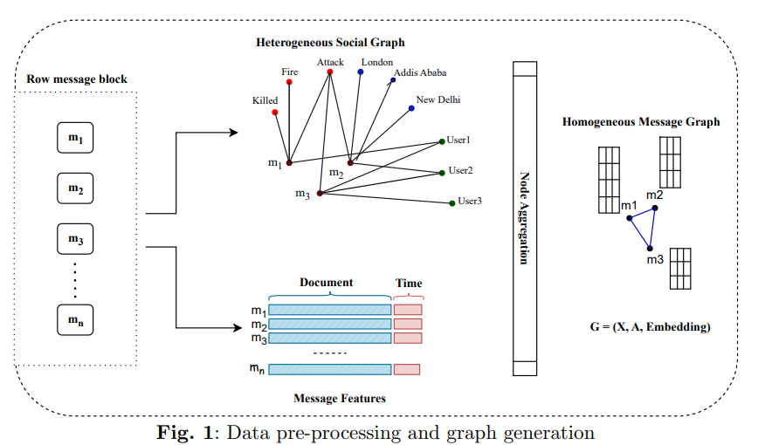
2. NETWORK DATA COLLECTION & SOURCES
The Benchmark Network
68,841
503
Messages
Event categories
16.36M
28 days
Graph edges
Oct 10 – Nov 7, 2022
SOURCE & HONESTY NOTE
This Twitter benchmark was not collected for this case study — it originates from the QSGNN benchmark (Ren et al., 2022) and is reused here, exactly as the base paper reuses it, so results stay comparable to prior published baselines (Word2Vec, LDA, BERT, KPGNN, QSGNN, …).
Fig. Raw message block → heterogeneous social graph → homogeneous message graph
What this repo builds instead: the raw stream → graph pipeline
Messages, users, entities (via NER), and keywords become nodes; edges link a message to what it contains. The heterogeneous network is then projected into a homogeneous message–message graph — fully reproducible via custom_message_graph.py.
4 / 13
Notes:
Lead with the honesty note before anyone can ask "did you collect this yourselves?" — say plainly that this reuses an established benchmark, and explain why that is the correct academic choice (comparability to prior baselines). Then walk the diagram left to right: raw block -> heterogeneous graph -> homogeneous message graph. This is the "network" the rest of the talk analyzes.

Slide 5





3. NETWORK MODELING & METHODOLOGY
SNA Techniques Applied — and Why
Graph Construction
Centrality Filtering
Attention-Weighted GNN
HIN → homogeneous message graph makes implicit relationships explicit and computable.
Degree + closeness + betweenness rank structural importance — a purely graph-theoretic noise filter.
2-layer GAT (4 heads) learns per-neighbor edge weights instead of fixing them by hand.
Community Detection
Contrastive Learning
Incremental Maintenance
DBSCAN / K-Means recover events as communities — no predefined class count needed.
Triplet + global-local loss shapes embeddings so communities are separable at scale.
Pre-train → detect → maintain lifecycle tracks a network that keeps growing.
5 / 13
Notes:
This is the core "methodology" slide for the rubric — name each technique explicitly as an SNA technique (centrality, community detection, etc.), not just a deep-learning component. If asked "why is this SNA and not just deep learning," point here: every box is a classical network-analysis concept, just implemented with learned components.

Slide 6

3. NETWORK MODELING & METHODOLOGY
Node Filtering: Content vs. Structure
Which better predicts that a message matters — what it says, or where it sits in the network?
DEFAULT
ALTERNATIVE
Sentiment-Based
Centrality-Based
DistilBERT scores each message; those with confidence > 50% are kept as genuine event reporting, the rest are treated as noise.
Degree + closeness + betweenness centrality are combined; nodes below the 50th percentile are dropped — no text is read at all.
Justification: emotionally/semantically confident messages correlate with real reporting of an unfolding event.
Justification: the classically-SNA alternative — importance defined purely by network position, for direct comparison against content-based filtering.
6 / 13
Notes:
This slide answers a likely grader question directly: why two filtering strategies? Frame it as an experiment in itself — content-based vs. purely structural importance — and say that both are implemented and swappable via a command-line flag, which shows this was actually built, not just described.

Slide 7
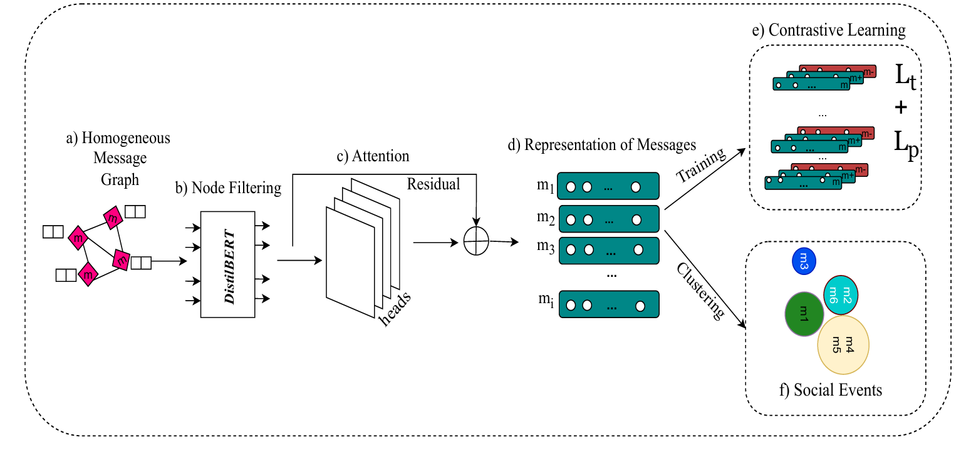
3. NETWORK MODELING & METHODOLOGY
End-to-End Pipeline
(a)
(b)
(c)
(d)
(e)
(f)
Homogeneous message graph
DistilBERT node filtering
Multi-head attention
Message representations
Contrastive learning (Lt + Lp)
Social event clustering
7 / 13
Notes:
Walk left to right through (a)-(f) once, briefly. This is the single diagram to point back to if anyone loses the thread later in the talk — "recall stage (b), the node filtering we just discussed" etc.

Slide 8
4. ANALYSIS & INTERPRETATION
Offline Evaluation: Graph Methods Win
Reading the chart: the three graph-based methods on the right (KPGNN, QSGNN, DistilBERT-GNN) beat every text-only method on AMI and ARI — evidence that network structure carries information about event membership that text alone does not.
8 / 13
Notes:
State clearly that these numbers are as reported in the base paper’s Table 4, not a run you personally executed — unless you have run main.py yourself, in which case swap in your own numbers here and say so explicitly. The point to land: the rightmost cluster of graph-based bars beats the left cluster of text-only bars on AMI/ARI — that gap is the whole argument for treating this as a network problem.

Slide 9
4. ANALYSIS & INTERPRETATION
How Much Network History Should Survive?
3
2
1
Keep All
Keep Relevant
Keep Latest
Never prune old nodes
Prune nodes disconnected from recent arrivals
Retrain only on the most recent block
Worst performance — highest memory cost
Moderate performance
Best performance — most efficient (default)
NON-OBVIOUS FINDING
OTHER ABLATIONS
Keeping more historical network structure does not help — it actively hurts. Old, now-irrelevant ties dilute the signal for detecting new communities.
• Hard-negative sampling consistently improves NMI
• Smaller maintenance windows (1–3 blocks) slightly outperform larger ones
• Batch size (1000–4000) has little effect on NMI/AMI
9 / 13
Notes:
This is the most "counter-intuitive" result in the case study, so slow down here: more memory of the network’s past is not free, and it actually hurts. That is a good line to quote verbatim if asked "what surprised you in this project."

Slide 10
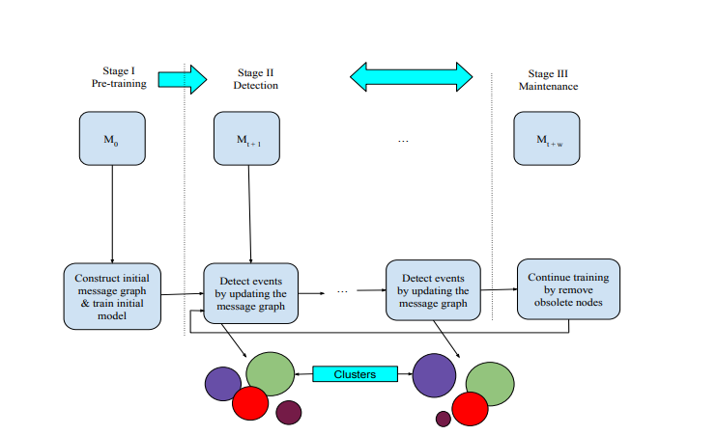

5. VISUALIZATION & GRAPH REPRESENTATION
From Architecture to Evidence
GENERATE BEFORE PRESENTING — REPLACE THESE PLACEHOLDERS
metrics_over_time.png
NMI/AMI/ARI across the incremental run — proves the model tracks a growing network
embedding_clusters_i.png
PCA scatter of message embeddings — proves events form separable communities
degree_distribution_i.png
Node-degree histogram — proves the network is non-trivially connected
Run: python tools/visualize_run.py metrics|embeddings|graph …
Fig. Pre-training → detection → maintenance lifecycle
10 / 13
Notes:
IMPORTANT: run tools/visualize_run.py before presenting and replace the right-hand placeholder list with the three actual generated PNGs (swap this slide’s content for real embedded images). Presenting the placeholder list as-is is fine as a fallback, but real figures score much better on the "Visualization & Graph Representation" rubric line.

Slide 11

6. DISCUSSION & IMPLICATIONS
What This Means — and Where It Falls Short
IMPLICATIONS
LIMITATIONS
• Early-warning layer: emerging event clusters can be flagged before any single report confirms them.
• Single platform, single 28-day window, 503 pre-labeled categories — generalization beyond Twitter is untested here.
• Keep-latest maintenance keeps production cost low — no need to reprocess the network’s full history.
• Both node-filtering strategies use fixed, hand-set thresholds (median percentile / 50% confidence), not tuned per deployment.
• Relational metadata (who, which entities, which hashtags co-occur) should not be discarded even when strong language models are available — structure and language are complementary.
• The benchmark’s event mix (disasters, breaking news) may not represent slower-burn events like misinformation campaigns.
11 / 13
Notes:
Do not skip the limitations column — volunteering them yourself, before a grader asks, reads as stronger critical thinking than being caught without an answer. Keep both columns balanced in speaking time.

Slide 12

7. CONCLUSION & SUMMARY
A Network Problem, Solved as One
0.72
0.53
0.24
CASE-STUDY TAKEAWAY
Treating social media content as a network problem — not just a text-classification problem — measurably improves event detection.
NMI
AMI
ARI
"DistilBERT-GNN uses dynamic social streams to continuously learn from new incoming data and adapt its parameters accordingly." — base paper, §7 Conclusion
The three techniques that make the difference: explicit graph construction, structural or content-based node filtering, and community detection over learned, attention-weighted embeddings.
12 / 13
Notes:
Close on the takeaway card, not the numbers — the numbers are supporting evidence, the boxed sentence on the right is the argument you want the audience to remember.

Slide 13
Thank You
Questions & Discussion
Repository: [your GitHub repo link] · Base paper: doi.org/10.21203/rs.3.rs-4193412/v1
Notes:
Fill in your repository link before presenting. Be ready for the two most likely questions: (1) why reuse a benchmark instead of collecting new data, and (2) why keep-latest beats keep-all for network maintenance — both are covered earlier in this deck.

