Slide 1








ELECTRONICS AND COMMUNICATION ENGINEERING
AUTOMATIC CUTOFF MOTOR

Slide 2
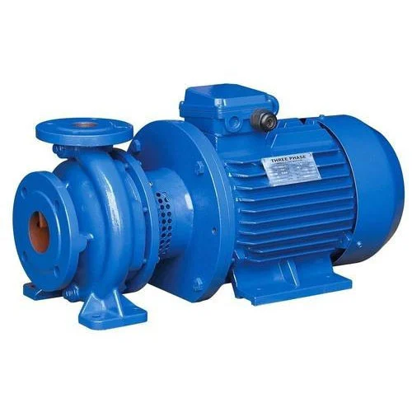
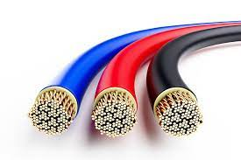

Slide 3
ABSTRACT :
This project presents a low cost and flexible pump automation by using a sensor. To demonstrate the feasibility and effectiveness of this system, devices such as pump, Raindrop sensor, wires, have been integrated with the proposed pump automation system.
In agricultural fields motor pump under the well plays a major role for irrigating water. Whenever we forgot to off the pump. This will cause a wastage of electricity and coils are gone if the pump operates for long time in absence of water level. When the water level in the ground-level in well becomes too low, the pump siphons air and shuts down, requiring a resident to manually prime the water pump to get it running again. Farmers struggle to monitor the water level of the tanks effectively and keep the pump running properly.
The proposed water on/off circuit is basically an automatic system where the pump is started automatically by using a raindrop sensor using a raindrop sensor , once the water level reaches the brim of the tank; the operation is switched off automatically by means of a absence of water in rain drop sensor. In order to avoid such situations we can have an electronic water level controller which can monitor the water level and switch the motor pump accordingly.

Slide 4
INTRODUCTION :
The automatic on/off motor circuit is used to automate the operation of an electrical water pump based on the presence of water on the sensor board .
The automatic on/off motor using Arduino circuit can be used as a standalone system and can be interfaced to the existing control panel. In this project we have used very common, efficient and cheap components.
It is very simple circuit and useful for all. It is used in home, agriculture farms , public forums, industries.

Slide 5
OBJECTIVES :
To protect motor from coil failure and to save the electricity.
This project doesn’t require any human to operates as it is fully automatic.
This can be connected in real life starter and control a motor.
The operating current of this circuit is very small and it doesn’t waste any power and doesn’t produce any heat.
Though it is automatic, it can be controlled using manual switches as per our convenient.
To verify how the motor pump cut off the load.

Slide 6
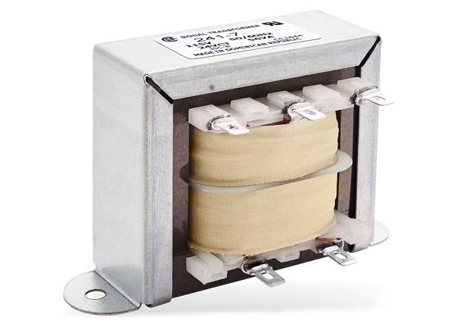
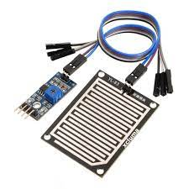
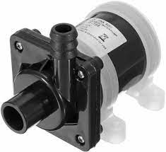
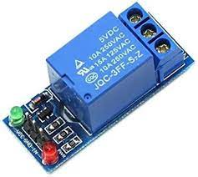
COMPONENTS :
Resistor 27k
Diode in 4007
Stepdown and stepdown transformer (230-6, 6-230)
Raindrop sensor
IC’s IC 7805
Capacitor 1μf, 0.1μf
Transistor 2N2222, BD140
Submersible motor 12v

Slide 7
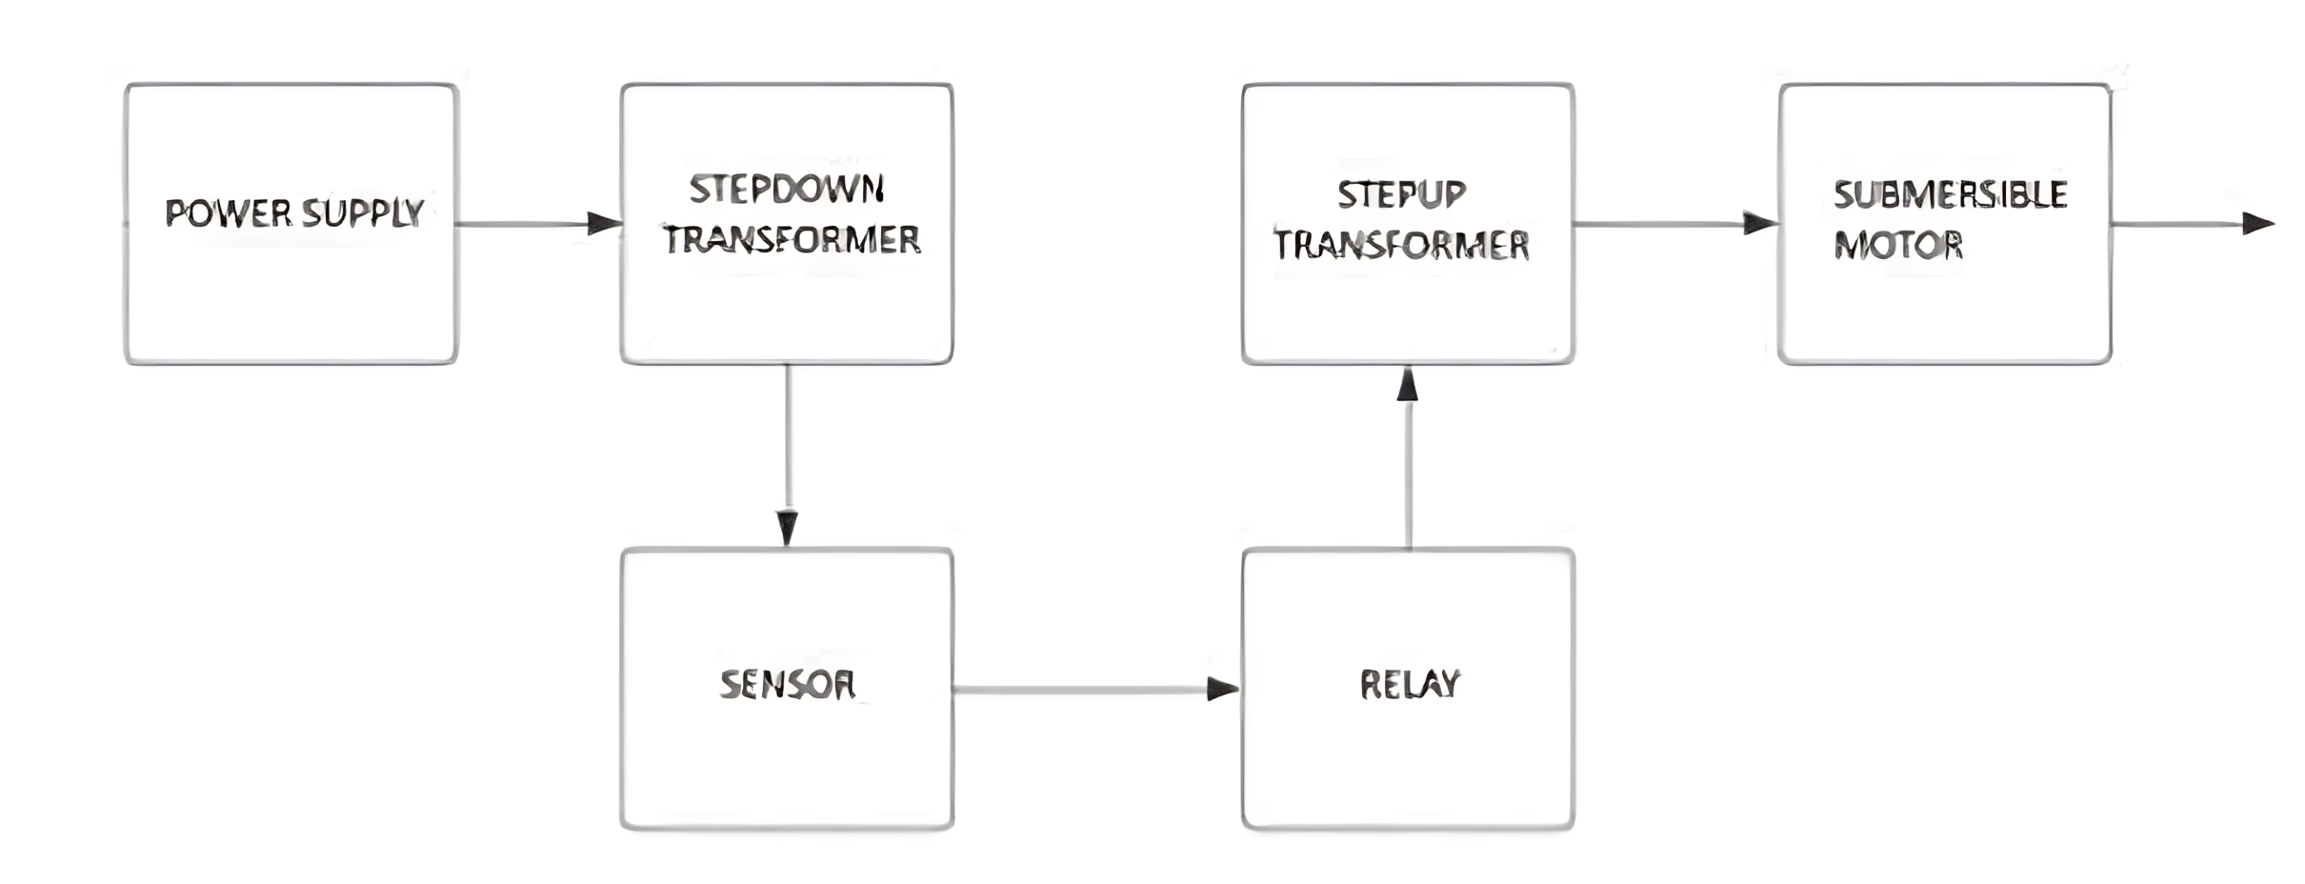
BLOCK DIAGRAM:

Slide 8
TRUTH TABLE FOR RELAY OPERATION :
Presence of water on board | Relay operation (RL2) | Pump motor Operation
Presence of water on board | On | Starts
Absence of water on board | Off | Stops

Slide 9
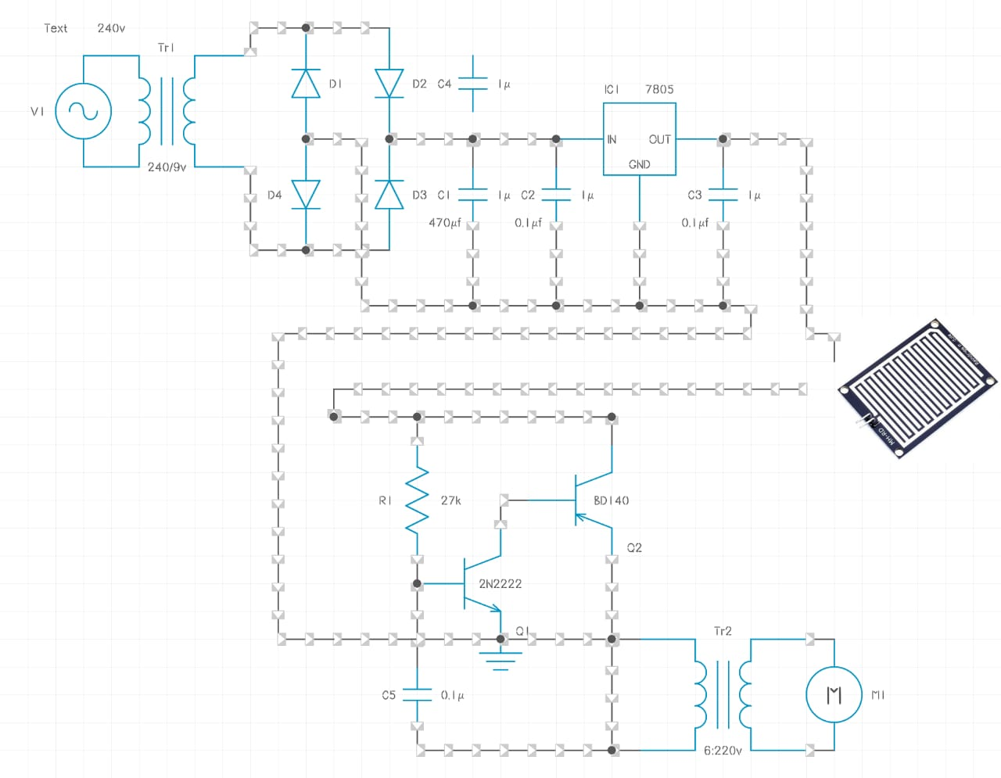
CIRCUIT DIAGRAM :

Slide 10
ADVANTAGES :
1.Cost Savings: By preventing coil damage, you can avoid the expenses associated with repairs or replacements, ultimately saving on maintenance costs.
2.Customization: Users can customize the automation based on specific requirements, allowing for tailored solutions to different scenarios.
3.Operational Reliability: Automation reduces the dependency on manual operation, minimizing the risk of human-related errors and ensuring more reliable pump operation.
4.Energy Efficiency: They can be programmed to operate only when needed, reducing energy consumption and lowering utility costs.
5.Extended Lifespan: Protecting coils from damage can contribute to a longer lifespan for the motor, reducing the frequency of replacements and associated costs

Slide 11
DISADVANTAGES :
1.Dependency on Power Supply: Automated pumps rely on a stable power source. Power outages or electrical issues can disrupt their functionality.
2.Initial Cost: The installation of automated systems may involve higher upfront costs compared to manual pumps.
3.Sensor Malfunctions: Sensors used in automated systems may malfunction, leading to inaccurate water level readings and potentially causing pump issues.
4.Vulnerability to Technical Failures: Like any automated technology, water pumps can be susceptible to technical failures, software glitches, or programming errors.
5.Dependency on Technology: Reliance on automated systems may reduce manual operation skills, creating a dependency on technology that can be a drawback in certain situations

Slide 12
CONCLUSION :
In this busy day to day life to prevent motor is essential one for daily uses .
In this case, some people may forget to switch on and switch off the motor properly .
This may leads to wastage of electricity and failure of coil .
In order to address the problem , we have to use this automatic cut off motor .
Through this automatic on/0ff motor, motor will turn on when there is available of water and turn off automatically when non-available of water .

