Slide 1

Employee Data Analysis using Excel
STUDENT NAME: KAVINESH.T
REGISTER NO: 2213211042114
DEPARTMENT: COMMERCE
COLLEGE: PRESIDENCY COLLEGE
1
Notes:
1

Slide 2

PROJECT TITLE
Salary and Compensation Analysis Through Excel Data Modeling
2

Slide 3

PROBLEMS
Analyzing salaries helps ensure fair compensation, boosting employee satisfaction and reducing turnover. It also allows employers to stay competitive in the job market and manage payroll budgets effectively. Additionally, it ensures legal compliance and promotes pay equity by identifying and addressing disparities. Overall, salary analysis supports better decision-making for both employers and employees.
4

Slide 4

OVER VIEW
The project uses Excel to analyze employee salaries, aiming to identify patterns, disparities, and ensure fair compensation. It involves comparing pay with industry standards, checking for pay gaps, and helping management make data-driven decisions. The goal is to create a transparent and equitable compensation system in the company
5

Slide 5

WHO ARE THE END USERS?
End users of the salary and compensation analysis dataset: HR Managers: For ensuring fair pay practices and managing payroll.
Company Executives and Management: For making strategic decisions on compensation and budgeting Finance Department: For financial planning and compliance. Employees: Indirectly benefit from fair and transparent compensation practices.
6

Slide 6

OUR SOLUTION AND ITS V ALUE PROPOSITION
The objective of the Salary and Compensation Analysis Through Excel Data Modeling is to evaluate and understand the compensation structure within an organization. This involves analyzing salary data to identify patterns, ensure competitive and fair pay, uncover any disparities (e.g., gender or race-based), and support data-driven decision-making for payroll, budgeting, and employee retention strategies.
7

Slide 7
Dataset Description
Employers Dataset is taken form Kaggle website for the analyse of Salary and Compensation Analysis Through Excel Data Modeling. Here’s a detailed description of the dataset structure and the significance of each data field:
Employee ID Name Gender Salary Start date FTE Employee type

Slide 8
MODELLING
1.Preparing the Data
Selecting the Data that was need
2. Finding the
average , minimum and maximum
of Salary of employers
3. Creating the chart
based on average, minimum
And maximum
4. Selecting the dataset that was need
5. Click Inset And creating the pivot table
6. And adding the final report of pivot chart
10

Slide 9
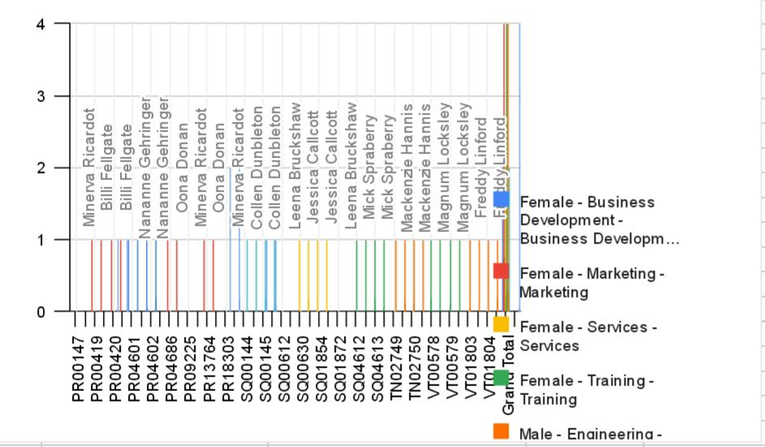
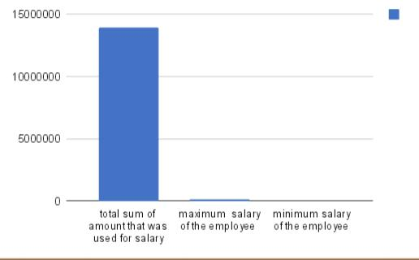
Result
11

Slide 10
conclusion
Summary of the effectiveness of Excel Pivot Tables and charts. Emphasis on the ease of use and clarity these tools provide. The impact of these tools on making informed business decisions. Final thoughts on the value of Excel in data analysis. Summarize the benefits of using Excel PivotTables and charts for data analysis. Emphasize how these tools provide clear, actionable insights that can support business decisions. Each of these sections aligns with the agenda and provides a comprehensive explanation of how to utilize Excel for data analysis.

