Slide 1



Waste classification using CNN
By Kavineshan K

Slide 2

Learning Objectives
Understand the role of AI in waste classification
Implement a CNN model for image-based waste categorization
Evaluate model performance and accuracy
Explore real-world applications of waste classification AI identify limitations and areas for improvement
Discuss ethical considerations in AI-based waste management
GOAL

Slide 3
Tools and Technology used
Python, TensorFlow, Keras
OpenCV, NumPy, Pandas, Matplotlib
Jupyter Notebook
Google Colab for training large datasets
Image processing libraries for data augmentation
Cloud-based model deployment platforms
Dataset: Kaggle (techsash/waste-classification-data)
https://www.kaggle.com/datasets/techsash/waste-classification-data/data

Slide 4
Methodology
Data Collection and Preprocessing
CNN Model Design
Training and Evaluation
Testing on New Data
Hyperparameter Tuning for Optimal Performance
Model Deployment and Real-Time Inference

Slide 5
Problem Statement:
Manual waste sorting is inefficient and prone to errors, leading to ineffective recycling and increased environmental impact. The current challenges include:
High Labor Costs and Time-Consuming Processes: Traditional waste sorting methods require significant human resources and time, making them unsustainable and costly.
Incorrect Waste Disposal: Errors in manual sorting contribute to improper waste disposal, which can harm the environment and reduce recycling rates.
Lack of Automation: The absence of automated systems in waste management leads to inconsistent sorting practices, exacerbating the challenges of effective waste classification.
Limited Public Awareness: There is a general lack of public understanding regarding waste segregation, which hinders participation in recycling efforts.
Challenges in Large-Scale Waste Classification: As urban areas grow, the volume of waste increases, complicating the management and classification of waste materials.

Slide 6
Solution:
A machine learning-based system utilizes input parameters (such as images of waste items, along with environmental factors like location and waste type) to classify waste into recyclable and non-recyclable categories using a Convolutional Neural Network (CNN).
The system enhances the efficiency of waste management by automating the sorting process, significantly reducing reliance on manual labor and minimizing errors in waste classification.
Classifications are presented through visual dashboards and reports, allowing for better understanding and informed decision-making regarding waste disposal and recycling strategies.

Slide 7
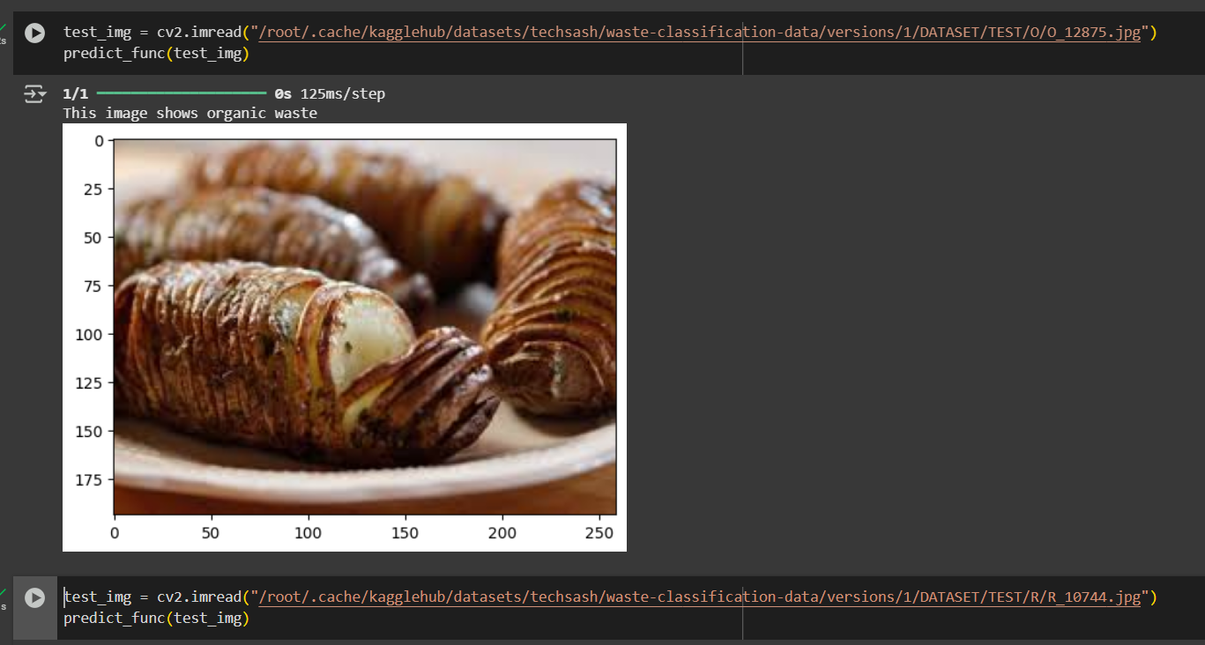
Screenshot of Output:

Slide 8
Conclusion:
The implementation of a machine learning-based waste classification system represents a significant advancement in waste management practices. By utilizing a Convolutional Neural Network (CNN) to automate the sorting process, we can achieve higher accuracy and efficiency in waste classification, reducing reliance on manual labor and minimizing errors associated with traditional sorting methods.
This system not only streamlines waste management operations but also enhances recycling rates and promotes environmental sustainability. By providing accurate classifications and insights, the system supports informed decision-making for resource allocation and waste disposal strategies.
Ultimately, this innovative approach contributes to the development of smart waste management solutions that can adapt to varying waste types and scales, fostering a more sustainable future. The integration of AI technology into waste management is a crucial step toward a circular economy, where waste is minimized, and resources are utilized efficiently.

