Slide 1
GENAI CAPSTONE
AI-Powered Telecom Network Operations Assistant
Similar-incident retrieval, multi-agent root-cause analysis and validated troubleshooting for NOC engineers
Kavini Muthamizhvalvan · GenAI capstone
Notes:
0:15. Introduce yourself and the one-line pitch.

Slide 2



The problem: slow, inconsistent incident triage
PROBLEM STATEMENT
NOC teams repeatedly face
Congestion
Weak signal
Latency
Packet loss
Call drops
Handover failures
Faults
Knowledge is buried
Searching by hand is slow
The cost
What similar incidents looked like, why they happened and what fixed them is buried in thousands of KPI records
Engineers dig through the history manually for every incident
Higher MTTR and inconsistent decisions between engineers
Notes:
0:25. NOC engineers face the same degradations repeatedly; the knowledge is buried in KPI history. Searching by hand is slow, which means higher MTTR and inconsistent decisions between engineers.

Slide 3






Business need: quicker, consistent triaging
BUSINESS NEED
Similar past cases
A classified, prioritized incident
INPUT
A plain-language description of the incident
Root-cause hypotheses
Cited, validated actions
And improve from engineer feedback · ratings and case relevance votes flow back into retrieval
Notes:
0:20. From a plain-language description, the business need is to return within seconds: similar past cases, a classified, prioritized incident, root-cause hypotheses and cited, validated actions, and to improve from engineer feedback.

Slide 4


What the engineer gets
SOLUTION OVERVIEW
Similar cases
Classification
Risk and priority
Hybrid search over 100,000 historical records, with filters
8 incident types + NORMAL; asks for clarification when vague
ML fault risk, P1–P4 priority with reasons, impact level
Root causes
Actions
Validation
Ranked hypotheses, each with evidence type and citations
Ordered, phased, with verification and change-approval flags
An LLM judge + rule checks; one revision; low-confidence flag
Deterministic (no LLM)
LLM component
Notes:
0:30. One request returns all of this; every step is grounded and cited.

Slide 5
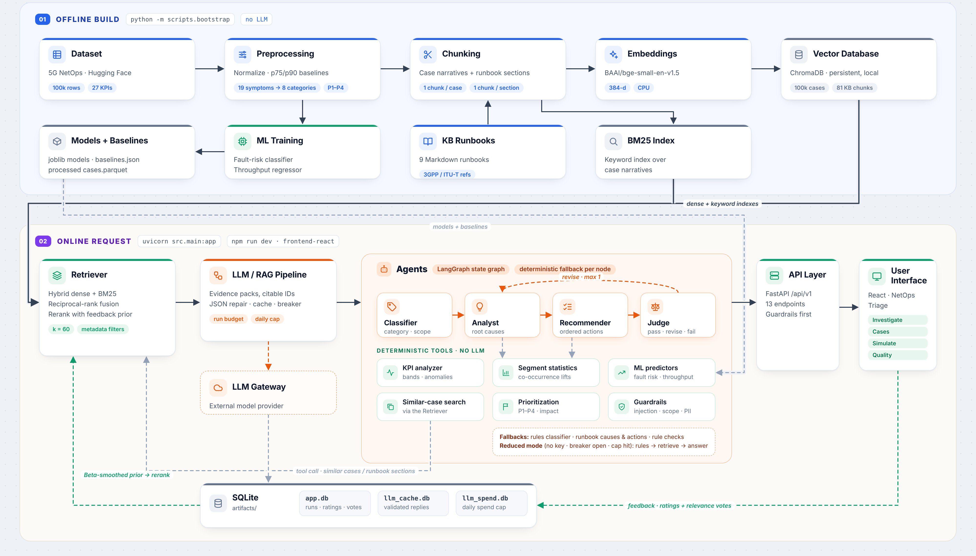
ARCHITECTURE
Offline build
Deterministic
LLM
Storage
Notes:
0:45. Top band: offline build, no LLM. Bottom band: the mandated spine Retriever → LLM/RAG Pipeline → Agents → API Layer → UI. Orange = LLM, green = deterministic.

Slide 6











Data flow: built once, used on every request
DATA FLOW
Offline
once, no LLM
scripts.bootstrap
Dataset
Preprocess
Chunk
Embed
Index + models
5G NetOps · 100k rows × 27 KPIs
Baselines (p75/p90), symptoms, priority
Case narratives + runbook sections
bge-small · 384-d
ChromaDB + BM25 · ML models
indexes + models
Online
per request
FastAPI + React
Ask
Retrieve
Evidence
Agents
Judge
Report
UI → API, guardrails first
Dense + BM25, RRF, rerank
Evidence pack, citable IDs
Classify → analyse → recommend
Scores + rule checks, 1 revision
Summary-first, detail in tabs
feedback: ratings + case relevance votes → Beta-smoothed prior in the rerank
Reduced mode (no key / circuit open / spend cap): rules → retrieve → evidence → deterministic answer
Notes:
0:30. Offline, once and with no LLM: the dataset is preprocessed, turned into case narratives and runbook chunks, embedded and indexed, and the ML models are trained. Online, every request passes the guardrails, retrieves similar cases, builds an evidence pack, runs through the agents and the judge, and returns a summary-first report. Engineer feedback flows back into the rerank.

Slide 7
The dataset: three surprising findings
THE DATA
5G NetOps dataset (Hugging Face fenar/5g_netops): 100,000 rows × 27 KPI columns, Apache-2.0
1. No text at all
2. Leaky columns
No incident descriptions, causes or actions.
Fault occurrence rate is an exact formula of other columns (R² = 1.00). 'Issue Reported' is noise (AUC 0.501).
WHAT WE DID
WHAT WE DID
Case narratives generated from the KPIs
9 authored runbooks as the knowledge source (81 sections)
ML on leading indicators only: fault-risk AUC 0.874, honest not perfect
Notes:
0:35. These findings shaped the whole design.

Slide 8





Technology stack
TECHNOLOGY STACK
LLM
AGENTS
RETRIEVAL
ML
Claude Haiku 5.5 via an LLM gateway (≈ ₹0.75 per analysis); Sonnet 5.5 = best measured
LangGraph state graph: 4 agents, judge loop, deterministic fallbacks
ChromaDB (dense, bge-small-en-v1.5) + bm25s, reciprocal-rank fusion + rerank
scikit-learn HistGradientBoosting: fault risk, throughput
API
FRONTEND
STORAGE
EVALUATION
FastAPI + Uvicorn: 13 endpoints, guardrails first, one error envelope
React 19 + TypeScript (Vite, TanStack Query): live agent progress, summary-first report
SQLite: runs, feedback, LLM cache, spend ledger
DeepEval (LLM judge) + retrieval, classifier, guardrail, ML and judge tests; pytest
Notes:
0:20. Everything runs locally except the LLM call; zero-key mode works too.

Slide 9






Agent workflow: why agents, and the judge loop
AGENT WORKFLOW
revision (max 1)
Classifier
Analyst
Recommender
Judge
Category, symptoms, filters, scope
Ranked root causes, evidence + citations
Ordered actions, verification, approval
4 scores + 6 rule checks
pass / revise / fail
DETERMINISTIC TOOLS · NO LLM
KPI analyzer
Segment statistics
ML predictors
Every LLM node has a deterministic fallback; with no key, or after the daily spend cap, the same request is answered by rules alone (reduced mode).
Prioritization + impact
Similar-case search
Guardrails (before any LLM)
Notes:
0:35. Only LLM decisions under ambiguity are agents; everything computable is a deterministic tool. The judge's verdict drives one revision; a second failure is shown as a low-confidence diagnosis.

Slide 10
DEMO

Slide 11





Challenges and learnings
CHALLENGES AND LEARNINGS
CHALLENGE
WHAT WE DID / LEARNED
Synthetic, text-free data
Generated narratives, authored runbooks, leakage-free ML
Agents cost 4 LLM calls instead of 1
Paid back in actionability and an independent check of every answer
Provider migration (NVIDIA → Claude)
Median latency 76 s → 31 s, no JSON failures
Cost: Sonnet evaluation ≈ $11
Haiku 5.5 via a prepaid gateway (≈ 10× cheaper per analysis): same accuracy, less consistent; the judge revised 3 of 11 and flagged 2 low-confidence
Information overload
A summary-first report: the essentials in 15 to 30 seconds, detail in tabs
Next: real data with timestamps, retrieve runbook verification sections, authentication
Notes:
0:25. End on the honest trade-offs.

Slide 12
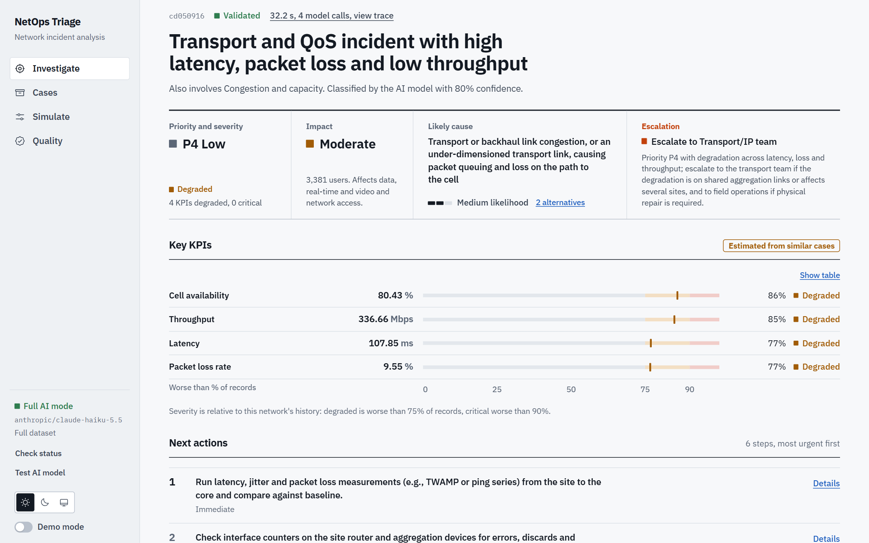
Backup: the report
BACKUP
Notes:
Hidden backup slide: use if the live demo fails. Recorded Haiku 5.5 run of PRD query 1 (32 s, 4 model calls, validated).

Slide 13
Evaluation results
EVALUATION RESULTS
Search, classification, guardrails, ML, answer quality vs basic RAG, judge reliability, cost
1.000
0.874
12 of 12
0.60 → 0.84
Search Hit@5
Fault-risk ROC-AUC
Guardrails blocked, 0 false pos.
Actionability: RAG → agents (Sonnet)
Same in both runs | Result
Search Hit@5 / nDCG@10 | 1.000 / 0.953
Guardrails blocked / false pos. | 12 of 12 / 0
Fault-risk ROC-AUC | 0.874
Priority scenarios | 6 of 6
Feedback loop | +0.006 nDCG, 0 worse
 | Sonnet 5.5 | Haiku 5.5 (demo)
Targets met | 26 of 28 | 27 of 28
Classifier accuracy | 0.955 | 0.955
Actionability: RAG → agents | 0.60 → 0.84 | 0.66 → 0.99
Planted errors caught | 12 of 12 | 12 of 12
Median time per analysis | 31 s | 35 s
Passed judge first time | 11 of 11 | 8 of 11
Cost per analysis | ≈ $0.076 | ≈ $0.007
Notes:
0:45. Left: parts that use no model, identical in both runs. Right: the two configurations. Sonnet is the best measured capability; Haiku is what the demo runs, about 10x cheaper with the same accuracy, less consistent, and the judge flags it. Answer-quality scores come from different judges, so compare basic RAG vs multi-agent within a run, not across runs.

Slide 14


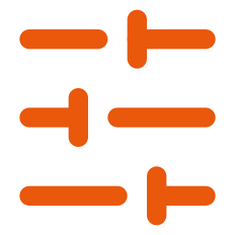


Live demo (3 minutes)
DEMO
Investigate 1:40
Cases 0:30
Simulate 0:25
Quality 0:25
Preset 1: agents working live, then the report: diagnosis, priority, likely cause, escalation, worst KPIs, top 3 actions; open a tab (causes, similar cases, agent trace)
Filters (state, season, weather) and the four-mode search comparison
Change KPIs → fault risk, throughput and priority update with reasons
Judge verdicts, feedback loop, both evaluation runs named by model
A daily spend cap and the prepaid LLM gateway balance bound the total cost
Notes:
3:00. Turn on Demo mode (rail switch): larger type, five incident cards, keys 1 to 5. Repeated queries come from the response cache, so they are instant and free. Backup: the screenshot on the hidden slide, or zero-key mode.

Slide 15
Backup: Haiku 5.5 vs Sonnet 5.5
BACKUP
Same test sets | Haiku 5.5 via LLM gateway (demo) | Sonnet 5.5 (best capability)
Evaluation judge | gpt-oss-120b | Claude Opus 5.5
Targets met | 27 of 28 | 26 of 28
Judge verdicts (11 queries) | 9 pass, 2 low confidence; 3 revised | 11 pass; 0 revised
Median / max time per analysis | 34.8 s / 78.8 s | 31.4 s / 33.9 s
Planted errors caught by the judge agent | 12 of 12, 0 false alarms | 12 of 12, 0 false alarms
Cost of the full evaluation | ≈ $0.27 | ≈ $11.4
Notes:
Hidden backup slide. Full suite on both configurations.

Slide 16
Backup: Q&A preparation
BACKUP
Why does synthetic data matter?
How was leakage avoided?
Generator artifacts; severity is relative; no trends
Leakage audit: R² from root columns ≥ 0.15 → excluded
Why agents and not one call?
Why Haiku for the demo?
Actionability 0.60 → 0.84 (Sonnet) and 0.66 → 0.99 (Haiku); judge catches 12/12
Same accuracy at ≈ 10x lower cost; weaker answers are revised or flagged, not hidden
How is hallucination controlled?
What does feedback change?
Citations validated against evidence IDs; rule checks; judge; fallbacks
A smoothed prior in the rerank (+0.006 nDCG on voted queries, 0 regressions)
Why Chroma and BM25?
Production needs
Metadata filters on both paths; exact terms + paraphrases
Real data, authentication, production vector DB, monitoring
Notes:
Hidden backup slide.

