Slide 1
Data Modelling using ER diagrams
Lecture - 05

Slide 2
Learning Outcome
LO3: Model data requirements using data models

Slide 3
Conceptual Modeling ER Diagrams
Many versions of ER-diagrams; differ both in their appearance and in their meaning
We will use the version appearing in the book (Database Management Systems by Elmasri Navathe)
Have a formal semantics (meaning) that must be thoroughly understood, in order to create correct diagrams

Slide 4
Entity-Relationship (ER) Model
Requirements gathering
Conceptual database design
high level data model(ER)created
The 2 main constructs of the ER model:
Entities ,Relationships.
different books use different graphical notation.

Slide 5
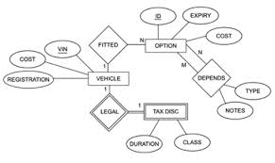
ER Diagrams

Slide 6
E-r Notation
Symbol
Meaning
ENTITY
WEAK ENTITY
RELATIONSHIP
IDENTIFYING RELATIONSHIP
ATTRIBUTE
KEY ATTRIBUTE

Slide 7
E-r Notation
Symbol
Meaning
MULTIVALUED ATTRIBUTE
COMPOSITE ATTRIBUTE
DERIVED ATTRIBUTE
TOTAL PARTICIPATION OF E₂ IN R
CARDINALITY RATIO 1:N FOR E₁:E₂ IN R
STRUCTURAL CONSTRAINT (min, max) ON PARTICIPATION OF E IN R
E₁
R
E₂
E₁
1
R
N
E₂
(min,max)
R
E

Slide 8
Entity
An entity is an object in the real world with an independent existence (place, person, car, house, company, job, university, etc).
A collection of similar entities is called an entity set.
Graphically,
First letter of each word in the entity name is uppercase
E.g., Student
Normally an entity is named using a ‘noun’ or ‘noun phrase’
ENTITY
STUDENT

Slide 9
Attributes
An entity is described using a set of attributes
Graphically, Oval.
For example staff has 3 attributes
Name
Position
Salary
Attribute
Name
STAFF
Address
Age

Slide 10
BOC Network
BOC is the largest bank network having over 5,000 branches and over 500,000 customers. Customers can open accounts in any bank branch.
Identify
Entities
At least 3 attributes /entity

Slide 11
SLIIT Student Registration
New students are required to produce their national ID card number, name, address, age, date of birth and gender during the registration process. they are also required to select the degree program of their choice.
The programs are selected based on the entry criteria, specialty, duration, fees etc.
Entity ?
Attributes ?

Slide 12
Entity Set
Example: name, id, age & salary are attributes in Employee entity
Salary
salary
name
e1
e2
e3
e4
e5
e6
…
age
id
Age
EMPLOYEE
Id
Name
Employee Entity set

Slide 13
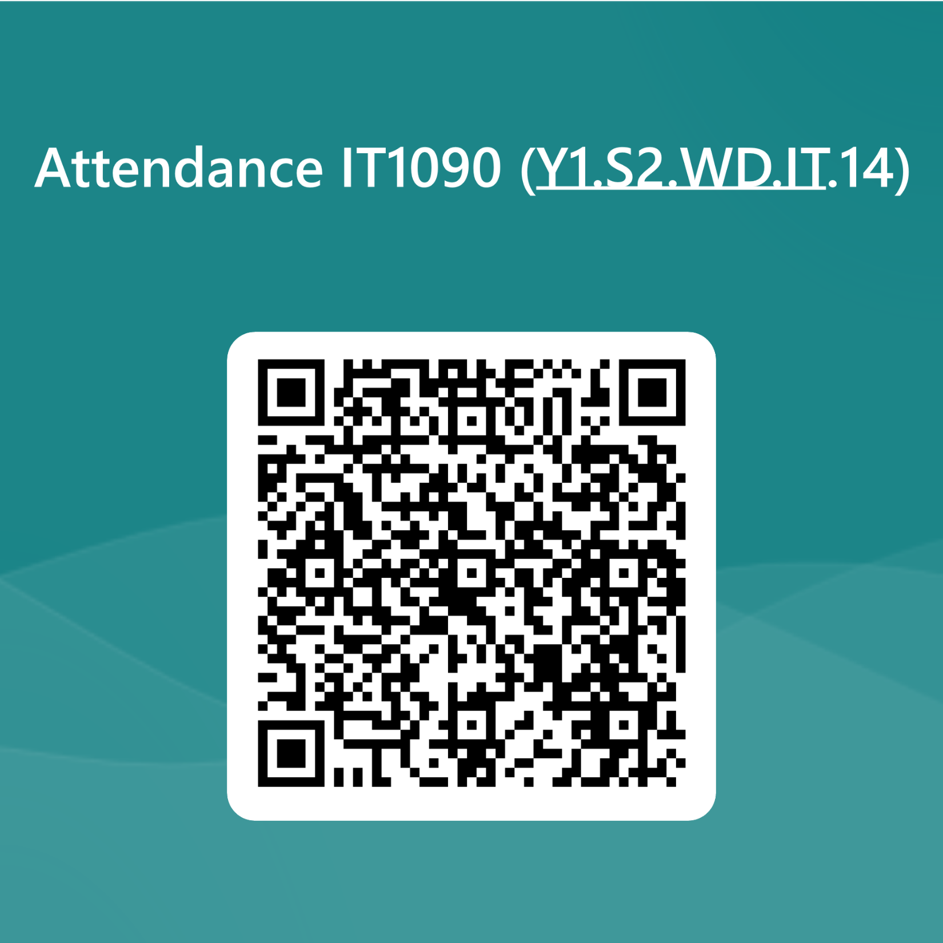

Slide 14
Example
Name
Manf
Entity set Juice has two attributes, name and manf (manufacturer).
Each Juice entity has values for these two attributes, e.g. (JustJUice, Anheuser-Busch)
JUICE

Slide 15
Domain of an Attribute
The domain of an attribute specifies the set of possible values that the attribute can have.
age : integer values from 0 - 120
name: 20 character string

Slide 16
Composite Attributes
Composite attributes can be divided into smaller subparts.
Graphically,
EMPLOYEE
Name
Surname
Middle_name
First_name

Slide 17
Your Turn!!
Think about the library database.
Identify entities , attributes and domain of attributes

Slide 18
Multi valued Attributes
Attributes containing multiple values are called multivalued attributes. Double lines
gmail , yahoo, SLIIT e-mail address
STUDENT
E-mail
Surname
First_name

Slide 19
Your Turn!!
Give an example for a multi valued attribute in library database

Slide 20
Derived Attributes
Some attributes can be derived - called derived attributes. Dotted line
For example, age is derived from date of birth & current date.
Employee
DOB
age
name
Derived attribute

Slide 21
An exercise
stuNum
stuName
stuMajor
stuDob
stuHrs
stuYr
stuGpa
stuAge
2103456
Aunt Annie
IT, Fine Art
14 Feb 1990
23
2
3.26
26
3006381
Bert Baxter
IT
23 Jun 1992
33
3
2.59
24
2007824
Corinne Creevey
IT, Education
5 Oct 1991
27
1
3.59
25
7650802
David Doo
Arts
28 Aug 1994
16
1
0
22
9635962
Eli Edwards
Arts, Teaching
15 Nov 1992
35
2
2.73
24
2113843
Fiona Fawcett
IT
30 Jul 1990
28
2
3.27
26

Slide 22
Tick where applicable
Attribute
simple
single-valued
composite
multivalued
derived
stuNum
stuName
stuMajor
stuDob
stuHrs
stuYr
stuGpa
stuAge

Slide 23
Key Attributes
key attribute - Minimal set of attributes which
uniquely identify an entity in the entity list. Underlined
salary
name
e1
e2
e3
e4
e5
e6
…
age
id
Employee Entity set

Slide 24
Primary Key
There can be multiple key attributes called candidate keys in a single entity.
A single candidate key is designated as the primary key.
Name
Employee
eid
nic
Candidate key

Slide 25
Composite Key
Sometimes, a group of attributes make up the key. This is called a composite key.
Example :
Composite key = (student no + Unit Number + marks)
ST ID | Unit ID | Marks
IT1601 | IT103 | 85
IT1601 | IT104 | 78
IT1602 | IT103 | 72
IT1603 | IT104 | 82

Slide 26
Super Key
Any other set of attributes that uniquely identify a tuple is called the superkey of a relation
Student ( SID, Name, Address, Contact, GPA)
What is the minimal set of attributes that uniquely identify the relation ?
SID =Referred to as Primary Key
(SID + Name) Is this unique?
Yes, but NOT the minimal set
Referred to as Super Key

Slide 27
Students should enroll for courses. Student need to provide studentID number, name, address , date of birth, gender, contact number when he/she is going to register for a course. University keeps track of course number , course name , offering faculty ,duration and course fee of each course.
How do you represent this scenario ?

Slide 28
How do we find the course name of the student IT160001
name
address
phone
student
gender
courseNo
dob
studentID
course
coursename
fee
duration
faculty

Slide 29
Relationship
Relationship is an association among two or more entities.
Collection of similar relationships - relationship set .
Shown as a line connecting the associated entities, labelled with the name of the relationship.
Normally a relationship is named using a ‘verb’ or ‘verb group’.
registers
N
1
Student
Course
relationship

Slide 30
Example: Relationships
name
addr
name
manf
Bar
Sells
Juice
Bars sell some
juices.
regNo
Drinkers like
some juices.
Frequents
Likes
Drinkers frequent
some bars.
Drinker
name
addr

Slide 31
Degree of a Relationship
Degree of a relationship is the number of participating entities in the relationship.
Degree / Number of Entities = 2 Or binary
registers
N
1
Student
Course
relationship

Slide 32
Degree of Relationship
= no of participating entities
Relationships can be classified based on their degree into
Binary – relationship with two participants-
Degree/No of Entities = 2
Ternary – relationship with three participants
Degree/No of Entities = 3
Quaternary – relationship with four participants
Degree/No of Entities = 4

Slide 33
Ternary Relationships
Sometimes, we need a relationship that connects more than two entity sets.
Suppose that drinkers will only drink certain juices at certain bars.
Our three binary relationships Likes, Sells, and Frequents do not allow us to make this distinction.
But a 3-way/ ternary relationship would.

Slide 34
A Typical Relationship Set
Bar Drinker Juice
Joe’s Bar Ann Avocado super
Sue’s Bar Ann Apple Lite
Sue’s Bar Ann Watermelon cool
Joe’s Bar Bob Mango Lite
Joe’s Bar Bob Avocado super
Joe’s Bar Cal Avocado super
Sue’s Bar Cal Apple Lite

Slide 35
Ternary Relationship
name
addr
name
manf
Bar
Juice
regNo
Preferences
Drinker
name
addr

Slide 36
Ternary relationship
name
Location
name
dname
ssn
lot
did
budget
Each employee can work at
most in one department at
a single location
Employees
works_In
Departments
12-233
D10
12-354
D12
12-243
D13
12-299
Rome
London
Paris
Notes:
6

Slide 37
Cardinality
The cardinality ratio for a binary relationship specifies the number of relationship instances that an entity can participate in.
There are three types of cardinality ratios for binary relationships.
one-to-one (1: 1)
one-to-many (1 : N)
many-to-many. (N : M)

Slide 38
One-to-One relationship
An employee manages at most one department. A department can have only one manager managing it.
Manages
1
1
Employee
Department

Slide 39
Your Turn !!
Think about the Library database and give an example of a 1:1 relationship

Slide 40
ONE-TO-MANY RELATIONSHIP
An employee works in at most one department.
This is a one-to-many (or many-to-one) relationship
N
Works in
1
Employee
Department

Slide 41
Example: One - Many Relationship
Favorite, from Drinker to Juice is one-many.
A drinker has at most one favorite juice.
But a juice can be the favorite of any number of drinkers, including zero.
N 1
Favorite
Drinker
Juice

Slide 42
Your Turn !!
Think about the Library database and give an example of a 1:N relationship

Slide 43
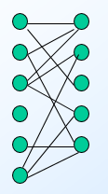
Many-to-many relationship
An employee can work on several projects. A project can have many employees working on it.
M
Works on
N
Employee
Project

Slide 44
Example: MANY - Many Relationship
Likes, from Drinker to Juice is many-many.
N M
like
Drinker
Juice

Slide 45
Your Turn !!
Think about the Library database and give an example of a N:M relationship

Slide 46
Exercise
Identify the Cardinality
Doctor patient
Principal School
Mother child
Husband wife
Teacher Student

Slide 47
Rosell, 23 years old, a diploma holder joined the ‘ABC’ company as a management trainee. She joined the Production department on 01/01/2005. When Rosell successfully completed her Commerce degree, she was promoted as Finance Executive and transferred to the Finance department from 02/02/2006.
Considering her MBA qualification, the management of the company promoted her as Assistant Manager - Business Development and transferred to the Business Development department with effect from 03/03/2008.

Slide 48
Descriptive Attributes
A relationships can also have descriptive attributes . Used to record information about the relationship rather than any one of the participating entities.
startdate
since
N
Works in
1
Employee
Department
Nimal works in accounts dept since 2008

Slide 49
Descriptive Attributes
1/2/99
e011
1/2/09
HR
e022
1/5/01
Sales
e033
1/2/07
Marketing
e044
1/3/05
Departments
Employees
Work_in

Slide 50
Attribute on Relationship
Sells
Bar
Juice
price
Price is a function of both the bar and the juice,
not of one alone.

Slide 51
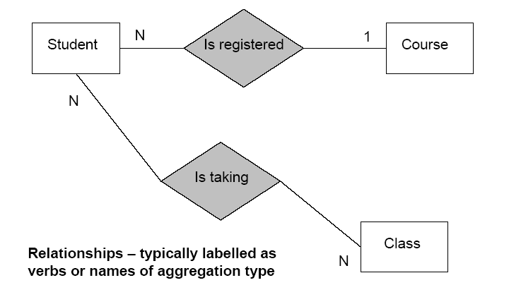
ER Diagram

Slide 52
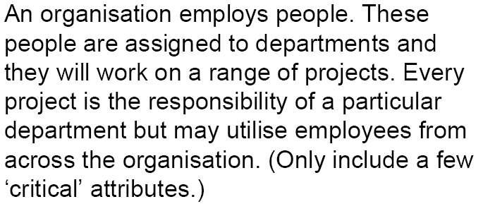
Your Turn !

Slide 53
Your Turn !!!
Identify the entities -> nouns
Identify the relationships -> verbs
Determine
Cardinality
Participation (total / partial)

Slide 54
Restrictions- constraints
What is the criteria to become a student at SLIIT?
Register for a degree
Mandatory /compulsory
Student MUST be registered in a degree
Restriction - Constraint
How do we present this information in the data base??

Slide 55
Student must be registered in a degree.
N 1
Register
Student
Course

Slide 56
Participating Constraints
Participating constraint specifies whether the existence of an entity depends on its being related to another entity via the relationship type.

Slide 57
Participation Constraints
For example, if we specify that an employee must always work for a department.
Then we say that the relationship “works in” is in total participation from employee entity to department entity.
(double lines) → total participation
Works in
Employee
Department
Employee must work in a department
Department may or may not have employees

Slide 58
E-R Model (contd.)
If the relationship is not in total participation, then it is known as in partial.
For example, from Department to Employee
Department may or may not have Employees

Slide 59
Participation Constraints
Participation Constraint
Student?

Slide 60
Weak Entity
Parents employed?
Does the company cover THE CHILDRENS medical insurance?
How do you claim your medical bills
Can you get it reimbursed or through your parents
Is the same coverage given to children after resignation

Slide 61
Weak Entity
Double lined box
Strong entity
Weak entity
1
covers
M
Employee
Dependent
id
age
id
name
age
Partial key

Slide 62
Weak Entity
Some entities can’t exist on its own.
Its’ existence-dependent on another entity, i.e., it cannot exist without the entity with which it has a relationship.
It inherits the part of the primary key from the entity to which it is related.
Entity types without any key attributes is called weak entity types.

Slide 63
The attributes in the weak entity participating in the key are called partial keys.
The owner entity and the weak entity participates in an identifying relationship.
The cardinality of the identifying relationship is either one-to-one or one-to-many from owner entity to weak entity.
The weak entity must have total participation in the identifying relationship.

Slide 64
EXAMPLE- Weak Entity
address
atmID
since
transac#
amount
1
N
type
ATM
facilitates
Transactions
Notes:
10

Slide 65
Recursive Relationship
Have you formed your project groups
What is the structure?
Leader and members
Both leader and members are students
1
Leads
N
Leader
Member
X
Leads
N
Student
1
Student

Slide 66
E-R Model (contd.)
Student leads set of students in group assignments.
leads
Group leader
1
Member
N
Student

Slide 67
Recursive Relationship
Entities participating in a relationship need not be distinct. Such relationships are called recursive relationships.
Each entity in the relationship play a role in the relationship. It is recommended to state the role in recursive relationships.

Slide 68
Recursive Relationships
In most companies, each employee (except the CEO) is supervised by one manager. Of course, not all employees are managers.
eno
name
eno
name
supervise
1
X
N
Manager
Employee
salary
salary
Job tittle
Job tittle
eno
name
1
Manager
supervise
Employee
salary
N
Subordinates
Job tittle

Slide 69
Your Turn !
Draw an ER diagram for the following requirements.
A company database needs to store information about employees (identified by NIC, salary, position, phone, office);
departments (identified by dno, with department name and annual budget);
children of employees (with name, and age as attributes).

Slide 70
Employees work in departments; each department is managed by an employee; a child must be identified uniquely by name when the parent (who is an employee; assume that only parent works for the company) is known. We are not interested about a child once the parent leaves the company.

Slide 71
Alternate Notation – Min: Max
Used to specify the number of possible occurrences of each participating entity type in a relationship.
Contains two parts
Min
Max
For example, (0,1)
Min = 0
Max = 1
Max of a multiplicity range denotes Cardinality
Min of the range denotes Participation constraint

Slide 72
THE (MIN,MAX) NOTATION
(1,1)
(0,1)
Manages
Department
Employee
Employee
Manages
Department
1
1
Employee may or may not mange a department. He can at most
manage one department.
A department must be managed by an employee

Slide 73
THE (MIN,MAX) NOTATION
(0,N)
(1,1)
Employee
Department
Works-for
Employee
Works-for
Department
N
1
(NN
Employee must work for a department. .
A department may or may not have any employee

Slide 74
Enhanced ER Modelling
ER modelling does not capture all the semantics of client’s domain, such as
‘ISA’ (‘is a’) relationship or specialization-generalization
‘Manager’ entity type ‘is a’ sub entity of ‘Staff’ entity.
Enhanced ER models represent the above relationships, hence capture client’s domain more comprehensively.

Slide 75
Diagrammatic Representation of ‘ISA’ relationship
name
position
staffNo
Staff
Specialization/generalization indicator
ISA
Both hourly employees & contract employees
Belong to the type Staff
Hourly_Emp
Contract_Emp
Hours worked
Contract_ duration
Hourly rate

Slide 76
End of Lecture 05
Questions ?

Slide 77


