Slide 1
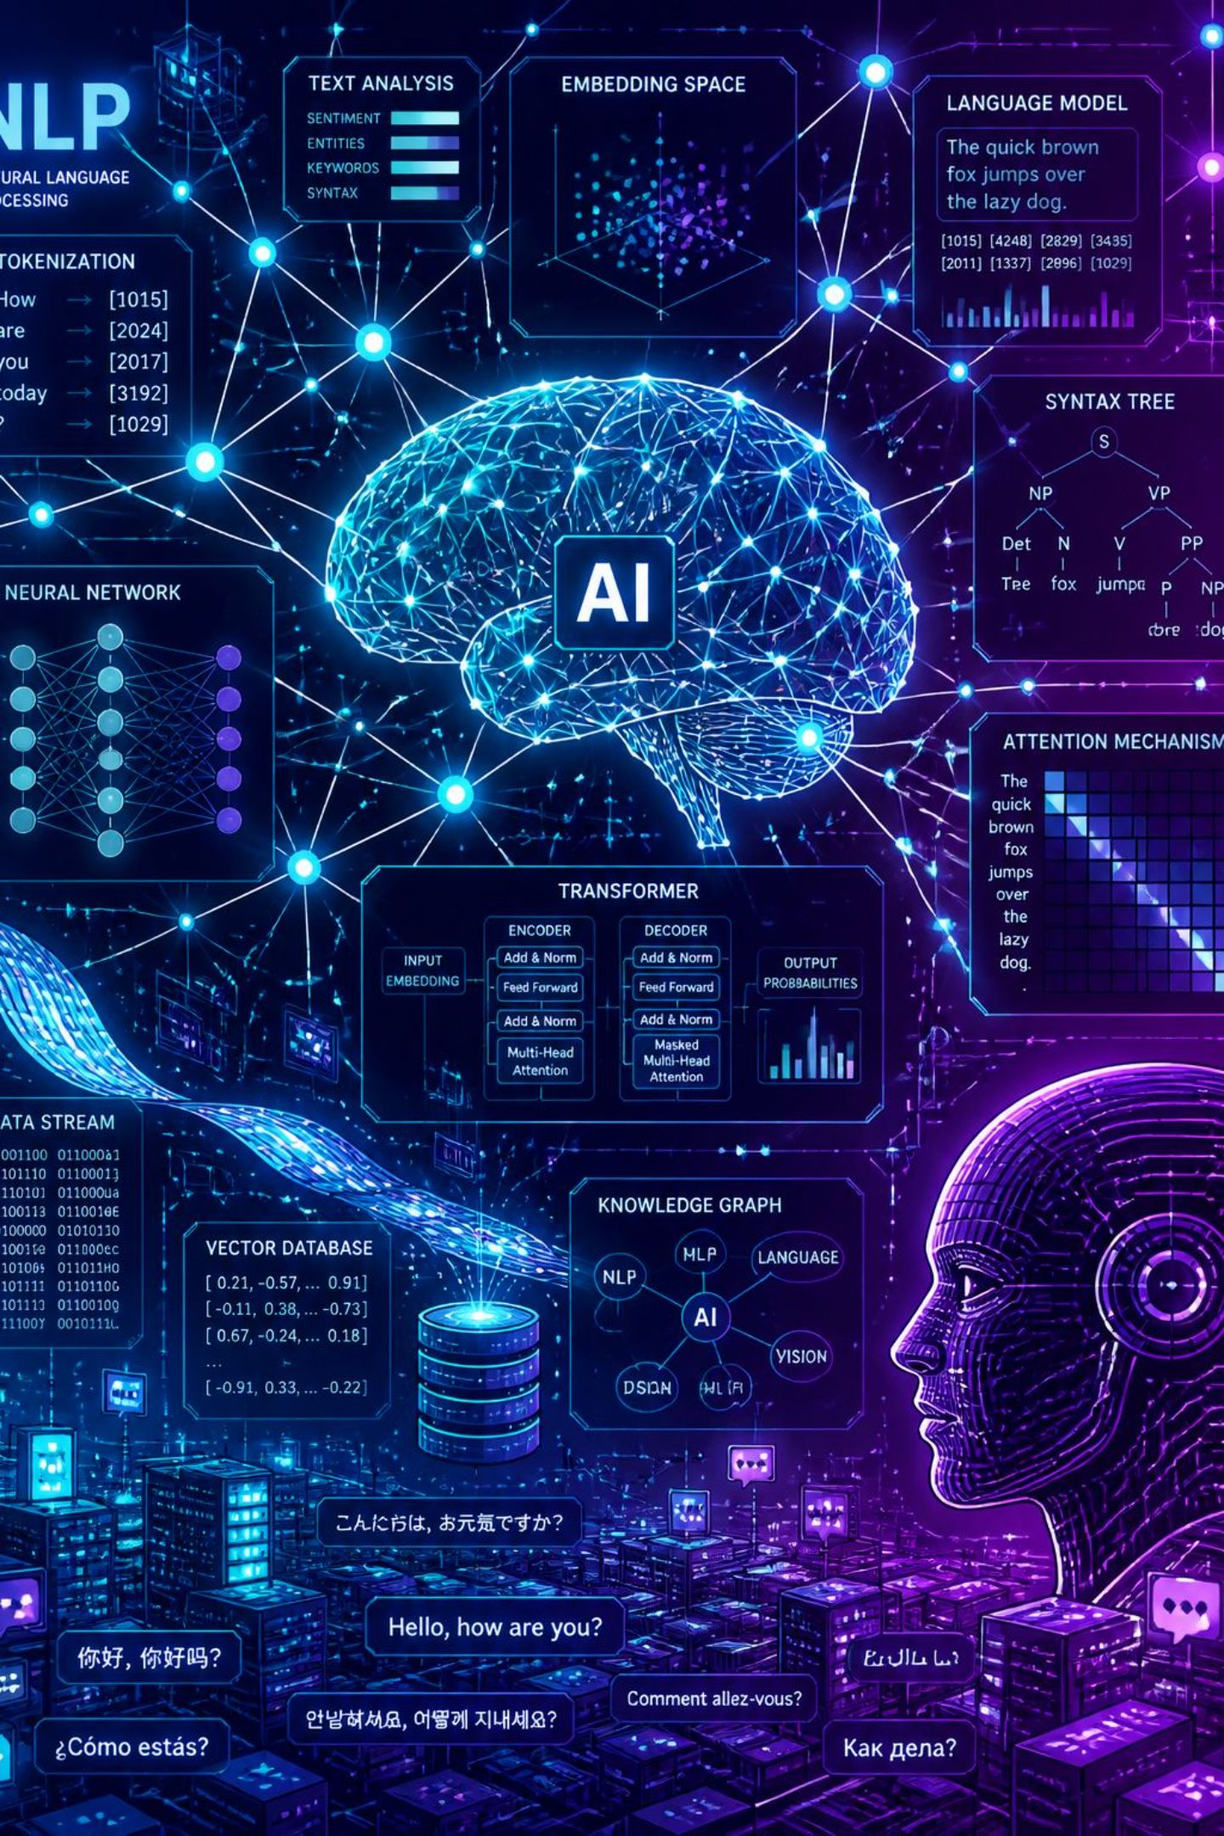
Coherence in Natural Language Processing (NLP)
Seminar Presentation — Artificial Intelligence and Machine Learning
Name: [Your Name] · Department / College: [Your College Name]

Slide 2
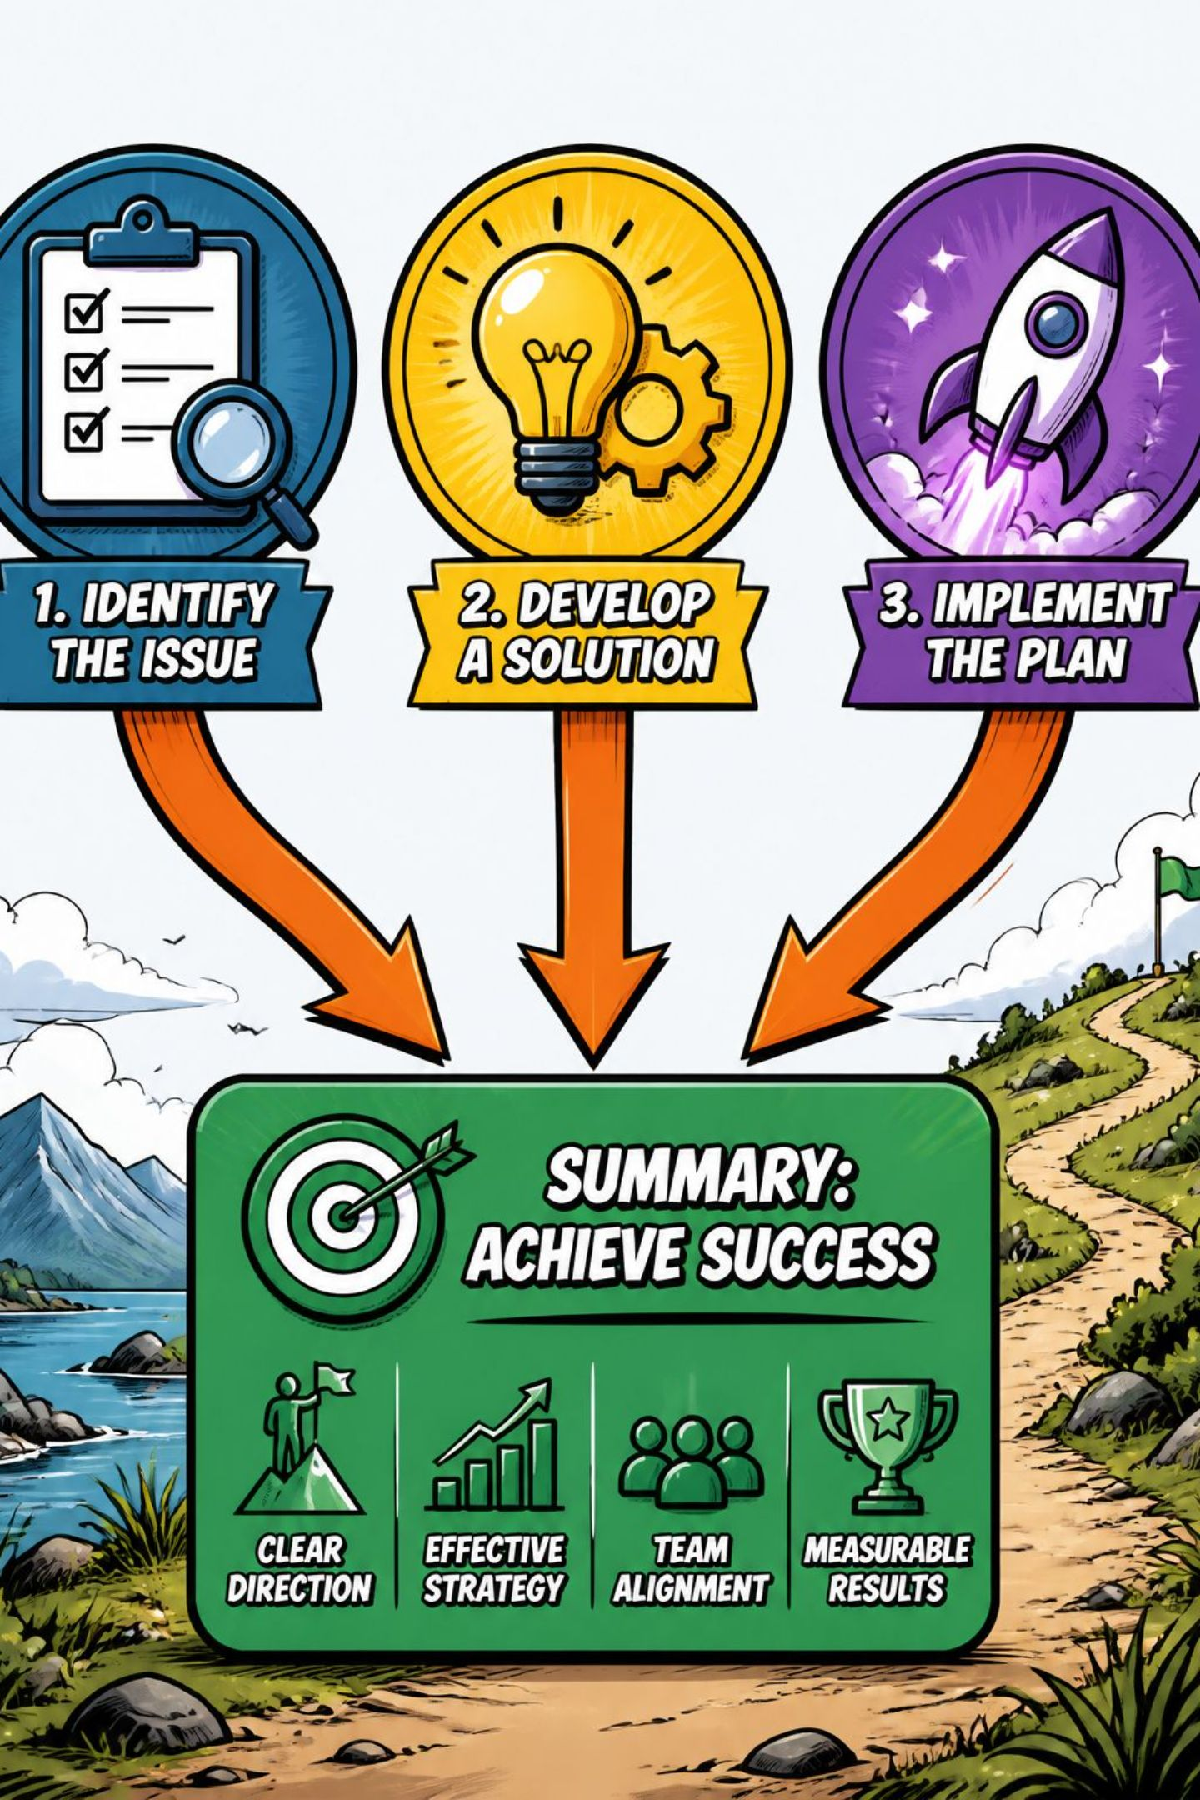
What is Coherence?
Coherence: the logical connection and meaningful flow of ideas across text.
Shows how sentences and paragraphs relate to each other to form one unified message.
Helps NLP systems infer document-level meaning and maintain context.
Visual: Sentence 1 → Sentence 2 → Sentence 3 → Overall Meaning

Slide 3
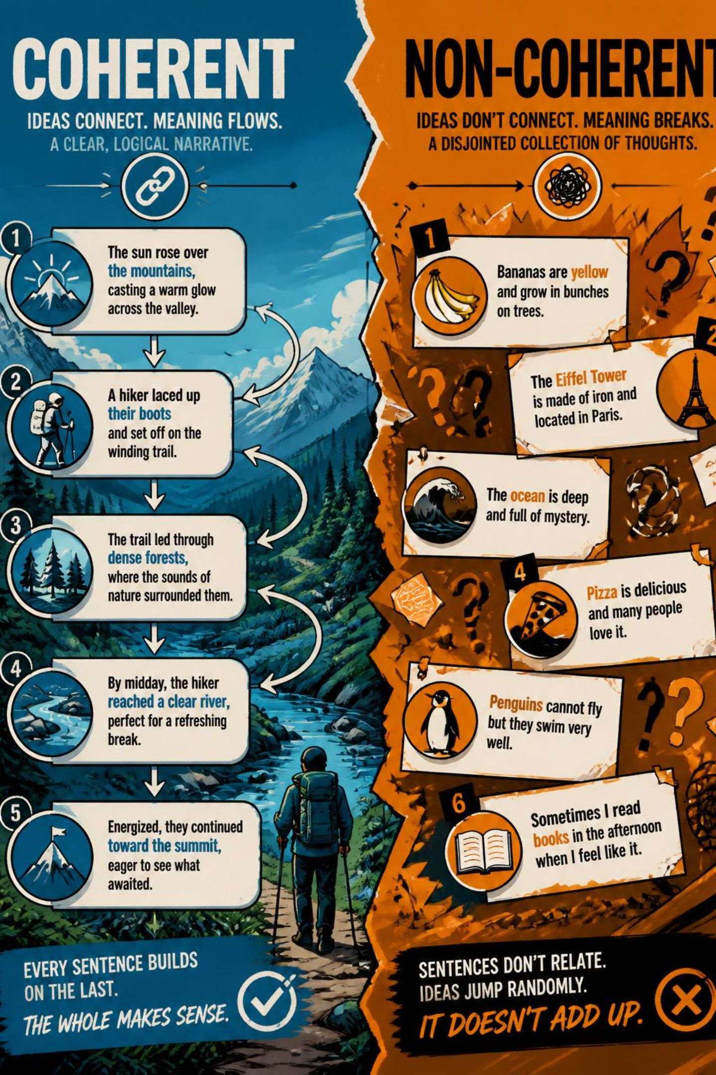
Coherent vs Non-Coherent Text
1
Coherent Example
“Ravi went to the library. He borrowed a book on AI. He read the book in the evening.”
Logical connection between sentences
Clear topic continuity
2
Non-Coherent Example
“Ravi went to the library. The weather is hot. Python is a programming language.”
Lacks topical links
Context and flow are broken
Key cues: logical connection · context · topic continuity · meaningful flow

Slide 4
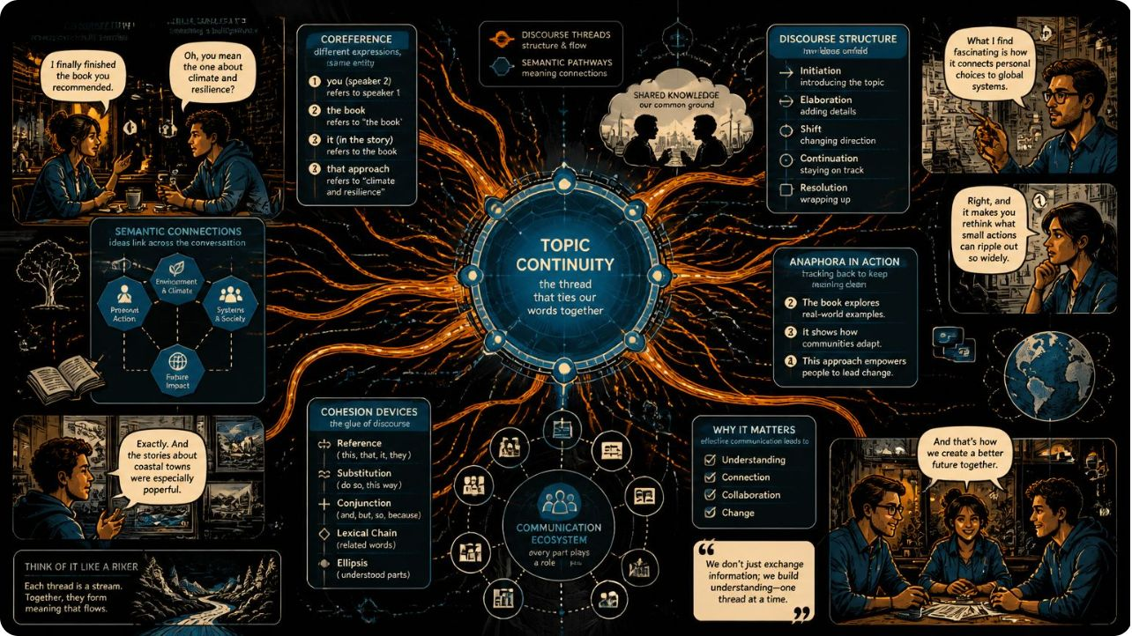
How Coherence Works in NLP
Primary factors that maintain coherence:
Topic continuity — maintain subject across sentences
Context — local and document-level background information
Sentence relationships — causal, temporal, contrastive links
Coreference / pronoun resolution — who/what each mention refers to
Discourse structure — rhetorical roles (e.g., explanation, contrast)
Semantic relationships — entailment, paraphrase, similarity

Slide 5



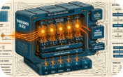
Coherence Models & Techniques
Entity-based Models
Discourse-based Models
Semantic Similarity
Neural Language Models (LLMs)
Track entities and their roles across sentences to preserve continuity.
Analyze sentence-to-sentence relations (e.g., cause, elaboration).
Measure meaning overlap to detect topical alignment and coherence breaks.
Use contextual embeddings and attention (e.g., Transformers) to maintain coherence during generation.
Modern trend: combine symbolic cues (entities, discourse) with deep contextual models for best results.

Slide 6
Applications & Challenges
Applications
Challenges
Text summarization — produce concise, coherent summaries
Machine translation — preserve discourse and anaphora
Chatbots & dialogue systems — maintain context over turns
Text generation — consistent multi-sentence outputs
Question answering & document analysis — link evidence coherently
Maintaining long-term context across long documents
Ambiguous references and unresolved pronouns
Unexpected topic shifts or digressions
Implicit relationships not stated explicitly
Generating factually consistent and stable information
Design note: Practical systems blend memory, entity tracking, and attention-based context windows to mitigate these issues.

Slide 7

Conclusion
Coherence ensures text has a logical, meaningful flow across sentences and paragraphs.
It enables NLP systems to relate ideas, resolve references, and produce reliable multi-sentence outputs.
Combining entity/discourse analysis with contextual neural models (Transformers/LLMs) improves coherence.
Key challenges remain around long-term context, ambiguity, and consistency.

