Slide 1
Cozy Haven Stay – Hotel Booking System
Web-based hotel reservation platform
By J Kavinila

Slide 2

Problem Statement
Manual booking processes are time-consuming and inefficient
Lack of a centralized system to manage hotel listings and reservations
Difficulty in checking real-time room availability and pricing
Limited access to reliable hotel information and user reviews
Need for a secure, fast, and user-friendly online booking system

Slide 3
Proposed Solution
Provide real-time room availability, pricing, and detailed hotel information
Implement secure user authentication using JWT
Allow easy booking, cancellation, and booking history management
Provide dashboards for hotel owners to manage rooms and bookings
Enable admin control for managing users, hotels, and reservations

Slide 4
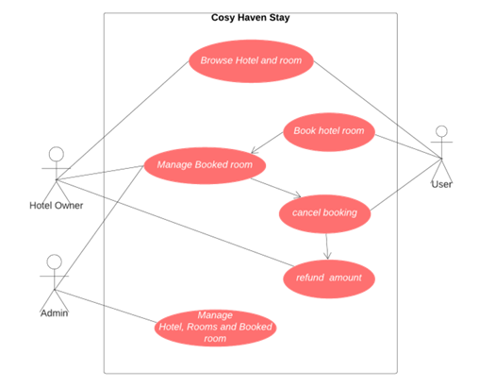
Key Features
Hotel search with filters
Room availability & pricing
Booking & reservation system
Booking history & cancellation
Reviews and ratings

Slide 5
Actors
User (Guest)
Hotel Owner
Administrator

Slide 6
User (Guest) Module
Register & login
Search hotels & view details
Book rooms and manage bookings
Cancel bookings & view history
Add reviews and ratings

Slide 7
Property Owner Module
Login to owner dashboard
Add, update, and delete rooms
Manage room availability
View bookings and process refunds

Slide 8
Admin Module
Manage user and hotel owner accounts
Manage hotel listings
Monitor and control all bookings
Ensure system security and access control

Slide 9
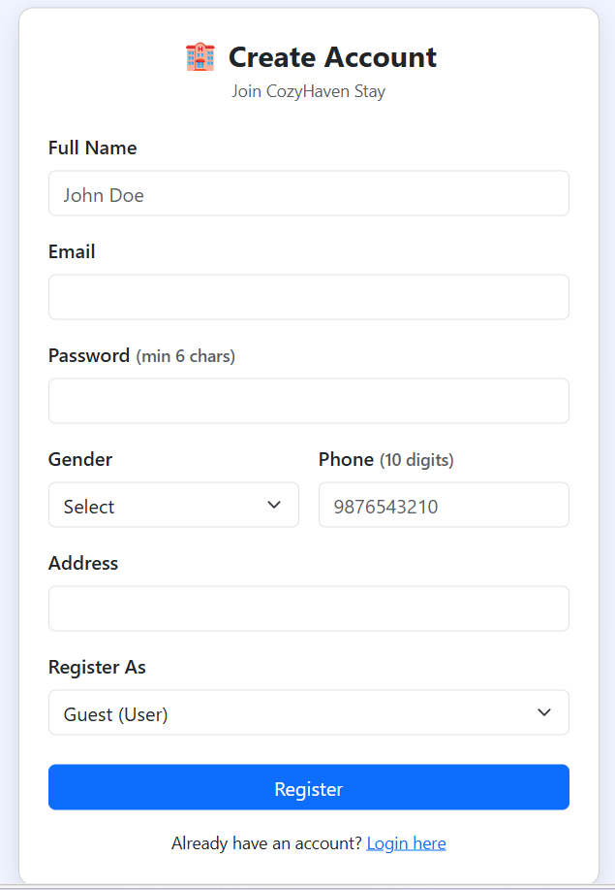
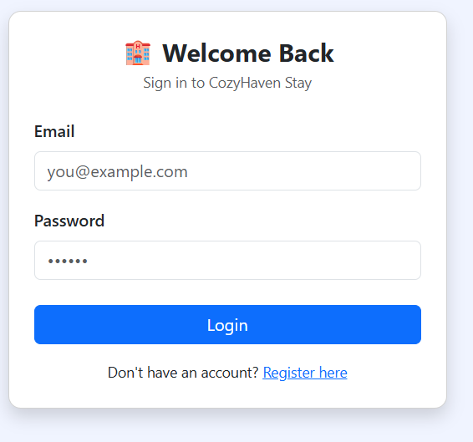
Implementation

Slide 10
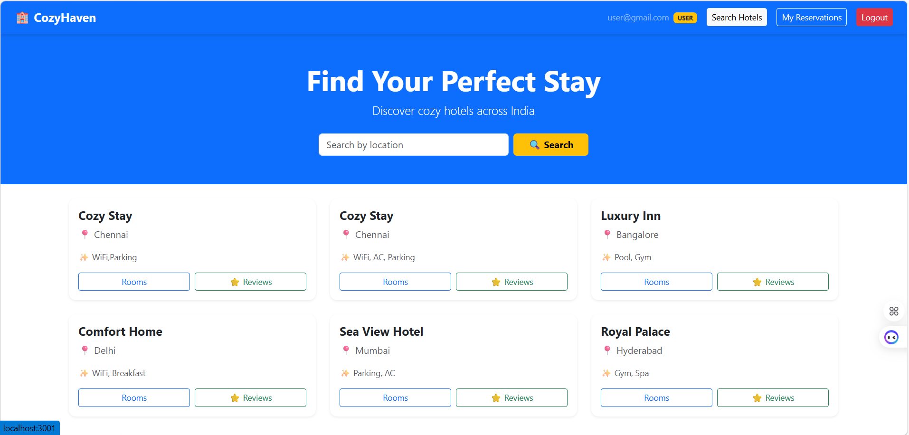
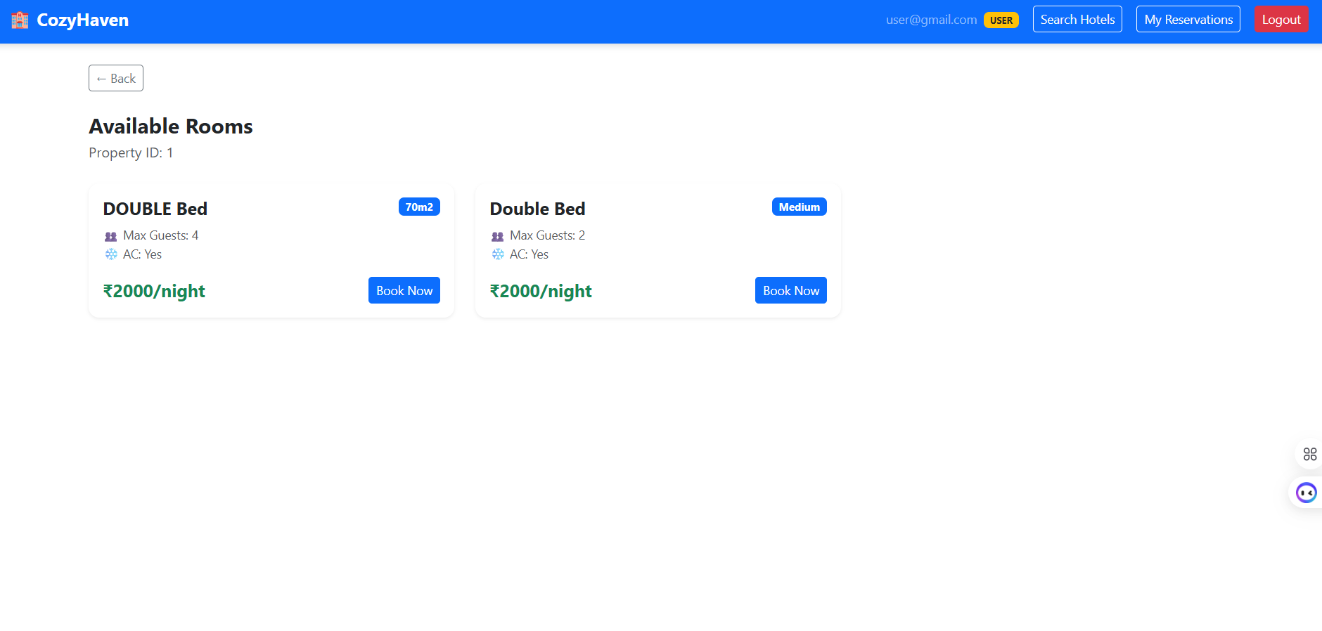

Slide 11
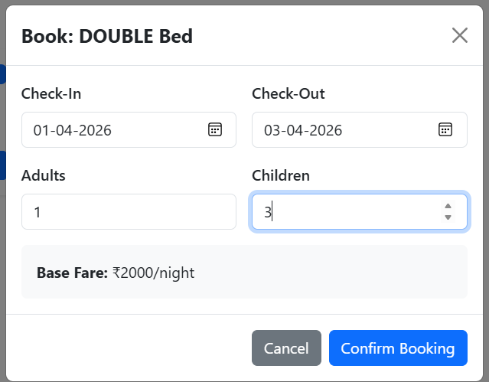
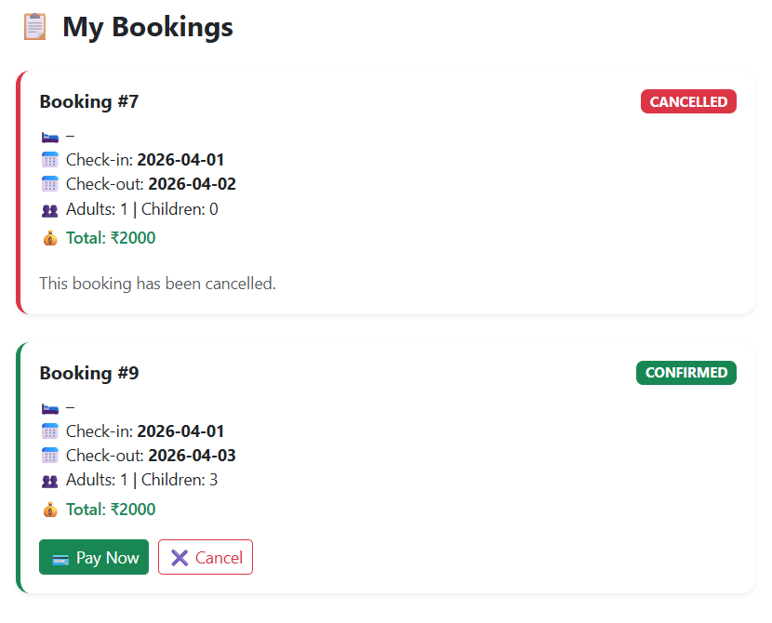

Slide 12
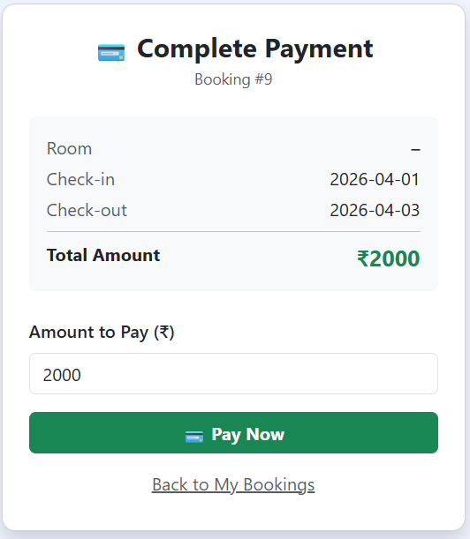
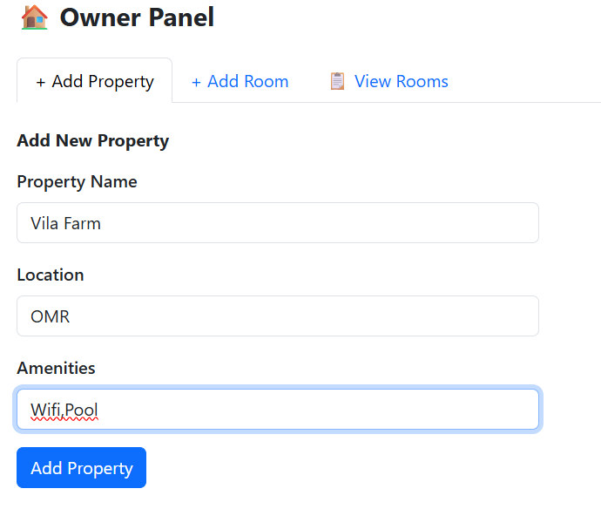

Slide 14
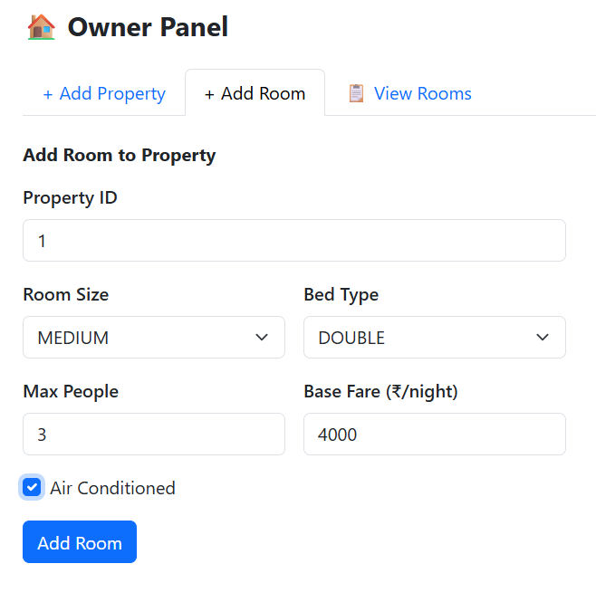
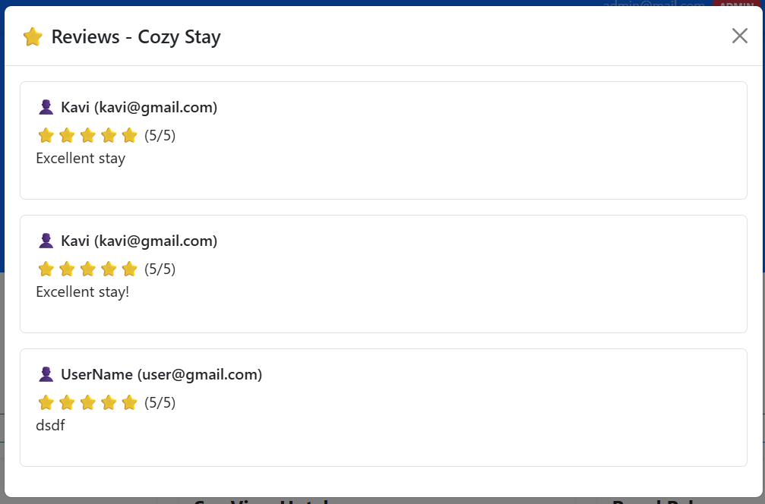

Slide 15
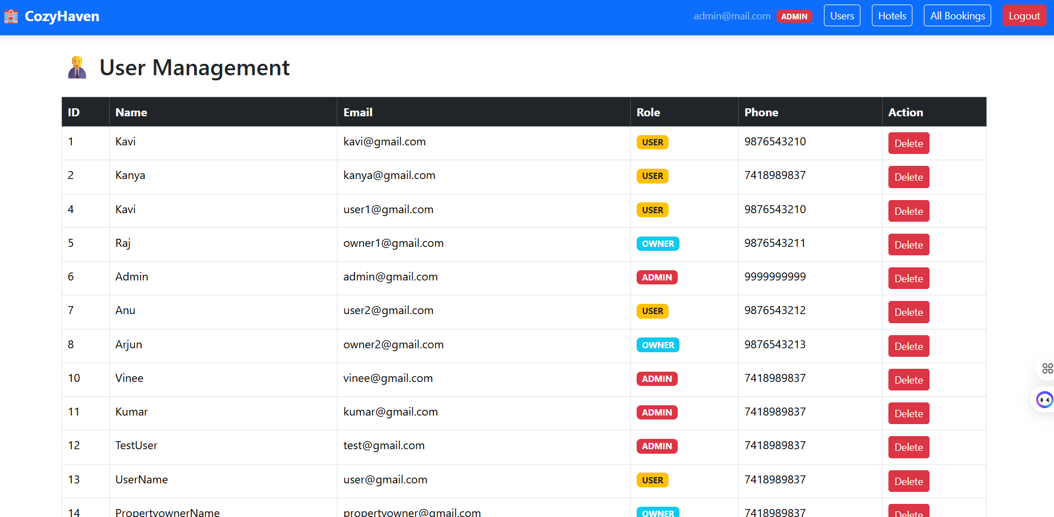
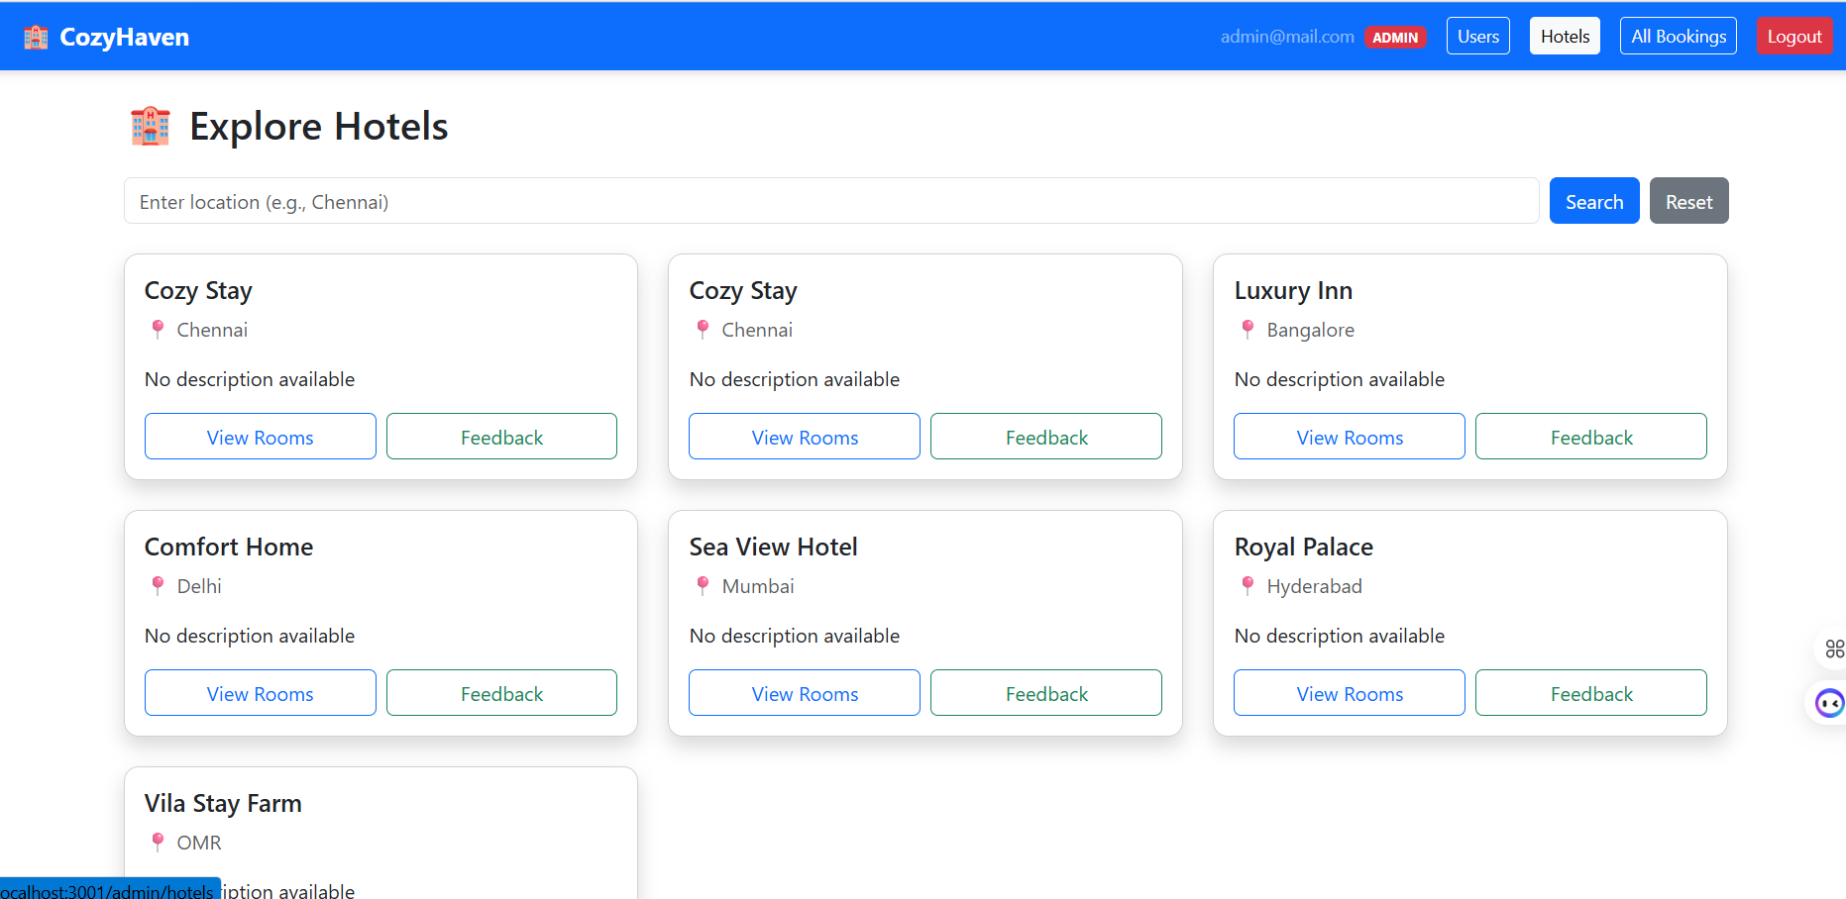

Slide 16
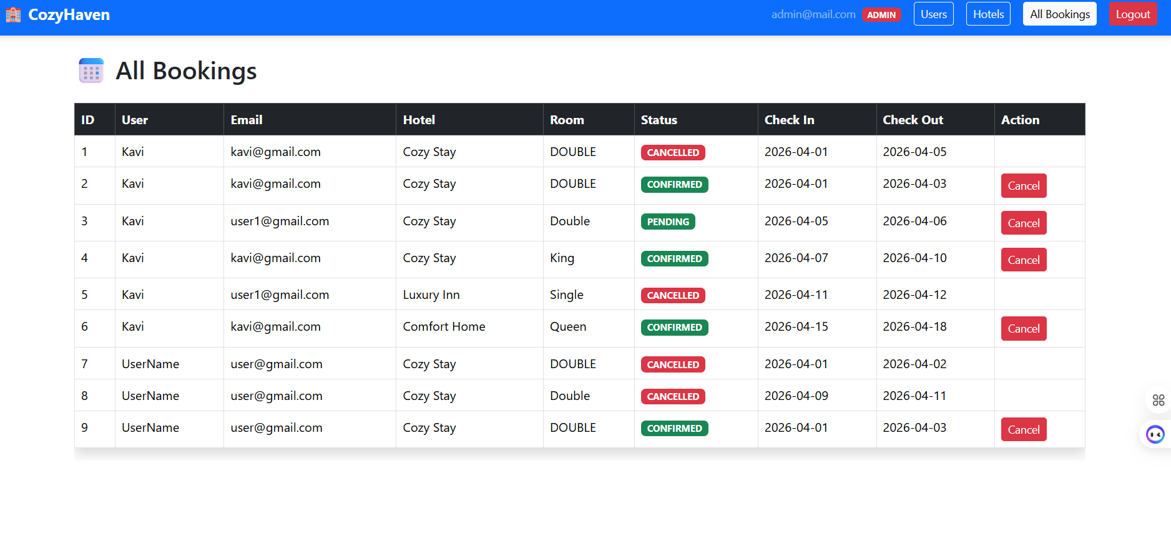

Slide 17
Technology Stack
Frontend: React.js
Backend: Spring Boot
Database: MySQL
Authentication: JWT

Slide 18
Conclusion

