Slide 1
MageIonic
Project Guide
Srikanth Janarthanan
Associate Professor-CSE
Project Members
Arun Kumar. A
Kaviraj. S
Kishore Chandra Y

Slide 2
What is MageIonic ?
MageIonic = Magento + Ionic
Magento - Open Source Framework for E-Commerce Developments.
Ionic - Open Source Framework for Various platform mobile application development.
Integration of two different frameworks to with some added features is MageIonic.
Developing Hybrid web applications using MageIonic.

Slide 3
Abstract
Mobile phone is a long-range, portable electronic device used for mobile communication. When the mobile phones are become popular, merchants set mobiles as a target of marketplace. So the need of mobile apps also increases. It is difficult to develop native apps for all the business needs. Because it requires much time and resource to develop a native mobile applications. So the Hybrid apps are best replacement for native apps. Mageionic focuses the hybrid web app in the e-commerce platforms. It is designed to reduce the time and cost of developing mobile apps for every e-commerce sites which was developed by magento.

Slide 4
Objectives
Integrating two different frameworks to provide combined features and functionalities.
Communication between these frameworks through API’s to obtain vice-versa operability
Providing the Concept of Hybrid Web applications to almost all platforms (i.e.)Desktop, Tablets, Mobiles.
Revolution in code reusability, reducing time and cost on providing multi environment compatibility.
Almost all kind of support for all business needs.

Slide 5

Magento
Magento is an ecommerce platform built on open source technology which provides online merchants with a flexible shopping cart system, as well as control over the look, content and functionality of their online store.
Magento offers powerful marketing, search engine optimization, and catalog-management tools.
We believe that Magento is one of the best ecommerce platforms available today, with editions ranging from community open source, to massive, large-scale enterprise SaaS based systems.
Roy Rubin
- June 25, 2009.

Slide 6

Ionic Framework
Ionic is an HTML5 mobile app development framework targeted at building hybrid mobile apps.
Hybrid apps are essentially small websites running in a browser shell in an app that have access to the native platform layer.
Hybrid apps have many benefits over pure native apps, specifically in terms of platform support, speed of development, and access to 3rd party code.
Unlike a responsive framework, Ionic comes with very native-styled mobile UI elements and layouts that you’d get with a native SDK on iOS or Android or Windows but didn’t really exist before on the web.
Max Lynch, Ben Sperry & Adam Bradley
-November 2013

Slide 7
Technology Used
PHP
APACHE
MYSQL
Angularjs
Bootstrap

Slide 8
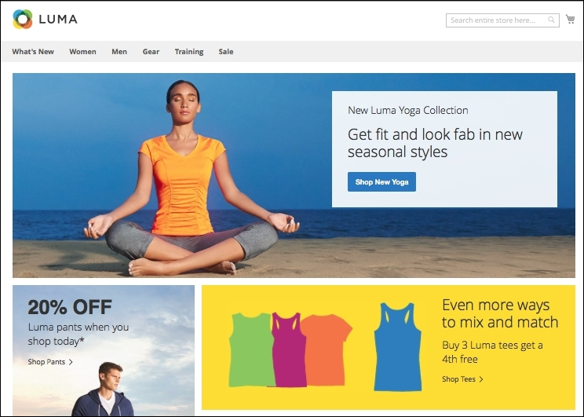
Desktop Homepage View

Slide 9
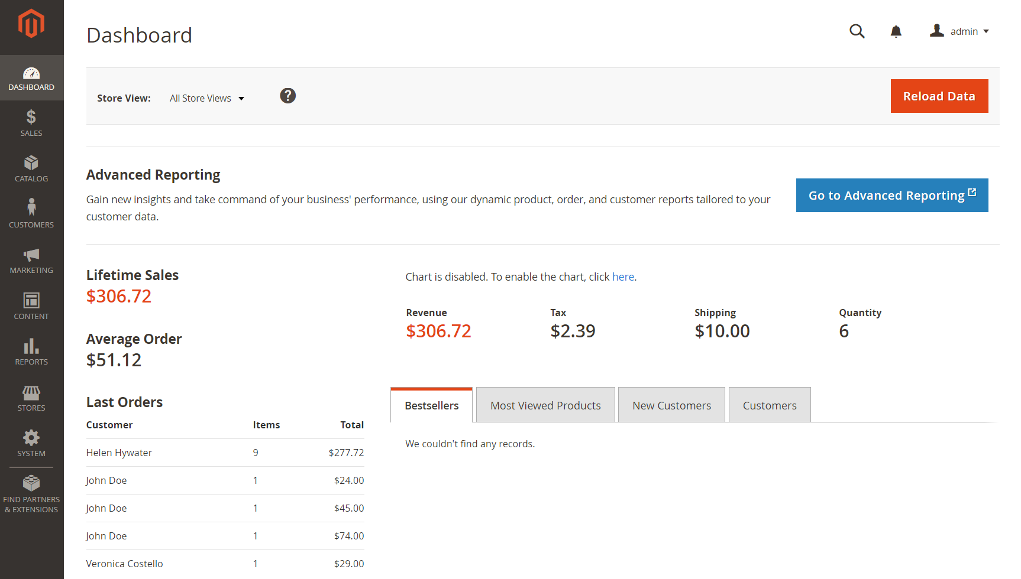
Desktop Admin View

Slide 10
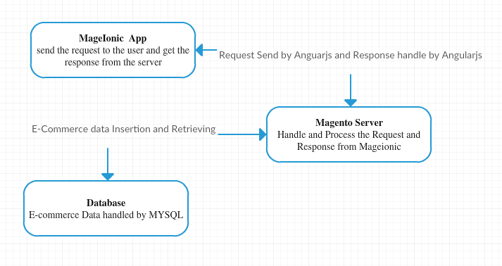
WORK FLOW

Slide 11
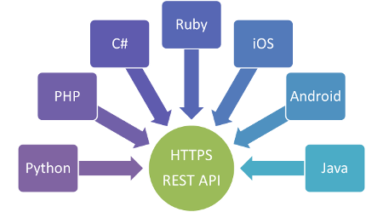
REST API
Recent technology trends in Web Services indicate that a solution eliminating the perceived complexity of the WS-* standard technology stack may be in sight: advocates of Representational State Transfer (REST) have come to believe that their ideas explaining why the World Wide Web works are just as applicable to solve enterprise application integration problems and to radically simplify the plumbing required to build service-oriented architectures. In this tutorial we take a scientific look at the WS-* vs. REST debate by presenting a technical comparison based on architectural principles and decisions.

Slide 12
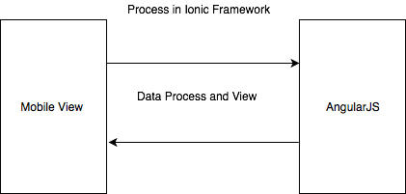
Working on REST API
config.js,
app.js,
controller.js,
services.js.
Step-1 : app.js and controller.js

Slide 13
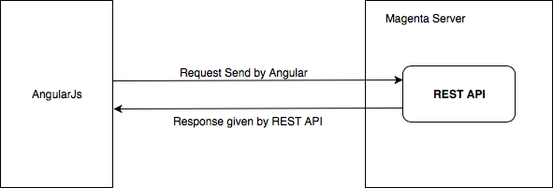
Step-2 : config.js, controller.js and services.js

Slide 14
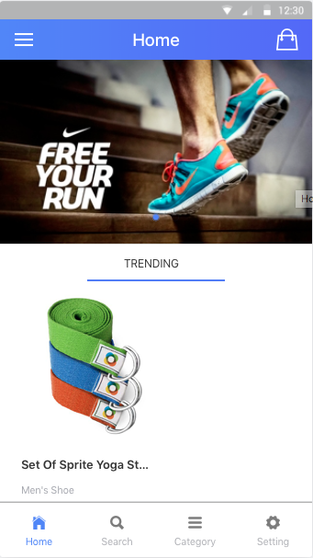
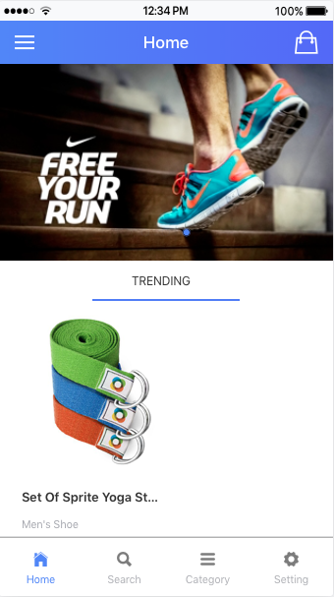

Magionic View from Magento Store
Android View
Iphone View
Windows Phone View

Slide 15
Requirements
System Requirements - Windows or Linux Operating System. - Memory 1GB of RAM, HDD space of 2GB(atleast). - LAMP or XAMPP stack. - PHP 5.6 or >= with simpleXML, GD, mcrypt, curl, SOAP. - MySQL 5.x with PDO_Mysql extensions. - Node JS, NPM, Cordova.

Slide 16
Conclusion
Mobile apps make an energizing market opportunity for online organizations. As it has potential to build a seamless shopping experience that will improve customer engagement. So, being an online store owner, you have to increase your market share by embracing a mobile strategy that not only satisfies your customers’ needs but also checking the endeavors of your rivals.

Slide 17
Reference
Magento 2.2 Developer Documentation
https://devdocs.magento.com
Ionic Framework Documentation
https://ionicframework.com/docs/
REST API Documentation
https://bocoup.com/blog/documenting-your-api

