Slide 1
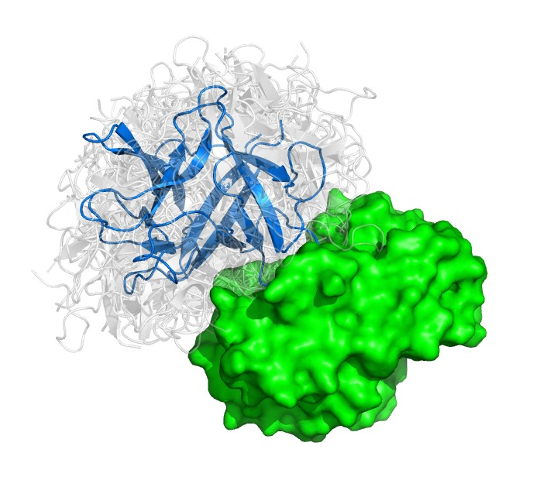
PROTEIN-PROTEIN INTERACTION PREDICTION USING MACHINE LEARNING
By: Kavisha Jignesh Patel
Ujas Vijaykumar Patel
Yash Sanklecha
Date: 05/08/2026
CS 697/AI 687_001_BK_Spring 2026
Instructor: Reda Nacif El Alaoui

Slide 2
OUTLINES
Introduction
Application
Literature review
Literature review results
Our Model
Dataset Description
Algorithm/ Approach
Architecture of Model
Understanding the Functions
Obtained Results
AI Ethical Considerations
Work Distribution
Conclusion
Future Scope
References

Slide 3
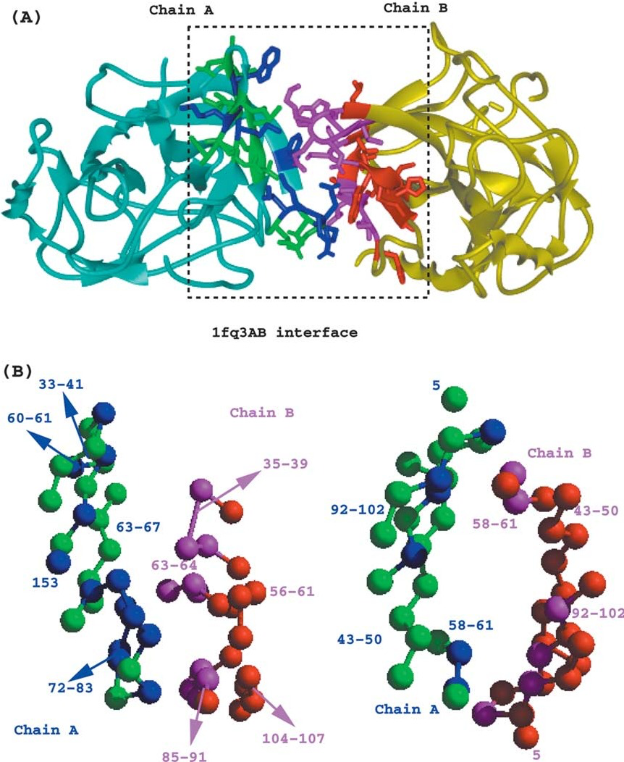
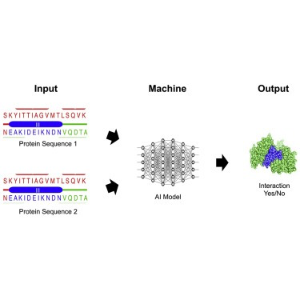
INTRODUCTION
Protein–Protein Interactions (PPIs) are physical and functional associations between proteins that enable biological functions.
PPIs help proteins bind, communicate, and form complexes, playing a key role in cellular organization, signaling, and regulation.
PPIs can be transient (signaling interactions) or stable (structural complexes) and control the flow of information inside cells.
The number of possible protein pairs is extremely large, making experimental validation alone impractical and time-consuming.
Machine Learning can learn complex, nonlinear biological patterns, which are difficult to capture using traditional rule-based methods.
ML-based approaches enable high-throughput, cost-effective prediction and help prioritize protein interactions for experimental validation.

Slide 4
APPLICATION
PPIs are essential for almost all cellular processes, including signal transduction, metabolism, gene regulation, and immune responses.
They enable the formation of protein complexes that carry out specialized cellular functions.
PPIs regulate cellular communication, allowing cells to respond to internal and external signals.
Disruption or abnormal PPIs can lead to diseases such as cancer, neurodegenerative disorders, and autoimmune conditions.
PPIs play a critical role in drug discovery, as targeting protein interactions can modulate disease-related pathways.

Slide 5
LITERATURE REVIEW
Paper 1 (xCAPT5) (Dang and Vu (2024)) | Paper 2 (DL-PPI) (Wu et al. (2023)) | Paper 3 (DF-PPI) (Tran et al. (2025))
• Transformer-based (ProtT5) • Learns contextual & evolutionary info • State-of-the-art performance | • CNN (local patterns) • BiLSTM (sequence dependencies) • Learns from raw sequences | • Combines AAC, APAAC, LD + embeddings • Uses MLP-based fusion • High accuracy (96–99%)
Limitation: • High computational cost | Limitation: • Limited global biological context | Limitation: • Manual feature engineering
Research Gap: Existing models focus on one aspect only → fusion OR deep learning OR language models
Our Contribution: Hybrid model combining BiLSTM + CNN + Cross-attention + Fusion Provides interpretability (hotspots, contact maps, networks)

Slide 6
LITERATURE REVIEW RESULTS
Aspect | xCAPT5 (ProtT5) | DL-PPI (CNN + BiLSTM) | DF-PPI
Accuracy | 90-95%+ | 85-92% | 96-99% (Highest)
Feature Strategy | Pretrained embeddings | Sequence-only | Fusion (handcrafted + embeddings)
Sequence Understanding | Very High (global context) | Moderate | Moderate
Generalization | Very Strong | Moderate | Strong (cross-species)
Computational Cost | Very High | Medium | Medium

Slide 7
OUR MODEL
The model is a Siamese-inspired Hybrid Deep Learning Network that integrates Bidirectional LSTMs for long-range sequence context with a Multi-Kernel CNN block (3, 5, 7) to extract multi-scale structural motifs, utilizing a cross-attention mechanism and gated fusion to model the intricate interfacial dynamics between two protein sequences.
The Benefit of Our Proposed Approach
Processes protein pairs through identical parallel branches using a 128-dimensional embedding layer to map complex biochemical relationships.
Combines Bidirectional LSTMs to capture long-range sequence dependencies with a Multi-Kernel Inception CNN(sizes 3, 5, 7) to detect local functional motifs.
Implements a soft-attention layer that allows residues in one protein to "attend" to the other, identifying specific binding sites through inter-sequence correlation.
Integrates Global Max/Average pooling with a gated MLP that calculates element-wise differences and products to learn the most significant interaction signals.
Beyond prediction, the model enables In-silico Alanine Scanning and Residue Contact Mapping to visualize physical binding interfaces and "hot-spot" residues.

Slide 8
DATASET DESCRIPTION
Point | Details
Dataset Type | Protein-Protein Interaction (PPI)
Source | Kaggle (Positive & Negative protein pairs)
Data Identity | Human (H. sapiens)
Input | Two protein sequences (P1, P2)
Output Label | 1 = Interaction, 0 = No Interaction
Amino Acids | 20 standard amino acids
Data Balance | Balanced dataset

Slide 9
ALGORITHM/APPROACH
Step 1
Data Collection and Preprocessing
Step 2
Model Training
Step 3
Testing
Step 4
Evaluation Metrics
Step 5
Model Performance Analysis
Step 6
Prediction and Ground Truth Comparison

Slide 10
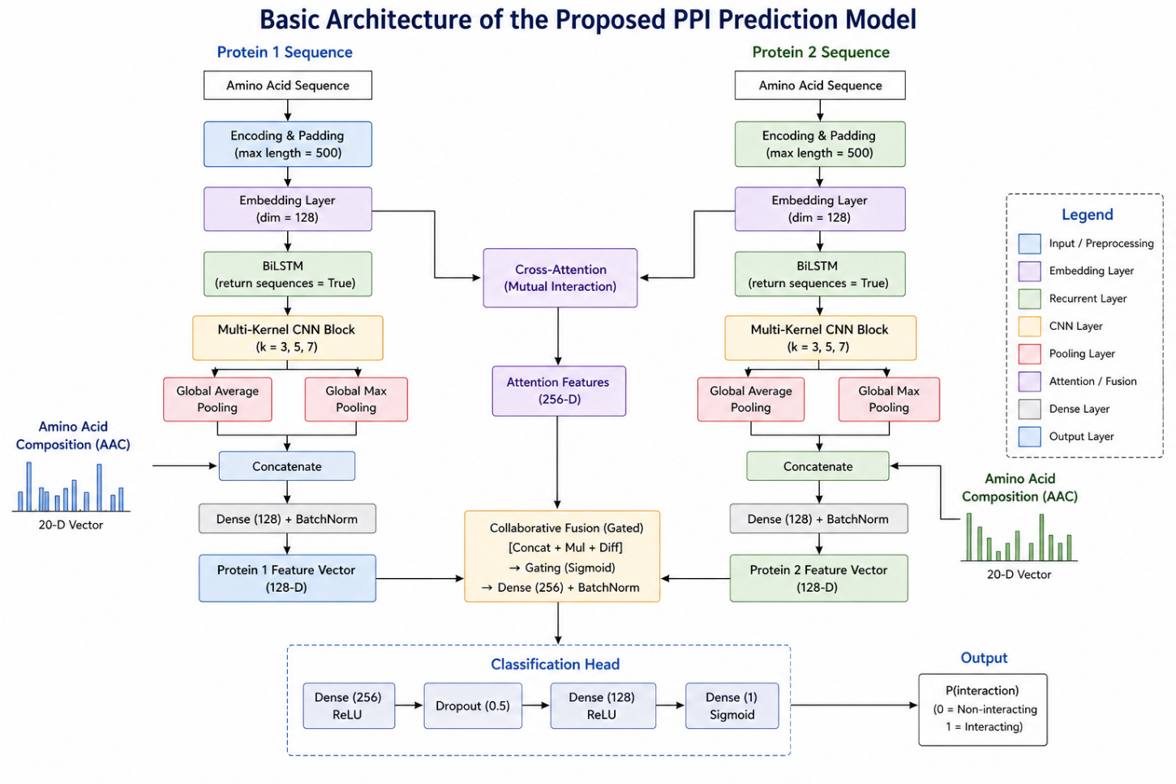
ARCHITECTURE OF MODEL

Slide 11
UNDERSTANDING THE FUNTIONS
Hybrid Dual-Path Encoding:
The model transforms raw sequences into 128-D embeddings, utilizing Bidirectional LSTMs to capture long-range global dependencies and AAC vectors to incorporate essential physico-chemical composition data.
Multi-Scale Motif Detection:
A specialized Inception-style CNN block uses parallel kernels (sizes 3, 5, and 7) alongside Global Max and Average Pooling to simultaneously detect local functional patterns and structural motifs of varying lengths.
Inter-Sequence Cross-Attention:
To model physical binding, a soft-attention mechanism aligns both protein branches, calculating mutual interactions to identify specific residue-residue pairs that contribute to the interface.
Collaborative Gated Fusion:
Extracted features are merged via logical operations (Concatenation, Multiplication, and Subtraction), while a Sigmoid gating mechanism filters out noise and prioritizes the most significant interaction signals.
Robust Probabilistic Prediction:
The final interaction score is generated through a high-capacity Dense MLP (256 units), using Batch Normalization and 0.5 Dropout to ensure high generalization and prevent overfitting during classification.

Slide 12
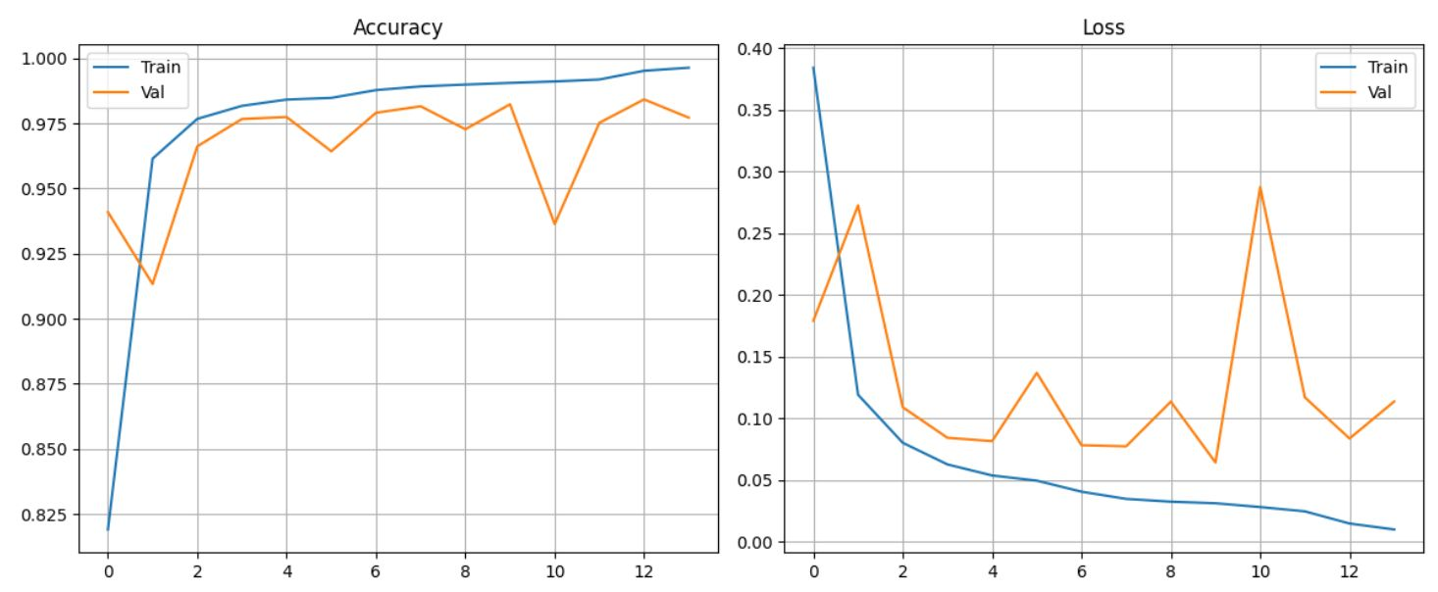
OBTAINED RESULT

Slide 13
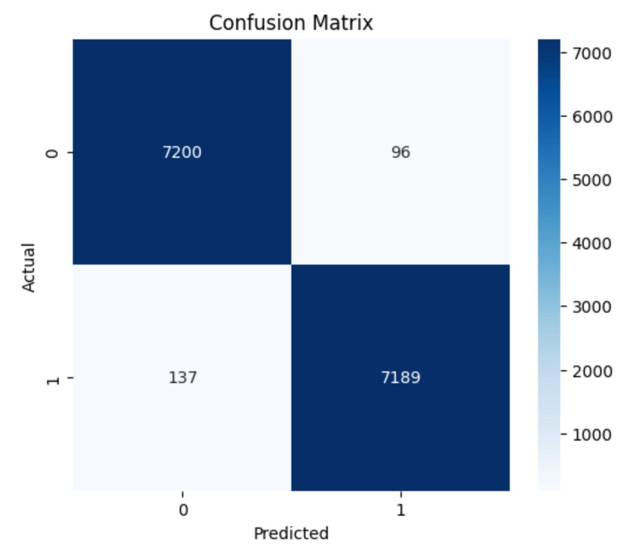
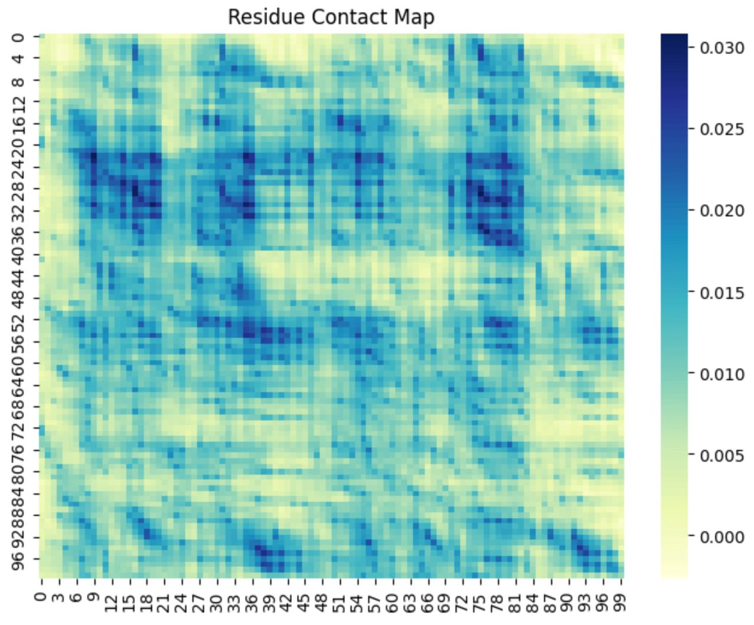

Slide 14
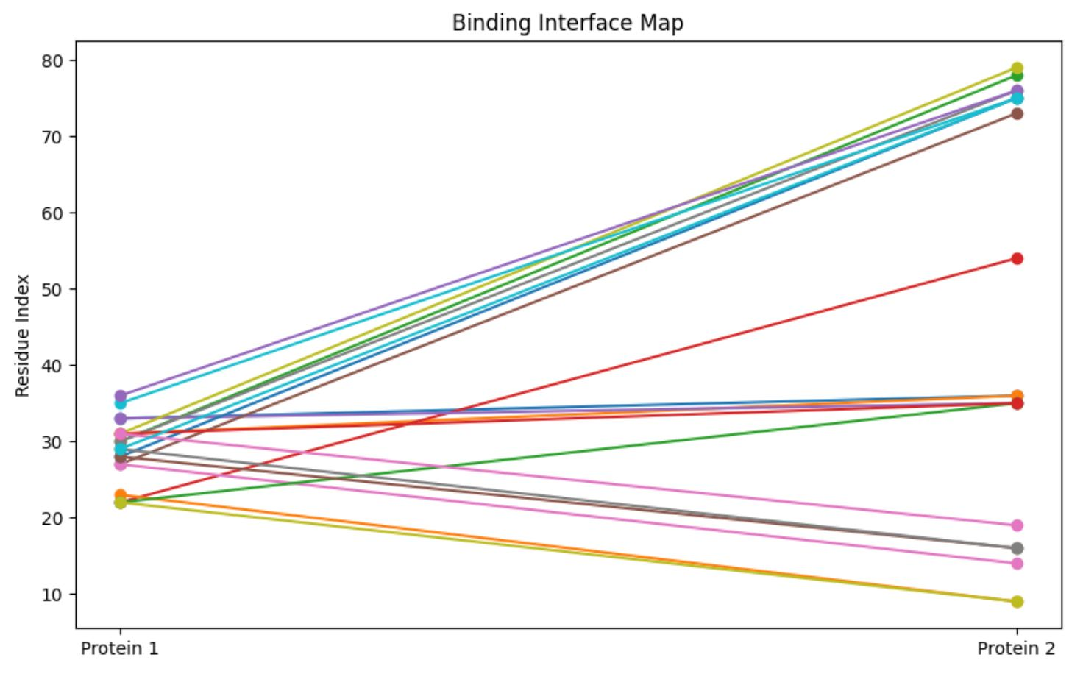
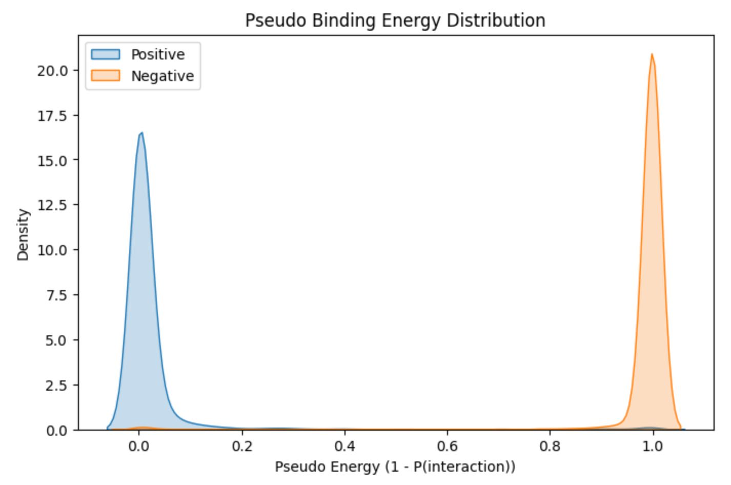
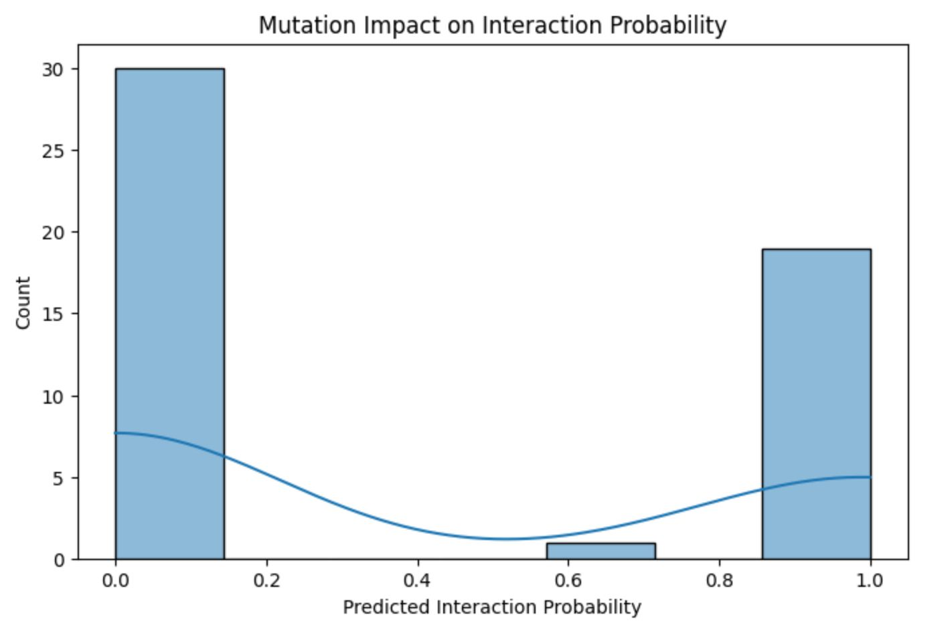

Slide 15
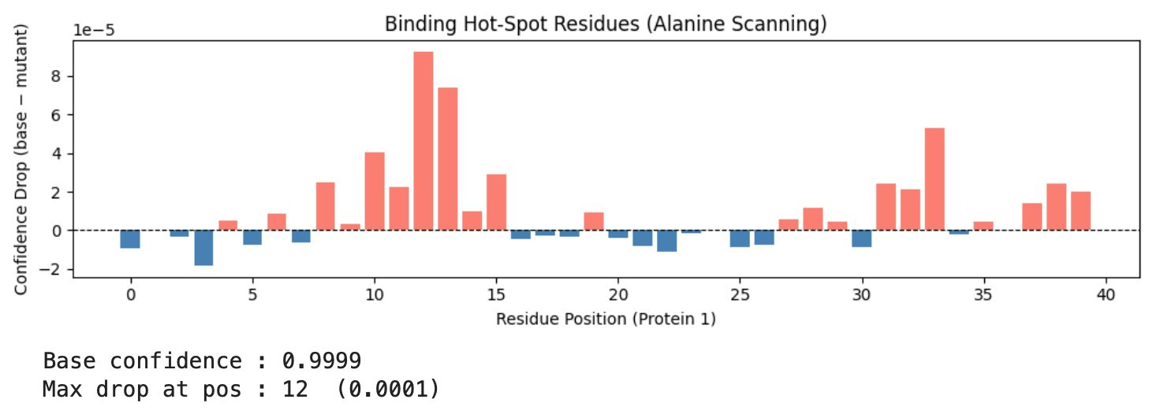

Slide 16
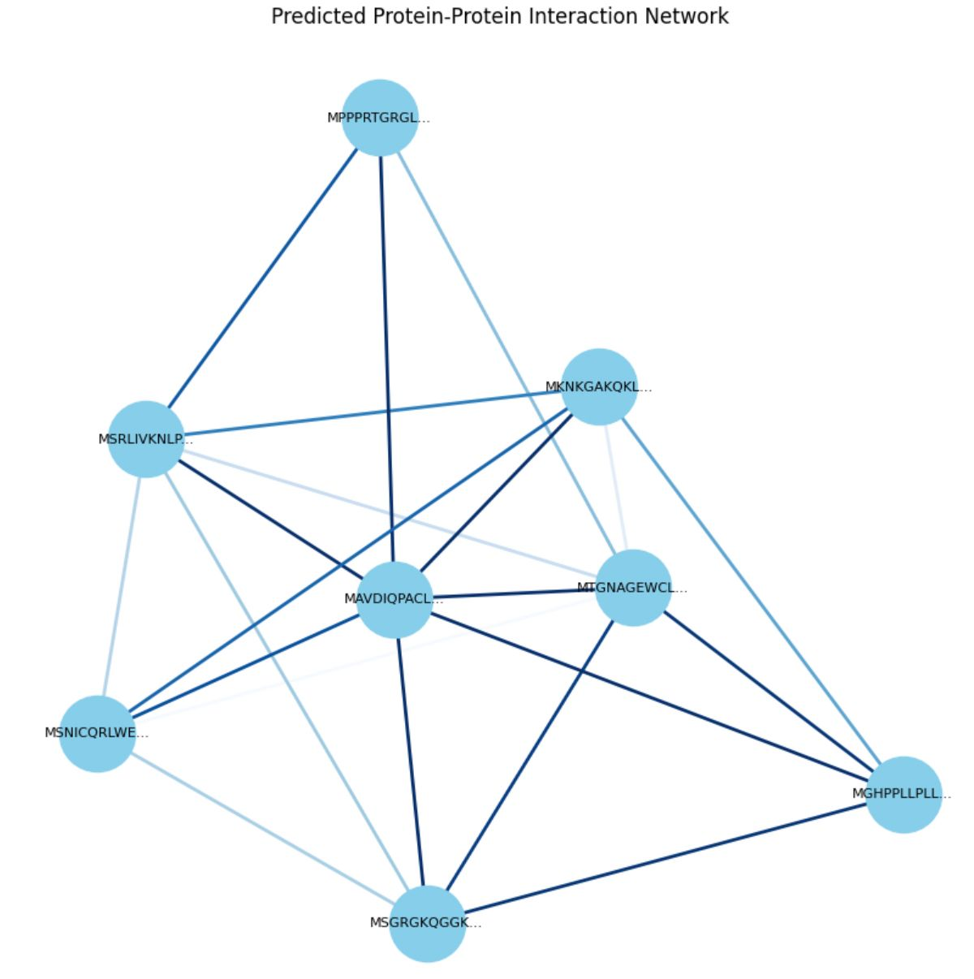

Slide 17
AI ETHICAL CONSIDERATIONS
Data Bias & Representation: The model is trained on publicly available PPI datasets, which may be biased toward well-studied proteins and organisms, potentially limiting predictions for rare or underrepresented proteins.
Prediction vs. Validation: AI-generated PPI predictions are probabilistic, not definitive; they should be used as hypotheses for experimental validation, not as final biological proof.
Model Transparency: Deep learning models (BiLSTM) act as black boxes, making biological interpretation challenging; results must be communicated with appropriate caution.
Risk of Overgeneralization: Predictions for unseen or cross-species protein pairs may carry uncertainty, especially when sequence similarity is low.

Slide 18
WORK DISTRIBUTION
Team Member | Role | Key Responsibilities
Kavisha | Biological Analysis Lead | Literature review, feature justification, interpretation of results, biological relevance & drug discovery insights, all documentation part
Ujas | Model Development Lead | Designing model architecture (BiLSTM, CNN, attention), implementing deep learning pipeline, training strategy, optimization and hyperparameter tuning
Yash | Evaluation & Analysis Lead | Performance evaluation (Accuracy, F1, AUC, MCC), visualization (confusion matrix, curves), advanced analysis (mutation study, network reconstruction)

Slide 19
CONCLUSION
Developed a high-performance Siamese hybrid deep learning architecture designed specifically for robust and scalable Protein-Protein Interaction (PPI) prediction.
Successfully integrated Bidirectional LSTMs and Multi-kernel Inception CNNs to capture both long-range sequence dependencies and local structural motifs.
Implemented dynamic cross-attention and gated collaborative fusion to accurately model the complex mutual interaction dynamics between protein pairs.
Achieved exceptional predictive performance across multiple validation benchmarks, including high Accuracy, F1-Score, and ROC-AUC metrics.
Provided advanced biological interpretability through automated residue-level contact mapping, alanine scanning hotspot detection, and interactome network reconstruction.

Slide 20
FUTURE WORK
Integration of 3D Structural Data: Incorporate AlphaFold-predicted PDB structures or contact maps to transition from 1D sequence-based analysis to 3D spatial interaction modeling.
Multi-Omics Data Fusion: Expand the model to include genomic, transcriptomic, and clinical data to predict how mutations or environmental factors alter protein-protein interactomes.
Transfer Learning with Protein LMs: Fine-tune the architecture using massive pre-trained Protein Language Models (like ESM-2 or ProtT5) to improve performance on low-data or "orphan" protein pairs.
High-Throughput Drug-Target Discovery: Adapt the model for virtual screening to predict how small molecules or peptides can competitively inhibit specific protein-protein interfaces.
Real-time Interactome Scalability: Optimize the inference engine to enable the rapid reconstruction of whole-organism interactomes, facilitating the discovery of entire biological pathways in seconds.

Slide 21
REFERENCES
T. H. Dang and T. A. Vu, “xCAPT5: protein–protein interaction prediction using deep and wide multi-kernel pooling convolutional neural networks with protein language model,” BMC Bioinformatics 2024 25:1, vol. 25, no. 1, pp. 106-, Mar. 2024, doi: 10.1186/s12859-024-05725-6.
A. Madani et al., “ProGen: Language Modeling for Protein Generation,” Mar. 2020, Accessed: Feb. 25, 2026. [Online]. Available: http://arxiv.org/abs/2004.03497
W. Yang, Y. Wang, and Y. Wang, “Deep learning-driven protein structure prediction and design: Key model developments by Nobel laureates and multi-domain applications,” Biophys. Rev., vol. 7, no. 1, Mar. 2026, doi: 10.1063/5.0273394.
X. Du, S. Sun, C. Hu, Y. Yao, Y. Yan, and Y. Zhang, “DeepPPI: Boosting Prediction of Protein-Protein Interactions with Deep Neural Networks,” J. Chem. Inf. Model., vol. 57, no. 6, pp. 1499–1510, Jun. 2017, doi: 10.1021/acs.jcim.7b00028.
H. N. Tran, P. X. Q. Nguyen, F. Guo, and J. Wang, “Prediction of Protein–Protein Interactions Based on Integrating Deep Learning and Feature Fusion,” Int. J. Mol. Sci., vol. 25, no. 11, p. 5820, Jun. 2024, doi: 10.3390/ijms25115820.

Slide 22
Questions

