Slide 1
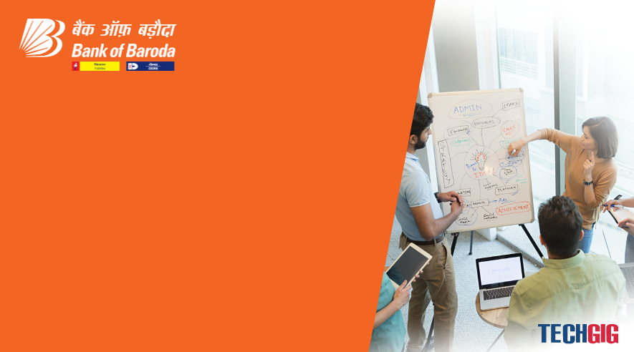

Bank of Baroda Hackathon - 2022
Technology Partner
Your Team Name :Team Hackathon
Your team bio :KAVISHNAVI R ,DHARANYA S
JENIFFER A ,MONISHA V Date : 12.9.2022

Slide 2
Problem Statement?
Why did you decide to solve this Problem statement?
To the best of our knowledge, there is no survey in the area of automatic cheque
processing, and there is a need of such a survey to know the state of the art.
Automatic cheque processing is an interesting field of research from both scientific
and commercial points of view.

Slide 3
User Segment & Pain Points
Which user /advertiser segment would be early adopter of your product & why?
Pre-processing:
Some pre-processing is applied on the image to reduce noise.
2.Handwriting Recognition:
After preprocessing handwriting recognition is used to find the amount written on cheque.
3. Signature Recognition:
An image of a signature or a direct signature is fed into the signature verification software and compared to the signature image on file. This step is important in the processing of cheque.
4. Post processing:
Post-processing deals with the process of combining the individual digits into complete number for account number, date and amount.

Slide 4
Pre-Requisite
What are the alternatives/competitive products for the problem you are solving?
Competitive products for the problem:
Magnetic Ink Character Recognition (MICR).
Artificial Intelligence based cheque clearance system.

Slide 5
Azure tools or resources
Azure tools or resources which are likely to be used by you for the prototype, if your idea gets selected We propose an automated system which extracts relevant details of a bank cheque like Payee Name, Amount, Date, Bank Name using Optical Character Recognition and Deep Learning and verifies the signature on the cheque with the existing signature stored in the database using feature extraction and principal component analysis.

Slide 6
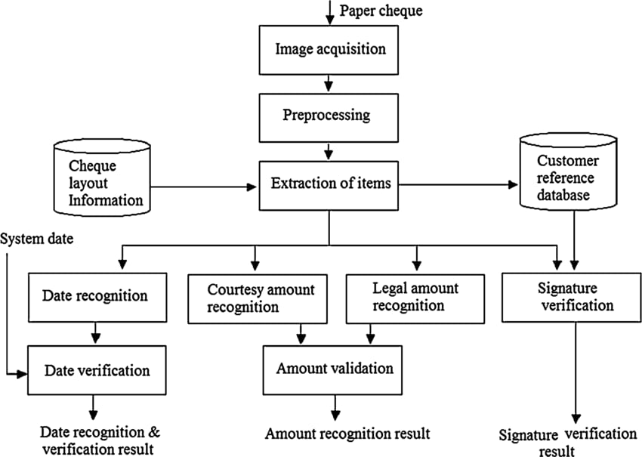
Any Supporting Functional Documents
Present your solution, talk about methodology, architecture & scalability

Slide 7
Key Differentiators & Adoption Plan
How is your solution better than alternatives and how do you plan to build adoption?
We have developed the model to verify the bank cheques using OCR, CNN, SIFT and SVM. We have used OCR method to identify the machine typographic characters with desirable accuracy and efficiency, whereas, we have performed CNN to give precise output for the handwritten digits written on the cheque leaflet.
We have proposed and implemented the algorithm to convert numbers into words to verify the cheque which is one of the major reasons of its bounce-off and of halt the monetary transaction. In order to achieve this, We have applied OCR technique to recognize the machine printing digits.

Slide 8
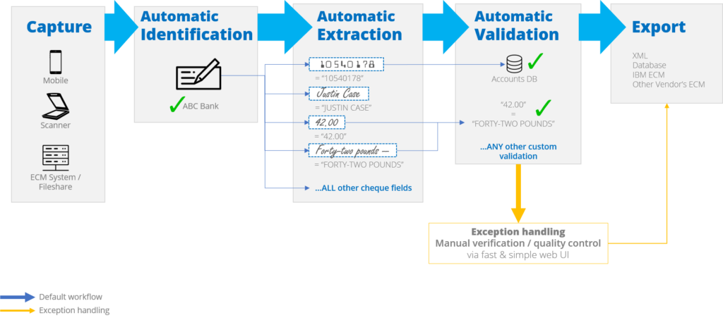
GitHub Repository Link & supporting diagrams, screenshots, if any
How far it can go?

Slide 9
Thank You
Team member names
KAVISHNAVI R
DHARANYA S
JENIFFER A
MONISHA V

