Slide 1
RoboNav: Robot Navigation in Dynamic Environment using Deep Reinforcement Learning
Group 7: Abhishek Jain, Kavit Nilesh Shah, Kenechukwu C. Mbanisi, Sanjeev Kannan
Guided By: Prof. Yanhua Li
<number>

Slide 2
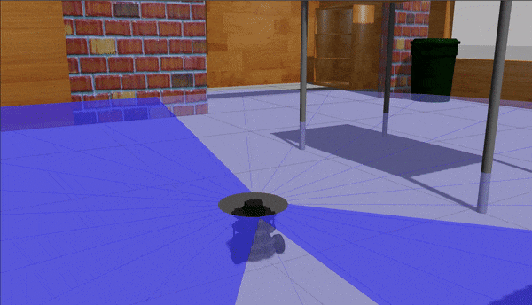
Where we’re headed!
<number>
Notes:
What we wanted our project to do :
Want to do.

Slide 3
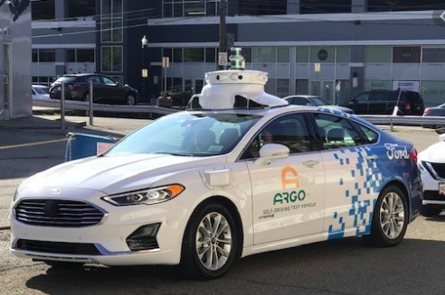
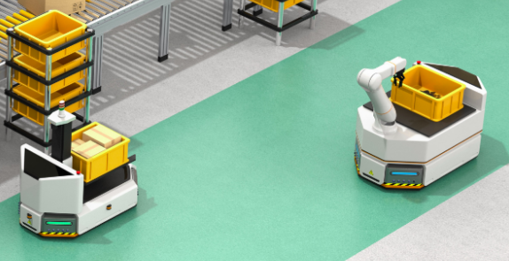
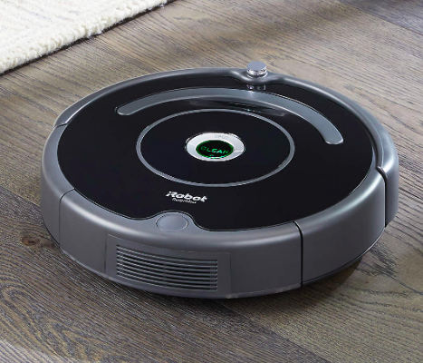
Introduction
Mobile Robot Navigation
Decide between several factors :
Shortest Distance Path
Obstacle avoidance
Least Time
Partially observable states
<number>

Slide 4
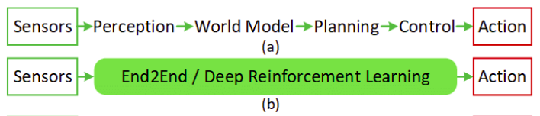
Related Work
Classical Mobile Robot Navigation Methods
Pipeline : Perception -> Planning -> Control [1]
Latest Methods include : SLAM [2], D*
Drawbacks with Classical Methods:
Perception, Making sense of data - high processing GPU required
Require Re-planning when obstacle is encountered
Reinforcement Learning - addresses most shortcomings
Only Laser Data - no “perception” or “prediction” required
Software Pipeline for Mobile Robot Navigation[3]
[1] http://wiki.ros.org/move_base
[2] Durrant-Whyte, Hugh, and Tim Bailey. ”Simultaneous localization and mapping: part I.” IEEE robotics & automation magazine 13.2 (2006): 99-110
[3] https://www.researchgate.net/figure/From-a-modular-pipeline-to-a-perception-planning-deep-neural-network-approach-for_fig1_334049155
<number>
Notes:
No prediction, perception - less compute

Slide 5
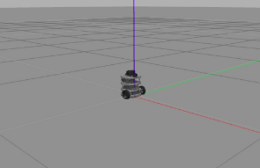
Methodology
Observation Space :
Laser Scan Data
Current position
Orientation
Action Space :
Discrete
Linear Velocity V_{x} = {0.15}
Angular Velocity w_{z} = {-1.5, -0.75, 0.0, .075, 1.5} rad/s
Continuous
Linear Velocity V_{x} = {0.15} m/s
Angular Velocity w_{z} = [-2,2] rad/s
Rewards :
+ve :
Getting close to Goal,
heading towards goal
-ve :
Increasing Distance from Goal
heading away from goal
Problem Formulation : Navigating an RL agent to a goal destination in a closed environment with static and moving obstacles
<number>

Slide 6
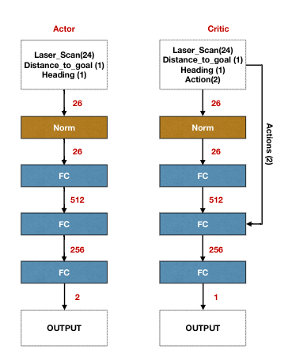
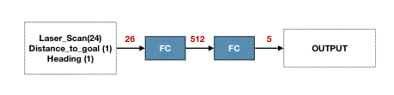
Neural Net Architecture
Deep Q Network
1 x Input Layer
2 x Fully Connected Layers
1 x Output Layer
DDPG
1 x Input Layer (26 units)
1 x Batch Normalization Layer
3 x Fully Connected Layers
1 x output Layer
<number>
Notes:
Action Space : move to

Slide 7
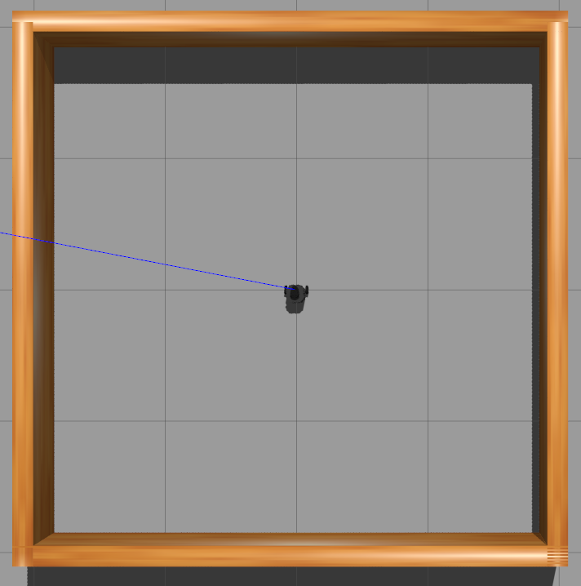
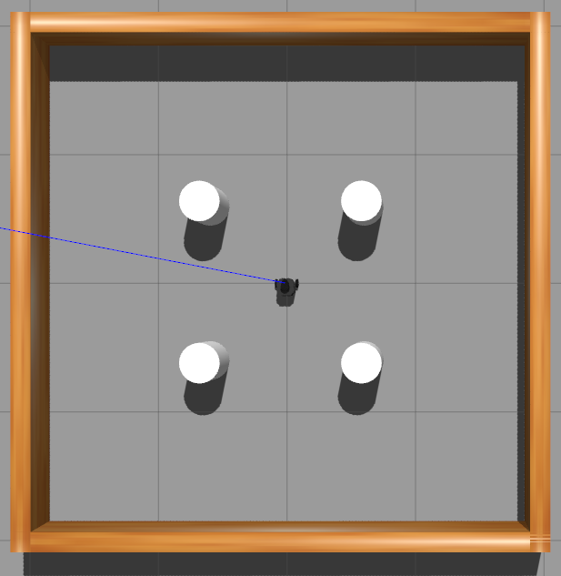
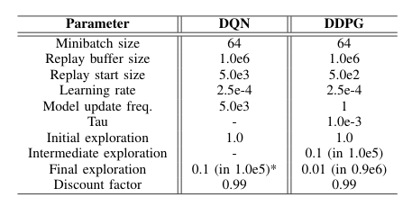
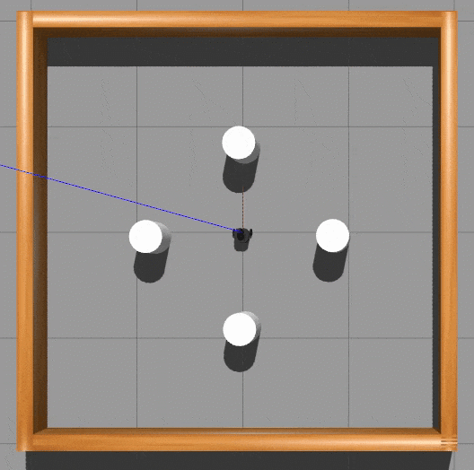
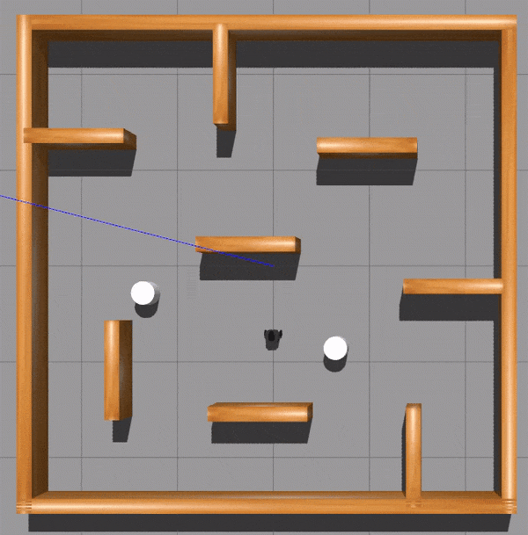
Experiments: Simulation Environments
Stage 1
Stage 2
Stage 3
Stage 4
<number>

Slide 8
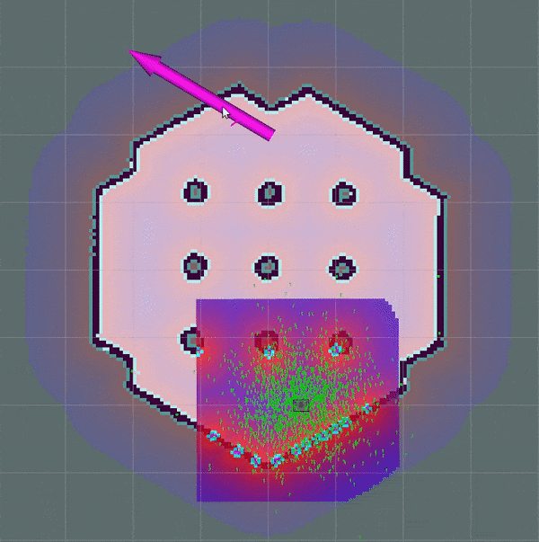
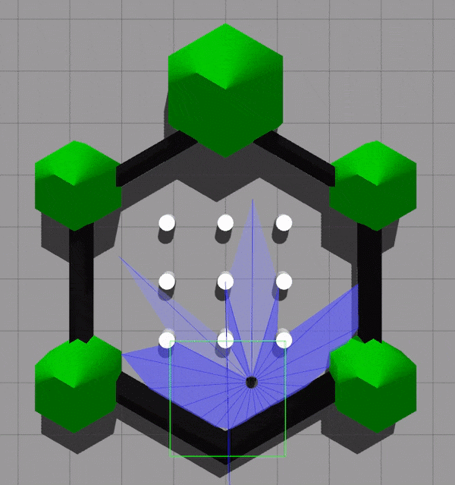
Experiments: Baseline (Move-Base)
Traditional ROS Navigation Stack Library
Employs a hierarchical motion planner with following submodules:
Global Planner : Computes a higher level path
Local Planner : Computer more fine-tuned local path
Controller
Works with both static and dynamic environment
Tries to find the “best” possible path from start to goal
<number>

Slide 9
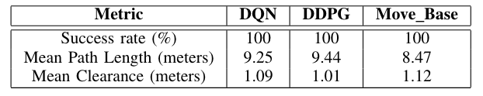
Experiments: Evaluation Metrics
Number of trials : 10
Number of goal per trial: 5
Data used to compute the metrics: x,y coordinates, distance to obstacles and velocities
Metrics:
Success Rate
Path Length
Clearance
<number>

Slide 10
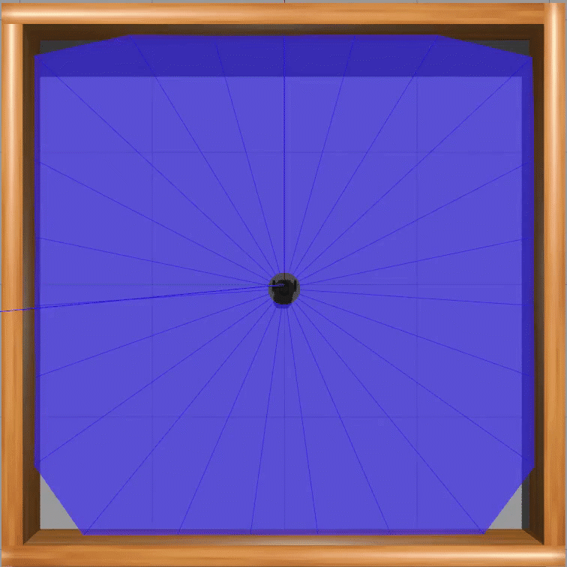
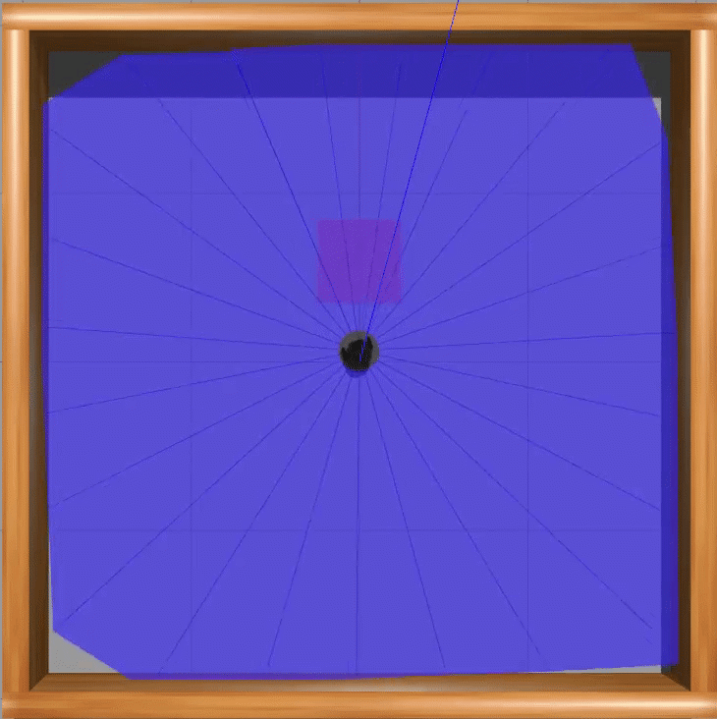
Simulation Results
STAGE 1
Untrained Agent
Trained Agent
<number>

Slide 11

Simulation Results
STAGE 1
No major obstacles
Static Environment
All the 3 agents perform good
<number>

Slide 12
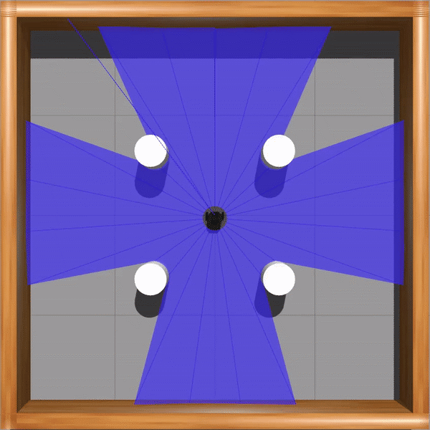
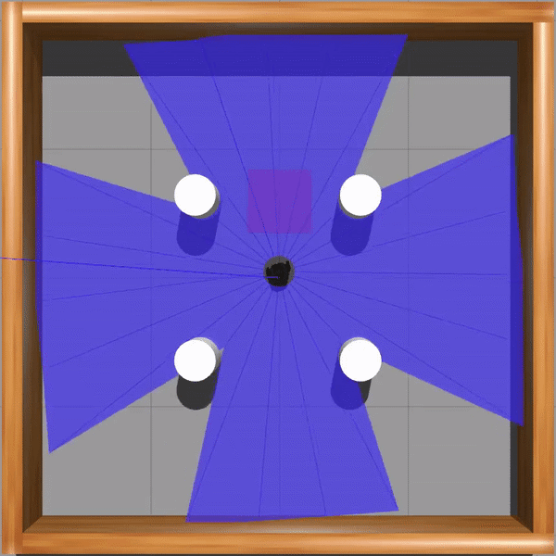
Simulation Results
STAGE 2
Untrained Agent
Trained Agent
<number>

Slide 13
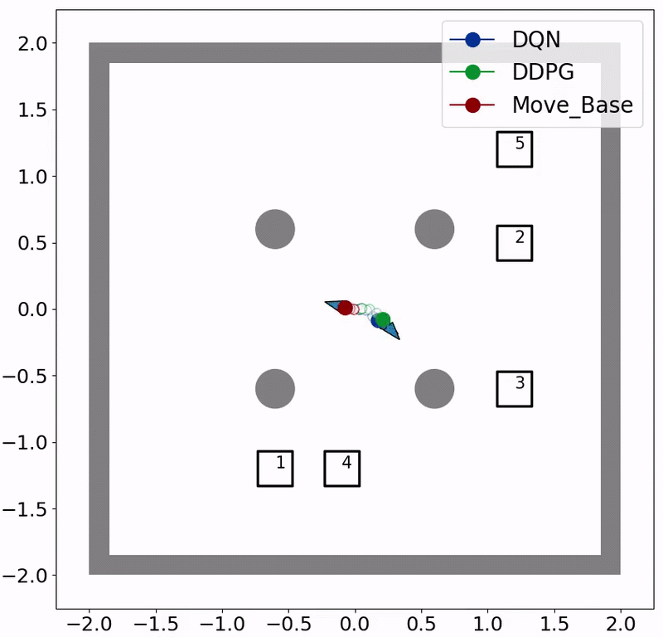
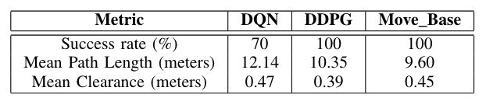
Simulation Results
STAGE 2
Some obstacles in form of cylindrical poles
Static Environment
DDPG and Move-Base agents give good performance while the DQN agent falters in some trials
<number>

Slide 14
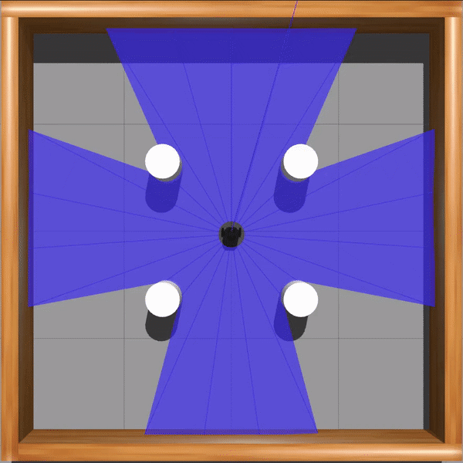
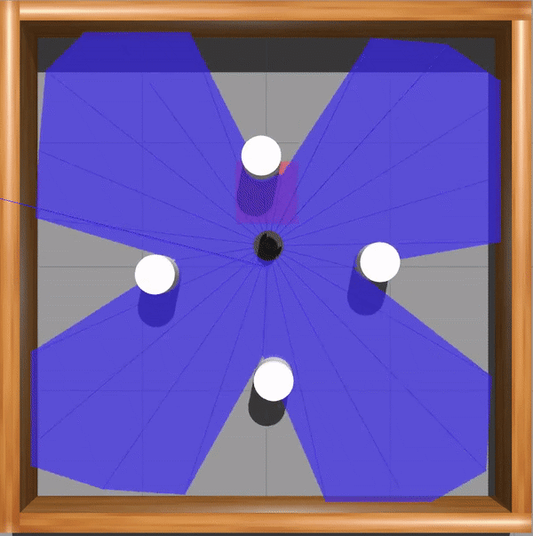
Simulation Results
STAGE 3
Untrained Agent
Trained Agent
<number>

Slide 15
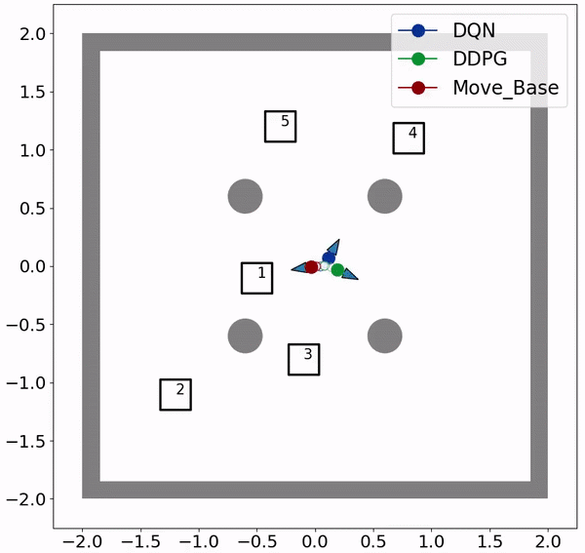
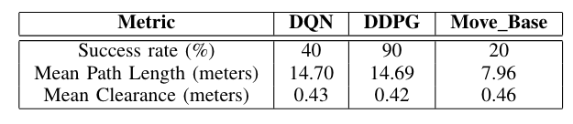
Simulation Results
STAGE 3
Fixed moving obstacles in form of cylindrical poles
Dynamic Environment
DDPG agent gives good performance while the DQN and Move-Base agents perform poorly.
<number>

Slide 16
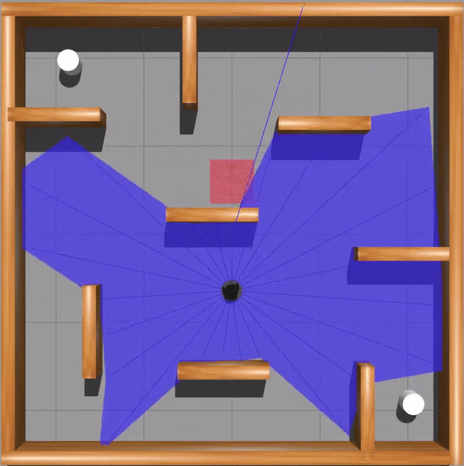
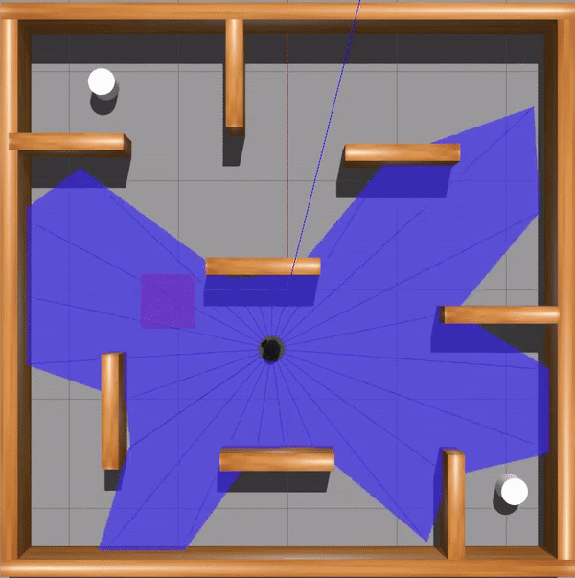
Simulation Results
STAGE 4
Untrained Agent
Trained Agent
<number>

Slide 17
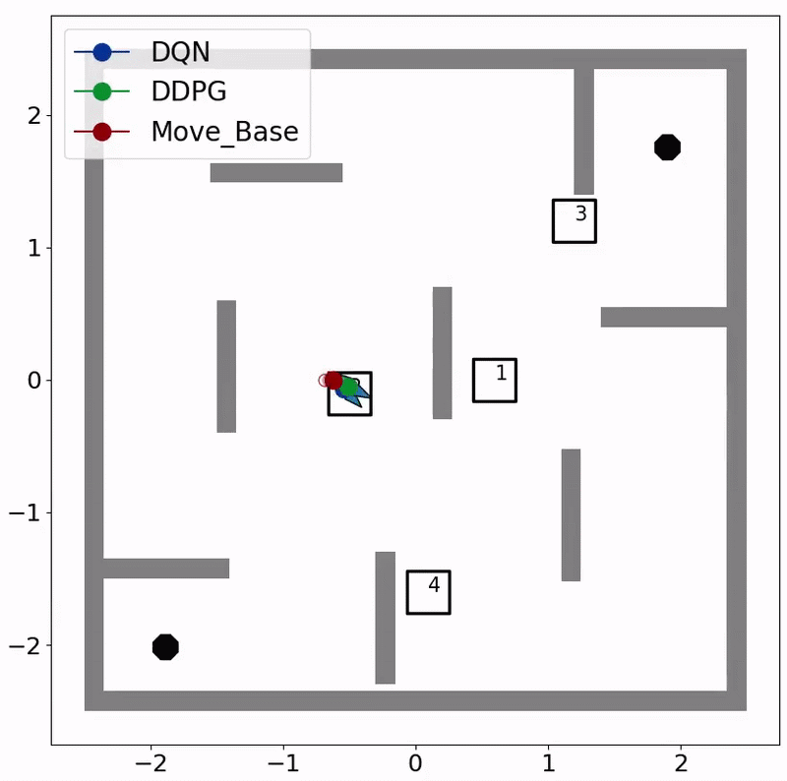
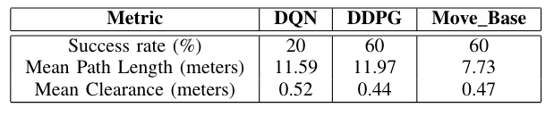
Simulation Results
STAGE 4
Random moving obstacles in form of cylindrical poles coupled with fixed obstacles in form of rectangular walls
Dynamic Environment
DDPG and Move-Base agents gives good performance while the DQN agent performs poorly.
<number>

Slide 18
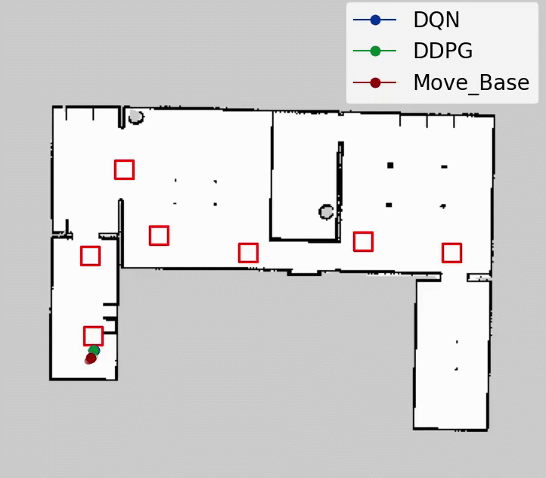
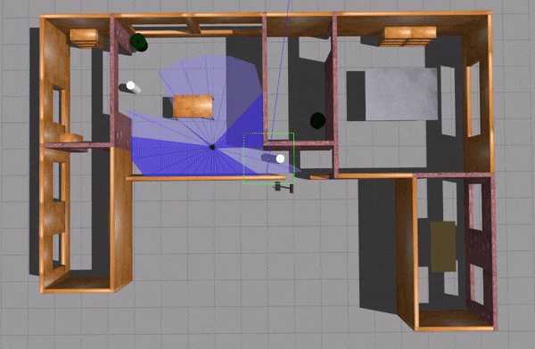
Simulation Results
STAGE 5
Novel dynamic environment
None of the agents were trained in this environment
All 3 agents perform good
<number>

Slide 19
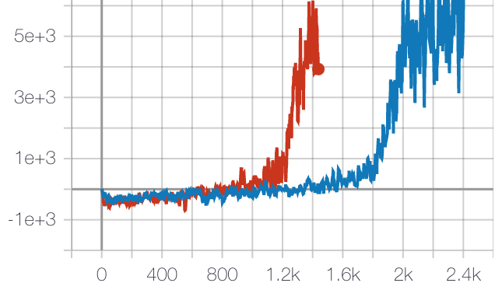
Discussion
2 different types of DRL agents were used: DQN and DDPG
DQN learns faster as compared to DDPG while DDPG gives better control and smoother trajectories than DQN.
DDPG gives better accuracy than DQN owing to its continuous action-space.
Move-Base tends to fail in dynamic environment while DRL agents give appreciable performance.
DDPG
DQN
Average Reward ( 30 ep.)
Number of Episodes
<number>

Slide 20
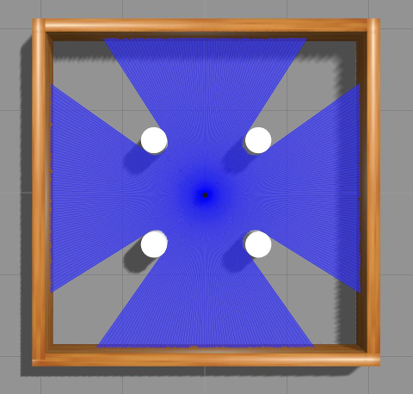
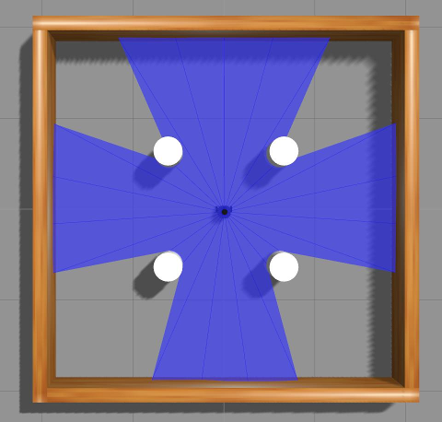
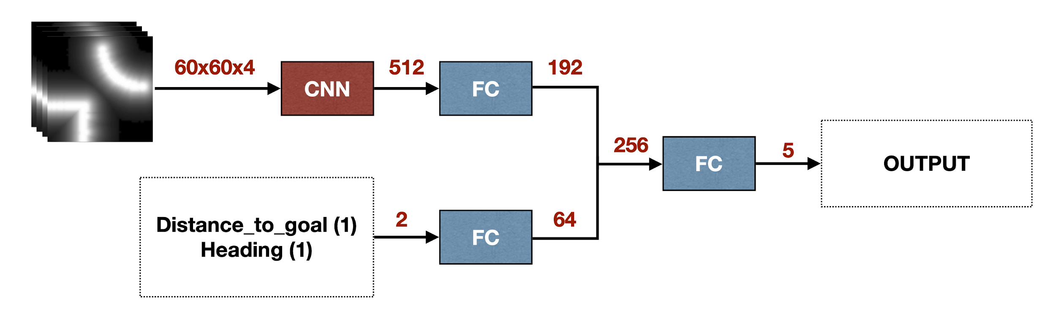
Future Work
Dense laser scans
Map-based approach
Including observation history
Normalizing laser scan information
Expanding action space (linear vel)
Sensor fusion (LiDAR + camera) for better scene/environment understanding
360 Samples
24 Samples
Map-based Approach
<number>

