Slide 1

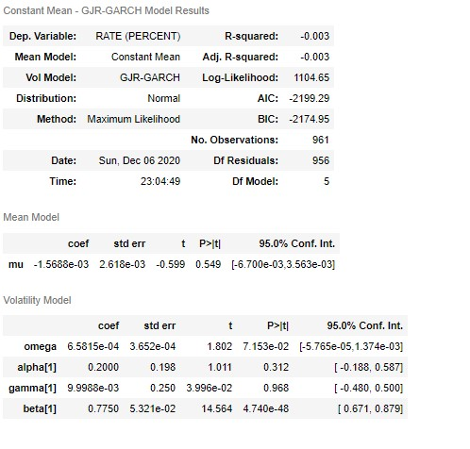
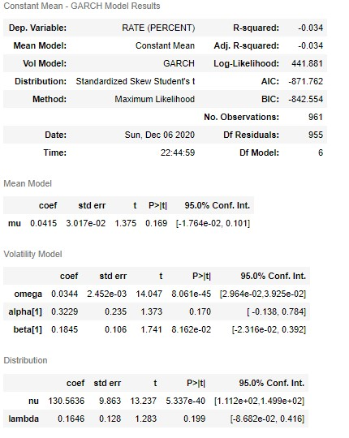
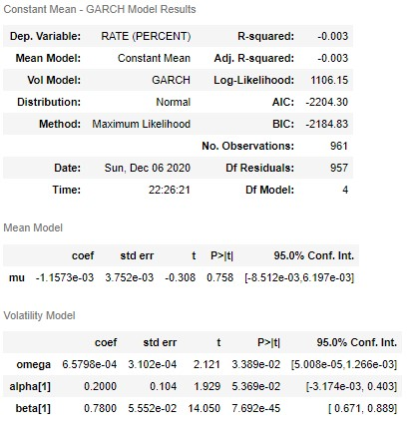
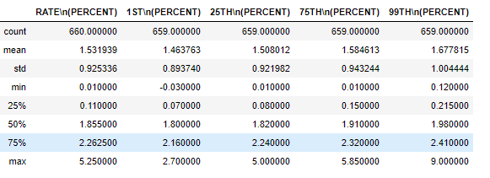
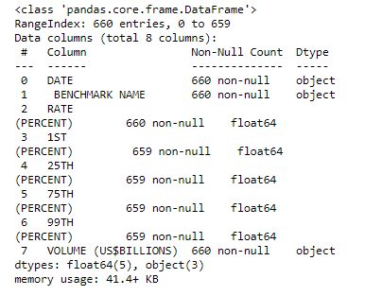
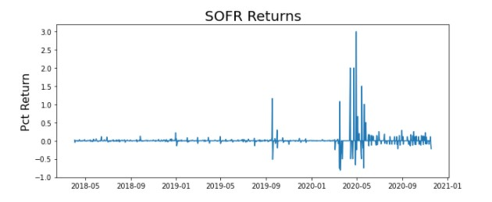
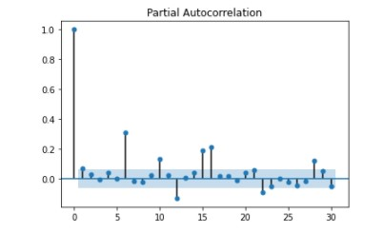
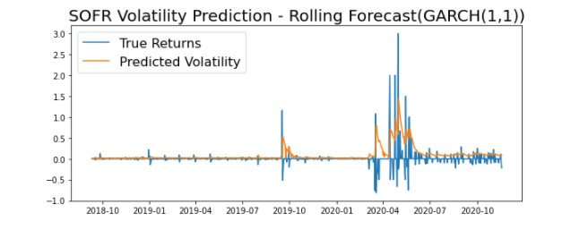
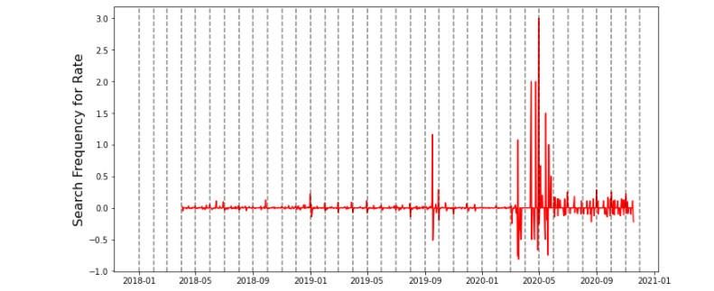
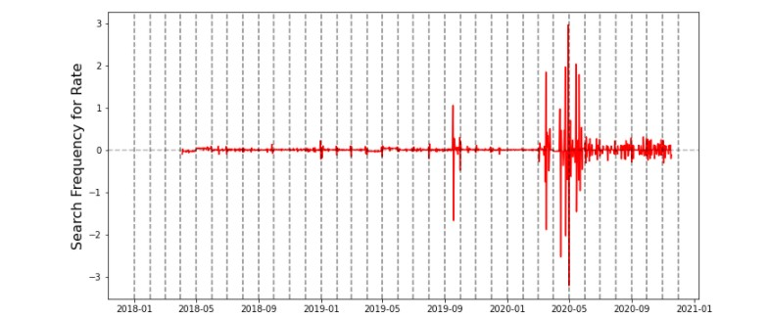
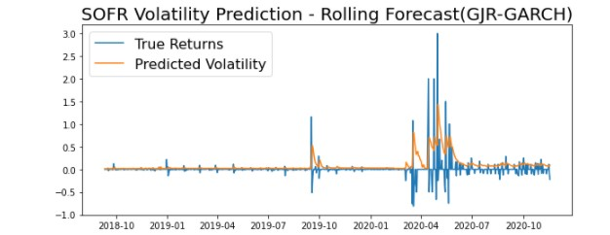
Time Series volatility model for SOFR Hariom Mehta, Shrey Kshatriya, Vaibhav Singh, Kavit Shah Instructor: German Creamer
Introduction: Problem
The Secured Overnight Financing Rate (SOFR) was first released in 2018 by BNY, NY and aims to globally replace the use of IBORs in the financial industry. It is a broad measure of the cost of borrowing cash overnight collateralized by the U.S. Treasury securities in the repurchase agreement (repo) market. By using this data, we reflect more on how the financial institutions can fund themselves, and can measure the spike, and help the institutions to take precautionary measures by predicting the SOFR values.
Modeling:
We performed following tests on the processed datasets on SOFR
Ljung Box-Test
Arch Test
PACF and ACF
Based on evaluation of the above plots we decided to implement these following models
GARCH(1,1) model
Skewness and Kurtosis Test
GARCH (skewness) distribution
GJR-GARCH
Data Understanding:
The dataset includes time-series data of overnight USD SOFR rates starting from its first publish date i.e., 3rd April 2018 to 18th November 2020. It contains observations of rates on a day-to-day basis over the sample period. The primary SOFR rate is calculated as a volume-weighted median and is the rate generated with 50 percentile of transaction volume. The 1st, 25th, 75th, and 99th percentiles for each rate are also calculated using the same volume-weighted methodology and rounded to the nearest basis point.
Results & Evaluation
Data Preparation:
The data used to build our forecasting model contained few null values since it also contained information for Weekends and public holidays where the Federal bank remains closed. We are not considering holidays to build our model We then normalize our data we found no trends but seasonality. We are considering only the SOFR rates and dropping columns like percentiles and volume.
Conclusion:
We observed that using GARCH(1,1) model has proven best to capture the trend as well as volatility. But we also observed that care needs to be taken for different properties of SOFR rates such as diffusion. Future scope of the project involves retro-fitting suggested models with an improved version to better capture negative volatility shocks.

