Slide 1
No SQL

Slide 2
Overview of Database
A database is a collection of interrelated data.
It is a computer based record-keeping system.
A database is a repository for stored data.
Database Management System is a set of pogroms to use and/or modify this data.
Evolved in 1960s to address common issue.
The component of Database are:
Hardware
Software
Data
User

Slide 3
Common Issues are:
Data Redundancy
Inconsistency
Isolation
Security Problem
Integrity Issue
Complexities of structural design

Slide 4
Advantage of DBMS
Minimal Redundancy
Data Consistency
Data Integration
Data Sharing
Data Access
Enforcement of Standard
Better Controls
Data Independence
Privacy and Security
Performance

Slide 5
Functions of DBMS
Data Definition
Data Manipulation
Data Security and Integrity
Data Recovery and Concurrency
Data Dictionary
Performance
Backup and Recovery

Slide 6
Need of NOSQL
Relational databases management systems (RDBMS) store data in tabular form of rows and columns, and Structured Query Language (SQL) is the language that is used to access and manipulate data in relational databases.
The rapid growth of data and the need for high availability, scalability, and performance in modern software applications have handicapped relational databases due to their design structure.
SQL is the only way to access data from relational databases, and going through billions and trillions of records takes time. This is where non-relational databases play a vital role.
Database management systems (DBMS) that do not use SQL to query databases are called NoSQL databases. NoSQL databases are also called non-SQL or nonrelational databases.
NoSQL databases are not a single kind of database.
NoSQL databases are various database technologies that allow data to be stored and managed in different formats without the use of SQL.
Some of the databases use their own mechanism, API, and some use non-SQL languages.
Non-relational databases have been in existence for decades, but the term “NoSQL” was coined by Carlo Strozzi in 1998 to name his lightweight Strozzi NoSQL open-source relational database.
The database did not use SQL to access and manipulate data.

Slide 7
Overview
NoSQL is literally a combination of two words: No and SQL
Means:
Not a SQL
Not a Relation
NoSQL is actually an acronym that expands to “Not Only SQL.”
NoSQL is used today as an umbrella term for all databases and data stores that don’t follow RDBMS principles
But often relate to large data sets accessed and manipulated on a Web scale.

Slide 8
NO SQL
NoSQL Database is used to refer a non-SQL or non relational database.
It provides a mechanism for storage and retrieval of data other than tabular relations model used in relational databases.
NoSQL database doesn't use tables for storing data.
It is generally used to store big data and real-time web applications.

Slide 9
History
NO RDBMS is not new
Non-relational databases advent of mainframes and have existed in specialized and specific domains — for example, hierarchical directories for storing authentication and authorization credentials — through the years.
The non-relational stores that have re-appeared in the world of NoSQL are a new incarnation, which were re-born in the world of massively scalable Internet applications.

Slide 10
Why NoSql
Google has, over the past few years, built out a massively scalable infrastructure for its search engine and other applications, including Google Maps, Google Earth, G-Mail, Google Finance, and Google Apps.
Google’s approach was to solve the problem at every level of the application stack.
The goal was to build a scalable infrastructure for parallel processing of large amounts of data.
Google therefore created a full mechanism that included a distributed filesystem, a column-family-oriented data store, a distributed coordination system, and a MapReduce-based parallel algorithm execution environment.

Slide 11
Big Data
How much data qualifies as big data?
Currently, any data set over a few terabytes is classified as big data.
It’s also the size at which traditional RDBMS techniques start showing the first signs of stress.
It’s difficult to assess the true size of digitized data or the size of the Internet but a few studies, estimates, and data points reveal that it’s immensely large and in the range of a zettabyte and more.

Slide 12
DATA SIZE MATH
Kilobyte (kB) — 103
Megabyte (MB) — 106
Gigabyte (GB) — 109
Terabyte (TB) — 1012
Petabyte (PB) — 1015
Exabyte (EB) — 1018
Zettabyte (ZB) — 1021
Yottabyte (YB) — 1024

Slide 13
Data Access Speed
When data grows the storage capacities, the disk access speeds to write data to disk and read data from it is not keeping pace.
1 TB disks claim to access data at the rate of 300 Mbps, rotating at the speed of 7200 RPM.

Slide 14
Scalability
Scalability is the ability of a system to increase throughput with addition of resources to address load increases.
Scalability can be achieved either by provisioning a large and powerful resource to meet the additional demands or it can be achieved by relying on a cluster of ordinary machines to work as a unit.
The advent of big data forced to adoption of horizontally scalable infrastructures.
Some of these horizontally scaled infrastructures at Google, Amazon, Facebook, eBay, and Yahoo!
The MapReduce model possibly provides one of the best possible methods to process large-scale data on a horizontal cluster of machines.

Slide 15
Map Reduce
MapReduce is a parallel programming model that allows distributed processing on large data sets on a cluster of computers.
MapReduce derives its ideas and inspiration from concepts in the world of functional programming.
Map and reduce are commonly used functions in the world of functional programming.
In functional programming, a map function applies an operation or a function to each element in a list.
For example, a multiply-by-two function on a list [1, 2, 3, 4] would generate another list as follows: [2, 4, 6, 8].
When such functions are applied, the original list is not altered.
Functional programming believes in keeping data immutable and avoids sharing data among multiple processes or threads.
This means the map function that was just illustrated, trivial as it may be, could be run via two or more multiple threads on the list and these threads would not step on each other, because the list itself is not altered.

Slide 16
Map Reduce
Like the map function, functional programming has a concept of a reduce function.
Actually, a reduce function in functional programming is more commonly known as a fold function.
A reduce or a fold function is also sometimes called an accumulate, compress, or inject function.
A reduce or fold function applies a function on all elements of a data structure, such as a list, and produces a single result or output.
So applying a reduce function-like summation on the list generated out of the map function, that is, [2, 4, 6, 8], would generate an output equal to 20.

Slide 17
Types of Database
RDBMS (Relational Database Management System)
OLAP (Online Analytical Processing)
NoSQL (recently developed database)

Slide 18
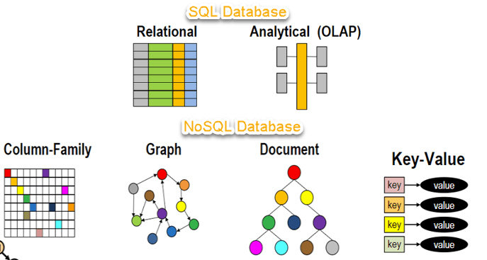
Sql Vs. No Sql

Slide 19
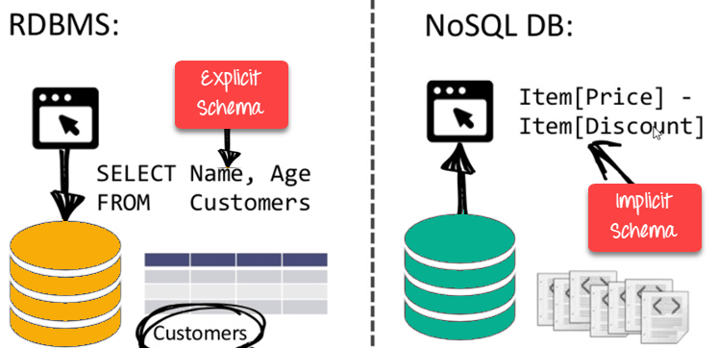
Schema

Slide 20
Types of NoSQL Databases
Key-value Pair Based
Column-oriented Graph
Graphs based
Document-oriented

Slide 21
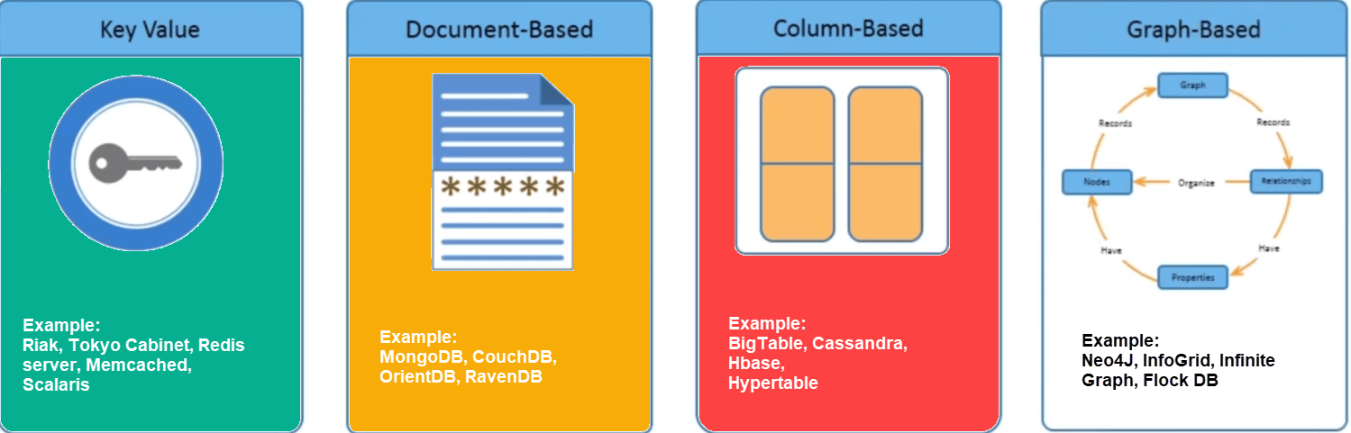
Types No SQL Database

Slide 22
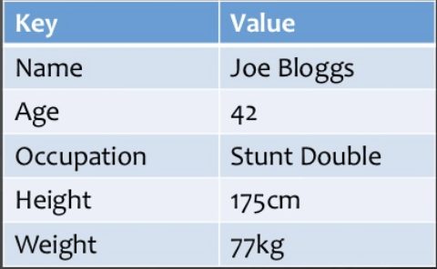
Key-value

Slide 23
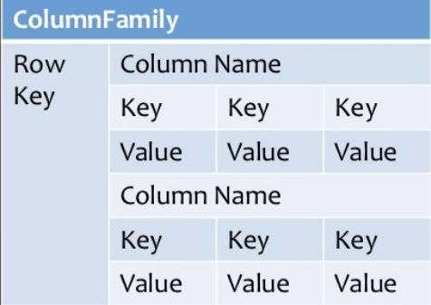
Column Based

Slide 24
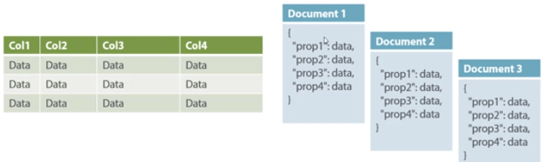
Document-Oriented:

Slide 25
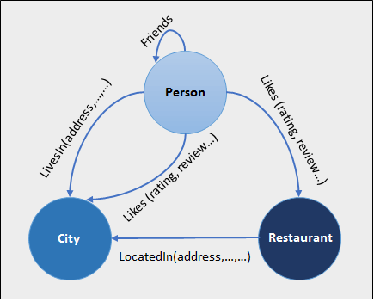
Graph based

Slide 26
Query Mechanism tools for NoSQL
Consistency
Availability
Partition Tolerance

Slide 27
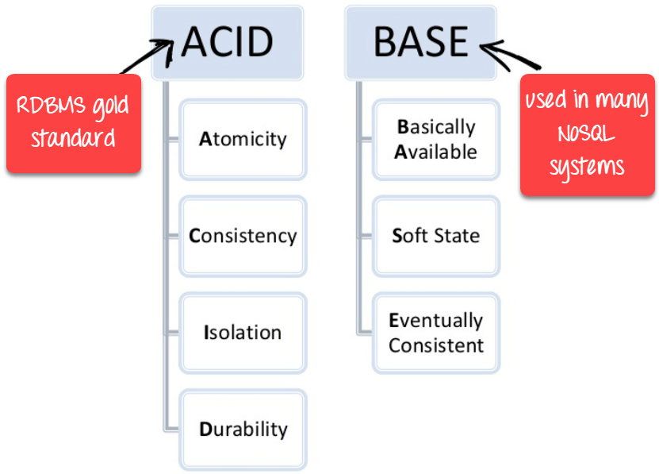
BASE Theorum

Slide 28
NoSQL Database
NoSQL Database is used to refer a non-SQL or non relational database.
It provides a mechanism for storage and retrieval of data other than tabular relations model used in relational databases.
NoSQL database doesn't use tables for storing data.
It is generally used to store big data and real-time web applications.

Slide 29
Advantages of NoSQL
It supports query language.
It provides fast performance.
It provides horizontal scalability.

Slide 30
Document based

Slide 31
Document Based
Document databases are not document management systems.
The word document in document databases connotes loosely structured sets of key/value pairs in documents usually using JSON.
Document databases treat a document as a whole and avoid splitting a document into its constituent name/value pairs.
Document contains collections to store diverse data.
Document databases allow indexing of documents on the basis of not only its primary identifier but also its properties.
MongoDB and CouchDB are the most commonly use document database.

Slide 32
Column-family based
Notes:
https://www.c-sharpcorner.com/article/what-is-a-column-store-database/

Slide 33
Overview
A column data store is also known as a column-oriented DBMS or columnar database management system.
Column storage DBMS stores data in columns rather than rows.
Relational database management systems (RDBMS) store data in rows and data properties as column headers.
Both row-based and column-based DBMSs use SQL as their query language, but column-oriented DBMSs may offer better performance.
Imagine you need to list all names from a table based on an ID; rather than going through all the rows, you could just access a single column of the table.

Slide 34
Column Family
The Column Family Store (CFS) is a high-performance, distributed database management system designed to manage large amounts of structured and semi-structured data across many commodity servers.
CFS offers scalability, fault-tolerance and provides strong support for data distribution and replication.

Slide 35
Structure of Column Family
Column store DBMS uses a keyspace that is like a database schema in RDBMS.
Column store DBMS has a concept called a column family. A column family is like a table on RDBMS. The keyspace contains all the column families in a database.
A column family contains multiple rows. Each row has a unique key called Row Key, which is a unique identifier for that row.
Each column in column store databases has a Name, Value, and TimeStamp fields.
Each row can contain a different number of columns. All rows don’t have to have the same columns.
Each column can contain multiple rows. All rows don’t have to have the same data type or size.

Slide 36
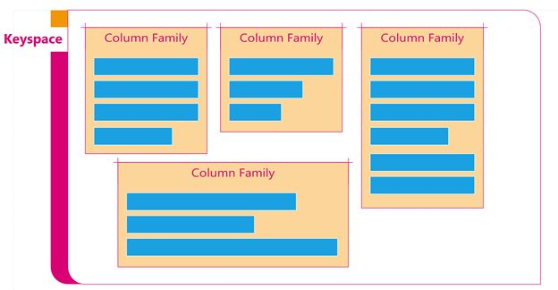
Column-family

Slide 37
Column Family
Column Family is like a table in RDBMS.
A keyspace can have multiple column families.
For example, a keyspace can have column families AuthorProfile, MemberProfile, Article, Blog, and Question.ly

Slide 38
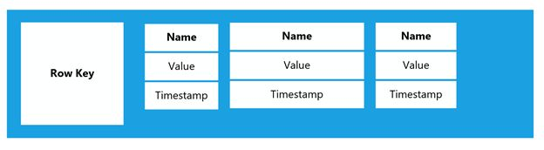
Row Key
A column family contains multiple rows. Here is an example of a row of a column family. The first item in a row is a single value row key that is a unique key to identify a row.

Slide 39
Column
Each row can have multiple columns.
A column in a column data store contains actual values.
The data in a column store database is stored in a key/value pair with a timestamp.
Each row can have a different number of columns.

Slide 40
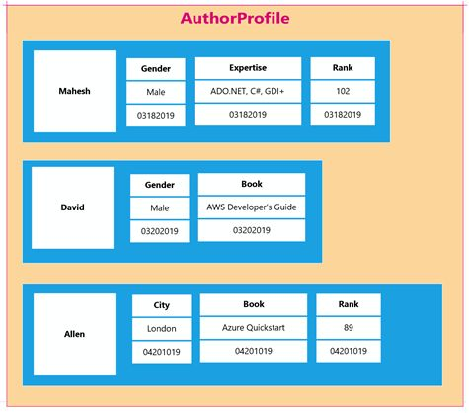

Slide 41
Popular Column databases
Bigtable
Cassandra
Hbase
Druid
Hypertable
MariaDB
Azure SQL Data Warehouse
Google BigQuery
IBM Db2
MemSQL
SQL Server
and SAP HANA.

Slide 42
Key/Value

Slide 43
KEY/VALUE STORES
HashMap or an associative array is the simplest data structure that can hold a set of key/value pairs.
Such data structures are extremely popular because they provide a very efficient, big O(1) average algorithm running time for accessing data.
The key of a key/value pair is a unique value in the set and can be easily looked up to access the data.
Key/value pairs are of varied types: some keep the data in memory and some provide the capability to persist the data to disk.
Key/value pairs can be distributed and held in a cluster of nodes.

Slide 44
Graph based

Slide 45
Overview
The NoSQL graph database is a technology for data management designed to handle very large sets of structured, semi-structured or unstructured data.
The semantic graph database also known as RDF triple store is a type of NoSQL graph database that is capable of integrating heterogeneous data from many sources and making links between datasets.
It focuses on the relationships between entities and is able to infer new knowledge out of existing information.

Slide 46
Graph Based
Graph databases are especially useful for data associated with relationships—everything from friendships on social networks to equipment supply chains or business processes.
They can quickly traverse vast amounts of linked data points to discover insights and hidden connections between entities, making them ideal for network analysis– such as financial fraud detection, recommendation engines and many other use cases– all while performing at scale.
Essentially, the natural structure of a NoSQL graph database encourages the creation of deep models that help businesses to uncover complex relationships across datasets; identify small changes in large amounts of related information; forecast outcomes; and create real-time dashboards with dynamic workflow automation.

Slide 47
Graph Database Vs. Relational Database
The traditional approach to data management, the relational database, was developed in the 1970s to help enterprises store structured information.
The relational database needs its schema (the definition how data is organized and how the relations are associated) to be defined before any new information is added.
However, mobile, social and Internet of Things (IoT) data is everywhere, with unstructured real-time data piling up by the minute.
Apart from handling a massive amount of data of all kind, the NoSQL graph database does not need its schema re-defined before adding new data.
This makes the graph database much more flexible, dynamic and lower-cost in integrating new data sources than relational databases.
Compared to the moderate data velocity from one or few locations of the relational databases, NoSQL graph databases are able to store, retrieve, integrate and analyze high-velocity data coming from many locations.

Slide 48
Next…

Slide 49
Graph Based DB …..

Slide 50
Essential components of a NoSQL graph database
A typical NoSQL graph database is made up of four essential components: nodes, edges, properties and labels.
Nodes are the basic unit of data in a graph database. They can represent anything—a person, an organization, a product, or even a transaction.
Edges are the lines that connect nodes, and they represent the graph relationships between them.
Properties are the attributes of nodes and edges.
Labels are used to categorize nodes and edges.
This visual structure of data makes it easy to see how different pieces of data are related to each other, one of the reasons why NOSQL graph databases are very efficient at handling relationships between data.
They don't have to rely on complex join operations, which can be slow and inefficient.
Instead, they can simply follow the relationships between nodes to find the data they're looking for.
This makes NOSQL graph databases perfect for applications that need to handle a lot of data relationships.

Slide 51
How graph database works
Think of it as a network of data points, all connected and able to communicate with each other. This makes it perfect for storing and managing complex data sets, such as social media networks or customer relationship data.
To illustrate this, let’s say you have a database of people and the relationships between them. In this database, each person would be represented by a node, and the relationships between them would be represented by edges.
So, if John is friends with Jane, there would be an edge between John’s node and Jane’s node. And if John is also friends with Bill, there would be an edge between John’s node and Bill’s node.
This might sound confusing, but it’s actually a very powerful way to store data. Because the relationships between nodes are represented by edges, it’s very easy to query the database to find out things like “who are all of the friends of John’s friends?” or “who are all of the friends of Jane’s friends?”
It’s also easy to add new data to a NoSQL graph database. For example, if John makes a new friend, you can just add a new edge between John’s node and the new friend’s node. There’s no need to restructure the entire database.

Slide 52
Advantages of NoSQL graph databases
Improved performance: Graph-based solutions greatly reduce complexity due to their connected nature. This dramatically reduces query times, allowing for faster access to valuable data points.
Flexibility: Instead of rigidly adhering to a predefined schema, NOSQL graph databases enable “schema-less” data models which can accommodate multiple use cases and types of business objects.
No redundancy: This makes it easier for data administrators to ensure accuracy and reduce space consumption on storage media.
Complex analysis: Due to their interconnected layers, graph databases provide invaluable insights by revealing hidden relationships among various elements within the structure that would have otherwise gone unnoticed.
Migration: There is an inherent level of interoperability between various formats in this type of database structure; this simplifies migration processes and makes it easy for users to move large datasets without having to start from scratch.
Large-scale data management: Graph databases can easily scale to store and manage billions of data points, while relational databases start to struggle at around the million-record mark.
Speed: NOSQL graph databases are incredibly fast. They can return query results in milliseconds.
Check out this article for comprehensive benefits of graph databases.

Slide 53
Examples of Graph database applications
Social media networks: Social media networks like Facebook and Twitter use graph databases to store information about users and their relationships. This allows them to recommend friends and content to users based on their interests and connections to other users.
eCommerce platforms: Ecommerce platforms like Amazon and eBay use graph databases to store information about products, sellers, and buyers. This allows them to recommend products to buyers based on their purchase history and connections to other products.
Location-based services: Location-based services like Foursquare and Yelp use graph databases to store information about businesses, users, and reviews. This allows them to recommend businesses to users based on their location and connections to other businesses.
A good example of a NoSQL graph database is Nebula Graph right here, a lightning fast open source graph database that can handle billions of nodes and trillions of edges without any performance issues. And because it's based on a distributed architecture, it's highly fault tolerant. It also offers an equally open source graph editing front-end library. Others include Neo4j, OrientDB, and ArangoDB among others.

Slide 54
Choosing the right NoSQL graph database for your needs
Your decision should be based on the type of graph shapes and connections required for your project. Consider if you need directional or non-directional graph patterns, reachability between graph elements, graph maneuvering methods such as splitting or merging orphan nodes, etc. Make sure to explore what types of graph operations are supported by the database in question as not all databases may support certain graph operations or some may have better performance than others in certain scenarios.
Equally think about your budget. NoSQL graph databases can range in price from free and open source options to expensive enterprise-level options. Choose the one that best fits your needs and budget.

Slide 55
Semantically Rich NoSQL Graph Database
The semantic graph database is a type of NoSQL graph database that is capable of integrating heterogeneous data from many sources and making links between datasets.
The semantic graph database, also referred to as an RDF triplestore, focuses on the relationships between entities and is able to infer new knowledge out of existing information. It is a powerful tool to use in relationship-centered analytics and knowledge discovery.
In addition, the capability to handle massive datasets and the schema-less approach support the NoSQL semantic graph database usage in real-time big data analytics.
In relational databases, the need to have the schemas defined before adding new information restricts data integration from new sources because the whole schema needs to be changed anew.
With the schema-less NoSQL semantic graph database with no need to change schemas every time a new data source is about to be added, enterprises integrate data with less effort and cost.
The semantic graph database stands out from the other types of graph databases with its ability to additionally support rich semantic data schema, the so-called ontologies.
The semantic NoSQL graph database gets the best of both worlds: on the one hand, data is flexible because it does not depend on the schema. On the other hand, ontologies give the semantic graph database the freedom and ability to build logical models any way organizations find it useful for their applications, without having to change the data.

Slide 56
The Benefits of the Semantic Graph Database
Apart from rich semantic models, semantic graph databases use the globally developed W3C standards for representing data on the Web. The use of standard practices makes data integration, exchange and mapping to other datasets easier and lowers the risk of vendor lock-in while working with a graph database.
One of those standards is the Uniform Resource Identifier (URI), a kind of unique ID for all things linked so that we can distinguish between them or know that one thing from one dataset is the same as another in a different dataset. The use of URIs not only reduces costs in integrating data from disparate sources, it also makes data publishing and sharing easier with mapping to Linked (Open) Data.
Ontotext’s GraphDB is able to use inference, that is, to infer new links out of existing explicit statements in the RDF triplestore. Inference enriches the graph database by creating new knowledge and gives organizations the ability to see all their data highly interlinked. Thus, enterprises have more insights at hand to use in their decision-making processes.

Slide 57
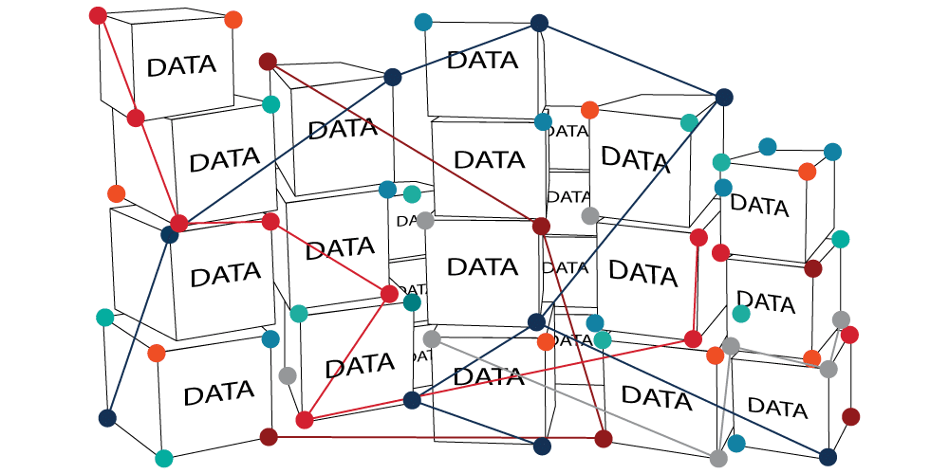

Slide 58
NoSQL Graph Database Use Cases
Apart from representing proprietary enterprise data in a linked and meaningful way, the NoSQL graph database makes content management and personalization easier, due to its cost-effective way of integrating and combining huge sets of data.
Semantic Technology and NoSQL also help organizations with social media analytics – just take a look at this report on how Twitter users felt about Brexit a few weeks before the vote in the UK.
The rise of IoT and social media on the one hand, and the growing use of big data analytics on the other hand, makes the NoSQL graph database a preferred choice for mastering huge sets of data, integrating heterogeneous data from varied sources, combining and analyzing highly interlinked data, and obtaining meaning and insights to support decisions. Ontotext’s graph database GraphDB adds a virtualization functionality on top and it becomes possible to also create a virtual graph by mapping the columns and rows of a table to entities in the graph. As a result, one can also retrieve information from external relational databases and have it play with the knowledge graph.

Slide 59
Types of graph databases
Graph databases can be categorized into two main groups based on data model and storage.
Data model-based graph databases
There are three major types under this category namely the property paragraph, RDF graphs, and hypergraph
1. Property graph
Property graphs organize data in relationships, nodes, and properties and store the data on relationships or nodes.
Nodes are entities and can hold multiple attributes called properties. You can tag nodes with labels that represent their roles in a domain. In addition, labels can attach metadata, like constraint or index information, to specific nodes.
Relationships provide relevant connections between different nodes. The relationship is directed, named, and has a start and end node. Furthermore, relationships have quantitative properties like distances, costs, ratings, weights, strengths, and time intervals. Relationships are efficiently stored, and thus nodes can share relationships without compromising performance. The navigation of relationships can be done in either direction, despite the fact that they are stored in one direction.
graph-database
2. Hypergraph
Hypergraphs are data models that allow relationships to connect to multiple nodes by allowing several nodes at either end. This will enable users to analyze and store data with numerous many-to-many relationships. The relationships in a hypergraph are referred to as hyperedges.
In contrast to property graphs, hypergraphs have multidimensional edges, making them more generalized. However, the two are isomorphic, meaning you can present a hypergraph as a property graph, but you can’t do the opposite.
3. Resource description framework (RDF)
An RDF, or triple store, stores data in a three-part format of subject-data-object data structure. A separate node is used to present any additional information. RDF graph models are made of Arcs and Nodes, and the graph notation is presented by two nodes, one for the subject and another for the object, and an arc presents the predicate.
Triple stores are categorized as data model-graph databases because they process logically linked data. However, their storage engines are not optimized for property graphs, nor do they support index-free adjacency; thus, they aren’t native graph databases.
RDFs can scale horizontally but can’t rapidly transverse relationships because they store triples as individual elements. They must create connections from independent facts and add latency to perform graph queries. Triple stores are mostly applied in offline analytics because of their shortcomings in latency and scale.

Slide 60
Storage-based graph databases
This category contains three major types as well, namely the native storage graph, relational storage, and key-value store graphs:
1. Native graph storage
Native graph storage uses edge and vertex units to store and manage graph databases. It is best suited for multiple-hop or deep-link graph analytics. Native graph storage is designed to maximize traversal speed in arbitrary graph algorithms.
2. Relational storage
This graph database stores the edge and vertex table using a relational model. During runtime, relational “JOIN” concatenates (links) the two tables. The relational model represents data in tables using an intuitive and easy-to-understand way. Each row is a record with a key, which is the unique ID. Each column holds an attribute of the data, and each record has the attribute’s value. This makes it easy to identify the relationships between data points.
3. Key-value store
A key-value store is a non-relational database that uses NoSQL databases to store data. It stores data in key-value pairs where the key is the unique identifier. The keys and values range from complex compound objects to simple objects. Perhaps the best benefit of a key-value graph DB vs relational DB is that the key-value graph is highly partitionable. As a result, it allows horizontal scaling that most database types cannot achieve.

Slide 61
How graph databases work
A graph database is a kind of NoSQL database. It's a type of database that focuses on storing data as entities and their relations.
Graphs are a natural way to model complex relationships in data, such as user profiles, social connections and recommendations.
The term "graph" might seem a bit abstract, but it actually refers to a type of data structure that's used to model relationships between different pieces of information.
For example, if you have a list of friends and their contact information, you can use a graph database to store this data in the form of nodes (pieces of information) and edges (connections between them).
Graph databases are different from other types of NoSQL databases because it stores data as nodes (vertices) and edges, rather than as rows and columns. This makes them ideal for storing highly connected data, such as social networks or recommendation systems.

Slide 62
Why choose a graph database for your business
You should choose graph databases because they perform way better at scale compared to other DBMS. They make it possible to represent data in a much more intuitive way, a versatile way of visualizing data which enhances query performance and enables businesses to make valuable decisions like never before. They are also less intense in terms of computational demands.
This is important because for many businesses, the ability to store, visualize, query, and analyze data at a deeper level is key to success these days. Traditional databases can maintain large amounts of data and are capable of running complex queries, yet they rely on rigid and often complex schemas. An alternative solution is a graph database that stores information as interconnected points. The interconnected structure helps to connect objects according to specific criteria, allowing data teams to find themes or patterns within the data more easily than with a traditional approach.
Queries in a graph database run much faster, as they don't have to traverse entire tables or deal with foreign key constraints. In addition, since relationships between entities are stored, the data remains consistent even when it changes over time.

Slide 63
Benefits of graph databases
The key benefit of graph databases is the ability to handle big data that is deeply interconnected. As we are right in the middle of the data era, this one perk will prove invaluable to businesses that are focused on boosting their success through big data.
Here are the comprehensive benefits of graph databases:
1. High performance
Graph databases allow users to query linked data quickly and efficiently, making them much faster than traditional relational databases. With sophisticated algorithms and powerful search functions, graph databases can return complex query results across an interconnected network in milliseconds.
Querying in traditional databases can become slow very quickly when dealing with more complicated and larger data sets. Conversely, the performance of graph databases will remain consistent, no matter how large or complex the data is.
For example, NebulaGraph can so easily store and process graphs with trillions of edges and vertices - the only open source graph database that is capable of doing this!

Slide 64
2. Data integrity
Graph databases are designed to maintain the integrity of data connections across a wide variety of data sources and formats. By connecting disparate pieces of information in a graph, organizations can ensure that their data remains consistent and accurate throughout their applications.
Instead of simply storing individual pieces of information in a database, graph databases link related data together using connected nodes and edges. This allows users to easily visualize highly connected data and establish how any changes to the data will affect other areas, hence enhancing data integrity.
graph-database-benefits
3. Enhanced contextual awareness
Because graph databases store data in the form of relationships between objects, they enable users to uncover nuances in interactions that may not be evident at first glance with traditional techniques such as tabular relational models or hierarchical tree structures.
This enhanced contextual awareness helps organizations make better decisions by leveraging high level insights from their data. This is a crucial benefit in the modern business landscape where there is far too much data that is just idle. Graph databases can mine this data and deliver transformative insights to spur organizational growth.
4. Scalability
The schema and structure of the graph model is incredibly adaptable and can keep up with the high pace of ambitious data teams. There's no need to go through the long-winded process of modeling domains; just add to the current structure without disrupting its existing functionality.
Traditional database technologies often reach a scalability bottleneck when trying to bridge multiple sources of data. But graph technologies avoid this issue entirely with their distributed nature which allows more flexible scaling up or down as needed.
NebulaGraph provides linear scalability, enabling users to expand the cluster with additional nodes or services without interfering with performance.

Slide 65
5. Agility
Today's development landscape is rapidly evolving. It's all about flexibility and quick changes as needs are regularly shifting. Graph databases are the ideal solution for this kind of adaptive environment, where unified progress and management is becoming the standard.
Check out the fundamental differences between relational databases and non relational databases.
Use cases for graph databases
Did you know that all the top tech giants such as Facebook and Google are already utilizing the revolutionary power of graph databases to build products that generate mega revenues? All these companies use graph databases in a broad range of products, harnessing the force of big data connections to build irresistible products.
The use cases can be as vast as the imagination of any ambitious business. Here are the most interesting ones

Slide 66
Use cases for graph databases
Did you know that all the top tech giants such as Facebook and Google are already utilizing the revolutionary power of graph databases to build products that generate mega revenues? All these companies use graph databases in a broad range of products, harnessing the force of big data connections to build irresistible products.
The use cases can be as vast as the imagination of any ambitious business. Here are the most interesting ones.
1. Recommendation engines
Real-time recommendation systems are very popular these days, especially in retail e-commerce, travel and social networks . The purpose of a recommendation engine is to predict customer preferences and recommend products or services they might be interested in whenever they are using your platform. The application of recommendation engines is quite exciting and is already being used by many companies to achieve immense success. But it would have been impossible to get this done were it not for graph databases.
recommendation-engine-with-graph-database
With graph databases, you can easily discover connections and generate recommendations for users. These recommendations are based on powerful graph analytics that match preferences with relevant products or services.
2. Fraud detection
Graph databases are being used to detect fraud by tracking transactional relationships between entities over a period of time.
By uncovering patterns of behavior across multiple financial transactions, it is possible to detect anomalies that could indicate fraudulent activities.
fraud-detection-graph

Slide 67
3. Network Analysis
Graph databases can be used to trace connections between technology components such as wireless routers, cables and microwave links, providing administrators with useful insights such as the types of connections being used at any given time.
This is important because network administrators have an ever-increasing responsibility when it comes to managing digital networks. They must be able to identify problems quickly and ensure that operational performance is maintained. They can use graphs to quickly find out which paths data packets take through the network by understanding IP addresses and traffic flow over large portions of the infrastructure. This way, they can know exactly where problematic areas are during troubleshooting or when planning upgrades or changes in configuration.
4. Power grid scheduling
Utility power grids are some of the most complex infrastructures in existence, requiring a fine balance between efficient usage and stability. Traditional models used for managing these grids relied heavily on tables and relational databases, leading to slow response times when working with high levels of data. However, graph databases can revolutionize how utility grids are scheduled.
Graph databases store nodes and edges that represent real-world relationships, allowing more precise and detailed understanding of the power grid's dependencies. By organizing data into separate networks, utility providers can quickly make decisions regarding load shedding, rotational outages, or even unexpected problems like capacitor failures.
In addition to providing flexibility in scheduling decisions, graph databases can also detect patterns of consumer behavior which can then be used to anticipate upcoming demand changes in order to deliver superior service while reducing costs.
5. Chatbot systems
Graph databases provide a flexible and easily navigable structure that allows bots to quickly access data and respond to queries in real time. Large datasets can be retrieved at high speeds, be used to construct a useful inventory of customer preferences and generate meaningful dialogue based on the collected insights.
Questions are organized in natural language and converted into knowledge graphs which are stored in graph databases. A semantic parser is used to resolve the questions in a question-answer format. The answers are then retrieved from the knowledge graph and passed on to the user.
6. Social networking
Social networking is a very popular use case for graph databases. Graph databases such as NebulaGraph is specifically designed to support social networks. A social network is a way of representing relationships between people or things. They are often represented visually in the form of graphs that show how things are connected. Graphs can be used to represent both online and offline relationships between people; for example, Facebook uses them to represent friendships between users and LinkedIn uses them to represent professional connections between users.

Slide 68
Latest trends in graph database
Graph database is a somewhat novel piece of technology and it is consistently evolving. The field was once dominated by traditional powerhouse Neo4j, but now the market is much more dynamic, with new players like NebulaGraph, AWS Neptune, and Janus Graph.
Graph databases have been around for more than 20 years. They were first used by computer scientists working on artificial intelligence (AI) projects, who needed a way to model complex systems that can't be represented as tables or lists of records.
Today, businesses are increasingly using graph databases for their own needs. The graph database market is expected to grow from $1.59 billion in 2020 to $11.25 billion by 2030, according to Emergen Research.
The popularity of graph databases has been driven by several factors:
Data grows rapidly — Every day we generate more than 2.5 quintillion bytes of data globally. This is expected to grow exponentially over time as sensors become more prevalent, mobile devices become more ubiquitous and machine-to-machine communication increases
Data types vary widely — From unstructured text documents and images to structured data such as financial transaction records or sensor readings, many different types of data exist today
Data distribution varies widely — Data can be distributed across multiple locations at different scales (local vs global) and in different formats (JSON vs XML).
Because of the explosion of global data volume and the distribution of data, graph databases are becoming more important and are adapting themselves to these trends.
Here are some of the latest trends in the graph database field.

Slide 69
Distributed graph databases
Distributed graph databases is the latest trend in graph database as global data grows rapidly. A distributed database is a database that is split into multiple servers, so that the throughput and storage capacity of the entire system is greater than the sum of its parts.
A distributed graph database is a database that consists of two or more files located in different sites either on the same network or on entirely different networks. Portions of the database are stored in multiple physical locations and processing is distributed among multiple database nodes.
Distributed databases provide high availability and fault tolerance because they maintain multiple copies of data that can be accessed through processes known as replication and shadowing. The cost of maintaining such systems has traditionally been considered too high for general purpose applications like spreadsheets or word processors, but with the advent of inexpensive disk storage there are now many applications that require such features.
Distributed databases are ideal for large-scale applications with complex data requirements, such as e-commerce systems and the Internet. They can also be useful when there are some constraints on the location of the data — for example, if you need to keep certain records in a certain jurisdiction (eg. the EU) because they contain sensitive information or if you have regional offices that need to share data across their networks.
The technical and cost advantages of distributed systems (like NebulaGraph) over single machines (e.g. Neo4j) or small machines are more obvious due to the increasing volume of data and computation. Distributed systems allow applications to access these thousands of machines as if they were local systems, without the need for much modification at the code level.
NebulaGraph is a distributed, easily scalable, and native graph database. It is capable of hosting graphs with hundreds of billions of vertices and trillions of edges, and serving queries with millisecond-latency.
With a shared-nothing distributed architecture, NebulaGraph offers linear scalability, meaning that you can add more nodes or services to the cluster without affecting performance. It also means that if you want to horizontally scale out NebulaGraph, you don’t need to change the configuration of the existing nodes. As long as the network bandwidth is sufficient, you can add more nodes without changing anything else.

Slide 70
GQL - The graph query language standard
One of the disadvantages of graph databases was the lack of a standard graph query language like SQL for relational databases.
In the past, you have got Cypher, a declarative graph query language invented by Neo4j; Gremlin, a graph traversal language developed by Apache TinkerPop; and nGQL, NebulaGraph’s SQL-like graph query language.
The lack of a standard in query languages made it difficult to build applications that used different graph databases from different vendors.
However, in the last few years, there has been a lot of research activity in this area and some standardization efforts have been made by the industry.
In September 2019, members of ISO/IEC Joint Technical Committee, which is responsible for international Information Technology standards, proposed a project to create a new standard graph query language (ISO/IEC 39075 Information Technology — Database Languages — GQL). GQL is intended to be a declarative database query language, like SQL.

Slide 71
Graph database is the future of business intelligence
Graph databases have been around for decades. In recent years, however, they’ve become increasingly popular because they offer new ways of visualizing and analyzing data that can help companies make better decisions about their business processes.
It's not just a buzzword; companies like Facebook, LinkedIn, Google and Twitter are using graph databases to store their data and make sense of it.
Graph databases are a carrier of big data, which makes it possible to process anything you need using an intuitive and effective means; by using information, relational data and non-relational data as input. The graph databases market is now young enough to raise your interest – the future looks very promising for graph databases.
For now, the future of business intelligence appears to be a distinctive blend of "old and new". Relational databases will continue to be widely used but increasingly supplemented with or replaced by graph databases – with the caveat that this switch is not an "either/or" affair. Nor does it represent a radical change in attitude toward data storage: the key lies in adopting an enterprise-wide understanding of data, rather than one based on individual silos.

