Slide 1

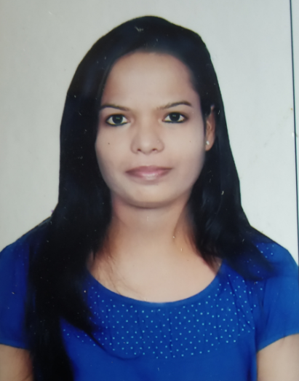
Career overview
Having 11 years of experience in software Testing which includes Functional Testing ,Regression and Automation Testing.
Hands on experience of preparation of preparation and execution of test cases using BDD-Cucumber ,Selenium WebDriver, TestNG , UFT Developer and API Testing.
Name Kavita Prajapati
Value addition for customer
Appreciated from the client(CBA)to automated most of the UI regression test cases for one of the application
Roles
Principal Consultant
Analyzed Business Requirements Documents to get a better understanding of the system both from technical and business perspectives.
Prepared Test plans, Test Scripts and Test cases based on functional specification and user requirements.
Developed and maintained automated regression test cases in UFT Developer using Java and Junit framework.
Identify the feasible test cases for automation.
Provided guidance and assistance on the testing process to integrate the UI script with the DevTest.
Involved in the Continuous Integration of the automation framework with Jenkins.
Worked in agile environment with frequently changing environment and feature set.
UI automation of the Dashboard using Selenium WebDriver-Java with TestNG.
Creation of automation framework based on timeline and requirement of the project.
Actively participated in Sprint Retrospective, Sprint Planning, Sprint Review and Daily Scrum.
Maintaining, reviewing and merging of code in GIT.
Involved in System Testing, Regression and E2E Testing.
Client Relationship Management
Received Best Team Award
Received Appreciation from client for automation of most of the regression test cases.
Prior Experience
List of Customers :
Banking
Retail
Industries
Retail
Banking
Genome Score:
Ilearn Score: 0%
Highlights:
UI Automation Tester
Roles
Assistant Consultant
Automation Tester
Education and Training/ certification
B.E. in Computer Science
Professional Scrum Master Certification-1
Splunk Fundamental Certification
Azure Fundamental(AZ-900)
ISTQB Fundamental Level
AWS Solution Architect Associate
AWS Cloud Practitioner
Tools & Technologies:
Selenium
TestNG
Cucumber BDD
JUnit
Maven
Git
Jenkins
Putty
WinSCP
UFT Developer
DevTest
REST API
Core Java
SQL
Agile-Scrum
JIRA
Confluence
7892182147
Kavita.prajapati@genpact.com

