Slide 1
Fine-Fettle
TEAM- AAVISHKAAR
MANSI BREJA
KAVITA MAURYA
KARAN

Slide 2
OUR TREK :-
As a part of our trek, we chose to visit VPS Rockland Hospital, Dwarka, New Delhi on the 20th of January, 2018.
The hospital is generally flooded with patients just like a common government hospital.
We interacted with several people and asked them varying questions in accordance with our questionnaire and tried to find out what problems they faced that we could cater to.
There were many people who did cooperate and help us in our survey.
We had prepared a questionnaire.

Slide 3
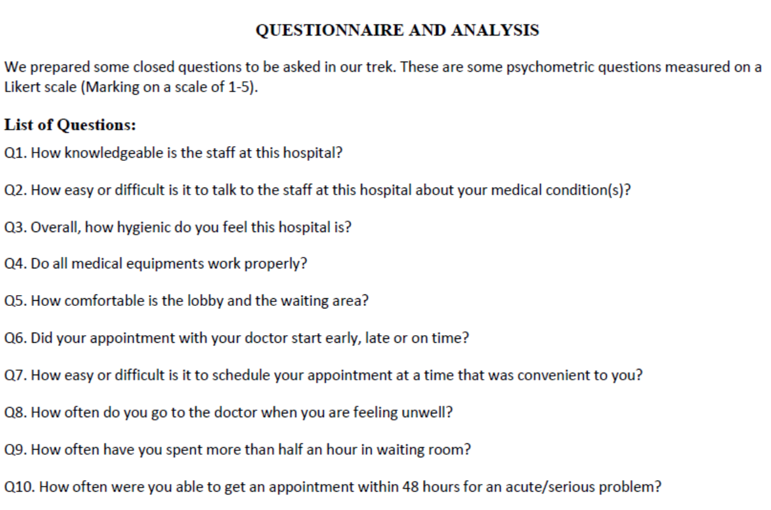

Slide 4
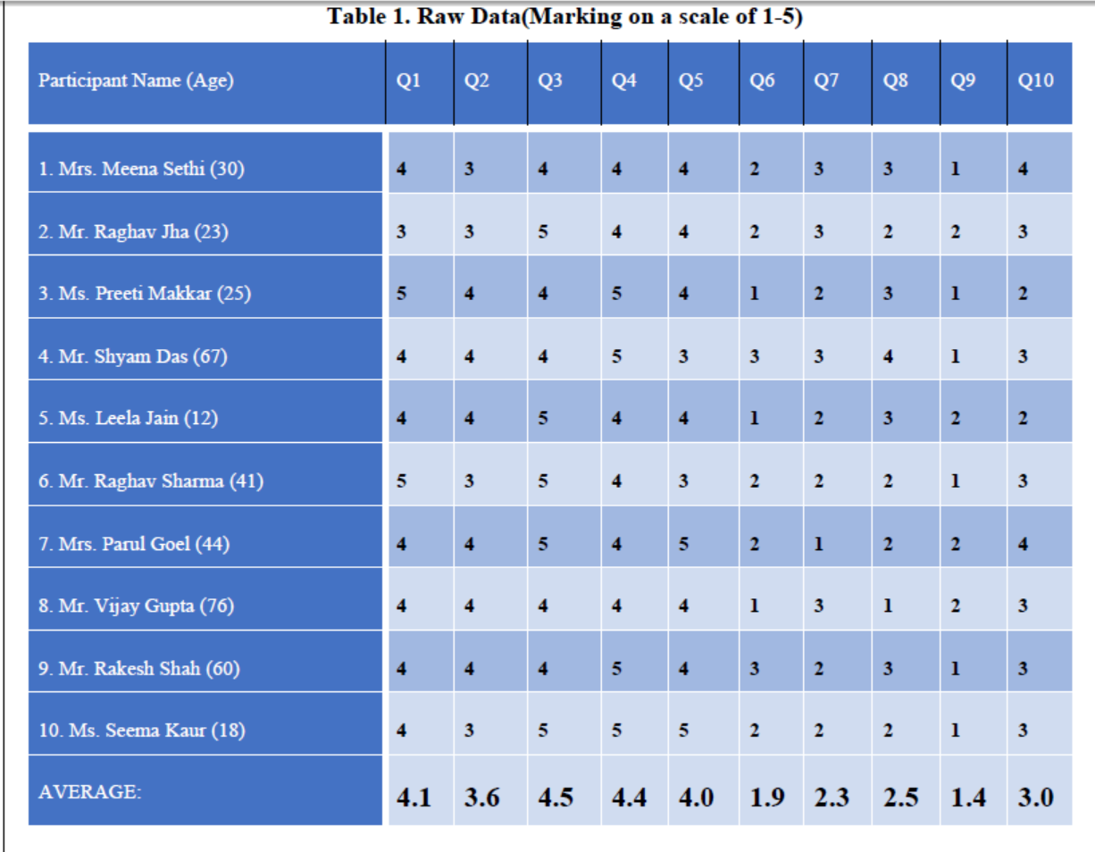
QUESTIONNAIRE :-

Slide 5
PROBLEM IDENTIFIED :-
LONG OPD QUEUES.
Patients go through two separate trials – one with the OPD doctor who then sends him/her to Admit Ward if required.
Patients who need to get admitted to ward end up wasting time in the OPD queue.
Time wastage of both patients and doctors.

Slide 6
SOLUTION PROPOSED :-
We planned to develop a web app – “ ”
It takes as inputs the general health parameters .
This parameter vector is then passed through our “LOGISTIC REGRESSION” Learning Algorithm based on one vs all scheme.
The algorithm ,based on the already fed dataset ,predicts the health condition of a person and whether or not he/she should be visiting the OPD doctor or get admitted in the ward.
This way the time of doctors and patients is saved as the patient goes directly to the ward or OPD doctor.

Slide 7
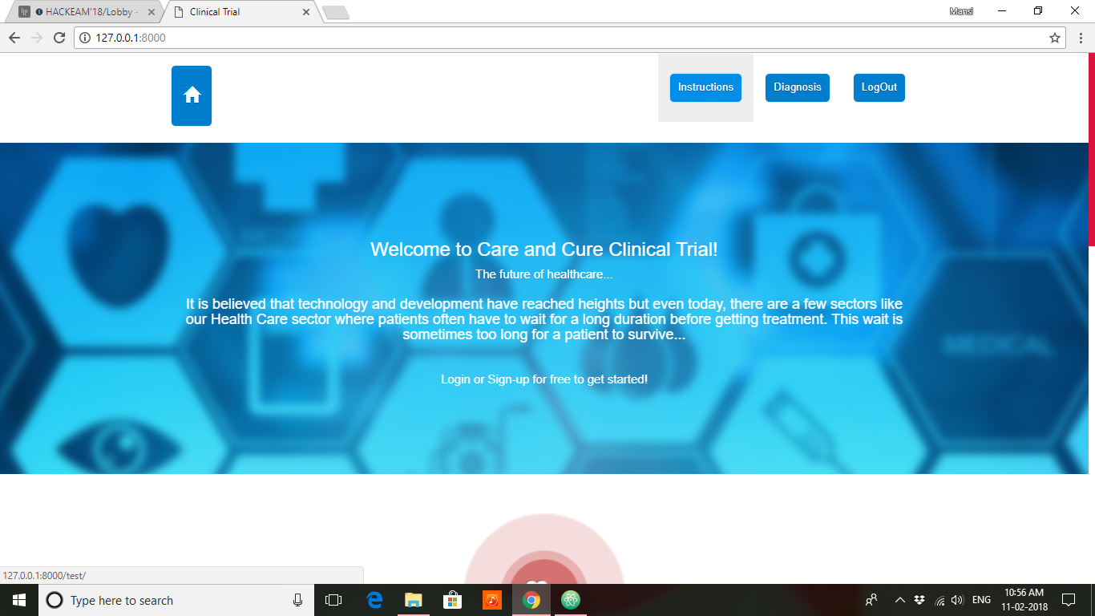

Slide 8
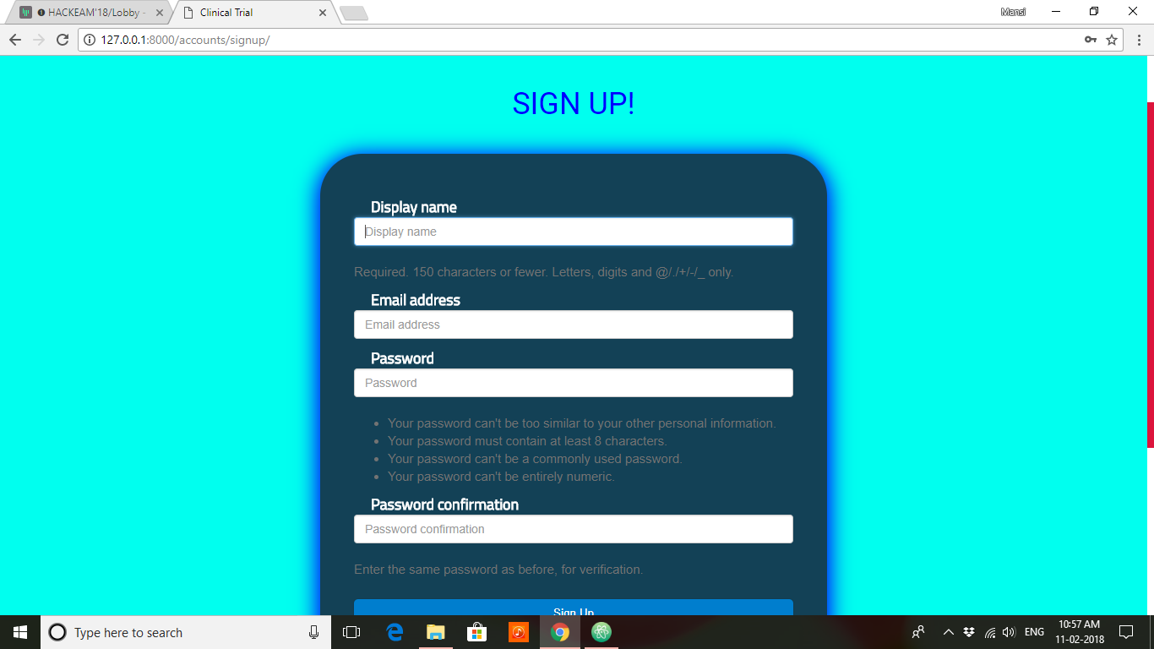

Slide 9
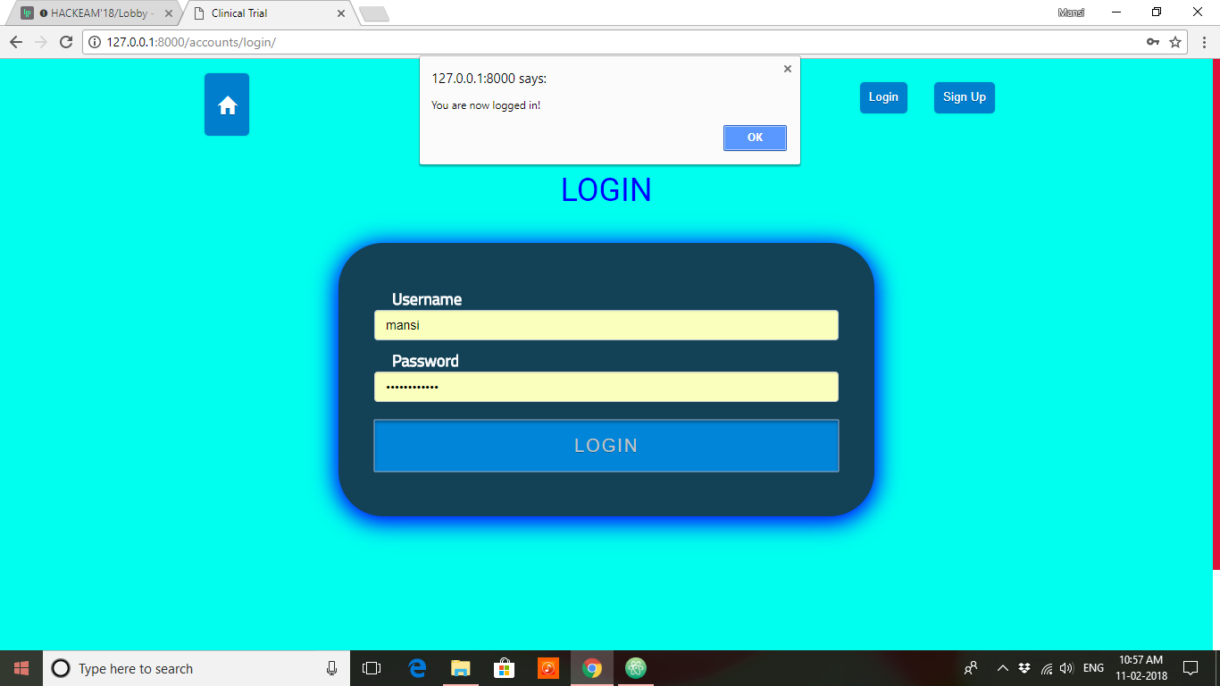

Slide 10
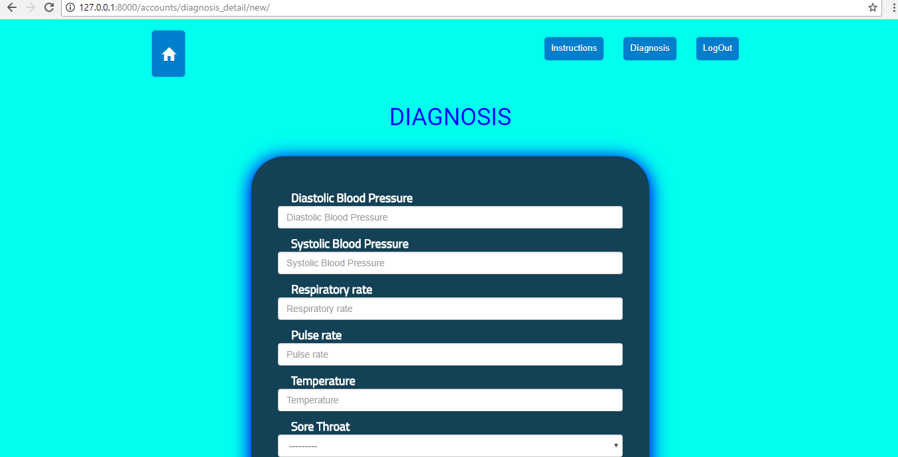

Slide 11
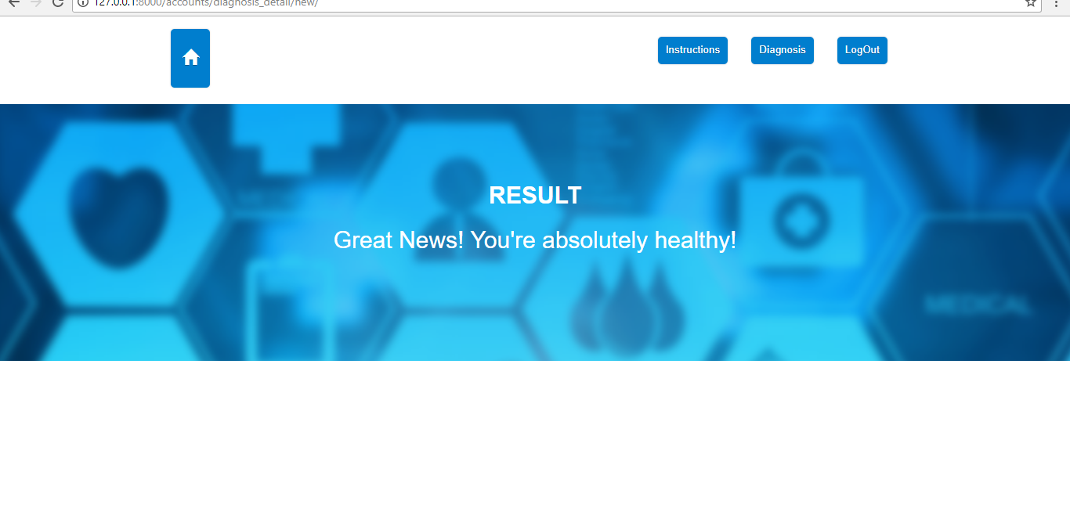

Slide 12
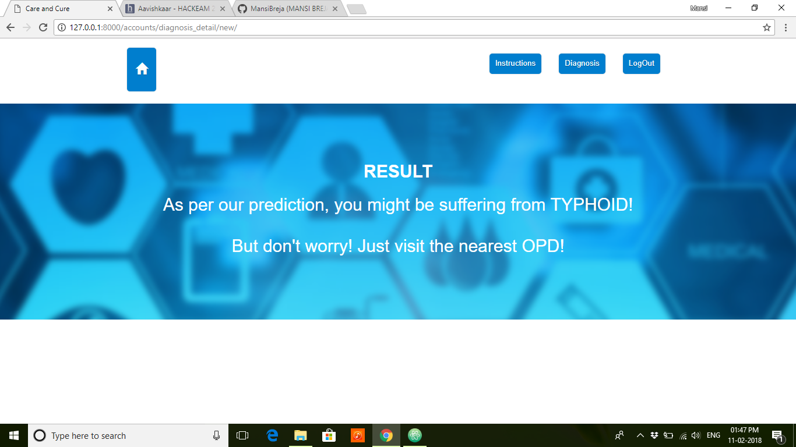

Slide 13
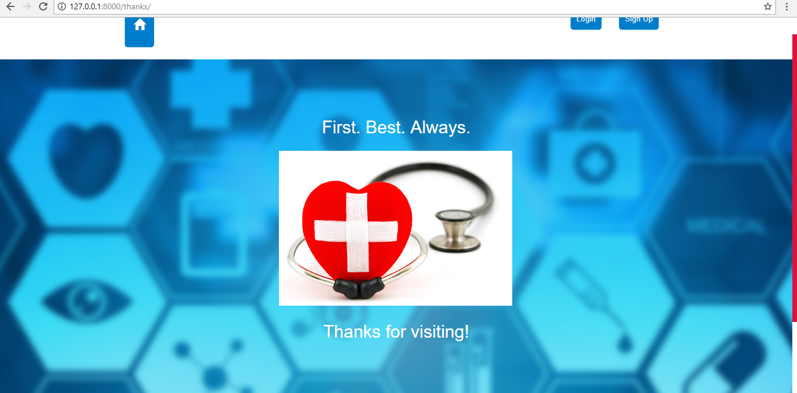

Slide 14
THANK YOU!

