Slide 1
Challenge #1
A 3 tier environment is a common setup. Use a tool of your choosing/familiarity create these resources. Please remember we will not be judged on the outcome but more focusing on the approach, style and reproducibility.
3 layer Architecture
client-server architecture
Presentation tier
front end layer- graphical user interface
Built in HTML5, JS or CSS or web dev frameworks like Angular, Aurora
Application tier
that drives the application core capabilities written in Java, Rub, Python, C#, C++ etc. It models a query and conveys to database tier
Data tier
web based application.
stores information
database management system that provides access to data. could be Oracle, Mongo, MySQL, MSSQL, PostgreSQL etc. data is accessed by the app layer through API calls
handles logic process commands, makes logical decisions
communicates with other tiers through application program interface calls
consists of database and a program managing read and write access to a database

Slide 2
Components of a 3 –tier web application hosting in AWS cloud
Presentation tier | Domain name | Route 53-DNS settings
 | Front end code –html, CSS | EC2 server
Business tier | Web application code | EC2 server
Data tier | Data services | RDS, Dynamo DB, ElastiCache
Allied services | Notification | SNS, SES, IAM
 | Routing policies | Route 53, Load Balancer
 | High availability | Autoscaling Group, Route 53, ELB
 | Load Balancing | ELB, Route53
 | Static Content storage- media files, images etc | S3, EBS volume
 | Content Delivery Network | Cloudfront
 | Security, Communication etc | IAM , WAF
 | Monitoring | CloudWatch, CloudTrail
 | Serverless computing | lambda

Slide 3

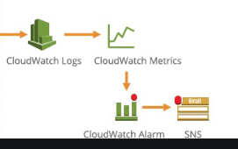





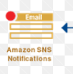









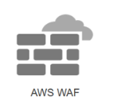

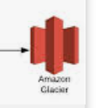

1
Developers
Testers
3-tier Web application architecture in AWS Cloud
13
Users
Roles
Credentials
16
2
6
Application Load Balancer
14
3
Routing Policies
Geo routing
Latency routing
EC2 instance WEB SERVER
EC2 instance WEB SERVER
15
4
9
8
11
14
RDS instance
RDS instance
5
12
Amazon
Glacier
7
10
Availability zone A
Availability zone B
US-East-Region 1
16

Slide 4
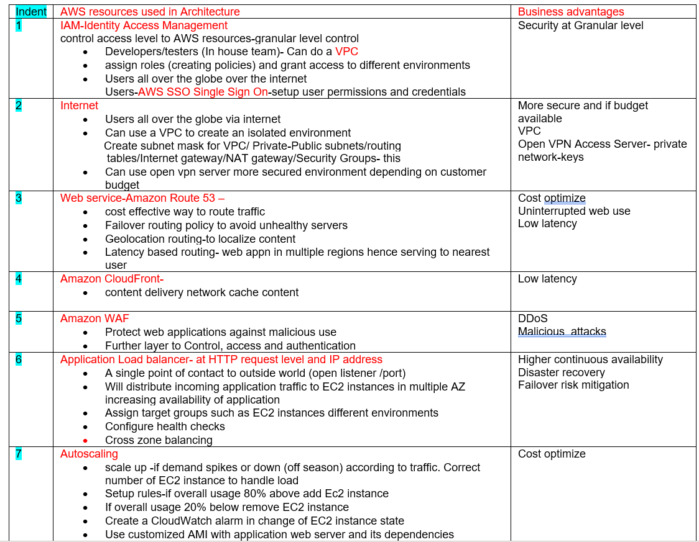

Slide 5
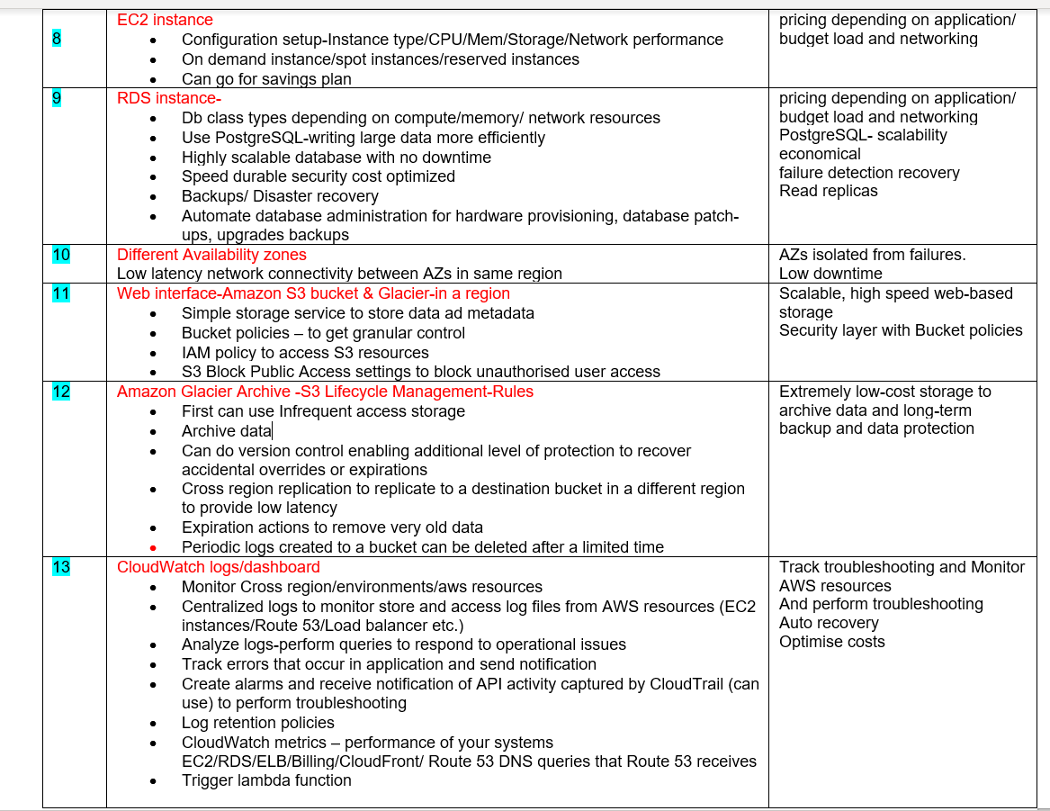

Slide 6
