Slide 1
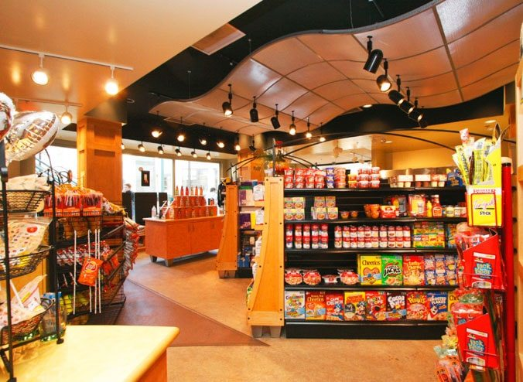
Retail Sales Analysis
KAVITA AGRAWAL

Slide 2
CLIENT EXPECTATIONS
To understand behaviour of
Customers
Products
Stores
Channels
Analysis of
Product category
Customer category & segment
Sales pattern, trends, & seasonality
Cross selling
Customer satisfaction
Cohort
Provide strategies
To increase sales
For Campaign

Slide 3
AVAILABLE DATA
Source of Data – From randomly selected 39 stores out of 535 stores for specific categories of products for randomly selected customers
Period of Data - Sep 2021 to Oct 2023
Dimension Table
Customers Master
Order Payment data
Order Review ratings
Product Master
Stores Master
Facts table
Order Master

Slide 4
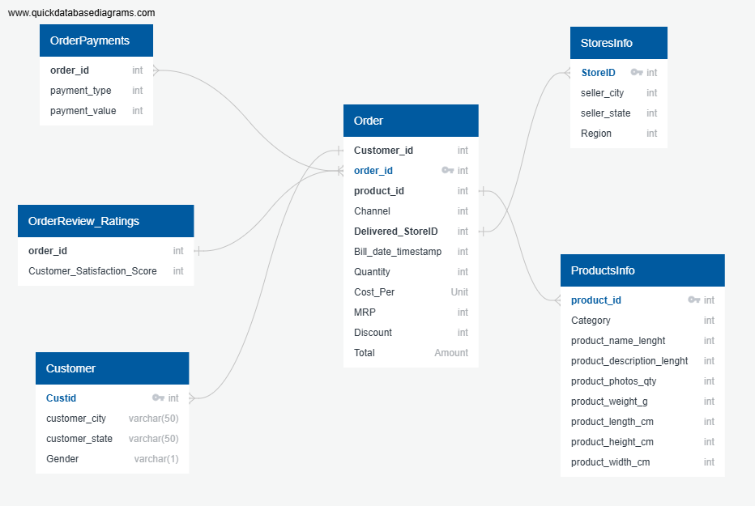
ER DIAGRAM (DATA DICTIONARY)

Slide 5
CUSTOMER TABLE
Data Audit
96802 unique customer ids No missing values Distinct Customer City – 4110 Distinct Customer State – 20
Data Discrepancies
No discrepancies

Slide 6
ORDER TABLE
Data Audit
96893 unique order ids No missing value Distinct channel in order table online,phone delivery ,instore
Data Discrepancies
Data available is from Feb 2020 - Sep 2023 but analysis required from Sep 2021-Oct 2023 For order_id 'bfbd0f9bdef84302105ad712db648a6c’ no payment has been made Same order_id having more than one store_id for 1007 orders ids (e.g. order_id '002f98c0f7efd42638ed6100ca699b42’has 2 store ids ST103 and ST301) Distinct store id is 37 instead of 39, maybe order data got missed for 2 store id. It is also possible that there is no order placed from those 2 store ids. Bill date format is inconsistence across diff stores One order_id has multiple payment_type(voucher) for same product id - 2246

Slide 7
PRODUCT TABLE
Data Audit
32951 unique products
Data Discrepancies
Distinct category 14 including 1 #N/A PROD_NAME , PROD_DESC , PROD_PHOTO has 610 null values PROD_WEIGHT , PROD_LEN , PROD_HEIGHT , PROD_WIDTH has 2 null value

Slide 8
STORES TABLE
Data Audit
Distinct seller city is 534 Distinct seller state is19 Distinct seller region is North, South, East, & West
Data Discrepancies
Store id “ST410” is duplicate Distinct store id in store_table is 543 whereas total stores should be 535

Slide 9
PAYMENT TABLE
Data Audit
No missing value Distinct payment_type - credit card, upi/cash, debit card, and voucher
Data Discrepancies
2961 order ids are duplicated 774 payments have been done without any order_id 9 Payment values are zero

Slide 10
ORDER REVIEW RATING TABLE
Data Audit
Distinct customer_satisfaction is1,2,3,4,5
Data Discrepancies
559 Duplicates - assuming it might be duplicate

Slide 11
RECOMMENDATIONS
Order Master
Bill date format should be in standard datetime format across all stores
To check the formula for amount calculation and discuss with the concern team
Same Product id should and should appear once in each order ID
Order Payment
Need to investigate why payment_type(voucher) is appearing multiple times
Product Master
Category need to be updated for all products
Stores Master
Remove duplicate Store ID

Slide 12
EXPLORATORY DATA ANALYSIS
SALES INFORMATION
ORDERS INFORMATION
Order Count: 96,893
Total Payment Method: 4
Total channel: 3
Average Discount Per Order: ₹ 5.08
Average Order Value: ₹ 159.5
Average Categories per order: 1.005
Average Items Per Order: 1.014
Total Revenue: ₹ 15.45M
Total Cost: ₹ 13.27M
Total Discount: ₹ 4.9 L
Total Profit: ₹ 2.18 M
Percentage of Discount: 3.31%
Percentage of Profit: 16.46%
Weekday Revenue: ₹ 12.25M
Weekend Revenue: ₹ 3.21M
Year | Total Revenue
2021 | 0.06M
2022 | 6.82M
2023 | 8.59M
Gender | Total Revenue | Revenue_%
Female | 10.81M | 69.93%
Male | 4.65M | 30.07%

Slide 13
EXPLORATORY DATA ANALYSIS
CUSTOMER INFORMATION
Total Customer: 96,802
Average discount per customer: ₹ 5.08
Average sales per customer: ₹159.65
Seller store information
Average profit per customer: ₹ 22.54
Transaction per customer: 1.0009
Avg no. of days between two transactions: 4.09
PRODUCT INFORMATION
SELLER STORE INFORMATION
Total product: 31,752
Total category: 14
Total quantity: 1,08,877
Total store: 37
Total states: 7
Total region: 4

Slide 14
EXPLORATORY DATA ANALYSIS

Slide 15
EXPLORATORY DATA ANALYSIS

Slide 16
EXPLORATORY DATA ANALYSIS

Slide 17
EXPLORATORY DATA ANALYSIS

Slide 18
EXPLORATORY DATA ANALYSIS
Region | Category | Orders | Sales
South | Toys & Gifts | 11.92K | 2.04M
West | Baby | 5.40K | 0.62M
North | Luggage_Accessories | 1.61K | 0.32M
East | Home_Appliances | 0.42K | 0.73M

Slide 19
EXPLORATORY DATA ANALYSIS

Slide 20
EXPLORATORY DATA ANALYSIS

Slide 21
EXPLORATORY DATA ANALYSIS

Slide 22
EXPLORATORY DATA ANALYSIS

Slide 23
EXPLORATORY DATA ANALYSIS
Observations
The number of new customers were significantly low in 2020 and 2021, after which the business started to acquire a greater number of new customers which peaked in months May and August.
Revenue generation increased after December 2021 and kept on escalating till August , 2023 followed by a sudden decline in September 2023.
By region the highest sales were seen in South and North , while the least in East.
By state the highest sales were seen Andhra Pradesh and Gujarat, while the least in West Bengal.
Toys & Gifts , Home appliances and Baby category product contribute to the highest sales amount .
The stores in southern region especially in Andhra Pradesh have the most bought products which has Toys & Gifts , Home appliances and Food & Beverages categories that are most sought after.

Slide 24
CUSTOMER BEHAVIOUR
Gender | Gender Count | Sales | Sales_%
Female | 67.61K | 10807.07K | 69.93%
Male | 29.195K | 4647.20K | 30.07%

Slide 25
CUSTOMER BEHAVIOUR
Types Of Customers | No Of Customers | Percentage
High Revenue Customers | 96,372 | 99.56%
Medium Revenue Customers | 380 | 0.39%
Low Revenue Customers | 50 | 0.05%
High Revenue Customers Having Revenue (>=3000)
Medium Revenue Customers Having Revenue (>=1500 and <3000)
Low revenue customers Having Revenue (<1500)

Slide 26
CUSTOMER BEHAVIOUR
RFM Segmentation
Recency (R): How recently a customer made a purchase.
➢Frequency (F): How often a customer makes a purchase over a certain period.
➢Monetary (M): How much money a customer spends on purchases over a certain period.
RFM SEGMENTATION
Each customer is assigned a score for Recency, Frequency, and Monetaryusing the NTILE(4) function, which divides the customers into quartiles (groups of 4).
R_Score: A score for recency, where the most recent buyers get higher scores.
F_Score: A score for frequency, where customers who have made more purchases get higher scores.
M_Score: A score for monetary value, where customers who have spent more money get higher scores.
Total_scoring:
This step combines the R, F, and M scores into a Total_scoreby summing R_Score, F_Score, and M_Score.
A customer with the lowest scores for recency, frequency, and monetary will have a total score of 3 (1 + 1 + 1), while a customer with the highest scores in all three categories will have a total score of 12 (4 + 4 + 4).

Slide 27
RFM SEGMENTATION
Based on the Total score, customers are classified into different segments:
Customer Needing Attention: Customer score < = 4
Loyal Customers: Customer score between 5 and 7
Lost Customers: Customer score >=8
Customers Segments | Sales | Sale_%
Customer Needing Attention | 8.98 M | 58.13 %
Loyal Customer | 4.80 M | 31.04 %
Lost Customer | 1.67 M | 10.83 %

Slide 28
CUSTOMER BEHAVIOUR
Types of Customer | No. of Customers | Percentage
One-Time Buyers | 96,77 | 99.97%
Repeat_Buyers | 36 | 0.04%
Discount-Seekers | 39,106 | 40.4%
Non Discount Seekers | 58,342 | 60.27%
No. of Customers purchasing from a Single Category | 96,314 | 99.495%
No. of Customers purchasing from Multiple Category | 488 | 0.504%
Customers who made purchases across all available channels: Online, Instore, and Phone Delivery | 1 | 0.001%

Slide 29
ONE TIME-CUSTOMER BEHAVIOUR

Slide 30
ONE TIME-CUSTOMER BEHAVIOUR
Region | Customer Count
South | 75.59K
West | 10.64K
North | 10.08K
East | 1.84K

Slide 31
ONE TIME-CUSTOMER BEHAVIOUR

Slide 32
BEHAVIOUR OF REPEAT BUYERS

Slide 33
BEHAVIOUR OF REPEAT CUSTOMERS

Slide 34
BEHAVIOUR OF CUSTOMERS
Customer | Sales | Sales_% | Avg Order Value
Discount Seekers | 6.38M | 41.26% | Rs 163.18
Non Discount Seekers | 9.08M | 58.74% | Rs 157.26

Slide 35
BEHAVIOUR OF DISCOUNT SEEKER

Slide 36
BEHAVIOUR OF DISCOUNT SEEKER
Region | No. of Customers
East | 886
North | 4,300
West | 4,666
South | 29,283

Slide 37
BEHAVIOUR OF NON DISCOUNT SEEKER

Slide 38
BEHAVIOUR OF NON DISCOUNT SEEKER
Region | No. of Customers
East | 946
North | 5,748
West | 5,935
South | 45,858

Slide 39
CUSTOMER PREFERENCES ANALYSIS
Channels | No. of Customers
Vouchers | 5,686
Credit Card | 75,927
UPI | 19,572

Slide 40
CUSTOMER PREFERENCES ANALYSIS

Slide 41
CUSTOMER PREFERENCES ANALYSIS
Payment Method | No. of Customers
Credit Card | 74,497
UPI/Cash | 19,315
Debit card | 1,489
voucher | 3,708

Slide 42
CUSTOMER PREFERENCES ANALYSIS
One-Time Buyers vs Repeat Buyers
Observation: The customer base has significantly high number of one-time buyers (96.7K) compared to repeat buyers (36)
Recommendation:Introduce loyalty programs or personalized marketing to encourage repeat purchases.
Gender Distribution
Observation: The customer base has more female customers (67.61 k) than male (29.19K). Female customers contributed to a higher sales percentage than males.
Customer Segmentation by Revenue
Observation:
The majority of customers fall into the low-revenue segment, generating less than 1.5K revenue.
Medium-revenue customers (1.5K to 3K revenue) are fewer in number compared to low-revenue customers.
High-revenue customers are significantly lower than the above.
Recommendations
Targeted Marketing:Focus marketing efforts on converting low-revenue customers to medium-revenue customers by offering personalized promotions and loyalty programs.
Customer Retention:Implement strategies to retain medium-revenue customers and encourage them to move to high-revenue segment.

Slide 43
CUSTOMER BEHAVIOUR
RFM Segmentation
Observations:
The majority of customers fall into the Standard segment 34.17K ( 28.47% )
The distribution indicates that a large portion of customers are in the lower-value Standard segment, with fewer customers in the higher-value Gold and Platinum segments.
Recommendations:
Develop targeted strategies to move customers from the Standard segment to higher-value segments like Gold and Platinum. This could include personalized offers, exclusive deals, and enhanced customer service.
Implement retention programs for Gold and Platinum customers to maintain their loyalty and encourage higher spending. Offer exclusive benefits and rewards to these high-value customers.
Educate customers in the Standard segment about the benefits of moving to higher-value segments. Highlight the advantages of frequent purchases and higher spending, such as access to premium products and services

Slide 44
CUSTOMER BEHAVIOUR
Discount Seekers Analysis :
Observation:
There are more non-discount seeker customers (57.72K) compared to discount seekers (39.08K).
Discount seeking customer’s mostly preferred stores in States like Andhra Pradesh (Store : ST103) and Gujarat are (Store: ST143) indicating these stores have a high engagement with discount seeking customer
The South region was seen to have the highest percentage of unique customers seeking discount.
Recommendations:
Analyze the strategies used by top-performing stores (ST103 and ST104) and replicate successful tactics in other stores.
Develop targeted campaigns for discount seekers and non-discount seekers to maximize engagement and sales.
Tailor discount promotions to regions with higher engagement, such as the South regions.
Focus on states with high discounted customer counts for targeted marketing campaigns to boost sales and customer loyalty.

Slide 45
CUSTOMER BEHAVIOUR
Non-Discount Seeker Analysis
Observations:
The southern region was seen to have the highest number of unique customers(78 %) with no preference on discounts indicating a strong preference for non-discounted purchases in this region. Out of the southern states Andhra Pradesh stands out with 45.41K unique customers with no preference on discounts.
Store ID ST103 leads with 16.66K unique customers with no preference on discounts. Other top stores include ST143, ST132, ST106, and ST118.
Recommendations:
Focus marketing efforts on the South region and Andhra Pradesh, as these areas have the highest concentration of non-discount seekers. Tailor campaigns to highlight the value and exclusivity of non-discounted products.
Analyze the strategies and practices of top-performing stores like ST103 to identify key factors contributing to their success. Implement similar strategies in other stores to boost non-discounted sales.
Develop loyalty programs and personalized offers for non-discount seekers to enhance their shopping experience and encourage repeat purchases. Highlight the benefits of non-discounted products, such as quality and exclusively.

Slide 46
SALES TREND ANALYSIS

Slide 47
SALES TRENDS, PATTERNS & SEASONALITY-1

Slide 48
SALES TRENDS, PATTERNS & SEASONALITY-2
Observations
Trend:The upward trend suggests that the business is growing or expanding
Seasonality:The recurring peaks and troughs suggest that there are factors influencing sales that are cyclical or seasonal. These could be related to factors like holidays, weather, or economic conditions
Correlation:The “Percentage contribution” line seems to follow the same seasonal pattern as the “Total Sales” line, indicating that the percentage is influenced by the overall sales volume.

Slide 49
SALES TRENDS, PATTERNS & SEASONALITY-3

Slide 50
SALES TRENDS, PATTERNS & SEASONALITY-4
Day of Week | Day Type | Total Sales
Saturday | weekend | 4,03,648
Sunday | weekend | 28,02,359
Thursday | weekday | 24,18,745
Tuesday | weekday | 28,28,835
Monday | weekday | 27,26,905
Wednesday | weekday | 42,06,017
Friday | weekday | 67,755

Slide 51
SALES TRENDS, PATTERNS & SEASONALITY-5

Slide 52
SALES TRENDS, PATTERNS & SEASONALITY-6
Recommendations:
Analyze the factors contributing to the sharp decline in sales and sudden growth spurt. Consider external factors like economic conditions, industry trends, or competitive pressures. Understanding these factors can help to enhance future growth
Use historical data and analysis to forecast future sales trends. This can aid in planning and resource allocation
Analyze customer data to identify different segments. This can help tailor marketing strategies and product offerings
Evaluate the competitive landscape and identify opportunities to differentiate products or services
Review operational costs and identify areas for improvement to enhance profitability
Consider implementing promotional strategies during off-peak seasons to stimulate demand and maintain sales levels
Monitor economic indicators and industry trends that may impact sales. Be prepared to adjust strategies in response to changing economic condition.

Slide 53
SALES TRENDS, PATTERNS & SEASONALITY-7
Recommendations:
Explore the impact of factors such as industry-specific events, regulatory changes, or competitive dynamics on sales trends
Gather customer feedback to understand their needs and preferences. This can help identify product improvements or new opportunities
Analyze long-term trends to identify any underlying shifts in customer preferences or market dynamics
Align sales strategies with the company's long-term goals and objectives

Slide 54
CATEGORY BEHAVIOUR

Slide 55
CATEGORYWISE –SALES (PARETO ANALYSIS)
Category | Sales | Cumulative Sales | Cum_Sales_%
Toys & Gifts | 2.6 M | 2.59 M | 16.82 %
Home_Appliances | 1.8 M | 4.36 M | 28.19 %
Baby | 1.64 M | 5.99 M | 38.8 %
Food & Beverages | 1.62 M | 7.62 M | 49.31 %
Luggage_Accessories | 1.62 M | 9.24 M | 59.79 %
Furniture | 1.30 M | 10.54 M | 68.23 %
Computer & Accessories | 1.26 M | 11.80 M | 76.37 %
Construction_Tools | 1.09 M | 12.89 M | 83.42 %
Stationery | 0.66 M | 13.56 M | 87.72 %
Auto | 0.66 M | 14.22 M | 92.02 %
Electronics | 0.54 M | 14.77 M | 95.54 %
Pet_Shop | 0.25 M | 15.01 M | 97.14 %
Fashion | 0.23 M | 15.24 M | 98.63 %
Others | 0.21 M | 15.45 M | 100 %
Pareto Principle:
Pareto Principle, also known as the 80/20 rule. According to the Pareto Principle, approximately 80% of the effects come from 20% of the causes.
We observe that around 50% of the categories contribute nearly 80% of total sales.

Slide 56
CATEGORYWISE –SALES (PARETO ANALYSIS)

Slide 57
PROFITABLE CATEGORY
Category | Profit | Profit_%
Home Appliances | 305196.46 | 13.97%
Baby | 280690.92 | 12.85%
Toys & Gifts | 275652.85 | 12.62%
Furniture | 267493.11 | 12.25%
Luggage_Accessories | 233376.42 | 10.68%
Food & Beverages | 216244.27 | 9.9%
Computer & Accessories | 159592.81 | 7.31%
Construction_Tools | 131475.09 | 6.02%
Stationery | 117452.65 | 5.38%
Auto | 91731.02 | 4.2%
Electronics | 81080.79 | 3.71%
Fashion | 40565.75 | 1.86%
Pet_Shops | 39916.06 | 1.83%
Others | 30317.51 | 1.39%

Slide 58
SALES CONTRIBUTION OF EACH CATEGORY
Category | Profit | Profit_%
Toys & Gifts | 2.60M | 16.82%
Home Appliances | 1.76M | 11.37%
Baby | 1.64M | 10.61%
Food & Beverages | 1.62M | 10.51%
Luggage_Accessories | 1.62M | 10.48%
Furniture | 1.30M | 8.44%
Computer & Accessories | 1.26M | 8.13%
Construction_Tools | 1.09M | 7.05%
Stationery | 0.67M | 4.3%
Auto | 0.66M | 4.3%
Electronics | 0.54M | 3.52%
Pet_Shop | 0.25M | 1.6%
Fashion | 0.23 | 1.49%
Others | 0.21M | 1.37%

Slide 59
POPULAR CATEGORY DURING FIRST PURCHASE

Slide 60
CUSTOMER SATISFACTION

Slide 61
AVERAGE RATING BY MONTH

Slide 62
AVERAGE RATING BY MONTH
Observations :
The seasonal trends in ratings show that After the initial peaks, the values stabilize and remain relatively uniform for the rest of the intervals, with minor fluctuations.
There is a slight dip in the middle and a small rise towards the end, suggesting some variation in the measured parameter.
The relatively stable values across most of the remaining intervals suggest consistent performance with minor fluctuations.
Inferences: Understand the period of stability for possible optimizations. The slight fluctuations
toward the end may indicate changes in trends or customer behavior.

Slide 63
AVERAGE RATING BY CATEGORY

Slide 64
AVERAGE RATING BY CATEGORY
Observations :
Pet Shop category has the highest satisfaction score at 4.22, indicating strong customer satisfaction in this category.
Others category has the lowest satisfaction score at 3.88.
Most categories have scores above 4.0, indicating that overall customer satisfaction is good, though there is room for improvement in certain segments.
Recommendations :
Consider improving product quality, delivery times, or customer service in the Furniture, Baby, and Others categories to boost satisfaction.
Sustain high performance in Pet Shop, Food & Beverages, and Luggage Accessories by rewarding loyal customers with promotions or discounts to strengthen loyalty.
Launch customer satisfaction improvement programs across all categories with a focus on
personalization, better customer service, and optimized shopping experiences.

Slide 65
Average rating by state

Slide 66
Average rating by state
Observations :
Goahas the highest average rating of 4.8, indicating high customer satisfaction.
Additionally, states like Punjab, Haryana, Rajasthan, and Uttar Pradesh also demonstrate strong customer satisfaction with ratings above 4.15.
States such as Uttaranchal, West Bengal, and Himachal Pradesh have a low average rating of around 3.92.
Recommendations :
Prioritize improvement in low-performing states like Uttaranchal, West Bengal, and Himachal Pradesh by identifying specific customer dissatisfaction points and implementing targeted efforts to improve customer satisfaction.
Analyze and replicate the strategies and services contributing to high customer satisfaction in Goa to maintain high satisfaction levels and consider implementing similar approaches in other states.
Enhance customer engagement, service consistency, and introduce customer feedback loops in mid-performing states like Gujarat, Karnataka, and Chhattisgarh to prevent ratings from falling below the 4.0 threshod.

Slide 67
AVERAGE RATING BY STORE

Slide 68
AVERAGE RATING BY STORE
Observations :
The top-performing stores, including ST138, ST301, and ST414, display strong customer satisfactionand service with average ratings above 4.20.
However, there are underperforming stores such as ST180, ST143 and ST463 which have lower ratings and may need operational improvements to enhance customer satisfaction.
Additionally, the wide rating distribution ranging from 3.76 to 4.26 indicates clear opportunities for improvement across the board, especially in the lower-rated stores.
Recommendations :
Investigate Low-Performing Stores: Conduct detailed audits to identify specific issues and initiate training programs to improve ratings.
Gathering specific customer feedback from the lower-rated stores and using surveys or interaction data to improve specific areas is crucial for enhancing performance

Slide 69
CUSTOMER RETENTION MONTH ON MONTH

Slide 70
CUSTOMER RETENTION MONTH ON MONTH
The customer retention data indicates a positive trend from 2021 to 2022, with significant growth in retained customers.
However, the fluctuations in 2023, particularly the drop in September,
need further investigation to ensure that the business can maintain and improve customer retention moving forward.

Slide 71
ORDER AND REVENUE ANALYSIS TIMEWISE

Slide 72
THANK YOU

