Slide 1
Customer Shopping
Behavior Analysis
Uncovering insights from 3,900 customer transactions
across multiple product categories, geographies, and demographics
3,900
$59.76
3.75★
Transactions
Avg Spend
Avg Rating
Data Analysis · Python · SQL · Power BI

Slide 2
Project Overview
01
02
03
Data Collection
EDA in Python
SQL Analysis
3,900 purchase transactions with 18 features covering demographics, purchase details, and shopping behavior
Data cleaning, missing value imputation, feature engineering (age groups, purchase frequency), and database loading
10 structured business queries in MS SQL Server answering revenue, segmentation, product, and behavior questions
🎯 Goal: Uncover actionable insights into spending patterns, customer segments, product preferences, and subscription behavior to guide strategic business decisions.

Slide 3
Dataset at a Glance
3,900
18
37
4
Total Rows
Feature Columns
Missing Ratings
Categories
Demographics
Purchase Details
Age · Gender · Location · Subscription Status
Item, Category, Amount · Season, Size, Color
Shopping Behavior
Engineered Features
Discount / Promo Code · Review Rating · Shipping Type
Age Group (binned) · Purchase Frequency (days)

Slide 4
EDA & Data Preparation
Data Loading
Missing Data Handling
1
2
Imported dataset using pandas. Checked structure with df.info() and summary statistics via .describe().
37 null values in Review Rating imputed using the median rating per product category.
Column Standardization
Feature Engineering
3
4
All columns renamed to snake_case for consistency and better documentation.
Created age_group via age binning and purchase_frequency_days from transaction history.
Data Consistency Check
Database Integration
5
6
Confirmed discount_applied and promo_code_used were redundant; dropped promo_code_used.
Connected Python script to MS SQL Server and loaded the cleaned DataFrame for SQL analysis.

Slide 5
SQL Analysis – Revenue Insights
Revenue by Gender
Revenue by Age Group
2.1×
$62.1K
discounts
Male customers
higher revenue than female
Young Adults
top revenue contributor
839 customers
but spent above average

Slide 6
SQL Analysis – Customer & Product Insights
Customer Segmentation
Top 5 Products by Rating
1. Gloves
★ 3.86
2. Sandals
★ 3.84
3. Boots
★ 3.82
4. Hat
★ 3.8
5. Skirt
★ 3.78
Most Discount-Dependent Products
Hat (50%)
Sneakers (49.7%)
Coat (49.1%)
Sweater (48.2%)
Pants (47.4%)

Slide 7
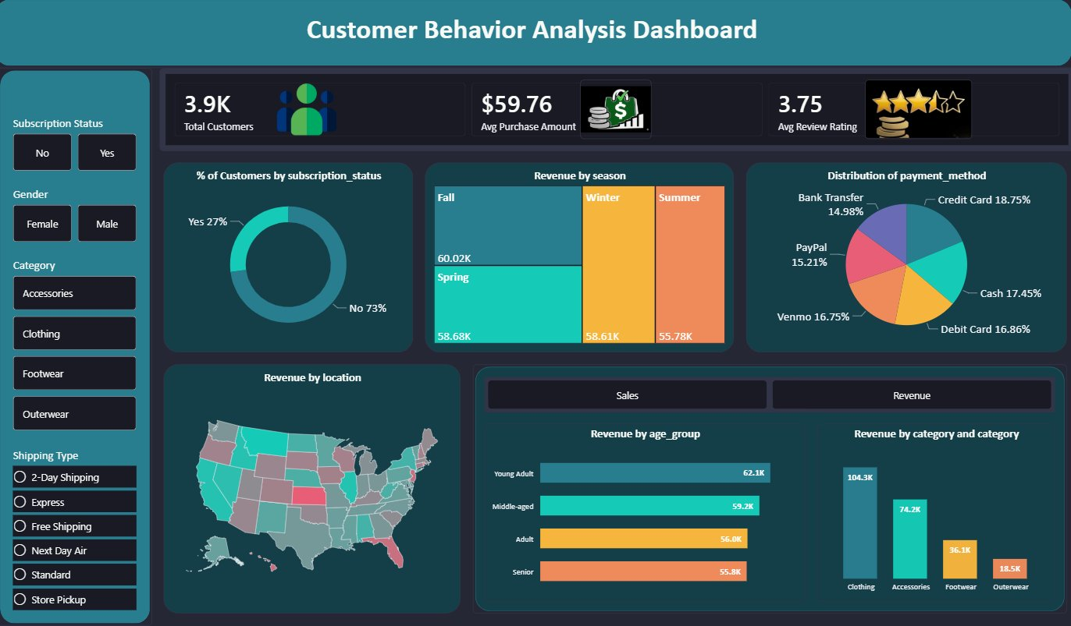
Interactive Power BI Dashboard

Slide 8
Business Recommendations
01
Boost Subscriptions
02
Customer Loyalty Programs
Only 27% subscribe. Promote exclusive perks, early access, and loyalty rewards to convert the 73% non-subscribers.
80% are already Loyal customers. Reward repeat buyers with tiered programs to deepen engagement and prevent churn.
03
Review Discount Policy
04
Product Positioning
Products like Hat (50%) and Sneakers (49.7%) have very high discount rates. Balance promotions with margin health.
Gloves, Sandals, and Boots lead in ratings. Feature these prominently in campaigns and homepage placements.
05
Targeted Marketing
Young Adults generate the most revenue ($62.1K). Focus digital campaigns and express-shipping upsells on this segment.

Slide 9
Key Takeaways
Male customers drive 2× the revenue of female customers
Young Adults are the #1 revenue segment at $62,143
80% of customers are already Loyal — focus on retention
Fall is the highest-revenue season at $60.02K
Clothing leads all categories with $104.3K in revenue
Customer Shopping Behavior Analysis

