Slide 1
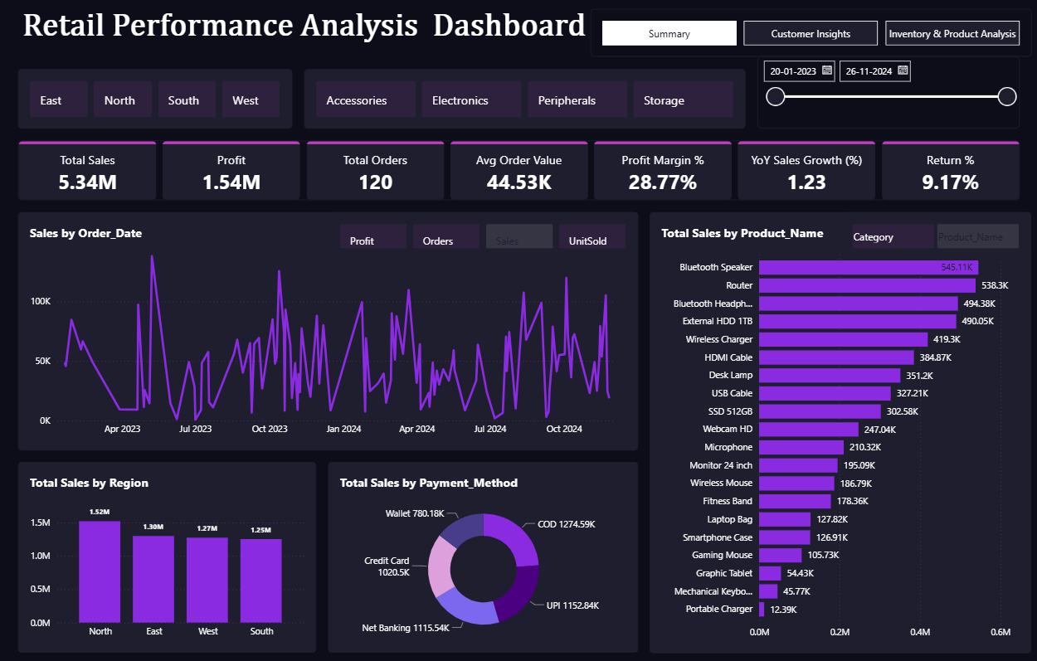
Retail Performance Analysis Dashboard
Power BI + SQL + Excel
Empowering retail business decisions through comprehensive data-driven insights and real-time performance monitoring.

Slide 2
Project Overview
The Challenge
The Solution
The retail company struggled with fragmented data across multiple systems, making it difficult to:
Developed an integrated analytics ecosystem combining Power BI's visualization capabilities with SQL's data processing power and Excel's flexibility.
Track sales performance accurately
Understand customer purchasing patterns
The result: A unified, interactive dashboard delivering actionable insights across sales, customers, and inventory management.
Manage inventory levels effectively
Make timely business decisions

Slide 3




Tools & Technology Stack
Power BI
SQL Server
Interactive visualizations with DAX-based KPIs for real-time insights and dynamic reporting capabilities
Robust data extraction, complex joins, and automated query execution for seamless data integration
Excel
DAX Language
Advanced data cleaning, preprocessing, and transformation to ensure data quality and consistency
Sophisticated measures for YoY growth, profit margins, AOV, and custom business metrics

Slide 4



Key Business Metrics
₹5.34M
+123%
120
60
Total Sales
YoY Growth
Total Orders
Customers
Comprehensive revenue across all channels
Exceptional year-over-year increase
Successfully processed transactions
Active customer base
28.77%
60%
9.17%
Profit Margin
Repeat Customer Revenue
Return Rate
Strong profitability indicator
Loyalty-driven sales contribution
Opportunity for improvement

Slide 5
Insights & Business Impact
Regional Performance Excellence
Category Winners
Supplier Performance
Accessories and Electronics emerged as top-performing product categories, driving significant revenue growth and customer engagement.
Supplier 'Boat' achieved the highest total sales of ₹1.52M, demonstrating strong brand appeal and product-market fit.
North region led with ₹1.52M in revenue, closely followed by East region at ₹1.38M, revealing strong market presence in these territories.
Customer Loyalty Strength
Return Rate Optimization
Inventory Intelligence
Repeat customers contributed 60% of total revenue, highlighting the effectiveness of retention strategies and customer satisfaction.
9.17% return rate identified as a key improvement area, requiring investigation into product quality and customer expectations alignment.
Automated low-stock detection via integrated Power BI and SQL systems improved restocking efficiency and prevented stockouts.

Slide 6
SQL Queries Powering the Dashboard
Top Products by Sales
Revenue by Region
Customer Lifetime Value
SELECT TOP 5 p.Product_Name, SUM(od.Quantity * od.Unit_Price * (1 - od.Discount)) AS Total_SalesFROM OrderDetails odJOIN Products p ON od.Product_ID = p.Product_IDGROUP BY p.Product_NameORDER BY Total_Sales DESC;
SELECT r.Region_Name, SUM(od.Quantity * od.Unit_Price * (1 - od.Discount)) AS RevenueFROM Orders oJOIN Customers c ON o.Customer_ID = c.Customer_IDJOIN Regions r ON c.Region_ID = r.Region_IDJOIN OrderDetails od ON o.Order_ID = od.Order_IDGROUP BY r.Region_NameORDER BY Revenue DESC;
SELECT c.Customer_Name, SUM(o.Total_Amount) AS Total_SpentFROM Customers cJOIN Orders o ON c.Customer_ID = o.Customer_IDGROUP BY c.Customer_NameORDER BY Total_Spent DESC;
Calculates individual customer value for targeted retention efforts.
Identifies highest-revenue generating products for strategic inventory decisions.
Analyzes geographic performance to optimize regional marketing strategies.

Slide 7
Dashboard Highlights
Three comprehensive pages designed for complete business visibility and actionable insights.
Sales & Performance Overview
Customer Insights
Inventory & Supplier Analysis
Real-time revenue tracking, YoY growth metrics, profit margins, and regional performance breakdowns
Customer segmentation, lifetime value analysis, purchase patterns, and retention metrics
Stock level monitoring, supplier performance evaluation, and automated restocking alerts

Slide 8




Business Outcomes & Value Delivered
Unified Business View
Consolidated data from multiple sources into a single, comprehensive performance dashboard accessible to all stakeholders.
60% Time Reduction
Eliminated manual data collection and reporting processes, freeing teams to focus on strategic analysis and action.
Enhanced Efficiency
Streamlined supplier evaluation and restocking operations through automated alerts and performance tracking.
Real-Time Decision Making
Empowered management with instant access to critical business metrics for faster, data-driven strategic decisions.

Slide 9
Summary & Key Takeaways
Interactive 3-Page Dashboard
Comprehensive Power BI solution covering sales, customers, and inventory with intuitive navigation
SQL-Driven Analytics
Automated data processing with complex queries delivering accurate, real-time KPI calculations
Management-Ready Insights
Actionable intelligence presented in business-friendly visuals enabling confident decision-making
Operational Excellence
Transformed data workflow reducing manual effort while improving accuracy and business agility

