Slide 1




Data Analytics Internship
Projects
Unified Mentor Private Limited
Power BI Python SQL Excel
Presented by: Kavita Bijarniya
Unified Mentor Private Limited

Slide 2
Tools & Technologies Used
Tool | Purpose
Excel | Data preprocessing and validation
Python | Data cleaning, EDA, and machine learning
SQL | Querying, filtering, and joining datasets
Power BI | Dashboarding and storytelling
Libraries Used | Pandas, Matplotlib, Seaborn, Scikit-learn

Slide 3
Project Overview
No. | Project Title | Domain / Focus | Tools Used
1 | Supply Chain Management Analysis | Forecasting & Optimization | Excel, Python, Power BI, SQL
2 | Google Play Store Apps Rating Analysis | App Market Insights | Excel, Python, Power BI, SQL
3 | Customer Satisfaction Analysis | Predictive Modelling | Excel, Python, Power BI, SQL
4 | Daily Transaction Analysis | Financial Analytics | Excel, Python, Power BI

Slide 4
Summary of Project Goals
Project | Key Outcome
Supply Chain | Demand forecasting and supply optimization
Play Store Apps | Identify factors influencing app success
Customer Satisfaction | Predict satisfaction using service data
Daily Transactions | Analyze and visualize personal finance patterns

Slide 5
Tools & Workflow
Data Collection (Excel / CSV Files)
↓
Data Cleaning & EDA (Python /SQL)
↓
Feature Engineering(Python)
↓
Machine Learning Model (Model Building)
↓
Visualization (Power BI)
↓
Deployment (Streamlit App)

Slide 6

Project 1: Supply Chain Management Analysis
📘 Overview:
Supply chain analytics helps organizations optimize operations by analyzing data from production to delivery.
This dataset, collected from a fashion and beauty startup, covers makeup product supply chains.
🧩 Features Include:
Product type, SKU, price, availability, stock levels, lead times, manufacturing costs, defect rates, transportation modes, etc.
🎯 Problem Statement:
Implement a demand forecasting model to optimize supply chain management through data-driven decisions on inventory, supplier performance, and logistics.
🛠 Tools Used:
Excel | Python | Power BI | SQL

Slide 7
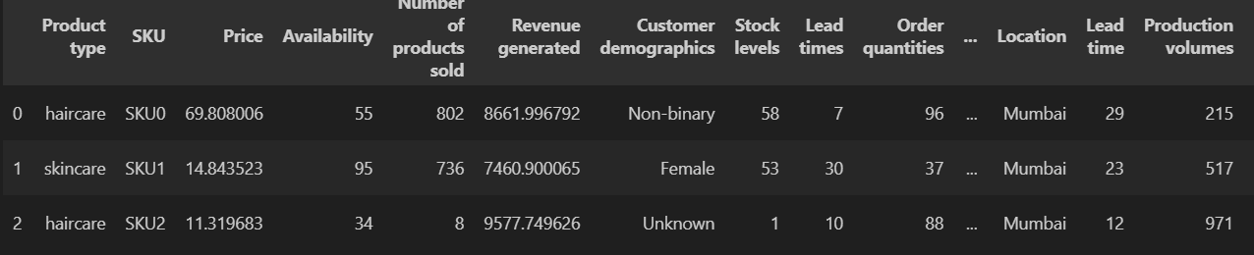
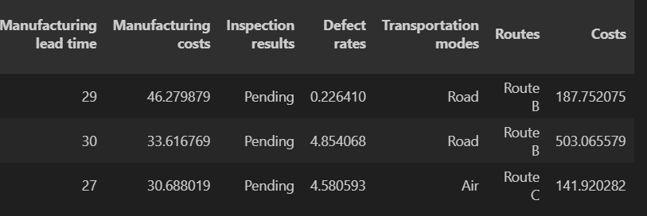
Python: Data Preparation
#Import necessary Libraries
import pandas as pd
import numpy as np
import matplotlib.pyplot as plt
%matplotlib inline
import seaborn as sns
import plotly.express as px
from datetime import datetime, timedelta
from sklearn.model_selection import train_test_split
from sklearn.preprocessing import RobustScaler, LabelEncoder
from sklearn.ensemble import RandomForestRegressor, GradientBoostingRegressor, VotingRegressor
from sklearn.metrics import r2_score, mean_squared_error, mean_absolute_error
#load data
df = pd.read_csv("E:/Unified_Mentor_Internship_Project/Supply chain/supply_chain_data.csv")
#print first 3 rows
df.head(3)

Slide 8
Python: Data Cleaning & Preparation
# Clean data
df_clean = df.copy()
# Handle missing values numeric value with median, categorical value with mode andoutlier with
numerical_cols = df_clean.select_dtypes(include=[np.number]).columns
for col in numerical_cols:
if df_clean[col].isnull().sum() > 0:
df_clean[col].fillna(df_clean[col].median(), inplace=True)
categorical_cols = df_clean.select_dtypes(include=['object']).columns
for col in categorical_cols:
if df_clean[col].isnull().sum() > 0:
df_clean[col].fillna(df_clean[col].mode()[0], inplace=True)
# Remove outliers
Q1 = df_clean['Number of products sold'].quantile(0.25)
Q3 = df_clean['Number of products sold'].quantile(0.75)
IQR = Q3 - Q1
df_clean = df_clean[
(df_clean['Number of products sold'] >= Q1 - 1.5 * IQR) &
(df_clean['Number of products sold'] <= Q3 + 1.5 * IQR)
]
print(f"✅ Data cleaned. Final records: {len(df_clean)}")

Slide 9
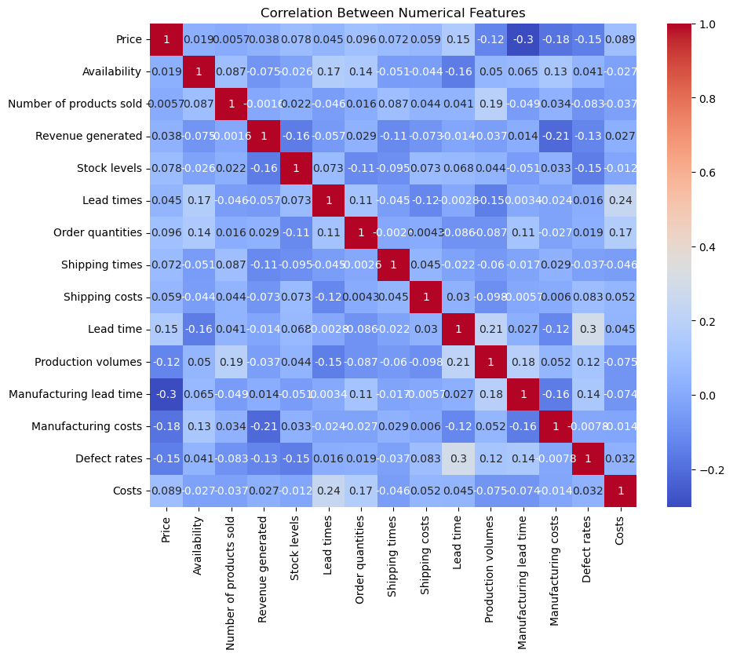
Python: Exploratory Data Analysis
# Correlation Heatmap
plt.figure(figsize=(10,8))
sns.heatmap(df_clean.corr(numeric_only=True), annot=True, cmap='coolwarm')
plt.title("Correlation Between Numerical Features")
plt.show()

Slide 10
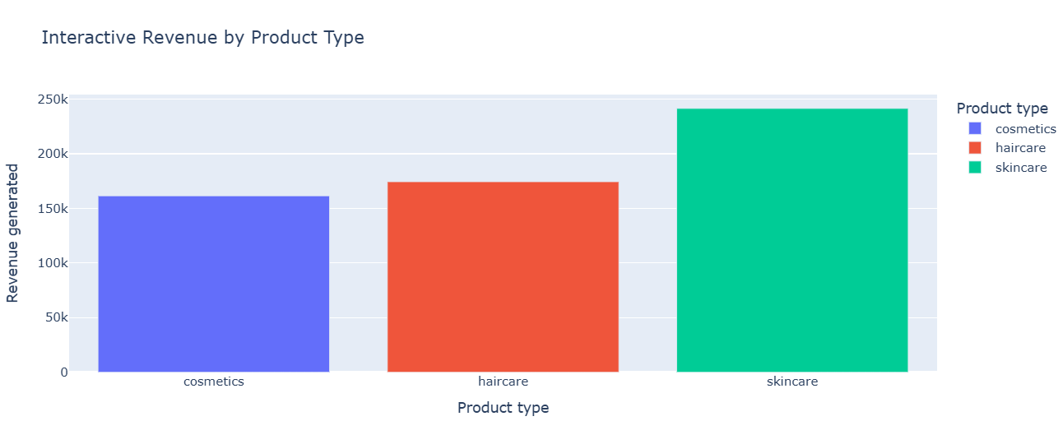
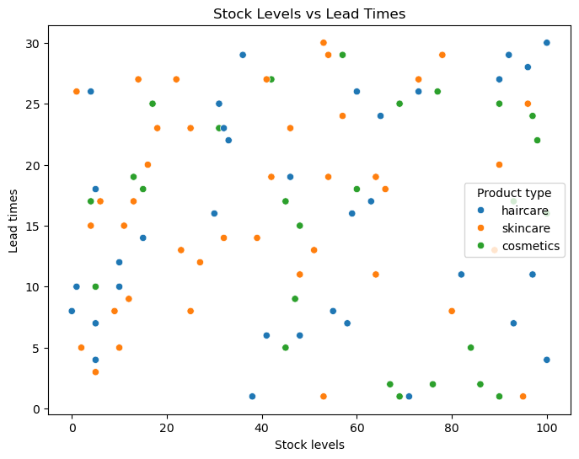
Python: Exploratory Data Analysis
# Interactive Revenue Trend
fig = px.bar(df_clean.groupby('Product type')['Revenue generated'].sum().reset_index(),
x='Product type', y='Revenue generated', color='Product type',
title="Interactive Revenue by Product Type")
fig.show()
# Stock vs Lead Time
plt.figure(figsize=(8,6))
sns.scatterplot(x='Stock levels', y='Lead times', hue='Product type', data=df_clean)
plt.title("Stock Levels vs Lead Times")
plt.show()

Slide 11
Python: Feature Engineering
#Feature Engineering
# Business metrics
df_clean['Revenue_per_Unit'] = df_clean['Revenue generated'] / (df_clean['Number of products sold'] + 1)
df_clean['Stock_Availability_Ratio'] = df_clean['Availability'] / 100
df_clean['Inventory_Turnover'] = df_clean['Number of products sold'] / (df_clean['Stock levels'] + 1)
df_clean['Supply_Efficiency'] = df_clean['Order quantities'] / (df_clean['Lead times'] + 1)
df_clean['Shipping_Efficiency'] = df_clean['Order quantities'] / (df_clean['Shipping times'] + 1)
df_clean['Cost_per_Unit'] = (df_clean['Manufacturing costs'] + df_clean['Shipping costs']) / (df_clean['Production volumes'] + 1)
df_clean['Profit_per_Unit'] = df_clean['Revenue_per_Unit'] - df_clean['Cost_per_Unit']
df_clean['Quality_Score'] = 1 - df_clean['Defect rates'] / 100
df_clean['Lead_Time_Total'] = df_clean['Lead times'] + df_clean['Manufacturing lead time']
df_clean['Price_to_Cost_Ratio'] = df_clean['Price'] / (df_clean['Cost_per_Unit'] + 1)
# Categorical indicators
df_clean['Low_Stock'] = (df_clean['Stock levels'] < df_clean['Stock levels'].median()).astype(int)
df_clean['Premium_Product'] = (df_clean['Price'] > df_clean['Price'].quantile(0.75)).astype(int)

Slide 12
Python: Model Building
# PART 3: PREPARE FOR MODELING
target = 'Number of products sold'
feature_columns = [
'Price', 'Availability', 'Product type_encoded','Stock levels', 'Lead times', 'Order quantities','Lead time', 'Production volumes', 'Manufacturing lead time',
'Shipping times', 'Shipping costs', 'Shipping carriers_encoded','Transportation modes_encoded', 'Routes_encoded','Supplier name_encoded', 'Location_encoded',
'Defect rates', 'Inspection results_encoded', 'Quality_Score',
'Manufacturing costs', 'Costs', 'Cost_per_Unit','Customer demographics_encoded',Stock_Availability_Ratio', 'Inventory_Turnover','Supply_Efficiency', 'Shipping_Efficiency','Lead_Time_Total', 'Low_Stock', 'Premium_Product'
]
feature_columns = [col for col in feature_columns if col in df_clean.columns]
X = df_clean[feature_columns]
y = df_clean[target]
# Train-test split
X_train, X_test, y_train, y_test = train_test_split(
X, y, test_size=0.2, random_state=42, shuffle=True
)

Slide 13
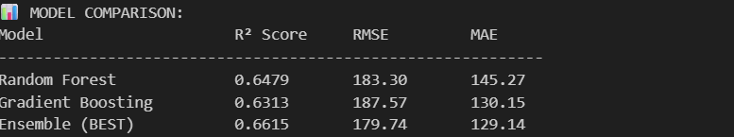
Python: Data Building & Evalution
# CREATE ENSEMBLE MODEL (BEST PERFORMER!)
ensemble_model = VotingRegressor([
('rf', models['Random Forest']),
('gb', models['Gradient Boosting'])
])
ensemble_model.fit(X_train_scaled, y_train)
y_pred_ensemble = ensemble_model.predict(X_test_scaled)
ensemble_r2 = r2_score(y_test, y_pred_ensemble)
ensemble_rmse = np.sqrt(mean_squared_error(y_test, y_pred_ensemble))
ensemble_mae = mean_absolute_error(y_test, y_pred_ensemble)
print(f"\n✅ ENSEMBLE Results:")
print(f" R²: {ensemble_r2:.4f} | RMSE: {ensemble_rmse:.2f} | MAE: {ensemble_mae:.2f}")
# Compare all models
print("\n📊 MODEL COMPARISON:")
print(f"{'Model':<25} {'R² Score':<12} {'RMSE':<12} {'MAE'}")
print("-" * 60)
for name in results:
print(f"{name:<25} {results[name]['r2']:<12.4f} {results[name]['rmse']:<12.2f} {results[name]['mae']:.2f}")
print(f"{'Ensemble (BEST)':<25} {ensemble_r2:<12.4f} {ensemble_rmse:<12.2f} {ensemble_mae:.2f}")

Slide 14
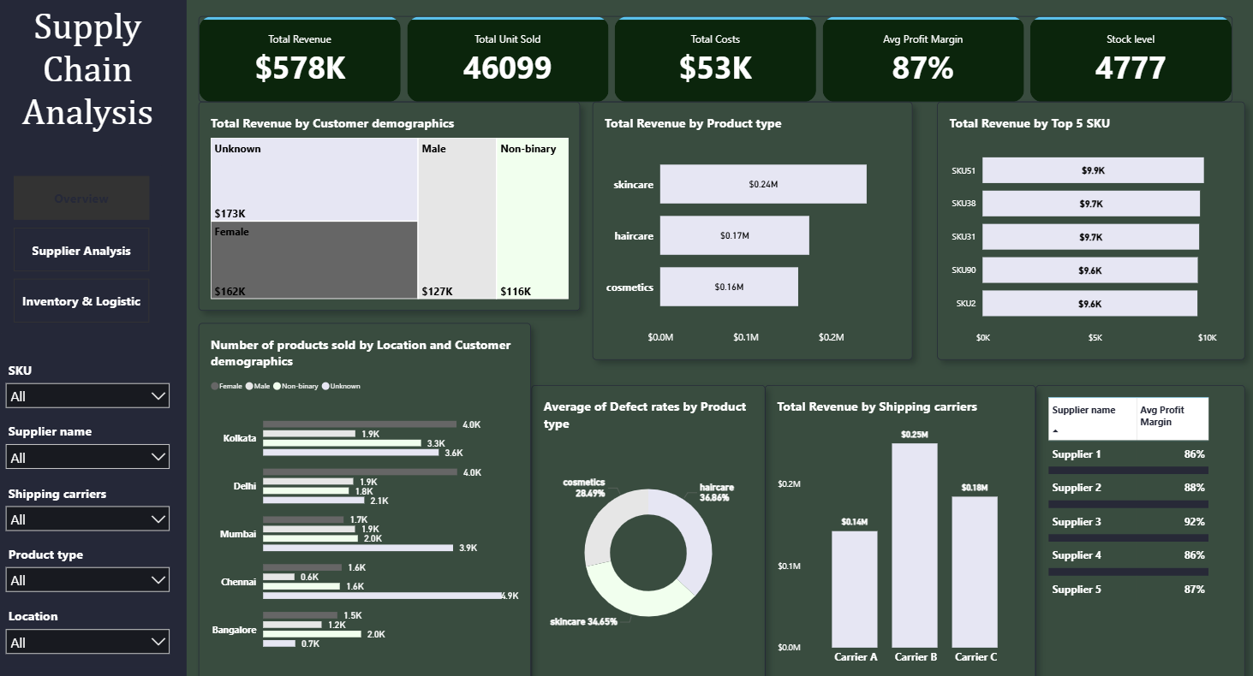
Power BI

Slide 15
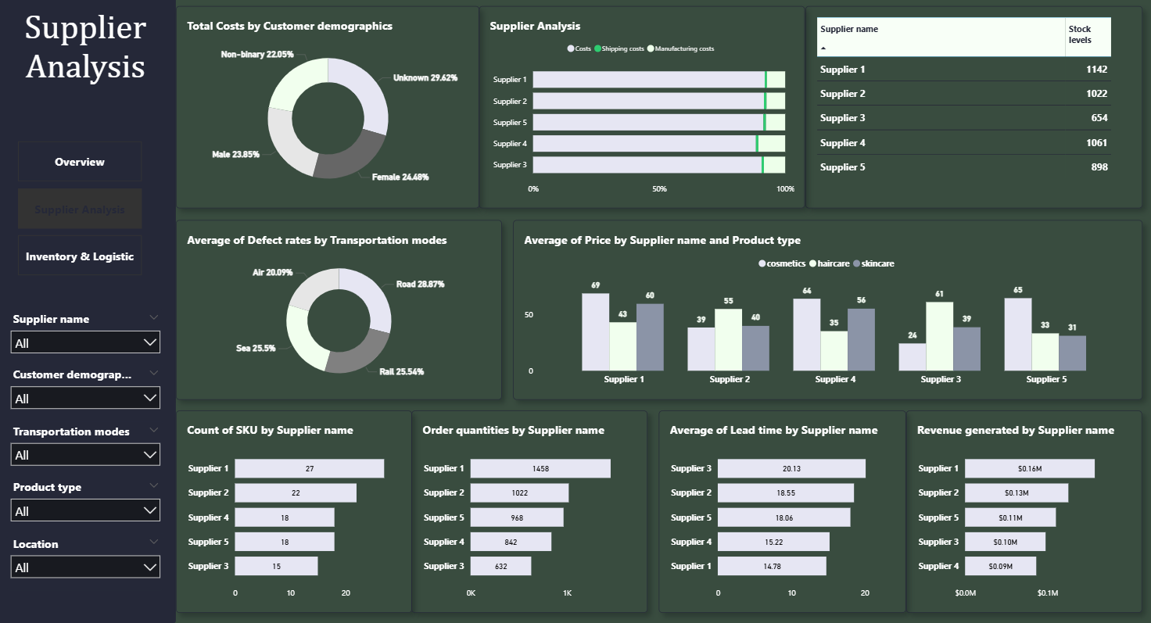
Power BI

Slide 16
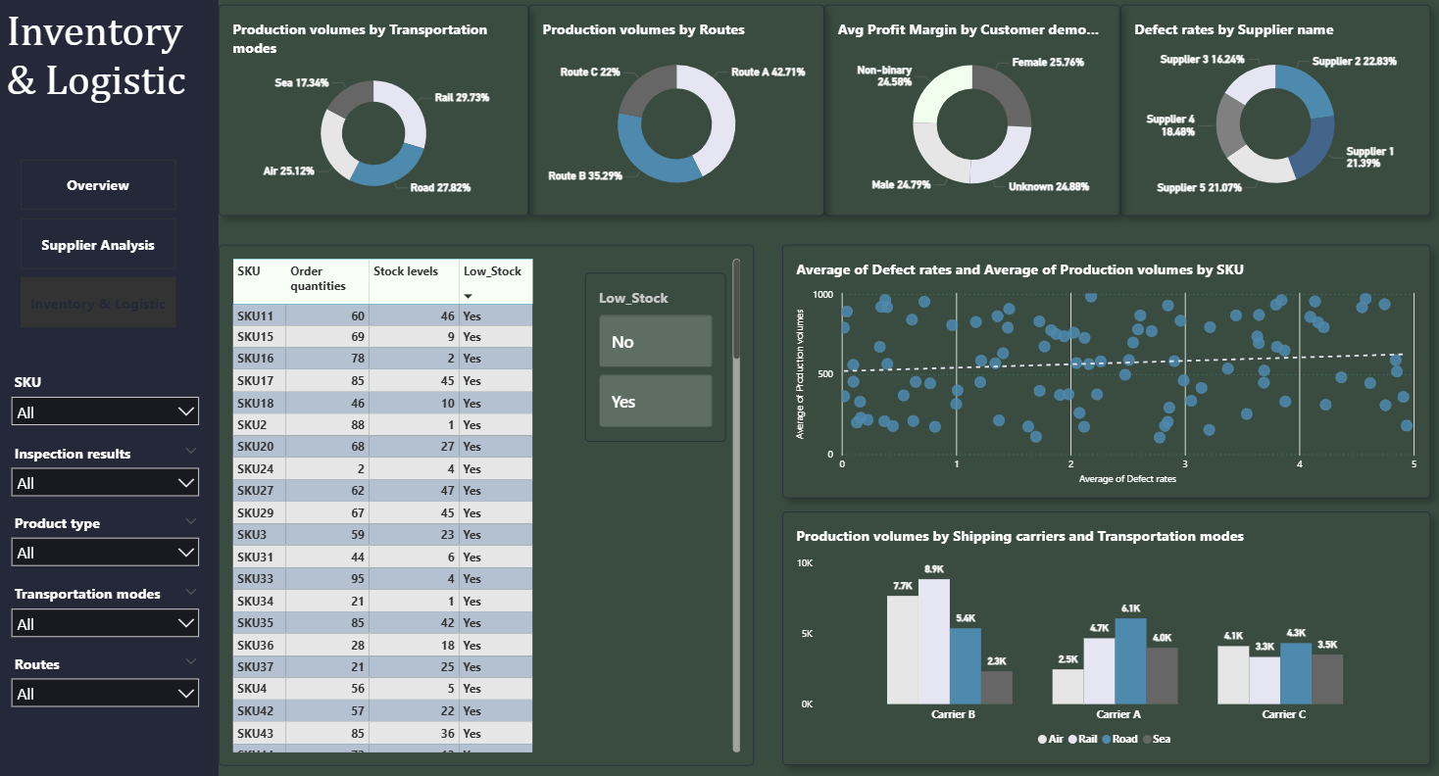
Power BI

Slide 17
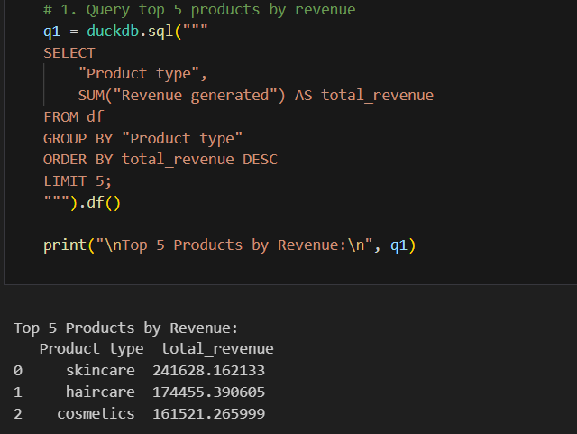
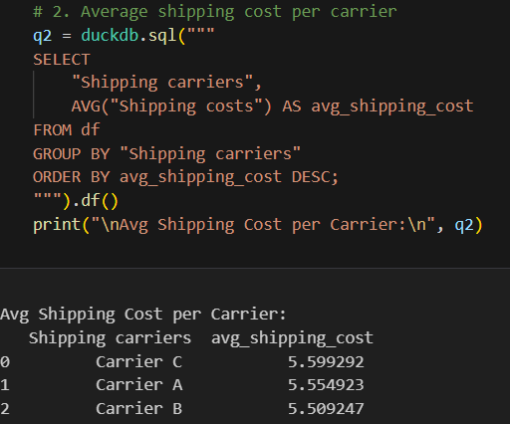
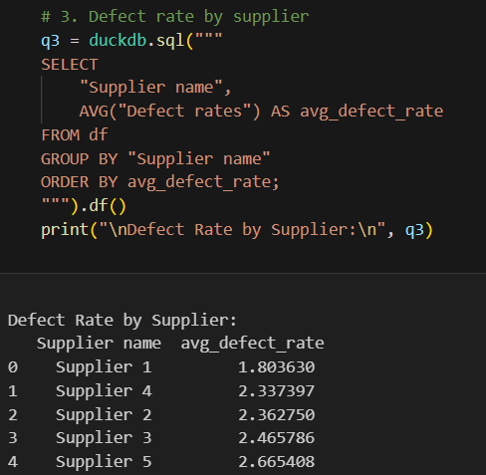
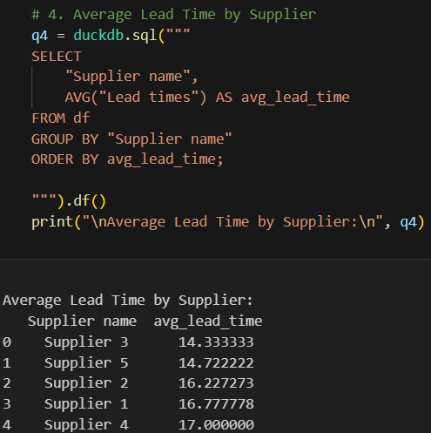
SQL

Slide 18
Supply Chain Management Analysis – Problem, Solution & Result
Problem:
Inefficient demand forecasting and supply chain operations led to overstocking, supplier delays, and increased logistics costs.
Solution:
• Built an end-to-end data pipeline integrating SQL, Python, and Power BI.
• Developed a demand forecasting model (Ensemble – R² = 0.66, RMSE = 179.74) to predict product demand.
• Analyzed supplier performance, cost efficiency, and logistics KPIs using interactive Power BI dashboards.
Result:
• Improved forecast accuracy through ensemble modeling
• Enhanced supplier and route optimization insights
• low-stock risks and improved cost management
• Enabled data-driven decision-making across the supply chain

Slide 19
Project Highlights
Dataset size:
• ~ 100 rows • ~ 24 columns
Tools Used:
Python, Power BI, Excel, SQL
Key Insights:
• Higher lead times → low stock availability
• Route C & specific suppliers caused frequent delays
• Shipping & manufacturing costs affected revenue per unit
• Forecasting revealed seasonal demand variation
Model Used:
• Random Forest
• Gradient Boosting
• Ensemble (Voting Regressor — Best Model)
• R² = 0.66
Final Outcome:
Improved demand forecasting, reduced low-stock risk, and enabled supplier performance tracking with Power BI dashboards.

Slide 20


Project 2: Google Play Store Apps Rating Analysis
📘 Overview:
Google Play Store data offers valuable insights for app developers to improve ratings and increase installs.
🧩 Features Include:
App names, categories, ratings, reviews, installs, types, prices, and update information etc.
🎯 Problem Statement:
Analyze and visualize patterns across apps to understand what factors influence app ratings and popularity.
Perform data cleaning, EDA, and trend visualization to derive actionable insights.
🛠 Tools Used:
Excel | Python | Power BI | SQL

Slide 21
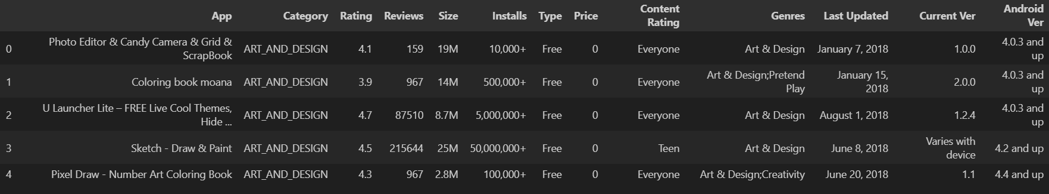
Python: Data Preparation
#Import necessary Libraries
import pandas as pd
import numpy as np
import matplotlib.pyplot as plt
import seaborn as sns
from sklearn.model_selection import train_test_split
from sklearn.ensemble import RandomForestRegressor
from sklearn.metrics import mean_absolute_error, mean_squared_error, r2_score
df = pd.read_csv("E:/Unified_Mentor_Internship_Project/Googleplay/googleplaystore.csv")
df.head()
print("Initial shape:", df.shape)

Slide 22
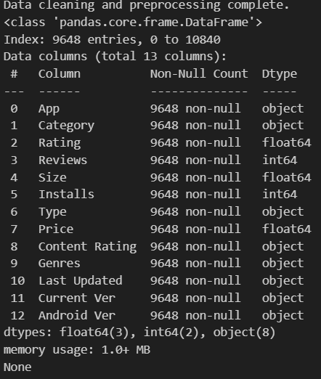
Python: Data Cleaning
# Correcting a known error in the dataset where one row is shifted
df = df[df['Android Ver'] != 'NaN']
df = df[df['Category'] != '1.9']
# Handle missing values by filling 'Rating' with the median
df['Rating'].fillna(df['Rating'].median(), inplace=True)
#dropping other NA rows
df.dropna(subset=['Type', 'Content Rating', 'Current Ver', 'Android Ver'], inplace=True)
# Convert 'Reviews' to a numeric type
df['Reviews'] = pd.to_numeric(df['Reviews'])
# Clean and convert 'Size' column to a numeric type (in bytes)
df['Size'] = df['Size'].apply(lambda x: str(x).replace('M', 'e6') if 'M' in str(x) else str(x))
df['Size'] = df['Size'].apply(lambda x: str(x).replace('k', 'e3') if 'k' in str(x) else str(x))
df['Size'] = df['Size'].replace('Varies with device', np.nan)
df['Size'] = pd.to_numeric(df['Size'])
df['Size'].fillna(df['Size'].median(), inplace=True)
# Clean and convert 'Installs' to a numeric type
df['Installs'] = df['Installs'].apply(lambda x: str(x).replace('+', '').replace(',', ''))
df['Installs'] = pd.to_numeric(df['Installs'])
# Clean and convert 'Price' to a numeric type
df['Price'] = df['Price'].apply(lambda x: str(x).replace('$', ''))
df['Price'] = pd.to_numeric(df['Price’])
# Remove duplicate app entries, keeping the first occurrence
df.drop_duplicates(subset='App', inplace=True)

Slide 23
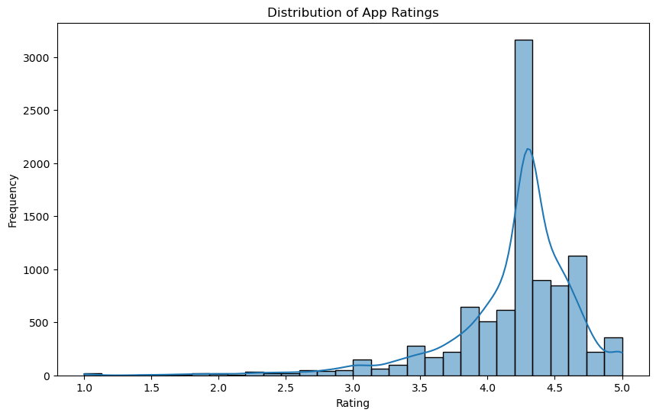
Python: Exploratory Data Analysis
#Exploratory Data Analysis (EDA)
#Distribution of App Ratings
plt.figure(figsize=(10, 6))
sns.histplot(df['Rating'], bins=30, kde=True)
plt.title('Distribution of App Ratings')
plt.xlabel('Rating')
plt.ylabel('Frequency')
plt.show()

Slide 24
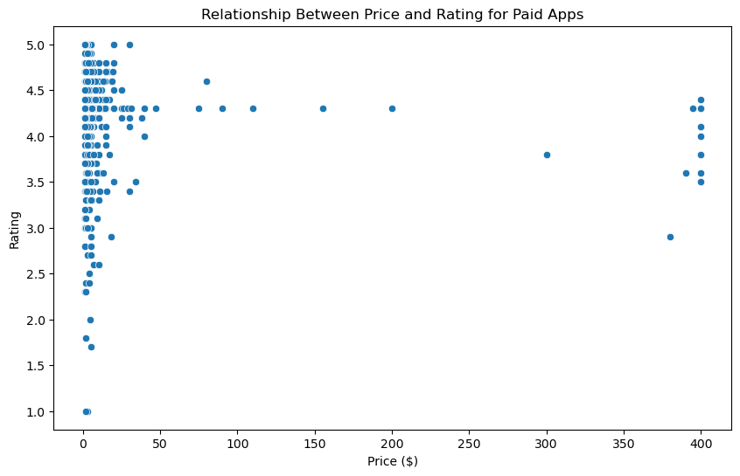
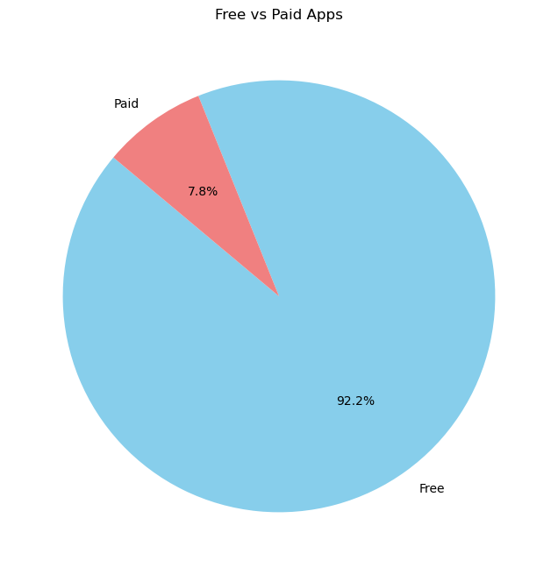
Python: Exploratory Data Analysis
#Free vs. Paid Apps
plt.figure(figsize=(8, 8))
free_vs_paid = df['Type'].value_counts()
plt.pie(free_vs_paid, labels=free_vs_paid.index, autopct='%1.1f%%', startangle=140, colors=['skyblue', 'lightcoral'])
plt.title('Free vs Paid Apps')
plt.ylabel('')
plt.show()
#Relationship Between Price and Rating
plt.figure(figsize=(10, 6))
sns.scatterplot(data=paid_apps, x='Price', y='Rating')
plt.title('Relationship Between Price and Rating for Paid Apps')
plt.xlabel('Price ($)')
plt.ylabel('Rating')
plt.show()

Slide 25

Python: Data Modeling & Evaluation
# Prepare Data for Modeling
# Select features and target variable
df_ml = df[['Category', 'Reviews', 'Size', 'Installs', 'Type', 'Price', 'Content Rating', 'Rating']]
# Convert categorical variables into dummy/indicator variables (one-hot encoding)
df_ml = pd.get_dummies(df_ml, columns=['Category', 'Type', 'Content Rating'], drop_first=True)
# Define features (X) and target (y)
X = df_ml.drop('Rating', axis=1)
y = df_ml['Rating']
# Split data into training and testing sets (80% train, 20% test)
X_train, X_test, y_train, y_test = train_test_split(X, y, test_size=0.2, random_state=42)
# Train the Machine Learning Model
model = RandomForestRegressor(n_estimators=100, random_state=42, n_jobs=-1)
# Fit the model on the training data
model.fit(X_train, y_train)
# Evaluate the Model
# Make predictions on the test data
y_pred = model.predict(X_test)
# Calculate performance metrics
mae = mean_absolute_error(y_test, y_pred)
mse = mean_squared_error(y_test, y_pred)
r2 = r2_score(y_test, y_pred)
# Print the evaluation results
print("--- Machine Learning Model Evaluation ---")
print(f"Mean Absolute Error (MAE): {mae:.2f}")
print(f"Mean Squared Error (MSE): {mse:.2f}")
print(f"R-squared (R2): {r2:.2f}")

Slide 26
Python: New Prediction
# 1. Define the data for the new prediction
new_app_data = {
'Category': 'BUSINESS',
'Reviews': 5000,
'Size': 25e6, # 25MB
'Installs': 100000,
'Type': 'Paid',
'Price': 9.99,
'Content Rating': 'Everyone'
}
new_app_df = pd.DataFrame([new_app_data])
# 2. Apply one-hot encoding
new_app_encoded = pd.get_dummies(new_app_df, columns=['Category', 'Type', 'Content Rating'], drop_first=True)
# 3. Align columns with the original training data
# This ensures the new data has the exact same structure as the training data
new_app_processed = new_app_encoded.reindex(columns=X.columns, fill_value=0)
# 4. Predict the rating
predicted_rating = model.predict(new_app_processed)
# 5. Print the result
print("--- New App Prediction ---")
print(f"App Data: {new_app_data}")
print(f"Predicted Rating: {predicted_rating[0]:.2f} ⭐")

Slide 27
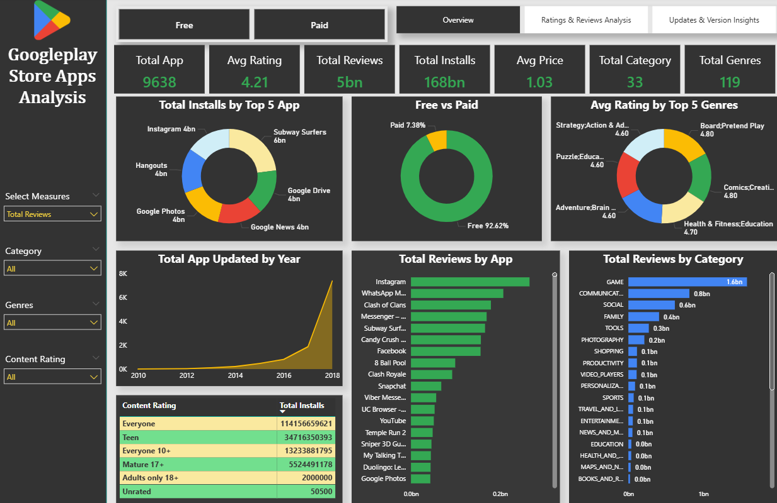
Power BI

Slide 28
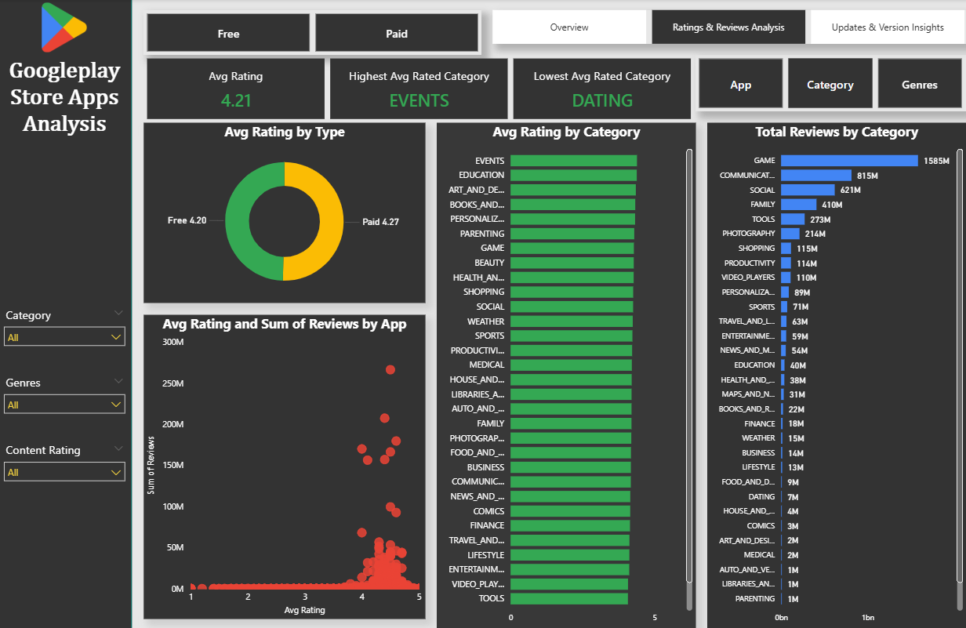
Power BI

Slide 29
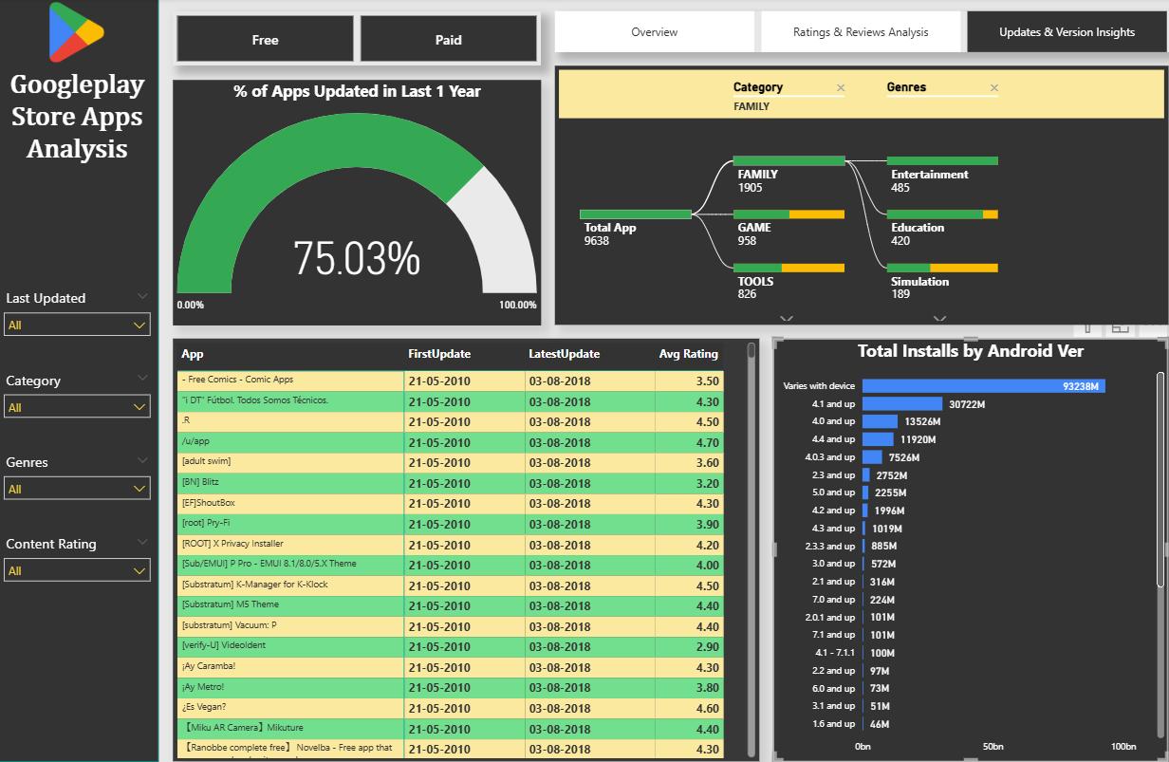
Power BI

Slide 30
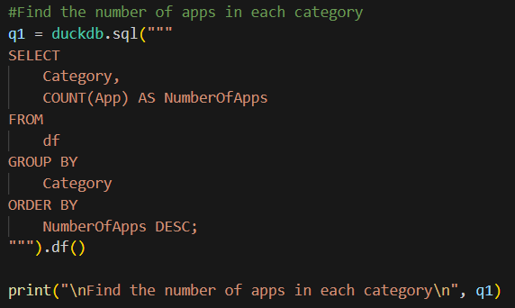
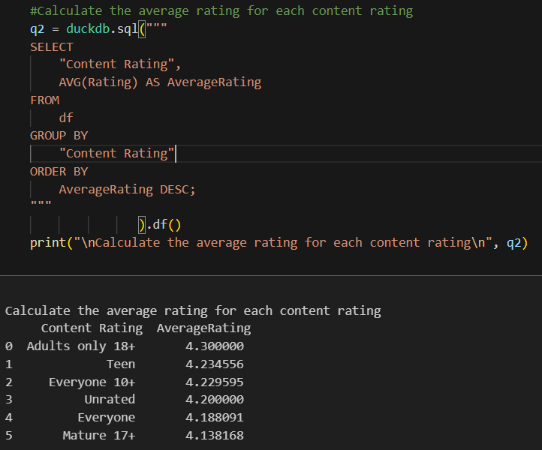
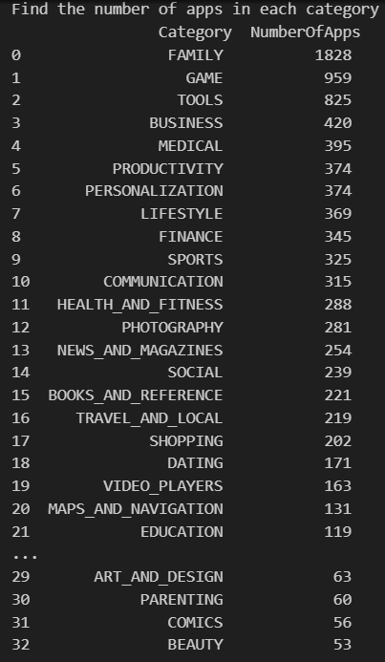
SQL

Slide 31
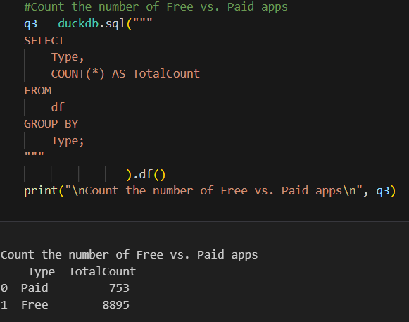
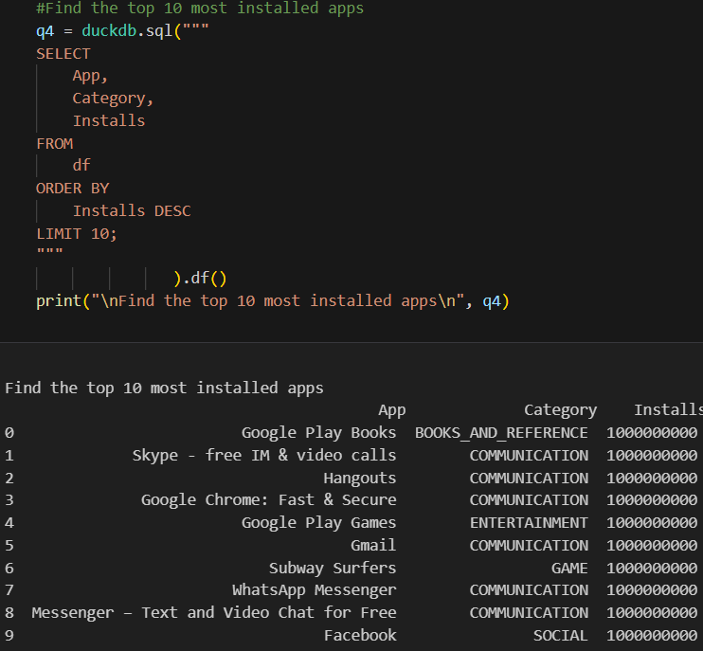
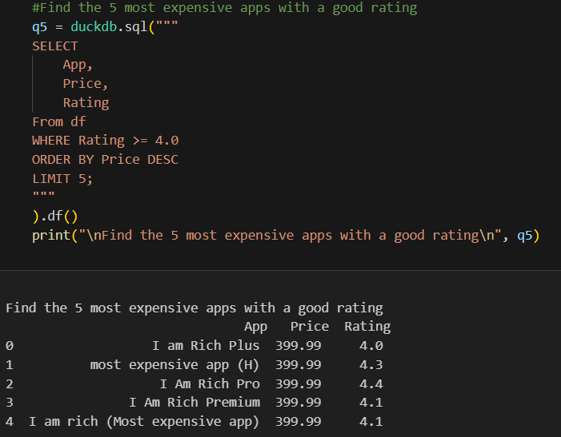
SQL

Slide 32
Google Play Store App Rating Analysis – Problem, Solution & Result
Problem:
Analyze and visualize patterns across apps to understand what factors influence app ratings and popularity. Perform data cleaning, EDA, and trend visualization to derive actionable insights.
Solution:
• Collected and cleaned Play Store data to remove duplicates, missing values, and formatting issues.
• Used Python (Pandas, Matplotlib, Seaborn) for Exploratory Data Analysis and feature correlation.
• Identified top-performing app categories, paid vs free performance, and trends by installs, ratings, and reviews.
• Built an interactive Power BI dashboard to visualize category performance, app updates, and rating distribution.
Result:
• Discovered that apps with frequent updates and smaller size tend to have higher ratings.
• Free apps dominate downloads, while paid apps have higher average ratings.
• Game and Communication categories lead in installs and engagement.
• The dashboard enables stakeholders to prioritize app features and update frequency to boost success metrics.

Slide 33
Project Highlights
Dataset size:
• ~ 10,841 apps • ~ 13 attributes
Tools Used:
Python, Power BI, Excel, SQL
Key Insights:
• Free apps dominate installs; paid apps have higher ratings
• Small-size apps and frequent updates perform better
• Game & Communication categories lead in user engagement
• Reviews strongly correlate with installs and rating quality
Model Used:
• Random Forest Regressor
• R² ≈ 0.05 | MAE ≈ 0.32
Final Outcome:
Identified factors influencing app rating and created a dashboard to help developers optimize category focus, pricing, and update strategy.

Slide 34

Project 3: Customer Satisfaction Analysis
📘 Overview:
This dataset contains customer support ticket data from tech products — covering ticket type, resolution, response time, priority, and customer satisfaction.
🧩 Features Include:
Ticket ID, Customer Name, Customer Email, Customer Age, Customer Gende, Product Purchased, Date of Purchase, Ticket Type, Ticket Subject, Ticket Description, Ticket Status, Ticket Priority, Ticket Channel, Customer Satisfaction Rating etc.
🎯 Problem Statement:
Build a predictive model to estimate customer satisfaction levels using ticket data and service-related factors.
🛠 Tools Used:
Excel | Python | Power BI | SQL

Slide 35
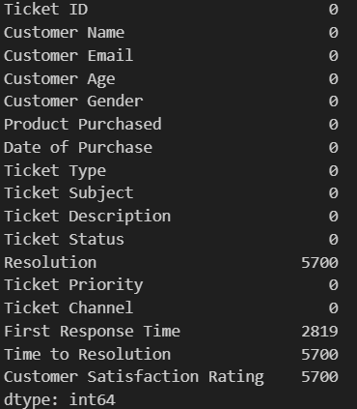
Python: Data Preparation
# Import essential libraries
import pandas as pd, numpy as np
from sklearn.preprocessing import OneHotEncoder, StandardScaler, LabelEncoder
from sklearn.compose import ColumnTransformer
from sklearn.pipeline import Pipeline
from sklearn.model_selection import train_test_split, GridSearchCV
from sklearn.linear_model import LogisticRegression
from sklearn.ensemble import RandomForestClassifier
from sklearn.metrics import classification_report, confusion_matrix, accuracy_score
from imblearn.over_sampling import SMOTE
import matplotlib.pyplot as plt
import seaborn as sns
import pickle
# Load the dataset
df = pd.read_csv("E:/Unified_Mentor_Internship_Project/Customer Satisfaction/customer_support_tickets.csv")
print(df.head(5))
print("Shape:", df.shape)
df.describe()
df.info()
df.isnull().sum()

Slide 36
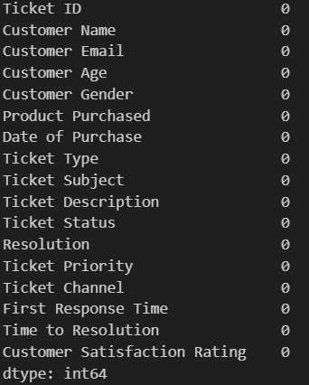
Python: Data Cleaning
# Data Preprocessing & Feature Engineering
# Filter for closed tickets
closed_tickets = df[df["Ticket Status"] == "Closed"].copy()
data.isnull().sum()
# Convert columns to datetime
data["First Response Time"] = pd.to_datetime(data["First Response Time"], errors="coerce")
data["Time to Resolution"] = pd.to_datetime(data["Time to Resolution"], errors="coerce")
# Fix by swapping dates (if you suspect they were reversed)
data.loc[data["Time to Resolution"] < data["First Response Time"], ["First Response Time", "Time to Resolution"]] = \
data.loc[data["Time to Resolution"] < data["First Response Time"], ["Time to Resolution", "First Response Time"]].values
# Calculate resolution time in hours
Resolution_Time_Hours = (
(data["Time to Resolution"] - data["First Response Time"]).dt.total_seconds() / 3600
).apply(lambda x: x if x >= 0 else np.nan
)
# Compute average
data["Average Resolution Time"] = Resolution_Time_Hours.mean()
print("Average Resolution Time (Hours):", data["Average Resolution Time"])

Slide 37
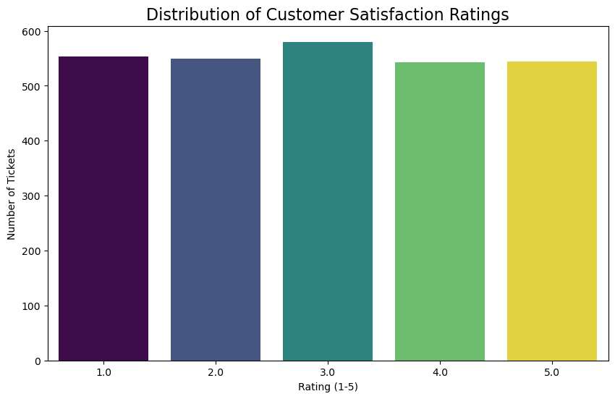
Python : Feature Engineering & Exploratory Data Analysis
# Convert date to days since purchase
data['Date of Purchase'] = pd.to_datetime(data['Date of Purchase'], errors='coerce')
data['Days Since Purchase'] = (pd.to_datetime('today') - data['Date of Purchase']).dt.days
# Drop unused datetime columns
data = data.drop(columns=["Ticket Status", "First Response Time", "Time to Resolution", "Date of Purchase"])
#Exploratory Data Analysis (EDA)
plt.figure(figsize=(10, 6))
sns.countplot(x='Customer Satisfaction Rating', hue='Customer Satisfaction Rating', data=data, palette='viridis', legend=False)
plt.title('Distribution of Customer Satisfaction Ratings', fontsize=16)
plt.xlabel('Rating (1-5)')
plt.ylabel('Number of Tickets')
plt.show()

Slide 38
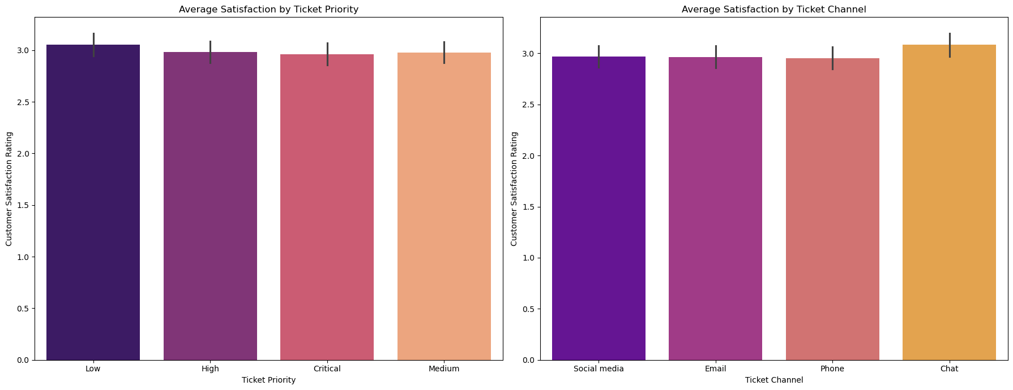
Python : Exploratory Data Analysis
fig, axes = plt.subplots(1, 2, figsize=(18, 7))
# Satisfaction by Ticket Priority
sns.barplot(
x='Ticket Priority',
y='Customer Satisfaction Rating',
hue='Ticket Priority',
data=data,
ax=axes[0],
palette='magma',
legend=False
)
axes[0].set_title('Average Satisfaction by Ticket Priority')
# Satisfaction by Ticket Channel
sns.barplot(
x='Ticket Channel',
y='Customer Satisfaction Rating',
hue='Ticket Channel',
data=data,
ax=axes[1],
palette='plasma',
legend=False
)
axes[1].set_title('Average Satisfaction by Ticket Channel')
plt.tight_layout()
plt.show()

Slide 39
Python : Model Building
# Prepare features and target
X = X = data[[
"Customer Age", "Customer Gender", "Product Purchased",
"Ticket Type", "Ticket Priority", "Ticket Channel",
"Average Resolution Time", "Days Since Purchase"
]]
y = data["Customer Satisfaction Rating"]
y = (y >= 4).astype(int) # Satisfied: 4-5, Unsatisfied: 1-3
# Train/test split
X_train, X_test, y_train, y_test = train_test_split(X, y, test_size=0.2, random_state=42, stratify=y)
# Balance with SMOTE
smote = SMOTE(random_state=42)
X_train, y_train = smote.fit_resample(X_train, y_train)
# Modeling
categorical_cols = ["Customer Gender", "Product Purchased", "Ticket Type", "Ticket Priority", "Ticket Channel"]
numeric_cols = ["Customer Age", "Average Resolution Time", "Days Since Purchase"]
preprocessor = ColumnTransformer(
transformers=[
("cat", OneHotEncoder(handle_unknown="ignore"), categorical_cols),
("num", StandardScaler(), numeric_cols)
]
)

Slide 40
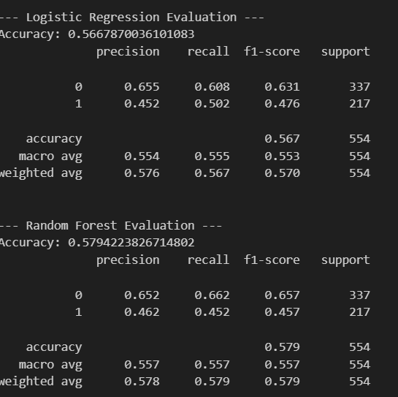
Python: Model Evalution
Logistic Regression pipeline
pipe_log = Pipeline([
("pre", preprocessor),
("clf", LogisticRegression(solver="liblinear", max_iter=200, random_state=42, class_weight="balanced"))
])
pipe_log.fit(X_train, y_train)
y_pred_log = pipe_log.predict(X_test)
# Random Forest pipeline
pipe_rf = Pipeline([
("pre", preprocessor),
("clf", RandomForestClassifier(n_estimators=100, random_state=42, class_weight="balanced"))
])
pipe_rf.fit(X_train, y_train)
y_pred_rf = pipe_rf.predict(X_test)
# Evaluation
print("\n--- Logistic Regression Evaluation ---")
print("Accuracy:", accuracy_score(y_test, y_pred_log))
print(classification_report(y_test, y_pred_log, digits=3))
print("\n--- Random Forest Evaluation ---")
print("Accuracy:", accuracy_score(y_test, y_pred_rf))
print(classification_report(y_test, y_pred_rf, digits=3))

Slide 41
Python: New Prediction
# Predict New
# Load pipeline
with open("customer_satisfaction_pipeline.pkl", "rb") as f:
model = pickle.load(f)
new_data = pd.DataFrame([{
"Customer Age": 32,
"Customer Gender": "Female",
"Product Purchased": "LG Smart TV",
"Ticket Type": "Technical Issue",
"Ticket Priority": "Critical",
"Ticket Channel": "Chat",
"Average Resolution Time" : 2,
"Days Since Purchase": 24
}])
prediction = model.predict(new_data)
print("\nPredicted Satisfaction (1=Happy, 0=Unhappy):", prediction[0])

Slide 42
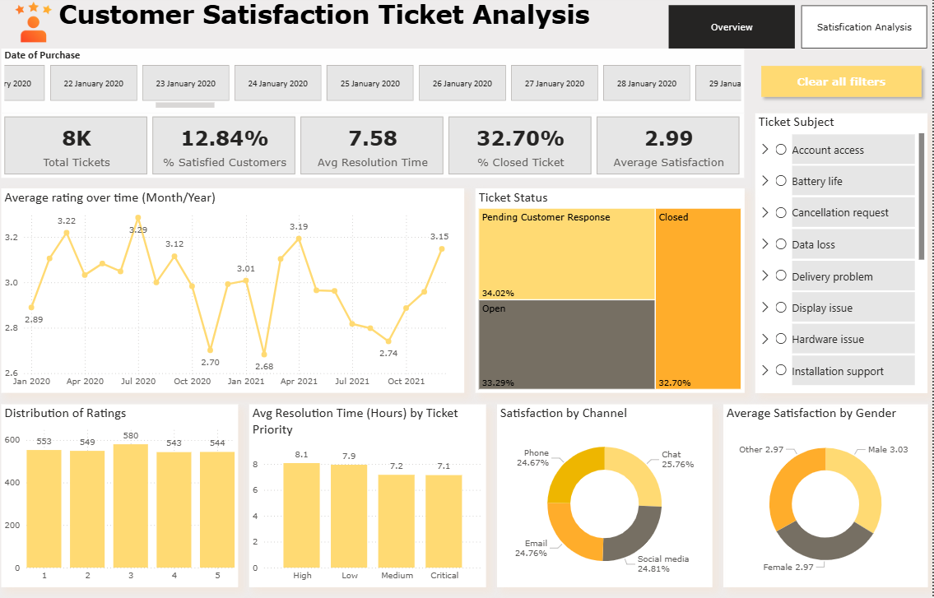
Power BI

Slide 43
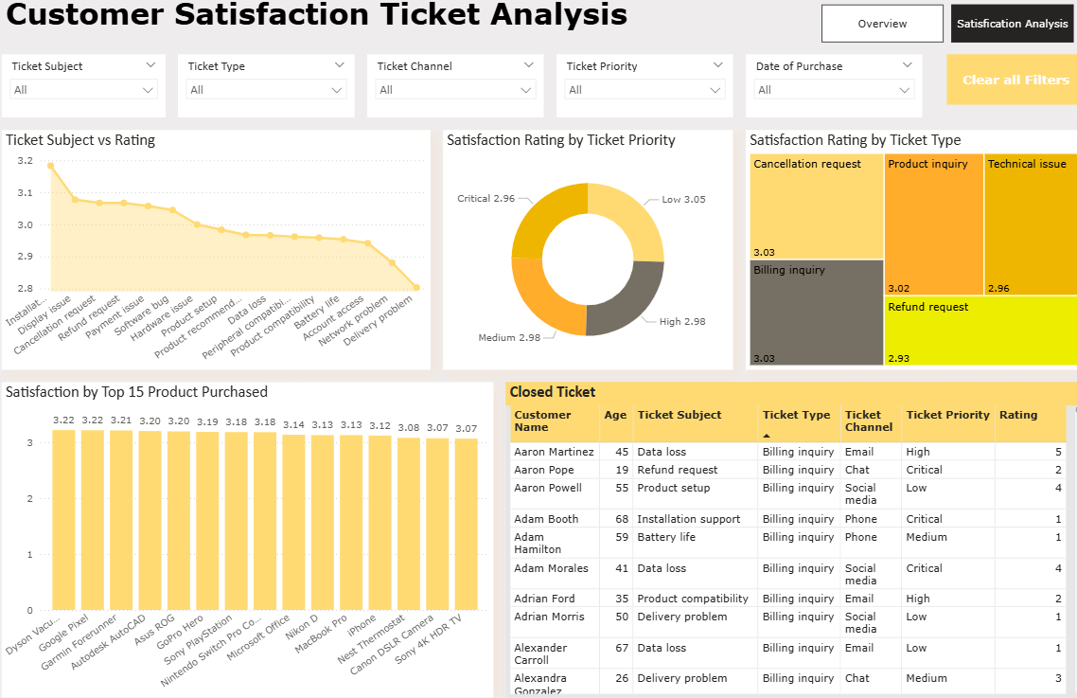
Power BI

Slide 44
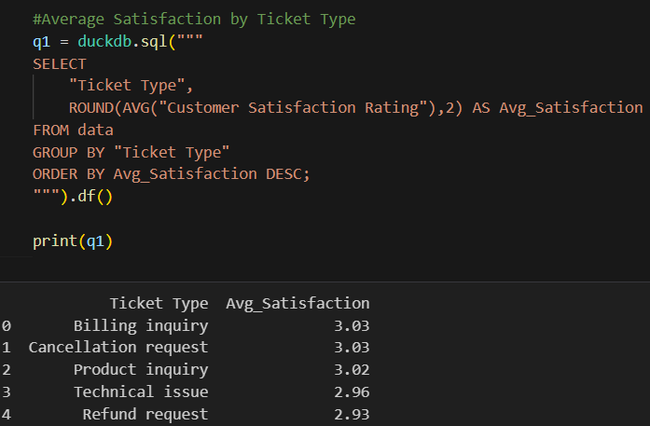
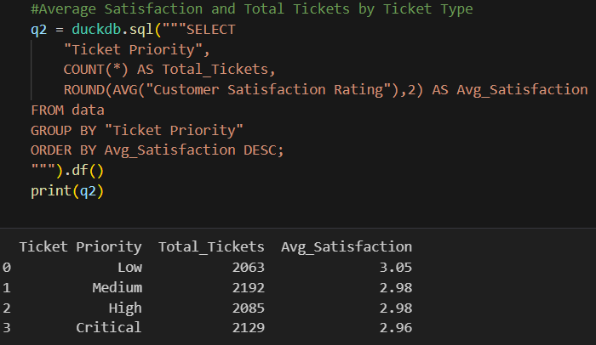
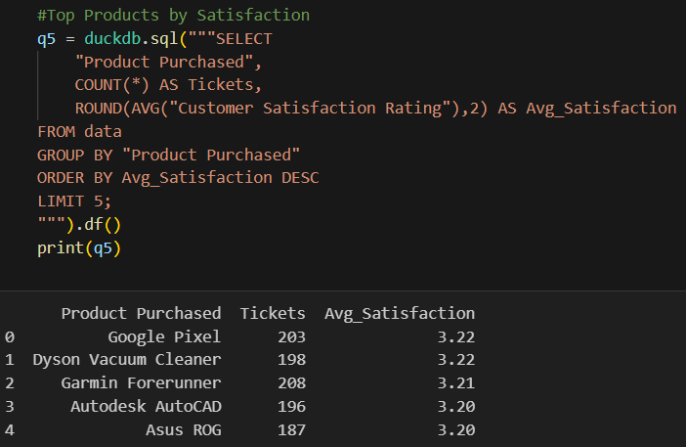
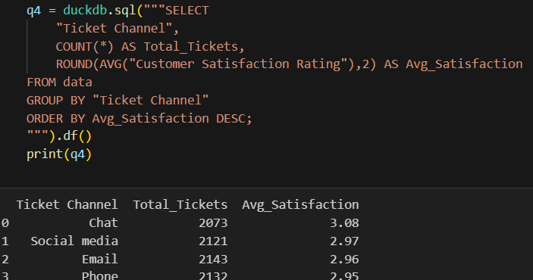
SQL

Slide 45
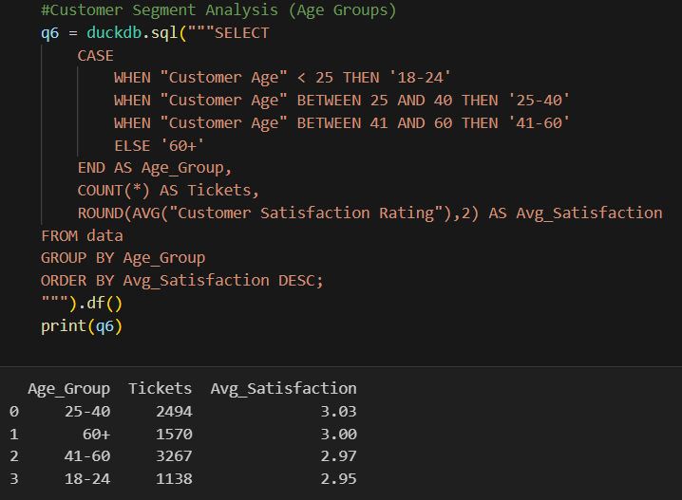
SQL

Slide 46
Customer Satisfaction Analysis – Problem, Solution & Result
Problem:
Build a predictive model to estimate customer satisfaction levels using ticket data and service-related factors.
Solution:
• Built classification pipelines (Logistic Regression & Random Forest) to predict whether a ticket results in a satisfied (rating ≥ 4) or unsatisfied outcome.
• Applied SMOTE to reduce class imbalance, engineered features from ticket metadata (resolution time, channel, priority), and visualized trends in Power BI
Result:
• Logistic Regression — Accuracy: 0.567 (Precision/Recall/F1 shown on slide)
• Random Forest — Accuracy: 0.579 (Precision/Recall/F1 shown on slide)
• Key drivers identified: Ticket priority, ticket channel, and resolution time.
• Business impact: Dashboards enable prioritizing high-impact tickets and monitoring SLA/response time improvements.

Slide 47
Project Highlights
Dataset size:
• ~ 8469 rows • ~ 17 columns
Tools Used:
Python (SMOTE, Scikit-Learn), Power BI, SQL
Key Insights:
• Priority, channel, and resolution time are strongest satisfaction drivers
• Critical tickets show lowest satisfaction levels
• Chat & Phone channels resolve issues fastest
• Long resolution time leads to dissatisfaction
Model Used:
• Logistic Regression (Accuracy ~0.56)
• Random Forest Classifier (Accuracy ~0.58)
Final Outcome:
Predicted satisfaction (Happy vs Unhappy) and built dashboards to help support teams prioritize high-impact tickets and improve SLAs.

Slide 48

Project 4: Daily Transaction Analysis
📘 Overview:
Daily transactions dataset records an individual’s purchases, payment modes, spending categories, and income sources.
🧩 Features Include:
Date, Mode, Category, Subcategory, Note, Amount, Income/Expense, Currency.
🎯 Problem Statement:
Analyze spending patterns, identify expense trends, and generate visual reports to improve financial planning and decision-making.
🛠 Tools Used:
Excel | Python | Power BI

Slide 49
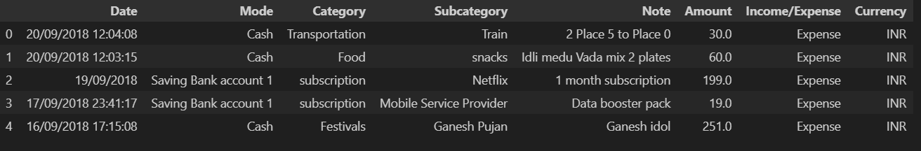
Python: Data Preparation
# Import essential libraries
import pandas as pd
import numpy as np
import matplotlib.pyplot as plt
import seaborn as sns
# Load the dataset (replace 'transactions.csv' with your actual file path)
df = pd.read_csv("E:/Unified_Mentor_Internship_Project/Daily Transactions/Daily Household Transactions.csv")
df.shape
df.head(5)

Slide 50
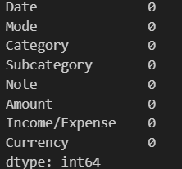
Python: Data Preparation
#Data Cleaning
def parse_mixed_datetime(val):
try:
return pd.to_datetime(val, format='%d/%m/%Y %H:%M:%S')
except:
try:
return pd.to_datetime(val, format='%d/%m/%Y')
except:
return pd.NaT
df['Date'] = df['Date'].astype(str).str.strip().apply(parse_mixed_datetime)
df['Subcategory'] = df['Subcategory'].fillna('Unknown')
df['Note'] = df['Note'].fillna('No Description')
df.isnull().sum()

Slide 51
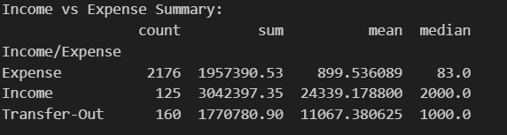
Python: Feature Engineering & Exploratory Data Analysis
#Feature Engineering
df['Year'] = df['Date'].dt.year
df['Month'] = df['Date'].dt.month
df['Day'] = df['Date'].dt.day
df['DayOfWeek'] = df['Date'].dt.day_name()
df['MonthName'] = df['Date'].dt.month_name()
total_income = df[df['Income/Expense'] == 'Income']['Amount'].sum()
total_expenses = df[df['Income/Expense'] == 'Expense']['Amount'].sum()
net_worth_change = total_income - total_expenses
print(net_worth_change )
#EDA
# Income vs Expense summary
print("\nIncome vs Expense Summary:")
income_expense_summary = df.groupby('Income/Expense')['Amount'].agg(['count', 'sum', 'mean', 'median'])
print(income_expense_summary)

Slide 52
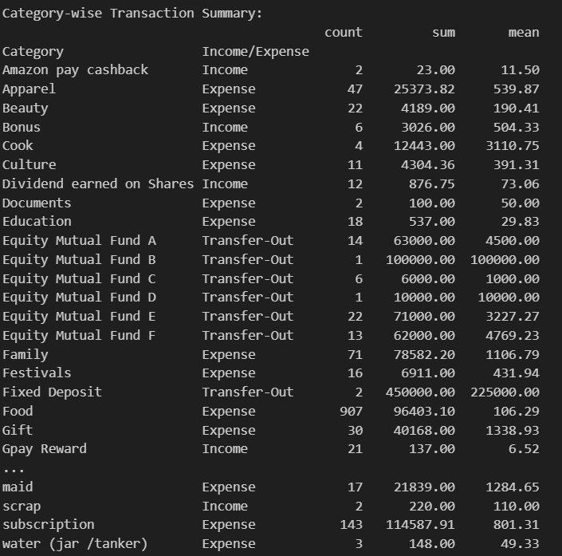
Python: Exploratory Data Analysis
# Category-wise analysis
print("\nCategory-wise Transaction Summary:")
category_summary = df.groupby(['Category', 'Income/Expense'])['Amount'].agg(['count', 'sum', 'mean']).round(2)
print(category_summary)

Slide 53
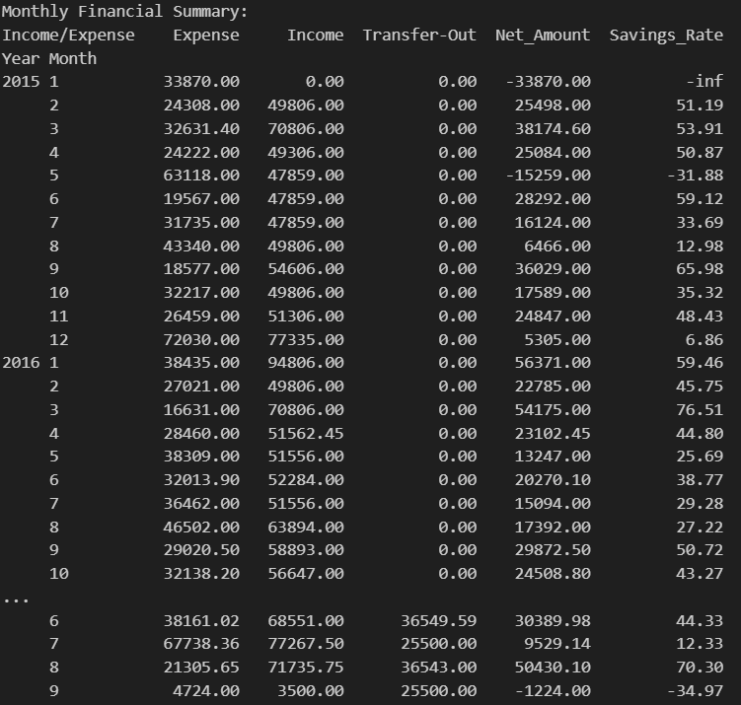
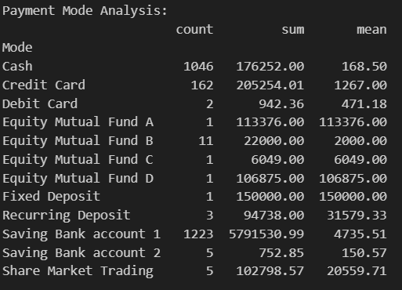
Python: Exploratory Data Analysis
# Payment mode analysis
print("\nPayment Mode Analysis:")
mode_summary = df.groupby('Mode')['Amount'].agg(['count', 'sum', 'mean']).round(2)
print(mode_summary)
# Monthly financial summary
print("Monthly Financial Summary:")
monthly_summary = df.groupby(['Year', 'Month', 'Income/Expense'])['Amount'].sum().unstack(fill_value=0)
monthly_summary['Net_Amount'] = monthly_summary.get('Income', 0) - monthly_summary.get('Expense', 0)
monthly_summary['Savings_Rate'] = (monthly_summary['Net_Amount'] / monthly_summary.get('Income', 1) * 100).round(2)
print(monthly_summary)

Slide 54
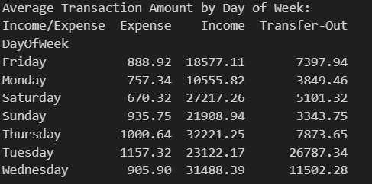
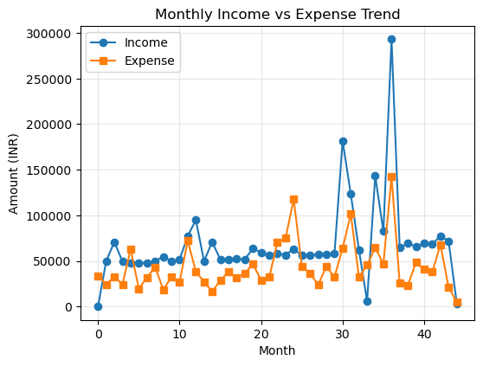
Python: Exploratory Data Analysis
# Average transaction amount by day of week
print("\nAverage Transaction Amount by Day of Week:")
daily_avg = df.groupby(['DayOfWeek', 'Income/Expense'])['Amount'].mean().unstack(fill_value=0).round(2)
print(daily_avg)
# 2. Monthly Trend
# Group income and expense by Year and Month
income = df[df['Income/Expense'] == 'Income'].groupby(['Year', 'Month'])['Amount'].sum()
expense = df[df['Income/Expense'] == 'Expense'].groupby(['Year', 'Month'])['Amount'].sum()
# Combine into a single DataFrame and fill missing values with 0
monthly_trend = pd.DataFrame({'Income': income, 'Expense': expense}).fillna(0)
# Create a numeric x-axis
months = range(len(monthly_trend))
# Plot
fig = plt.figure(figsize=(20, 15))
plt.subplot(3, 3, 2)
plt.plot(months, monthly_trend['Income'].values, label='Income', marker='o')
plt.plot(months, monthly_trend['Expense'].values, label='Expense', marker='s')
plt.title('Monthly Income vs Expense Trend')
plt.xlabel('Month')
plt.ylabel('Amount (INR)')
plt.legend()
plt.grid(True, alpha=0.3)

Slide 55
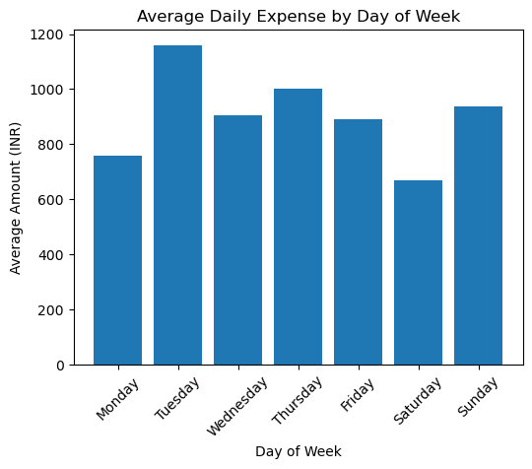
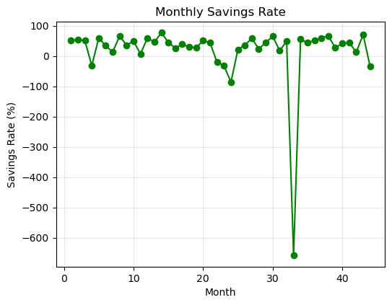
Python: Exploratory Data Analysis
# Monthly Savings Rate
fig = plt.figure(figsize=(20, 15))
plt.subplot(3, 3, 8)
if 'Savings_Rate' in monthly_summary.columns:
plt.plot(range(len(monthly_summary)), monthly_summary['Savings_Rate’],
marker='o', color='green')
plt.title('Monthly Savings Rate')
plt.xlabel('Month')
plt.ylabel('Savings Rate (%)')
plt.grid(True, alpha=0.3)
# Daily Average Spending
fig = plt.figure(figsize=(20, 15))
plt.subplot(3, 3, 5)
if 'Expense' in daily_avg.columns:
daily_expense = daily_avg['Expense']
days_order = ['Monday', 'Tuesday', 'Wednesday', 'Thursday', 'Friday', 'Saturday', 'Sunday']
daily_expense_ordered = daily_expense.reindex(days_order, fill_value=0)
plt.bar(daily_expense_ordered.index, daily_expense_ordered.values)
plt.title('Average Daily Expense by Day of Week')
plt.xlabel('Day of Week')
plt.ylabel('Average Amount (INR)')
plt.xticks(rotation=45)

Slide 56
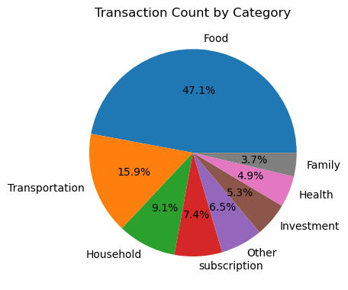

Python: Exploratory Data Analysis
# Income vs Expense Pie Chart
fig = plt.figure(figsize=(20, 15))
plt.subplot(3, 3, 1)
income_expense_total = df.groupby('Income/Expense')['Amount'].sum()
plt.pie(income_expense_total.values, labels=income_expense_total.index, autopct='%1.1f%%', startangle=90)
plt.title('Income vs Expense Distribution’)
# Transaction Count by Category
fig = plt.figure(figsize=(20, 15))
plt.subplot(3, 3, 9)
category_counts = df['Category'].value_counts().head(8)
plt.pie(category_counts.values, labels=category_counts.index, autopct='%1.1f%%')
plt.title('Transaction Count by Category')

Slide 57

Python: Key Insights
total_income = df[df['Income/Expense'] == 'Income']['Amount'].sum()
total_expense = df[df['Income/Expense'] == 'Expense']['Amount'].sum()
net_savings = total_income - total_expense
savings_rate = (net_savings / total_income) * 100 if total_income > 0 else 0
print(f"📊 FINANCIAL OVERVIEW:")
print(f" • Total Income: ₹{total_income:,.2f}")
print(f" • Total Expense: ₹{total_expense:,.2f}")
print(f" • Net Savings: ₹{net_savings:,.2f}")
print(f" • Savings Rate: {savings_rate:.2f}%")
# Top expense category
top_expense_cat = expense_categories.index[0] if not expense_categories.empty else "N/A"
top_expense_amount = expense_categories.iloc[0] if not expense_categories.empty else 0
print(f" • Highest expense category: {top_expense_cat} (₹{top_expense_amount:,.2f})")

Slide 58
Python: Key Insights
# Average transaction amounts
avg_income = df[df['Income/Expense'] == 'Income']['Amount'].mean()
avg_expense = df[df['Income/Expense'] == 'Expense']['Amount'].mean()
print(f" • Average income per transaction: ₹{avg_income:.2f}")
print(f" • Average expense per transaction: ₹{avg_expense:.2f}")
# Most used payment mode
top_payment_mode = df['Mode'].value_counts().index[0]
print(f" • Most used payment mode: {top_payment_mode}")
if savings_rate < 20:
print(" • Consider increasing your savings rate. Aim for at least 20% of income.")
else:
print(" • Great job! Your savings rate is healthy.")

Slide 59

Power BI

Slide 60

Power BI

Slide 61

Power BI

Slide 62

Power BI

Slide 63
Daily Household Transaction Analysis – Problem, Solution & Result
Problem:
Limited visibility into daily financial activities made it difficult to monitor expenses, track income patterns, and identify savings opportunities.
Solution:
• Cleaned and structured transaction data using Python and SQL for analysis.
• Performed Exploratory Data Analysis (EDA) to detect spending trends and anomalies.
• Built an interactive Power BI dashboard to visualize daily, weekly, and monthly expense insights.
• Calculated key metrics such as total income, total expenses, average transaction value, and savings percentage.
Result:
• Identified top expense categories and peak spending days.
• Improved understanding of income vs expense balance and cash flow patterns.
• Provided actionable insights for better budgeting and savings optimization.
• Enabled data-driven decision-making for personal finance management.

Slide 64
Project Highlights
Dataset size:
• ~ 2461 rows • ~ 8 columns
Tools Used:
Python, Power BI, Excel
Key Insights:
• Identified top expense categories and peak spending days
• Calculated savings rate, net income, monthly trends
• Highlighted imbalance in income vs expense distribution
• Most used payment modes: UPI / Cash
Model Used:
(No ML model — EDA-based analysis)
Final Outcome:
Created a full financial analysis dashboard showing spending patterns, savings behavior, and areas for improving personal budgeting.

Slide 65
🔚 Conclusion
This internship allowed me to work on 4 real-world, end-to-end analytics projects involving:
• Data Cleaning
• Exploratory Data Analysis
• SQL Queries
• Machine Learning Models
• Power BI Dashboard Development
• Business Insights & Reporting
Each project strengthened my skills in Python, SQL, Power BI, Excel, and storytelling, and helped me solve real analytical problems through data-driven insights.
Thank You
Thank you for reviewing my work!
I appreciate this learning opportunity with Unified Mentor and look forward to applying these skills to future analytics challenges.

