Slide 1


Team Details
Team name: Kisan Mitra
Team leader name: Kavita Chegaraddi
Problem Statement: Sustainability & Social Impact — Smallholder Crop Advisory Agent for tomato farmers in the Kolar belt, Karnataka

Slide 2

Note: Please download this template to make your edits and submit the final version.
To download, go to File > Download > Microsoft PowerPoint (.PPTX). Kindly refrain from sending edit requests.

Slide 3
Brief about the idea
• A smallholder tomato farmer in the Kolar belt, Karnataka spots a diseased leaf with no agronomist to call and unreliable connectivity to search with.
• Existing diagnosis apps (Plantix, PlantVillage) identify the disease but stop there — they don't say where to buy the treatment nearby, what it costs, or whether a nearby outbreak means the farmer should check sooner.
• Kisan Mitra turns a photo and a spoken description into a cited diagnosis, a spoken Kannada advisory, the nearest in-stock dealer with today's price, a proactive outbreak alert, a crop-loss insurance evidence packet, a group-buy discount alert, and an anonymized district dashboard for extension officers.
• Target users: smallholder tomato farmers in the Kolar tomato belt, Karnataka — typically 0.5–4 acre plots, variable literacy, intermittent connectivity, no dedicated access to an agronomist. Primary language: Kannada.

Slide 4
Opportunities
• How different is it: Plantix diagnoses, AgroStar connects to dealers, PlantVillage pairs AI with weather — none combine diagnosis, voice, and market linkage in one flow, and none reason across farmers or across time on the same plot.
• How it solves the problem: the outbreak alert reaches a farmer before their own crop shows damage; the insurance claim assistant turns a diagnosis into a fileable claim; the group-buy alert turns an early warning into a coordinated bulk discount; the district dashboard turns farmer-level data into a resourcing signal for an extension officer or NGO.
• USP: moves the system from advice to economic action and policy support — no existing tool in this space does all four.

Slide 5
List of features offered by the solution
• Cited disease diagnosis from a photo + spoken description — not a black-box guess
• Spoken advisory in Kannada, weather-aware (holds off spraying before forecast rain)
• Nearest in-stock dealer lookup with today's price
• Proactive outbreak early-warning — alerts nearby farmers before their own crop shows symptoms
• Plot-level memory — flags recurring disease as a root-cause issue (e.g. drainage), not just a repeat treatment
• Sell-side market linkage — best nearby mandi price when a healthy crop is near harvest
• Crop-loss insurance claim assistant — auto-generates a fileable evidence packet
• Group-buy / collective bargaining alert — coordinates nearby farmers for a bulk discount
• District dashboard — anonymized, village-level view for an extension officer or NGO
• Gemini-driven orchestration — the model itself decides which of these tools to call, via real function-calling, not a hardcoded decision tree

Slide 6
Process flow diagram or Use-case diagram
• Farmer speaks/types symptom + optionally uploads a photo, entirely in the browser
• → Gemini multimodal diagnosis call, grounded by RAG retrieval (TF-IDF, hand-rolled in JS) over bilingual English + Kannada disease guides shipped with the site
• → Weather tool call (Open-Meteo) checked before recommending a spray
• → A second Gemini call, using real function-calling, decides WHICH of 4 tools to invoke (dealer lookup, sell-price lookup, insurance-claim check, group-buy check) based on the diagnosis, outbreak signal, and near-harvest flag — not a hardcoded if/else
• → Chosen tools run against the known dealer/pricing data; results assembled
• → Advisory translated to Kannada, spoken via the browser's own Web Speech API if a kn-IN voice is available
• → Response rendered: diagnosis, dealer card, outbreak banner, insurance packet, group-buy card
• → Separately: district dashboard loads a pre-aggregated, anonymized village-level snapshot built at deploy time, never raw farmer data

Slide 7
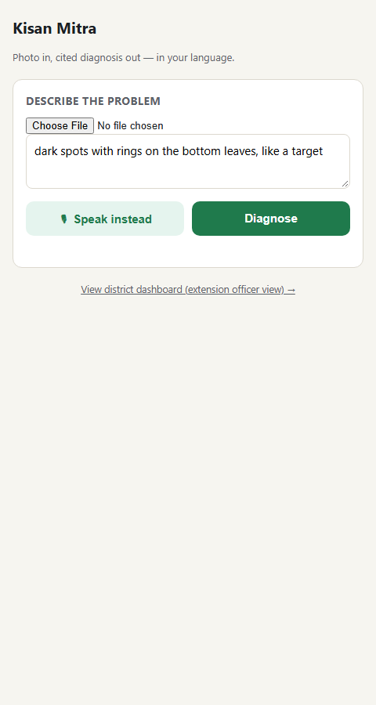
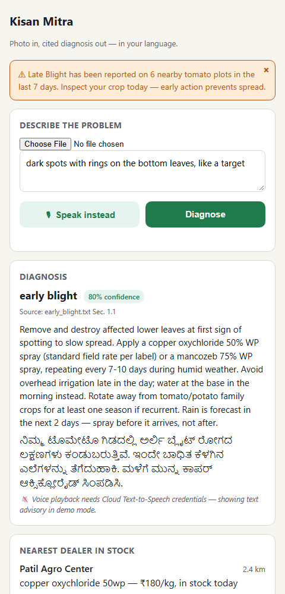
Wireframes / Mock diagrams of the proposed solution

Slide 8
Architecture diagram of the proposed solution
• 100% client-side static site — no backend server, no billing account, no credit card anywhere in the deployed stack — Firebase Hosting (free Spark plan) serves the app
• Diagnosis: a real Gemini multimodal API call direct from the browser, grounded by a hand-rolled TF-IDF + cosine-similarity RAG index over 18 disease documents (9 English + 9 Kannada), so a Kannada symptom description retrieves relevant passages natively
• Orchestration: a second Gemini call uses real function-calling (tools/functionDeclarations) to decide which of 4 downstream tools to invoke — the model drives the decision, not a hardcoded branch — falling back to equivalent deterministic rules only if the live call fails after retries
• Weather: a direct, keyless call to the free Open-Meteo API (confirmed CORS-enabled)
• Dealer directory, mandi prices, and diagnosis history ship as static JSON/CSV with the site; the district dashboard loads a pre-aggregated snapshot built at deploy time from the private farmer dataset, so raw farmer/plot linkage never ships publicly
• Voice advisory: the browser's own Web Speech API (SpeechSynthesis), feature-detecting a kn-IN voice at runtime

Slide 9
Technologies to be used in the solution
• Gemini API (gemini-3.8-flash) — called directly from the browser for two things: multimodal diagnosis, and a second call using real function-calling to decide which tools to invoke
• Firebase Hosting — free Spark plan, zero billing, serves the entire static site
• Vanilla JavaScript (ES modules) — no framework, no bundler, no agentic framework (no LangChain/CrewAI/Vertex Agent Builder) — direct fetch() calls to the Gemini API
• Hand-rolled TF-IDF + cosine similarity (JS) — RAG retrieval over the disease guides, no vector database or external search service
• Open-Meteo — free, keyless weather API
• Web Speech API (browser-native) — speech recognition for Kannada voice input, SpeechSynthesis for voice output
• Static JSON/CSV data files — dealer directory, mandi prices, diagnosis history
• Python (data generation, build-time dashboard aggregation), Playwright (verification)

Slide 10
Estimated implementation cost
• Current deployed cost: $0 — no billing account, no credit card, anywhere in the stack
• Firebase Hosting: free Spark plan, no usage cap reached at this scale
• Gemini API: free tier via Google AI Studio — 20 requests/day per project for gemini-3.8-flash; each diagnosis now uses 2 calls (diagnosis + orchestration), so roughly 10 full diagnoses/day before the app gracefully falls back to deterministic logic for the rest of the day
• Open-Meteo, Web Speech API: free, no quota observed in testing
• Scaling beyond the free tier: upgrading to a paid Gemini tier is the only cost that would be needed to raise the daily diagnosis cap — no other paid service is required even at higher usage, since there is no backend, database, or search service to scale

Slide 11
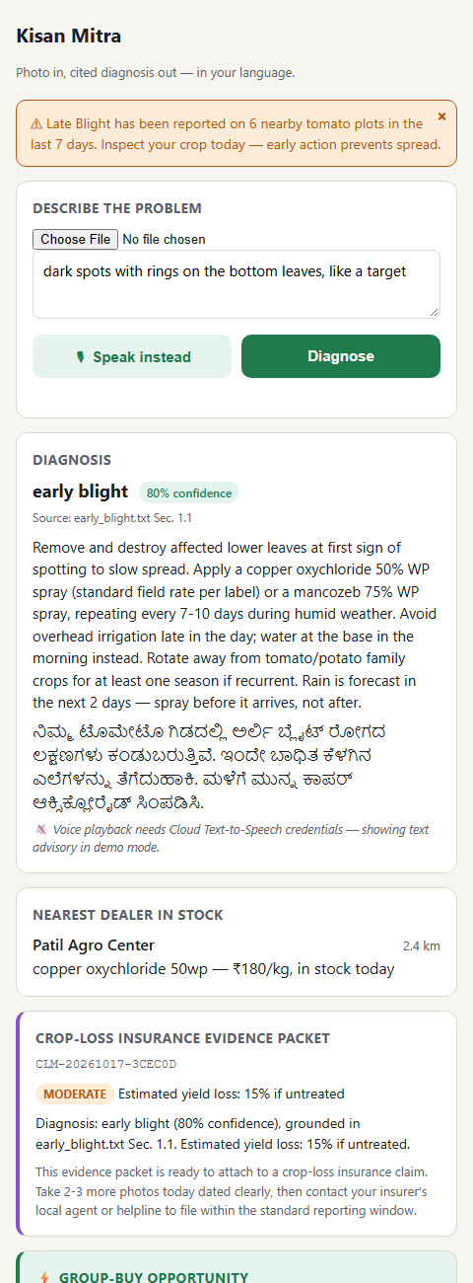
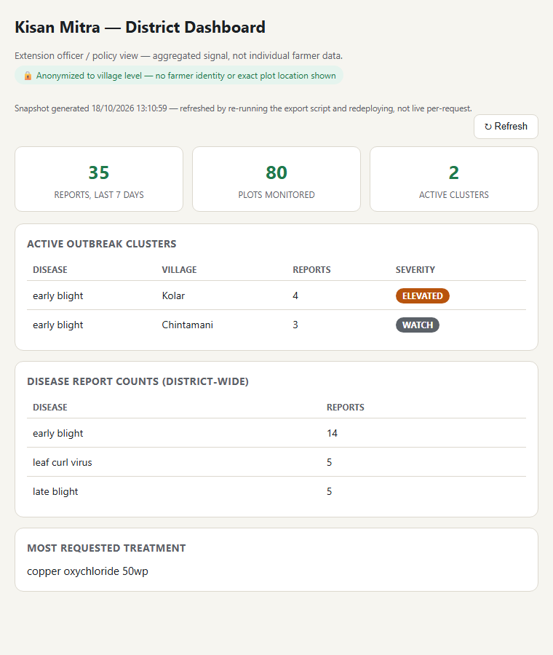
Snapshots of the prototype

Slide 12
Prototype Performance report / Benchmarking
• Measured live in the browser against the deployed static site (5 calls per operation):
• RAG retrieval (TF-IDF index build, cold) — ~92ms once per session; warm lookups <1ms
• Dealer / sell-price lookup — ~0.1–2.5ms (in-memory JSON lookups)
• Outbreak check (geo-radius over 300 diagnosis records) — ~3.6ms avg
• District dashboard snapshot load — ~17ms avg
• Weather (live Open-Meteo call) — ~660ms avg (external network call)
• Full diagnosis pipeline (2 Gemini calls: diagnosis + orchestration) — several seconds under normal quota; up to ~20s worst case if quota is exhausted and both calls exhaust retries before falling back
• Verified end-to-end with Playwright against the live deployed URL, with zero local servers running — confirms zero hidden dependency on anything other than the public Gemini and Open-Meteo APIs

Slide 13
Additional Details / Future Development
• Next step — upgrade to managed Google Cloud services once billing is available: Gemini moved behind a Cloud Run/Cloud Functions proxy (closes the current public-key exposure and removes the 20-req/day free-tier ceiling), Firestore replacing the static dealer/price/history JSON so the district dashboard becomes genuinely live instead of a deploy-time snapshot, Vertex AI Search replacing the hand-rolled TF-IDF retrieval, and Cloud Translation/Text-to-Speech replacing the template-based Kannada advisory. Every substitute today sits behind one isolated call site per module, so each swap is incremental, not a rewrite.
• Offline-first fallback (planned): a distilled on-device TensorFlow Lite classifier for the 8–10 most common regional diseases, so core diagnosis keeps working when connectivity drops entirely. Training script already written, pending a real multi-hour training run on the full PlantVillage dataset.
• Expansion path: adding a new crop or region means indexing a new disease guide into the retrieval layer, not rewriting the diagnosis logic — the architecture is crop-agnostic by design even though this build is scoped to tomato in Karnataka for the demo.
• Resource & environmental impact: targeted treatment instead of blanket spraying, weather-timed application to reduce chemical runoff, and earlier detection to reduce crop loss — moving this beyond social impact into genuine sustainability.

Slide 14
Provide links to your:
GitHub Public Repository: https://github.com/Kavitacs08/kisan-mitra
Demo Video Link (3 Minutes): [add link before submission]
Final Product Link: https://kisan-mitra-2026-56c5d.web.app

Slide 16


