Slide 1


Caffe_Talk
Mobile Application Development Project
National Institute of Business Management

Slide 2
Introduction
This mobile application is for online ordering system in a coffee shop. Through this mobile application customers can place their orders and get them to their door step. New users have to register first and registered customers can log and place orders. When a customer place a order by using our mobile application automatically we track the customer location and get the address. Customer has to enter quantities for each coffee types and finally customer get the invoice in her/his mobile phone. After customer place a order, there are several admins in our system and they check and get the invoice details with customer details and send it to the kitchen. Then the order deliver to the customer location with the copy of invoice.

Slide 3
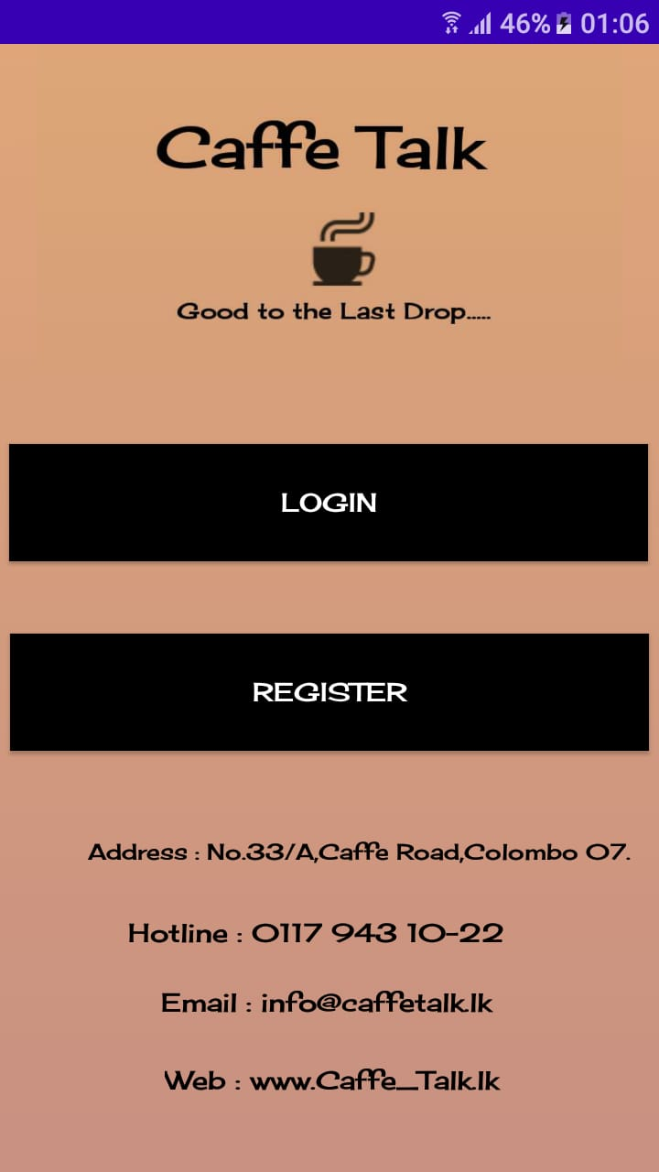
Caffe_Talk Home UI
Customer is an existing user in caffe_talk app. He/she can login.
If Customer is a new user for caffe_talk app. He/she first must register.

Slide 4
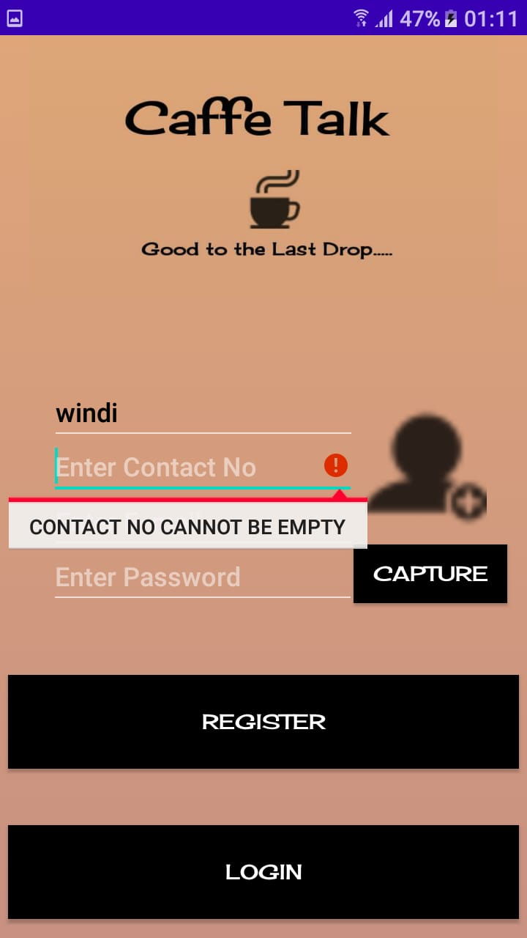
Customer Register UI
Customer must fill his/her details in this UI.
Customer can capture his/her photo for this form.
if Customer not fill some fields. Shows the error message.

Slide 5
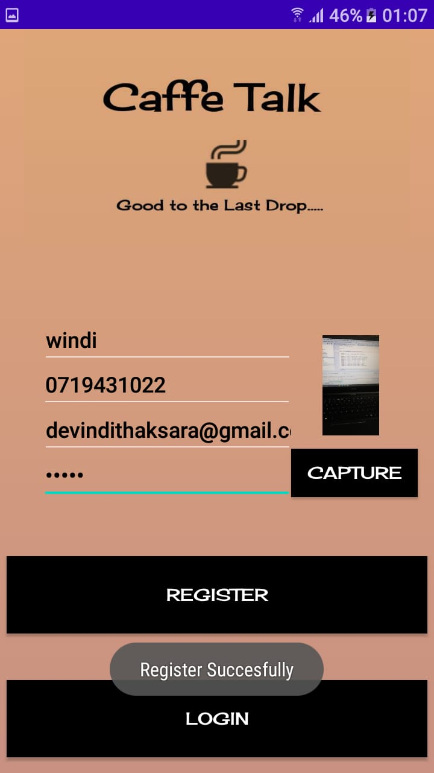
After Customer filled all fields. He/she press Register button.
When these data & current date time will save in customer table of sqlite databse.
Customer can see “Register Successfully” toast message with data savings.
Now customer can login in app.
His/her email address and password need to login.

Slide 6
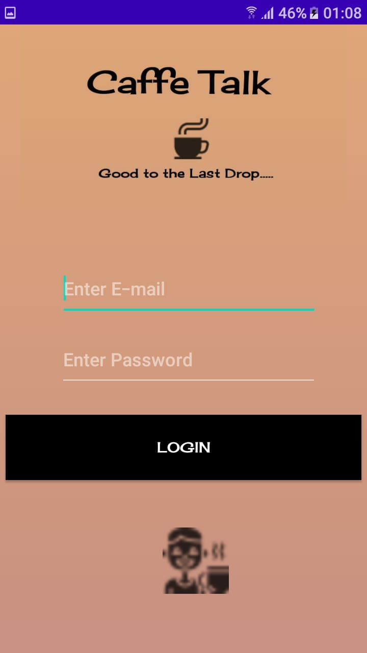
Customer Login UI
Customer must give his/her correct email address & password. When his/her login is successfully. Either shows “Email or Password is Incorrect” message.

Slide 7
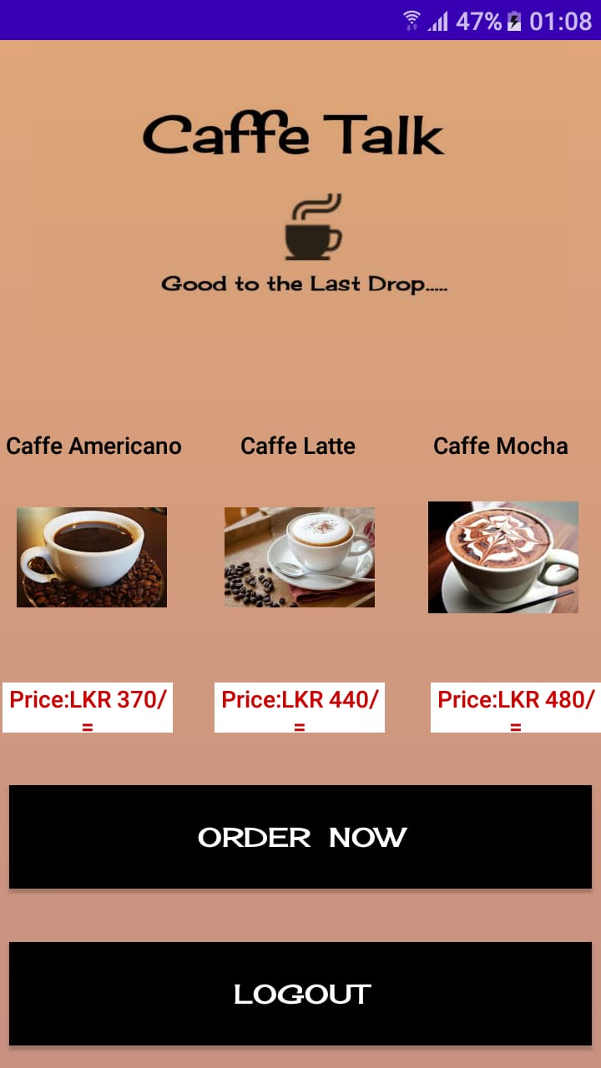
Caffe_Talk Menu UI
Customer can see coffee types & prices in this UI.
If He/she need coffee, must click the ‘Order Now’ button.

Slide 8
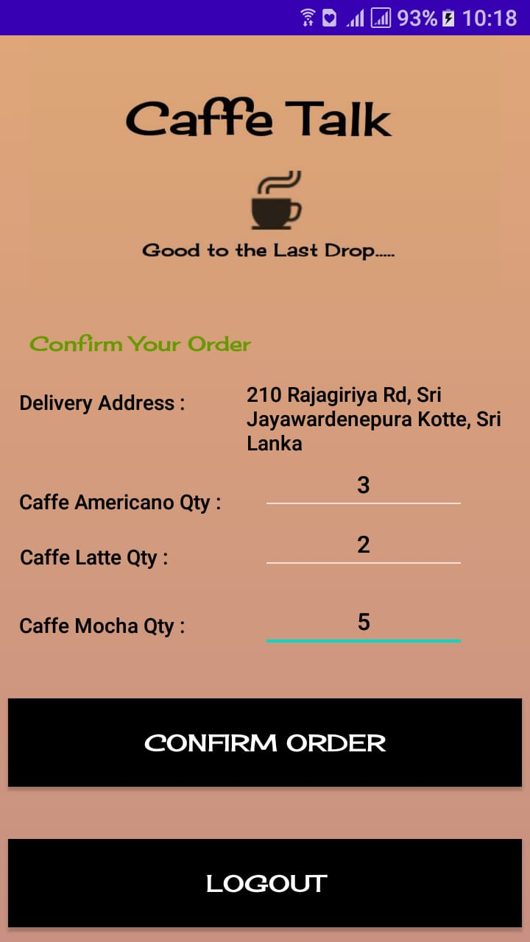
Order Page
Automatically getting current location address for delivery address. (longitude & latitude convert through geocoder)
He/she must type coffee quantity to need his/her order.
These details & current date time will save orders table in sqlite database & quantity values will pass next UI for generate invoice with click ‘Confirm Order’ button.
If you don’t need order. You can logout.

Slide 9
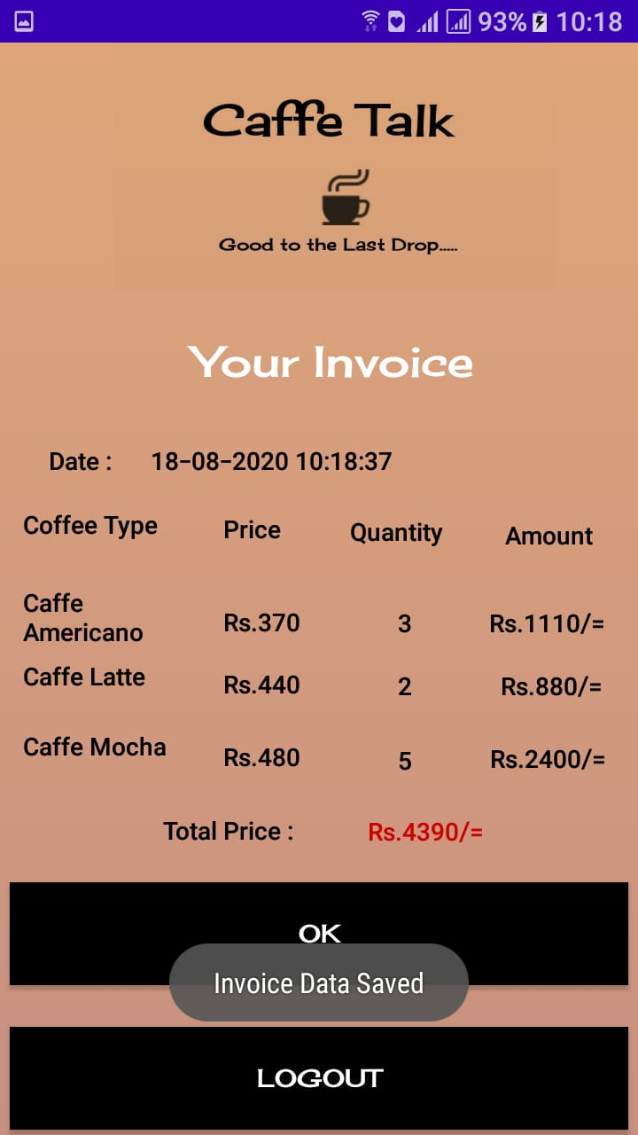
Invoice UI
Quantity values get in previous UI.
Calculates and shows each coffee prices & total price.
These details & current date time will save incomes table in sqlite database with click ‘OK’ button.
Now his/her coffee order process is finished.
He/she can logout.
His/her order will receive.

Slide 10
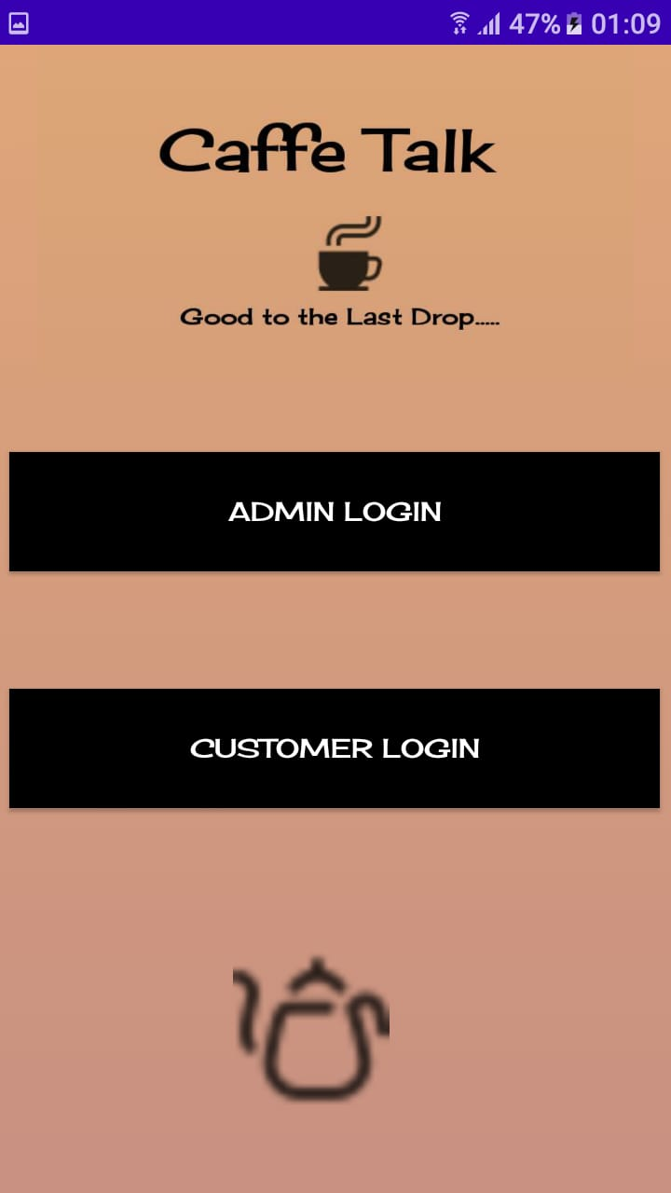
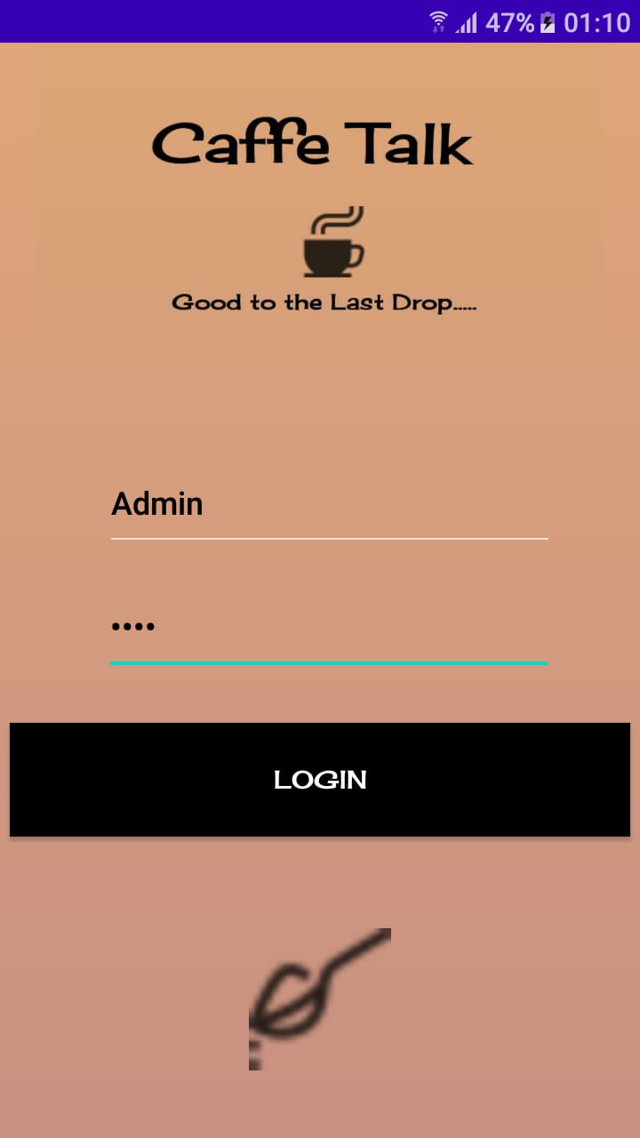
Caffe_Talk Admin Login
Admin must give username & password. When his/her login is successfully.
Either shows “Unrecognized Admin Login” message.

Slide 11
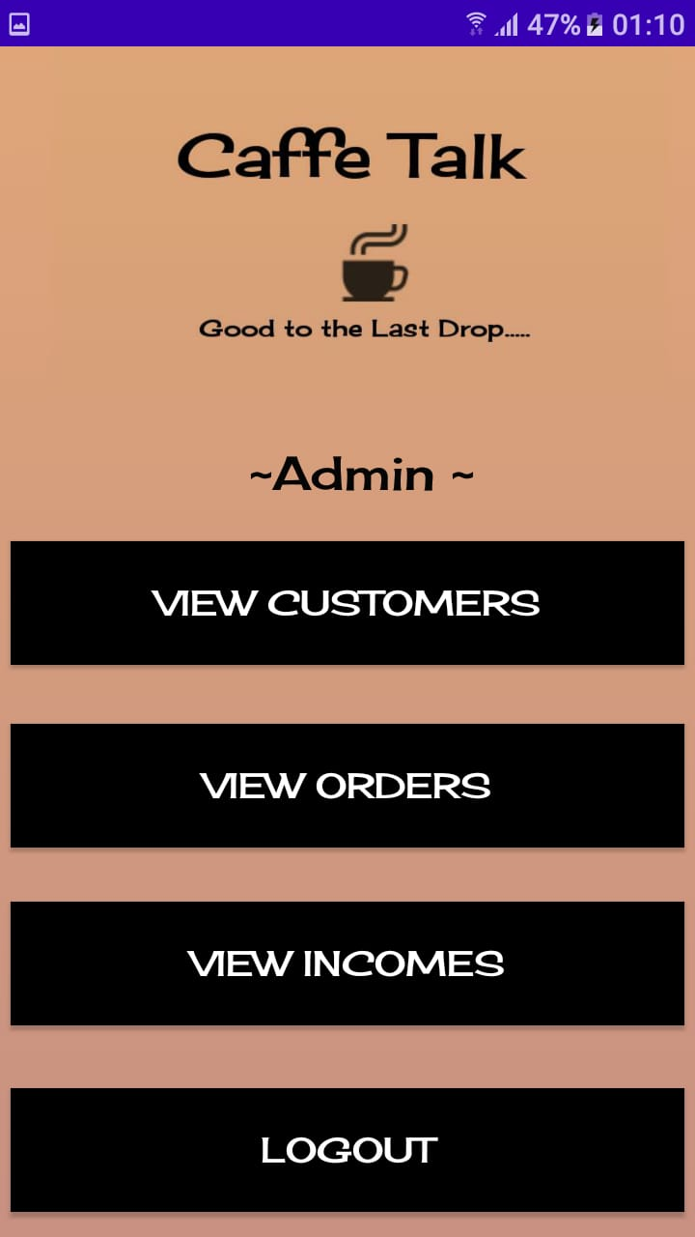
Admin UI
Admin can view customer, order, income details in caffe_talk.

Slide 12
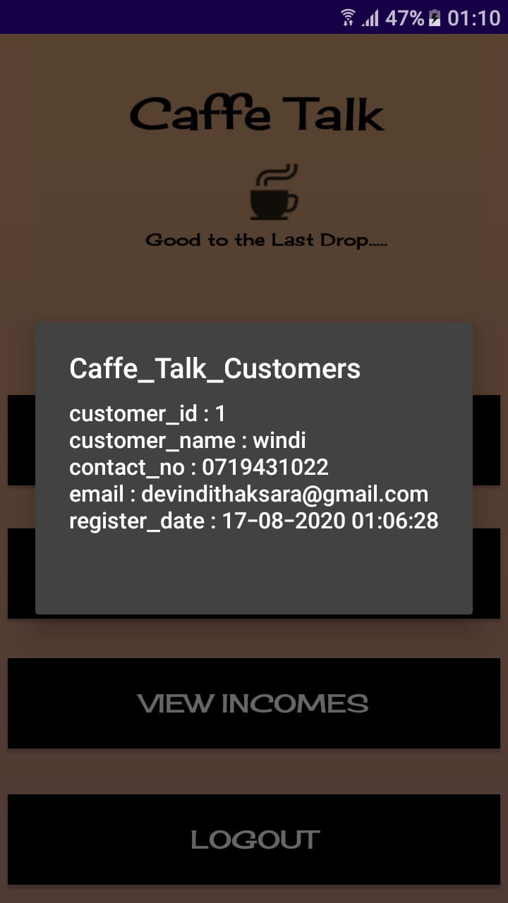
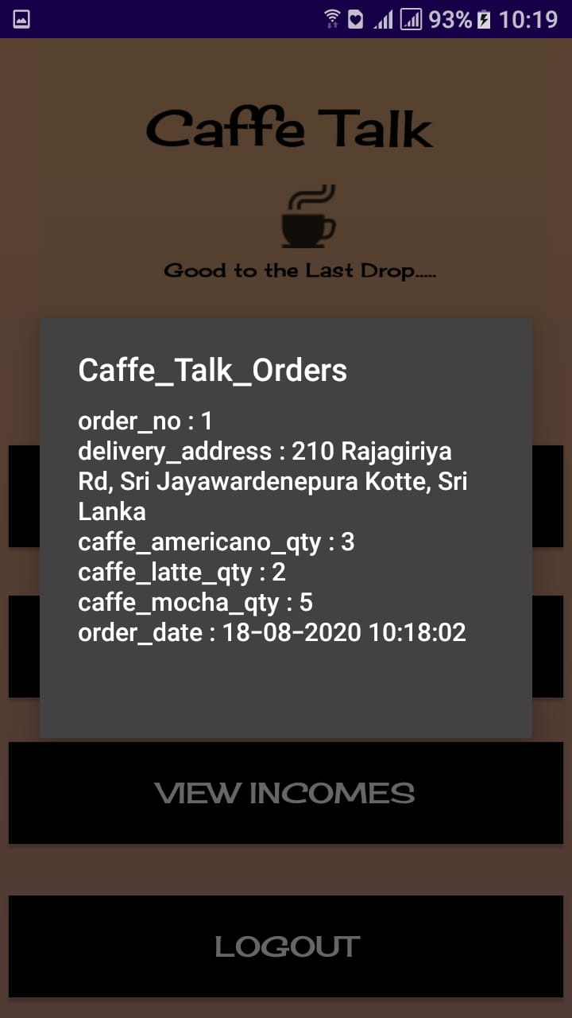
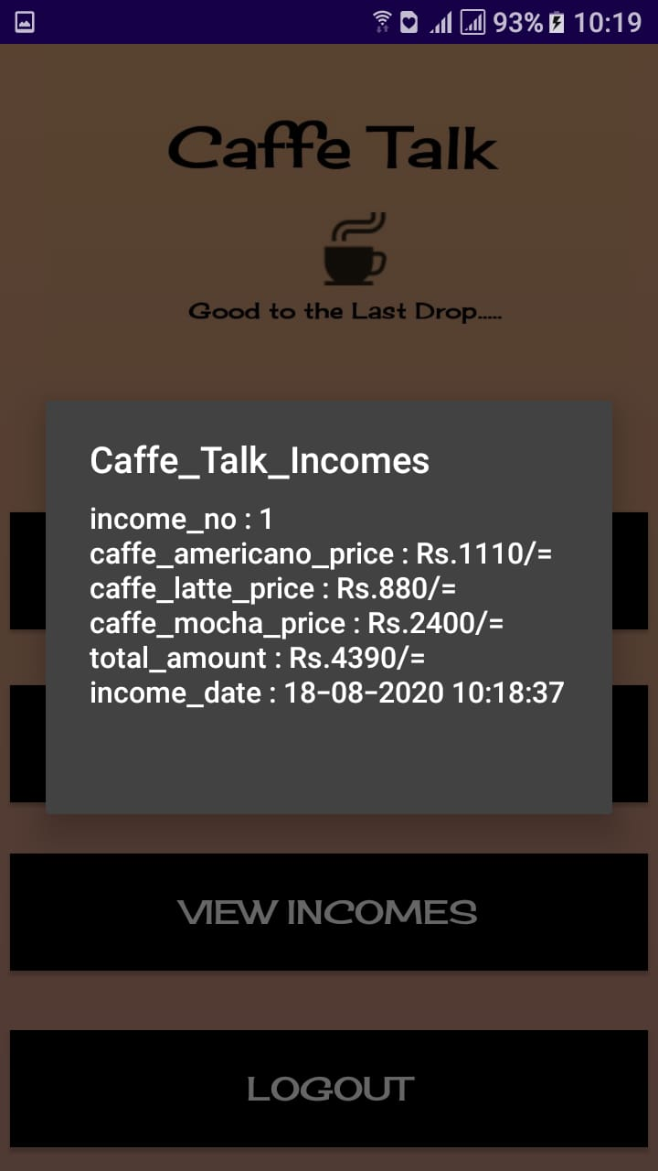
View Customers, Orders & Incomes

Slide 13
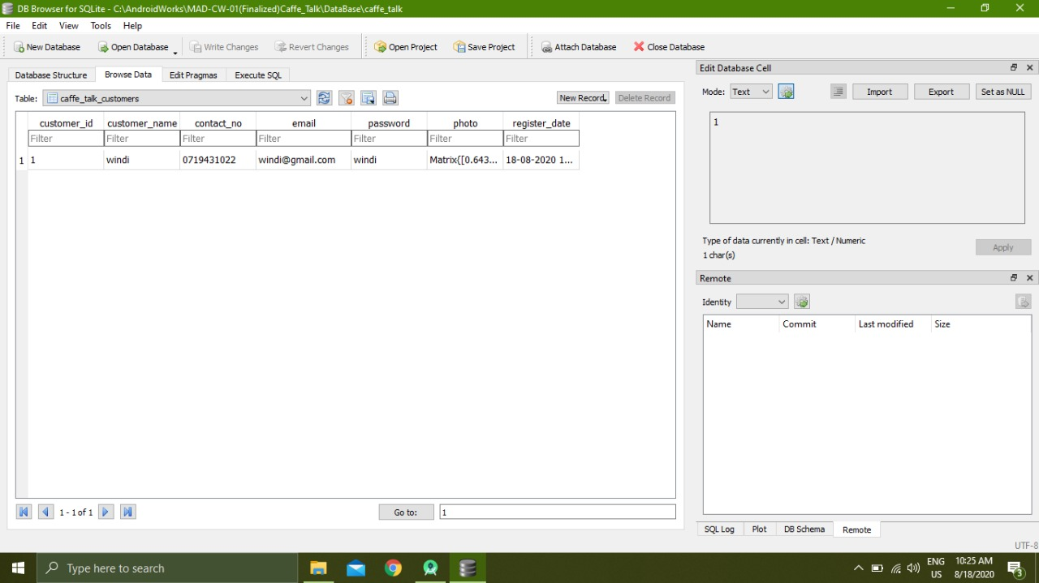
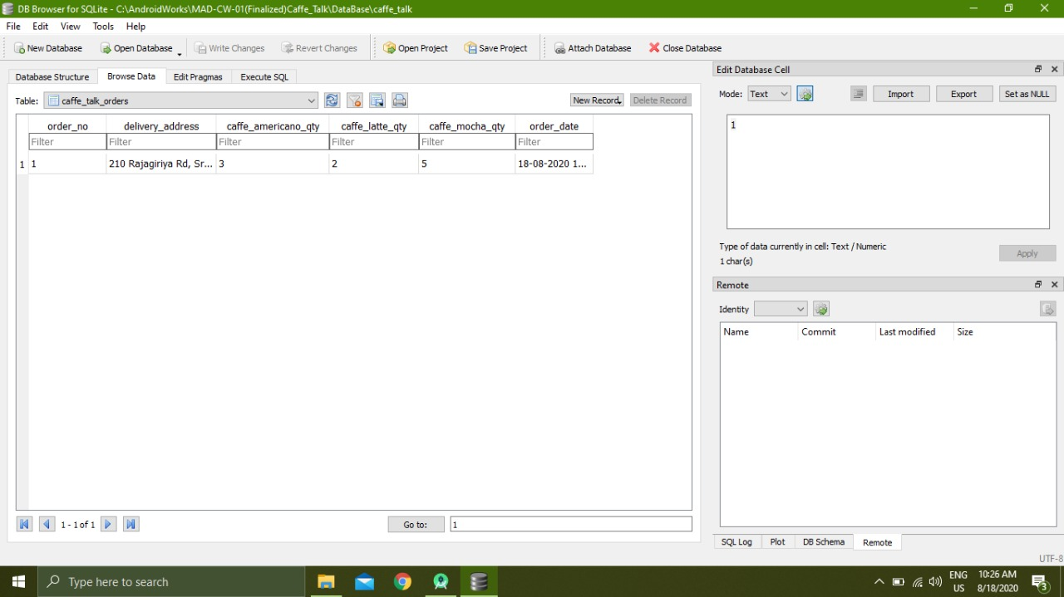
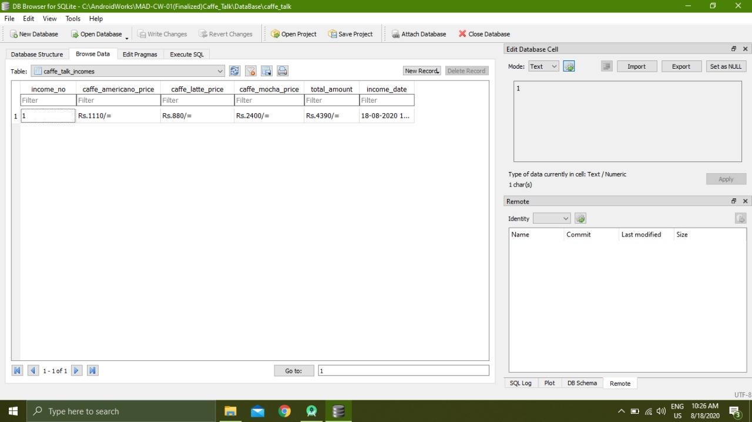
Let us see, How the data saved in the sqlite database
We used database helper class for data save & view.

Slide 14
Group Members
COHNDISM192F-001 - Thilakarathna A.H.I.C.
COHNDISM192F-003 - Attanayaka D.T.
COHNDISM192F-006 - Maduja M.H.D.K.
COHNDISM192F-011 - Weerakoon W.M.P.T.

Slide 15
Thank You.

