Slide 1
Authentication and Authorization

Slide 2
Authentication
Register:
GET
POST
Login:
GET
POST(passport)
Index:
Logout

Slide 3
Authorization

Slide 4
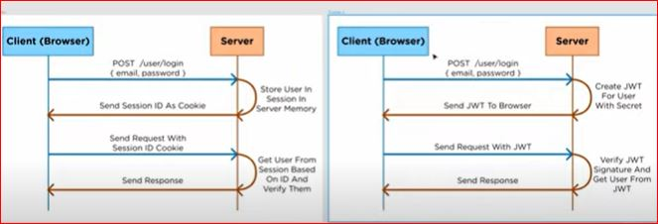

Slide 5
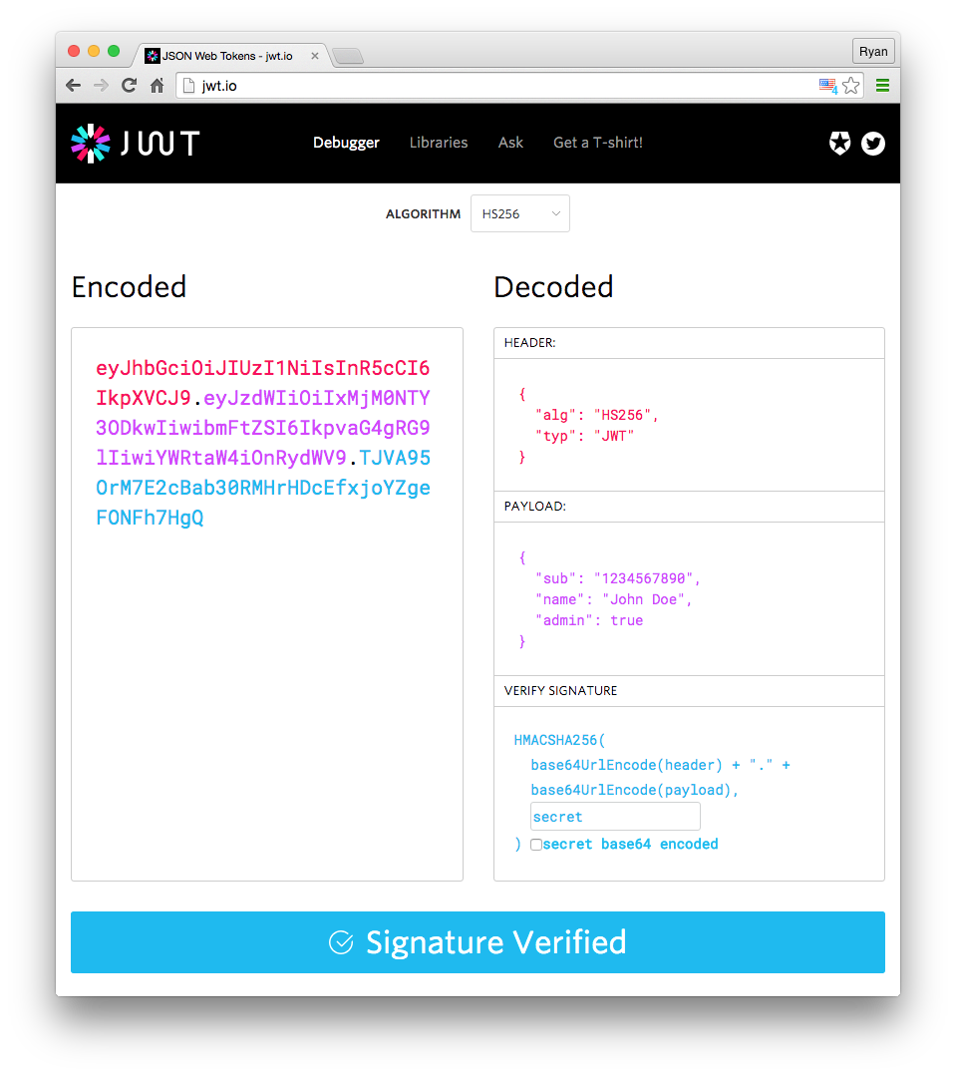

Slide 6
