Slide 1
ONLINE LEARNING PLATFORM USING MERN
TEAM ID NUMBER: NM2024TMID10070
TEAM MEMBERS:
KAVITHA S (211521104069)
KEERTHANA V (211521104071)
MANISHA V (211521104085)
AKSHA RUTH A (211521104008)

Slide 2
TABLE OF CONTENTS
ABSTRACT
INTRODUCTION
PROPOSED SYSTEM
IMPLEMENTATION:MERN STACK
FRONTEND
BACKEND
INTEGRATION
MODEL SCREENSHOT
CONCLUSION

Slide 3
ABSTRACT
The Online Learning Platform is a full-stack MERN (MongoDB, Express.js, React, Node.js) web application developed to offer a comprehensive, interactive environment for online education. The platform allows users to access and manage a variety of educational content, track learning progress, and engage in real-time interactions. With features such as secure user authentication, intelligent content recommendations, and data protection, the system provides a robust solution for both learners and educators, enhancing the accessibility and quality of online education.

Slide 4
INTRODUCTION
Effective learning management is crucial for any organization aiming to provide accessible, high-quality educational resources and foster skill development. Traditional education often relies on in-person classes and manual tracking, which can limit scalability and accessibility. Addressing these limitations, the Online Learning Platform leverages modern web technologies to create a streamlined, user-friendly environment for both learners and instructors. Built using the MERN stack, the platform supports end-to-end learning management, from content access and course tracking to real-time interaction, enhancing the accessibility and effectiveness of online education.

Slide 5
PROPOSED SYSTEM
The proposed system is a web-based platform that enables users to:
Register and log in to access their personalized learning dashboard.
Browse and enroll in courses, accessing comprehensive content such as video lectures, reading materials, and interactive exercises.
Track their learning progress in real-time and receive notifications about course updates, new assignments, and upcoming deadlines via email or SMS.
Engage directly with instructors and fellow learners through discussion boards and live Q&A sessions to enhance understanding and gain feedback.
Benefit from enhanced security measures like data encryption, user authentication, and compliance with data protection standards.
The platform also enables administrators to manage course content, monitor user engagement, and ensure smooth operation. Intelligent content recommendations suggest relevant courses to users, while administrators can assess learner progress, gather feedback, and maintain the overall system to optimize the learning experience.

Slide 6
IMPLEMENTATION:MERN STACK
FRONTEND
Material UI/Bootstrap: Utilized for responsive and accessible styling, providing a user-friendly experience across various devices, from desktops to mobile.
Axios : Used to manage HTTP requests between the frontend and backend, enabling smooth data transfer and communication for features like content updates, course progress tracking, and enrollment.
Real-Time Updates: Socket.io is integrated for real-time interactions, offering instant notifications for course announcements, discussion replies, and assignment updates, enhancing the interactive learning experience.

Slide 7
BACKEND
Server-Side Logic: Managed by Express.js, handling routes and APIs for user registration, authentication, course access, and progress tracking.
MongoDB: A NoSQL database used for storing user profiles, course content, enrollment records, and progress data. MongoDB Atlas is utilized for cloud storage, offering scalability and high availability.
APIs: RESTful APIs are developed to manage data flow between the frontend and backend, supporting CRUD operations (Create, Read, Update, Delete) for courses, user interactions, and progress tracking, ensuring a seamless learning experience.

Slide 8
INTEGRATION
Frontend-Backend Communication: Axios is used on the frontend to send API requests to the backend, handled by Express.js. This allows seamless data exchange for functionalities such as course enrollment, fetching content, and submitting assignments.
Database Integration (MongoDB): The backend interacts with MongoDB to store and retrieve data related to users, courses, and progress. Express.js communicates with the database via Mongoose, a Node.js library that simplifies MongoDB queries.
Real-Time Features: Socket.io enables real-time interactions between students and instructors, supporting instant chat for Q&A sessions and live notifications for course updates. WebRTC can be added for interactive voice/video sessions to further enhance the learning experience.

Slide 9
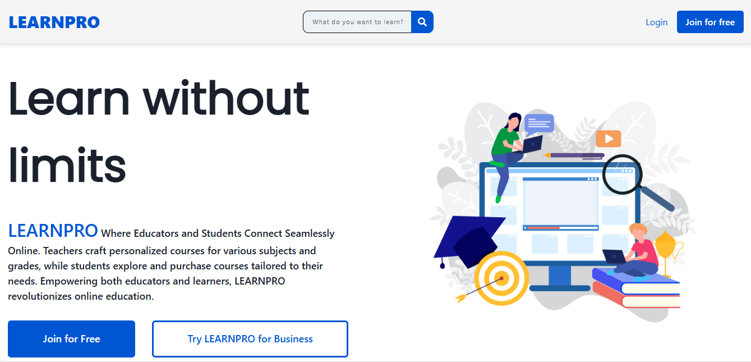
MODEL SCREENSHOT

Slide 10
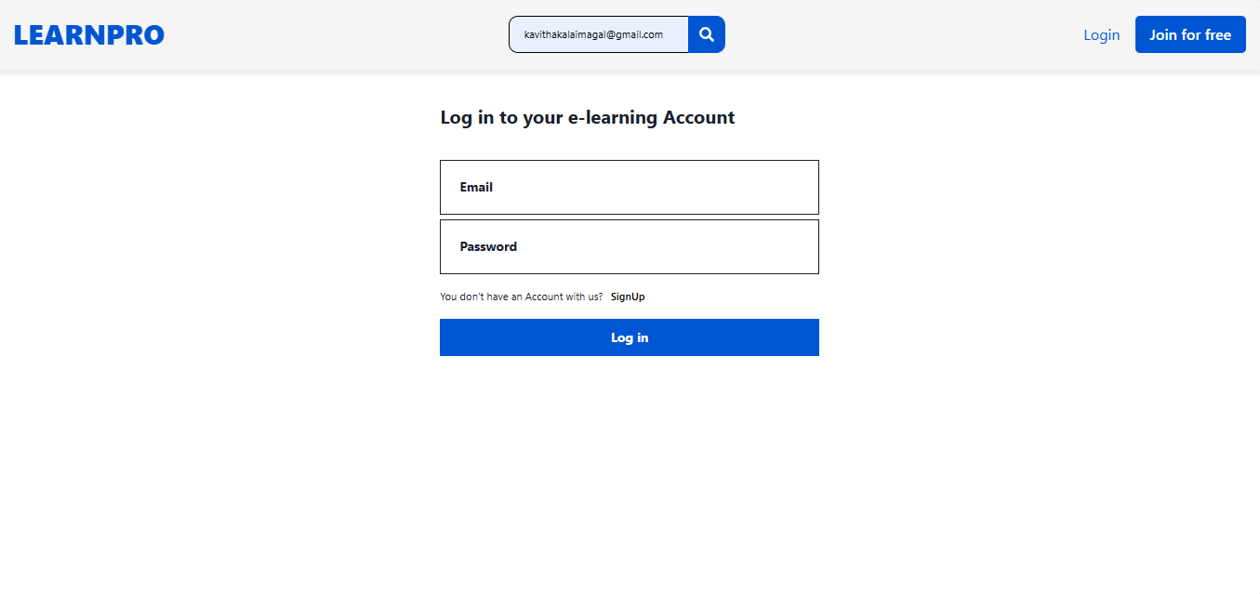

Slide 11
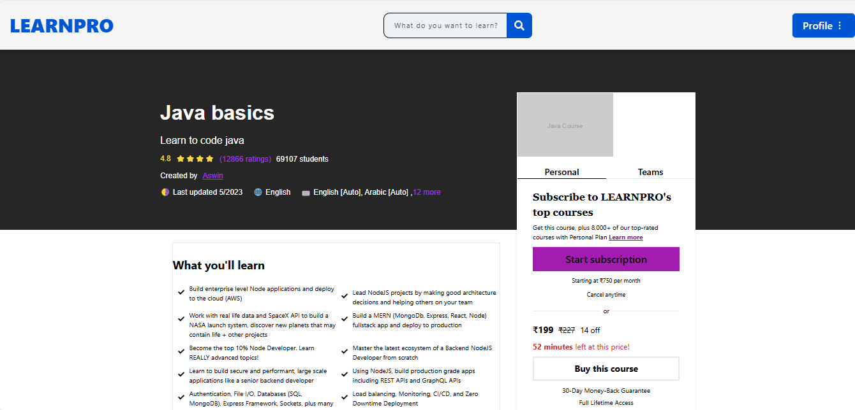

Slide 12
CONCLUSION
The Online Learning Platform provides a comprehensive solution for delivering and managing educational content effectively. Built on the MERN stack, the platform ensures a responsive, user-friendly interface and secure data handling, supporting seamless access to courses and interactive learning experiences. This platform not only simplifies course management for administrators but also enhances the learning experience with real-time updates, progress tracking, and direct communication between students and instructors. Its scalability makes it suitable for educational institutions and organizations of varying sizes, fostering accessibility and engagement in online learning.

Slide 13
THANK YOU!

