Slide 1
RETAIL SALES PERFORMANCE ANALYSIS
MySQL | Excel Power BI | Tableau
By
KAVITHA JAYENDRAN
GUVI Final Project

Slide 2
PROJECT OVERVIEW
Analyze retail sales data to understand sales performance and customer behavior.
Identify sales trends, top-performing products, customers, and countries.
Use SQL and Excel for data preparation and exploratory analysis.
Develop interactive dashboards using Power BI and Tableau.
Generate actionable business recommendations from the analysis.

Slide 3
PROJECT OBJECTIVES
Clean and validate the retail sales dataset
Perform exploratory data analysis
Create interactive Power BI and Tableau dashboards
Analyze revenue, orders, products, and customers
Generate business insights and recommendations
Identify country-wise and time-based sales trends

Slide 4
Dataset & Technology Stack
TOOLS
MySQL – Data preparation, validation & SQL analysis
Excel – Data preparation, pivot analysis & trends
Power BI – Interactive dashboard & KPIs
Tableau – Interactive visualization & dashboard
INITIAL DATA PREPARATION
Imported CSV into MySQL
Renamed Customer ID to Customer_ID
Converted Invoice Date from TEXT to DATETIME
Created Revenue = Quantity × Price
Verified record count and table structure

Slide 5

SQL ANALYSIS: KEY ANALYSES
Key SQL Analyses
Monthly Sales Revenue Trend
Revenue by Country
Top 10 Products by Revenue
Top 10 Products by Quantity
Top 10 Customers by Total Spending
Purpose of SQL Analysis
To identify revenue trends, high-performing products, major markets, and high-value customers from the retail sales data.

Slide 6
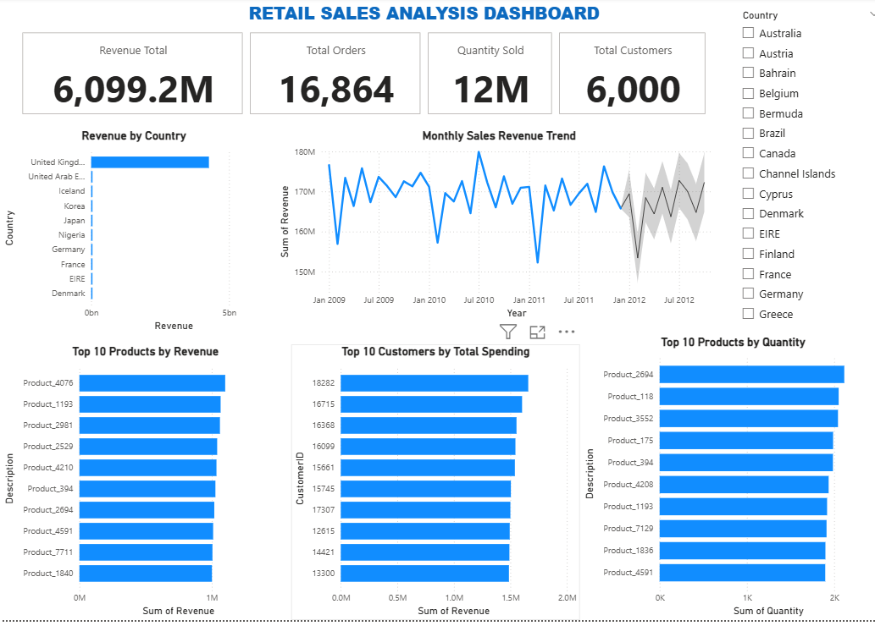
POWER BI DASHBOARD
Interactive dashboard developed to monitor overall sales performance, revenue trends, product performance, and customer spending.

Slide 7
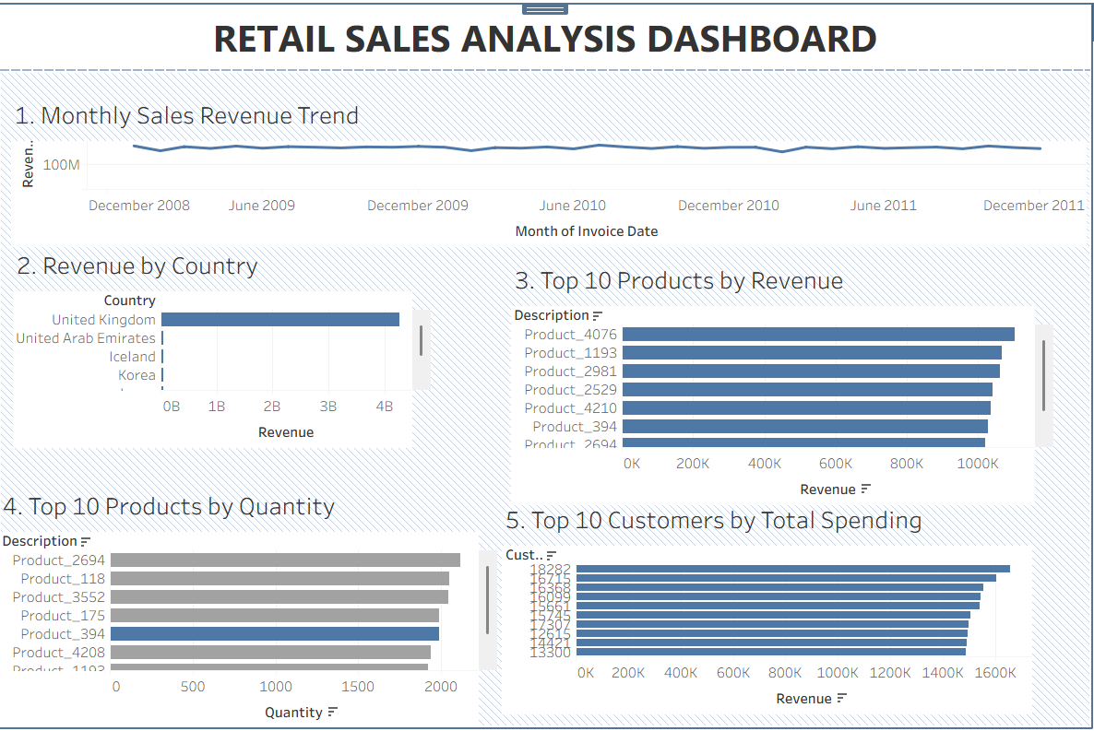
TABLEAU DASHBOARD – RETAIL SALES ANALYSIS
Interactive Tableau dashboard created to analyze sales trends, country-wise revenue, product performance, and customer spending.

Slide 8
KEY INSIGHTS
REVENUE PERFORMANCE
Total revenue reached 6,099.2M, indicating strong overall sales performance.
COUNTRY PERFORMANCE
The United Kingdom is the dominant revenue-generating country, significantly ahead of the other markets.
PRODUCT PERFORMANCE
Product_4076 ranks first by revenue, while Product_2694 ranks first by quantity sold.
CUSTOMER VALUE
Customer 18282 has the highest total spending among the top 10 customers.
SALES TREND
Monthly revenue remains relatively consistent overall, with noticeable fluctuations and periodic peaks and dips.
Overall, the analysis highlights strong revenue concentration in the UK, high-performing products, and a group of high-value customers that can be targeted for growth and retention.

Slide 9
BUSINESS RECOMMENDATIONS
Strengthen the UK Market
Focus on customer retention, targeted promotions, and inventory availability in the highest-revenue market.
Promote High-Performing Products
Prioritize top-revenue and high-volume products through targeted campaigns and product placement.
Retain High-Value Customers
Introduce loyalty offers and personalized promotions for customers with consistently high spending.
Optimize Inventory
Maintain sufficient stock for high-quantity products to reduce the risk of missed sales opportunities.
Monitor Sales Trends
Use the Power BI and Tableau dashboards regularly to track revenue fluctuations and support timely business decisions.
Data-driven decisions can improve customer retention, product performance, inventory planning, and overall revenue growth.

Slide 10

CONCLUSION
The retail sales dataset was successfully cleaned, validated, and analyzed using SQL.
Power BI and Tableau were used to create interactive dashboards for sales performance monitoring.
The analysis identified key markets, high-performing products, and high-value customers.
The findings can support better marketing, customer retention, inventory planning, and revenue-growth decisions.
Overall, the project demonstrates how data-driven analysis can transform retail sales data into actionable business insights.
From raw data to actionable business insights

