Slide 1

AMAZON FRESH ANALYTICS
using MySQL
GUVI Capstone Project
Submitted by
Kavitha Jayendran
Business Analytics & Digital Marketing
MySQL Workbench 8.0

Slide 2
PROJECT OVERVIEW & OBJECTIVES
📌 Project Overview
  Amazon Fresh Analytics is a SQL-based project that analyzes customer, product, and order data to generate business insights.
🎯 Objectives
Design a relational database.
Perform SQL data analysis.
Apply DDL, DML & Constraints.
Analyze customer and product performance.
Generate business insights.

Slide 3
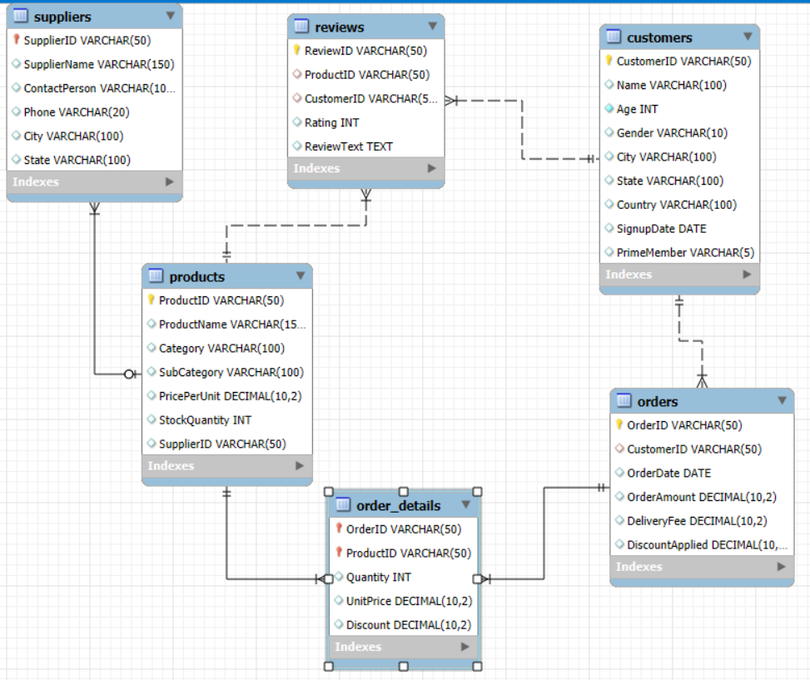
DATABASE DESIGN
DATABASE STRUCTURE
6 interconnected tables designed for efficient data storage and analysis.
Table | Description
Customers | Customer Data
Products | Product Data
Suppliers | Supplier Data
Orders | Order Records
Order Details | Order Items
Reviews | Customer Reviews
RELATIONSHIP
Customers → Orders
Orders → Order Details
Products → Order Details
Products → Reviews
Suppliers → Products

Slide 4
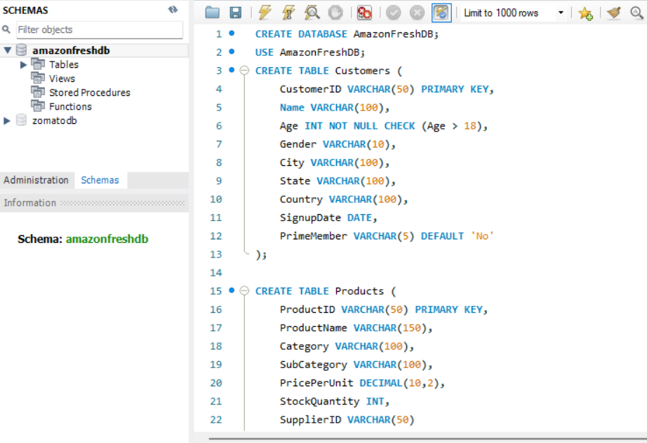
DATA IMPORT & DATA CLEANING
DATA SOURCE
  Imported Amazon Fresh datasets into MySQL Workbench
  Connected MySQL database with Power BI
DATA CLEANING
  Checked for NULL values
  Removed duplicate records
  Verified data types
  Validated relationships between tables
OUTCOME
Clean and reliable dataset ready for SQL analysis and dashboard creation.

Slide 5
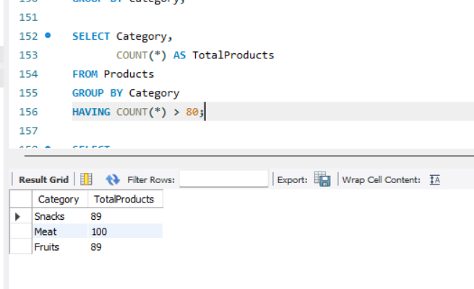
SQL QUERIES & ANALYSIS
KEY SQL ANALYSIS PERFORMED
📊 Data Analysis
  Total Sales Revenue
  Total Orders
  Average Order Value
  Top Selling Products
  Customer Purchase Analysis
  Product Category Performance
⚙️ SQL Concepts Used
SELECT, WHERE , GROUP BY, ORDER BY, JOIN, SUM(), COUNT(), AVG()
Outcome
Prepared data for Power BI dashboard development

Slide 6
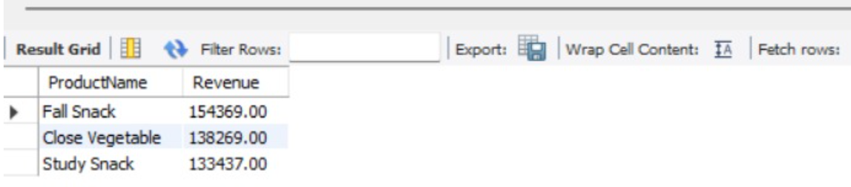
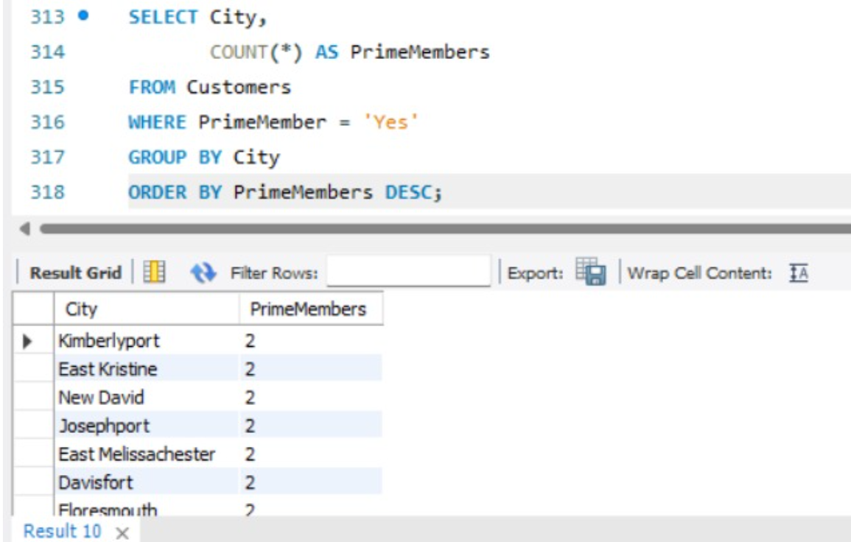
ADVANCED SQL OPERATIONS
Include:
  UPDATE
  ALTER TABLE
  DELETE
  Normalization (3NF)
  Subqueries
  Foreign Keys

Slide 7
BUSINESS INSIGHTS
💰 Sales revenue calculated using SQL queries.
📦 Product category performance identified.
🛒 Customer purchasing trends analysed.
⭐ Frequently ordered products recognized.
👥 Prime member distribution analysed.
📊 SQL insights prepared for Power BI visualization.

Slide 8
RECOMMENDATIONS
Improve inventory for high-selling products.
Focus promotions on top-performing categories.
Reward loyal and Prime customers.
Monitor sales trends regularly.
Use SQL reports for data-driven decisions.

Slide 9
CONCLUSION
Successfully designed a relational database using MySQL, performed SQL analysis, applied normalization and subqueries, and generated meaningful business insights for decision-making.

