Slide 1


Slide 2
introduction to NYKAA
Founded: 2012 by Falguni Nayar Headquarters: Mumbai, Maharashtra Industry: Beauty, Wellness, and Fashion E-commerce Overview: Leading platform delivering high-quality beauty and wellness products globally Parent Organization: FSN E-commerce Ventures Pvt Ltd

Slide 3
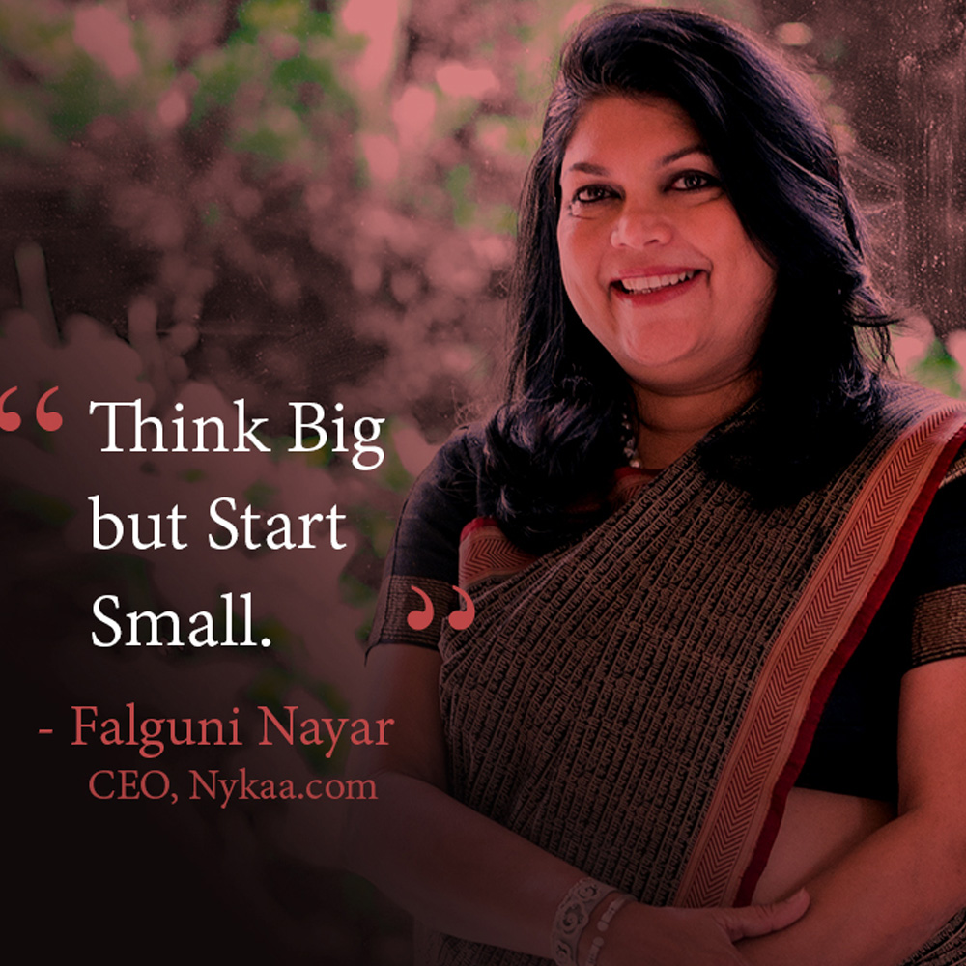
Background: Former banker, IIM Ahmedabad MBA in Finance Career: 8 years at A F Ferguson & Co 19 years at Kotak Mahindra Group (Managing Director, Kotak Investment Banking) Entrepreneurial Journey: Started Nykaa at age 50, proving age is no barrier Inspiration: Empowering women entrepreneurs through her success

Slide 4
BEGINNING OF NYKAA
Motivation: Limited availability of beauty products in India compared to global markets (e.g., France, Japan) Starting Point: Launched with 3 employees, 60 orders initially Vision: Create a pioneering beauty and fashion e-commerce platform Key Insight: Passion, perseverance, and hard work lead to success at any age

Slide 5
PRODUCTS AND SERVICES
Product Range: 1,30,000 products from 500+ brands Categories: Makeup, Skincare, Hair, Appliances, Fragrance, Bath & Body Pop-ups (Bags, Footwear, Clutches), Mom & Baby, Men’s Store, Natural Content Offerings: Beauty Book: Digital magazine with blogs on beauty, fashion, fitness Nykaa TV: Makeup and beauty tip videos by experts Beauty Buying Guides: Shopping assistance Customer Support: Helpline for personalized product selection Authenticity: Products sourced directly from manufacturers

Slide 6
Challenges and Solutions
Unique Selling Point (USP): Challenge: Competing with established players like Myntra, Ajio Solution: Direct procurement from brands, focus on quality over low prices System Issues: Challenge: Early website crashes and glitches Solution: Fixed bugs, improved platform stability Customer Engagement: Challenge: Maintaining shopper interest and seamless experience Solution: Personalized products, innovative UX, and engaging content

Slide 7
CUSTOMER SERVICE
Nykaa offers a well-rounded customer support system with multiple contact points tracking mechanisms, and escalation options. Nykaa’s Unique Customer Support Features as follows, Multi-Channel Accessibility, Toll-free helpline, Email support and Live Chat 2) Structured Complaint Tracking Ticket/reference number to track the status of the request 3) Grievance Officer for Escalations If the issue isn’t resolved satisfactorily, you can escalate it to the designated 4) Policy of Safe Communication Nykaa explicitly clarifies it will never solicit sensitive details like OTPs, CVV, PINs, or bank info.

Slide 8
CUSTOMER REVIEW
POSITIVE REVIEW Users praise product authenticity and trustworthiness. Easy navigation and wide product range. Good delivery experience and reliability. Example: 'Excellent experience! Always original brands.
NEGETIVE REVIEW Widespread complaints about delivery delays and poor customer service. Refund and return issues frequently reported. Incorrect or damaged products delivered. Low ratings on Trustpilot (1.4–1.7 stars) and Site jabber (1.2 stars). Example: 'Terrible delivery service... a scam when it comes to offers.'
NEUTRAL REVIEW Skepticism about authenticity of positive reviews. Some users note better UI and verified sellers compared to competitors. Mixed opinions when compared to platforms like Amazon. Example: 'Nykaa is better than other websites any day.'
REVIEW SUMMARY Positive: Trust in authenticity, easy navigation, prompt delivery. Negative: Poor service, delays, refund issues, wrong products. Neutral: Distrust of reviews, mixed platform comparisons.

Slide 9
Business and Revenue Model
Business Model: Direct-to-Consumer (D2C), inventory-based
  Procures products from manufacturers, stored in warehouses (Bangalore, Mumbai, New Delhi)
  Retail formats: Nykaa Luxe, Nykaa On Trend, Nykaa Kiosks
Revenue Streams:
  Product sales (online and in-store)
  Banner advertisements, commissions, discount income, miscellaneous
Advantage: High-profit margins through direct sourcing and fair pricing

Slide 10
Marketing Strategies
Key Strategies: Influencer marketing for brand visibility Engaging, relevant content creation Intuitive, user-friendly UI for seamless UX Collaborations for exclusive offers and discounts Socially relevant ads on YouTube, Instagram Outcome: Global brand awareness and customer loyalty

Slide 11
Funding and IPO
Total Funding: $341.9 million Key Investors: Anchor Investors: INR 2,396 Crore Fidelity Management, Steadview Capital ($13M), TPG Growth (INR 191 Crore) Lighthouse Funds (INR 113 Crore), TVS Capital Funds (INR 25 Crore) Personal investments: Katrina Kaif (Kay Beauty), Alia Bhatt IPO (Oct 28, 2021): Price Band: INR 1,085–1,125 per share Raised: $670 million (US$7.4 billion valuation) Listed at 77.87%–79.38% premium on BSE/NSE Current Valuation: $13 billion (2022)

Slide 12
Major Acquisitions
Acquired Companies: 20Dresses (Fashion, 2019) Pipa.Bella (Jewellery, 2021) Dot & Key Wellness (Skincare, 2021) Kica (Swimwear, 2022) Nudge Wellness (Nutraceuticals, 2022) Little Black Book, Earth Rhythm, MensXP (Planned) Purpose: Expand product portfolio and market reach

Slide 13
Milestones
2012: Founded Nykaa 2014: $3.4M funding, first physical store at T3 Airport, New Delhi 2015: Launched Nykaa Cosmetics, omni-channel presence 2016: $12M funding (Hero Group), launched Nykaa Naturals 2017: Nykaa Luxe store in Mumbai 2018: Launched Nykaa Man, Nykaa Fashion, Nykaa Network 2019: Launched Kay Beauty, acquired 20Dresses 2020: Achieved Unicorn status 2021: IPO, Nykaa Fashion store, acquired Pipa.Bella 2022: Falguni Nayar named India’s richest self-made woman

Slide 14
Accolades and Recognition
Awards: Disruptor of the Year, India Business Leader Awards 96% returns on investor capital Recognition: Unicorn status (2020) Falguni Nayar: India’s richest woman (IIFL Wealth Hurun India Rich List 2022)

Slide 15
Future Plans
Current Stats: 17 million Monthly Active Users 70 physical stores, 1.5 million orders/month 3.1 million SKUs Goals by 2024: Expand to 180 physical stores Increase warehouse capacity by 40% Vision: Global expansion, enhanced operations, and broader product offerings

Slide 16
Conclusion
Nykaa’s Impact: Transformed India’s beauty and wellness industry Falguni Nayar’s Legacy: Inspiration for entrepreneurs, especially women Key Takeaway: Passion, innovation, and resilience drive success Future Outlook: Poised to become a global beauty and fashion leader

