Slide 1
BI Environment Checkout Automation
© Cerner Corporation. All rights reserved. This document contains Cerner confidential and/or proprietary information which may not be reproduced or transmitted in any form or by any means without the express written consent of Cerner.
Owners:
Debasis Banerjee & Suman Kundu
BI Team
13.03.2018

Slide 2
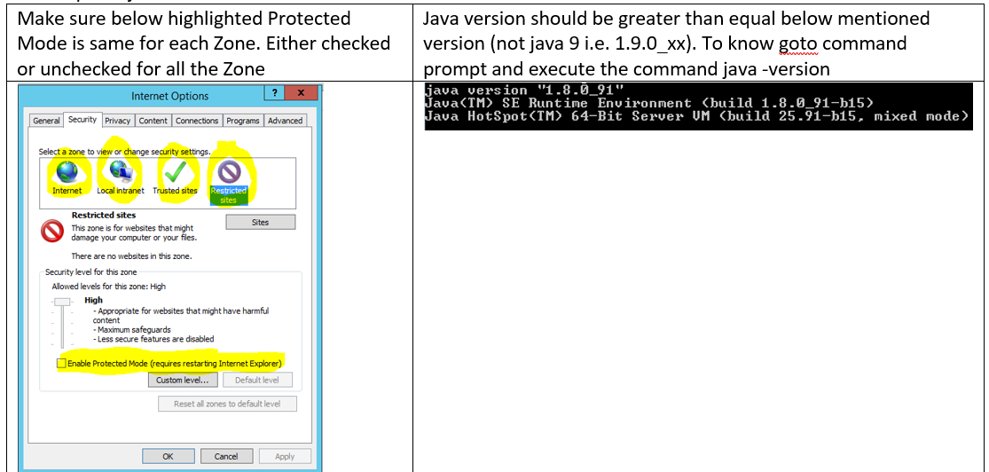
Preparation of Laptop/BOX where automation script will run – First Time Only
1. Prerequisite step:
Go to the laptop/box (properly configured DSS Client box)
IE Setup and java version
Launch the IE browser
Open the HIUI link
Log in to the HIUI Application
Make sure Application is
opening successfully without
any certification error.

Slide 3
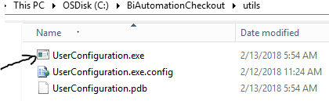
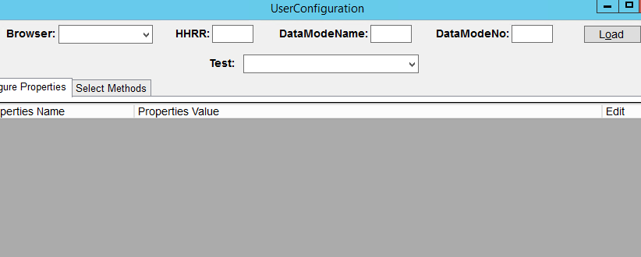
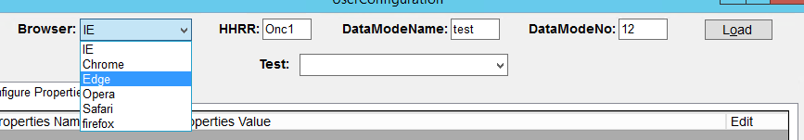
Steps to run the script
Step1: Copy the BIAutomation folder to any folder to the laptop/box.
Step2: Open the utils folder and double click on UserConfiguration.exe
Step3: Below screen will appear.
Step4: Select the Browser dropdownlist,put the HHRR, DataModeName,DataModeNo.

Slide 4
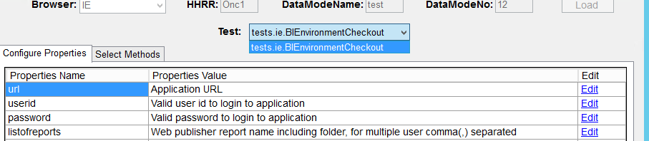
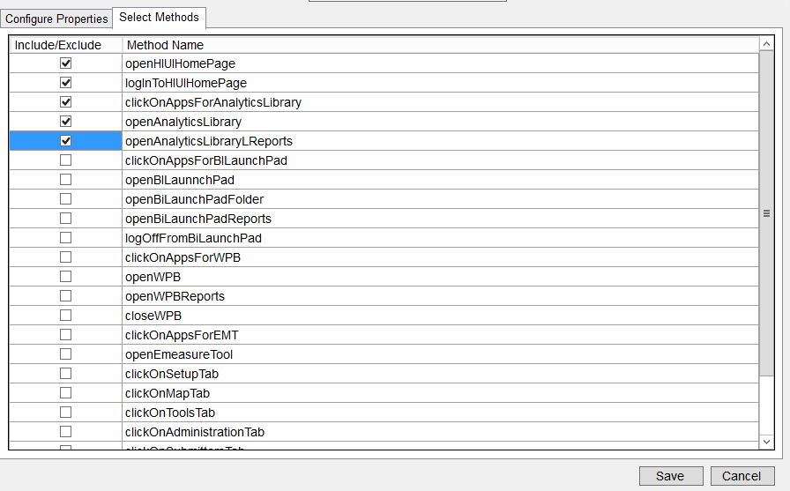
Steps to run the script
Step5: Click On Load Button
Step6: Select the test Name from the dropdown.
Step7: Click On Configure Properties tab.
Step8: Edit the Properties Value by clicking on
Edit link button.
Step9: A pop up box will appear and put the correct text in the popup box and click on OK button
Step10: Click on Select Methods Tab.
Step11: Include the methods which will run in the script
by checking the checkboxes.
Step12: Click on Save button.

Slide 5
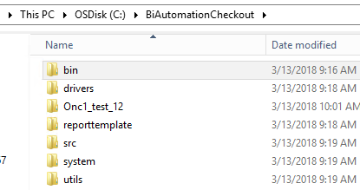
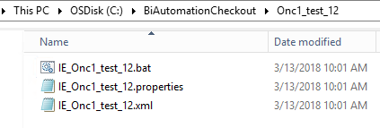
Steps to run the script
Step13: A folder will be created with the name
hhrr_datamodename_datamodeno
Step14: Open the folder and double click on the
batch file with the name
browser_hhrr_datamodename_datamodeno

Slide 6
Questions
???

